Slide 1

E-Invoicing & Everything about ASMT-10 : Scrutiny of returns under GST
-By CA (Adv.) Ravi Gupta
Email: ravinosadar@gmail.com
Mobile: 82900-50002

Slide 2
E-Invoicing

Slide 3
Why E-Invoicing ?
Vide Notification No.68/2019–Central Tax Dated: 13th December, 2019 following sub rules 4, 5 & 6 in Rule 48 were inserted:
(4) By such class of registered persons as may be notified by the Government,.
(5) Every invoice issued by a person to whom sub-rule (4) applies in any manner other than the manner specified in the said sub-rule shall not be treated as an invoice.
(6) The provisions of sub-rules (1) and (2) (invoice in triplicate/duplicate) shall not apply to an invoice prepared in the manner specified in sub-rule (4).

Slide 4
What is E-Invoice?
E-invoice is neither about invoice being in soft copy like PDF etc. nor means generation of invoice by a Government portal.
Taxpayers will continue to create their GST invoices on their own Accounting/Billing/ERP Systems .
These invoices will now be reported to ‘Invoice Registration Portal (IRP).
On reporting, IRP returns signed e-invoice with unique ‘Invoice Reference Number (IRN)’ and a QR Code.
Then, the invoice can be issued to receiver (with QR Code)
A GST invoice will be valid only with a valid IRN.

Slide 5
Who is required to issue E-Invoice?
Phase | Applicable to taxpayers having an aggregate turnover of more than | Applicable date | Notification number
I | Rs 500 crore | 01.10.2020 | 61/2020 – Central Tax and 70/2020 – Central Tax
II | Rs 100 crore | 01.01.2021 | 88/2020 – Central Tax
III | Rs 50 crore | 01.04.2021 | 5/2021 – Central Tax
IV | Rs 20 crore | 01.04.2022 | 1/2022 – Central Tax

Slide 6
Illustration
The taxpayers must comply with e-invoicing if the turnover exceeds the specified limit in any financial year from 2017-18 to 2021-22. Also, the aggregate turnover will include the turnover of all GSTINs under a single PAN across India.
If the turnover in the last FY was below the threshold limit but it increased beyond the threshold limit in the current year, then e-Invoicing would apply from the beginning of the next financial year.
Suppose ABC ltd aggregate turnover was as follows:
FY 2017-18: Rs 15 crore
FY 2018-19: Rs 17 crore
FY 2019-20: Rs 24 crore
FY 2020-21: Rs 19 crore
FY 2021-22: Rs 18 crore
The ABC ltd shall mandatorily generate e-invoices from 01.04.2022 irrespective of the current year’s aggregate turnover as it has crossed the Rs 20 crore turnover limit in FY 2019-20.

Slide 7
Applicability of e-invoice
B to B : Business to Business
B to G : Business to Government
Export
Through E-Commerce Operators
Reverse Charged transactions

Slide 8
Applicability of e-invoice
Applicable:
Invoices
Debit Note
Credit Note
Not Applicable:
Delivery challan
Bill of Supply
Job work

Slide 9
Voluntary E-invoicing
Not voluntary; only those above specified turnover are enabled to report invoices on IRP
As a facilitation measure:
- taxpayers enabled to report invoices to IRP.
- Based on the turnover of GSTR-3B as available in GST System.
- Search the status of enablement of a GSTIN on e-invoice portal:
https://einvoice1.gst.gov.in/ > Search > e-invoice status of taxpayer
If e-invoicing is not applicable to a taxpayer, they need not be concerned about the enablement status and may ignore it.

Slide 10
If not enabled on the portal
In case any registered person, is required to do e-invoicing but not enabled on the portal, he/she may request for enablement on portal: Registration -> e-Invoice Enablement.

Slide 11
IRN on Invoice
IRN Need not be printed on e-invoice (It’s already embedded in QR Code)

Slide 12
IRN Reporting & Cancellation
REPORTING: No prescribed time window for reporting to IRP
CANCELLATION: IRN can be cancelled within 24 hours (from the time of generation of IRN) However, if the connected e-way bill is active or verified by officer during transit, cancellation of IRN will not be permitted. In case of cancellation of IRN, GSTR-1 also will be updated with such ‘cancelled’ status.

Slide 13
IRN Amendments
AMENDMENTS: Amendments are not possible on IRP. Any changes in the invoice details reported to IRP can be carried out on GST portal (while filing GSTR-1). However, these changes will be flagged to proper officer for information.

Slide 14
ASMT-10 : Scrutiny of returns under GST

Slide 15
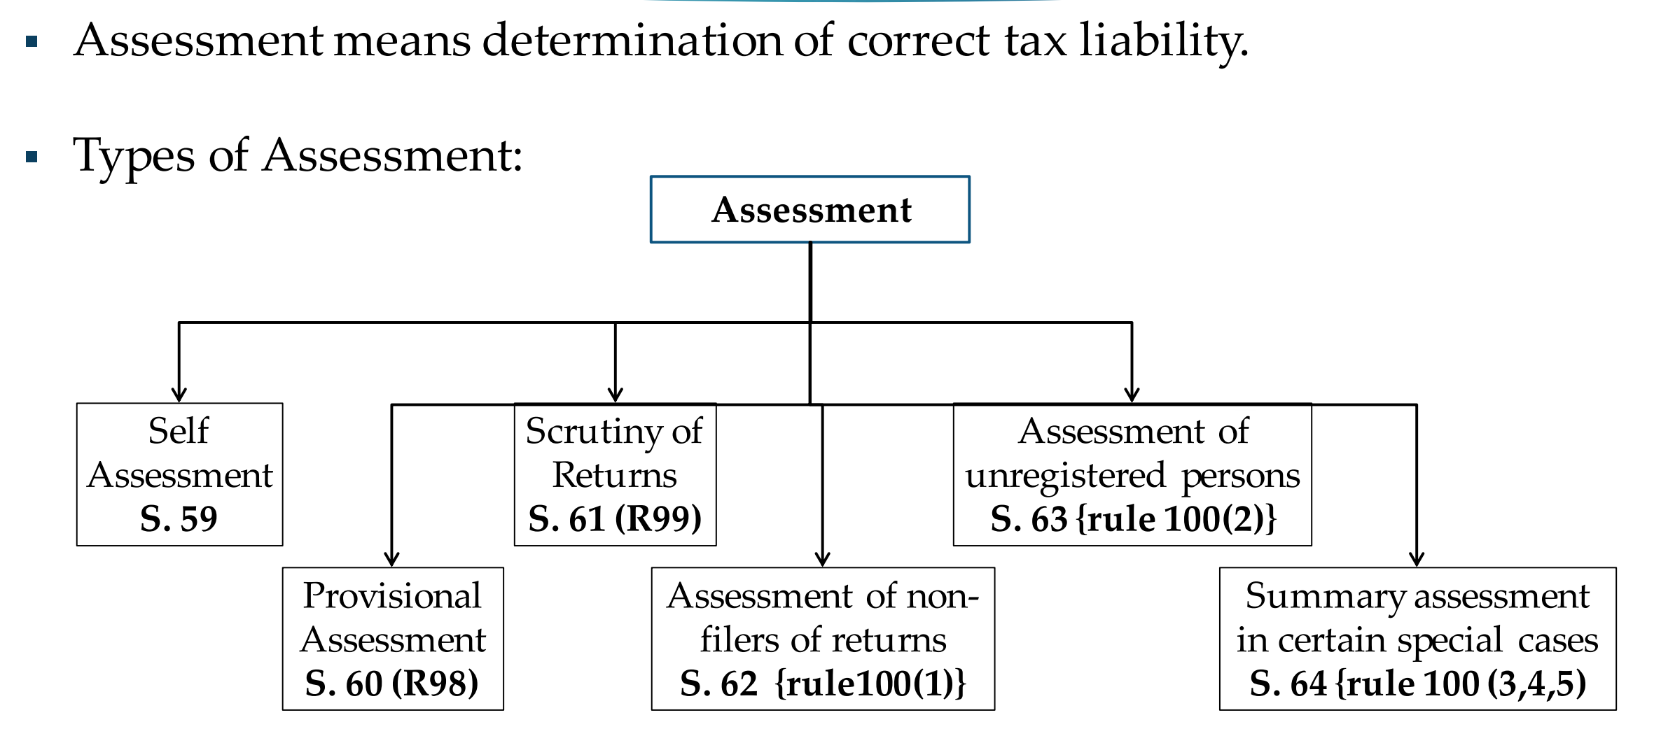
Assessment

Slide 16
Section 61. Scrutiny of Returns
The proper officer may scrutinize the return and related particulars furnished by the registered person to verify the correctness of the return and inform him of the discrepancies noticed, if any, in such manner as may be prescribed and seek his explanation thereto.
In case the explanation is found acceptable, the registered person shall be informed accordingly and no further action shall be taken in this regard.
In case no satisfactory explanation is furnished within a period of thirty days of being informed by the proper officer or such further period as may be permitted by him or where the registered person, after accepting the discrepancies, fails to take the corrective measure in his return for the month in which the discrepancy is accepted, the proper officer may initiate appropriate action including those under Section 65 or Section 66 or Section 67, or proceed to determine the tax and other dues under Section 73 or Section 74. [See Rule 99]

Slide 17
Rule 99. Scrutiny of Returns
Where any return furnished by a registered person is selected for scrutiny, the proper officer shall scrutinize the same in accordance with the provisions of section 61 with reference to the information available with him, and in case of any discrepancy, he shall issue a notice to the said person in FORM GST ASMT-10, informing him of such discrepancy and seeking his explanation thereto within such time, not exceeding thirty days from the date of service of the notice or such further period as may be permitted by him and also, where possible, quantifying the amount of tax, interest and any other amount payable in relation to such discrepancy.
The registered person may accept the discrepancy mentioned in the notice issued under sub-rule (1), and pay the tax, interest and any other amount arising from such discrepancy and inform the same or furnish an explanation for the discrepancy in FORM GST ASMT- 11 to the proper officer.
Where the explanation furnished by the registered person or the information submitted under sub-rule (2) is found to be acceptable, the proper officer shall inform him accordingly in FORM GST ASMT-12.

Slide 18
Selection of Returns for Scrutiny
Selection of returns for scrutiny is to be based on specific risk parameters. For this purpose, the Directorate General of Analytics and Risk Management (DGARM) has been assigned the task to select the GSTINs registered with Central tax authorities, whose returns are to be scrutinized, and to communicate the same to the Commissionerate concerned for further action.

Slide 19
INDICATIVE LIST OF PARAMETERS FOR SCRUTINY
Tax liability on account of “Outward taxable supplies and zero rated supplies as declared in FORM GSTR-3B may be verified with corresponding tax liability in respect of outward taxable supplies declared in table of FORM GSTR-1.
Tax liability on account of “Inward supplies (liable to reverse charge)” as declared in Table 3.1(d) of FORM GSTR-3B may be verified with the ITC availed in Table 4(A)(2) and Table 4(A)(3) of FORM GSTR-3B : Availment of ITC in excess of the liability discharged on account of reverse charge supplies may indicate either short payment of tax liability on account of RCM supplies or excess availment of input tax credit in respect of RCM supplies.

Slide 20
INDICATIVE LIST OF PARAMETERS FOR SCRUTINY
Where the RCM supplies declared in table 3.1(d) of FORM GSTR-3B are less than the inward supplies attracting reverse charge as per details available in FORM GSTR-2A, it may indicate short payment of tax liability on account of RCM supplies
ITC availed in respect of “All other ITC” in Table 4(A)(5) of FORM GSTR-3B may be verified with Table 3 and Table 5 (along with the net effect of amendments thereof in Table 4 and Table 6 respectively) of FORM GSTR-2A.

Slide 21
INDICATIVE LIST OF PARAMETERS FOR SCRUTINY
Rule 138 of the CGST Rules : e-way bill values with GSTR values.
Ineligible ITC availed in respect of invoices / debit notes issued by the suppliers who have not filed their GSTR-3B returns for the relevant tax period.
Whether GSTR-3B of a tax period is filed after the last date of availment of ITC in respect of any invoice / debit note as per section 16(4).

Slide 22
INDICATIVE LIST OF PARAMETERS FOR SCRUTINY
Wherever required, the details of such imports may also be cross-verified from ICEGATE portal.
Whether the registered person has made reversals of ITC in accordance with provisions of rule 42 and rule 43 of the CGST Rules. Rule 42 of the CGST Rules provides for manner of determination of input tax credit in respect of inputs or input services and reversal thereof. Rule 43 provides for manner of determination of input tax credit in respect of capital goods and reversal thereof in certain cases. The registered person avails ITC in table 4(A) of FORM GSTR-3B and reverses in Table 4(B). It may be verified whether requisite reversals have actually been made by the said registered person.

Slide 23
INDICATIVE LIST OF PARAMETERS FOR SCRUTINY
Whether the registered person has paid interest liability in terms of section 50.
Whether the registered person has paid late fee in terms of section 47 in respect of returns/statements: As per section 47 of the CGST Act a registered person is required to pay late fee for delayed filing of returns / statements under the Act. It may be verified whether late fee payable as per the provisions of section 47 of the CGST Act has actually been paid by the registered person.

Slide 24
Who shall conduct scrutiny of returns
Scrutiny of returns of a taxpayer may be conducted by Superintendent of Central Tax in-charge of the jurisdictional range of the said taxpayer for further action.

Slide 25
No communication before issuance of FORM GST ASMT-10
It may be noted that at this stage, the proper officer is expected to rely upon the information available with him or with the department. As far as possible, scrutiny of returns should have minimal interface between the proper officer and the registered person and, there should normally not be any need for seeking documents/ records from the taxpayers before issuance of FORM GST ASMT-10

Slide 26
Process of scrutiny by the Proper Officer
The Proper Officer shall scrutinize the returns and related particulars furnished by the registered person to verify the correctness of the returns. Information available with the proper officer on the system in the form of various returns and statements furnished by the registered person and the data/details made available through various sources like DGARM, ADVAIT, GSTN, E-Way Bill Portal, etc. may be relied upon for this purpose.
DRC-03 Already Submitted: There may be cases where the registered person may already have made additional payment of tax, cess, etc., after filing of the returns for the relevant tax period, through FORM GST DRC-03. The payments thus made through FORM GST DRC-03 may also be taken into consideration while communicating discrepancies to the taxpayer in FORM GST ASMT-10.

Slide 27
Scrutinize all the returns of the Financial Year
For each GSTIN identified for scrutiny for a financial year, the proper officer is required to scrutinize all the returns pertaining to the corresponding Financial Year under consideration and a single compiled notice in FORM GST ASMT-10 may be issued to the taxpayer for that financial year.

Slide 28
Taxpayer : What to do ?
The registered person may accept the discrepancy mentioned in the notice issued in FORM GST ASMT-10, and pay the tax, interest and any other amount arising from such discrepancy through FORM GST DRC-03 and inform the same or may furnish an explanation for the discrepancy in FORM GST ASMT-11 to the proper officer within the time period prescribed under rule 99 of CGST Rules.

Slide 29
Acceptance of the Explanation
Where the explanation furnished by the registered person or the information submitted in respect of acceptance of discrepancy and payment of dues is found to be acceptable by the Proper Officer, he shall conclude the proceedings by informing the registered person in FORM GST ASMT-12.

Slide 30
Non Acceptance of the Explanation
If no satisfactory explanation is furnished or after accepting the discrepancies, fails to pay the tax, interest and any other amount, the proper officer, may proceed to determine the tax and other dues under section 73 or section 74.
However, if the proper officer is of the opinion that the matter needs to be pursued further through audit or investigation to determine the correct liability of the said registered person, then he may refer the matter to the jurisdictional Commissioner through the divisional Assistant / Deputy Commissioner, for the decision whether the matter needs to be referred to Audit Commissionerate or Anti-evasion Wing of the Commissionerate, as the case may be.

Slide 31
Timelines for scrutiny of returns
Scrutiny of returns is to be conducted in a time bound manner, the following timelines may be observed by all concerned:
S. no. | Process/Event | Timeline/ Frequency
(i) | Communication of list of GSTINs selected for scrutiny by DGARM to the Commissionerate) | From time to time.

Slide 32
Timelines for scrutiny of returns
S. no. | Process/Event | Timeline/ Frequency
(ii) | Reply by the registered person in FORM GST ASMT-11 | Maximum within a period of thirty days of being informed by the proper officer in FORM GST ASMT-10 or such further period as may be permitted by the proper officer
(iii) | Issuance of order in FORM GST ASMT- 12 for acceptance of reply furnished by the registered person, where applicable | Within thirty days from receipt of reply from the registered person in FORM GST ASMT-11

Slide 33
Timelines for scrutiny of returns
S. no. | Process/Event | Timeline/ Frequency
(iv) | Initiation of appropriate action for determination of the tax and other dues under section 73 or section 74, in cases where no reply is furnished by the registered person | Within a period of fifteen days after completion of the period of thirty days of issuance of notice in FORM GST ASMT-10 or such further period as permitted by the proper officer
(v) | Initiation of appropriate action for determination of the tax and other dues under section 73 or section 74, in cases where reply is furnished by the registered person, but the same is not found acceptable by the proper officer | Within thirty days from receipt of reply from the registered person in FORM GST ASMT-11

Slide 34
Timelines for scrutiny of returns
S. no. | Process/Event | Timeline/ Frequency
(vi) | Reference, if any, to the Commissioner for decision regarding appropriate action under section 65 or section 66 or section 67 | Within thirty days from receipt of reply from the registered person in FORM GST ASMT-11 or within a period of forty-five days of issuance of FORM GST ASMT-10, in case no explanation is furnished by the registered person.

Slide 35
QUESTION & ANSWER

Slide 36
Question & Answer
1. Does a taxpayer get any intimation about the notice or order issued to him?
Taxpayer will get intimation of issue of all notices and orders issued to him/her though SMS and e-mail.
2. From where one view/reply notice issued for Scrutiny of Returns?
Navigate to Services > User Services > View Additional Notices/Orders > View > NOTICES option.

Slide 37
Question & Answer
3. A taxpayer received ASMT- 10 regarding mismatch in 3B Vs 2A, what should he do when ITC is not shown in GSTR-2A, but he has all invoices which are claimed by him and all payment is done to the supplier?
In the above case, recovery should be done from the seller instead of the buyer, we can refer to the below mentioned press release. circular and high court judgments:
As per circular No.123/42/2019-GST Dated 11th November, 2019 The restriction of rule 36(4) will be applicable only on the invoices /debit notes on which credit is availed after 09.10.2019.
Article 20(1) of the Constitution of India: No person shall be convicted of any offence except for violation of a law in force at the time of the commission of the Act charged as an offence, nor be subjected to a penalty greater than that which might have been inflicted under the law in force at the time of the commission of the offence.

Slide 38
Question & Answer
Vide the press release issued by the Central Board of GST council on 4.5.2018, it has been mentioned that there shall not be any automatic reversal of input tax credit from the buyer on non­payment of tax by the seller. In case of default in payment of tax by the seller, recovery shall be made from the seller. However, reversal of credit from buyer shall also be an option available with the revenue authorities to address exceptional situations like missing dealer, closure of business by the supplier or the supplier not having adequate assets etc.

Slide 39
Question & Answer
Madras High court in case of D.y. Beathel Enterprises vs The State Tax Officer ([2021] 33 TAXLOK.COM 130 (Madras)) has been held that if the default is made by non-payment of tax by the seller, the recovery shall be made from the seller, and only in exceptional circumstances, it can be from the recipient.
Therefore department shall recover amount from seller of goods instead of buyer and there shall not be
any automatic reversal of input tax credit from the buyer.
Delhi High Court has issued notice to union of India that ITC should not be restricted Just because supplier has not filed his return in matter of Bharti Telemedia Ltd vs Union of India dated 29.05.2019. Citation of such judgment is [2019] 12 TUD Online 059 (Delhi).
.

Slide 40
Question & Answer
4. A taxpayer received ASMT-10 from department for ITC reversal. He claimed ITC in return which has submitted on time but supplier filed GSTR-1 after due date of next year September return.
Reply: Under section 16(4) a registered person shall not be entitled to take input tax credit in respect of any invoice or debit note for supply of goods or services or both after the due date of furnishing of the return under section 39 for the month of September following the end of financial year to which such invoice or 4[***] debit note pertains or furnishing of the relevant annual return, whichever is earlier.
Therefore, you are eligible to claim ITC if you have claimed it in accordance to sec 16(4).If supplier has filed GSTR-1 after due date it will not effect your right to claim the same.

Slide 41
REASONS OTHER THAN FRAUD, ETC.
(SECTION 73)
Proper Officer shall serve notice to show cause as to why he should not pay the amount of tax as specified and the amount of interest & penalty as applicable
Notice under FORM
GST DRC-01

Slide 42
Notice by proper officer
Time Limit: At least 3 months prior to the time limit to pass order (3 years from due date of annual return, or from date when erroneously refunded).
Where Notice is served, proper officer may serve a statement containing the details for PERIODS OTHER THAN THOSE COVERED UNDER THE NOTICE under FORM GST DRC-02.
This shall be deemed to be service of notice only if the grounds for the tax period in the statement are covered in the notice served.
Payment of tax + interest before notice is served
If payment made – inform the proper officer of such payment
Thus the proper officer shall not serve any notice
If the payment made is short of the amount payable, proper officer shall proceed to issue notice w.r.t. Amount falls short of.
After notice is served
If Tax + interest paid within 30 days of issue of SCN. Intimate proper officer. no penalty payable. Notice Concluded.
Penalty payable if exceeds 30 days.
If representation follows – proper officer shall consider the same and determine the amount of tax + interest + penalty (penalty = 10% of tax or `10,000/- whichever is higher).
Officer shall issue order within 3 years from due date of furnishing annual return for the financial year to which the shortfall/ erroneous tax pertains OR within 3 years from date of erroneous refund.
Order by Proper Officer

Slide 43
Due Dates for Annual Return
F.Y. 2017-18 05-02-2020
F.Y. 2018-19 31-12-2020
F.Y. 2019-20 31-03-2021
F.Y. 2020-21 28-02-2022

Slide 44
REASONS ARE FRAUD, ETC.
(SECTION 74)
Tax not paid
Proper Officer shall serve notice to show cause as to why he should not pay the amount of tax as specified and the amount of interest & penalty as applicable
Appear to proper officer that
Short-paid tax
By reason of fraud/ willful misstatement/ “suppression” of facts to evade tax
Erroneously
Refunded
ITC Wrongly Availed
“Suppression”–non declaration (of facts or info to be declared in return, report, document, etc.), or failure to furnish info on being asked for by proper officer.
ITC Wrongly Utilized

Slide 45
Notice by proper officer
Time Limit: At least 6 months prior to the time limit to pass order (5 years) from due date of annual return, or from date when erroneously refunded).
Where Notice is served, proper officer may serve a statement containing the details for PERIODS OTHER THAN THOSE COVERED UNDER THE NOTICE.
This shall be deemed to be service of notice only if the grounds for the tax period in the statement are covered in the notice served.
Payment before notice is served
If tax + interest + penalty (15% of tax) is paid before notice– inform the proper officer of such payment then the proper officer shall not serve any notice.
If the payment made is short of the amount payable, proper officer shall proceed to issue notice w.r.t. amount it falls short of.
After notice is served
If Tax + interest + penalty (25% of tax) is paid within 30 days of issue of SCN. Notice Concluded.
Penalty payable if exceeds 30 days.
If representation– proper officer shall consider the same and determine the amount due.
Order by Proper Officer
Officer shall issue order within 5 years from due date of furnishing annual return for the financial year to which the shortfall/ erroneous tax pertains OR within 5 years from date of erroneous refund.
If tax + interest + penalty (50% of tax) paid within 30 days or order – proceedings concluded.

Slide 46
PAYMENT OF TAX AND OTHER AMOUNT IN
INSTALLMENTS (S. 80)
On application filed by a taxable person the Commissioner extend the time for payment other than the self-assessed amount
Also may allow payment in monthly installments, not exceeding 24, subject to payment of interest under S.50 (other than the self-assessed amount).
In default of any one installment on its due date the whole outstanding balance payable on such date shall become due and payable forthwith and shall, without any further notice served on the person, be liable for recovery

Slide 47
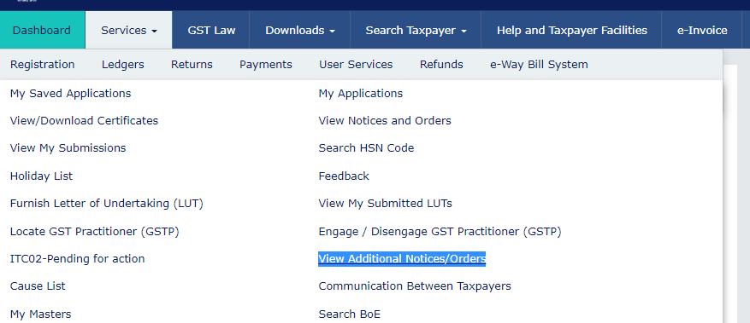

Slide 48
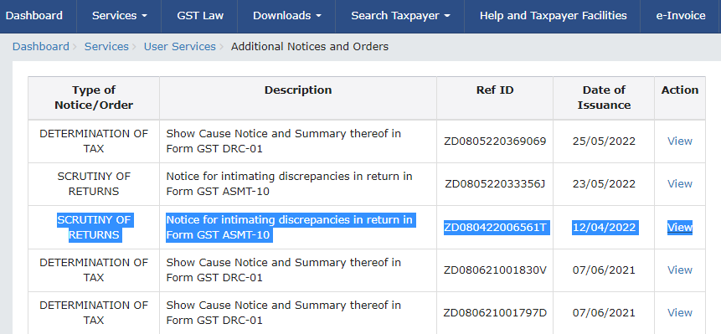

Slide 49
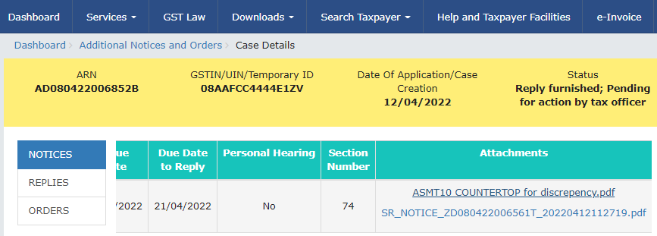

Slide 50
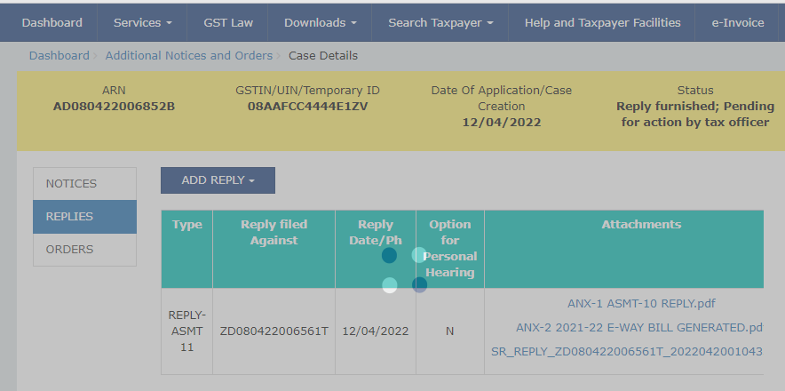

Slide 51
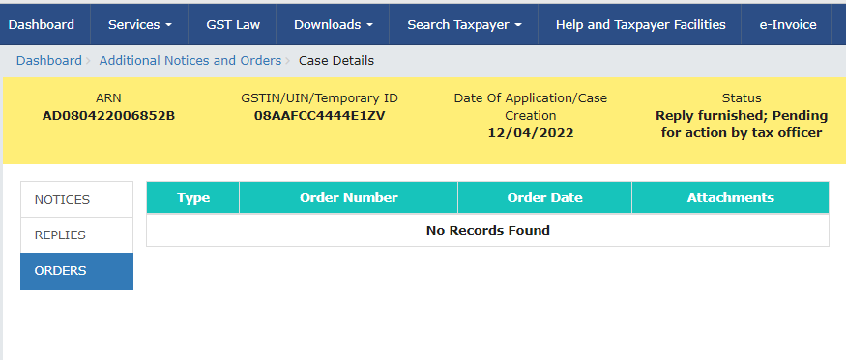

Slide 52

Ravi Gupta & Associates
GST Counsel & Consultants
S-11,Alankar Plaza, Central Spine, Vidhyadhar Nagar, Jaipur.
Email: ravinosadar@gmail.com
Mobile: 82900-50002

