Slide 1

Changing Role of CA in Dynamic Environment
CA Prayas Sharma-Founder & CEO Beyond Accounting
www.basol.in

Slide 2
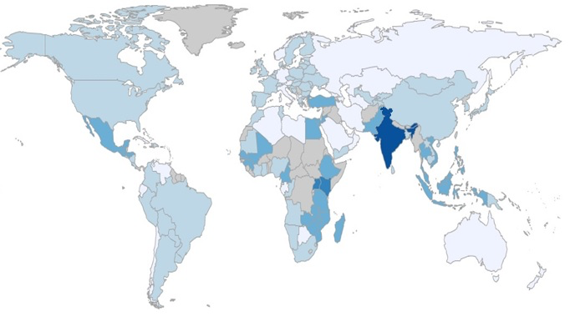


India to outperform most global economies by 2024
Global Growth Projections : Predicted Growth Rates up to 2024
Highest growth rate for India, China slows down
7%
$5
Trillion nominal GDP
4th
Rank ( up from 7th ) as per nominal GDP
Population between 20 to 60 years ( from 53%)
55%
Source : USDA, Harvard Center for International development, Morgan Stanley

Slide 3

And this growth will bring affluence ; ~ 3x growth in consuming class
3X Consuming Class ¹
Technology and analytics will be key enablers for while retail customer is chased
322
3 X
265
204
3 X
(INR Lakh Crores)
(millions of households)
Source : 1) Income classes defined with household disposable income at 2012 prices at: Globals (> ` 1,700,000), Consumers (` 485,000-1,700,000). The Globals & Consumers are collectively called the consuming class;

Slide 4
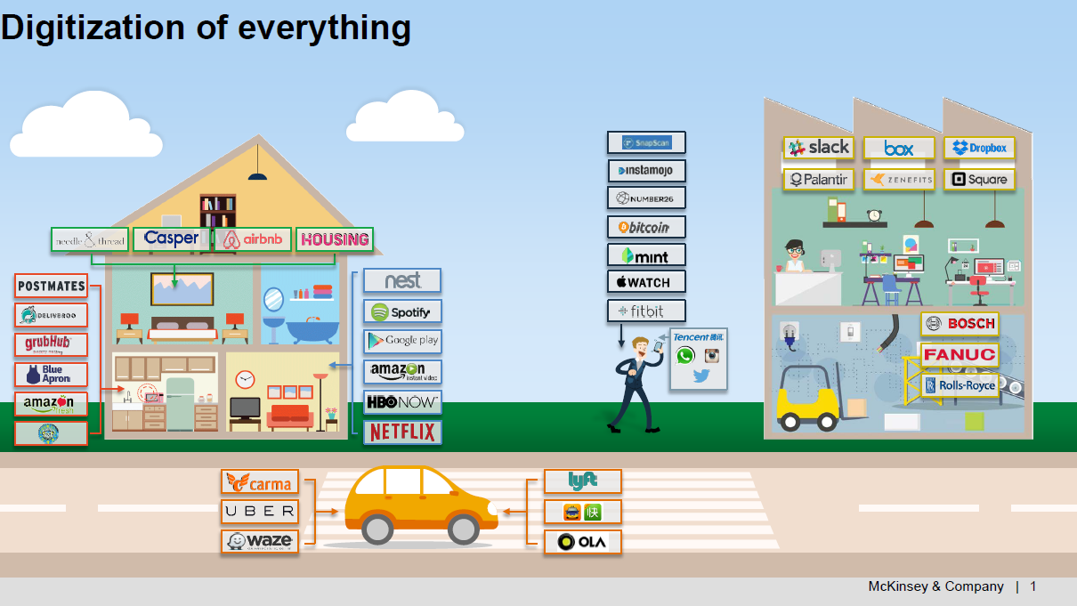


Slide 5

The customer of the future is becoming more demanding
Smarter, aided by digital tools
Demanding cross-channel interaction
Less loyal, shops around
Compares on experience & pricing
Socially connected -feedback
Omni- Channel experience
Memory across channels
Having a universal digital identity
Seeking control over his experience
Responsive designs
Two way interactions
Customer analytics to service
Expect digital delivery of all products & services
Having expectation spill over
As good as:-
Amazon for delivery
Apple for customer support
McDonalds - consistency

Slide 6
Digital Disruption
Many people misinterpret this as meaning the process of digital disruption is a negative one; that it is an attack on their business
Digital disruption is a transformation that is caused by emerging digital technologies and business models
The extent of digital disruption is identified by two factors
Degree of Impact (bang)
Timing (fuse)
Example
Kodak were one of the first to introduce cameras to the mainstream market. They monopolised the markets for the majority of the 20th century
unfortunately failed to keep up with the changing identities of their customers and the changing needs and expectations that came along with them.
Digital cameras made the move from being a just piece of photographic equipment to being a much more life-friendly, fun gadget..
Despite rapidly losing market share, they refused to succumb to the inevitable force of digital disruption and in 2012 they eventually declared bankruptcy.
Negative force for those who ignore or try to fight it
Those who embrace it often find that it can benefit their business in various ways, contributing to their success.
Digital disruption is a transformation that is caused by emerging digital technologies and business models.
Notes:
Don’t be fooled by the term ‘disruption’. Many people misinterpret this as meaning the process of digital disruption is a negative one; that it is an attack on their business. In reality, it is only a negative force for those who chose to ignore it or try to fight it. Those who embrace it often find that it can benefit their business in various ways, contributing to their success.
Digital disruption is a transformation that is caused by emerging digital technologies and business models. These innovative new technologies and models can impact the value of existing products and services offered in the industry. This is why the term ‘disruption’ is used, as the emergence of these new digital products/services/businesses disrupts the current market and causes the need for re-evaluation..
The extent of digital disruption is identified by two factors
Degree of Impact (bang)
Timing (fuse)
The lesson we can learn from Kodak is that digital disruption is an unstoppable force and to try and fight it is futile.
what businesses can do is embrace digital disruption, even plan for it
Keeping an eye on the ball and knowing the signs of digital disruption emerging in your industry means you can get ahead of the game and work with the flow rather than against it
Digital disruption typically marks changes in consumer needs and therefore working with the tide allows you to fulfil these emerging needs, keeping existing customers happy and opening up opportunities for new customers to find what they need from your brand.
Kodak’s rapid decline is even more surprising when we find that in 1975 Kodak built one of the first digital cameras, and during the early years of digital photography Kodak held more patents in this field than any of its competitors. So, Kodak had the digital technology, a dominant position in the traditional market, a world class brand and plenty of funds to invest – yet they were unable to put all of this together and turn it into a success model under new and very different conditions.

Slide 7

Disruption by industry
Short Fuse Big Bang Retail Media Education Banking & Insurance Real Estate Professional Services Leisure Food | Long Fuse Big Bang Manufacturing Healthcare Transportation Utilities Agriculture Government
Short Fuse Small Bang Construction | Long Fuse Small Bang Mining, oil & gas, chemicals

Slide 8

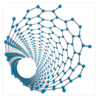










Disruptive tech:
A convergence of forces
Changing the building blocks of everything
Next-generation genomics
Advanced materials
IT and how we use it
Mobile internet
Cloud technology
Internet of things
Automation of knowledge work
Rethinking energy comes of age
Machines working for us
Energy storage
Advanced Oil & Gas Exlporation & recovery
Renewable energy
Advanced robotics
Autonomous & Near Autonomous vehicles
3D printing

Slide 9
V U C A -Environment
Volatility
Vision
Uncertainty
Understanding
Complexity
Clarity
Ambiguity
Agility

Slide 10

Survival of Fittest & Adaptable

Slide 11
Accountant to Controller to Enabler with same DNA
Business environment needs enablers not controllers
Finance transformation vs. Finance management
Robotic process automation vs Internal audit
Analytics not Paralytics
Use of Big data for business development

Slide 12
Examples of Being a Controller-Don’ts
Acting as Blood hound as against watch dog
Complicate to ensure non-payment
Little knowledge dangerous
Micro management
Over do of control
Start with No
Bureaucratic
Not flexible

Slide 13
Examples of Being a Enabler-Do’s
Understand the business
Understand implication of error
Be in shoes of customer
Be a simplifier
Simple and Speedy yet compliant
Futuristic vision & business planning
Continuous learning
Never feel entitled & content

Slide 14
Core DNA of a CA- Don’t try to change
Varied Domain expertise
Passion
Understand implication of error
Eye for Detail
Ability to zoom in Zoom out
Ability to fly at all altitudes
Cognitive Intelligence

Slide 15
8 Universal Critical Capabilities – the stuff you need to be able to do
Inspirational Leadership
Competitive edge
Strategic
Direction
Execution
Influence
Collaboration
Business Judgment
Building Talent
4 Universal Potential Factors - the stuff you need to have
Change Potential
Intellectual Potential
People potential
Motivational Potential
Notes:
Inspirational Leadership
Energising & Builiding Confidence in people about digital
Competitive edge
Motivating people to innovate & experiment
Strategic
Direction
Setting & aligning the business behind a transformative digital version
Influence
Driving mindset shifts amongst senior leaders to champion a digital agenda
Collaboration
Building Strategic partnerships inside and outside of the enterprise
Business Judgment
Rapidly building working business models that release transformation
Execution
Driving optimal performance between people and technology to deliver results
Building talent
Sourcing the talent required to deliver the digital strategy
Change Potential
Driving & Responding to change; seeing opportunity in uncertainty
Intellectual Potential
Thinking quickly & flexibly
People potential
Adapting to complex and changing interpersonal demands
Motivational Potential
Adapting personal drive and focus to achieve in new and changing contents

Slide 16
New Emerging areas for CAs
Management consulting
Forensic audit
Outsourcing
Cyber security & Information audit
Corporate Governance
SEZ laws
CSR compliance
FDI
ECB (External Commercial Borrowings)
International Taxation
Fintech laws
Start up consulting
Virtual CFO
FCRA (Foreign contribution regulation Act)
Finance Transformation
Cross Border Transactions
Functional SME for ERP implementation

Slide 17
Key adoption –Be a Digital leader for every field

Slide 18
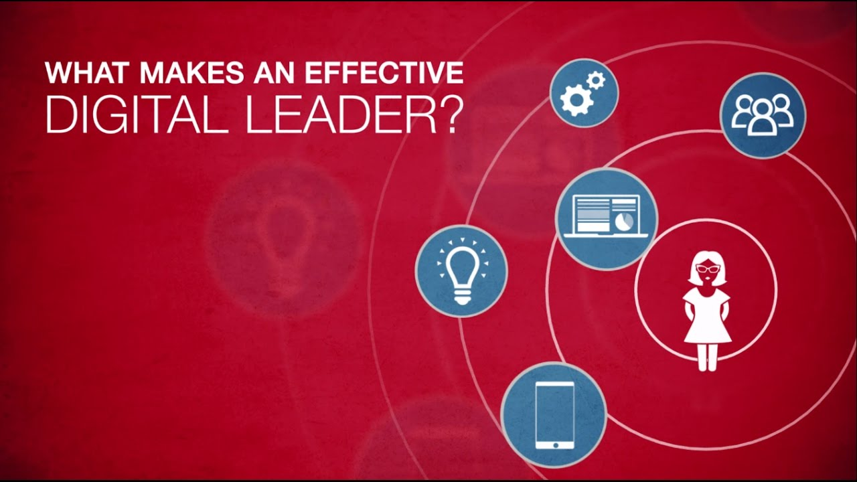
Customer Centric
Tech Savvy
Visionary
Adaptive & Agile
Data Driven
Notes:
Customer Centric
Leaders prioritize development driven by customer experiences
And align structures, processes & strategies towards seamless customer experiences
Tech Savvy
Visionary
Adaptive & Agile
Decision Making

Slide 19
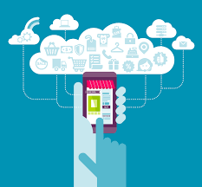
The 3 key success factors for digital leaders
1.
Executive & Supervisory Board visibility
Have the power and standing to drive change top down
2.
Focus on digital as core of the role
Perform the transition within 2-5 years
3.
P&l Control
Connect digital transformation with tangible business goals

Slide 20
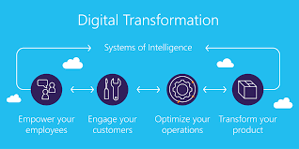
Digital Transformation requires top to bottom organizational transformation, which requires leaders who are willing and able to leverage digital to innovate and drive value.
Awareness
Realisation
Transformation
Constant Innovation
While the first 3 steps ensure survival, the 4th step is necessary to create sustainable future value
Notes:
Awareness
QUESTIONS:
What has happened or is happening to companies across industries?
Where does my own industry & company stand?
What kind of digital technologies exist & how could they possibly affect my business?
ACTIONS
Benchmark analysis of similar companies and industry
Competitor analysis
Research on existing and rising digital technologies
Realization
QUESTIONS
Which threats is Digitization causing for my company and what are the possible mitigations?
How much do I have to reach?
Who is responsible for DIGITAL?
What are the next concrete steps?
ACTIONS
Analysis of the individual fuse/bang scenario
Digital maturity assessment
Definition of a Digital Strategy & execution plan
Transformation
QUESTIONS
Who is the right person to be a digital leader?
How can we lead cultural change in order to enable new solutions, technologies and businesses in future/
What kind of technologies need to be established to transform succesfully?
ACTIONS
Analysis of internal skills & capabilities needed for digital transformation
Analysis of organizational structures
Appointing a Digital leader (eg. CDO)
Constant Innovation
QUESTIONS
How can we change our culture to enable responsibility and innovation?
How do we ensure constant change?
How can we collaborate with our ecosystem to stay ahead of new trends and technologies?
ACTIONS
Redesign the company’s DNA
Implementation of Innovation leadership
Building external relationships for an effective ecosystem

Slide 21


Slide 22
Thank You
CA Prayas Sharma : 9772421222
Prayas@basol.in
www.basol.in

