Slide 1
Books of Accounts under Companies Act and Audit Trail

Slide 2
Management’s Responsibility
Accounts of the Companies: Sec: 128
1.Place of keeping and manner and mode of maintenance
2. in case branch outside India- sufficient compliance if proper books are kept at that place and proper summarized returns are sent at registered office or other place
3. Inspection- made open during business hours
4. responsibility of the officer for providing assistance in carrying out inspection
5. Period of retention of Books of account- 8 immediately preceding years (minimum) + current year
6. Penalty- MD, WTD in charge of finance, CFO or other persons charged by board shall be punishable – not less than 50000/- subject to max of Rs. 5.00 Lakhs

Slide 3
Place of keeping of Books of Accounts:
Registered office
Other than Registered office: intimation o such other place to registrar within seven days – AOC-5 (rule 2A of Companies (Accounts ) Rules-2014
Manner of Maintenance of Books of Accounts –
Accrual basis and double accounting system

Slide 4
Mode of Accounting system:
Manual
2. Electronic mode- in the prescribed manner- (Companies Accounts Rules 2014)
- Rule(3) Sub-Rule (1)- Accessible at All time in India so as usable for subsequent reference:
Provided that for the financial year commencing on or after the 1st day of April, 2023, every company which uses accounting software for maintaining its books of account, shall use only such accounting software which has a feature of recording audit trail of each and every transaction, creating an edit log of each change made in books of account along with the date when such changes were made and ensuring that the audit trail cannot be disabled.
3. Retention of books of accounts - in the format in which they were originally generated, sent or received and electronic records shall remain complete and unaltered, including branch records (Sub –Rule 2 & 3).

Slide 5
4. The information in the electronic record of the document shall be capable of being displayed in a legible form (Sub Rule – 4).
5. There shall be a proper system for storage, retrieval, display or printout of the electronic records as may be deemed appropriate by the Audit Committee or board and such records shall not be disposed of or rendered unusable, unless permitted by law.
Mandatory compliance to have a backup of books of accounts and other records maintained in electronic mode in servers physically located in India on a daily basis (Sub Rule – 5).

Slide 6
6. The company shall intimate to the Registrar on an annual basis at the time of filing of financial statement-
(a) the name of the service provider;
(b) the internet protocol address of service provider;
(c) the location of the service provider (wherever applicable);
(d) where the books of account and other books and papers are maintained on cloud, such address as provided by the service provider.
(e) where the service provider is located outside India, the name and address of the person in control of the books of account and other books and papers in India.

Slide 7
Rule – 4 Conditions Regarding Maintenance and Inspection of Certain Financial Information by Directors
Summarized returns of books kept and maintained outside India at registered office at quarterly intervals
the director shall furnish a request to the company for any other information maintained outside India and company shall produce such financial information within fifteen days
Rule – 4A Forms and Items Contained in Financial Statements
As per Schedule III to the Act and in compliance with Accounting Standards or Indian Accounting Standards as applicable.
Rule – 5 Form of Statement Containing Salient Features of Financial Statements of Subsidiaries
The statement containing the salient feature of the financial statement of a company's subsidiary or subsidiaries, associate company or companies and joint venture or ventures under the first proviso to sub-section (3) of section 129 shall be in Form AOC-1.

Slide 8
Rule – 6 Manner of Consolidation of Accounts.
Rule – 7 Transitional Provisions with Respect to Accounting Standards.
Rule – 8 Matters to be Included in Board’s Report
Rule – 8A Matters to be included in Board’s Report for One Person Company and Small Company.
Rule – 9 Disclosures About CSR Policy.
Rule – 10 Statement Containing Salient Features of Financial Statements.
Rule – 11 Manner of Circulation of Financial Statements in Certain Cases
Rule – 12 Filing of Financial Statements and Fees to be Paid Thereon

Slide 9
Rule – 13 Companies Required to Appoint Internal Auditor
Listed Company | Unlisted Public Company | Private Limited Company
Mandatory for every company | Paid up capital – 50 crores or more during the preceding F.Y.; or
 | Turnover – 200 crores or more during the preceding F.Y.; or | Turnover – 200 crores or more during the preceding F.Y.; or
 | Outstanding borrowings from banks or FIs – 100 crores or more at any point of time during the preceding F.Y.; or | Outstanding borrowings from banks or FIs – 100 crores or more at any point of time during the preceding F.Y.; or
 | Outstanding deposits – 25 crores or more at any point of time during the preceding F.Y.

Slide 10
Definitions :
Sec. 2(12) “book and paper” and “book or paper” include books of account, deeds, vouchers, writings, documents, minutes and registers maintained on paper or in electronic form
Sec. 2(13) “books of account” includes records maintained in respect of—
(i) all sums of money received and expended by a company and matters in relation to which the receipts and expenditure take place;
(ii) all sales and purchases of goods and services by the company;
(iii) the assets and liabilities of the company; and
(iv) the items of cost as may be prescribed under section 148 in the case of a company which belongs to any class of companies specified under that section
Sec. 2 (1)(r) of Information Technology Act, 2000 "electronic form" with reference to information means any information generated, sent,
received or stored in media, magnetic, optical, computer memory, micro film, computer generated micro fiche or similar device (Machine Language)

Slide 11
Sec. 2 (1)(t) of Information Technology Act, 2000 ) "electronic record" means data, record or data generated, image or sound stored, received or sent in an electronic form or micro film or computer generated micro fiche (Legible information)
Audit Trail (or edit log) is a visible trail of evidence enabling one to trace information contained in statements or reports back to the original input source.
Audit Trails are the chronological record of the changes that have been made to the data. Any change to the data including creating the new data, updating or deleting data that must be recorded.
Records maintained as audit trail may include the following information :
a. when
b. who
c. what
Accounting Software is a computer program or system that enables recording, maintenance and reporting of books of accounts

Slide 12
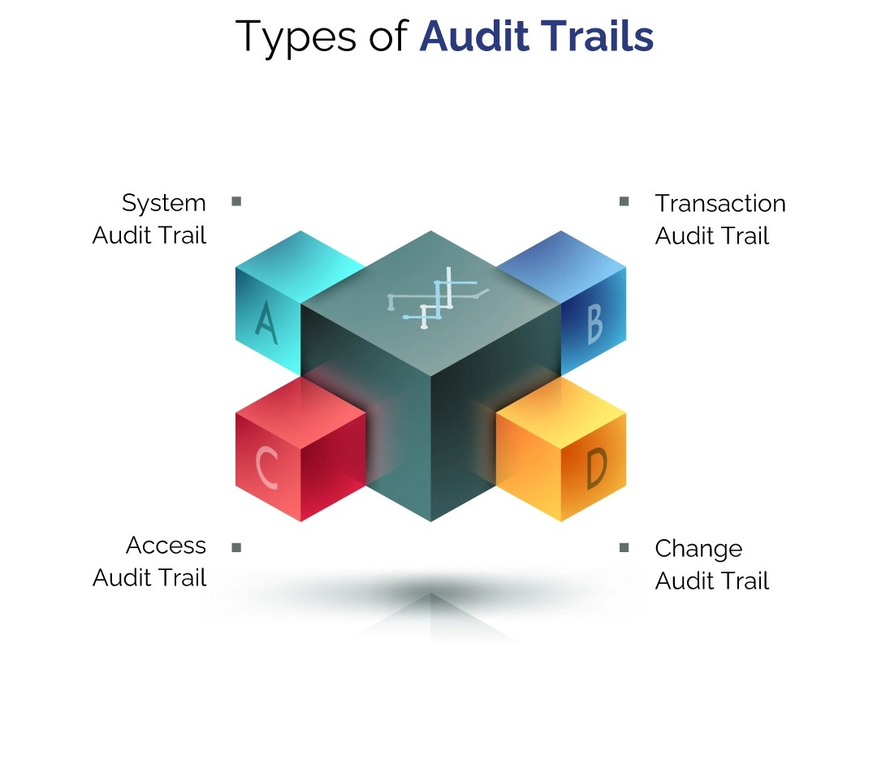
A system audit trail records all system-level events, such as system startups and shutdowns, user logins and logouts, system configurations, and security-related events. System audit trails are essential for detecting system-level attacks, such as unauthorized access, malware infections, and configuration changes.
A transaction audit trail records all transaction-level events, such as data entry, updates, deletions, and transfers. Transaction audit trails are essential for detecting and investigating data manipulation, fraud, and theft.
An access audit trail records all access-level events, such as file and folder access, network connections, and remote access. Access audit trails are essential for detecting and investigating unauthorised access and data breaches
A change audit trail records all changes made to the system or application, such as software updates, patches, and configuration changes. Change audit trails are essential for detecting and investigating system vulnerabilities, misconfigurations, and errors.

Slide 13
The Benefits of Audit Trails
Audit trails provide several benefits, including:
Improved security and data integrity: Audit trails help to detect and prevent unauthorized access, modifications, or deletions of sensitive data.
Compliance with regulations and policies: Audit trails play a crucial role in ensuring adherence to industry regulations and internal policies by providing a means to track and verify compliance.
Forensic capabilities for investigating security breaches or other incidents: Audit trails provide a complete record of system activity that can be used to investigate security incidents or other types of incidents.
Improved operational efficiency by identifying areas for process improvements: Audit trails can be used to identify areas for process improvements, helping businesses to operate more efficiently.
Increased accountability for users and administrators: Audit trails provide a clear record of user and administrator activity, increasing accountability and helping to prevent fraud.

Slide 14
Auditor’s Responsibility :
The auditor is under the obligation to report on the following aspects in relation to books of accounts:
Whether in his opinion proper books of accounts have been kept by the company so far as appears from the examination [Sec. 143(3)(b)].(General)
Opinion on whether company’s financial statements are in agreement with the books of accounts [Sec. 143(3)(d)].(General)
Report of the observation for the financial transactions having adverse effect on the functioning of the company [Sec. 143(3)(f)]. (Only in case of adverse comment)
Qualification, reservation or adverse remark in relation to maintenance of books of accounts [Sec. 143(3)(h)].

Slide 15
The Companies (Audit and Auditors) Rules, 2014 Rule 11(g) – Other Matters to be included in the Audit Report
[Whether the company, in respect of financial years commencing on or after the 1st April, 2022,] has used such accounting software for maintaining its books of account
which has a feature of recording audit trail (edit log) facility and
the same has been operated throughout the year for all transactions recorded in the software and
the audit trail feature has not been tampered with and
the audit trail has been preserved by the company as per the statutory requirements for record retention

Slide 16
Audit Approach:
Identify the records and transactions that constitute books of accounts u/s 2(13)
Identify the software- IT environment including applications, web portal, data base, interface, data warehouse, data lakes, cloud infrastructure or other component used for processing and storing data
Ensure such software have the audit trail feature
Ensure that such audit trail capture the changes to each and every transaction-
When
Who
What
5. Ensure that the audit trail feature always enabled
6. Ensure that the Audit trail is enabled at the data base level
7. Ensure that the audit trail is appropriately protected from any modification
8. Audit trail is retained as per statutory requirement
9. Ensure that the control over maintenance and monitoring of audit trail and its features are designed effectively through out the period of reporting.

Slide 17
Performance of the Audit procedure:
1. Assess management identification of records and transactions where audit trails need to be captured
2.Eveluation of management approach for identification of accounting software.
3. Enquiry from the management on how they evaluated changes that are required for maintenance of audit trail
Consider the involvement of specialist/ expert

Slide 18
Out come of the enquiry and audit procedure:
Management maintain adequate audit trail as required by law- compliance
2. Management may not have identified all records/ transactions for which audit trail should be maintained- Modified and adverse reporting
3. Accounting software does not have the feature to maintain the audit trail or it was not enabled- Modified and adverse reporting

Slide 19
Illustration of unmodified reporting:
“based on our examination which includes test checks, the company has used an accounting software for marinating its books of accounts which has a feature of recording audit trail (edit log facility) and same has been operated throughout the year for all relevant transactions recorded in software. Further, during the closure of our audit we did not come across the instances of audit trail feature tempered with.
(additionally, the audit trail has been preserved as per statutory requirement for record retention-not applicable being first year).
Illustration of Modified report:
based on our examination which includes test checks, the company except for the instances below, has used an accounting software for marinating its books of accounts which has a feature of recording audit trail : (edit log facility) and same has been operated throughout the year for all relevant transactions recorded in software. Further, during the closure of our audit we did not come across the instances of audit trail feature tempered with.
Also Refer the illustrations mention at page no. 13 to 16 of guidance note

Slide 20
Fraud Scenario
When some error or fraud could not be established due to lack of maintenance, availability of irretrievability of audit trail:
Auditors judgment in respect of following aspects:
1. The deficiency will result in a material misstatement and
2. The importance of such outcome
Accordingly reporting is required in terms of rule 11(g) and 143(12)
Reporting under rule 11(g) v/s Reporting under Audit of internal Financial Control over Financial Reporting (IFC of FR):
Guidance note uses expression “audit trail” to describe the control activities in relation to policies procedure related to information processing system but des not entail any detailed audit procedure in respect of reporting against Rule 11(g)
In case o non maintenance of internal control of lack of deficiency the report of (IFC of FR) is required to be modified.

Slide 21
Management representation:
Acknowledging the management responsibility for establishing and maintenance of adequate control for identifying, controlling and monitoring the audit trail.
Performance and evaluation for adequacy and effectiveness of procedure for compliance of audit trail
Outcome of such performance and evaluation about the adequacy and effectiveness of the procedure.
Disclosure of deficiencies in design or operation of control maintained for audit trail.
Identification of Fraud
Resolution of deficiencies
(Detailed format at appendix-II at page 23-26 of guidance note)

Slide 22
Audit Documentation:
- Planning and performance of audit in accordance with implementation guide
- Sufficient and appropriate records:

Slide 23
FAQ- guidance note

Slide 24
Thanking You

