Slide 1




CHARITABLE TRUSTS UNVEILED: NAVIGATING KEY ISSUES AND IMMEDIATE COMPLIANCES TO BE FOLLOWED
Jaipur Branch of CIRC of ICAI- 25/05/2024

Slide 2


TABLE OF CONTENTS
General Law of Charitable Institution
Applicability : Audit Report
Coverage in Form 10B / 10BB
Clause to Clause Discussion: Specific to Critical Clauses ( Form 10B/10BB
Section 80G
Section 115BBC
Income Tax Provisions – Receipt of Cash Donation
Intimation for Keeping Books of Accounts other than Registered Office
Provisional and Regular Registration
Corpus Donation
Inter Charity Donation
Repayment of Loans / Borrowings
Tax on Accredited Income u/s 115TD
R SOGANI & ASSOCIATES
www.soganiprofessionals.com

Slide 3

General Law
R SOGANI & ASSOCIATES
Jaipur Branch of CIRC of ICAI- 25/05/2024

Slide 4
Basic Concept of availing Income Tax exemption for Charitable Institutions(CI)
Registration u/s
12AB or 10(23C)
If 85% of income applied as Application of Income(AOI)
AOI= Capital exp.+ Revenue exp.
Income tax exemption-15% Blanket exemption will be allowed
General Law in case of Charitable Institutions
R SOGANI & ASSOCIATES
Jaipur Branch of CIRC of ICAI- 25/05/2024

Slide 5
In case 85% of income not applied as AOI i.e. AOI <85%
Charitable Institution(CI) has to pay tax being progressive tax payer as under
Now what needs to be done?
CATEGORY OF CHARITABLE INSTITUTIONS | SLAB RATE
Non Trading Company, Society, Trust | Individual Slab Rate
Section 8 Co. | 25%
R SOGANI & ASSOCIATES
Jaipur Branch of CIRC of ICAI- 25/05/2024

Slide 6
Applicability: Audit Report
R SOGANI & ASSOCIATES
Jaipur Branch of CIRC of ICAI- 25/05/2024

Slide 7
Applicability of Form 10B & 10BB (NEW)
Form 10B | Form 10BB
The total income of the charitable institution, exceeds rupees five crores during the previous year; or | If the conditions of Form 10B are not applicable, then Form 10BB has to be filed.
Such charitable institution has received any foreign contribution during the previous year; or
Such charitable institution has applied any part of its income outside India during the previous Year.
R SOGANI & ASSOCIATES
Jaipur Branch of CIRC of ICAI- 25/05/2024

Slide 8
Coverage in Form 10B/10BB
R SOGANI & ASSOCIATES
Jaipur Branch of CIRC of ICAI- 25/05/2024

Slide 9
All amendments of Income Tax Act
New Audit Report Format is the consolidation of:
Also covers provision in addition to Chapter III
Earlier 10B
Earlier 10BB
ITR- 7
Compilation of Personal Information details of Trust and Trustee
Assessment Order of AO
Assessment Order of CIT
Assessment Order of ITAT
Order of HC
Order of SC
It will make filing of ITR 7 easier.
Experience of registration under new law
Registration Form 10A/ 10AB
Notification for Books of accounts
R SOGANI & ASSOCIATES
Jaipur Branch of CIRC of ICAI- 25/05/2024

Slide 10
Overview of Form 10B
R SOGANI & ASSOCIATES
Jaipur Branch of CIRC of ICAI- 25/05/2024

Slide 11
1
General Information
Total Clauses (related to General information) – 20
Basic Details (Clause 1 to 6)
Legal Clause (Clause 7 to 8)
Registration Details (Clause 9)
Management Details (Clause 10)
Object (Clause 11 to 12)
Commencement of Activities (Clause 13)
Details of Place where books of accounts as per Rule 17AA and other documents have been maintained (Clause 14)
Advancement of GPU (Clause 15 to 16)
Business Undertakings (Clause 17)
Business Incidental to objects (Clause 18)
Details of Receipts where TDS is deducted (Clause 19)
Applicability of Provisions of Section 13(10) (Clause 20)
R SOGANI & ASSOCIATES
Jaipur Branch of CIRC of ICAI- 25/05/2024

Slide 12
2
Computation of Taxable Income
Total Clauses – 14
Voluntary Contributions (Clause 21 to 27)
Income to be applied (Clause 28 to 30)
Application of Income (Clause 31) – Most Important and trickiest Part of the form
Taxable income (Clause 32)
Income Taxable under Section 115BBI (Clause 33)
Anonymous Donation chargeable to tax (Clause 34)
R SOGANI & ASSOCIATES
Jaipur Branch of CIRC of ICAI- 25/05/2024

Slide 13
3
Other Reportable Clauses
Total Clauses – 15
Other Income (Clause 35)
Capital Assets u/s 11(1A) (Clause 36)
Application of Income out of different sources other than Income (Clause 37)
Payment or credit in excess of Rs.50 Lakhs to a Single person during previous year (Clause 38)
Details of Income u/s 13(10) (Clause 39)
Details of expenses for religious purpose for 80G registered Trusts (Clause 40)
Details of 13(3) Persons –Specified Persons (Clause 41-42)
Details of Specified violation u/s 13(2) –Specific Violations (Clause 43)
Details of claim of Depreciation where cost of asset is already claimed (Clause 44)
Details of deduction u/s 10 (Clause 45)
Details regarding Section 269SS (Clause 46)
Details regarding Section 269ST(Clause 47)
Details regarding Section 269T (Clause 48)
TDS requirement as per Chapter XVII-B or Chapter XVII-BB (Clause 49)
R SOGANI & ASSOCIATES
Jaipur Branch of CIRC of ICAI- 25/05/2024

Slide 14
Overview of Form 10BB
R SOGANI & ASSOCIATES
Jaipur Branch of CIRC of ICAI- 25/05/2024

Slide 15
1
General Information
Total Clauses – 11
Basic Details (Clause 1 to 6)
Legal Clause (Clause 7 to 8)
Management Details (Clause 9)
Commencement of Activities (Clause 10)
Details of Place where books of accounts as per Rule 17AA and other documents have been maintained (Clause 11)
R SOGANI & ASSOCIATES
Jaipur Branch of CIRC of ICAI- 25/05/2024

Slide 16
2
Computation of Taxable Income
Total Clauses – 15
Voluntary Contributions (Clause 12 to 20)
Income to be applied (Clause 21 to 22)
Application of Income (Clause 23)
Taxable income (Clause 24)
Income Taxable under Section 115BBI (Clause 25)
Anonymous Donation chargeable to tax (Clause 26)
3
Other Reportable Clauses
Total Clauses – 6
Application of income out of different sources (Clause 27)
Details of 13(3) Persons –Specified Persons (Clause 28-29)
Details of Specified violation u/s 13(2) –Specific Violations (Clause 30)
Details of claim of Depreciation where cost of asset is already claimed (Clause 31)
TDS requirement as per Chapter XVII-B or Chapter XVII-BB (Clause 32)
R SOGANI & ASSOCIATES
Jaipur Branch of CIRC of ICAI- 25/05/2024

Slide 17
Clause to Clause Discussion: Specific to Critical Clauses
R SOGANI & ASSOCIATES
Jaipur Branch of CIRC of ICAI- 25/05/2024

Slide 18
COMMON CLAUSES
R SOGANI & ASSOCIATES
Jaipur Branch of CIRC of ICAI- 25/05/2024

Slide 19
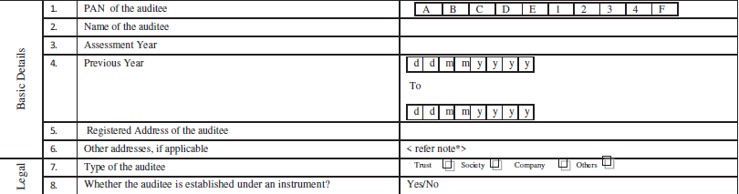
Clause to Clause Discussion of 10B & 10BB
Common Clauses
Here the problem emerges that if assessee has not submitted any intimation to the jurisdictional assessing officer, then whether we should report the other addresses if any of the books of account are kept at that place?
Auditor shall give qualification in the observation/qualification paragraph of Audit Report.
Since department has already notified through notification dated 10th Aug 2022, to intimate the addresses of other places where books of accounts are kept, now it is certifying from auditor whether such addresses were intimated to assessing officer.
R SOGANI & ASSOCIATES
Jaipur Branch of CIRC of ICAI- 25/05/2024

Slide 20

Clause to Clause Discussion of 10B & 10BB
Common Clauses
Clause 34/18 of Form No. 10B/10BB respectively.
“Anonymous donation” means any voluntary contribution referred to in section 2(24)(iia), where a person receiving such contribution does not maintain a record of the identity indicating the name and address of the person making such contribution and such other particulars as may be prescribed.
R SOGANI & ASSOCIATES
Jaipur Branch of CIRC of ICAI- 25/05/2024

Slide 21
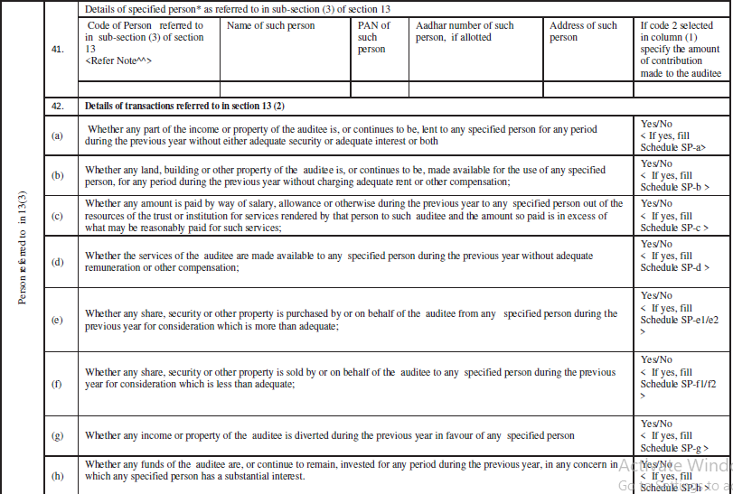
Clause to Clause Discussion of 10B & 10BB
Common Clauses
Clause 41 & 42/28 & 29 of Form 10B/10BB respectively.
For Clause 28/41, in case of trusts have large number of trustees, it is highly problematic to fill details of each members of trustees, which can be filled by using the offline utility (via software).
R SOGANI & ASSOCIATES
Jaipur Branch of CIRC of ICAI- 25/05/2024

Slide 22

Clause to Clause Discussion of 10B & 10BB
Common Clauses
Clause 49/32 of Form No. 10B/10BB respectively.
This Clause is similar to the details required to be furnished in tax audit reports (3CA/3CB-3CD) where following details are required to be reported:-
TDS required to be deducted under various sections & tax deducted
Details of forms furnished w.r.t tax deducted (24Q/26Q/27Q)
Amount of Interest payable u/s 201(1A) & interest paid
R SOGANI & ASSOCIATES
Jaipur Branch of CIRC of ICAI- 25/05/2024

Slide 23

Clause to Clause Discussion of 10B & 10BB
Common Clauses
There shall be no difference in the information required to be filled in ITR-7 in comparison to reporting in Audit report.
This Audit Report will definitely make the practitioner expertise in Trust Law!!
R SOGANI & ASSOCIATES
Jaipur Branch of CIRC of ICAI- 25/05/2024

Slide 24
Detailed Clauses in Form 10B
Part of clause indicated in RED BOX are common in both FORMS
R SOGANI & ASSOCIATES
Jaipur Branch of CIRC of ICAI- 25/05/2024

Slide 25
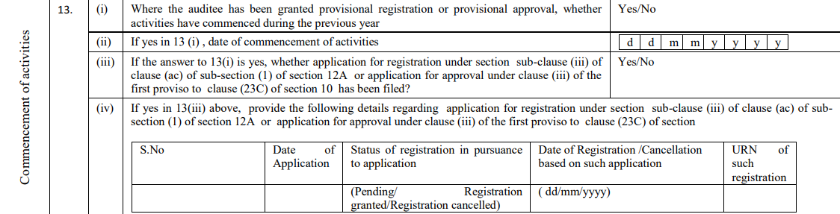
Clause to Clause Discussion of 10B & 10BB
Which are more detailed in 10B
Clause 13/10 of Form 10B/10BB respectively.
Special Focus
Date of Commencement of Activities
R SOGANI & ASSOCIATES
Jaipur Branch of CIRC of ICAI- 25/05/2024

Slide 26
Clause to Clause Discussion of 10B & 10BB
Common Clauses
All the forms i.e., Form 10A, Form 10AB were filed using the DSC of client itself.
But now department is keen to certify such details of commencement of activities & date of application for provisional registration by the auditor.
If in any case, incorrect information is being furnished or there exists mismatch between the audit form & earlier filed forms, then it may lead to enquires from department demanding the withdrawal of registration granted to such institution.
Department is also collecting the auditor’s certified data from its assessees in order to process such information and issues notices to those charitable trusts who have submitted wrong/incorrect information.
R SOGANI & ASSOCIATES
Jaipur Branch of CIRC of ICAI- 25/05/2024

Slide 27
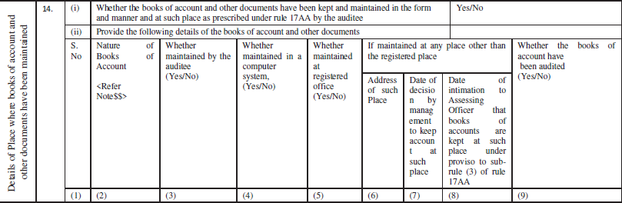
Clause to Clause Discussion of 10B & 10BB
Which are more detailed in 10B
Clause 14/11 of Form 10B/10BB respectively.
Here the problem emerges that if assessee has not submitted any intimation to the jurisdictional assessing officer, then whether we should report the other addresses if any of the books of account are kept at that place?
Auditor shall give qualification in the observation/qualification paragraph of Audit Report
R SOGANI & ASSOCIATES
Jaipur Branch of CIRC of ICAI- 25/05/2024

Slide 28
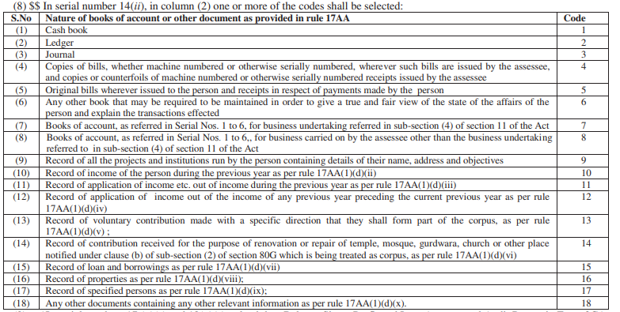
Clause to Clause Discussion of 10B & 10BB
Which are more detailed in 10B
Here, form is giving option at last i.e., “any other documents containing any other relevant information as per rule 17AA(1)(d)(x)” which gives endless options for specifying the documents.
Department has prescribed a huge list of books of account or other documents which are not even prescribed in case of other assessees.
R SOGANI & ASSOCIATES
Jaipur Branch of CIRC of ICAI- 25/05/2024

Slide 29


Clause to Clause Discussion of 10B & 10BB
Which are more detailed in 10B
Since department has already notified through notification dated 10th Aug 2022, to intimate the addresses of other places where books of accounts are kept, now it is certifying from auditor whether such addresses were intimated to assessing officer.
R SOGANI & ASSOCIATES
Jaipur Branch of CIRC of ICAI- 25/05/2024

Slide 30
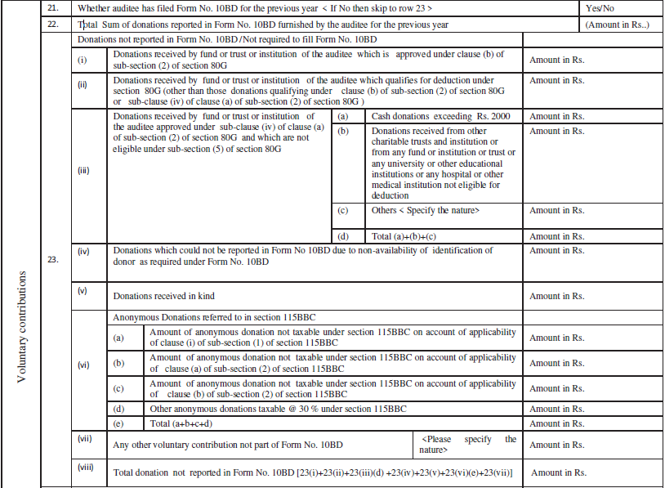
Clause to Clause Discussion of 10B & 10BB
Which are more detailed in 10B
Clause 21,22,23/12,13,14 of Form 10B/10BB respectively.
10BB require only gross amount of donations not reported/ not required to be reported in Form 10BD
R SOGANI & ASSOCIATES
Jaipur Branch of CIRC of ICAI- 25/05/2024

Slide 31
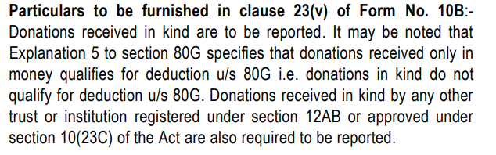
Clause to Clause Discussion of 10B & 10BB
Which are more detailed in 10B
Clause 23(v)
Technical guide on Donation received in kind:-
R SOGANI & ASSOCIATES
Jaipur Branch of CIRC of ICAI- 25/05/2024

Slide 32

Clause to Clause Discussion of 10B & 10BB
Which are more detailed in 10B
Clause 29/19 of Form 10B/10BB respectively.
Here, irony is that Form10BB also requires reporting of income applied outside India although if any amount is applied outside India, then 10BB can’t be filed as per the conditions of applicability of Form 10BB/10B.
This clause also requires detailed reporting of income applied outside India for promoting international welfare in which India is interested.
R SOGANI & ASSOCIATES
Jaipur Branch of CIRC of ICAI- 25/05/2024

Slide 33
Clause to Clause Discussion of 10B & 10BB
Which are more detailed in 10B
Now comes the most difficult one.
R SOGANI & ASSOCIATES
Jaipur Branch of CIRC of ICAI- 25/05/2024

Slide 34
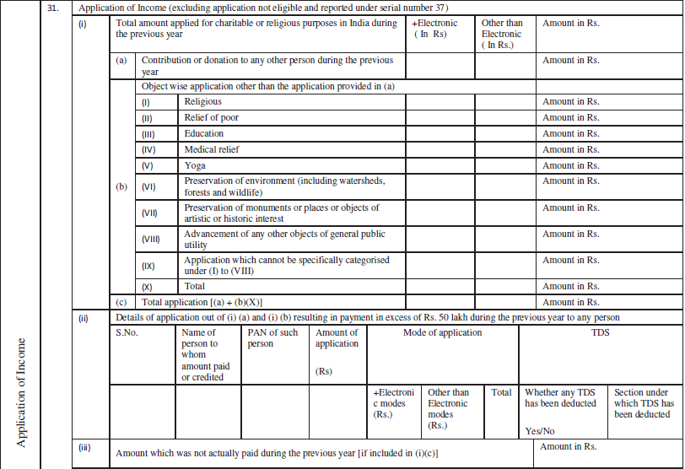
Clause to Clause Discussion of 10B & 10BB
Application of Income
Which are more detailed in 10B
Clause 31/23 of Form 10B/10BB respectively.
R SOGANI & ASSOCIATES
Jaipur Branch of CIRC of ICAI- 25/05/2024

Slide 35
Clause 31 (i) –Form 10B
1
Application of Income
Application of income excluding application not eligible and reported under serial number 37 of Form 10B.
2
Bifurcation of Application of Income (Object Wise)
Application of income should be bifurcated as per the objects reported under serial number 11 of Form 10B.
Now, here is a catch that if the client bifurcated application of income in objects specified under clause 11, those objects should be reconciled with objects specified in Form 10AB. Otherwise it may attract scrutiny.
Another catch is point (IX) of Clause 31 sub-clause(b), which talks about application which cannot be specifically categorized under objects at I TO VIII of Clause 31 sub – Clause (b), now if we select in this head then again, scrutiny may be attracted as all the objects according to section 2(15) is already specified in above points.
R SOGANI & ASSOCIATES
Jaipur Branch of CIRC of ICAI- 25/05/2024

Slide 36
3
Bifurcation of Application of Income (Electronic & Non-Electronic)
Application of income should be bifurcated in two modes one is electronic and other one is non- electronic.
Electronic modes includes which are referred in rule 6AABA of income tax rules,1962:
Credit card
Debit card
Net Banking
IMPS
UPI
RTGS
NEFT
BHIM
All other modes of payment other than specified above will be classified as non – electronic modes of Payment.
R SOGANI & ASSOCIATES
Jaipur Branch of CIRC of ICAI- 25/05/2024

Slide 37
Account Payee Cheque – Consider As Electronic Mode Or Not ??
R SOGANI & ASSOCIATES
Jaipur Branch of CIRC of ICAI- 25/05/2024

Slide 38
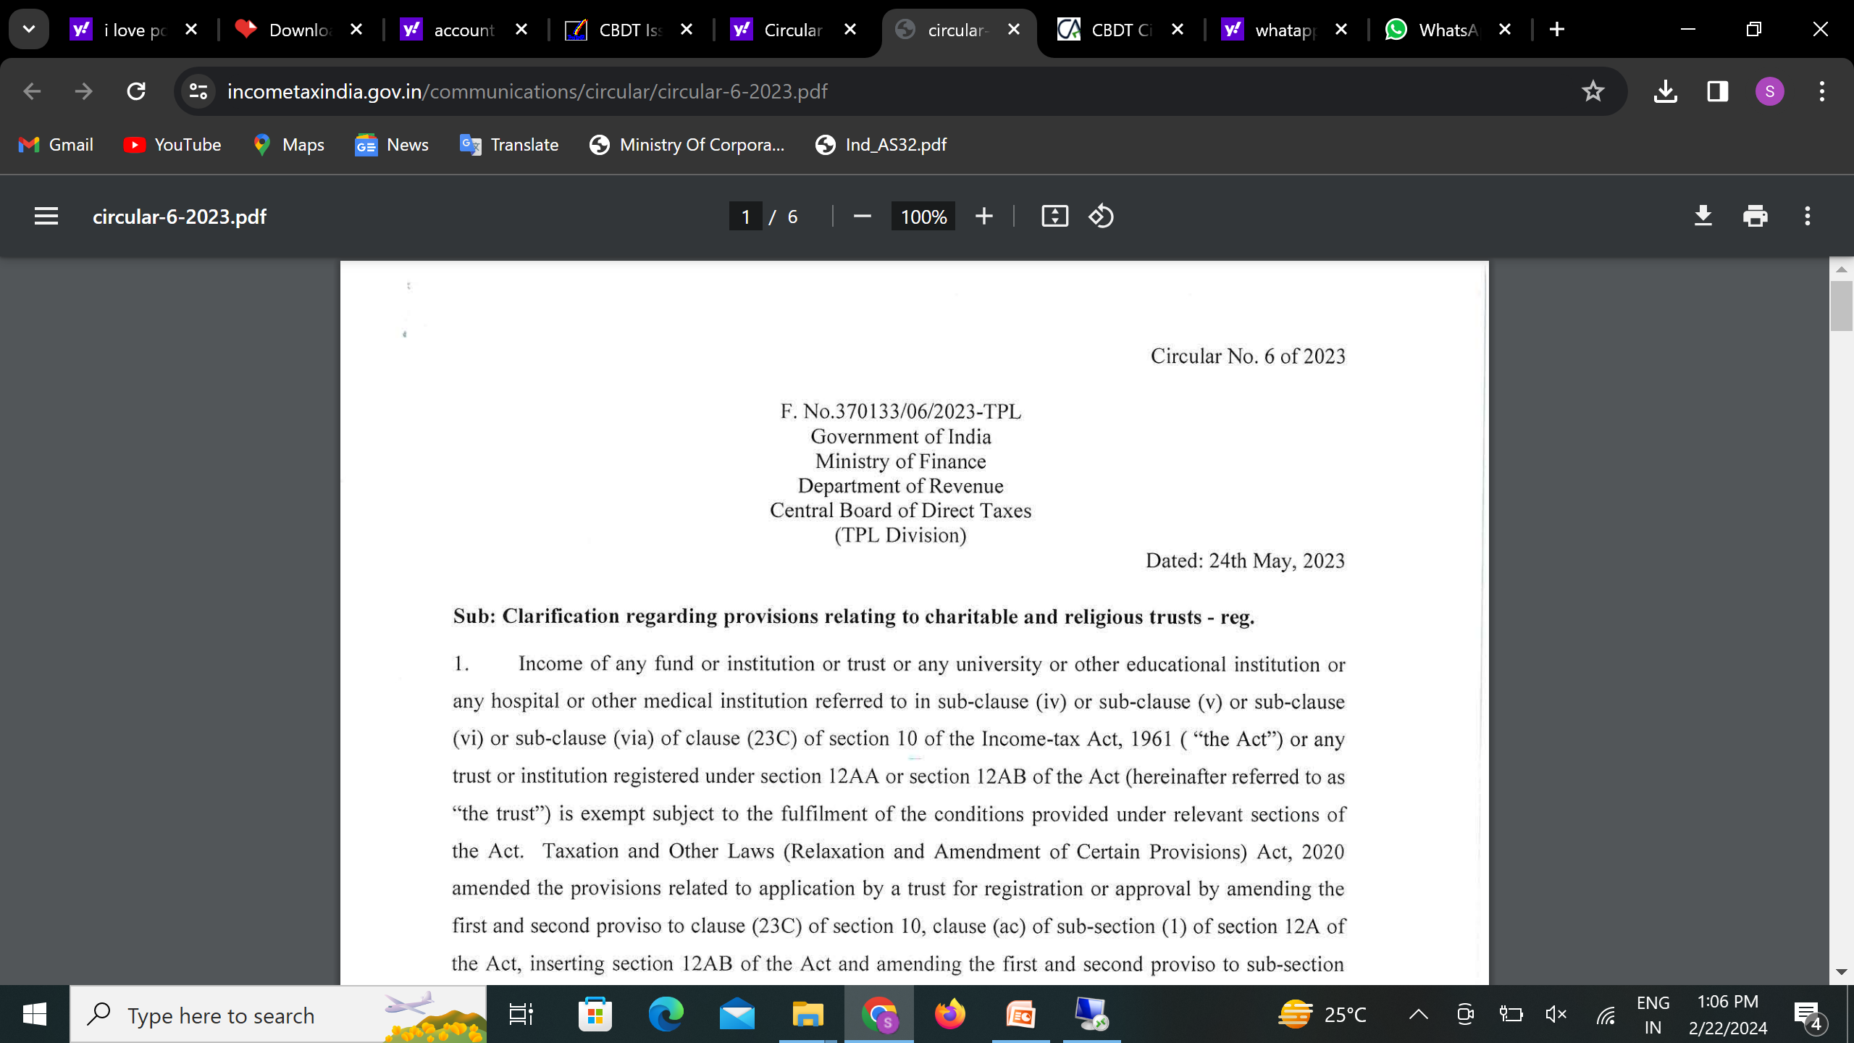
R SOGANI & ASSOCIATES
Jaipur Branch of CIRC of ICAI- 25/05/2024

Slide 39
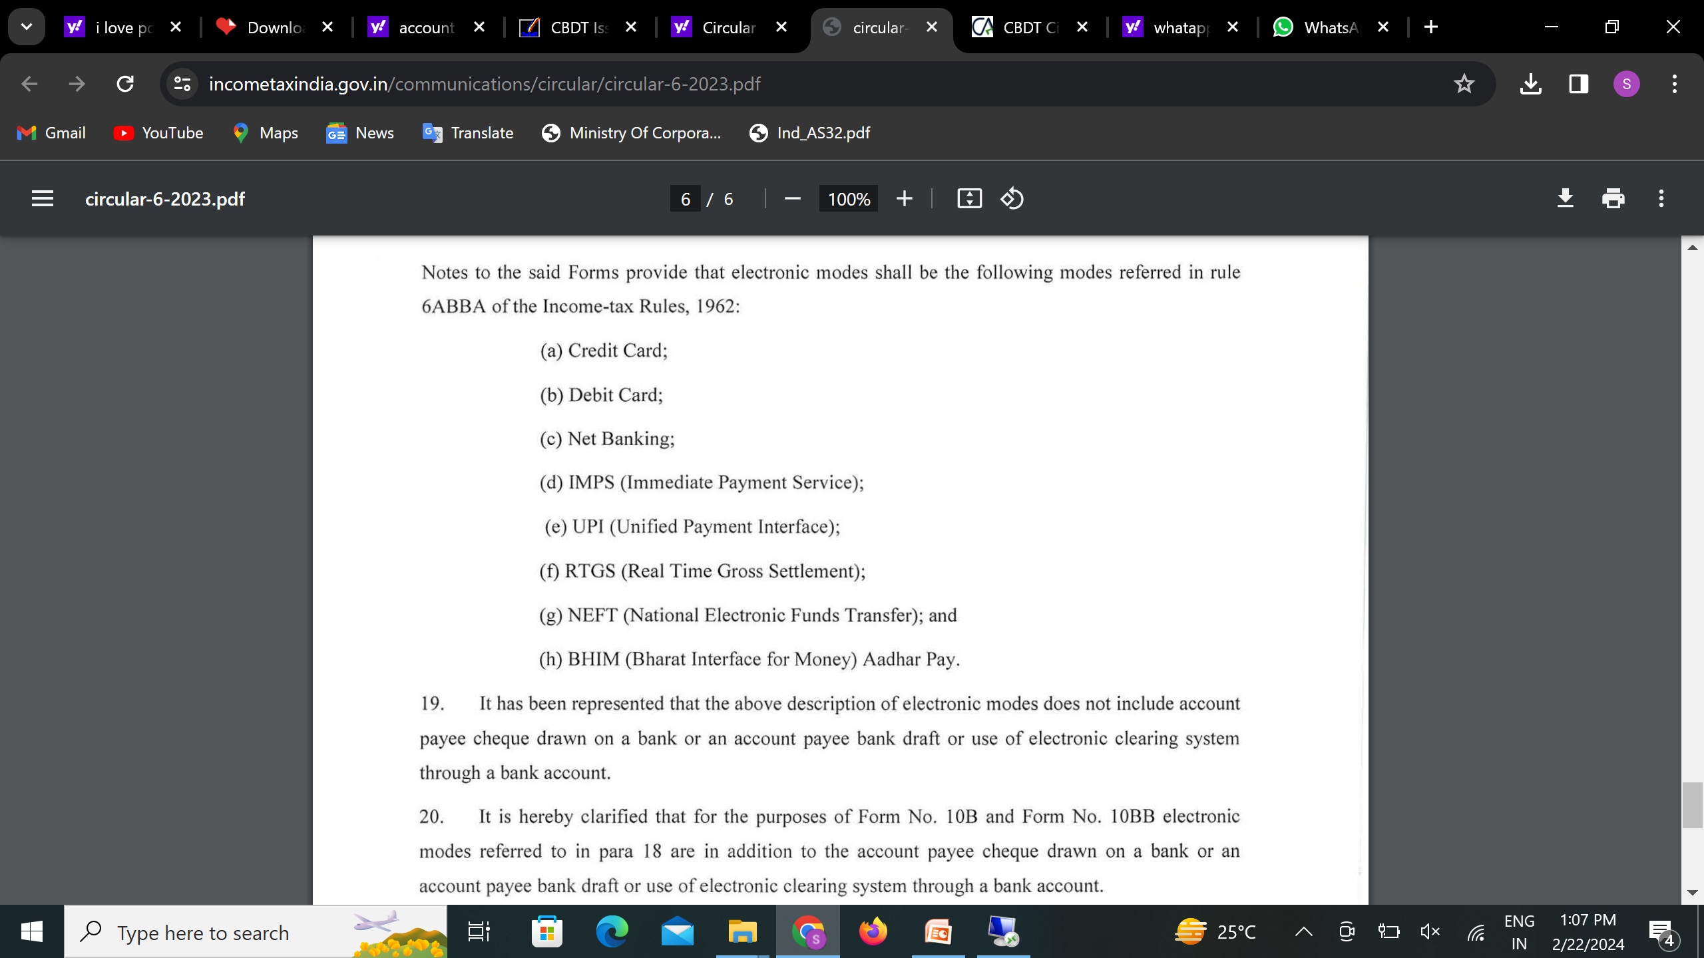
R SOGANI & ASSOCIATES
Jaipur Branch of CIRC of ICAI- 25/05/2024

Slide 40
Clause 31 (ii) –Form 10B
1
Details of application out of (i) (a) and (i) (b) of Clause 31
Here, the requirement of this clause is that if during the previous year, if payment or credit is made to any person in excess of Rs. 50 lakhs then following details of that person are required to be reported:-
Name of the person
Whether any TDS has been deducted
PAN of such person
Mode of application
Section under which TDS has been deducted
Amount of application
R SOGANI & ASSOCIATES
Jaipur Branch of CIRC of ICAI- 25/05/2024

Slide 41
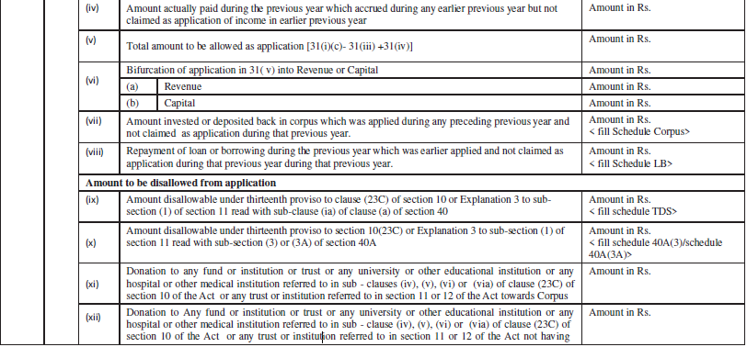
Clause to Clause Discussion of 10B & 10BB
Which are more detailed in 10B
Form 10BB does not require bifurcation as per clause 31 (vi) where bifurcation of application of income into revenue & capital is required to filed.
R SOGANI & ASSOCIATES
Jaipur Branch of CIRC of ICAI- 25/05/2024

Slide 42
Application out of different sources
Income accumulated under third proviso of section 10(23C) or u/s 11(2)
Why this Clause
Clause 37 is discussed about details and bifurcation in modes :- the amount of application out of following sources during the previous year
Clause 37
Income deemed to be applied in any preceding year under clause 2 explanation 1 of section 11(1)
Income of earlier previous years up to 15% accumulated or set apart
This clause can only be filled if we have application of Income more than 100%
Corpus
Borrowed Fund
Any other than Please specify it
R SOGANI & ASSOCIATES
Jaipur Branch of CIRC of ICAI- 25/05/2024

Slide 43
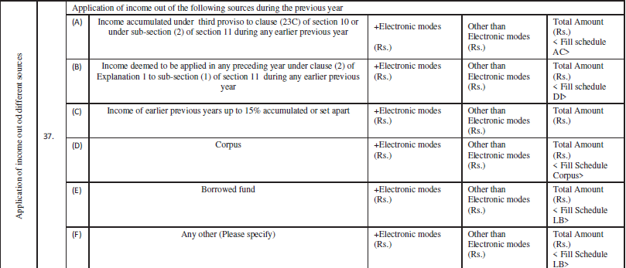
Clause to Clause Discussion of 10B & 10BB
Which are more detailed in 10B
Clause 37/27 of Form 10B/10BB respectively.
Form 10BB does not require bifurcation between electronic & other than electronic modes.
Here, If we select the option “ Any other”, it may lead to further enquiry by the department.
R SOGANI & ASSOCIATES
Jaipur Branch of CIRC of ICAI- 25/05/2024

Slide 44
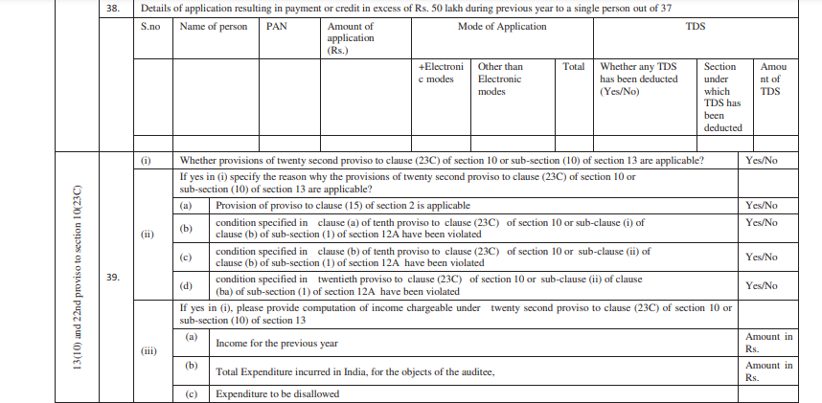
Clause to Clause Discussion of 10B & 10BB
Only in 10B
Clause 38 of form 10B is discussed about the details of application where during previous year excess of Rs. 50 lakhs to a single person paid or credited.
Clause 38 will required to be filled only if we report application of funds from different sources in Clause 37
R SOGANI & ASSOCIATES
Jaipur Branch of CIRC of ICAI- 25/05/2024

Slide 45
There shall be no difference in the information required to be filled in ITR-7 in comparison to reporting in Audit report.
This Audit Report will definitely make the practicioner expertise in Trust Law!!
R SOGANI & ASSOCIATES
Jaipur Branch of CIRC of ICAI- 25/05/2024

Slide 46
Clauses only in 10B
This is important to notice that clauses only asked in form 10B, which interprets that departments also wants to first focus on the big trust than on small trust so they didn’t asked various information in Form 10BB.
R SOGANI & ASSOCIATES
Jaipur Branch of CIRC of ICAI- 25/05/2024

Slide 47
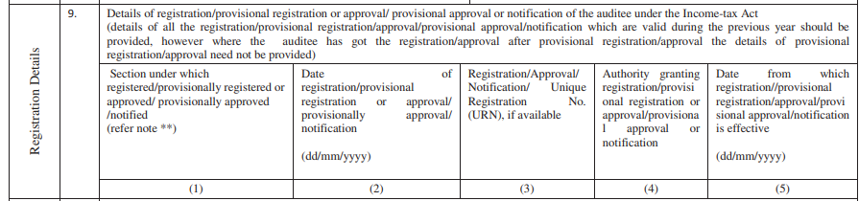
Clause to Clause Discussion of 10B & 10BB
Registration details
Only in 10B
Clause 9 is exclusively discussed in Form 10B, which asks about the details of registration with date of approval.
It need to be ensured that details are filled accurately as it will process such details with details of registration filled while filing Income Tax Return (ITR).
Here details of registration under section 10(23)(c), 12AB, 80G & section 35(1)(iii) is also required to be reported.
R SOGANI & ASSOCIATES
Jaipur Branch of CIRC of ICAI- 25/05/2024

Slide 48
Clause to Clause Discussion of 10B & 10BB
Registration details
Only in 10B
R SOGANI & ASSOCIATES
Jaipur Branch of CIRC of ICAI- 25/05/2024

Slide 49
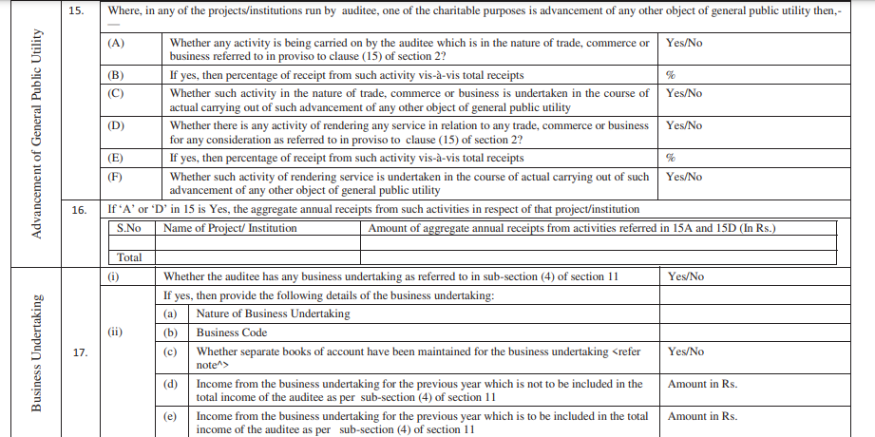
Clause to Clause Discussion of 10B & 10BB
GPU Related details
Only in 10B
R SOGANI & ASSOCIATES
Jaipur Branch of CIRC of ICAI- 25/05/2024

Slide 50
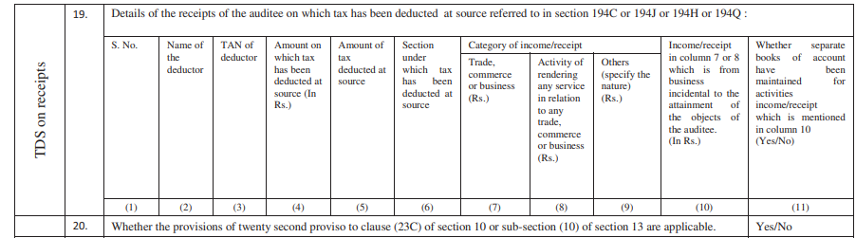
Clause to Clause Discussion of 10B & 10BB
Details of receipts on which TDS was deducted
Only in 10B
Clause 19 is exclusively in form 10B which enquires about the details of the receipts of the auditee, on which the tax has been deducted at source under the section 194C,194J,194H,194Q.
In short, Clause 19 talks about the 26AS of the client.
This clause helps to carve out the effect of quoting wrong section under which the tax has been deducted by the deductor, so here a responsibility of auditor arises that auditor have to request the auditee to provide a reconciliation of the amounts reported therein and the amounts which are reflected in the auditee’s books of accounts along with the details of the nature of such income.
This clause focuses on whether the receipts of the trusts are in nature of commercial or not.
R SOGANI & ASSOCIATES
Jaipur Branch of CIRC of ICAI- 25/05/2024

Slide 51
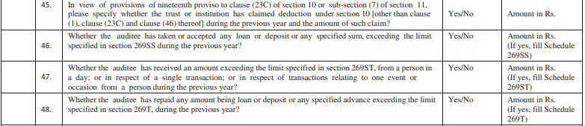
Clause to Clause Discussion of 10B & 10BB
Only in 10B
Department is active these days by covering the assessees doing disallowance of Section 269SS/ST/T
R SOGANI & ASSOCIATES
Jaipur Branch of CIRC of ICAI- 25/05/2024

Slide 52
Clause to Clause Discussion of 10B & 10BB
Only in 10B
Details required even outside the requirement of Chapter III of Income Tax Act, 1961.
Here, in the form 10B some of the details which it requires to fill is outside the chapter III of Income Tax Act, 1961. Like :-
Clause 46 which is same as section 269SS of chapter XX – B
Clause 47 which is same as section 269ST of chapter XX – B
Clause 48 which is same as section 269T of chapter XX– B
It states that in coming year further clauses from different chapter will also be included in the audit report. So, be prepared for the same. Like section 36(1)(va), any sum received from employees towards contributions to any provident fund or superannuation fund or any other fund gets disallowed.
R SOGANI & ASSOCIATES
Jaipur Branch of CIRC of ICAI- 25/05/2024

Slide 53
There shall be no difference in the information required to be filled in ITR-7 in comparison to reporting in Audit report.
This Audit Report will definitely make the practitioner expertise in Trust Law!!
R SOGANI & ASSOCIATES
Jaipur Branch of CIRC of ICAI- 25/05/2024

Slide 54
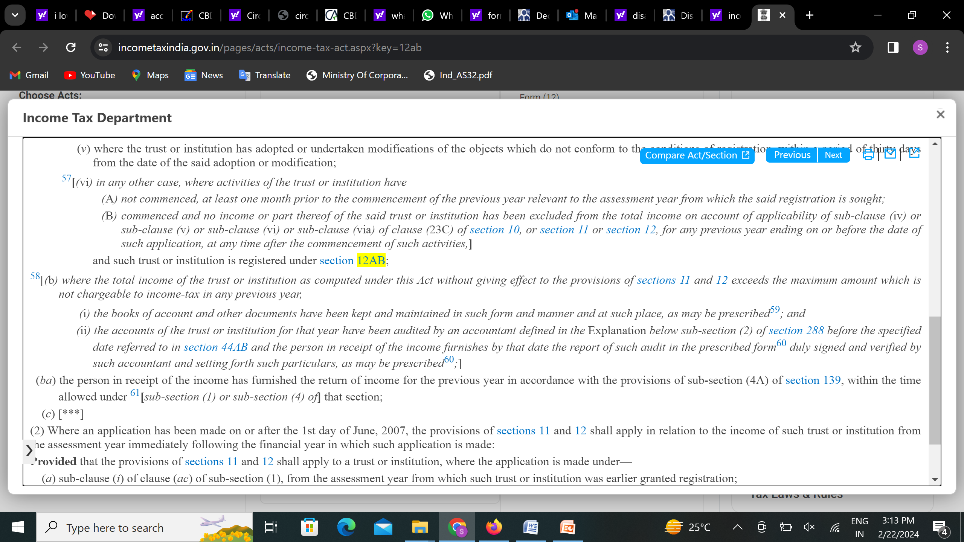
Is it Mandatory to file the Audit Report on
or before due date for Exemption??
“YES”
R SOGANI & ASSOCIATES
Jaipur Branch of CIRC of ICAI- 25/05/2024

Slide 55
Section 80G
R SOGANI & ASSOCIATES
Jaipur Branch of CIRC of ICAI- 25/05/2024

Slide 56
From F.Y. 2021-22 Charitable Institutions are required to file 80G returns by
Filing Form 10BD
Receipt of Donation Certificate as 10BE
by 31st May
Else would attract late fees u/s 234G and penalty u/s 271K
R SOGANI & ASSOCIATES
Jaipur Branch of CIRC of ICAI- 25/05/2024

Slide 57
PRESCRIBED PENALTIES/ LATE FEES
Late Fees u/s 234G – Rs. 200 per day
Penalty u/s 271K – Rs.10,000 <= Rs.1,00,000
R SOGANI & ASSOCIATES
Jaipur Branch of CIRC of ICAI- 25/05/2024

Slide 58
Where the total income of a charitable institution registered or approved under section 12AB or 10(23C) includes any income by way of any anonymous donation, the income-tax payable shall be the aggregate of—
(i) the amount of income-tax calculated at the rate of thirty per cent on the aggregate of anonymous donations received in excess of the higher of the following, namely:—
115BBC:
Anonymous Donations to be taxed in certain cases
(A) five per cent of the total donations received by the assessee;
(B) one lakh rupees
OR
R SOGANI & ASSOCIATES
Jaipur Branch of CIRC of ICAI- 25/05/2024

Slide 59
Case-I
Total donation (including Anonymous Donation) received by a Charitable Institution during a financial year is Rs. 1,00,00,000.
Total anonymous donation received during the year Rs. 5,00,000.
Can the Charitable Institution file return of 80G without having the details of the donation received of Rs. 5,00,000?
R SOGANI & ASSOCIATES
Jaipur Branch of CIRC of ICAI- 25/05/2024

Slide 60
Case-II
Total donation (including Anonymous Donation) received by a Charitable Institution during a financial year is Rs. 1,00,000.
Total anonymous donation received during the year Rs. 1,00,000.
Is the Charitable Institution required to file return of 80G?
R SOGANI & ASSOCIATES
Jaipur Branch of CIRC of ICAI- 25/05/2024

Slide 61
Provisional
Registration No.
Regular
Registration
No.
v/s
R SOGANI & ASSOCIATES
Jaipur Branch of CIRC of ICAI- 25/05/2024

Slide 62
Income Tax Provisions –Receipt of Cash Donation
R SOGANI & ASSOCIATES
Jaipur Branch of CIRC of ICAI- 25/05/2024

Slide 63
Cash & In Kind Donations
Cash Donations more than Rs. 2000 not eligible for 80G deduction
In kind, donations are not eligible for 80G deduction
R SOGANI & ASSOCIATES
Jaipur Branch of CIRC of ICAI- 25/05/2024

Slide 64
Cash Donations Received by a Trust
R SOGANI & ASSOCIATES
Jaipur Branch of CIRC of ICAI- 25/05/2024

Slide 65
I. What are the implications if the “Trust” receives cash donations exceeding Rs. 2,000?
From the perspective of the Donee, i.e., the “Trust” | From the perspective of the Donor
There are no concerns regarding the acceptance of cash donations exceeding Rs. 2,000. The “Trust” can receive cash donations exceeding Rs. 2,000. | Donations exceeding Rs. 2,000, if made in cash, shall not qualify for the deduction under section 80G of the Income Tax Act, 1961.
R SOGANI & ASSOCIATES
Jaipur Branch of CIRC of ICAI- 25/05/2024

Slide 66
II. What will be the implication, if cash donation exceeding Rs. 2,00,000 is received in
a single instance?
From the perspective of the Donee, i.e., the “Trust” | From the perspective of the Donor
If the “Trust” issues a single receipt of Rs. 2,00,000 for a donation received in cash, the Income Tax Department may impose a penalty equivalent to the amount of the donation under section 271DA of the Income Tax Act, 1961 on the “Trust”. | There will be no legal implication for the donor if they provide a cash donation in a single instance exceeding Rs. 2,00,000 to the "Trust." It is important to note that the Donor will not be eligible for deduction under section 80G of the Income Tax Act, 1961 for such cash donation, as it exceeds the limit of Rs. 2,000. Cash donation from the donor to the “Trust” has to be from legitimate and explainable sources.
R SOGANI & ASSOCIATES
Jaipur Branch of CIRC of ICAI- 25/05/2024

Slide 67
III. What will be the implication, in case, cash donation received in case of Religious Trust in Gullak / DAAN PETI / Donation Box?
From the perspective of the Donee, i.e., the “Trust” | From the perspective of the Donor
Religious Trusts are eligible to receive cash donations in Gullak/ DAAN PETI/ Donation Box maintained by the “Trust”, from the public at large for various religious activities. There are no adverse implications under the provisions of the Income Tax Act, 1961, if the donation is solely intended for religious activities. However, Charitable Trust may face 115BBC. | Cash donation by donor in Gullak/ DAAN PETI/ Donation Box has no adverse implication as per the provisions of the Income Tax Act, 1961. Donor will not be eligible for deduction under section 80G of the Income Tax Act, 1961 for such donation.
R SOGANI & ASSOCIATES
Jaipur Branch of CIRC of ICAI- 25/05/2024

Slide 68
Intimation for keeping Books of Accounts other than registered office
R SOGANI & ASSOCIATES
Jaipur Branch of CIRC of ICAI- 25/05/2024

Slide 69

Can BOA be kept at an Additional Place of Business? Yes, by passing a resolution and communicating it to Jurisdictional AO within 7 days by person authorized to file ITR.
R SOGANI & ASSOCIATES
Jaipur Branch of CIRC of ICAI- 25/05/2024

Slide 70
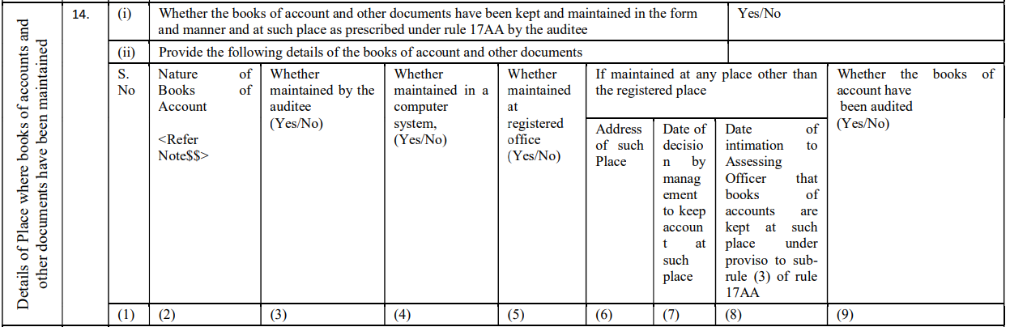
Reporting of Books of Accounts in Audit Report:
(a) Form 10B
R SOGANI & ASSOCIATES
Jaipur Branch of CIRC of ICAI- 25/05/2024

Slide 71
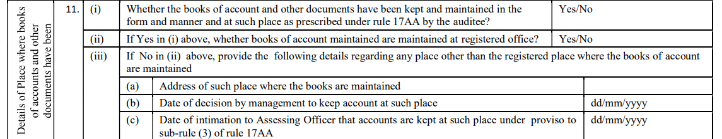
(b) Form 10BB
R SOGANI & ASSOCIATES
Jaipur Branch of CIRC of ICAI- 25/05/2024

Slide 72
Circular No. 17/2023 dated 9 October 2023 issued by the CBDT
Reporting Details About Significant Donors
To be considered as a relaxation or not???
R SOGANI & ASSOCIATES
Jaipur Branch of CIRC of ICAI- 25/05/2024

Slide 73
CBDT provides certain relaxations to charitable institutions for reporting details about Significant Donors and their relatives/concerns in audit report
Wherein the CBDT provides relaxation to charitable institutions in providing details of Significant Donors and its relatives/concern in audit report for tax year 2022-23. The CBDT provides that for the purposes of reporting in audit report, any person who has given donation of more than Rs.50,000 during the tax year may be considered as Significant Donor and past years donation may not be reckoned for the purposes of such reporting. Also, details of relatives/Concerns of such Significant Donor may be reported ‘if available’.
R SOGANI & ASSOCIATES
Jaipur Branch of CIRC of ICAI- 25/05/2024

Slide 74
Comment
Income Computation:
The Circular does not offer relief for income computation of charitable institutions; it only addresses reporting obligations. If a charitable institution has provided any benefit to a donor who contributed Rs.50,000 in earlier years and became a related person, that income is still taxable, despite the person not needing to be reported under the audit report.
Significant Donors Reporting:
The relaxation is only for reporting information on Significant Donors. Other specified related parties (e.g., settlor, trustee) still require complete reporting, with no relaxation granted.
R SOGANI & ASSOCIATES
Jaipur Branch of CIRC of ICAI- 25/05/2024

Slide 75
Comment
Ambiguous Language:
The Circular's language may imply that only current year donations of Rs.50,000 need reporting, omitting past Significant Donors. However, the spirit of the obligation suggests that if information on past Significant Donors is available, it should be reported. The term ‘if available’ indicates that charitable institutions should make a reasonable effort to collect and report this information.
One-time Relaxation:
The relaxation applies only for the tax year 2022-23 due to the short time available to charitable institutions following the introduction of new audit report forms.
R SOGANI & ASSOCIATES
Jaipur Branch of CIRC of ICAI- 25/05/2024

Slide 76
Provisional and Regular Registration
R SOGANI & ASSOCIATES
Jaipur Branch of CIRC of ICAI- 25/05/2024

Slide 77
Bridging Error Between Provisional and Regular Registration
Firstly, Institution which commences activity for the first time can go for provisional registration. There would not be any detailed enquiries.
Secondly, Institution which has already commenced its activities has to apply for regular registration directly, thereby omitting the requirement to apply for provisional registration. Subsequently, detailed enquiries would be initiated.
Effective from 01.10.2023.
R SOGANI & ASSOCIATES
Jaipur Branch of CIRC of ICAI- 25/05/2024

Slide 78
How To Register Under Section 12AB
Step-1
NGO is initially required to apply for Provisional Registration in Form 10A.
Step-2
After obtaining Provisional Registration, the NGO has to apply for Regular Registration in Form 10AB for validity of 5 years, adhering to the following timelines:
a. Within six months from the date of commencement of activities,
or
b. Six months before the expiry of Provisional Registration,
whichever is earlier
R SOGANI & ASSOCIATES
Jaipur Branch of CIRC of ICAI- 25/05/2024

Slide 79
Commenced or Not Commenced
Activities Of Trust ??
R SOGANI & ASSOCIATES
Jaipur Branch of CIRC of ICAI- 25/05/2024

Slide 80
Corpus Donation
R SOGANI & ASSOCIATES
Jaipur Branch of CIRC of ICAI- 25/05/2024

Slide 81

Corpus Donation refers to the donation made with a SPECIFIC DIRECTION from donor to the donee with regard to object for which funds should be utilized.
CORPUS DONATION
R SOGANI & ASSOCIATES
Jaipur Branch of CIRC of ICAI- 25/05/2024

Slide 82
Relevant Laws
Treatment of Corpus Donations received by a Trust/ Charitable Institution registered/approved under section 12AB or 10(23C) (before amendment by Finance Act, 2021 i.e., upto A.Y. 2021-22):-
As per Section 11(1)(d), any voluntary contributions received by a Trust/Institution created wholly for charitable or religious purposes with a specified direction that they shall form part of the Corpus of the Trust/Institution will be part of taxable income but enjoys exemption by virtue of section 11(1)(d).
Treatment of corpus donations received by a Trust/Institution registered under section 12AB or 10(23C) (after amendment by Finance Act, 2021 i.e., upto A.Y. 2022-23):-
After the introduction of amendment under section 11(1)(d) as well as third proviso to section 10(23C), corpus donation shall be exempt only if the amount is invested or deposited in the specified modes as per Section 11(5) of the Income Tax Act, 1961.
R SOGANI & ASSOCIATES
Jaipur Branch of CIRC of ICAI- 25/05/2024

Slide 83
Relevant Laws
Explanation 4(i) to section 11(1) restricts on application out of Corpus Donations. It specifies that Corpus Donation shall not be considered as an application for charitable or religious purposes in the year of application. However, the first proviso to Explanation 4(i) provides that when such Corpus Donations are invested or deposited back into one or more of the forms or modes specified in section 11(5) maintained specifically for such corpus, such amount shall be allowed as an application in the previous year in which it is deposited back to the corpus to the extent of such deposit or investment.
Amendment from Finance Act, 2023
The Finance Act, 2023, inserted a third proviso to Explanation 4(i) which stipulates that, amount used from Corpus Funds need to be reinvested/restored within the period of 5 years.
R SOGANI & ASSOCIATES
Jaipur Branch of CIRC of ICAI- 25/05/2024

Slide 84
Depositing Back of Corpus
Corpus
Used for Non Corpus purpose
Not treated as Application of Income
Unless it is reinvested in 11(5) mode
Treated as Application of Income
Corpus Investment/Deposit back has to be made in 5 years.
Effective from A.Y. 2023-24
R SOGANI & ASSOCIATES
Jaipur Branch of CIRC of ICAI- 25/05/2024

Slide 85
Inter Charity
Donation
R SOGANI & ASSOCIATES
Jaipur Branch of CIRC of ICAI- 25/05/2024

Slide 86
Voluntary Donation
as
Voluntary Donation
R SOGANI & ASSOCIATES
Jaipur Branch of CIRC of ICAI- 25/05/2024

Slide 87
Donation by Charitable Institutions to other Charitable Institutions
Application of Income - Now restricted to 85% of amount of donation.
For example:
Prior to the amendment, if Trust X gives donation to Trust Y of Rs.1,000, Application of income will be Rs.1,000 for Trust X.
Now same equation after the amendment:
If Trust X gives donation to Trust Y of Rs 1,000, the Application of income will be restricted to Rs.850
Effective from A.Y. 2024-25.
Treatment of Donation to other Trusts
R SOGANI & ASSOCIATES
87
Jaipur Branch of CIRC of ICAI- 25/05/2024

Slide 88
Corpus Donation
as
Corpus Donation
R SOGANI & ASSOCIATES
Jaipur Branch of CIRC of ICAI- 25/05/2024

Slide 89
Can an organization registered/approved under 12AB or 10(23C) which received Corpus Donation give the same as Corpus to other organization registered under the 12AB or 10(23C)?
Law is totally silent whether a trust can give Corpus donation to another trust from its corpus fund.
The journey so far for Corpus Donation was not restricted with harsh provisions. But in recent Finance Acts, the department is focusing more on Corpus Donation received by the Charitable Institutions. From such amendments it can be inferred that the institutions should keep and apply Corpus Donation received in the specified direction themselves and not give it to other Charitable Institution as Corpus Donation because the same would result in violation of Income Tax provisions as the fund is neither invested in the modes specified under section 11(5) nor is utilized in the purpose directed by the Original Donor.
R SOGANI & ASSOCIATES
89
Jaipur Branch of CIRC of ICAI- 25/05/2024

Slide 90
Conclusion: It is to be noted that there are chances of litigation from the Original Donor who contributed towards Corpus Fund to the particular Charitable Institution on the ground that the original idea of the donor of making the donation to the particular trust was that the said trust should have applied the funds towards the directed purpose itself, which was ultimately defeated when the trust decided to transfer the same Corpus Fund to another trust as corpus.
Diversion of Corpus Fund
The Corpus Donation is received at the belief and trust of donor in a Charitable Institution.
When the Donor gives a specific direction for which the funds have to be utilized, it becomes a moral obligation upon the trust to utilize the said funds for that particular purpose only. The trust cannot divert the funds for a purpose other than the purpose directed by the Donor. Diversion of the Corpus Fund for a purpose other than the wishes of the Original Donor (including giving it to other Charitable Institution as Corpus Donation) would tantamount to 'breach of trust'.
R SOGANI & ASSOCIATES
90
Jaipur Branch of CIRC of ICAI- 25/05/2024

Slide 91
Repayment of Loans/
Borrowings
R SOGANI & ASSOCIATES
Jaipur Branch of CIRC of ICAI- 25/05/2024

Slide 92
Repayment of Loans/
Borrowings
Application from Loans and Borrowings
Not treated as Application of Income
Repayment of Loan
Treated as Application of Income
Repayment of Loan has to be done in 5 years
Effective from A.Y. 2023-24
R SOGANI & ASSOCIATES
92
Jaipur Branch of CIRC of ICAI- 25/05/2024

Slide 93
Tax on accredited Income u/s 115TD
R SOGANI & ASSOCIATES
Jaipur Branch of CIRC of ICAI- 25/05/2024

Slide 94
SECTION 115TD
Any trust or institution
Merge with any charitable entity having different objects, or
Merge with any non charitable entity, or
, Converted into any form – not eligible for grant of registration, i.e. Partnership, Company etc.
Failed to transfer its assets within 12 months upon dissolution to entity having similar objects.
Charitable Institutions not applying in time for provisional to regular or re-registration or re-approval.
Effective from A.Y. 2023-24
R SOGANI & ASSOCIATES
Jaipur Branch of CIRC of ICAI- 25/05/2024

Slide 95
Accreted income shall be taxable at 34.944%
(30%+12%Surcharge+4%HEC)
Tax Liability
What is Accreted Income?
Fair Value of Assets- Book value of Liabilities
R SOGANI & ASSOCIATES
Jaipur Branch of CIRC of ICAI- 25/05/2024

Slide 96
Section 115TD: Becomes More Stringent
New Category Added
Charitable Institutions not applying in time for provisional to regular or reregistration or reapproval
Exit tax comes into play
Effective from A.Y. 2023-24
R SOGANI & ASSOCIATES
Jaipur Branch of CIRC of ICAI- 25/05/2024

Slide 97
QUERIES??
R SOGANI & ASSOCIATES
Jaipur Branch of CIRC of ICAI- 25/05/2024

Slide 98
KEY CONTACT
R SOGANI & ASSOCIATES
Chartered Accountants
CA NARESH KUMAR KABRA
(PARTNER)
Email: naresh@soganiprofessionals.com
Mobile: 9982222442
Phone: 141-2222734 2220735, 2220736
Phone
0141-2222734, 2220735 - 736 , 4017005
Email
rsa@soganiprofessionals.com
Website
www.soganiprofessionals.com
Address
R-20, “Shree Dham”, Yudhishter Marg, C- Scheme, Jaipur - 302005

