Slide 1
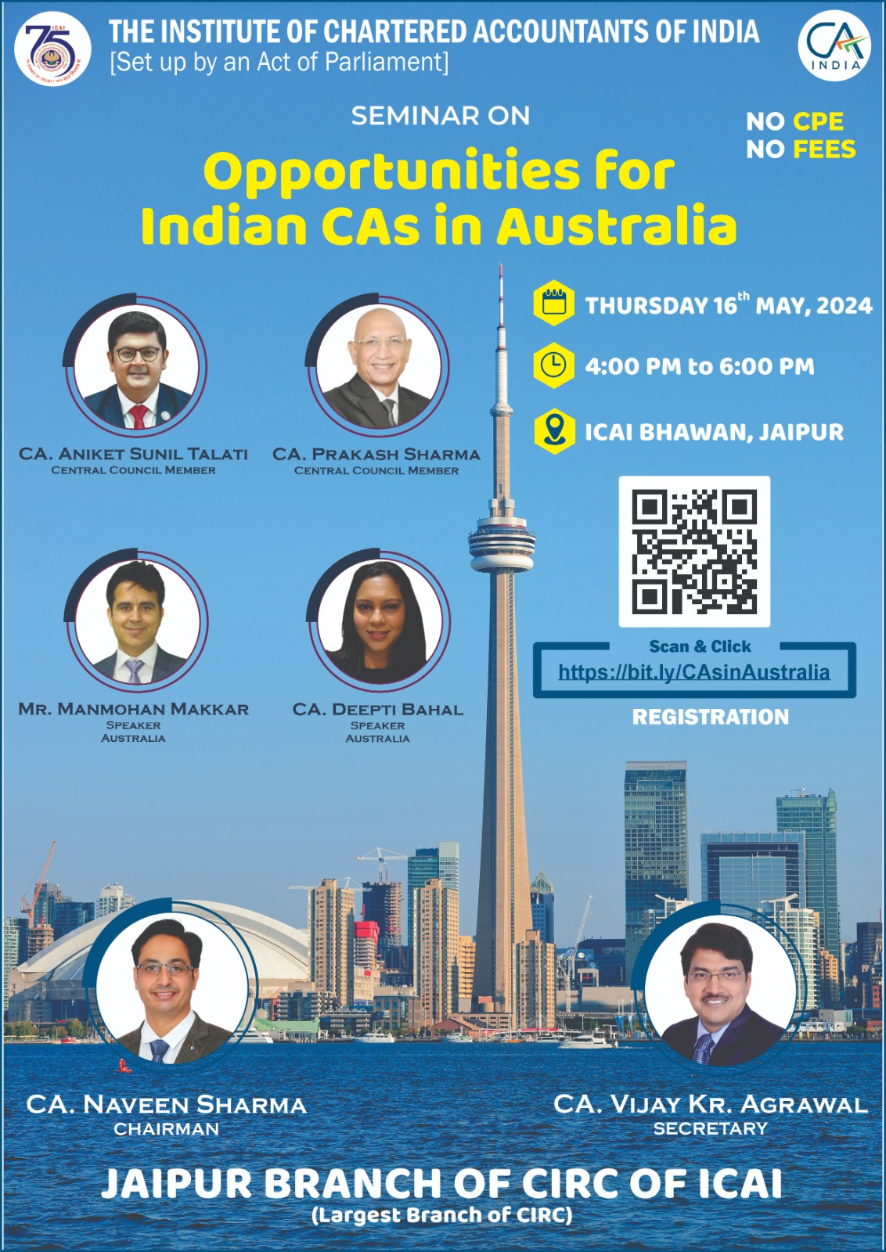
Opportunities for Indian CA’s in Australia
Notes:
b

Slide 2

About todays Seminar
30 – 45 min
Open discussion questions
TOPICS
Introduction
About Australia
Permanent visa pathways for Australia
Occupation and Benefits
Courses for Students
Benefits of Immigration Lawyer/MARN

Slide 3


About Myself and Auzworld
Solicitor (Immigration Lawyer)
Registered MARA Agent
Justice of Piece
Qualified Education Counceller

Slide 4


5 Best things about Australia
Notes:
12000 beaches – 1 day a beach takes 32 years

Slide 5
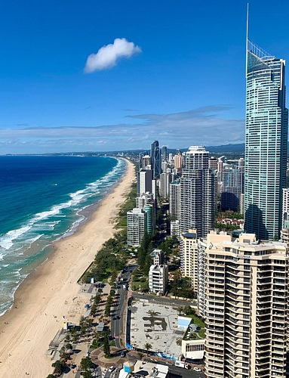


1. Beautiful beaches and tourist places
Notes:
12000 beaches – 1 day a beach takes 32 years

Slide 6


2.
Work life
Balance
8 Hrs a day/5 days a week
10 public holidays
28 annual leave
Plus sick leaves, family leave, maternity leave etc
Approx 200 working days in a year
Notes:
200 Days in a year work

Slide 7
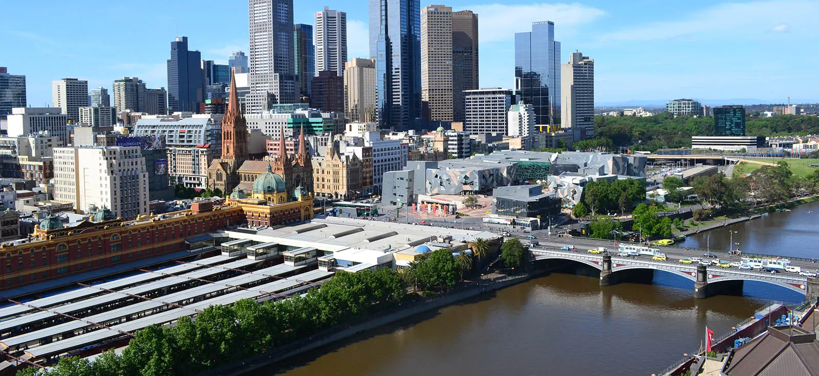

3.
WORLD’s Top Livable cities
Vienna, Austria:
Copenhagen, Denmark
Melbourne, Australia
Sydney, Australia
Vancouver, Canada
Zurich, Switzerland
Calgary, Canada
Geneva, Switzerland
Toronto, Canada
Osaka, Japan
Notes:
12000 beaches – 1 day a beach takes 32 years

Slide 8
3.
WORLD’s Top Livable cities
Vienna, Austria:
Copenhagen, Denmark
Melbourne, Australia
Sydney, Australia
Vancouver, Canada
Zurich, Switzerland
Calgary, Canada
Geneva, Switzerland
Toronto, Canada
Osaka, Japan
MELBOURNE
SYDNEY
Notes:
12000 beaches – 1 day a beach takes 32 years

Slide 9

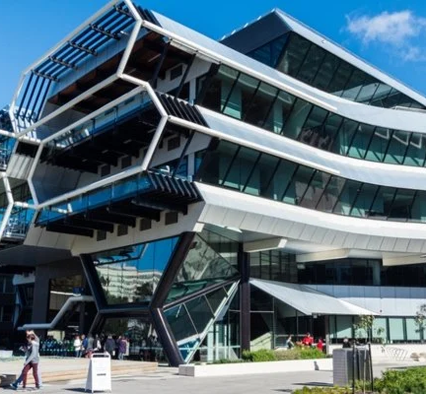
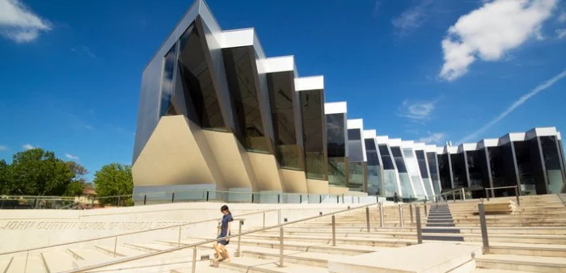
4. Best Education
42 Universities
9629 Schools
Around 70% are Government schools
FREE EDUCATION
Monash University
ANU University Campus
Notes:
12000 beaches – 1 day a beach takes 32 years

Slide 10



5. Best and free
Medical System
Notes:
12000 beaches – 1 day a beach takes 32 years

Slide 11


Five Best Pathways to Australian Permanent Residency
Skilled Migration
Employer Sponsored Visas
Business and Investment Visas
Family Visas
Global Talent Visa
Notes:
General Skilled Migration (GSM): The GSM program includes visas like the Skilled Independent Visa (Subclass 189) and Skilled Nominated Visa (Subclass 190). It's for individuals who possess skills in occupations Australia needs.
Employer-Sponsored Visas: Visas like the Employer Nomination Scheme (ENS) Subclass 186 and Regional Sponsored Migration Scheme (RSMS) Subclass 187 allow employers to sponsor foreign workers for permanent residency.
Business and Investment Visas: The Business Innovation and Investment Visa (Subclass 188/888) is suitable for individuals with business acumen or investment skills, enabling them to contribute to the Australian economy.
Family Visas: Family visas include partner, parent, and child visas, allowing eligible family members to migrate to Australia based on their relationship with an Australian citizen or permanent resident.
Distinguished Talent Visa: The Distinguished Talent Visa (Subclass 858) is for exceptionally talented individuals who have achieved international recognition in a profession, sport, or the arts.

Slide 12

Occupations and Benefits
674 Occupations (Home Affair List)
6 States 2 Territories Lists
Multiple Regional Bodies List
12 DAMA Lists

Slide 13
Best Categories and Benefits
Nursing and Aged Care
IT Professionals
Trade Occupations
Engineers
Teachers
CA’s
Notes:
General Skilled Migration (GSM): The GSM program includes visas like the Skilled Independent Visa (Subclass 189) and Skilled Nominated Visa (Subclass 190). It's for individuals who possess skills in occupations Australia needs.
Employer-Sponsored Visas: Visas like the Employer Nomination Scheme (ENS) Subclass 186 and Regional Sponsored Migration Scheme (RSMS) Subclass 187 allow employers to sponsor foreign workers for permanent residency.
Business and Investment Visas: The Business Innovation and Investment Visa (Subclass 188/888) is suitable for individuals with business acumen or investment skills, enabling them to contribute to the Australian economy.
Family Visas: Family visas include partner, parent, and child visas, allowing eligible family members to migrate to Australia based on their relationship with an Australian citizen or permanent resident.
Distinguished Talent Visa: The Distinguished Talent Visa (Subclass 858) is for exceptionally talented individuals who have achieved international recognition in a profession, sport, or the arts.

Slide 14

Nursing and Aged Care OCCUPATIONS
Community Arts Worker
Recreation Officer
Welfare Worker
Community Worker
Disabilities Services Officer
Family Support Worker
Parole or Probation Officer
Residential Care Officer
Youth Worker
Nurse Practitioner
Registered Nurse
Medical Administrator
Medical Superintendent
Nursing Clinical Director
Primary Health Organisation Manager
Welfare Centre Manager
Notes:
General Skilled Migration (GSM): The GSM program includes visas like the Skilled Independent Visa (Subclass 189) and Skilled Nominated Visa (Subclass 190). It's for individuals who possess skills in occupations Australia needs.
Employer-Sponsored Visas: Visas like the Employer Nomination Scheme (ENS) Subclass 186 and Regional Sponsored Migration Scheme (RSMS) Subclass 187 allow employers to sponsor foreign workers for permanent residency.
Business and Investment Visas: The Business Innovation and Investment Visa (Subclass 188/888) is suitable for individuals with business acumen or investment skills, enabling them to contribute to the Australian economy.
Family Visas: Family visas include partner, parent, and child visas, allowing eligible family members to migrate to Australia based on their relationship with an Australian citizen or permanent resident.
Distinguished Talent Visa: The Distinguished Talent Visa (Subclass 858) is for exceptionally talented individuals who have achieved international recognition in a profession, sport, or the arts.

Slide 15
Nursing and Aged Care OCCUPATIONS
Community Arts Worker
Recreation Officer
Welfare Worker
Community Worker
Disabilities Services Officer
Family Support Worker
Parole or Probation Officer
Residential Care Officer
Youth Worker
Nurse Practitioner
Registered Nurse
Medical Administrator
Medical Superintendent
Nursing Clinical Director
Primary Health Organisation Manager
Welfare Centre Manager
Notes:
General Skilled Migration (GSM): The GSM program includes visas like the Skilled Independent Visa (Subclass 189) and Skilled Nominated Visa (Subclass 190). It's for individuals who possess skills in occupations Australia needs.
Employer-Sponsored Visas: Visas like the Employer Nomination Scheme (ENS) Subclass 186 and Regional Sponsored Migration Scheme (RSMS) Subclass 187 allow employers to sponsor foreign workers for permanent residency.
Business and Investment Visas: The Business Innovation and Investment Visa (Subclass 188/888) is suitable for individuals with business acumen or investment skills, enabling them to contribute to the Australian economy.
Family Visas: Family visas include partner, parent, and child visas, allowing eligible family members to migrate to Australia based on their relationship with an Australian citizen or permanent resident.
Distinguished Talent Visa: The Distinguished Talent Visa (Subclass 858) is for exceptionally talented individuals who have achieved international recognition in a profession, sport, or the arts.

Slide 16

IT Occupations
ICT Trainer
Multimedia Specialist
Network Administrator
Network Analyst
Software and Application Programmer
Software Engineer
Software Tester
Systems Administrator
Systems Analysts
Web Administrator
Web Developer
Analyst Programmer
Chief Information Officer
Computer Network and Systems Engineer
Database Administrator
Developer Programmer
ICT Business Analysts
ICT Managers NEC
ICT Project Manager
ICT Quality Assurance Engineer
ICT Security Specialist
ICT Support Engineer

Slide 17
IT Occupations
ICT Trainer
Multimedia Specialist
Network Administrator
Network Analyst
Software and Application Programmer
Software Engineer
Software Tester
Systems Administrator
Systems Analysts
Web Administrator
Web Developer
Analyst Programmer
Chief Information Officer
Computer Network and Systems Engineer
Database Administrator
Developer Programmer
ICT Business Analysts
ICT Managers NEC
ICT Project Manager
ICT Quality Assurance Engineer
ICT Security Specialist
ICT Support Engineer

Slide 18
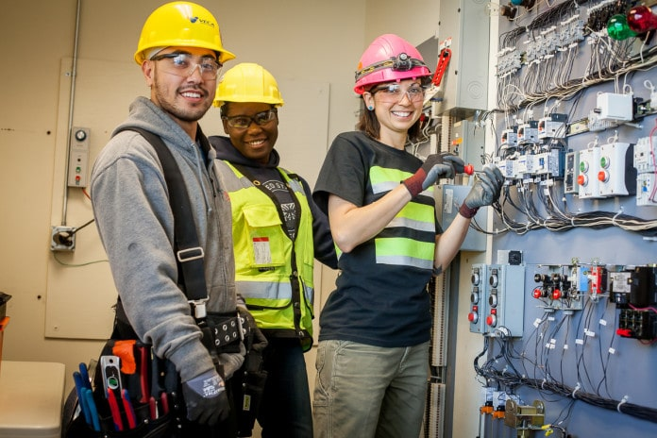
TRADE OCCUPATIONS
Automotive Electrician
Baker
Bricklayer
Cabinetmaker
Carpenter
Carpenter and Joiner
Chef
Cook
Diesel Motor Mechanic
Metal Machinist (First Class)
Motor Mechanic (General)
Panel beater
Pastrycook
Plumber (General)
Sheet Metal Trades Worker
Toolmaker
Welder (First Class)
Airconditioning and Refrigeration Mechanic
Electronic Equipment Trades Worker
Electrician (General)
Electrician (Special Class)
Fitter (General)
Fitter and Turner
Fitter-Welder
Hairdresser
Joiner
Metal Fabricator

Slide 19
TRADE OCCUPATIONS
Automotive Electrician
Baker
Bricklayer
Cabinetmaker
Carpenter
Carpenter and Joiner
Chef
Cook
Diesel Motor Mechanic
Metal Machinist (First Class)
Motor Mechanic (General)
Panel beater
Pastrycook
Plumber (General)
Sheet Metal Trades Worker
Toolmaker
Welder (First Class)
Airconditioning and Refrigeration Mechanic
Electronic Equipment Trades Worker
Electrician (General)
Electrician (Special Class)
Fitter (General)
Fitter and Turner
Fitter-Welder
Hairdresser
Joiner
Metal Fabricator

Slide 20

ENGINEERING OCCUPATIONS
Environmental Engineer
Industrial Engineer
Mechanical Engineer
Mining Engineer
Petroleum Engineer
Structural Engineer
Telecommunications Engineer
Aeronautical Engineer
Agricultural Engineer
Biomedical Engineer
Chemical Engineer
Civil Engineer
Electrical Engineer
Electronics Engineer

Slide 21
ENGINEERING OCCUPATIONS
Environmental Engineer
Industrial Engineer
Mechanical Engineer
Mining Engineer
Petroleum Engineer
Structural Engineer
Telecommunications Engineer
Aeronautical Engineer
Agricultural Engineer
Biomedical Engineer
Chemical Engineer
Civil Engineer
Electrical Engineer
Electronics Engineer

Slide 22

Teaching Occupations
Early Childhood (Pre-primary School) Teacher
Middle School Teacher
Primary School Teacher
Secondary School Teacher
Special Education Teachers nec
Special Needs Teacher
Teacher of the Hearing Impaired
Teacher of the Sight Impaired

Slide 23
Teaching Occupations
Early Childhood (Pre-primary School) Teacher
Middle School Teacher
Primary School Teacher
Secondary School Teacher
Special Education Teachers nec
Special Needs Teacher
Teacher of the Hearing Impaired
Teacher of the Sight Impaired

Slide 24

Occupations Related to CA
Accountant (General)
Taxation Accountant
Management Accountant
External Auditor
Internal Auditor
Finance Manager

Slide 25
Occupations Related to CA
Accountant (General)
Taxation Accountant
Management Accountant
External Auditor
Internal Auditor
Finance Manager

Slide 26

5 Best Courses for Students
Bachelor in Nursing
Bachelor of IT (Software Development, Cybersecurity, Data Science)
Bachelor of Engineering: Civil, Mechanical, Electrical
TRADE Courses - Construction Management, Hospitality, Automotive
Bachelor of Education
Other Courses
Bachelor of Social Worker
Advance Diploma in Community Work
Advance Diploma in Civil Engineering Draft Person
Advance Diploma in Teaching

Slide 27

5 Benefits of Immigration Lawyer/MARN
Qualified, Experience and Updated Information
Registered under the Australian Government Authority
Transparency of Work
Fraud Protection
Fees Insured

Slide 28
ARE YOU INTERESTED IN WORKING IN AUSTRALIA?

Slide 29




WORK VISA
EMPLOYERS
AUZWORLD
MIGRATION
SUBMIT YOUR PROFILE
EMPLOYEE

Slide 30

Register for
WORK VISA
Contact us
Australia
Ph: +61 2 9635 47444
Mob : +61 431049352
Whatsapp : +91 91222 86000
India
SUBMIT YOUR PROFILE

