Slide 1
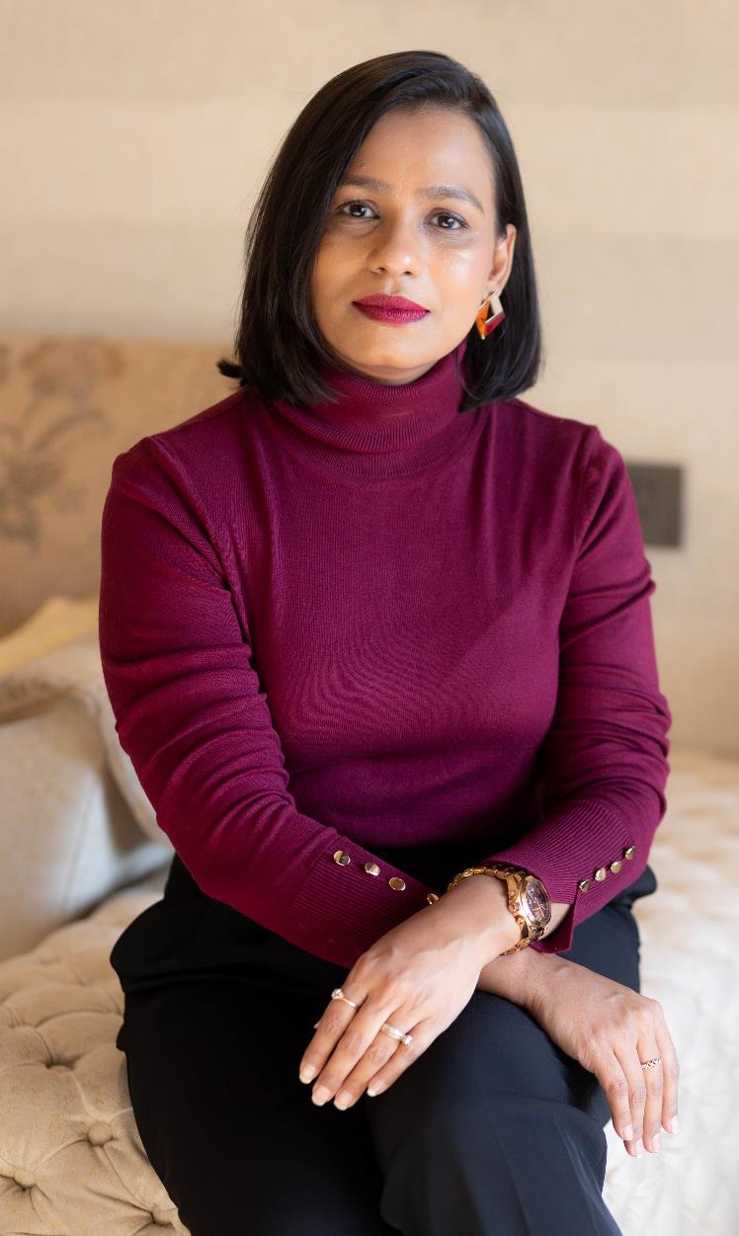


For ICAI
Digital and Ethical branding –for CAs
CA Parinita Adukia
Personal Branding Coach

Slide 2

What is your sales strategies?

Slide 3
How many are digitally active?

Slide 4
What is your Digital marketing strategies?

Slide 5
What is your marketing funnel?

Slide 6
What are your goals?

Slide 7
Are you
Networking well?

Slide 8
Why are we talking about
Social Media today?
Start with WHY

Slide 9
~ 4,00,000

Slide 10
~ 433 crore

Slide 11
~ 13.5 lakhs
70%
~ 30 crore
50%
~ 3 crore
50%

Slide 12
~ 1,50,000
CAs
~ 4.33 billion

Slide 13
What are your
Reservations when using
Social Media?

Slide 14

I cannot do this…
This is very tough…
This is against ICAI regulations…

Slide 15
Clause 6
Solicits clients or professional work, either directly or indirectly, by circular, advertisement, personal communication or by any other means.

Slide 16
Outbound
Inbound
Outbound
Outbound
Outbound
Outbound
Inbound
How can you market?
Difference between
Marketing and Branding
Push
Pull
Outbound
Inbound

Slide 17
Then why are we getting stuck with
only “near-by” or referral clients?

Slide 18
WHY are we not using
Social Media to market?

Slide 19
Let us Change this today

Slide 20
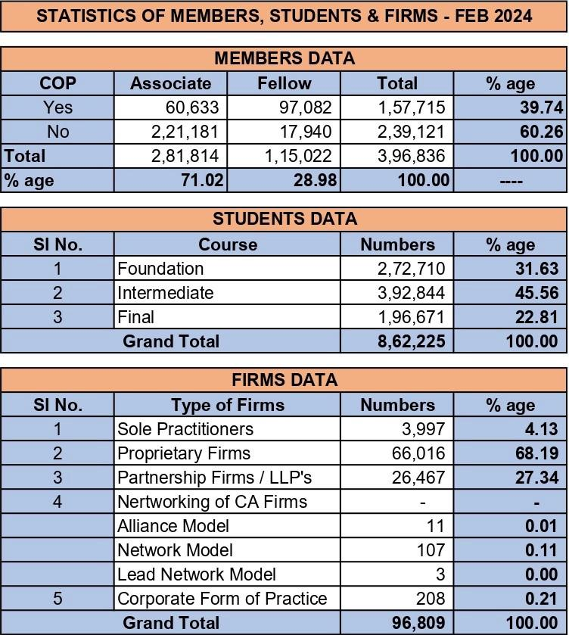

Slide 21
As a service provider people buy into “YOU”

Slide 22
Hence you need to develop a Personal brand on Social Media

Slide 23
”
Biggest mistake?
We are not on the right platforms
We are on all platforms
We are only present there.
We are not using it correctly.

Slide 24
Let us look at how can we
“Actually” use Social Media to get
Clients and build a Brand.

Slide 25
What is your
WHY

Slide 26
Your WHY can be –
Thought Leader
Gain clientele
Inspire/Motivate

Slide 27
Steps
A
B
C
D
Right Platform?

Slide 28
Target Audience and Platform
1
2
3
4
See your
Client Base
See where they
Are present
See what kind of
Content works on the SM
Select the platform

Slide 29
Platforms
1
2
3
4
LinkedIn
Facebook
Instagram
Twitter
WhatsApp
Telegram
YouTube
Quora
Podcasts-
Spotify
Any other

Slide 30
Steps
A
B
C
D
Right Platform?
Expertise?

Slide 31
What are you known for?
What is your expertise?

Slide 32
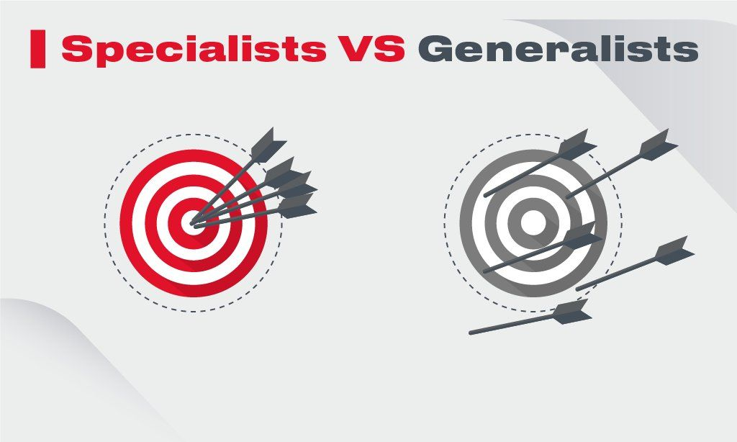

Slide 33
Where do you stand?
Does your Target audience know
that you are best at something?
Does your friends, family, neighbours, or anyone know you are best at something?

Slide 34
Brand yourself as an
Expert –
Not calling yourself but BRANDING

Slide 35
Steps
A
B
C
D
Right Platform?
Expertise?
Profile?

Slide 36
The trick in marketing is always-
Be Remembered
Be easy to understand
Be easy to reach out

Slide 37
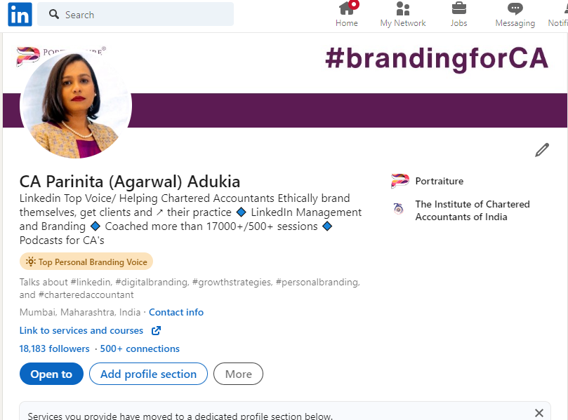
Name
Headline
Institute
Photo
Cover photo
Contact details

Slide 38
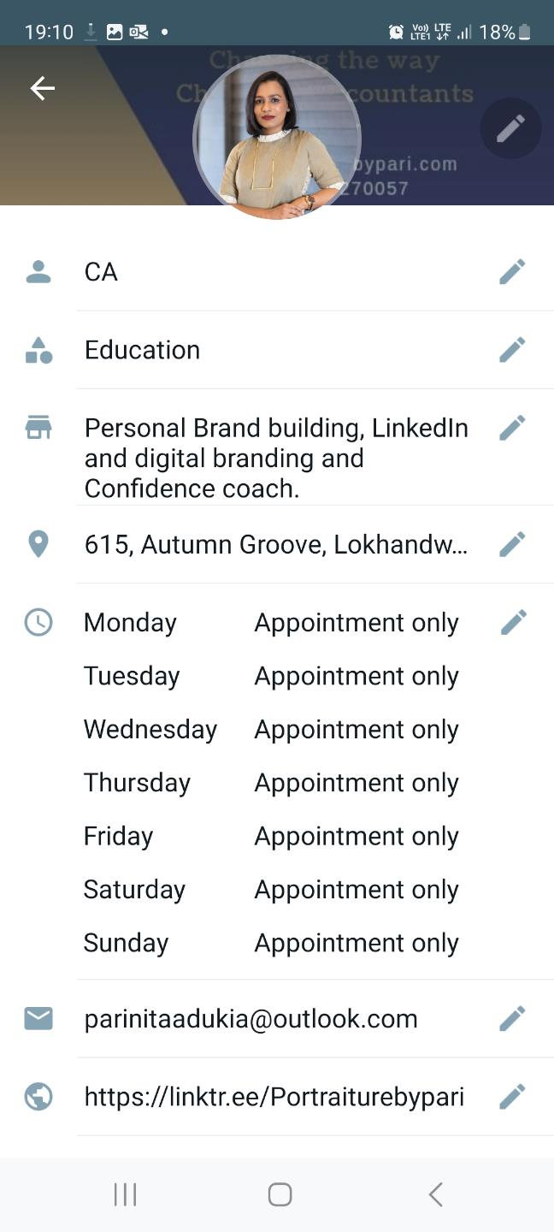
WhatsApp Business
Name
Headline
Links to website/ Linktree/YouTube/ LinkedIn
Photo
Cover photo

Slide 39
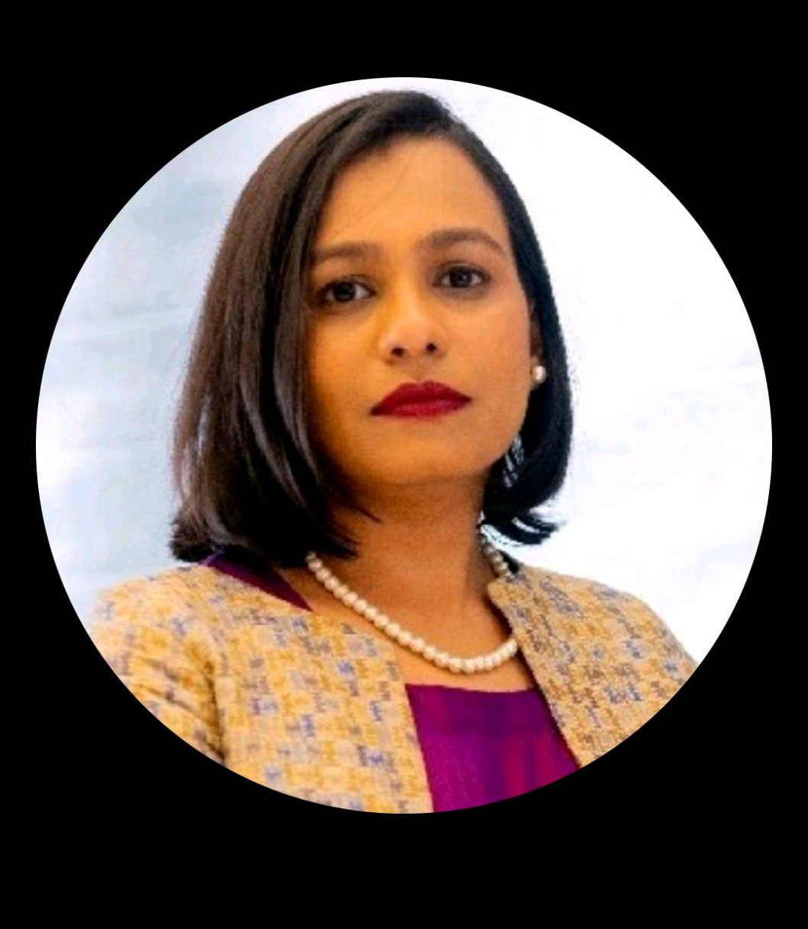
LinkedIn profiles with
Professional headshots get
14 times more profile views

Slide 40
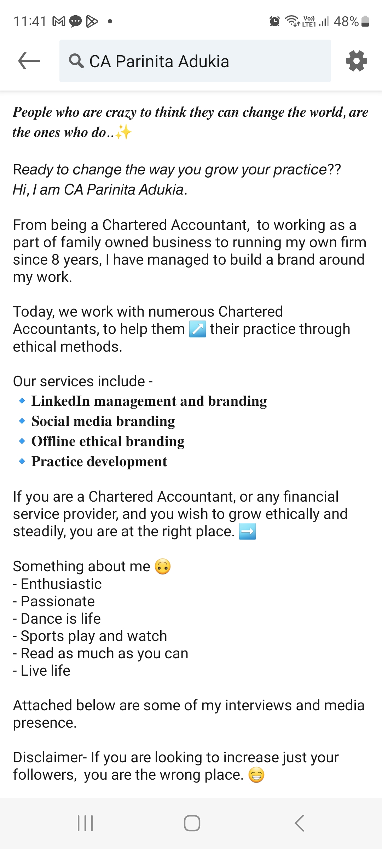
About –
Short description
Background
Goal – NO vision of the firm or professional goals
Services
Attachments

Slide 41
Platforms
1
2
3
4
LinkedIn
Facebook
Instagram
Twitter
WhatsApp
Telegram
YouTube
Quora
Any other
Consistent Branding

Slide 42
Steps
A
B
C
D
Right Platform?
Expertise?
Profile?
Show your
Expertise?

Slide 43
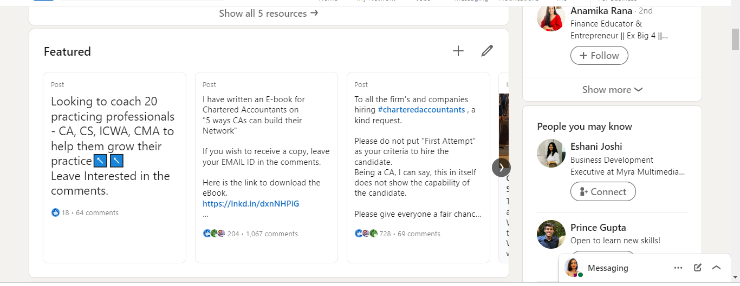
Link to –
Article
Blog
Ebook
Youtube

Slide 44
Ways to show expertise
1
2
3
4
LinkedIn
Feature
WhatsApp
Links –
Linktree
App
Publications
Blogs
Webinars
Seminar
Books/E-books

Slide 45
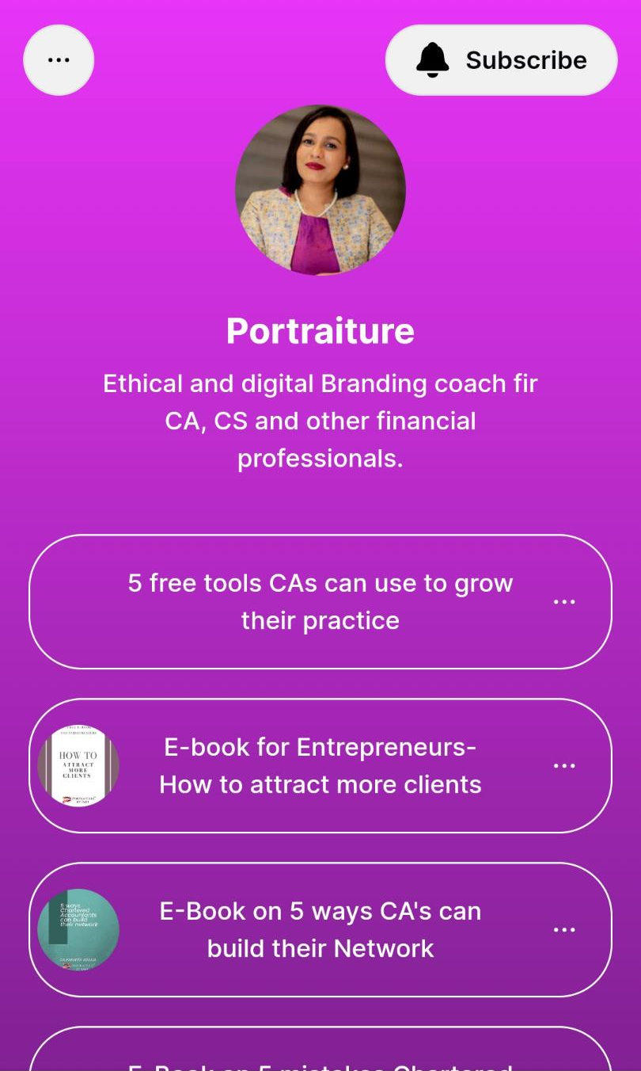
Linktree
Intro
Document
Photo
Video

Slide 46
Steps
E
F
G
H
Posts?

Slide 47
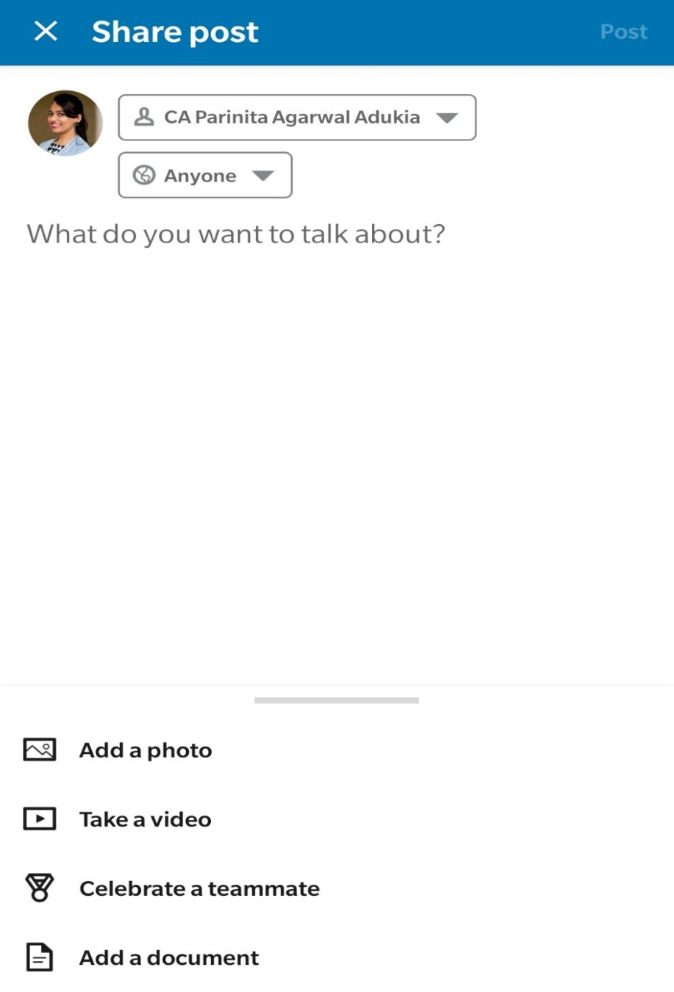
Post-
Article
Document
Photo
Video
News, quotes, books, inspirational stories, personal experiences, and skills - which reflect your expertise.

Slide 48
Content and Comments

Slide 49
Types of Posts -
The WHY
It creates
Teaches
Hacks, Things to Do, Ideas to follow, Books to read,
Steps to take, Strategies to apply.
Clientele,
TL
Motivates/ Inspires
Your Story, Someone’s story, Your experience,
Something you saw, Quotes, Life story.
Inspires
Opinion
Your Opinion, Controversial opinion.
Common opinion of people, Your observation.
TL, Branding
NO-
Client
Services
Soliciting

Slide 50
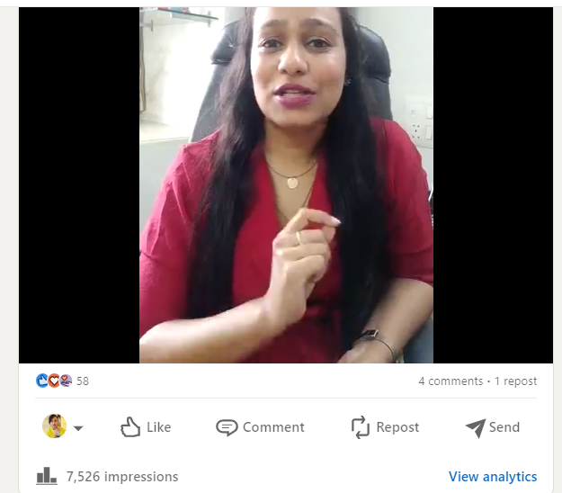
Hacks for CAs
Clientele
Video

Slide 51
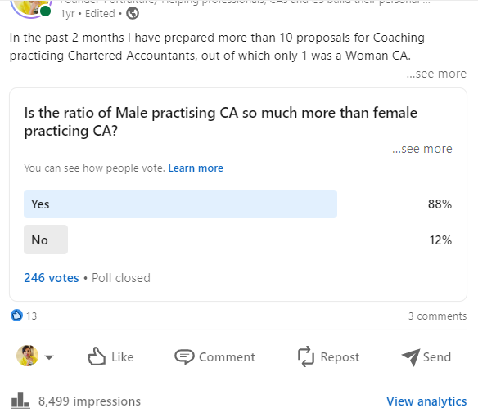
Opinion
Branding
Poll

Slide 52
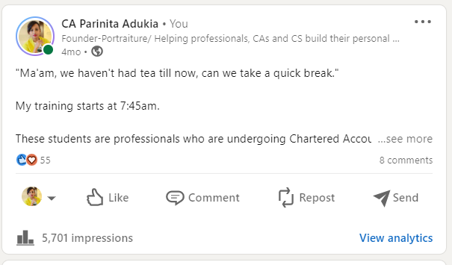
Experience
Inspiration
Text/story

Slide 53
Tricks are
Thinking from TA’s perspective –
value adding
Keep updating

Slide 54
NO-
Client
Services
Soliciting
Ways to keep updating
1
2
3
4
Job opening
Firm updates
New office
Meetings
Travel
Software
WhatsApp
Status
Simplifying
amendments
Publications
Blogs
Webinars
Seminar
Books/E-books-
OF OTHERS

Slide 55
If you are still not comfortable with posting a lot-
Engage with people – comment on their posts and share posts you like.

Slide 56
Steps
E
F
G
H
Posts?
Target Audience?

Slide 57
Who are your
Target Audience?

Slide 58
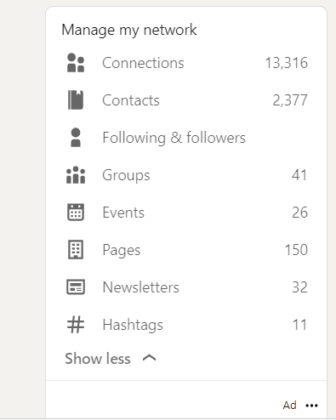
Connections –
Right People
Message them on connecting
Ask doubts or professional help/
Ask for calls to discuss things
Pages
Groups

Slide 59
Steps
E
F
G
H
Posts?
Target Audience?
What are you
looking for?

Slide 60
What are you looking for on
Social media?

Slide 61
Look for -
Clients
Collaborations
Expertise sharing opportunities
Groups

Slide 62
Steps
E
F
G
H
Posts?
Target Audience?
What are you
looking for?
Main aspect?

Slide 63





Google?
Website?
Contact details given?
Providing value?
Messaging?

Slide 64
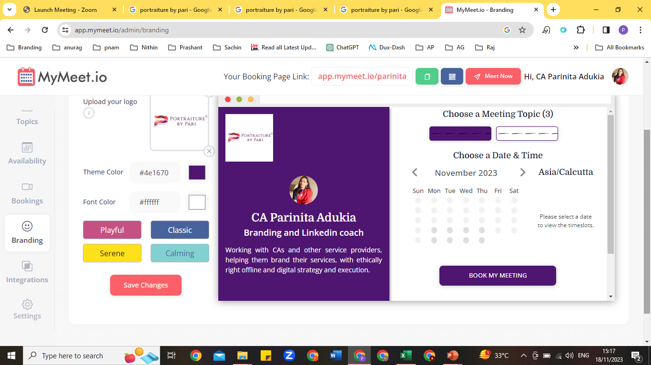

Slide 65
What do you think is the main
Aspect here?

Slide 66
Be
Consistent
But
Smart?

Slide 67
The potential is unlimited,
You need to find the
Right time
Right method
Right platform
Right content
Right resource
Right visibility

Slide 68
What
WHAT
HOW
WHY

Slide 69
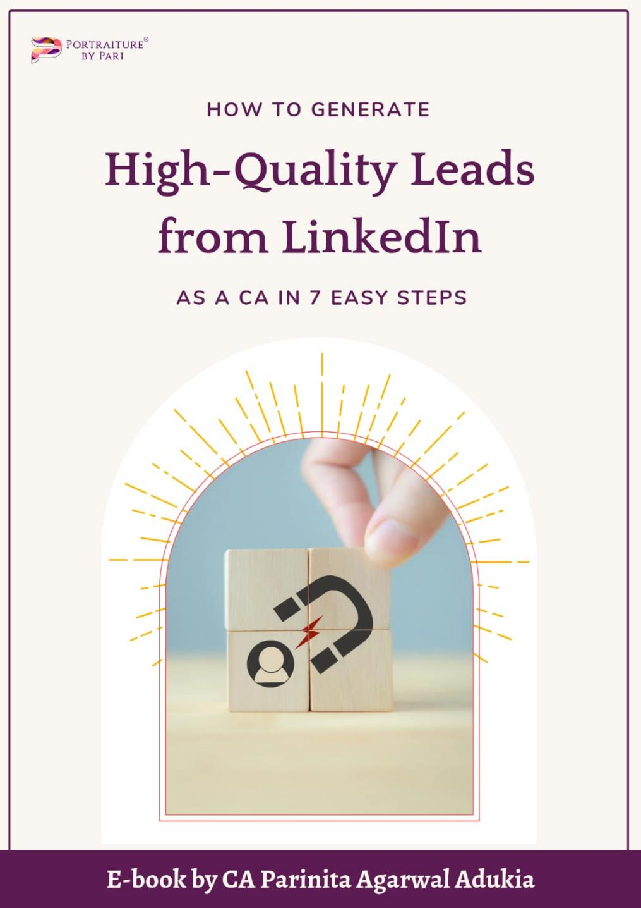
Mail Me
If you want
a copy
portraiturepari@gmail.com

Slide 70

Ask ME

Slide 71

Thank you
CA Parinita Adukia
Personal Branding Coach
+91-9137270057
www.portraiturebypari.com

