Slide 1

Welcomes You
On
NSIC’s Schemes for MSMEs
26/06/2024
1

Slide 2

VISION
To be premier organization fostering the promotion & growth of Micro, Small and Medium Enterprises in the country.
MISSION
To enhance the Competitiveness of Micro, Small and Medium Enterprises by provinding integrated support services encompassing, Marketing, Finance, Technology and other Services.
2
Notes:
2

Slide 3

NETWORK OF OFFICES
Head Office
SC/ST HUB(14)
Zonal
Offices
(11)
NTSCs
(08)
Branch
Offices/ Sub Office
(52)
NSIC Services backed up by more than 650 professionals spread across the country
3

Slide 4

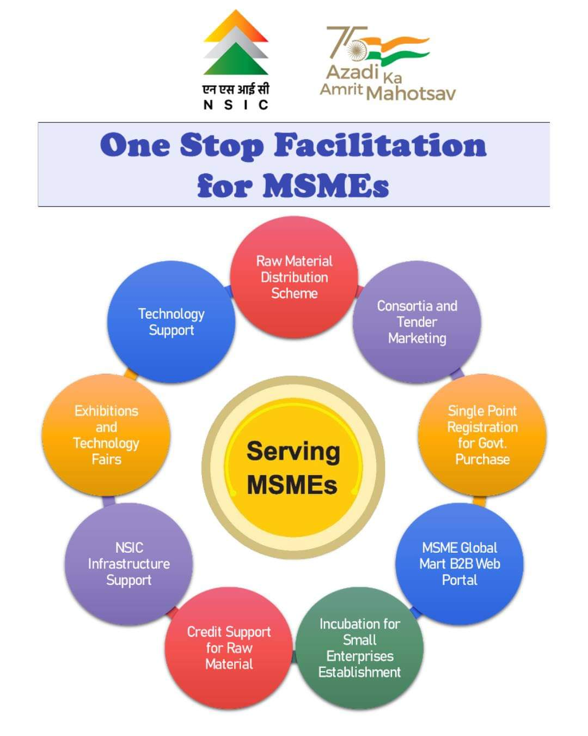
- Integrated Support to MSMEs -
NSIC Schemes and Programs

Slide 5

MARKETING
SUPPORT
SINGLE POINT REGISTRATION SCHEME
NSIC operates a Single Point Registration Scheme under the Government Purchase Programme, wherein the MSEs are enlisted after third party Technical Inspection of Certification of their competency/qualitative and quantitative capacity.
5

Slide 6

SINGLE POINT REGISTERATION SCHEME
The small enterprises registered under this scheme get the following
Facilities:
Issue of Tenders free of cost.
Exemption from payment of earnest money deposit.
Every Central Ministries/Departments/PSUs shall set an annual goal of minimum 25 per cent of the total annual purchases of the products or services produced or rendered by MSEs. Out of annual requirement of 25% procurement from MSEs, 4% is earmarked for units owned by Schedule Caste /Schedule Tribes and 3% is earmarked for the units owned by Women entrepreneurs. SPRS registered units are integral part of the supply chain to Government
In tender participating MSEs quoting price within price band of L1+15 per cent shall also be allowed to supply a portion upto 25% of requirement by bringing down their price to L1 Price , where L1 is non MSEs.
In addition to the above, 358 items are also reserved for exclusive purchase from MSE Sector
6

Slide 7
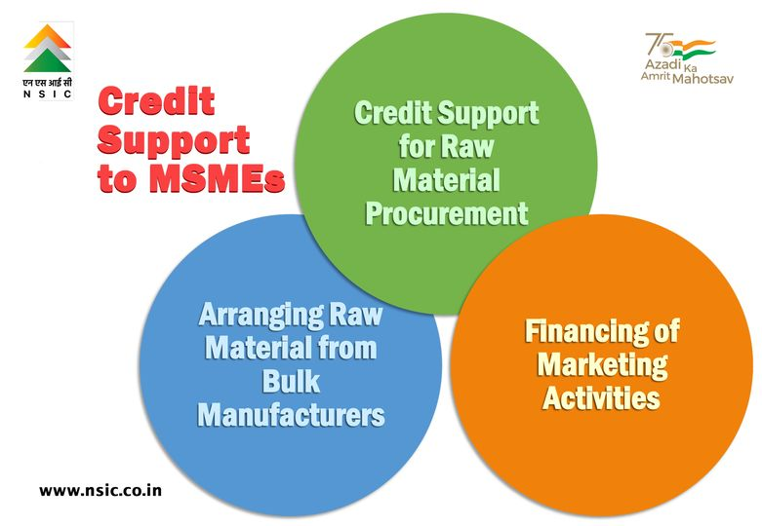


7

Slide 8
NSIC’s Raw Material Assistance
Procurement of Indigenous Raw Material
Short Term Financing
8

Slide 9

MARKETING
SUPPORT
Benefits to MSMEs
To Facilitate MSMEs for getting Raw Material at Competitive Price leading to reduction in cost of Raw Material and making the end product competitive.
NSIC has signed MoUs with bulk Producers like SAIL & RINL (Steel), NALCO (Aluminium), AMNS (Flat Products), JSW (Steel) , Ambuja Cement & Shree Cement( Cement) & Other Large Producers for Imported ( Bitumin) and Indigenous ( customised Steel ,TMT etc ) Material .
Due to Bulk buying on behalf of MSMEs, Benefits of Economies of scale is shared with MSMEs and largely passed on to the unit.
In case MSMEs need any credit support for raw material procurement, NSIC facilitates it by arranging the raw Material on making payments to suppliers on behalf of MSMEs against Bank Guarantee.
9

Slide 10
CREDIT
SUPPORT
NSIC’s Bill Discounting Scheme
10

Slide 11

NSIC’s Bill Discounting
Scheme
The Scheme will cover discounting of bills arising out of genuine trade transactions i.e. supplies made by Micro, Small and Medium Enterprises (MSMEs) to reputed Public Limited Companies / State and Central Govt. Departments / Undertakings / Private Limited Companies (not traders), engaged in manufacturing / service activities.
BUYERS
i) State and Central Govt. Departments / Undertakings
ii) Public Limited Companies
iii) Private Limited Companies
SELLERS
Micro, Small & Medium Enterprises engaged in
manufacturing / service activities
11

Slide 12
MARKETING
SUPPORT
CONSORTIA TENDER MARKETING SCHEME
12

Slide 13

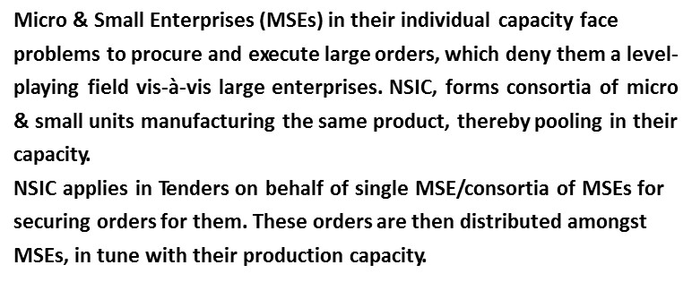
CONSORTIA TENDER MARKETING
13

Slide 14
MARKETING
SUPPORT
NSIC’s B2B PORTAL
(www.msmemart.com)
PROVIDING OPPORTUNITY
TO MSMEs
14

Slide 15

MSME Global Mart B2B portal for MSMEs
NSIC is assisting MSMEs through MSME Global Mart Web Portal (www.msmemart.com).
The portal provides an online platform to B2B marketing activities. The portal hosts vast database of registered members who are looking for business opportunities, in terms of sustainable partnership,subcontracting and participation in Public Procurements.
Major features of MSME Global Mart are :-
• Interactive database of MSMEs
• Global and National Tender Notices
• Self Web development tool
• Centralized Mail System
• Popular product section
• Unlimited Global Trade Leads
• Trust Seal of NSIC
• Multiple Language Support
• Discussion Board
• Call centre support
• Payment Gateway for membership subscription
15

Slide 16









सूक्ष्म उधम के लिए सुनहरा मौका
आजादी के 75 वर्ष पर, ई-कॉमर्स प्लेटफॉर्म को अपनाने के लिए सूक्ष्म उधम को 75% सब्सिडी की पेशकश
एनएसआईसी के ई-मार्केटिंग पोर्टल के साथ अपना व्यवसाय बढ़ाएं
“MSME GLOBAL MART”
दृश्यता और खोज क्षमता बढ़ाएँ
उत्पादों और सेवाओं को ऑनलाइन प्रदर्शित करें
खरीदारों और विक्रेताओं से जुड़ें
असीमित टेंडर अलर्ट और ट्रेड लीड प्राप्त करें
अनुसूचित जाति/अनुसूचित जनजाति सूक्ष्म और लघु उद्यमों के लिए विशेष सब्सिडी
अपने उद्यम के लिए एक डिजिटल उपस्थिति बनाने के लिए,
visit https://www.msmemart.com/membership OR
उद्यम प्रति के साथ निकटतम एनएसआईसी फील्ड कार्यालय पर जाएं.
http://www.nsic.co.in/Corporate/SearchBranch.aspx
bojai@nsic.co.in
MSME Global Mart Mobile App Now available on
+91-9413400035
Umang App
Mobile Sewa Appstore
+91-141-2742991, 2742059

Slide 17
CREDIT
SUPPORT
NSIC’s BANK TIEUP
FOR SANCTION OF CREDIT LIMITS TO MSMEs
17

Slide 18
NSIC’s Bank Tieup
NSIC has entered into a strategic alliance with Nationalised and Private banks to facilitate long term/ working capital financing requirements of MEMEs
assistance in filling up of Form, guidance, documentation and submission of documents will also be provided in NSIC’s Finance Facilitation Centre.
The loan proposals after validation by NSIC will be submitted online to Banks selected by MSME units for speedy disposal of their credit proposals thereby providing them easy access to finance, saving time without any additional cost
All credit requirements i.e. Term Loan, Working Capital, Bank Guarantee, L/C, etc are being forwarded and followed up are being made with Banks for speedy Disposals
18

Slide 19
NATIONAL SC/ST HUB
(NSSH)
19

Slide 20
AIM FOR NSSH
To ensure, that benefits of growth spread across all sections of the society, especially the marginalized groups including SC/ST entrepreneurs,
Government is trying to make procurement activities of the public sector to more inclusive and participative. In this regard, the “Public Procurement Policy for MSEs” of 2012 mandates that central government ministries, departments and public sector undertakings procure minimum of 25 percent of their annual value of goods or services from MSEs. In addition, 25% of such procurement from MSEs, i.e. 5% of total procurement of goods and services shall be made from Micro and Small Enterprises owned by SC & ST entrepreneurs
20

Slide 21
AIM FOR NSSH
Contd..
To expedite achievement of the policy target, the government has initiated the establishment of the National SC/ST Hub with an aim not only to increase market access and ensure higher participation of SC/ST entrepreneurs in public procurement but also promote creation of new enterprises. Ministry of Micro, Small and Medium Enterprises (MoMSME), has made an initial allocation of Rs. 490 Crore for for the National SC/ST Hub
21

Slide 22
Benefits to MSMEs owned by SC/ST
Registration under NSIC Single Point Registration at nominal fee of Rs. 100 and No Inspection fee is charges
Participation in 6 exhibitions ( 4 Domestic and 2 International ) totally free during financial year 2019-20
Exempted in Enlistment fee under Consortia & Tender Marketing Scheme for Participation in Govt. Departments Tender on behalf of SC/ST Units
Other benefits like Testing Fee, EPC membership
22

Slide 23
Thanks...

