Slide 1
Sharpening Your Sword: Personality Development for Chartered Accountants
By CA Shalini Sharma

Slide 2

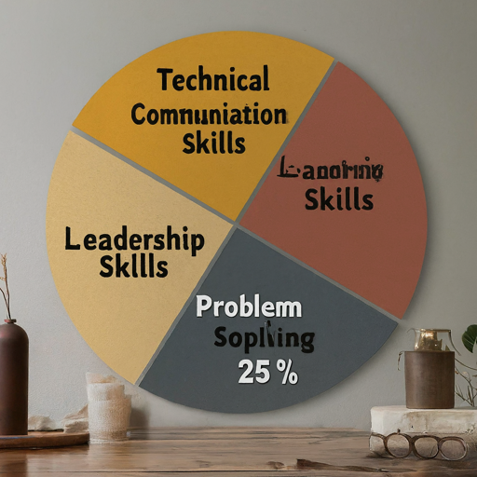
Why is Personality Development Important for CAs?
Technical skills are the foundation (20%)
But soft skills like communication (30%), leadership (25%), and problem-solving (25%) are crucial for career advancement

Slide 3
Key Areas of Personality Development
Communication: Verbal, written, and active listening
Leadership: Taking initiative, motivating others, and building teams
Time Management: Prioritizing tasks, managing deadlines, and staying organized
Emotional Intelligence: Self-awareness, self-regulation, social awareness, and relationship management

Slide 4
Mastering the Market: Management Skills for Capital Market Success
The Symbiotic Relationship: Management & Capital Markets
Management skills provide the foundation for success in the capital market
Capital markets offer a platform to leverage management expertise

Slide 5
Key Management Skills for Capital Market Success
Financial Management: Budgeting, forecasting, and capital allocation
Risk Management: Identifying, assessing, and mitigating financial risks
Communication Skills: Clear and concise communication with investors, stakeholders, and regulators
Leadership Skills: Inspiring and motivating teams to achieve financial goals

Slide 6
Thank You

