Slide 1
Union Budget 2024
An Analysis
Sanjay Jhanwar
Sr. Advocate

Slide 2
Macro Economics
Personal Taxation
Capital Gains
Business Profits
Topics to be covered
Block Assessment
Assessment - Reassessment
Vivad Se Vishwas
Charitable Institutions/Trusts
Miscellaneous
TDS and TCS
Other Laws and Policies

Slide 3
Macro Economics

Slide 4
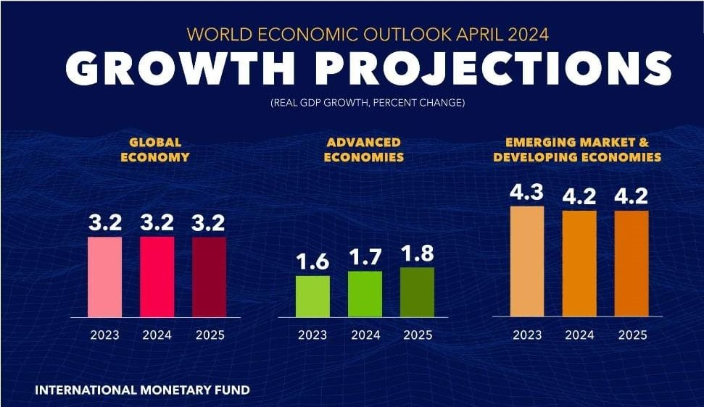
Global Growth Projections

Slide 5
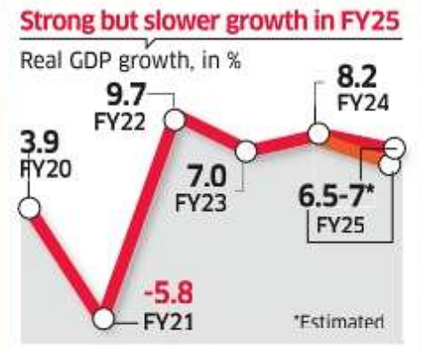
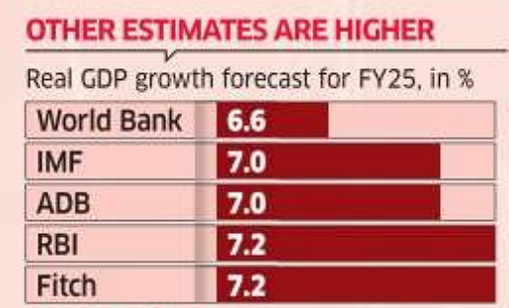
Growth Projections for India

Slide 6
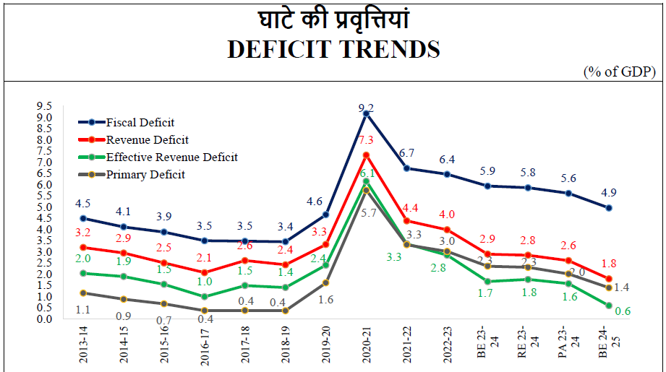
Steadily declining deficit ratios

Slide 7
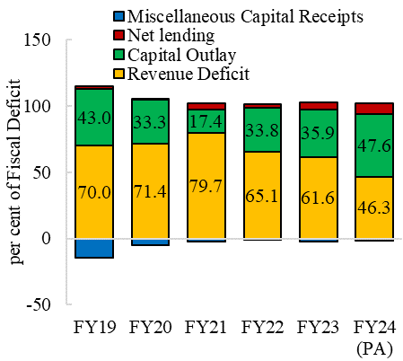
Fiscal Deficit Outlay

Slide 8
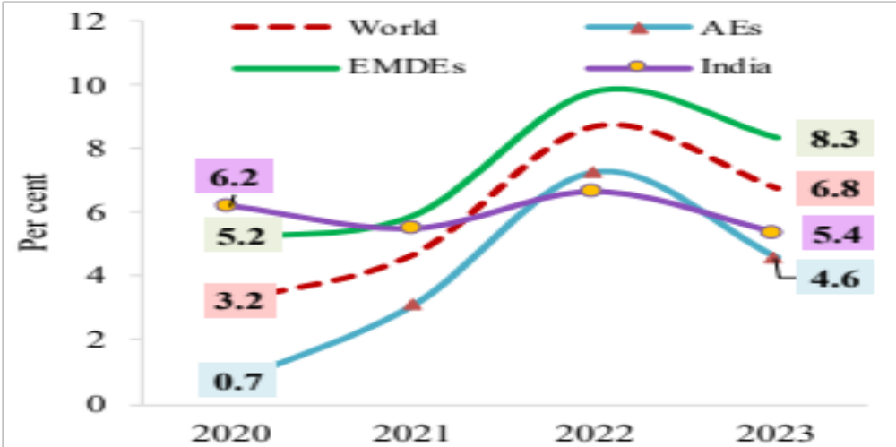
India’s Inflation vis-à-vis Global Trends
EMDE - Emerging Market & Developing Economies AE – Advanced Economies

Slide 9
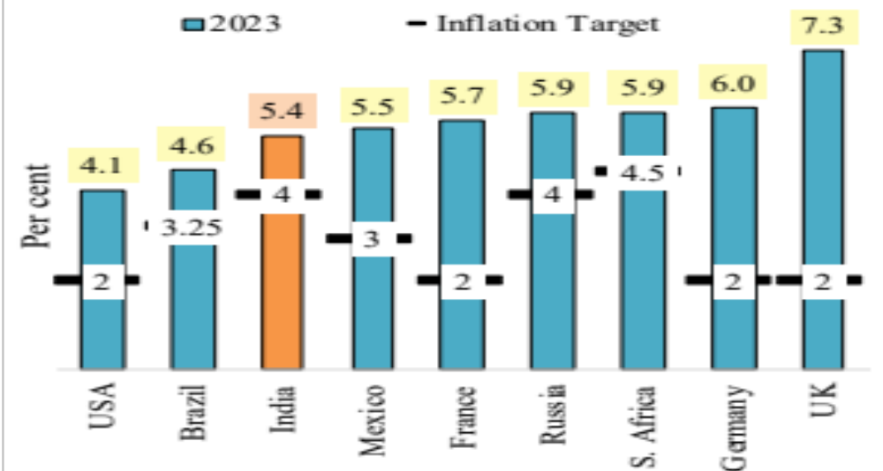
Target Inflation to Actual Gap

Slide 10
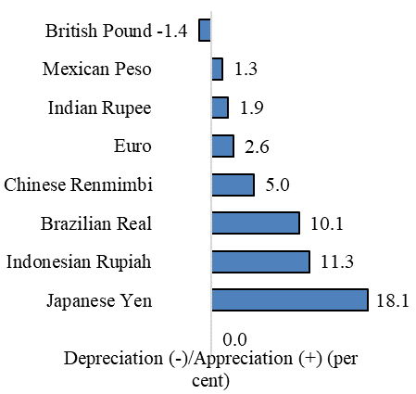
Resilient Rupee in FY 2024

Slide 11
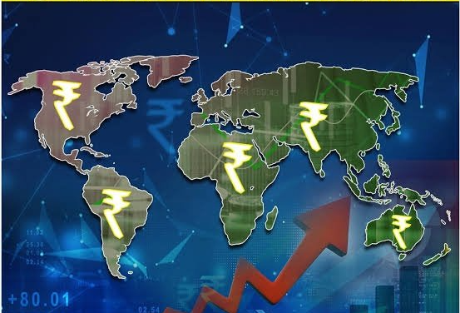
India to transact in INR
There are 18 Countries with which India has made an agreement to transact in INR.
Countries like Germany, Russia, Singapore, Srilanka, Botswana, Fiji, Guyana, Israel, Kenya, Malaysia, Mauritius, Myanmar, New Zealand, Oman, Seychelles, Tanzania, Uganda and UK
Will help in reduction of :-
India’s current account deficit (CAD)
The burden of maintaining large foreign-exchange reserves.
Exchange Rate risks
Trade related transaction costs

Slide 12
GDP to Debt Assessment

Slide 13
Debt to GDP Ratio comparatives
Notes:
https://economictimes.indiatimes.com/news/economy/indicators/india-shines-as-a-global-growth-leader-contributing-over-16-to-the-worlds-growth-imf/articleshow/106106869.cms?from=mdr
https://www.livemint.com/economy/india-to-contribute-30-of-global-gdp-by-2040-focus-on-champion-states-growing-at-11-per-annum-amitabh-kant-11716050613021.html

Slide 14
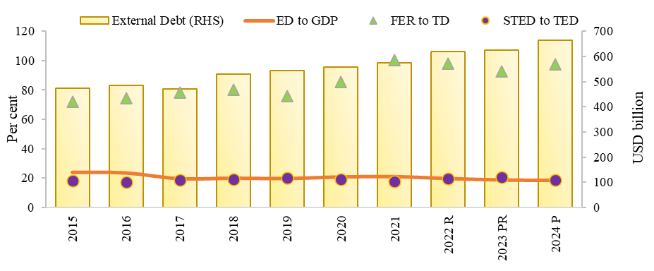
India’s stable external debt position and vulnerability indicators
FER: Foreign Exchange Reserve STED: Short Term External Debt TED: Total External Debt
Notes:
https://economictimes.indiatimes.com/news/economy/indicators/india-shines-as-a-global-growth-leader-contributing-over-16-to-the-worlds-growth-imf/articleshow/106106869.cms?from=mdr
https://www.livemint.com/economy/india-to-contribute-30-of-global-gdp-by-2040-focus-on-champion-states-growing-at-11-per-annum-amitabh-kant-11716050613021.html

Slide 15
Quality Expenditure

Slide 16
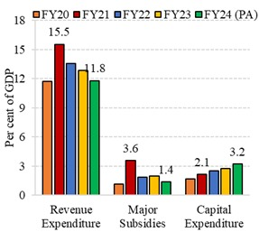
Government Expenditure Trends

Slide 17
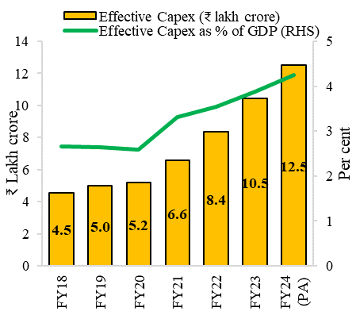
Government Effective Capex to GDP Ratio

Slide 18
Revenue trends for Govt.

Slide 19
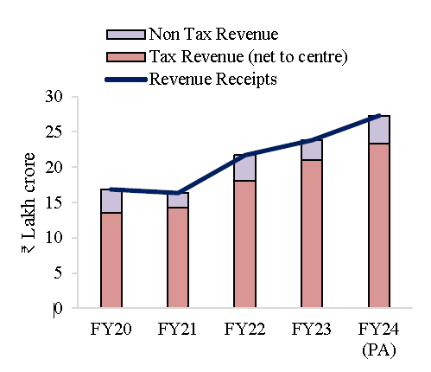
Revenue Increment for Government

Slide 20
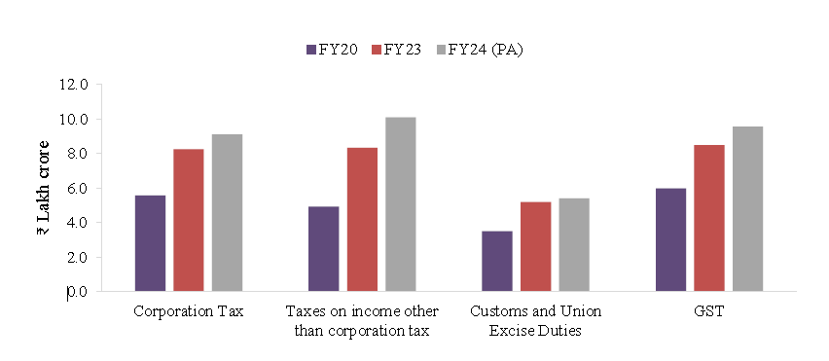
Tax Revenue Trends

Slide 21
AI Impact Assessment on Global Economy

Slide 22
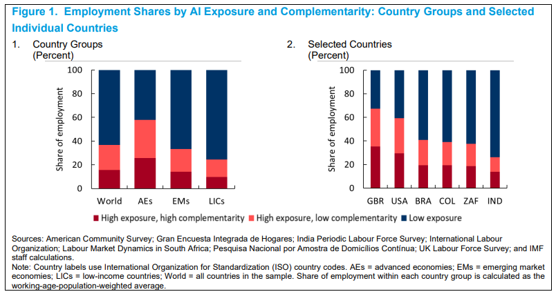
Impact of AI on Global Economy
Occupations can be categorized into three groups: “high exposure, high complementarity”; “high exposure, low complementarity”; and “low exposure”
Notes:
https://www.weforum.org/agenda/2024/01/economic-outlook-2024-recession-inflation/#:~:text=The%20International%20Monetary%20Fund%20(IMF,down%20from%203%25%20in%202023.

Slide 23
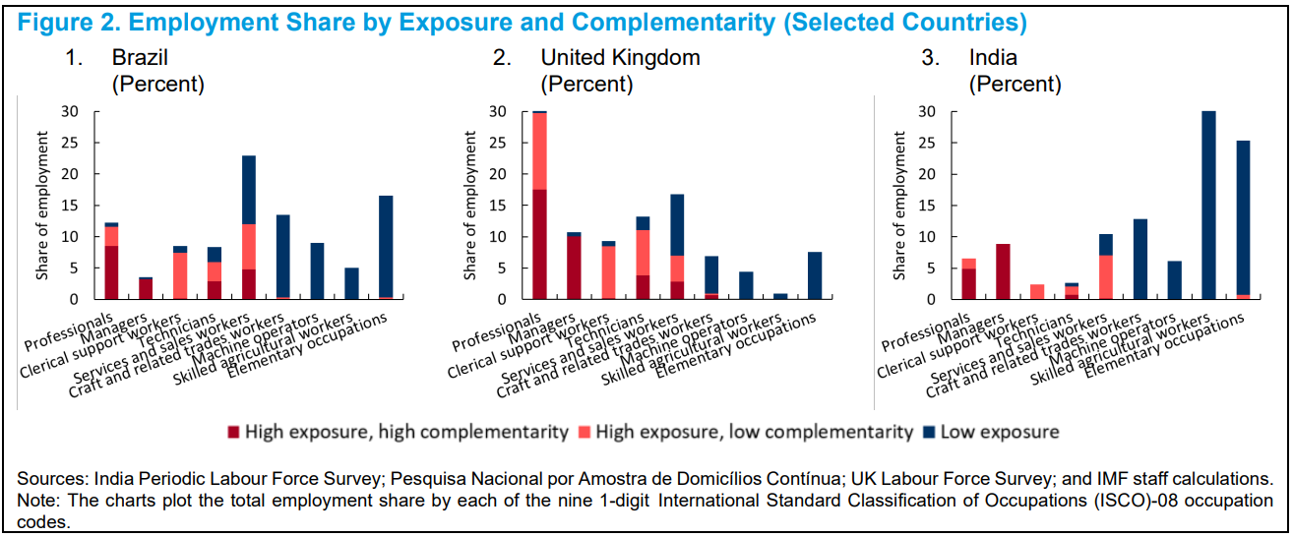
Impact of AI on Global Economy - Professionals
Notes:
https://www.weforum.org/agenda/2024/01/economic-outlook-2024-recession-inflation/#:~:text=The%20International%20Monetary%20Fund%20(IMF,down%20from%203%25%20in%202023.

Slide 24
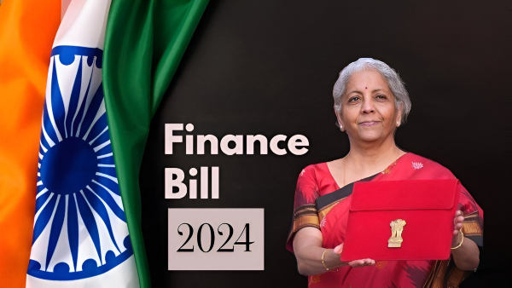
Finance Bill

Slide 25
Personal Taxation

Slide 26

Section 115BAC(1A) – New Tax Regime
For Individuals or HUF or AOP (other than Co-operative Society) or BOI, whether incorporated or not, or Artificial Juridical Person
Default Rates of Taxes
Rate of Tax | A.Y. 2025-26 | A.Y. 2024-25
Nil | Up to Rs. 3,00,000 | Up to Rs. 3,00,000
5% | From Rs. 3,00,001 to Rs. 7,00,000 | From Rs. 3,00,001 to Rs. 6,00,000
10% | From Rs. 7,00,001 to Rs. 10,00,000 | From Rs. 6,00,001 to Rs. 9,00,000
15% | From Rs. 10,00,001 to Rs. 12,00,000 | From Rs. 9,00,001 to Rs. 12,00,000
20% | From Rs. 12,00,001 to Rs. 15,00,000 | From Rs. 12,00,001 to Rs. 15,00,000
30% | Exceeding Rs. 15,00,000 | Exceeding Rs. 15,00,000
Surcharge as per individual rates would be applicable
*Section 87A Rebate → upto Rs. 25,000/-, , if Total Income < Rs. 7,00,000/-.
26

Slide 27

Increase in Standard Deduction on Salary
w.e.f.01.04.2025
A.Y. 2025-26 onwards
Existing Provision
Proposed Change
Standard deduction u/s 16(ia)
– Rs. 50,000/-
Standard deduction u/s 16(ia)
– Rs. 75,000/-
27

Slide 28

Increase in Deduction of family pension
w.e.f.01.04.2025
A.Y. 2025-26 onwards
Existing Provision
Proposed Change
Deduction u/s 57(iia) of family pension maximum – Rs. 15,000.
Deduction u/s 57(iia) of family pension maximum - Rs. 25,000.
28

Slide 29

Rate of Deduction from Employer’s Contribution
w.e.f.01.04.2025
A.Y. 2025-26 onwards
Existing Provision
Proposed Change
Deduction u/s 80CCD(2) on employer’s contribution
is 10%.
Deduction u/s 80CCD(2) on employer’s contribution
to be 14%*,
only when employees salary is chargeable to tax u/s 115BAC(1A) i.e. new tax regime
29

Slide 30


Revision of rates of STT
w.e.f. 01.10.2024
Nature of securities | Rates of STT
 | Existing | Proposed
Options | 0.0625% of the option premium | 0.1% of the option premium
Futures | 0.0125% of the price | 0.02% of the price
30

Slide 31
Buy Back of shares taxable as deemed dividend
w.e.f. 01.10.2024
Present Provision:
Proposed Provision:
Buy back of shares
Buy back of shares
Taxable @ 20% in hands of company u/s 115QA
Exempt in hands of shareholder u/s 10(34A)
A new clause (f) in Sec. 2(22) of IT Act:
Taxable as ‘deemed dividend’ in hands of shareholder at the applicable rates.
31

Slide 32
An Illustration on Taxability of Buy Back
2020
100 shares bought @Rs. 40/- per share
Cost of Acquisition = Rs. 4,000/-
2024
20 shares bought back @Rs. 60/- per share by Company = Rs. 1200/-
2025
50 Shares sold @Rs. 70 per share
Capital Gain (Rs. 3500 – Rs. 40 x 50) = Rs. 1500/-
Rs. 1200/- taxable as deemed dividend u/s 2(22)(f).
No deduction u/s 57.
Capital Gain u/s 46A:
Value of consideration = NIL
Cost of Acquisition = Rs. 800/-
Not allowed to be set off now, shall be carried forward
Net Capital Gain after set off of Rs. 800/-
= Rs. 700/-
32

Slide 33
Revamp of capital Gains Tax regime

Slide 34

Period of holding
w.e.f. 23.07.2024
Category of investment | Period of holding for qualifying as long term capital assets
 | Existing | Proposed
Listed shares, units of UTI or Equity oriented mutual fund or zero coupon bonds | 12 months | 12 months
Listed units of business trust | 36 months | 12 months
Unlisted Shares and immovable property | 24 months | 24 months
Bonds, debentures and gold | 36 months | 24 months
34

Slide 35

Long term capital gain u/s 112A
w.e.f. 23.07.2024
Existing Provision
Proposed Change
Long term capital gains shall not be chargeable to tax if aggregate amount does not exceed
- Rs. 1 Lakh
Long term capital gains shall not be chargeable to tax if aggregate amount does not exceed
- Rs. 1.25 Lakh
35

Slide 36
Bonds and debentures
w.e.f. 23.07.2024
S.No. | Category of Investment | Period of holding for qualifying as long term capital assets |  | Tax rate on short-term capital gains |  | Tax rate on long-term capital gains
 |  | Existing | Proposed | Existing | Proposed | Existing | Proposed
1. | Listed Bonds and debentures (other than zero coupon bonds) | 12 months | 12 months | At normal tax rate | At normal tax rate | 10% (without indexation) | 12.5% (without indexation)
2. | Unlisted bond or debentures | 36 months | Deemed to be short term u/s 50AA | At normal tax rate | At normal tax rate | 20% (without indexation) | N.A.
3. | Market linked debentures and Specified mutual funds | Deemed to be short term u/s 50AA | Deemed to be short term u/s 50AA | At normal tax rate | At normal tax rate | N.A. | N.A.
36

Slide 37
Rationalization of Capital gains
w.e.f. 23.07.2024
Income | Transfers before 23rd July,2024 | Transfers after 23rd July,2024
Long-term capital gains u/s 112(1)(c)(iii) – Non Resident | 10% | Clause not applicable
Long-term capital gains u/s 112A exceeding Rs. 1,25,000. | 10% | 12.5%
Long-term capital gains u/s 112. | 20% With indexation | 12.5% Without indexation
Short-term capital gains u/s 111A. | 15% | 20%
Other short-term capital gains | As per normal tax rates | As per normal tax rates
37

Slide 38
Proposed amendments of TDS for non-residents
w.e.f. 23.07.2024
Income | Transfers before 23rd July,2024 (TDS Rate) | Transfers after 23rd July,2024 (TDS Rate)
Long-term capital gains u/s 115E | 10% | 12.5%
Long-term capital gains u/s 112(1)(c)(iii) | 10% | Clause not applicable
Long-term capital gains u/s 112A exceeding Rs. 1,25,000. | 10% | 12.5%
Long-term capital gains u/s 112 | 20% With indexation | 12.5% Without indexation
Long-term capital gains ( not being u/s 10(33) & 10(36) ) | 20% | 12.5%
Short-term capital gains u/s 111A | 15% | 20%
38

Slide 39
Business Profits

Slide 40
Remuneration to Working Partner of Firm
w.e.f. 01.04.2025
(from A.Y. 2025-26)
Existing Limit
Proposed Limit
Particulars | Limit
On first Rs. 3,00,000/- book profit or in case of loss | Higher of:- 90% of Book Profit Rs. 1,50,000/-
On the balance book profit | 60% of Book Profit
Particulars | Limit
On first Rs. 6,00,000/- book profit or in case of loss | Higher of:- 90% of Book Profit Rs. 3,00,000/-
On the balance book profit | 60% of Book Profit
Effective Increment: Rs. 90,000/-

Slide 41
TDS on Payments to Partners by Firm/LLP
W.e.f. 01.04.2025
New Section 194T
TDS to be deducted on payments made by a firm in nature of salary, remuneration, interest, bonus, or commission to a partner.
Applicable TDS rate will be 10% on payments exceeding Rs. 20,000/- in a F.Y.
41

Slide 42

Abolition of Angel Tax u/s 56(2)(viib)
w.e.f 01.04.2025
A.Y. 2025-26 onwards
Tax charged on consideration received against shares issued for amount > FMV of shares
It is now proposed to omit this section

Slide 43

Letting out Income not to be charged under PGBP
w.e.f. 01.10.2024
Shall be chargeable to tax under ‘Income from House property’
Not as Business Income
Income from letting out of residential house property
A new explanation 3 to Section 28 is proposed to be inserted
43

Slide 44

Section 37 – Allowable Business Expense
w.e.f. 01.04.2025
(A.Y. 2025-26 onwards)
Settlement Amounts
are incurred due to an infraction of law and relate to contraventions
Not an allowable expenditure

Slide 45


Reduction in Tax rate of Foreign Companies
w.e.f.01.04.2025
A.Y. 2025-26 onwards
Existing Provision
Proposed Change
Taxed @ 40%
To be taxed @ 35%
45

Slide 46





Corporate Gifts not Covered u/s 47(iii)
w.e.f. 01.04.2025 (A.Y. 2025-26 and onwards)
Narrowing the scope of Sec 47(iii)
Capital gain shall not apply on transfer of a capital asset, under a gift or will or an irrevocable trust, by an individual or a HUF.
Individual
HUF
Corporates
Eligible to Gift
u/s 47(iii)
Section 50D & 50CA: FMV provisions aimed at bolstering the anti-avoidance machinery
Example
Gift of Shares of Other Co. by a Co.
46

Slide 47
BLOCK ASSESSMENT
–
OLD WINE IN NEW BOTTLE

Slide 48
Evolution of Search Assessment Regime
Regular Assessment/Reassessment
Block Assessment (Assessment of Undisclosed income)
Assessment u/s 153Aor 153C
Reassessment u/s 148
After 01.09.2024
01.04.2021 – 31.08.2024
Block Assessment (Assessment of total income including undisclosed income)
01.06.2003 - 31.03.2021
After
30.06.1995 - 31.05.2003
Before 30.06.1995
Curated form of Block Assessment
Notes:
For Search Action
Regular Assessment/Reassessment
Block Assessment (Assessment of Undisclosed income) w.e.f. 30.06.1995 to 31.05.2003
Assessment u/s 153A (‘Abated Assessment’) w.e.f. 01.06.2003 till 31.03.2021
Reassessment u/s 148 w.e.f. 01.04.2021

Slide 49
Reason for reviving block assessment in search and requisition cases
Challenges Under Current Scheme
Benefit of Block Assessment
Lack of consolidated assessment
Staggered assessment over years.
Escalating litigation cost
Changing legal position over time.
Difficulty on coordinated investigation
Early finalization of search assessment
Reduction in multiplicity of proceedings.
Cost-effectiveness for Assessee and Department.
Early finalization of assessment

Slide 50
Block Assessment – Definition
Block Period
Undisclosed Income
Money, bullion, jewellery or other valuable article or thing or any expenditure or any income based on any entry in the books of account
Money, bullion, jewellery, valuable article, things, entry not disclosed.
any expenses, deductions, or allowances which is found to be incorrect in respect of block period
Six AY(s) preceding the previous year of search or requisition
Period starting from 01.04.2024 of that previous year to last date of authorization for search or requisition

Slide 51
Key Highlights of Block Assessment
Total income (other than undisclosed income) of the year of search or requisition shall be assessed separately in accordance with other provisions of the IT Act
Tax shall be charged at 60% on total income determined u/s 158BC for the block period
Penalty on undisclosed income of the block period would be levied at 50% of tax payable on such income
No interest u/s 234A, 234B, 234C or penalty u/s 270A of the IT Act shall be levied or imposed
If return u/s 158BC is not filed or furnished beyond due date, then interest @ 1.5% per month or part of month on tax on undisclosed income shall be leviable

Slide 52
Computation of Total Income
Returned income u/s 158BC
Already assessed income u/s 143(3), 144, 147,153A or 153C (prior to date of initiation of search or the date of requisition
Return income filed u/s 139 in response to notices u/s 142(1) or 148 when not filed, excluding cases (i) and (ii).
Total income for ongoing previous years, based on entries in books and documents up to the search/requisition authorization date
Undisclosed income determined by the AO u/s 158BB(2)

Slide 53
Computation of Tax Chargeable
Returned income u/s 158BC
Already assessed income u/s 143(3), 144, 147,153A or 153C (prior to date of initiation of search or the date of requisition
Return income filed u/s 139 in response to notices u/s 142(1) or 148 when not filed, excluding cases (i) and (ii).
Total income for ongoing previous years, based on entries in books and documents up to the search/requisition authorization date
Undisclosed income determined by the AO u/s 158BB(2)
Income referred in clause (ii), (iii), (iv) of Section 158BB(1).
returned income or assessed income if loss shall be ignored

Slide 54
Procedure for block assessment
AO to take prior approval of the authority and issue notice to Assessee to file return of income within 60 days
Return filed is akin to return filed u/s 139
AO will determine total income including undisclosed income, as per section 158BB
Ao will pass an order of assessment or reassessment
Any pending assessment as well as pending reference u/s 92CA(1) as on date of search or requisition for AY falling withing the bock period would abate.
Provision of Section 142(1)/143(2)/145A or 145 would also apply

Slide 55

Time Limit for completion of block assessment u/s 158BE
12 months from the end of the month when the last search or requisition authorization (under section 132 or 132A) was executed
Time limit in case of person other than searched person would start from the date on which notice u/s 158BC was issued
An additional 12 months is allowed if a reference u/s 92CA(1) is initiated during pendency of assessment or reassessment for the block period
Period not exceeding 180 days, from the date of initiation of search or requisition until the seized assets (like books, documents, money, jewelery) are handed over to the AO shall be excluded

Slide 56
Penalty Provision
w.e.f. 01.09.2024
No order imposing penalty unless Assessee is given opportunity of being heard
If an amount of penalty exceeds Rs. 2 Lakh, the order of Penalty cannot be passed except with the prior approval of the Additional Commissioner or the Additional Director or Joint Commissioner or the Joint Director
Section 158BFA
No reference to Section 271AAB(1A) and 271AAC
No Penalty u/s 271AAD(1) or 271D or 271DA or 271E shall be levied for block period if:
Return filed u/s 158BC(1) and
tax payable as per return has been paid and established:
No appeal against the income which is shown in return of income.
Penalty would be levied on excess amount only.
Others

Slide 57
Rationalization of Provisions related to Assessment or Reassessment

Slide 58
Powers of Set aside to CIT(A)
w.e.f. 01.10.2024
Assessment orders passed u/s 144 as best judgment cases-
CIT(A) shall have the power to set aside the assessment and refer the case back to AO for a fresh assessment.

Slide 59
Rationalisation of Time Limit for filing Appeal before ITAT
w.e.f. 01.10.2024
Existing
Within 60 days of the date on which the order sought to be appealed is communicated to the assessee or the PCIT/CIT.
Proposed
2 months from the end of the month in which the order sought to be appealed against is communicated to the assessee or PCIT/CIT.
Also proposed to include reference of Section 158BFA in Section 253 giving opportunity to assesses to appeal against interest and penalty orders passed u/s 158BFA.

Slide 60

Prosecution u/s 276B
w.e.f. 01.10.2024
Existing
Proposed
Section 276B
Failure to pay TDS by Payer to Government under Provisions of Chapter XVII-B
No prosecution if Payment of TDS is made at any time on or before the time prescribed for filing TDS return for a quarter u/s 200(3)
Imprisonment of
3months
to
7 Years
with Fine

Slide 61
Set Off and Withholding of Refunds u/s 245
w.e.f. 01.10.2024
Existing
After recording reasons in writing,
Proposed
After recording reasons in writing,
Obtaining previous approval of the PCIT/CIT,
Opinion that grant of refund is likely to adversely affect the revenue.
Obtaining previous approval of the PCIT/CIT.
Proposed to extend the period of withholding refund upto 60 days from the date on which pending assessment or reassessment is made.

Slide 62
Changes in Time Limit to issue notice u/s 148
w.e.f. 01.09.2024
Period | Basis | Threshold limit of income escapment | Time limit for issuance of notice | Reckoning Date
Prior to 01.07.2012 | Reason to believe | Any amount | 4 years | From the end of the relevant AY
 |  | Exceeding Rs. 1 lac | 6 years | From the end of the relevant AY
On or after 01.07.2012 before 01.04.2021 | Reason to believe | Any amount | 4 years | From the end of the relevant AY
 |  | Exceeding Rs. 1 lac | 6 years | From the end of the relevant AY
 |  | Any amount | 16 years | From the end of the relevant AY for escaped foreign income

Slide 63
Continue….
w.e.f. 01.09.2024
Period | Basis | Threshold limit of income escapment | Time limit for issuance of notice | Reckoning Date
On or after 01.04.2021 before 01.09.2024 | Information | Any amount | 3 years | From the end of the relevant AY
 | Books of accounts or other documents or evidence reveals income escapement in the form of asset, expense or entry in books of accounts | Rs. 50 lacs or more | 10 years | From the end of the relevant AY
On or after 01.09.2024 | Information | Any amount | 3 years 3 months | From the end of the relevant AY
 | Books of accounts or other documents or evidence reveling income escapement in the form of asset, expense or entry in books of accounts | Rs. 50 lacs or more | 5 years 3 months | From the end of the relevant AY

Slide 64
Widening the scope of Section 148
w.e.f. 01.09.2024
Amending time limit to furnish return, to the period as specified in the notice which shall not be exceeding 3 months.
Prior approval of specific authority only in cases where information is received u/s 135A of IT Act.
Expanding the scope of ‘information’ to include the information emanating from survey u/s 133A of IT Act.
Omitting the explanation 2 i.e., deemed information, in view of consequential amendments made for search assessment.

Slide 65
Amendment to Section 148A
w.e.f. 01.09.2024
Eliminating the requirement under existing clause (a) to conduct enquiry.
Removing specific time-frame for Assessee to respond to notice.
Show cause notice to be accompanied with information suggesting escaped assessment.
Removing time limit of 1 month for AO to pass an order.
Section 148A to not apply only in the case where AO has received information under scheme notified u/s 135A.

Slide 66
Time period modified u/s 149
w.e.f. 01.09.2024
Section 148
Section 148A
Existing
(A) 3 years
(B) 10 years
Proposed
(A) 3 years 3 months
(B) 5 years 3 months
Existing
(A) Nil
(B) Nil
Proposed
(A) 3 years
(B) 5 years

Slide 67
Change in authority u/s 151
w.e.f. 01.09.2024
Proposed
Principal commissioner
Principal director
Principal Director General
Principal Chief Commissioner
Additional Commissioner
Additional Director
Joint Director
Joint Commissioner
Existing
The proposed amendment has also removed the classification of the specific authority based on the time-period lapsed.

Slide 68
Insertion of new Sub-sections u/s 152
w.e.f. 01.09.2024
Provisions u/s 147-151 shall apply as stood before Finance Act, 2024 to proceedings initiated u/s 132, 132A or 133A b/w 01.04.2021 to 01.09.2024.
Section 152(3)
Section 152(4)
Provisions u/s 147-151 shall apply as stood before Finance Act, 2024 to notice or order passed u/s 148/148A prior to 01.09.2024.

Slide 69
Time Limit for Completion of Assessment, Reassessment and Recomputation

Slide 70
Proposed Amendments in Section 153
w.e.f. 01.10.2024
Case | Time Limit | Relevant Event
ROI filed in consequence of an order u/s 119(2)(b). | Within 12 months | From the end of F.Y. in which ROI is furnished.
Set aside assessments by CIT(A) | Within 12 months | From the end of F.Y. in which order u/s 250 is received by the PCCIT/CCIT/PCIT/CIT
Revived assessment/reassessment as a consequence of annulment of block assessments | Within 1 year | From the end of month of such revival or period specified in Sec 153B(1), whichever is later.
Order u/s 158BC | Within 12 months | From the end of the month in which the last of the authorisations for search under section 132, or requisition under section 132A, was executed or made, as the case may be
6th proviso to Explanation 1 - Where period of limitation ends before the end of the month, then the said period shall extend to the end of the month.

Slide 71
The Direct Tax Vivad Se Vishwas Scheme 2024

Slide 72
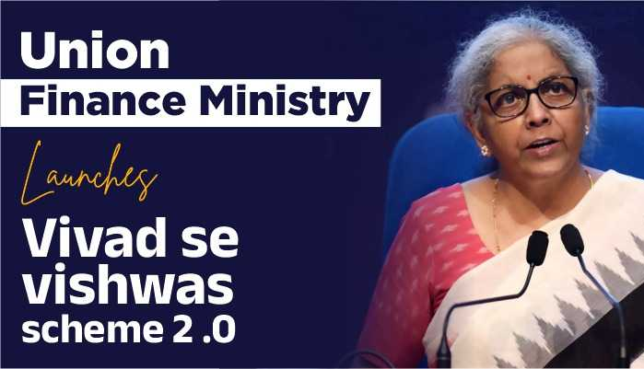
Objects and Reasons
DTVVS 2024
To provide one-time settlement for pending cases
To reduce direct tax litigation
To expedite resolution of tax disputes
To minimize costs for both taxpayer & exchequer
Collection of significant locked up revenue

Slide 73
Applicability
DTVVS 2024
Appeals/ writ petition/SLP filed by taxpayers or income-tax authority
CIT/JCIT (Appeals), ITAT, HC or SC
Pending on or before 22.07.2024
Objections filed by the taxpayer u/s 144C
Dispute Resolution Panel
Direction has been issued by dispute resolution panel
Assessment order by AO as per the direction
Taxpayer filed a revision application u/s 264

Slide 74
What is Disputed Tax ?
DTVVS 2024
In case of Appeal/ writ/ SLP pending before CIT(A)/ ITAT/ HC/ SC as on 22.07.2024
In case of Objections filed by the appellant is pending before DRP u/s 144C as on 22.07.2024
Amount of tax payable as if such Appeal/ writ/ SLP decided against the assessee
Amount of tax payable as if DRP was to confirm the variation proposed in
the draft order

Slide 75
What is Disputed Tax ?
DTVVS 2024
In case of DRP has issued direction u/s 144C(5) and AO has not passed order u/s 144C(13) on or before 22.07.2024
In case of application for revision u/s 264 is pending as on 22.07.2024
The amount of tax payable as per assessment order to be passed u/s 144C(3) by AO
Amount of tax payable as if such application is not accepted

Slide 76
Disputed Tax: Illustration 1
DTVVS 2024
In case of ABC Firm:
Assessed Income u/s 143(3): Rs. 10 Lakh
Returned Income: Rs. 4 Lakh
The addition of Rs. 6 Lakh was challenged before CIT(A) by an appeal and the said appeal was pending on 22.07.2024
Tax on Assessed Income @30%(A): Rs. 3 Lakh*
Tax on returned Income @ 30% (B) : Rs. 1.2 Lakh* [Tax on Rs. 4 Lakh (10 Lakh - 6 Lakh)]
Disputed Tax = A-B = Rs. 1.8 Lakh*
*To be increased by surcharge and cess, as applicable

Slide 77
Disputed Tax: Illustration 2
DTVVS 2024
In case of Firm namely PQR Associates:
Assessed Income u/s 143(3): Rs. 10 Crore (includes additions amounting to Rs. 8 Crore)
Returned Income: Rs. 2 Crore
Assessee filed an appeal before CIT(A) challenging the addition of Rs.6 Crores.
Tax on Assessed Income @30%(A): Rs. 3 Crore*
Tax on Returned Income @ 30% (B) : Rs. 0.60 Crore* [Tax on Rs. 2 Crore]
Tax on additions not challenged before CIT(Appeals @30%) (C)- Rs. 0.60 Crore* [Tax on Rs. 2 Crore]
Tax on additions challenged before CIT(Appeal) (D)- Rs. 1.8 Crores* [Tax on Rs. 6 Crore]
Disputed Tax-??
*To be increased by surcharge and cess, as applicable

Slide 78
Disputed Tax: Illustration 3
DTVVS 2024
In case of Firm namely XYZ Associates:
Assessed Income u/s 143(3): Rs. 20 Crore (includes additions amounting to Rs. 10 Crore and Rs. 4 Crore)
Returned Income: Rs. 6 Crore
On appeal before CIT(A), addition of Rs. 10 Crore was deleted and addition of Rs. 4 Crore was confirmed. Against the order of CIT(A), both department and the assessee are in appeal before ITAT and both the appeals were pending on 22.07.2024.
Tax on Assessed Income @30%(A): Rs. 6 Crore*
Tax on returned Income @ 30% (B) : Rs. 1.8 Crore* [Tax on Rs. 6 Crore (20 Crore – 14 Crore)]
Disputed Tax = A-B = Rs. 4.2 Crore*
*To be increased by surcharge and cess, as applicable

Slide 79
Amount Payable by Declarant
DTVVS 2024
S.No. | Nature of tax arrear |  | Amount payable under Scheme on or before 31.12.2024 | Amount payable under Scheme on or after 01.01.2025 but on or before the last date*
(a) | Aggregate of Disputed Tax + Interest + Penalty | Appeal filed between 31.01.2020 and 22.07.2024 | Amount of Disputed Tax | 110% of Disputed Tax
 |  | Appeal filed on or before 31.01.2020 and pending at the same appellate forum | 110% of Disputed Tax | 120% of Disputed Tax
(b) | Disputed Interest or Penalty or Fee | Appeal filed between 31.01.2020 and 22.07.2024 | 25% of Disputed Interest or Penalty or Fee | 30% of Disputed Interest or Penalty or Fee
 |  | Appeal filed on or before 31.01.2020 and pending at the same appellate forum
 |  |  | 30% of Disputed Interest or Penalty or Fee | 35% of Disputed Interest or Penalty or Fee
* To be notified

Slide 80
Amount Payable by Declarant
DTVVS 2024
If an appellant files an appeal before the CIT (Appeals) or JCIT (Appeals), or raises objections before the Dispute Resolution Panel on an issue already decided in their favor by the ITAT or HC
If an appeal or petition has been filed by the Income Tax Authority
If an appellant files an appeal before the ITAT on an issue already decided in their favor by the HC
The payable amount will be half of the amount specified in the Table

Slide 81
Filing of Declaration
DTVVS 2024
Upon filing declaration, appeal pending before CIT(A) or ITAT shall be deemed to be withdrawn w.e.f. date of certificate issued by designated authority for tax arrears and amount payable.
Appeal filed before the appellate forum or writ filed before HC or SC shall be withdrawn with the leave of the Court, wherever required.
The declarant shall furnish an undertaking waiving his right, whether direct or indirect, to seek or pursue any remedy or any claim in relation to the tax arrear.
Declaration to be filed before the designated authority in the prescribed form and verified in the prescribed manner.

Slide 82
Filing of Declaration
DTVVS 2024
No appellate forum shall proceed to decide any issue relating to the tax arrear mentioned in the declaration in respect of which an order has been made u/s 92(1) by the designated authority on the payment of sum determined under that section.
Declaration presumed to never have been made and proceedings under IT Act shall be revived if:
(a) any material particular furnished in the declaration is found to be false at any stage;
(b) the declarant violates any of the conditions referred to in this Act;
(c) the declarant acts in any manner which is not in accordance with the undertaking given by him u/s 91(4).

Slide 83
Time and Manner of Payment
DTVVS 2024
Pass an order determining the amount payable by the declarant and grant a certificate [Section 92(1)]
Designated Authority (Officer not below the rank of CIT notified by PCCIT)
Within 15 days
of receipt of declaration
Within 15 days
Order to be conclusive and no matter covered by the said order shall be reopened under the IT Act or any other law
The designated authority shall pass an order acknowledging that the declarant paid the amount.
Declarant shall pay the determined amount and intimate the details of same.

Slide 84
Ineligibility Criteria
DTVVS 2024
Tax arrears in respect of-
Assessments done u/s 143(3) or 144 or 147 or 153A or 153C pursuant to search proceedings
An A.Y. in respect of which prosecution has been instituted before date of filing of declaration
Undisclosed income from foreign source or undisclosed assets located outside India
Assessment or reassessment made on the basis of information received under agreement referred to section 90 or 90A
Any person in respect of whom prosecution for any offence launched or instituted under the following laws on or before the date of declaration:
Unlawful Activities (Prevention) Act, 1967
Narcotic Drugs and Psychotropic Substances Act, 1985
Prevention of Corruption Act, 1988
Prevention of Money Laundering Act, 2002
Prohibition of Benami Property Transactions Act, 1988

Slide 85
Ineligibility Criteria
DTVVS 2024
Any person in respect of whom order of detention has been made under provision of Conservation of Foreign Exchange and Prevention of Smuggling Activities, 1974 before date of filing of declaration provided order of detention is not revoked or set aside.
Any person in respect of whom prosecution for the purpose of enforcement of any civil liability under the provisions of Bharatiya Nyaya Sanhita, 2023 has been instituted on or before the date of declaration; or such person has been convicted of any such offence punishable under any of those Acts.
Any notified person u/s 3 of the Special Court (Trial of Offences Relating to Transactions in Securities) Act, 1992 on or before the filing of declaration
E.g.: Harshad Mehta

Slide 86
Miscellaneous Clauses
DTVVS 2024
Immunity
No proceedings shall be instituted in respect of any offence; or
No penalty shall be imposed or levied; or
Refund
Any amount paid under clause 91 shall not be refundable
No interest shall be charged
in respect of tax arrear
If amount already paid before filing declaration exceeds the amount payable under the Scheme, declarant is entitled to get refund of excess without interest u/s 244A of IT Act.

Slide 87
Miscellaneous Clauses
DTVVS 2024
Nothing contained in this Scheme shall be construed as conferring any benefit, concession or immunity on the declarant in any proceedings other than those in relation to which the declaration has been made.
No benefit, immunity or consession

Slide 88
Miscellaneous Clauses
DTVVS 2024
Power of Board to issue directions, etc.
Power to remove difficulties
Power to make rules

Slide 89
Exemptions –
Uniting Two Regimes for Charitable Institutions/Trusts

Slide 90
Merger of Two Existing Regimes
w.e.f. 01.10.2024
Trusts or institutions u/s 12AB
Institutions under Section 10(23C)(iv)/(v)/(vi)/(via) (“First Regime”)
Merge
Merge
Trusts u/s 12AA/12AB and covered by provision of Section 11-13 (“Second Regime”)
No application made on or after 01.10.2024 seeking approval shall be allowed. Applications filed before 01.10.2024 would be processed under First Regime itself.

Slide 91
Merger of Two Existing Regimes
w.e.f. 01.10.2024
Sec 12A to cover institutions/trust registered under First Regime.
Eligible to apply for registration subsequently under the second regime.
Till the approval, approved trusts would continue to get the benefit of exemption.
Eligible modes of investment of first regime shall be protected in Second Regime.

Slide 92
Extension of Timelines for Trusts seeking Registration U/s 12AB & 80G
w.e.f. 01.10.2024
Existing Provision
Proposed Change
PCIT/CIT can pass an order u/s 12AB(1)(b)(ii) within 6 months from the end of month of the filling of the application.
PCIT/CIT can pass an order u/s 12AB(1)(b)(ii) within 6 months from the end of quarter of the filling of the application.

Slide 93
Miscellaneous Amendments
Power to PCIT/CIT to condone the delay in filing of application where reasonable cause is shown.
w.e.f. 01.10.2024
New Section 12AC proposed to be inserted which shall end the exit tax on merger of trusts on satisfaction of specified conditions.
w.e.f. 01.04.2025
Section 11(7) to include reference to Section 10(23EA)/(23ED)/(46B) giving them 1 time option to apply for registration u/s 12AB operative.
w.e.f. 01.04.2025

Slide 94
TDS and TCS

Slide 95
Reduction in TDS Rates
Section | Present TDS Rate | Proposed TDS Rate | With effect from
Section 194D-Payment of insurance commission (in case of person other than company) | 5% | 2% | 1.4.2025
Section 194DA - Payment in respect of life insurance policy | 5% | 2% | 1.10.2024
Section 194G –Commission etc. on sale of lottery tickets | 5% | 2% | 1.10.2024
Section 194H - Payment of commission or brokerage | 5% | 2% | 1.10.2024
Section 194-IB - Payment of rent by certain individuals or HUF | 5% | 2% | 1.10.2024
Section 194M - Payment of certain sums by certain individuals or Hindu undivided family | 5% | 2% | 1.10.2024
Section 194-O - Payment of certain sums by e-commerce operator to e-commerce participant | 1% | 0.1% | 1.10.2024
Section 194F relating to payments on account of repurchase of units by Mutual Fund or Unit Trust of India | Proposed to be omitted |  | 1.10.2024
95

Slide 96
Interpretation of Sec 194-IA
W.e.f. 01.10.2024
Existing Interpretation
Proposed Interpretation
Consideration: 75 lacs
Consideration: 75 lacs
Transferor 1: 50 lacs
TDS deducted
Transferor 1: 25 lacs
TDS not deducted
Transferor 1: 50 lacs
TDS deducted
Transferor 1: 25 lacs
TDS deducted
Earlier limit was interpreted to be transferor/ transferee wise, instead of value of property
Now limit will be interpreted property wise instead of transferor/ transferee wise.
96

Slide 97
Definition of Work u/s 194C
w.e.f. 01.10.2024
Work shall include—
(a) advertising;
(b) broadcasting …..
…….
(e) supplying a product according to the requirement or specification of a customer by using material purchased from such customer,
but does not include—
(A) manufacturing or supplying a product according to the requirement or specification of a customer by using material purchased from a person, other than such customer or associate of such customer; or
(B) any sum referred to in sub-section (1) of section 194J.

Slide 98

Employers to Consider TCS and TDS
w.e.f. 01.10.2024
For Calculation of Total Income consider
For Calculation of Total Tax already deducted consider
Salary Income
+
Other Income
+
Loss from House Property
Tax already deducted (TDS) on other income
+
Tax Collected at Source (TCS)
Lesser TDS u/s 192(1)
More in hand salary

Slide 99


TCS on Notified Luxury Goods u/s 206C(1F)
W.e.f. 01.01.2025
Presently sec 206C(1F) is only applicable on sale of motor vehicle of value exceeding Rs. 10 lacs @ 1%.
To expand tracking of spending on luxury goods, “any other goods, as may be specified by the Central Government by notification in the Official Gazette”
of value exceeding Rs. 10 lacs along with motor vehicle is proposed to be added.
Cars
Luxury Goods
TCS u/s 206(1F) @ 1%
99

Slide 100




Equalisation Levy
w.e.f. 01.08.2024
Finance Bill 2016,
amended by Finance Bill 2020
Finance Bill 2024
Equalisation levy
On
Non Resident
E-Commerce Operator
@ 2%
Equalisation levy
On
Non Resident
E-Commerce Operator
@ 2%
Income arising from E-commerce supply or services on or after 01.04.2020 but before 01.08.2024 only exempted u/s 10(50)

Slide 101

Interest on delayed TCS @1.5% p.m.
w.e.f. 01.04.2025
Delay in deposition of TDS
Section 201(1A)
Delay in deposition of TCS
Section 206C(7)
Pay Interest @ 1.5 % per month for each month & part thereof
Pay Interest @ 1% 1.5% per month for each month & part thereof

Slide 102

TDS on FRSB 2020 u/s 193
W.e.f. 01.01.2025
Sec 193 provides for TDS on payment of any income to a resident by way of interest on securities.
It is proposed deduct TDS on payment of interest, exceeding Rs. 10,000/- on Floating Rate Savings Bonds (FRSB) 2020 (Taxable) and any security of the Central Government or State Government, as the Central Government may, by notification in the Official Gazette.
102

Slide 103

TCS Credit of Minor in Hands of Parents
w.e.f. 01.01.2025
Proposed to amend Section 206C(4)
Where credit of Tax collected are given to person other than collectee
Credit of TCS of minor shall only be allowed if
Income of minor is clubbed with Parent income as per Section 64(1A)

Slide 104
Reducing Time Limit for Orders Deeming any Person to be Assessee in Default – u/s 201 & 206C
w.e.f. 01.04.2025 (AY 2025-26)
Section 201
Section 206C (6A)
Amendment in Section 201 (3)
New
Section 206C (7A)
Failure to deduct Tax
Failure to collect Tax
PROPOSED
Failure to deduct/ collect whole or any part of tax
Time limit of 7 Years for order deeming a person to be Assessee in Default
Time limit of 6 Years* for order deeming a person to be Assessee in Default
Deemed to be assessee in default
*6 years from end of FY in which payment/credit/collection made or 2 years from the end of FY in which correction statement delivered, whichever is later

Slide 105
Lower Deduction/ Collection Certificate of Tax at Source – u/s 197 & 206C (9)
w.e.f. 01.10.2024
Section 194Q
TDS by a buyer for the purchase of any goods of value exceeding Rs. 50,00,000/- @ 0.1% of the sum exceeding Rs. 50,00,000/-
Existing
Proposed
No Provision for seeking lower Deduction
Option to Seek lower Deduction/Collection Certificate
Section 206C (1H)
TCS by Seller @ 0.1% of consideration exceeding Rs. 50,00,000/- against sale of any goods.
Section 194Q
Section 197
In Ambit of
Section 206C(1H)
Section 206C(9)

Slide 106
Penalty for failure to furnish TDS or TCS Statements
Amendment in Section 271H(3)
Existing Provision
Proposed Change
No Penalty levied if person has filed TDS or TCS statement before expiry of 1 year from due date.
No Penalty levied if person has filed TDS or TCS statement before expiry of 1 month from due date.

Slide 107
Notification of certain persons or class of persons as exempt from TCS u/s 206C
Insertion of new Section 206C(12)
No TCS shall be made or made at lower rate in specified transactions, from specified person notified by Central Govt.

Slide 108
Setting Up a Time Limit to file correction of TDS/TCS statement
Amendment in
Sec 200 & Sec 206C(3B)
Existing Provision
Proposed Change
Time limit to file correction statement No
Time limit to file Correction Statement 6 years from end of FY in which TDS/ TCS statement delivered.

Slide 109
Various Amendments in Penalty Provisions

Slide 110
Rationalization of Period of Limitation
w.e.f. 01.10.2024
Calculating period of limitation for imposing penalty u/s 275(1)(a) and (1A)
Existing
Date of receipt of order of the JCIT(A) or CIT(A) or ITAT by the PCCIT or CCIT or PCIT or CIT.
Proposed
Date of receipt of order of the JCIT(A) or CIT(A) or ITAT by the PCIT or CIT.

Slide 111
Upgradation in Section 271FAA
w.e.f. 01.10.2024
Existing
Existing failures
Proposed failures
Failure to comply with the due diligence requirement as per section 285BA(7) of IT Act, or
Deliberate action, knowledge of the inaccuracy without informing the authorities, or
Discovery of the inaccuracy post-submission without timely correction as per section 285BA(6) of IT Act.
Furnishing inaccurate information in the statement.
Failure to comply with due diligence requirement in the statement.
No penalty, if reasonable cause proved u/s 273B.

Slide 112
Miscellaneous

Slide 113
Amendment in Section 80G (2)(a)(iiihg)
w.e.f. 01.04.2025
Existing
Deduction for donation to National Sports Fund
Proposed
Deduction for donation to National Sports Development Fund

Slide 114

Foreign Tax Income to be disclosed in ITR
w.e.f. 01.04.2025
AY 2025-26
Indian Income
Foreign Income not considered
Foreign Income
Indian ITR
Tax in Foreign
Jurisdiction
FTC taken
Resulted in Double Deduction
Section 198 clarifies , if FTC taken, such Foreign Income shall be
deemed to be income received

Slide 115
Calculation of profits of life insurance business
W.e.f. 01.04.2025
Rule 2 of First Schedule
Expenditure Disallowed u/s 37
Profits of Life Insurance Business
Existing:
The profits and gains of life insurance business were annual average of surplus arrived by adjusting surplus or deficit disclosed by the actuarial valuation.
Proposed:
Any expenditure which is not admissible u/s shall be added back to the profits and gains of the life insurance business.
115

Slide 116
Specified Mutual Fund (SMF) modified u/s 50AA
W.e.f. 01.04.2026
Existing
"Specified Mutual Fund" means a Mutual Fund by whatever name called, where not more than 35% of its total proceeds is invested in the equity shares of domestic companies:
Provided that the percentage of equity shareholding held in respect of the Specified Mutual Fund shall be computed with reference to the annual average of the daily closing figures.
Proposed
SMF shall mean:
a Mutual Fund by whatever name called, which invests more than 65% of its total proceeds in debt and money market instruments; or
a fund which invests 65%or more of its total proceeds in units of a fund referred to in sub-clause (a)
116

Slide 117
Miscellaneous
w.e.f. 01.10.2024
New sub section (9A) to the Section 139-
Provisions u/s 139 shall apply to any return of income which is furnished in pursuance of an order passed u/s 119(2)(b).

Slide 118

Shares FMV transferred via OFS in IPO
w.e.f. 01.04.2018
(from A.Y. 2018-19)
Unlisted Shares Acquired
Shares Sold in OFS in IPO
Listing Date
Later (After 3-4 days)
Remain unlisted on this date. No STT Paid
STT Paid on this date
Argued by assessee that computation mechanism fail as situation not covered u/s 55
Section 55(2)(ac)
Explanation clause (a) (iii) insertion of clause AA as
FMV bears to Cost of Acquisition in the same proportion as CII for FY 2017-18 bears to CII
for the first year asset held by assessee or
year beginning on 01/04/2001,
whichever is later

Slide 119
Submission of statement by liaison office of non-resident in India
w.e.f 01.04.2025
A.Y. 2025-26 onwards
Amendment in
Sec 285
Non-resident with liaison office in India to submit statement within 60 days from end of FY
Proposed to amend- such period as prescribed in rules.
New Sec 271 GC is proposed to be inserted
Failure to furnish statement u/s 285, AO may direct to pay penalty-
- Rs. 1000 every day for failure up to 3 months or
- Rs 1 lakh, in any other case.
Amendment in
Sec 273B
In sec 273B, Sec 271GC is proposed to be inserted.
Sec 273B provides no penalty if assessee proves reasonable cause.

Slide 120
Determination of ALP in respect of SDT
w.e.f 01.04.2025
A.Y. 2025-26 onwards
Existing Provision
Proposed Amendment
Section 92CA(1)- AO refers International Transaction or SDT to TPO
Clause (2B) and (2C) proposed to include Specified Domestic Transaction (SDT) along with International Transaction
(2B)- International Transaction comes to notice of TPO
Clause (1) will be applicable
(2C)- International Transaction not reported in Audit Report

Slide 121
Removal of Reference to National Housing Board in Section 43D of the Act
w.e.f. 01.04.2025
Existing Provision of Sec. 43D
Proposed Amendment
Clause (b) states that public company involved in housing finance, having regard to the guidelines issued by National Housing Bank
It is proposed to remove reference to National Housing Bank by omitting clause (b) of Section 43D.
Finance Act, 2019 has amended the NHB Act, conferring powers for regulation of Housing Finance Companies (HFCs) with RBI. Consequently, HFCs have come under the purview of the RBI as a category of NBFC. In the Act, separate provisions already exist in Section 43D with respect to NBFCs.

Slide 122
Discontinuation of the provisions allowing quoting of Aadhaar Enrolment ID in place of Aadhaar number
Amendment in Section 139AA
Existing Provision
Proposed Change
Quoting of Aadhaar number or Enrolment ID for allotment of PAN or in return of Income.
Discontinue the option of quoting of Enrolment ID for allotment of PAN related forms or returns.
Every person who has allotted PAN, shall intimate his Aadhaar Number.

Slide 123
Power to Withdraw Application before BAR
w.e.f. 01.10.2024
New proviso u/s 245Q(4)
Applicant may request in writing the Board for Advance Ruling on or before 31.10.2024 for withdrawal of application so transferred where BAR has not passed an order u/s 245R(2) up to the date of request.
Consequential amendment u/s 245R
On receipt of the application by the BAR under proviso to Section 245Q(4), the BAR may, by an order, reject the application referred to in Section 245R(1) thereof as withdrawn on or before the 31.12.2024.

Slide 124
Other Laws & Policies

Slide 125
Prohibition of Benami Property Act

Slide 126
Amendments in PBPT Act
w.e.f. 01.10.2024
New Sub-section (2A) in Section 24
Time limit upto 3 months to furnish explanation or submissions by the benamidar and beneficial owner against notice issued u/s 24(1) and u/s 24(2).
Time limit of passing an order for provisional attachment or continuing or revoking or deciding not to attach a property
Time limit for Initiating Officer to draw a statement of the case and refer it to the Adjudicating Authority
Existing
90 days
Proposed
4 months
Existing
15 days
Proposed
1 month

Slide 127
‘Approver’ under Benami Act
w.e.f. 01.10.2024
Powers given to Initiating Officer for Tendering Immunity from Prosecution
55A(1)
May Tender immunity to benamidar or such other persons other than beneficial owner from prosecution with previous sanction of competent authority subject to full and true disclosure of benami transaction.
55A(2)
Benamidar or such other persons remain immune from prosecution and penalty u/s 53 to the extent immunity tendered or accepted.
55A(3)
Tendered immunity may be withdrawn in case of non-compliance of the conditions with previous sanction of the competent authority
55A(4)
After withdrawal of immunity, the person may be tried for the offences which appears to have been committed and shall be liable to any penalty which would otherwise have been liable for such benami transaction.

Slide 128
Black Money Act

Slide 129
Proposed Amendments in Black Money Act
w.e.f. 01.10.2024
Insertion of reference of liabilities of Black Money Act u/s 230(1A) of IT Act to obtain a tax clearance certificate.
Widening of Scope of Section 132B of IT Act
Insertion of reference of Black Money Act u/s 132B of IT Act to recover existing liabilities under Black Money Act out of asset seized or requisitioned u/s 132.
Penalties u/s Section 42 and 43 shall not apply in respect of such assets other than immovable property where aggregate value of such assets does not exceed Rs. 20 Lacs.

Slide 130
Amendment in Sec 42 and 43 of Black Money Act Related to Penalty For Failure to Disclose Foreign Income And Asset In The ITR
w.e.f. 01.10.2024
Section 42
Section 43
Assessee being resident other than not ordinarily resident in India, who has failed to furnish the ITR and also the details of foreign income and assets or is beneficiary of an asset located outside India.
Assessee being resident other than not ordinarily resident in India, who has failed to furnish information or furnish inaccurate details related to foreign income and assets or is beneficiary of an asset located outside India in the ITR filed.
Proposed Amendment
Existing provisos to the Sec. 42 and 43 states that the provisions of these sections shall not apply i.r.o. an asset, being one or more bank accounts having an aggregate balance which does not exceed Rs.5 Lacs at any time during the previous year
It is proposed to amend the provisos to provide that the provisions of these sec. shall not apply i.r.o. an asset or assets (other than immovable property) where the aggregate value of such asset or assets does not exceed Rs.20 Lacs.

Slide 131
Support to MSMEs

Slide 132


New Credit Assessment Model
PSBs to develop new in-house credit assessment model
Based on Digital Footprints of MSMEs in the economy
MSMSEs without formal accounting system will also be covered

Slide 133


TReDS – Reduced Threshold
Turnover Threshold for Mandatory Onboarding reduced from ₹500 crores to ₹250 crores
Expected addition of 7,000 + companies
Medium enterprises to be included in the definition of ‘Supplier’.

Slide 134
Credit in Stress Period
Due Date
New mechanism for continuation of bank credit to MSMEs during SMA stage
Importance of Credit for continuation of business and avoid getting into NPA stage
Credit availability through guarantee from a government-supported fund.
SMA 0
SMA 1
SMA 2
NPA
30 days
60 days
90 days
90 + days

Slide 135


Mudra Loans Limit Enhancement
Shishu Loans up to ₹ 50,000/-
Kishore Loans ₹50k - ₹5 Lakh
Tarun Loans ₹5 – 10 Lakh
Limit enhanced to ₹ 20 Lakh for entrepreneurs who have availed and successfully repaid previous loans under the ‘Tarun’ category

Slide 136

Credit Guarantee Scheme
For Machinery and Equipment
Facilitate loans to MSMEs without collateral or third-party guarantee
Set up a fund to provide guarantee up to ₹100 crore.

Slide 137
Employment & Skilling

Slide 138

Employment Linked Incentive
Scheme A: First Timers
Scheme B: Job Creation in manufacturing
Scheme C: Support to Employers
Scheme Period : 2 years

Slide 139
Scheme A: First Timers
Sector
Eligibility
Benefits
Conditions
Subsidy to be refunded if employment ends within 12 months.
Subsidy in 3 instalments
All sectors
New entrants (EPFO) with wage < ₹1 lakh p.m.
1 month’s wage as subsidy (maximum ₹15,000/-)
Before 2nd instalment, complete online Financial Literacy course

Slide 140
Scheme B: Job Creation in manufacturing
Sector
Eligibility
Benefits
Conditions
Manufacturing
New entrants (EPFO) with wage < ₹1 lakh p.m.
Employer’s 3-year EPFO track record
Employer must hire at least 50 or 25% of the baseline [whichever is lower]
Incentives (as % of wage, shared equally between employer & employee)
2nd year – 24%
3rd Year - 16%
4th Year – 8%
1st year – 24%
Wage cap ₹25,000/- p.m.
Subsidy to be refunded if employment ends within 12 months
Suspension if non-maintenance of threshold level of enhanced employment
Benefit in addition to Scheme A

Slide 141
Scheme C: Support to Employers
Sector
Eligibility
Benefits
Conditions
All
New entrants (EPFO) with wage < ₹1 lakh p.m.
Employer who Increases employment above the baseline* by at least 2 employees (for those < 50 employees) OR 5 employees (for those with >50 employees) and sustains the higher level
Annual reimbursement capped to ₹3,000 p.m.
If the employer creates > 1000 jobs: Reimbursement on quarterly basis & Subsidy will continue for the 3rd & 4th year.
New employees need not be new entrants to EPFO.
Benefit in addition to Scheme A
Not applicable for those Employees covered under Scheme B

Slide 142
Other Next Gen. Reforms

Slide 143

Internship in Top Companies
Purpose
Provide internship opportunities to 1 crore youth in top 500 companies over the next 5 years.
Applicability
Individuals not employed and not engaged in full time education
Ineligibility
Candidate has IIT, IIM, IISER, CA, CMA etc as qualification
youth aged between 21 and 24 years
Any member of the family is assessed to Income Tax
Any member of the family is a government employee, etc.

Slide 144
Internship in Top Companies
Stipend:
Monthly allowance of Rs. 5,000/-
One-time assistance of Rs. 6,000/-
Cost Sharing
Government – Rs. 54,000/- towards monthly allowance (plus Rs. 6,000/- grant for incidentals).
Company – Rs. 6,000/- from CSR funds towards monthly allowance
Training cost to be borne by the Company from CSR funds
Participation
For companies, this scheme is voluntary

Slide 145
Land Reforms
To be completed within
3 years
Includes
land administration, planning and management
urban planning, usage and building bylaws.
Reforms and Actions
Proposed for -
Benefits
Urban Land
Digitization with Geographic Information System (GIS) mapping
and
Establishment of IT based system for property record administration, updating, and tax administration.
Facilitate credit flow
Improvement in the financial position of urban local bodies

Slide 146
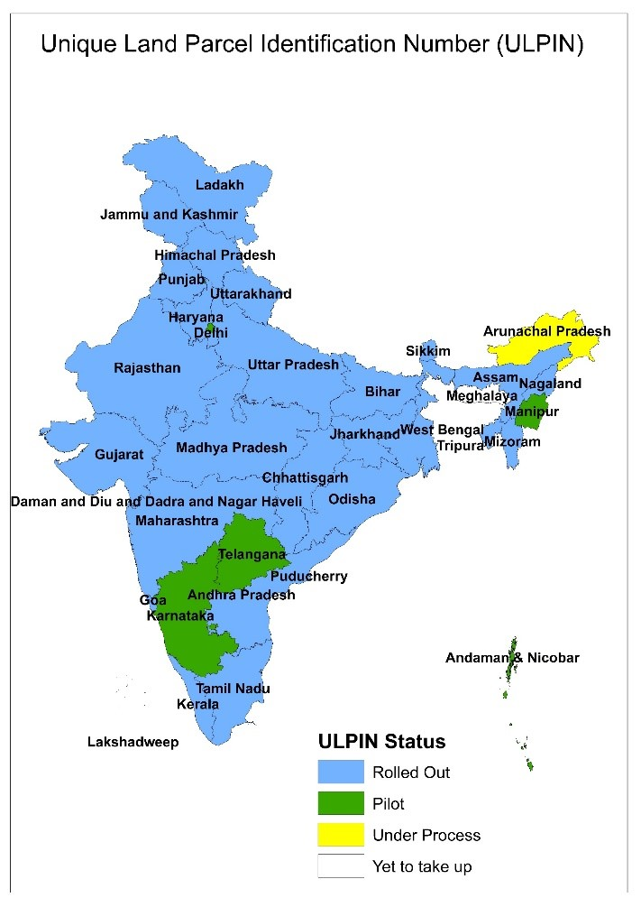
Urban and Rural Land Reforms
Rural Land
Digitization through Bhu-Aadhaar, i.e. ULPIN for all lands
Digitization of cadastral maps
Survey of map sub-divisions as per current ownership
Establishment of land registry
Linking to the farmers registry

Slide 147
IBC Eco-system and Easy Corporate Exits
By reforming & strengthening NCLT, DRT and their respective appellate tribunals
By setting up exclusive tribunals for disposal of case under Companies Act (to be notified)
Set up of Additional Tribunals
Set up of Integrated Technology Platform
Set up of additional tribunals to speed insolvency resolution process
C-PACE* to be extend from Company to voluntary closure of LLPs also.
*Centre for Processing Accelerated Corporate Exit

Slide 148
Ease of Doing Business
EXISTING
Jan Vishwas (Amendment of Provision) Bill, 2023
Rationalization of 183 Criminal and Penal provisions of 42 central Acts
PROPOSED
Jan Vishwas Bill 2.0
Further rationalization of Criminal and Penal provisions of various Acts to enable Businesses and citizens to work freely without fear of being punished severely

Slide 149

Education Loan
In the form of Interest subvention of 3% through E-Vouchers to 1 lac students every year
Announced financial support for loans up to Rs. 10,00,000/- for Higher education in domestic institutions
Eligibility
Students not eligible for benefit under any other schemes and policies.

Slide 150
NPA Vatsalya
Contribution by Parents & Guardian
“NPA Vatsalya” National Pension Scheme for Minors
Easy conversion of NPA Vatsalya to Normal NPA at the age of majority

Slide 151

Simplifying Norms for FDI and OI
Facilitate and enhance the inflow of FDIs.
Focus investments on priority sectors.
Encourage the use of Indian Rupee as a currency for overseas investments.
Proposed to simplify rules and regulations of OI and FD to-

Slide 152
MEASURES TO PROMOTE INVESTMENT AND EMPLOYMENT

Slide 153
Tax Incentives to International Financial Services Centre (IFSC)
w.e.f 01.04.2025
A.Y. 2025-26 onwards
Tax Incentives for IFSC
Amendment in Sec 10(4D)
Definition of Specified Fund proposed to include
1. Retail Schemes or
2. Exchange traded funds
regulated under IFSCA
Amendment in Sec 10(23EE)
Proposed to include clearing corporation set up in IFSC
Amendment in Sec 68
Proposed to include in first & second proviso, any credit received from VCF regulated by IFSC
Amendment in Sec 94B
Proposed to not apply to Finance Companies located in IFSC

Slide 154

Promotion of Cruise Ship Operations by Non-Residents in India
Presumptive taxation regime for a non-resident.
New Section 44BBC proposed
Deemed Profits- 20% of aggregate amount received/ receivable by, or paid/ payable to, non-resident cruise-ship operator.
New clause (15B) in Section 10 proposed
Exemption of Lease rentals paid by company which opt presumptive taxation u/s 44BBC.
Exemption only if recipient co. & payer co. are subsidiaries of same holding co.

