Slide 1
Union Budget 2024
An Analysis of Indirect Tax Laws
- By. Adv. Rahul Lakhwani

Slide 2
Goods and Service Tax

Slide 3
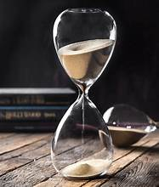
Relaxation in time limit
Sec 16(5)
In respect of any invoice or debit note,
Sec 146
Where the tax paid or ITC reversed, no refund shall be admissible.
pertaining to F.Y. 2017-18, 2018-19, 2019-20, 2020-21,
a registered person entitled to take ITC in any return in FORM GSTR-3B filed upto 30.11.2021
In-principal approval for relaxation in condition of Section 16 (4) of CGST Act, 2017 was granted during 53rd GST Council Meeting.

Slide 4
Eligibility to avail ITC on revocation of Cancellation of registration
Allow registered person to claim ITC in respect of invoice or debit note in return filed for period during which GST registration was cancelled.
If any ITC which is unclaimed & not restricted u/s 16(4) then such ITC can be claimed in any returns filed u/s 39 for the period from date of cancellation to date of revocation of cancellation, if filed within 30 days from revocation.
Introduced Section 16(6)
Allowance to Claim ITC for the Period Registration From Date of Cancellation of Registration till the Date of Order of Revocation of Registration

Slide 5
Amnesty Scheme u/s 128A
New Section 128A under CGST Act
Waiver of Interest and Penalty
F.Y. 2017-18, 2018-19 & 2019-20
SCN u/s 73(1) / 73(3) where no order passed u/s 73(9)
Order passed by Adjudicating Authority on SCN issued u/s 73 where no order passed by Appellate Authority
Order passed by Appellate Authority where no order passed by Appellate Tribunal
No refund if interest penalty has already been paid
Not eligible if appeal or writ petition filed is pending and not withdrawn
Full tax liability is paid before a date to be notified

Slide 6

Introduction of Section 74A
Provide for common time limit for issuance of demand notices and orders in respect of demands for F.Y, 2024-25 onwards.
74A (1) deals with determination of tax not paid or short paid or erroneously refunded or ITC wrongly claimed or utilised
74A(2) provides for time limit to issue Notice:
42 months from due date of furnishing of annual return for the relevant financial year.
74A(5) provides for penalty where tax is short paid or erroneously refunded:
1. For reason of fraud: 100% of tax
2. For any other reason:
Higher of 10% of tax or Rs.10,000/-
74A(7) provides for issuance of order:
within 12 months from date of issuance of notice, which can be further extended for 6 months

Slide 7
74A(8) provides for suo-moto payment of tax for reason other than fraud etc:
Proceedings shall be concluded if person chargeable with tax:
74A(9) provides for suo-moto payment of tax by reason of fraud
Proceedings shall be concluded if Person chargeable with tax:
Pays full amount with interest and penalty equivalent to 15%, before issuance of SCN;
Pays full amount with interest, before issuance of SCN;
Pays full amount with interest within 60 days of issuance of SCN.
Pays full amount with interest and penalty equivalent to 25%,within 60 days of issuance of SCN;
Pays full amount with interest and penalty equivalent to 50%,within 60 days of communication of order.

Slide 8
Introduction of Section 75(2A):
Penalty for Notice issued u/s 74A(1)
When penalty under clause (ii) of Section 74A(5)
Penalty equivalent to tax evaded
not sustainable for reason that charges of fraud, willful misstatement or suppression of facts has not been established
Penalty shall be payable as per clause (i) of Section 74A(5)
Penalty equivalent to 10% of tax evaded or Rs.10,000/-, whichever is higher

Slide 9
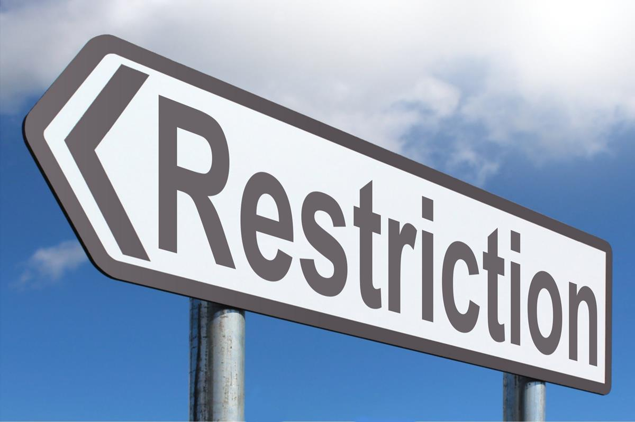
Restriction on applicability
Section 73(12)
Restrict the applicability of Section 73 for determination of tax pertaining to the period upto F.Y. 2023-24
Section 74(12)
Restrict the applicability of Section 74 for determination of tax pertaining to the period upto F.Y. 2023-24.
Intensify scrutiny of tax matters for the covered period

Slide 10
Amendment to Section 31(3)
Section 31(3)(f) provides for self-invoicing if goods received from unregistered supplier
Invoice in respect of goods or services or both received from unregistered supplier, must be issued to self within period prescribed.
The expression ‘supplier who is not registered’ shall include supplier who is registered solely for the purpose of deduction of tax under Section 51

Slide 11
Time of Supply of Services in Reverse Charge supplies.
Section 13(3) deals with time of supply provisions for supply of services liable to be taxed under RCM
Existing Provision
Proposed Change
Earlier of the following:
1. Date of payment; or
2. Date immediately following 60th day from date of issue of invoice.
Earlier of the following:
1. Date of payment; or
2. Date immediately following 60th day from date of issue of invoice; or
3. Date of issue of invoice by recipient.

Slide 12
Clarification regarding non-availability of ITC u/s 17(5) of CGST Act, 2017
Sec 17(5)(i) be read as “any tax paid in accordance with the provision of Sec 74 in respect of any period upto F.Y. 2023-24.
Amendment omits the reference to “tax paid in accordance with the provisions of Section 129 and 130”.
The amendment is corrective measure as amount paid under both the sections is not in the nature of ‘tax’ but of ‘penalty’.

Slide 13
Introduction of Section 11A
Empowers the Govt. to regularize non-levy or short levy of central tax where tax short paid or not paid due to general trade practice.
New provision provide relief from retrospective tax demands and reduce volume of litigation.

Slide 14
Return by Person Registered u/s 51 of CGST Act
Existing Provision
Proposed Change
A registered person, required to deduct TDS u/s 51,
furnish return for every month, irrespective of whether deductions made or not,
within such time limit as prescribed.
Accurate and up to date reporting.
Higher administrative costs.
A registered person, required to deduct TDS u/s 51,
furnish return for the month in which deductions made
within 10 days after end of such month

Slide 15
Prohibition of refund in zero rated supply of goods which subjected to export duty
Section 54 :-
Refund of Tax
Section 54(3):-
Refund of unutilized ITC
Omitted second proviso of Section 54(3)
Inserted new sub-section (15)
Existing Provision
Proposed Change
Goods subject to export duty:-
No Refund of unutilized ITC
Zero Rated Supply of Goods subject to export duty:-
No Refund of unutilized ITC
&
No Refund of Integrated Tax paid

Slide 16
Reduction in maximum amount of pre-deposit for filling appeal
Section 107: Appeal to Appellate Authority
Section 112: Appeal to Appellate Tribunal
w .e. f 01.08.2024
Effect of amendment: Maximum Pre-deposit
Rs. 25 Crore CGST --> Rs. 20 Crore CGST
Section 107(6)
Amount required to be paid before filling appeal
Pre-deposit
20 % -> 10% of the tax in dispute
Section 112(8)
Amount required to be paid before filling appeal
Maximum Pre-deposit
Rs. 50 Crore CGST --> Rs. 20 Crore CGST
53rd GST Council has recommended reduction in pre-deposit to ease cash flow and working capital blockage for taxpayer.

Slide 17
Extension of time limit for filing appeals before the Appellate Tribunal
S.R.No | SECTION | BEFORE AMENDMENT | PROPOSED AMENDMENT
1 | Section 112(1) | within 3 months from date of communication to the aggrieved person | within 3 months from date of communication to aggrieved person Date notified by Govt on recommendations of Council. whichever is later.
2 | Section 112(3) | within 6 months from date on which order passed | within 6 months from date on which order passed or; Date notified by Govt. on recommendations of Council whichever is later.

Slide 18
Extension of time limit for admitting appeal by the Appellate Tribunal [Section 112(6) of CGST Act]
Before amendment
Proposed amendment
within 3 months after expiry of period- for taxable person
within 3 months after expiry of period mentioned in sub-sec. (1)
within 3 months after the expiry of the period
-for appeal by department

Slide 19
Revocation of Cancellation of Registration
Insertion of Proviso after Sec 30(2)
Revocation of cancellation of Registration subject to conditions & restrictions as specified
Rules prescribing conditions will be issued in the course of time

Slide 20
Other proposed amendment on recommendation of 53rd GST Council meeting
No Levy on
“undenatured extra neutral alcohol or rectified spirit used for manufacture of alcoholic liquor, for human consumption”
Amendment in Sec 9(1) of CGST Act
Levy and Collection
Authorised representative ->
allowed to appear on behalf of a summoned person
Insertion of Sec 70(1A)
Power to Summon person
Only applicable on Electronic Commerce Operator (ECO) -> required to collect TCS u/s 52 of the CGST Act.
Sec 122(1B) of CGST Act
Penal Provision -ECO

Slide 21
Customs Act, 1972

Slide 22
Change in Rate of Basic Custom Duty

Slide 23
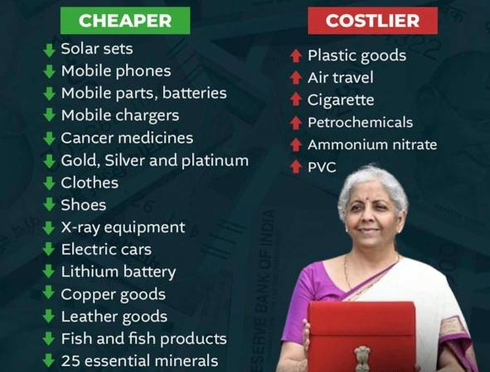
Change in Rate of Basic Custom Duty

Slide 24
Thank You!

