Slide 1
Reporting under 43B(h)
By CA Ram Avtar Sharma
FCA, DISA
Jaipur Mobile No 9351145820

Slide 2
MSME
As per schedule III of the Companies Act, separate disclosure is required of the dues payable to Micro and Small Enterprises (MSE) including interest for delayed payments and other particulars.
As per the Notification for classification of MSE’s w.e.f 01-07-2020, the criteria for such classification Micro, Small and Medium Enterprises is as under:- Criteria Investment Turnover
MICRO Investment in plant and machinery does not exceeds Rs. 5 Crores
  does not exceed Rs. 1Crore
SMALL Investment in plant and machinery does not exceeds Rs. 50 Crores
  does not exceed Rs. 10 Crore
MEDIUM Investment in plant and machinery does not exceeds Rs. 250 Crores
  does not exceed Rs. 50 Crore

Slide 3
MSME
For ensuring compliance, the company must ascertain the MSE status of each supplier immediately as per the revised criteria and based on the Udyam registration certificate (copy thereof is also required to be obtained). Further, a system may be incorporated so that the status of each new supplier is ascertained before issuing work order/purchase order as per revised criteria for classification of MSE.

Slide 4
Further, section 15 of the Micro, Small and Medium Enterprises Development (MSMED) Act 2006 (MSMED Act) provides that the period agreed between the parties (buyer and seller) for payment shall not exceed 45 days from the date of acceptance or deemed acceptance of goods or services. In case of no written agreement, payment is to be made within 15 days from the date of acceptance or deemed acceptance of goods or services. As per law any defect needs to be communicated to the supplier within 15 days from the date of the delivery of goods or receipt of services otherwise there is an interest liability as per section 16 of the MSMED Act, which states that the buyer is liable to pay interest with the monthly rests to the supplier in case of non-payment or delayed payment. The interest is compounded at three times the bank rate notified by the RBI. Such interest is not an allowable expenditure under the Income Tax Act 1961 and its details are also required to be disclosed in the financial statements.

Slide 5
MSME Return for Companies
A return is also required to be filed with MCA on half yearly basis under Form MSME-1 within 1 month from
the end of each half year stating the delay in payment to such parties and interest on such delayed payment.

Slide 6
Related changes made in Union Budget 2023 u/s 43B of the Income Tax Act 1961 (applicable from FY 2023-24)
To ensure timely payment to micro and small enterprises, the sum payable (related to goods or services procured) to micro or small enterprise beyond the time limit specified in section 15 of Micro, Small and Medium Enterprises Development (MSMED) Act 2006, will be allowed as deduction under Income Tax Act only on actual payment basis.
• Section 15 of MSMED Act provides following payment time limits:
i) As per written agreement, which cannot be more than 45 days.
ii) If no written agreement, payment to be made within 15 days.
• If payment is not made as per time limits (written agreement, 45 days or 15 days, as the case may be), deduction of related expenditure will be allowed only in the previous year in which the payment is made.

Slide 7
S. 43B
Notwithstanding anything contained in any other provision of this Act, a deduction
otherwise allowable under this Act….
Clause (h) inserted w.e.f. 1.4.2024 i.e. AY 2024-25 i.e. FY 2023-24
  Any sum payable by assessee to
  a Micro or Small enterprise
  beyond
  Time Limit specified in s. 15 of MSMED Act, 2006

Slide 8
S. 43B
Shall be allowed (irrespective of the PY in which liability to pay such sum was incurred by the assessee according to the method of accounting regularly employed by him) only in computing income referred to in section 28 of that PY in which such sum is actually paid by him
Before 139(1) – not allowed (Excluded from the Proviso)
Form 3CD amended to include reporting on 43B(h)

Slide 9








IMPORTANT DATES
2.10.2006
16.11.2007
13.4.2009
MSMED Act 2006
Schedule VI of Companies Act 1956 amended
Clause 22 inserted in Form 3CD
4.9.2015
Schedule III of Companies Act 2013 amended
22.1.2019
26.6.2020
MSME Form 1
Change in classification w.e.f. 1.7.2020
2.7.2021
1.4.2024
MSME Ministry Office Memorandum
S. 43B(h) Income Tax Act

Slide 10


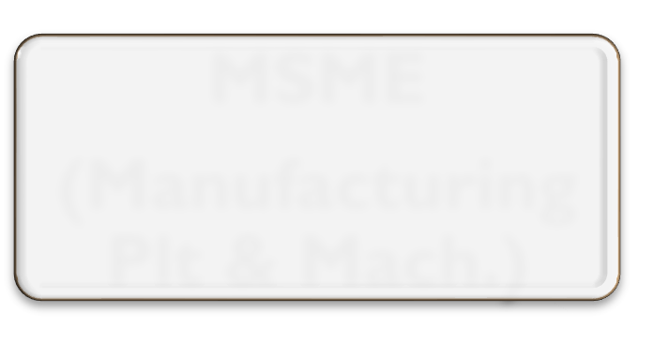











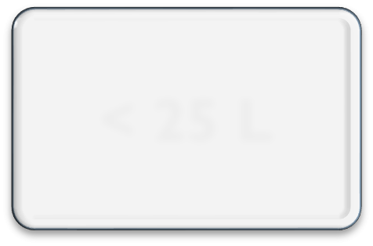
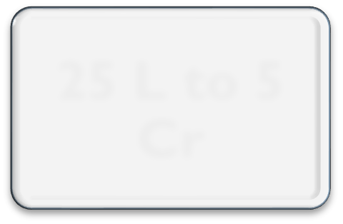
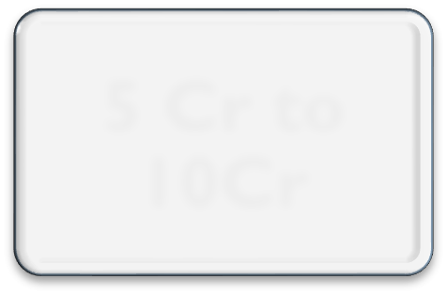
MSME
(Manufacturing Plt & Mach.)
Micro
Small
Medium
25 L to 5 Cr
5 Cr to 10Cr
< 25 L

Slide 11


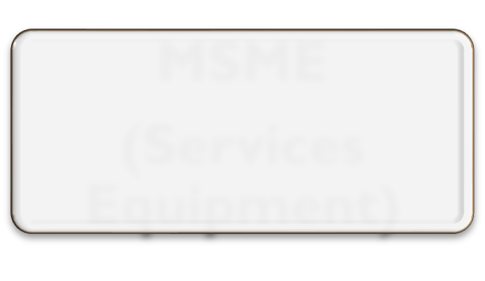











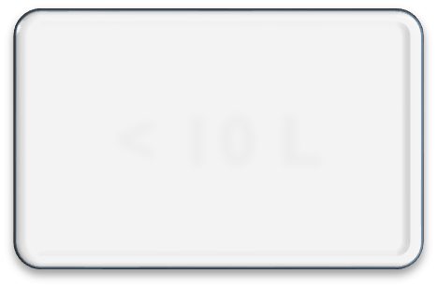
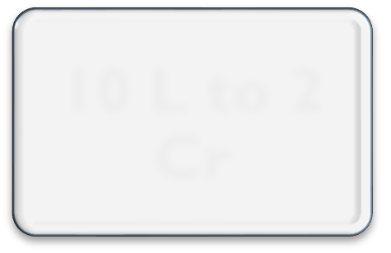
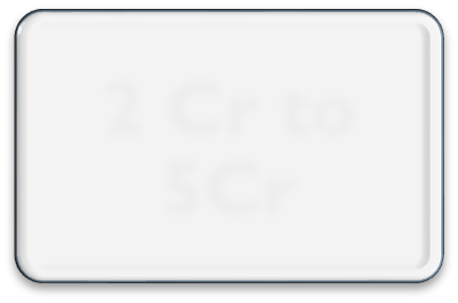
MSME
(Services Equipment)
Micro
Small
Medium
10 L to 2 Cr
2 Cr to 5Cr
< 10 L

Slide 12



















Invt. < 1 Cr
Micro
TR < 5 Cr
Invt. < 10
MSME
Cr
TR < 50 Cr
Small
(Mfg & Services)
Invt. < 50 Cr
TR < 250
Cr
Medium

Slide 13

Calculation of investment in plant & machinery or equipment will be linked to ITR of PY
New enterprise, invest. on self-declaration - relaxation shall end after 31st March of FY in which it files its first ITR.
Plt & Mach. Same as IT Act - shall include all tangible assets (other than land & building, furniture & fittings).
Purchase (invoice) value of Plt & Mach. or equip., whether purchased 1st hand or 2nd hand, excluding GST, if enterprise is a new.
Cost to exclude .. Pollution control, R&D, Industrial
safety devices, + not. dt. 5.10.2006

Slide 14

SECTION 15 - Where any supplier supplies any goods or renders any services to any buyer, the buyer shall make payment therefor on or before the date agreed upon between him and the supplier in writing or, where there is no agreement in this behalf, before the appointed day:
Provided that in no case the period agreed upon between the supplier and the buyer in writing shall exceed 45 days from the day of acceptance or the day of deemed acceptance.

Slide 15


DEFINITIONS
Appointed day - day following immediately after 15 days from the day of acceptance or the day of deemed acceptance of any goods or any services by a buyer from a supplier
  Day of acceptance
🞄 day of the actual delivery of goods or the rendering of services; or
🞄 where any objection is made in writing by the buyer regarding acceptance of goods or services within 15 days from the day of the delivery of goods or the rendering of services, the day on which such objection is removed by the supplier
  Day of deemed acceptance - where no objection is made in writing by the buyer regarding acceptance of goods or services within 15 days from the day of the delivery of goods or the rendering of services, the day of the actual delivery of goods or the rendering of services

Slide 16

Q
SECTION 16 - Where any buyer fails to make payment of the amount to the supplier, as required u/s 15, the buyer shall, notwithstanding anything contained in any agreement between the buyer and the supplier or in any law for the time being in force, be liable to pay compound interest with monthly rests to the supplier on that amount from the appointed day or, as the case may be, from the date immediately following the date agreed upon, at 3 times of bank rate notified by RBI.

Slide 17
CONSEQUENCES
SECTION 23 - Notwithstanding anything contained in the Income-tax Act, 1961 the amount of interest payable or paid by any buyer, under or in accordance with the provisions of this Act, shall not, for the purposes of computation of income under the Income-tax Act, 1961, be allowed as deduction.

Slide 18

FS RE ORTING
P
SECTION 22 - Where any buyer is required to get his annual accounts audited under any law for the time being in force, such buyer shall furnish the following additional information in his annual statement of accounts, namely:—
principal amount & interest due thereon (to be shown separately) remaining unpaid to any supplier as at the end of each accounting year;
amount of interest paid by buyer in terms of s.16, along with the amount of payment made to supplier beyond the appointed day during each accounting year;
amount of interest due and payable for the period of delay in making payment (which have been paid but beyond the appointed day during the year) but without adding the interest specified under this Act;
amount of interest accrued and remaining unpaid at end of each accounting
year;
amount of further interest remaining due and payable even in the succeeding years, until such date when the interest dues as above are actually paid to the small enterprise, for the purpose of disallowance as a deductible expenditure u/s 23

Slide 19

SECTION 24
The provisions of sections 15 to 23 shall have effect notwithstanding anything inconsistent therewith contained in any other law for the time being in force.

Slide 20
S. 43B
Any sum payable by assessee to a
Micro or Small enterprise
beyond
Time Limit specified in s. 15 of MSMED Act, 2006

Slide 21
Important Definitions
Enterprise - means an industrial undertaking or a business concern or any other establishment, by whatever name called, engaged in the manufacture or production of goods, in any manner, pertaining to any industry specified in 1st Schedule to the Industries (Development and Regulation) Act, 1951 or engaged in providing or rendering of any service or services

Slide 22

Supplier - means a micro or small enterprise, which has filed a memorandum with authority referred to in section 8(1), and includes
  NSCI registered as a company
  SIDC of a state or UT registered as company
  any company, co-operative society, trust or a body, by whatever name called, registered or constituted under any law for the time being in force and engaged in selling goods produced by micro or small enterprises and rendering services which are provided by such enterprises

Slide 23

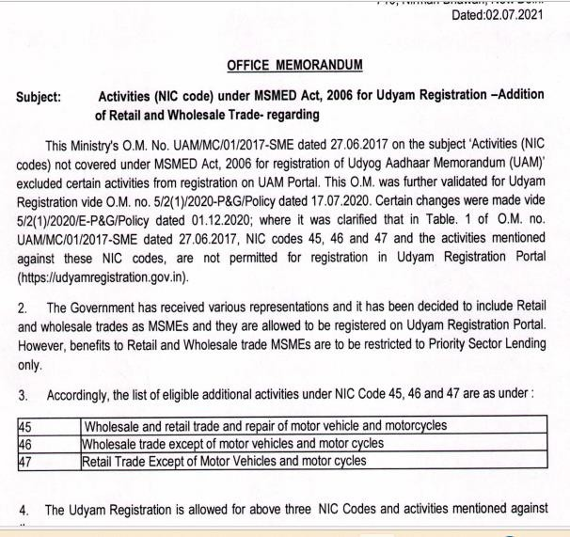
TRADERS

Slide 24
CASE STUDY
Purchase 10.5.2023, paid – 10.9.2023
  No 43B(h), but interest
Purchase 15.3.2024, paid – 15.4.2024
  No 43B(h), no interest
Purchase 15.3.2024, paid – 15.5.2024
  43B(h) & interest

Slide 25
ISSUES
Registered or Not
Traders !!
Opening Balance
Capital Asset
Purchases not consumed
Only for entities audited or for all

Slide 26
ISSUES
Written agreement !!
Date of delivery or date of invoice
Advance received – allowed on payment basis!!
Purchase and sale with same party
Is TDS deducted… money paid!!
GST amount due !!

Slide 27
ISSUES
S. 44AD / 44ADA / 44AE
Interest not receivable due to agreement or waiver
TDS on interest
MSE registration surrendered
Payment on LIFO basis
Buyer is not MSE. Is he covered?

Slide 28
Suggested details
S. No. | Name of supplie r | Micro / small / mediu m | Udya m Aadh ar No. | Date of Udya m Aadh ar No. | Majo r Activ ity | Agre emen t writt en or not | Credi t perio d as per agree ment | Credi t perio d as per MSM ED Act | Bal. as on ₃₁st Marc h 24 | Amo unt disall owed u/s 43B( h)

Slide 29
S. 43B(h) & FORM 3CD
Cl 26 amended for S. 43B(h) on 5th March 2024
Form 3CD again amended on 19.3.2024 –from Cl. 26 to Cl. 22
Now Cl. 22:
  The amount of interest inadmissible under section 23 of the Micro, Small and Medium Enterprises Development Act, 2006 or any other amount not allowable under clause (h) of section 43B of the Income-tax Act, 1961
No reporting in Cl 26 !!!
Implementation Guide with respect to Changes in Form No. 3CD & No.3CEB

Slide 30
Audit process
Obtain List of all Creditors
Assess the methodology adopted to identify MSME Status
Quantify the defaulters payments
Check Provisions of Interest

Slide 31
Reporting By Auditor- Situation 1
Situation- Auditee has not identified the status of MSME
Report in 3CA/3CB Col: 3/5
Company has not procured/received information from Creditors about their status as MSME, therefore no disallowance u/s 43B(h) can be determined and no provision for interest has been made.
Obtain Written representation
Check the Purchases Invoices containing MSME details

Slide 32
Reporting By Auditor- Situation 2
Situation- Auditee has identified the status of MSME but no interest provided.
Report in 3CA/3CB Col: 3/5
Company has procured/received information from Creditors about their status as MSME, therefore disallowance u/s 43B(h) is mentioned in column of 3CD no provision for interest on delayed payment has been made.
Obtain Written representation
Check the Process of identifying MSME Status

Slide 33
Reporting By Auditor- Situation 3
Situation- Auditee has identified the status of MSME and interest provided.
No need to Report in 3CA/3CB Col: 3/5
Obtain Written representation
Check the Process of identifying MSME Status
Check disallowance of Expenses and Interest Both
Clause 22 Interest to be mentioned
Clause 26 Expenses to be disallowed

Slide 34
THANK YOU

