Slide 1

Understanding GSTR 9: Your Comprehensive Guide to Filing the Annual GST Return
This presentation provides a clear and concise guide to filing your GSTR 9, the annual GST return, ensuring you understand the process and avoid any potential complications. We will cover the key aspects of GSTR 9, including who is required to file, important timelines, late filing fees, and the necessary documents to prepare for filing.
By CA. Sanjay Kumar Rathi
ICAI Bhawan, Jaipur, 30/11/2024
Notes:
1

Slide 2
Who Needs to File GSTR 9?
The Goods and Services Tax (GST) regime in India requires registered regular taxpayers with an aggregate turnover exceeding Rs. 2 crore to file GSTR 9. While it is optional for those with lower turnover, understanding the requirements is crucial for all taxpayers. (Vide notification no. 14/2024 dated 10.07.2024)
Mandatory Filing
Optional Filing
Exempted
  Regular Taxpayers (Turnover > Rs. 2 Crore)
  Regular Taxpayers (Turnover ≤ Rs. 2 Crore)
  Casual Taxable Persons
  Non-resident Taxable Persons
  TDS Payers (Section 51)
  Input Service Distributors
Notes:
2

Slide 3
Some Important Definition's
Exempt Supply
Aggregate Turnover
  Sec 2(47) of CGST act, “Exempt supply” means supply of any goods or services or both which attracts nil rate of tax or which may be wholly exempt from tax under section 11, or under section 6 of the Integrated Goods and Services Tax Act, and includes non-taxable supply
    Sec 2(6) of CGST act “Aggregate turnover” means the aggregate value of all taxable supplies (excluding the value of inward supplies on which tax is payable by a person on reverse charge basis), exempt supplies, exports of goods or services or both and inter-State supplies of persons having the same PAN, to be computed on all India basis but excludes central tax, State tax, Union territory tax, integrated tax and cess.
Non-Taxable Supply
  Sec 2 (78) of CGST act, “non-taxable supply" means a supply of goods or services or both which is not leviable to tax under this Act or under the Integrated Goods and Services Tax Act;
Notes:
2

Slide 4

Legal Framework & Significance
The legal foundation for GSTR 9 rests on Section 44 of the CGST Act, 2017, which mandates annual return filing for all registered taxpayers. This return acts as a consolidated summary of all transactions, including inward and outward supplies, taxes paid, and any potential additional liabilities.
Section 44 (Rule 80)
Consolidated Summary
Mandates annual return filing for all registered taxpayers, except those specifically exempted.
GSTR 9 summarizes all transactions for the financial year, providing a comprehensive overview of your tax compliance.
Additional Liabilities
The return allows for reporting any additional tax liabilities identified during the review process, ensuring accurate tax compliance.
Notes:
3

Slide 5
Key Considerations for GSTR 9
Filing GSTR 9 requires careful attention to detail. It is crucial to understand the key pointers to ensure accurate and timely filing, avoiding potential penalties.
1
Nil Return Filing
2
Prior Return Filing
Even if no transactions occurred during the year, filing a Nil Annual Return is mandatory for registered businesses.
Ensure GSTR 1 and GSTR 3B are filed accurately and on time for the relevant financial year before proceeding with GSTR 9.
3
Importance of Accuracy
4
DRC-03 Payment
Accurate information in the Annual Return is crucial for avoiding tax demands, interest, and penalties, as well as potential future legal complications and GSTR-9 does not allow for any revision after filling.
Utilize DRC-03 form to deposit any liabilities identified during the annual return filing process, specifying the reason for payment.
Notes:
4

Slide 6
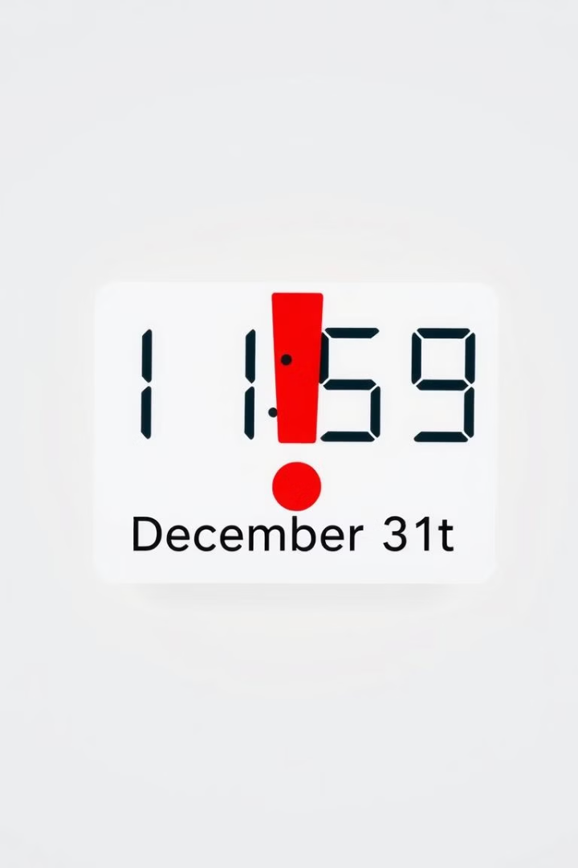



Crucial Aspects of GSTR 9
Understanding the filing deadline and potential consequences of non-compliance is essential to ensure smooth and timely tax compliance.
Deadline
Non-Compliance
GSTR 9 must be filed by 31st December of the year following the relevant financial year.
As per sec. 46 of CGST Act read with rule 68, if a registered person fails to file returns under sec 39, 44, or 45, a notice will be issued u/s 46 of return defaulter.
Notes:
5

Slide 7

Late Filing Fees for GSTR 9
Under section 47 of the CGST Act, Penalties apply for late filing of GSTR 9, varying based on turnover. It is essential to adhere to the deadline to avoid these fees.
S.No
Turnover Limit
Late Fee per Day (C+S)
Maximum Late Fee
1
Up to Rs 5 crore
Rs 50 (C+S)
0.04% of turnover
2
More than Rs 5 crore and less than Rs 20 crore
Rs 100 (C+S)
0.04% of turnover
3
More than Rs 20 crore
Rs 200 (C+S)
0.50% of turnover
Notes:
6

Slide 8

Navigating the complexities of Annual Return under GST
Notes:
1

Slide 9
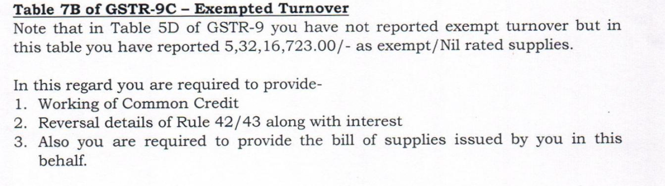
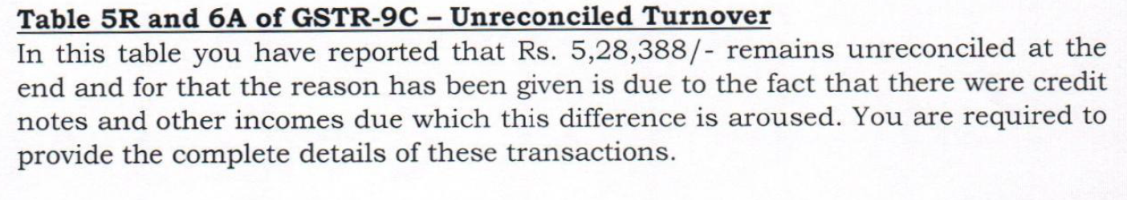
Departmental Scrutiny Notices Issues
Case 1
Rs ____
Case 2
Rs ___

Slide 10
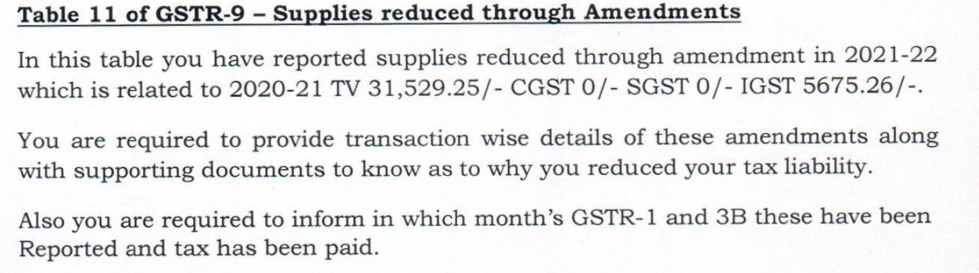
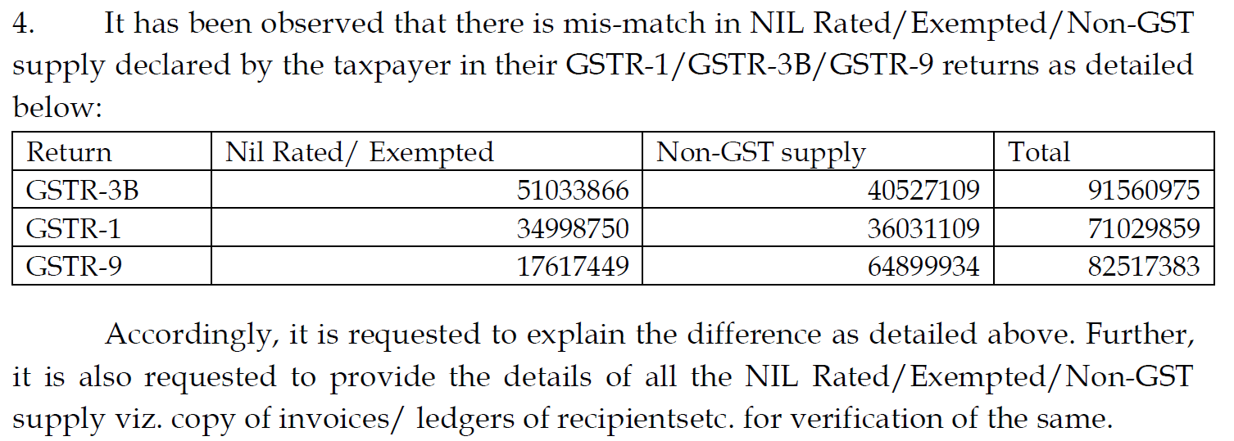
Case 3
Case 4

Slide 11
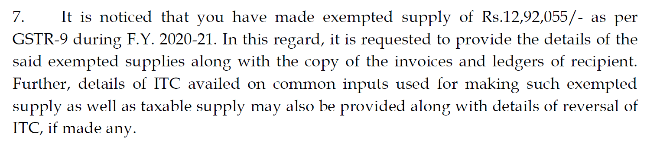
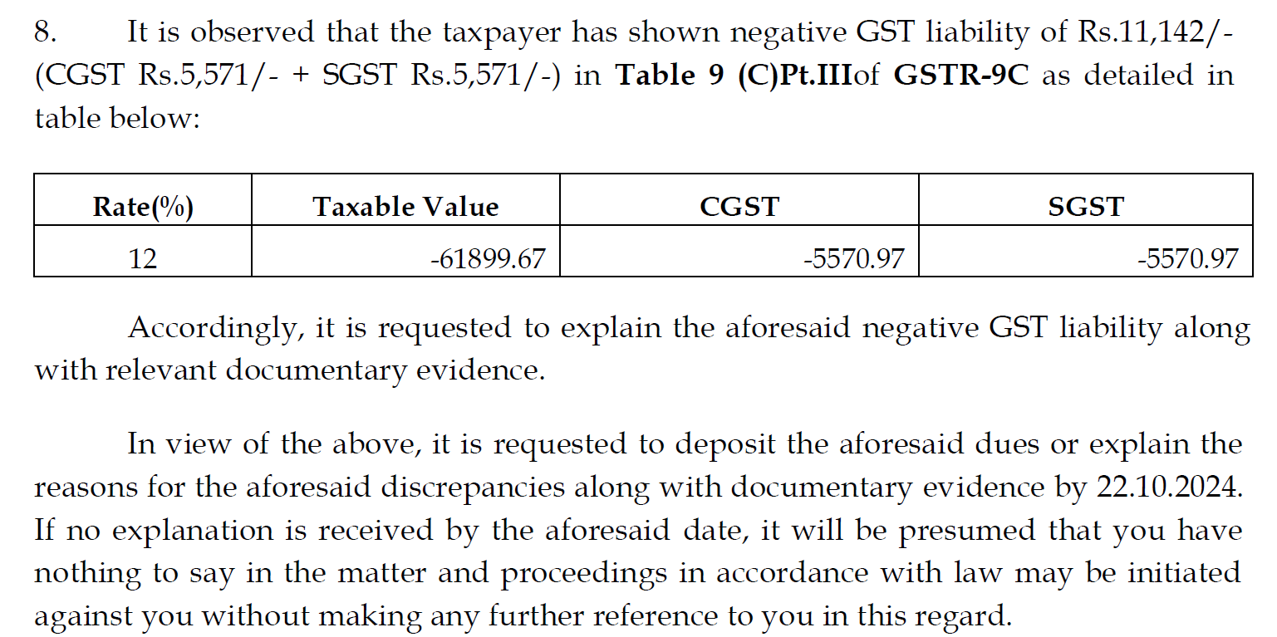
Case 5
____
Case 6

Slide 12


Addressing Common Issues in Annual Return Filing
1
ITC Reversal: Understanding the Timeline
Reversal of excess or wrongly availed ITC in GSTR-3B has specific reporting requirements based on the filing year. Ensure accurate reporting in the table no. 12 of GSTR-9.
2
Negative Values in Table 8: Documentation is Key
If the value in Clause D of Table no. 8 is negative, prepare for potential scrutiny from the department. Keep thorough documentation, including invoices and proof of payment.
Notes:
3

Slide 13
3.
ITC denied due to supplier’s retrospective registration cancellation
If a supplier’s registration is cancelled retrospectively, the recipient loses the ITC claimed on purchases made during period of cancellation, ensuring ITC is not claimed for invalid transaction .
4.
Reporting of Table no. 14 in GSTR 9: Ensure proper reporting
If there is any payment of tax in table no. 10, then ensure that it should also be reported in table no. 14 as payable and paid.
Notes:
3

Slide 14
GSTN Common Portal Generated Reports:
Auto Populated GSTR-9
GSTR -3B v/s 2B v/s GSTR-1 report
Documents will help and provide details related R-1 and 3B filing. Prefilled Annual Return.
Reconciliation of liability between GSTR-3B and GSTR-1.Reconciliation of Input as per GSTR-2B and GSTR-3B.
GSTR-2B
Party wise GSTR-2B for the FY. It will be used for GSTR-2B and books reconciliation.
Notes:
5

Slide 15
Software Generated Reports:
Rate wise outward supply
GSTR-3B and GSTR-1 consolidated report
Summary of rate wise outward supply on yearly basis. Required for GSTR 9C
Overall Reconciliation of Tax liability and turnover .
GSTR-3B offset summary
Month wise summary of liability and input as per GSTR-3B. And how the liability been discharged, by cash or credit.
Notes:
6

Slide 16
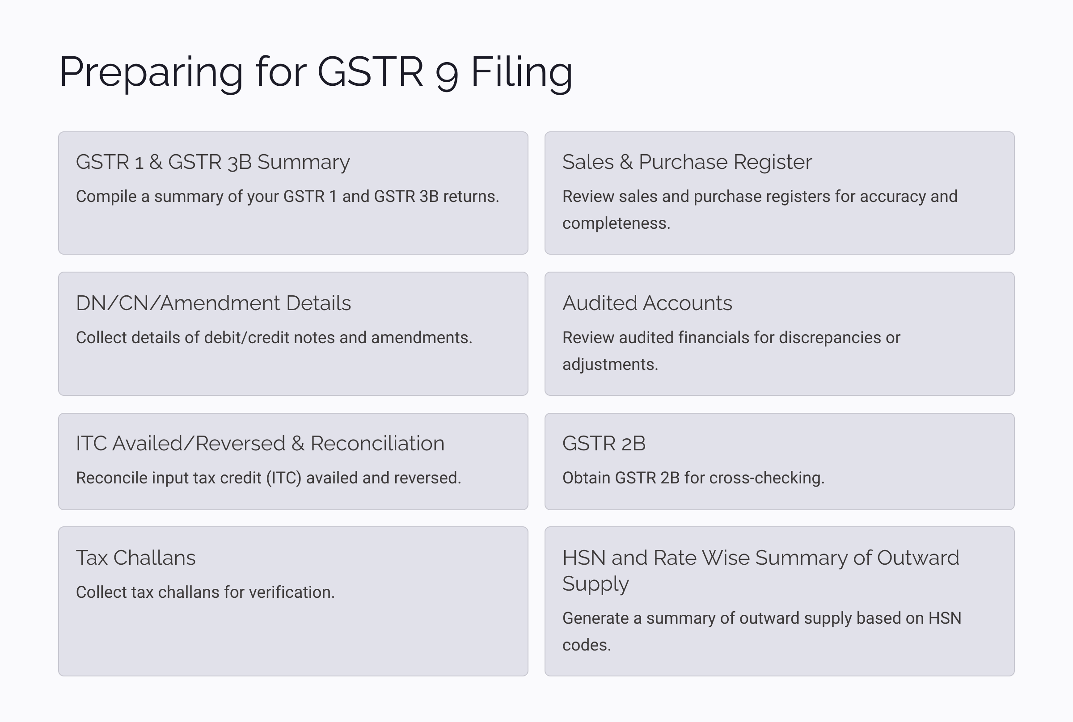
Notes:
7

Slide 17
Optional/Amendments in 9 and 9C
Notification 12/2024 dt 10/07/2024
E-commerce operator supply column has been inserted.
Exempted and Nil rated supplies have option to declare on consolidated basis. Non GST supply must be reported separately.
Cr Note / Dr Note related to Exempted, Nil rated and Non GST Supplies optional to declared on consolidated basis.
Option to declare ITC related to Goods and Services on Consolidated basis except ITC on Capital Goods.
Option to declare HSN on Inward supplies.
2A in column no 8A has been replaced by 2B.

Slide 18

Structure of GSTR 9
The GSTR-9 is divided into six parts and 19 tables to effectively capture all the necessary information for your annual GST return.
6
19
Parts
Tables
The form consists of six distinct parts.
Each part contains multiple tables for detailed reporting.
Notes:
8

Slide 19
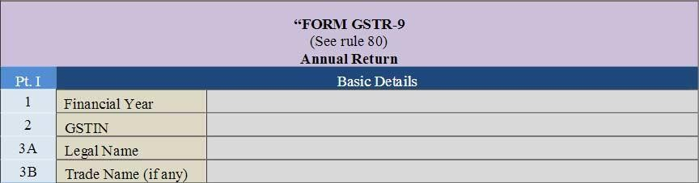
Part I: Basic Details
This initial part of the GSTR 9 form captures fundamental information about the taxpayer and the financial year for which the return is being filed.
Financial Year
GSTIN and Legal/Trade Name
Specify the financial year for which the return is being filed.
Enter the GSTIN of the taxpayer and the legal/trade name of the registered business.
Notes:
9

Slide 20
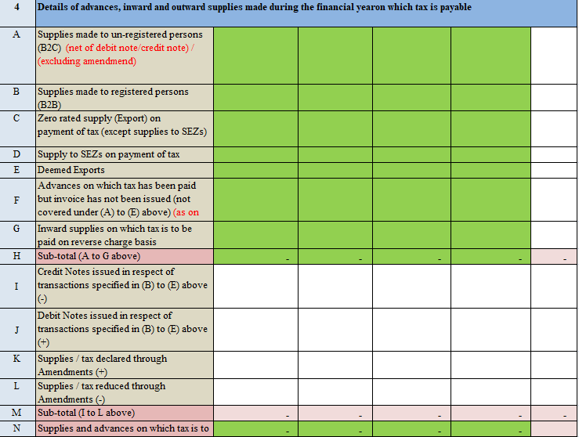
Part II: Outward and Inward Supplies
Part II(4): comprises details of all outward supplies and advances received during the particular financial year. This section is crucial for capturing accurate records of all supplies for which payment has been made through GSTR 3B between the financial year.

Slide 21
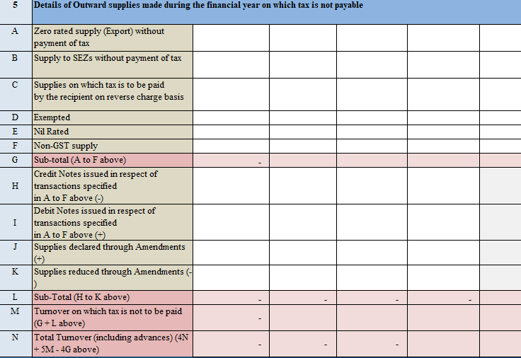
Part II(5): This section focuses on outward supplies made during the financial year where GST is not applicable. It helps to determine the overall tax liability by accounting for exempted goods and services.

Slide 22
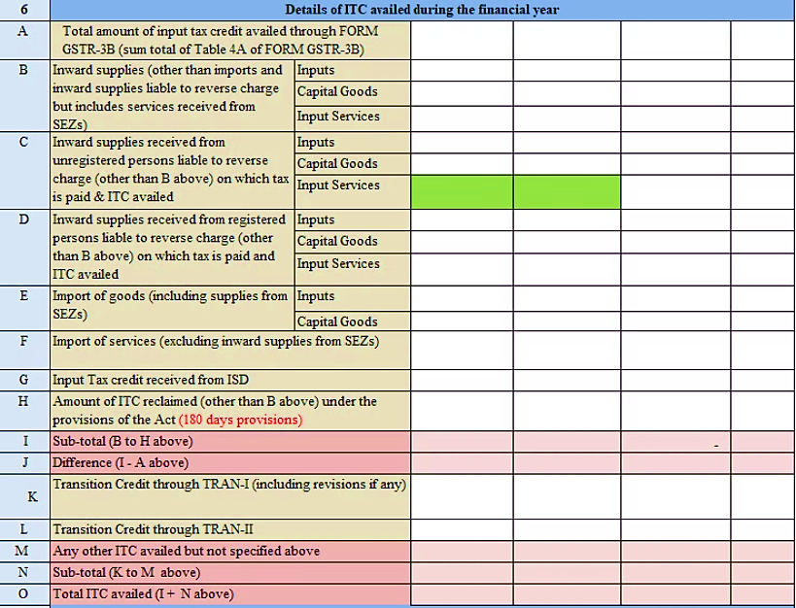
Part III: Details of ITC for the F.Y.
Part III: It consists of details of all ITC availed and reversed in the financial year for which annual return is filed.
6. This section can be filled by taking help of Form GSTR-3B of Financial year:
Notes:
2

Slide 23
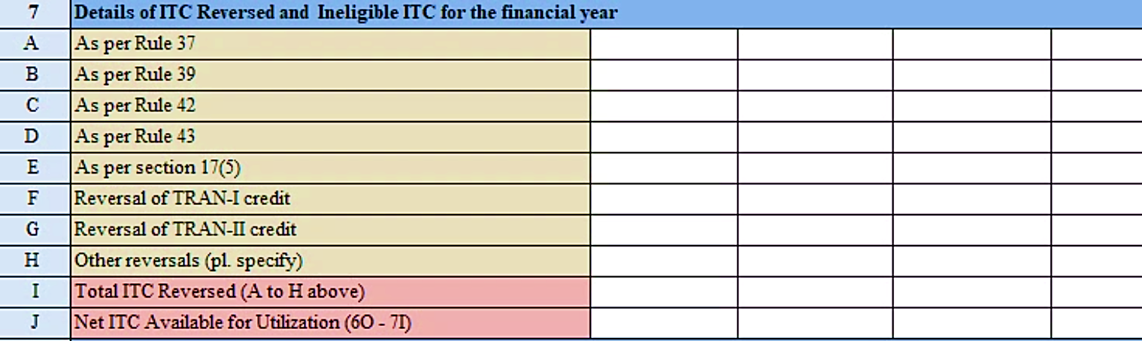
Part III (7) : It consists details of ITC Reversed and Ineligible ITC as declared in returns filed during the F.Y.
1
ITC Availment
This section encompasses the details of ITC availed and reversed during the financial year. It aims to ensure accurate calculation of ITC utilized and the potential for any adjustments.
2
ITC Reversal
It includes details of ITC reversed due to various factors like non-payment to suppliers within 180 days (rule 37), distribution by an Input Service Distributor (ISD) (rule 39), and reversal of common input services and of capital goods.(rule 42 and 43).
3
Ineligible ITC
Details of ineligible or blocked ITC {sec 17(5)}are also included in this section. It ensures that only eligible ITC is utilized for offsetting the tax liability.
4
Net ITC Available
The final step in this section is the calculation of the net ITC available for utilization, subtracting the total ITC reversed from the total ITC claimed.
Notes:
3

Slide 24
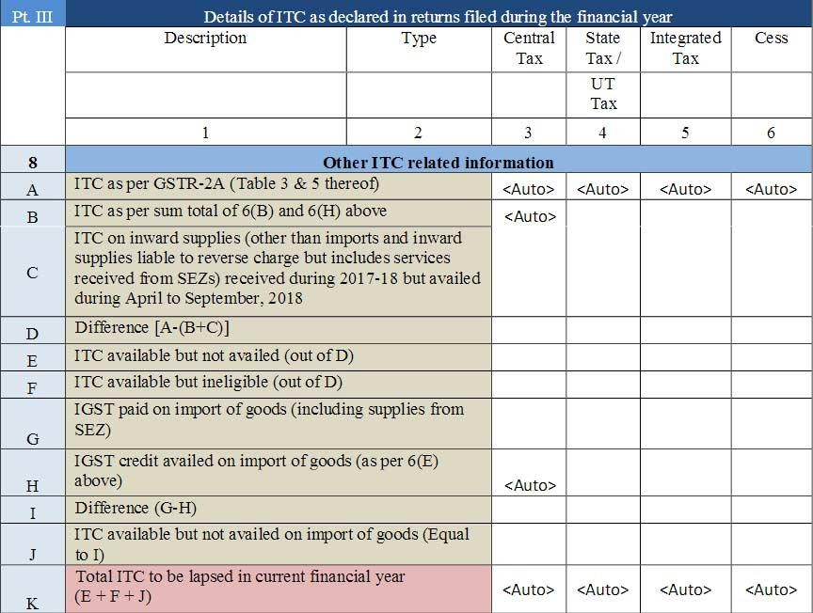
Part III: ITC Reconciliation: A Closer Look
ITC as per GSTR-2B[ table 3(1)]
Part III (8): This part covers comparison of GSTR-2B and ITC availed in GSTR-3B. Difference if any need to be classify in Column E and F. Ideally, if 8D is positive, the sum of 8E and 8F shall be equal to 8D.consists of details of ITC as declared in returns filed during the financial year
Notes:
4

Slide 25
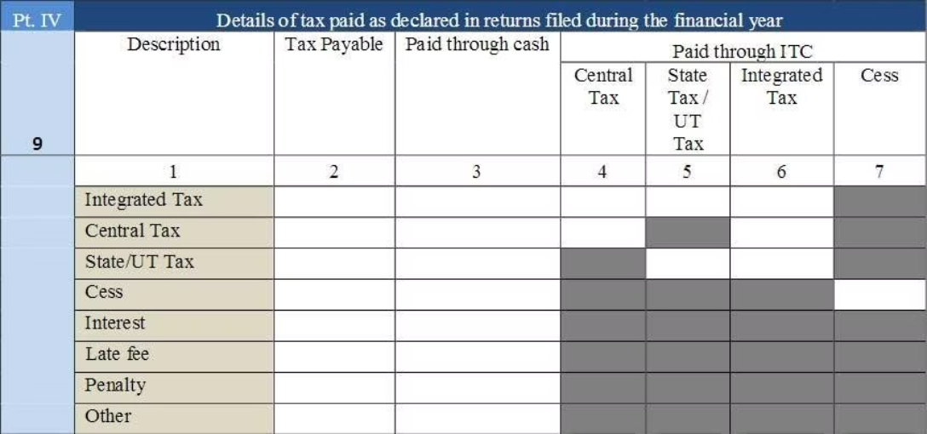


Part IV: Tax Paid During the Financial Year
This table focuses on the details of tax paid during the financial year. It involves reconciling the tax paid with the tax liability, verifying the accuracy of payments, and reporting these details in the GSTR-9 return.
1
Tax Paid
2
Reconciliation
3
Verification
4
Reporting
Notes:
5

Slide 26
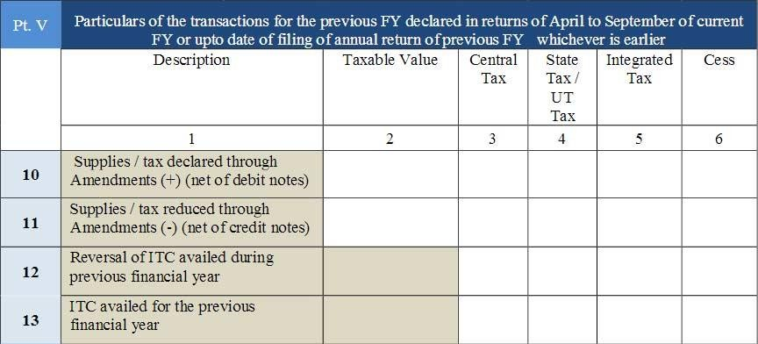
Part V: Previous Year Transactions
Particulars of transactions for the F.Y declared in returns of then next F.Y. till the specified period
1
April - March
This section captures details of relevant transactions from the previous financial year (April to March) declared in returns filed during the specified period or up to the date of filing the GSTR-9, whichever is earlier.
2
Reconciliation
It involves reconciling the transactions from the previous financial year with the current year's information to ensure consistency and accuracy in reporting.
3
Accuracy
Accurate reporting of previous year transactions helps to ensure a complete and accurate reflection of the taxpayer's financial position.
Notes:
6

Slide 27
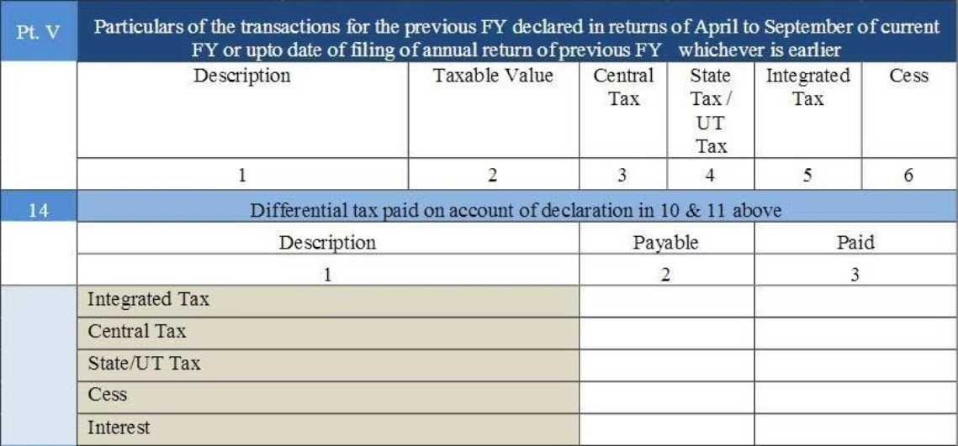
Particulars of transactions for the F.Y declared in returns of then next F.Y. till the specified period
Differential tax paid on account of declaration of 10 and 11 above
Part V(14): Differential tax paid on account of declaration in 10 & 11
Notes:
7

Slide 28
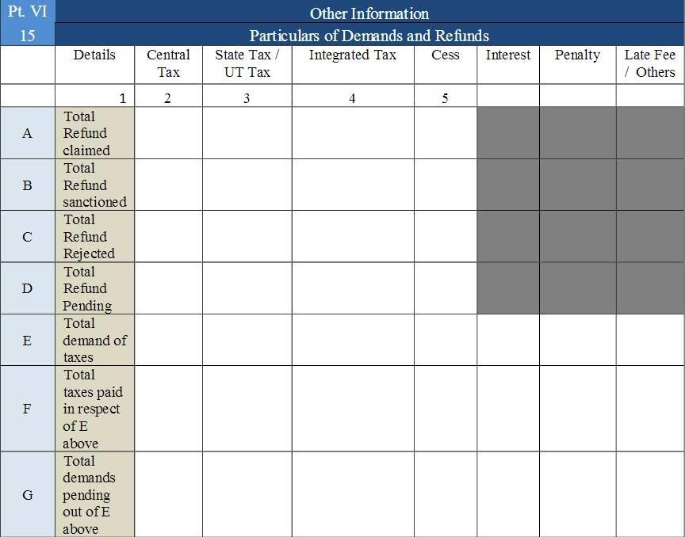
Part VI: Other Information
Refund Claims
Tax Demands
This includes the aggregate value of all refund claims filed during the financial year, including those sanctioned, rejected, or pending processing.
The total value of confirmed tax demands issued by the adjudicating authority during the financial year is declared here.
Pending Demands
The total value of confirmed tax demands still pending recovery is reported in this section. This provides an insight into the outstanding liabilities.
Notes:
8

Slide 29
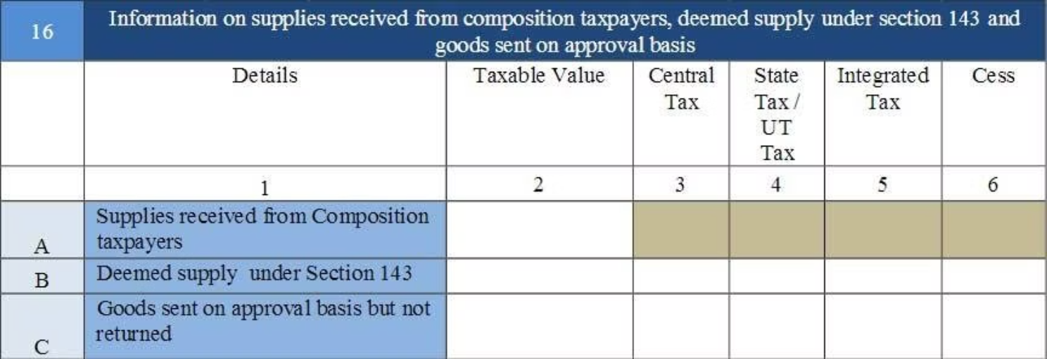
Part VI: (16) Supplies Received from Composition Taxpayers
16A: Supplies from Composition Taxpayers
16B: Deemed Supply under Section 143
16C: Goods Sent on Approval Basis
An aggregate value of all deemed supplies from the principal to the job-worker in terms of sub-section (3) and sub-section (4) of Section 143 of the CGST Act shall be declared here.
An aggregate value of all deemed supplies for goods which were sent on approval basis but were not returned to the principal supplier within one eighty days of such supply shall be declared here.
An aggregate value of supplies received from composition taxpayers shall be declared here. Table 5 of FORM GSTR-3B may be used for filling up these details.
Notes:
2

Slide 30
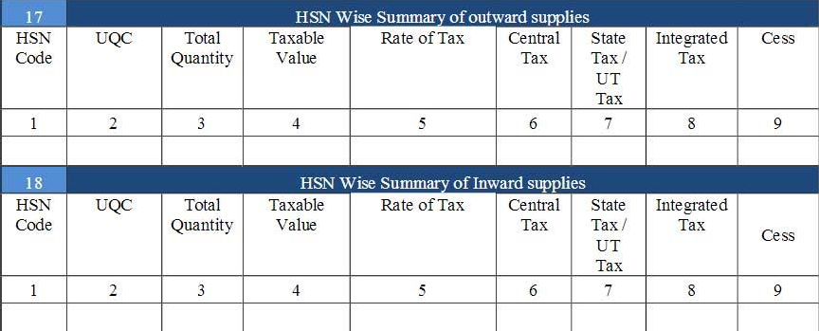
HSN Wise Summary of Supplies
1
HSN Code Reporting
2
UQC Details
3
Quantity Reporting
Vide notification no 78/2020 of Central tax dated 15.10.2020, it will be mandatory to report HSN code of Four(4) digits level for taxpayers having an annual turnover in the preceding year upto ₹ 5.00 Crore and of Six (6) digits' level for taxpayers having an annual turnover above ₹ 5.00 Crore.
Unit Quantity Code (UQC) details to be furnished only for the supply of goods.
Quantity is to be reported net of returns. Table 12 of FORM GSTR1 may be used for filling up details in Table 17.
Notes:
3

Slide 31
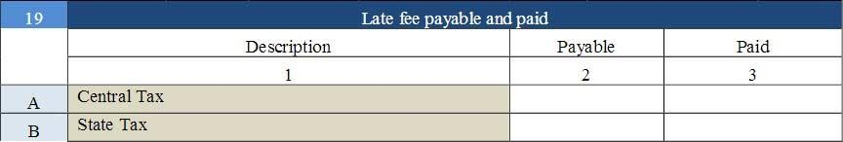
Late Fee Payable and Paid
Late fee will be payable if annual return is filed after the due date.
Notes:
4

Slide 32

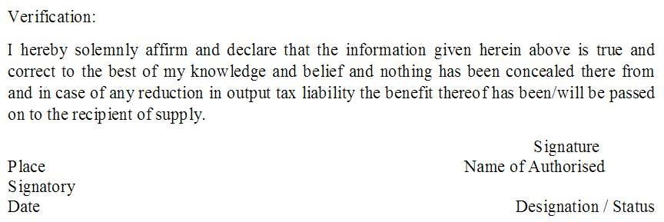
Verification

Slide 33

Understanding GSTR-9C: Your Comprehensive Guide to Filing the GST Reconciliation Statement
This presentation provides a clear and concise guide to filing GSTR-9C, the GST Reconciliation Statement, helping you navigate the process effectively and avoid potential issues. We will cover the key aspects of GSTR-9C, including who needs to file it, important deadlines, late filing penalties, and the necessary documents to prepare for the filing.
Notes:
1

Slide 34
Overview of GSTR-9C
1
1. What is the GSTR-9C?
2
2. Who is required to file GSTR-9C?
GSTR-9C is a reconciliation statement that needs to be filed by taxpayers to reconcile their annual turnover and tax liability as per their books of accounts with the details furnished in their GSTR-9 returns.
All registered taxpayers who have a turnover above 5 Crores for the financial year are required to file GSTR-9C.
3
3. When to file GSTR-9C?
4
4. How to file GSTR-9C?
The due date for filing GSTR-9C is 31st December of the subsequent financial year.
GSTR-9C can be filed online through the GST portal. The taxpayer needs to log in to the portal and upload the required documents.
Notes:
2

Slide 35
Details on GSTR 9C Filing
  The GSTR 9C is an Reconciliation Statement.
  It must be filed annually by tax payers with a turnover above Rs. 5 crores.
  It is basically a reconciliation statement between the annual returns filed in GSTR-9 and the taxpayer's audited annual financial statements.
  The form will contain the taxpayer's gross and taxable turnover according to their accounting books, reconciled with the corresponding figures after consolidating all of their GST returns for the financial year, and any difference revealed by the reconciliation.
  The difference, and the reason for it, should be mentioned explicitly.
  A GSTR-9C must be issued for every GSTIN.
  General Penalty for non filers of GSTR 9 and 9C is Rs. 25,000 each .
Notes:
3

Slide 36




Filing Process for GSTR 9C
Login to GST Portal
1
Access the GST portal using your login credentials.
2
Select GSTR 9C
Navigate to the GSTR 9C filing section.
3
Fill in Details
Enter the required information in Part A and Part B.
4
Submit and Verify
Submit the form and verify it using the OTP or E-signature.
Notes:
4

Slide 37
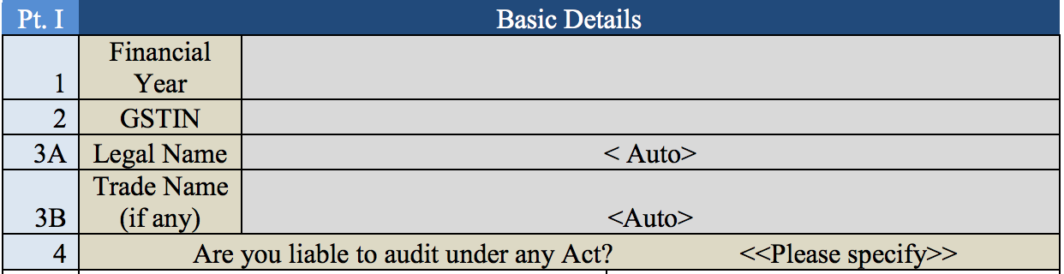
Part 1: Basic Details
In Part A of the GSTR-9C form, you need to provide the following details:
1.Financial Year
2.GSTIN
3A.Legal Name
3B.Trade Name (if any)
4.Audit Liability: Specify whether you are liable to audit under any Act.

Slide 38
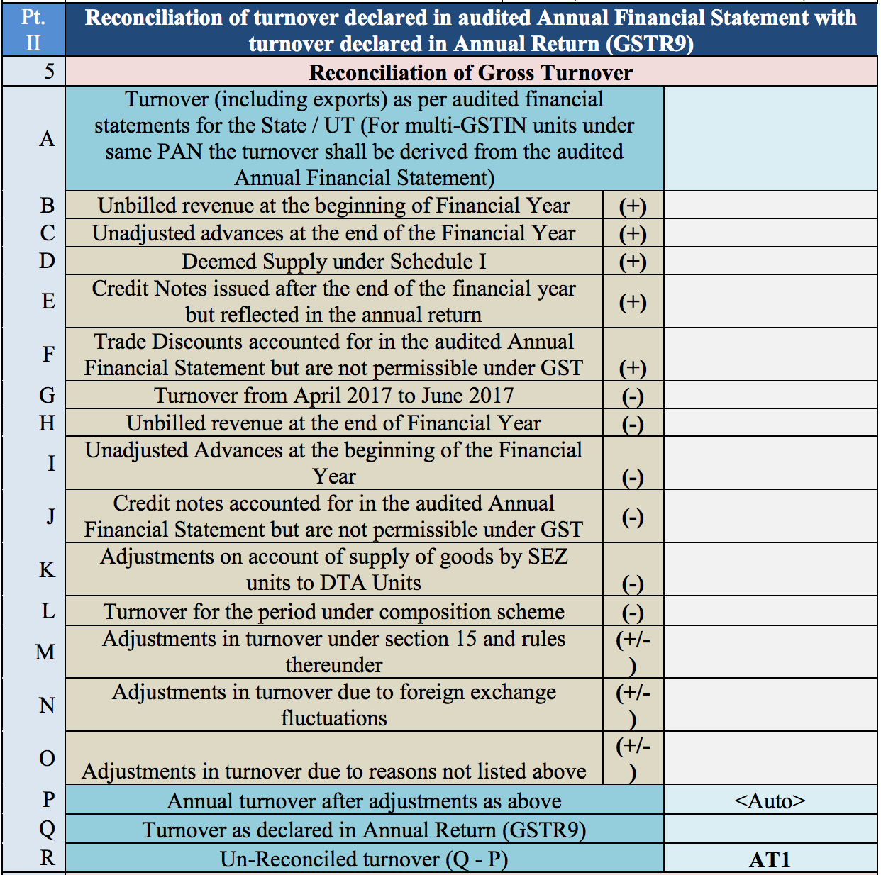
Part 2: Reconciliation of turnover declared in audited Annual Financial Statement
In Part 2 , you’ll enter information about your turnover based on your audited Annual Financial Statement. Table 5 is for details regarding the reconciliation of your gross turnover. This involves reporting the gross and taxable turnover.

Slide 39
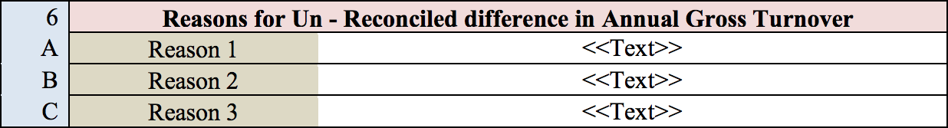
Part 2 Table 6: Reasons for un-reconciled differences in the annual gross turnover
Under Table 6, you can list any possible reasons for un-reconciled differences in the annual gross turnover that may have occurred.

Slide 40
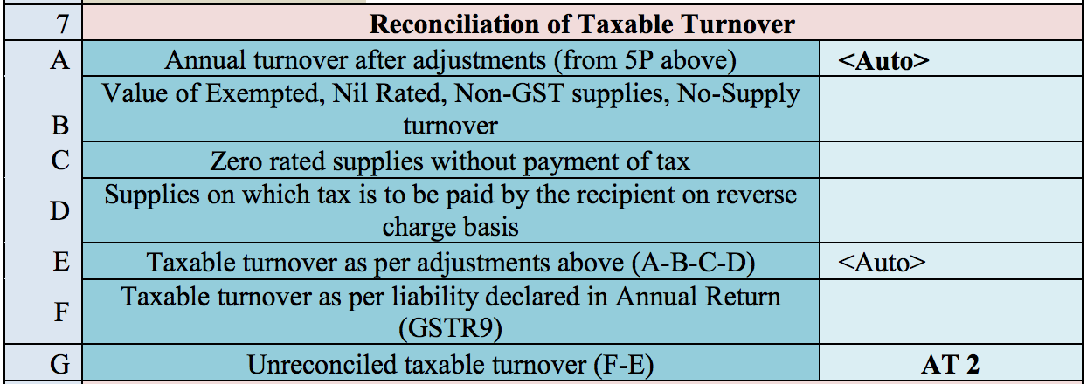
Part 2 Table 7: Reconciliation of taxable turnover
In this table of GSTR-9C, you need to reconcile the taxable turnover by filling in the following values:
A: Annual turnover after adjustments (auto-populated).
B: Value of exempted, nil-rated, non-GST supplies, and no-supply turnover.
C: Value of zero-rated supplies for which no tax was paid.
D: Value of supplies subject to reverse charge (tax paid by recipient).
E: Taxable turnover after adjustments (A - B - C - D).
F: Taxable turnover as per the annual return (GSTR-9).
G: Unreconciled taxable turnover (F - E).

Slide 41
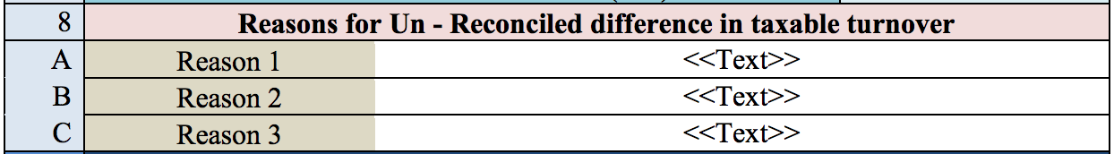
Part 2 Table 8: Reasons for un-reconciled differences in the Taxable Turnover
Similar to table 6, table 8 allows you to list reasons for the difference between the taxable turnover declared in the annual return and the taxable turnover derived from line E of table 7.

Slide 42
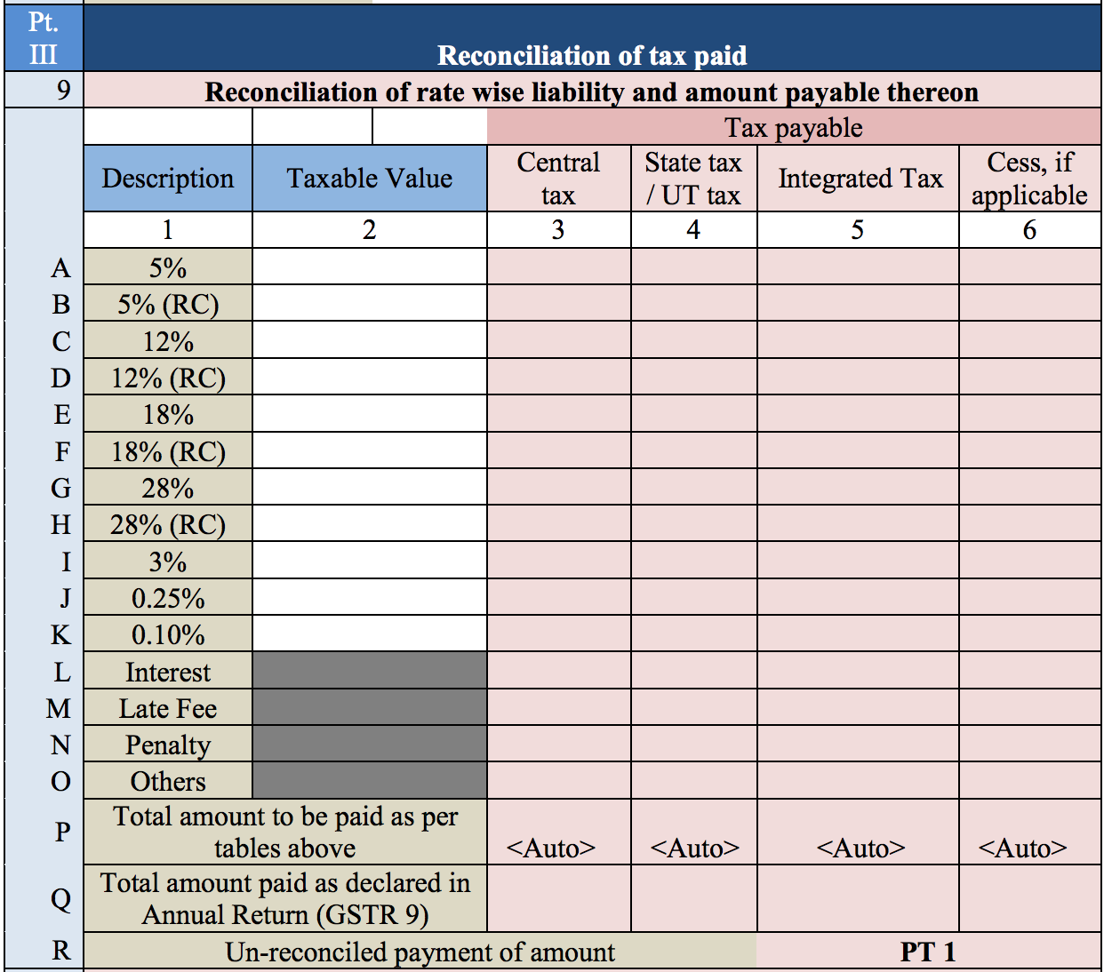
Part 3: Reconciliation of Tax Paid
Part 3 collects information about the tax you have paid. In Table 9, you are to fill in the taxable value, central and state tax, integrated tax, and cess value for each tax rate: 5%, 12%, 18%, 28%, 3%, 0.25%, and 0.10%. For each rate, tax paid by reverse charge is listed in a separate line from tax collected normally.

Slide 43
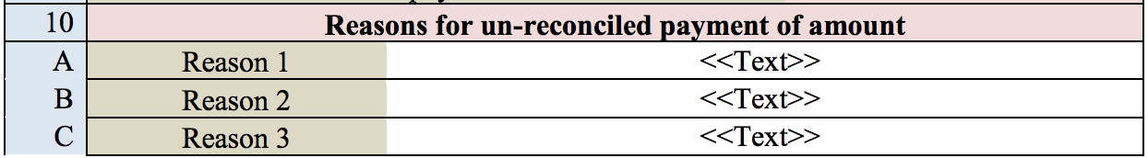
Part 3 Table 10: Reasons for un-reconciled payment of amount
Under table 10, you can enter the reasons for the difference between the total amount of tax paid as per the reconciliation statement, and the total amount of tax paid as given in the annual return (GSTR-9).

Slide 44
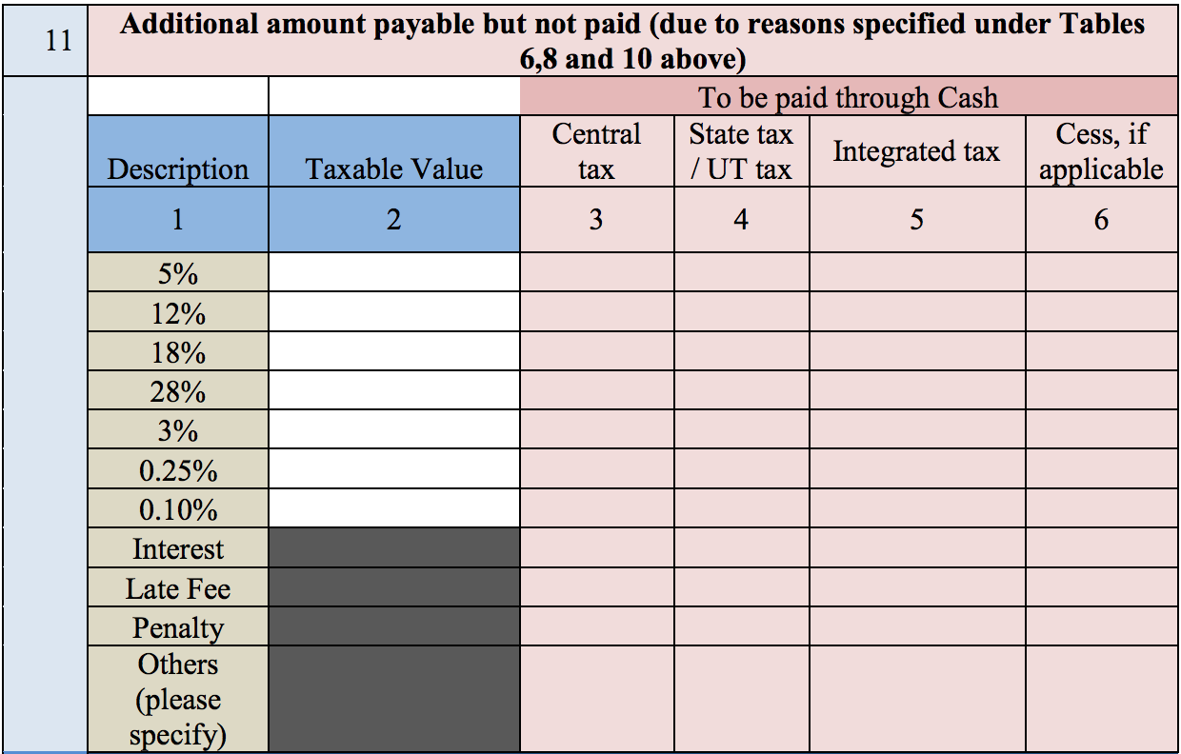
Part 3 Table 11: Details of Tax Payable but Not Yet Paid (Due to Provisions in Tables 6, 8, and 10)
Table 11 is for details of any tax payable, but not yet paid, because of the reasons specified in tables 6, 8, and 10.

Slide 45
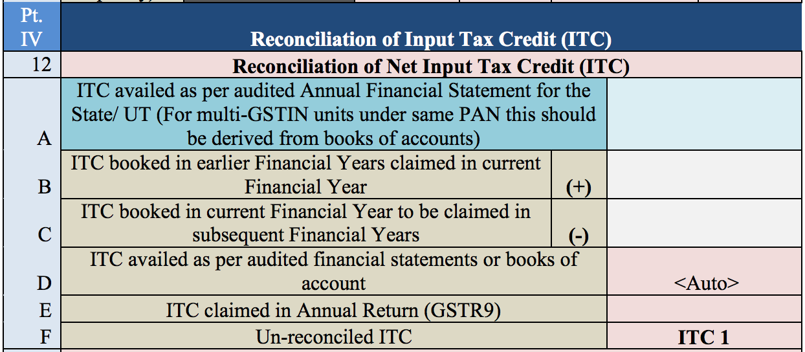
Part 4: Reconciliation of ITC
Part 4 contains information for reconciling your ITC. Under table 12, mention the value of the ITC availed

Slide 46
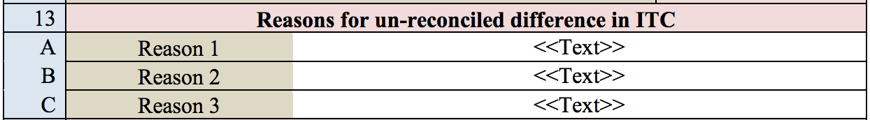
Part 4 Table 13: Reasons for un-reconciled difference in ITC
Under table 13, you can list any reasons for a difference between the ITC claimed according to the annual return filed (GSTR-9) and the ITC claimed as per the audited financial statement.

Slide 47
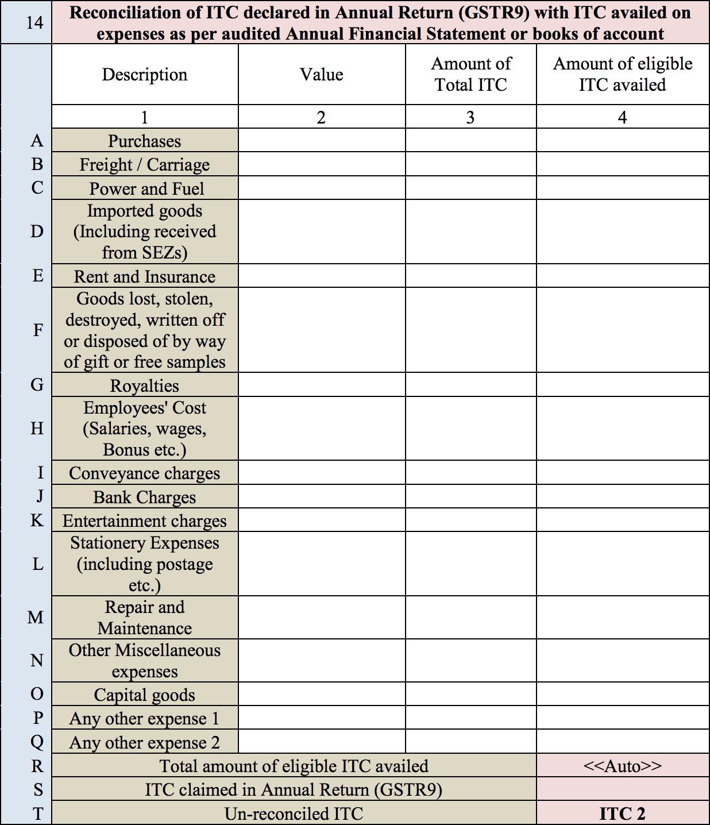
Part 4 Table 14: Reconciliation of ITC Declared in GSTR-9 with ITC Availed on Expenses as per Audited Financial Statements or Books of account.
Under table 14, specify the value, amount of total ITC, and amount of eligible ITC availed with regard to each category of expenses.

Slide 48
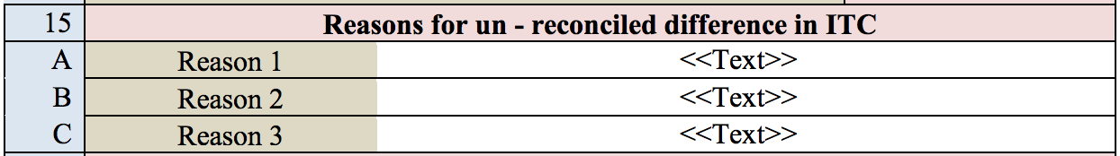
Part 4 Table 15: Reasons for un-reconciled difference in ITC
In Table 15, fill in the reasons for any difference between the amount of ITC availed for the different expenses and the availed ITC as per the annual return.

Slide 49
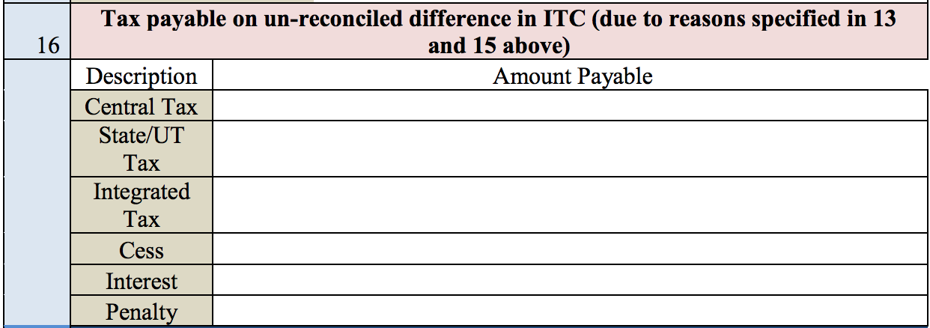
Part 4 Table 16: Tax payable on un-reconciled differences in ITC (due to reason specified in 13 & 15 above)
In Table 16, fill in the central and state tax, integrated tax, cess value, interest, and penalty payable with regard to the un-reconciled differences described in Sections 13 and 15..

Slide 50
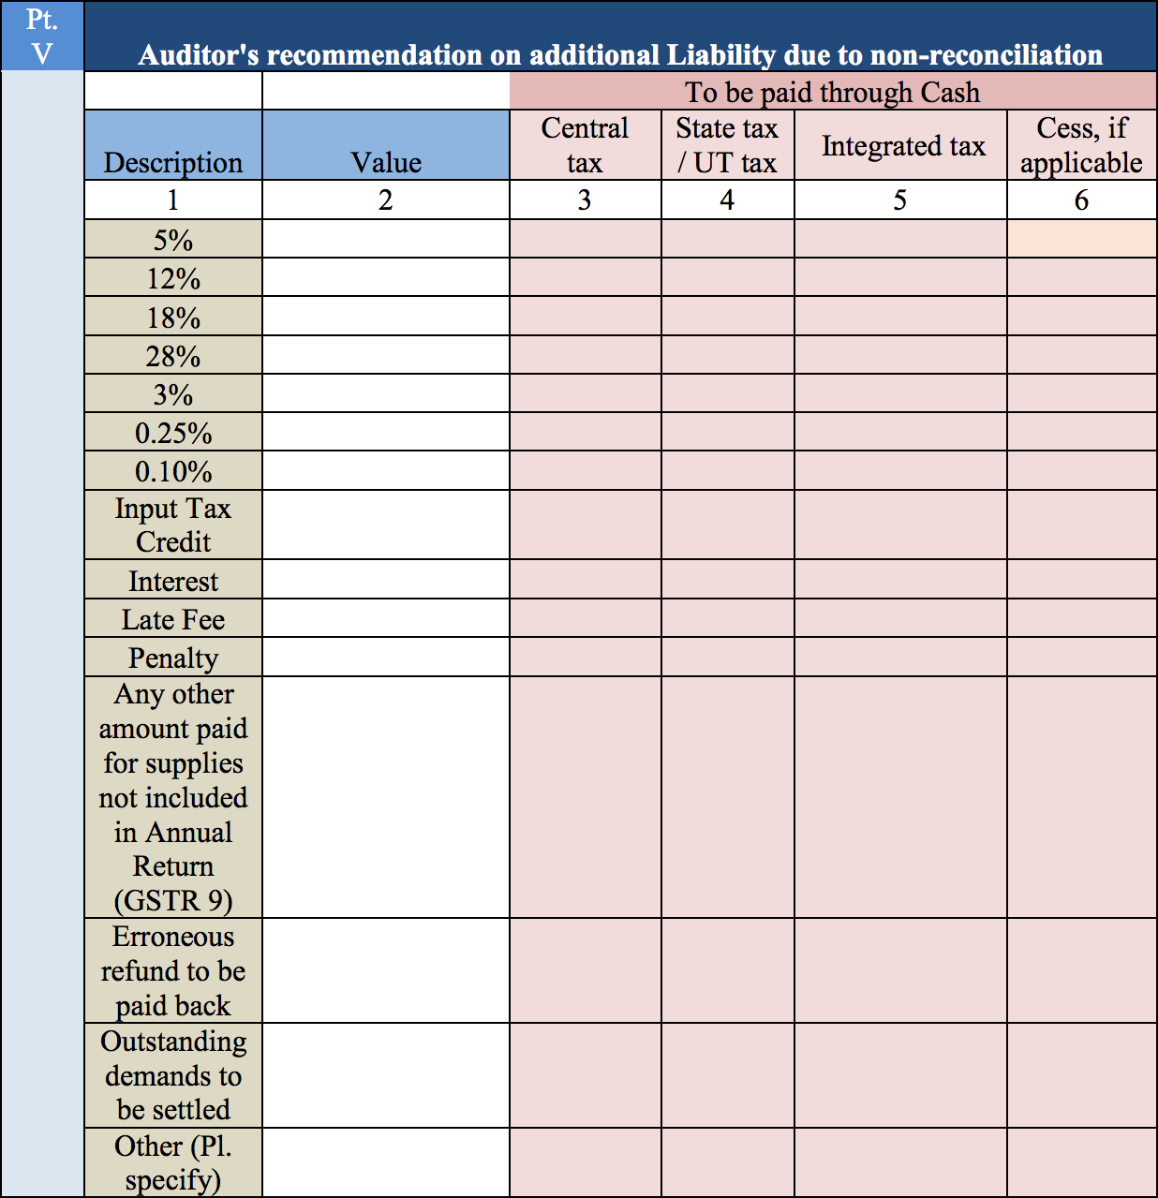
Part 5: Additional liability due to non-reconciliation
Additional liability due to non -reconciliation
This table requires to enter details of the taxable value, central and state tax, integrated tax, and cess (if applicable) for various tax rates (5%, 12%, 18%, 28%, 3%, 0.25%, 0.10%). It also includes the applicable ITC, interest, late fees, penalties, any other amounts paid but not reported in GSTR-9, erroneous refunds to be repaid, and outstanding demands to be settled.

Slide 51

Burning Issue
Circular No -211/5/2024/GST dated 26.06.2024
Discussion of time limit to avail credit in case of GST paid under RCM supplies received from URD
Limitation under 16(4) is escalated by department
Reading down Sec 16 (2) which prescribed Invoice as documents to avail credit read down with section 31 (3) (f)
Joint reading and uniformity of practice. Credit is allowed. But interest to be paid for delayed invoicing.

Slide 52
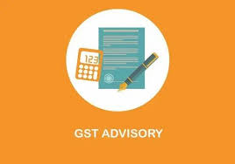
Advisory Dated 08th November, 2024
For reducing the tax disputes and to provide a big relief to the taxpayers, GST Council in its 53rd meeting held on 22nd June, 2024 had recommended for waiver of interest and penalties in the demand notices or orders issued under Section 73 of the CGST Act, 2017 (i.e. the cases not involving fraud, suppression or wilful misstatement, etc.) for the Financial years 2017-18, 2018-19 and 2019-20. To avail this waiver, the condition is that the full tax demanded is paid on or before 31.03.2025.
Form SPL 01 and SPL 02 prescribed under Rule 164 will be available on Portal by First week of Jan 2025.
SPL 01 within 3 Months from 31.03.2025
SPL 02 within 6 Month from order date
Tax paid upto 31.03.2025 will be considered
Tax recovered by officer will be considered.
Demand of Interest and Penalty order were also considered, except the liability self assesses and delayed reporting of supply.
Full SCN or order to cover under scheme no part waiver.

Slide 53

Conclusion
By understanding the nuances of GSTR-9 and GSTR-9C, its components, and the essential data requirements, you can navigate the complexities of annual return filing with confidence. Proactive preparation and accurate documentation play a pivotal role in ensuring a seamless process. Remember, timely and accurate filing is crucial for maintaining compliance with GST regulations.
Notes:
10

Slide 54
THANK YOU

