Slide 1




Pros & Cons –
LLP Vs Partnership Vs Company
Jaipur Branch of CIRC of ICAI- 20/12/2024
1

Slide 2

R SOGANI & ASSOCIATES
2

Slide 3

Overview of These Business Entities
R SOGANI & ASSOCIATES
3

Slide 4



Brief of Partnership Firms
Definition of
Partnership Firm
Governing Law
Profit Sharing
As per Section 4 of the Indian Partnership Act, 1932, a partnership is an agreement where individuals share business profits and are jointly, severally and personally liable for the firm's obligations.
The Indian Partnership Act, 1932: outlining the rights, duties, and liabilities
Other Acts such as Income Tax Act, 1961, Indian Contract Act, 1872, ESI & PF Acts, etc.
U/s 13 of The Indian Partnership Act, 1932
If specified in partnership deed – As per deed
If not specified in deed – Equally
R SOGANI & ASSOCIATES
4

Slide 5
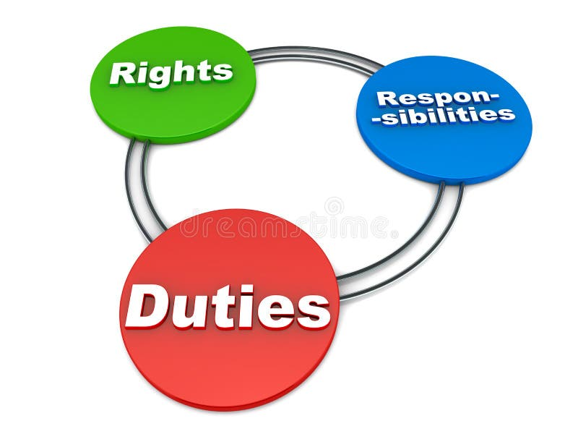

RIGHTS OF PARTNERS
- Right to Participate in Business
- Right to Access Accounts
- Right to be Consulted
- Right to Retire
- Right to Dissolve
DUTIES OF PARTNERS
- Duty to Act in Good Faith
- Duty to Carry Out Business
Diligently
- Duty to Indemnify for Willful
Neglect
OBLIGATIONS OF PARTNERS
- Liability to Third Parties
- Liability for Acts of the Firm
- Continuing Liability
Legal Relationships
Principal - Agent Relationship
Joint and Several Liability
Fiduciary Duty: Partners are bound by a fiduciary duty to act in good faith, maintain honesty, and ensure transparency with each other as specified in Section 9 of Indian Partnership Act, 1932.
R SOGANI & ASSOCIATES
5

Slide 6




Brief of Companies
Definition of a Company
Company is a legal entity separate from its members, capable of owning assets and conducting business independently, while providing limited liability and perpetual succession to its stakeholders.
Legal Registration under the Companies Act
Anyone looking to incorporate a company must register it under the provisions of The Companies Act, 2013.
R SOGANI & ASSOCIATES
6

Slide 7
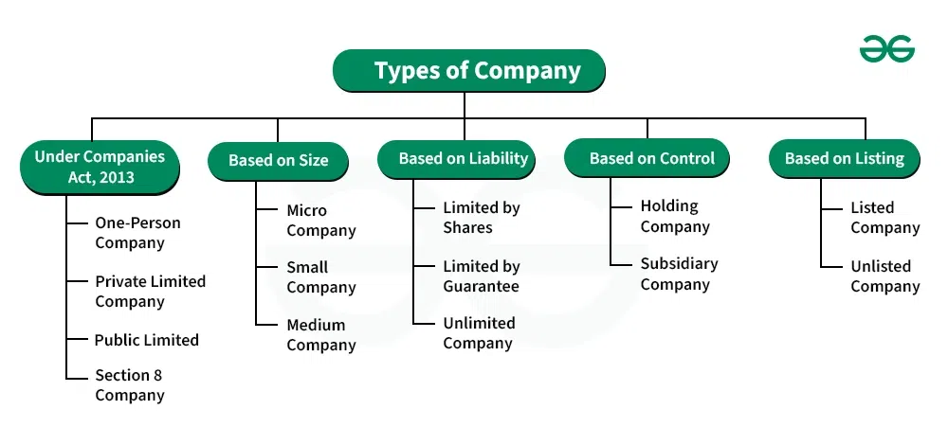

R SOGANI & ASSOCIATES
7

Slide 8



Limited Liability Partnership (LLP)
Definition of LLP
Hybrid Structure
Legal Registration
An LLP under the LLP Act, 2008, is a separate legal entity with limited liability for partners, offering flexibility and safeguarding personal assets.
An LLP blends the flexibility of a partnership with the limited liability and separate legal entity status of a corporation. This allows partners to manage operations efficiently.
Established under the LLP Act of 2008, an LLP must be registered for legal recognition and compliance with regulations.
R SOGANI & ASSOCIATES
8

Slide 9

Advantages of LLP for Entrepreneur
Limited Liability Protection: Safeguards partners' personal assets from business debts, as creditors can only claim LLP assets, ensuring financial security.
Startup-Friendly Structure: Offers operational flexibility, lower compliance requirements, and making it ideal for new businesses.
Cost-Effective Incorporation: Easier and cheaper to set up compared to companies, making it an attractive option for startups.
R SOGANI & ASSOCIATES
9

Slide 10
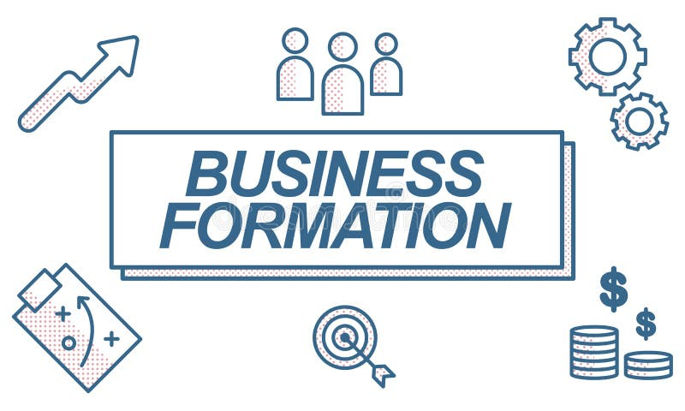
R SOGANI & ASSOCIATES
10

Slide 11

Formation of a Partnership Firm
1. Selection of a Name
Indian Partnership Act does not restrict firms from having similar names; exclusive rights require
registration or trademarking.
2. Drafting of the Partnership Deed
The deed outlines firm/partner details, business nature, capital, profit-sharing, partner changes,
and partnership duration.
Section 58 of Indian Partnership Act, 1932 requires submitting firm details,
including the partnership deed, for registration.
R SOGANI & ASSOCIATES
11

Slide 12
3. Registration of the Partnership Deed/Firm
Visit the Registrar of Firms (RoF) and submit the deed and other required documents.
1
Application for registration (Form A), certified copy of the partnership deed, proof of principal place of business, PAN and identity proofs of all partners.
2
Pay the prescribed registration fee.
3
4
The Registrar verifies the application and documents.
U/s 59 upon satisfaction, the firm is registered, and a Certificate of Registration is issued.
5
R SOGANI & ASSOCIATES
12

Slide 13
Formation of a Company
Obtain DSC
1
DSC is mandatory for proposed directors and subscribers for electronic filings with MCA.
2
Obtain DIN
Apply for a Director Identification Number (DIN) through the SPICe+ Form during the incorporation process if it has not been obtained earlier
Name Reservation
3
Use SPICe+ Part A to check and reserve the company name as per Section 4.
4
Drafting and Filing Documents
Prepare MOA, AOA, DIR-2 and other compliance declarations.
File SPICe+ Part B along with e-MOA (INC-33), e-AOA (INC-34), and AGILE-PRO-S for GST, EPFO, and ESIC.
Certificate of Incorporation (COI)
5
After verification, RoC issues the COI with CIN, confirming the company's legal existence.
PAN and TAN are automatically generated during the process.
R SOGANI & ASSOCIATES
13

Slide 14
Formation of an LLP
1
Form RUN-LLP
Name reservation form
2
Form FiLLiP and Form 9
FiLLiP: Certificate of incorporation and also DIN is applied through this form for designated partners.
Form 9: Consent to act as designated partners
3
Form 3
Form 3 is filed to submit the LLP Agreement with the Registrar of Companies, outlining partners' rights, duties, and profit-sharing ratios.
R SOGANI & ASSOCIATES
14

Slide 15
Summary of Time and Cost involved
in formation
Business Structure | Time Involved | Cost Involved (Other than professional fee)
Partnership Firm | 7 to 10 days (if registered) | ₹3,000 - ₹4,000 (assuming ₹50,000 capital base)
LLP | 7 to 15 days | ₹3,000 - ₹4,000 (assuming ₹50,000 capital base)
Company | 10 to 20 days | ₹6000 - ₹7000 (assuming ₹1,00,000 capital base)
R SOGANI & ASSOCIATES
15

Slide 16
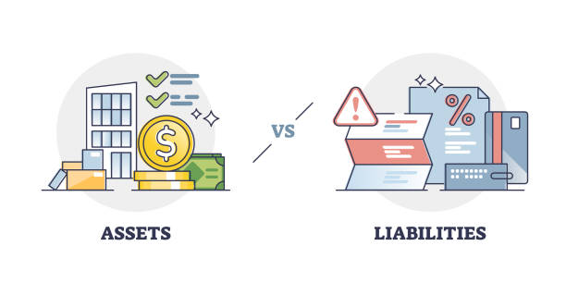
Liability of Partners/Members
in All 3 Structures
R SOGANI & ASSOCIATES
16

Slide 17


Liability of Members in a Company
Types of Liability
Limited Liability for Shareholders
Companies Limited by Shares: Liability is limited to unpaid share capital.
Liability of Shareholders: Shareholders in “a company limited by shares” are liable only for the unpaid portion of their subscribed share capital.
Companies Limited by Guarantee: Liability is restricted to the amount agreed in the MoA.
R SOGANI & ASSOCIATES
17

Slide 18

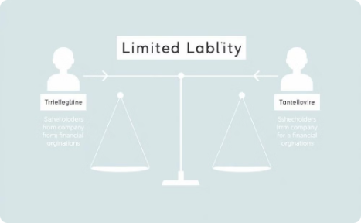
Company limited by guarantee
Implications on Personal Assets
As per Section 2(21), in a company limited by guarantee, members agree to a predetermined liability amount mentioned in the Memorandum of Association.
Protection of Personal Assets: Personal assets are protected and cannot be used to satisfy company debts.
Practical Example: If a member agrees to a liability of ₹1,000, they are liable only up to this amount in the event of company winding up.
Exceptions:
  Fraudulent Conduct: Personal liability if fraud is proven (Section 339, Companies Act).
R SOGANI & ASSOCIATES
18

Slide 19


Liability of Partners: Partnership
Unlimited Liability
Risk to Personal Assets
Section 25 of Indian Partnership Act, 1932
Loss of Personal Assets in Partnership Defaults
Full Liability: Partners are jointly and severally liable
for firm debts.
Assets at Risk:
  Immovable property (house, land).
  Implications: Creditors can claim the full debt from any
  partner’ personal assets.
  Bank deposits, shares, and investments.
Risk Mitigation:
Transition to LLP (Limited Liability Partnership).
Obtain Professional Indemnity Insurance.
R SOGANI & ASSOCIATES
19

Slide 20



Liability of Partners: LLP
Limited Liability Protection
(Section 28 of LLP Act, 2008)
Distinct Legal Entity
(Section 3 of LLP Act, 2008)
Unlimited liability in case of fraud
(Section 30 of LLP Act, 2008)
Limited Liability: A partner is not personally liable for any obligation of LLP.
An LLP is separate from its members.
An LLP shall have perpetual succession.
Any change in partners of LLP shall not affect
the existence, rights or liabilities of the LLP.
General Rule: Partners are not personally liable for LLP debts.
Asset Protection: Personal assets (e.g., house, savings) are safeguarded.
Exception: Personal liability arises under Section 30 for fraud or misrepresentation.
R SOGANI & ASSOCIATES
20

Slide 21

Understanding Unlimited Tax Liability in Partnerships, LLP and Companies
R SOGANI & ASSOCIATES
21

Slide 22
Section 167C: LLP Partner Liability
Joint and Several Liability
Implications for Partners
According to Section 167C of the Income Tax Act, 1961, each partner of an LLP is jointly and severally liable, alongside the LLP, for the payment of any tax due in respect of the LLP's income.
This means that the tax authorities can pursue any individual partner for the full amount of the tax owed, if the LLP is unable to pay.
R SOGANI & ASSOCIATES
22

Slide 23

Section 179: Director Liability in Private Company
Section 179 of the Income Tax Act states that directors are jointly and severally liable for unpaid taxes if they cannot demonstrate that the non-recovery was not due to their gross neglect, misfeasance, or breach of duty.
This provision applies solely to private companies, including those undergoing liquidation, and covers all unpaid taxes, including interest and penalties.
R SOGANI & ASSOCIATES
23

Slide 24

Section 188A: Liability of Partners in Firms
Joint and Several Liability
Implication of non-compliance
Similar to LLP partners, Section 188A of the Income Tax Act extends joint and several liability to partners of firms for the payment of any tax due on the firm's income.
This means that each partner can be held accountable for the entire tax debt, if the firm itself is unable to fulfill its tax obligations.
R SOGANI & ASSOCIATES
24

Slide 25

R SOGANI & ASSOCIATES
25

Slide 26

Company: A Distinct Legal Personality
Independent Existence
A company is a separate legal entity, with its own legal personality, independent of its shareholders or directors.
Limited Liability
Shareholders are typically not personally liable for the company's debts, with liability limited to the amount unpaid on their shares.
R SOGANI & ASSOCIATES
26

Slide 27
LLP: A Separate Legal Entity
Separate Existence
An LLP is considered a separate legal entity from its partners, registered under the Limited Liability Partnership Act, 2008.
Limited Liability
Partners' liability is limited to their capital contribution, protecting personal assets from business debts.
R SOGANI & ASSOCIATES
27

Slide 28

Partnership: An Extension of the Partners
Not a Separate Entity
A partnership is not a separate legal entity under the Indian Partnership Act, 1932, and its partners are directly responsible for its actions.
Unlimited Liability
Partners have unlimited liability, meaning they are personally responsible for the partnership's debts and obligations.
R SOGANI & ASSOCIATES
28

Slide 29

Succession and Continuity: Planning for the Future
1
Partnerships: Disrupted Transitions
Can be disruptive if partner dies, unless otherwise specified in agreement
2
LLPs: Smooth Transfer of Ownership
Succession planning
Smooth transfer of ownership even partner change
3
Companies: Seamless Inheritance
Succession planning
Ownership transfer through shares
R SOGANI & ASSOCIATES
29

Slide 30
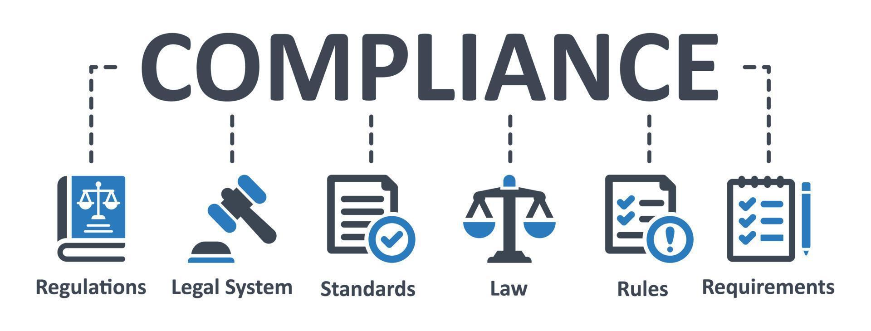
Compliance Obligations: LLP vs. Partnership vs. Company
Filing Requirements
Keeping of BOA
Taxation
R SOGANI & ASSOCIATES
30

Slide 31




Filing Requirements: Company
Annual Return
Form AOC-4 (Financial Statements) and Form MGT-7 (Annual Return) must be filed.
Financial Statements
Financial statements must be filed with the Registrar of Companies (ROC) annually.
Books of Account
Maintain books of account for 8 years as per the Companies Act.
R SOGANI & ASSOCIATES
31

Slide 32

Filing Requirements: Partnership
1
Annual Return
No annual return filing requirement under the Partnership Act.
2
Financial Statements
No specific filing requirements for financial statements under the Partnership Act.
3
Books of Account
Maintain books of account for 6 years as per section 44AA, and 3 and 5 Years depends on scrutiny as per rule 6F(3) of the Income Tax Act.
R SOGANI & ASSOCIATES
32

Slide 33




Filing Requirements: LLP
Annual Return
Form 11 must be filed within 60 days of the financial year end.
Financial Statements
Form 8 is due within 30 days after the end of six months from the close of the financial year.
Books of Account
Maintain books of accounts for 8 years, including statutory records.
R SOGANI & ASSOCIATES
33

Slide 34

Audit Requirements as per respective acts
1
LLP
LLPs are subject to mandatory audit if their turnover exceeds ₹40 lakh or capital contribution exceeds ₹25 lakh.
2
Partnership
Partnerships are not required to undergo mandatory audits unless specifically agreed upon in the partnership deed.
3
Company
Companies are subject to mandatory audit as per the Companies Act, 2013, regardless of their turnover or capital contribution.
R SOGANI & ASSOCIATES
34

Slide 35


R SOGANI & ASSOCIATES
35

Slide 36




Lending and Borrowing: Company
Lending and Borrowing of Loans
Term Loans
Debentures (Section 71 of the Companies Act, 2013)
Overdrafts & Credit Facilities
Restrictions on Borrowing
Compliance of Section 73 of the Companies Act - Deposits
Compliance of Section 180 of the Companies Act – Special Resolution
Loans to Directors (Section 185 of Companies Act, 2013)
Prohibition: No loans, guarantees, or securities to:
Directors or their relatives.
Entities with significant director interest.
Charge Registration (Section 77, Companies Act, 2013)
Requirement: Register charges (e.g., mortgage, lien) with RoC within 30 days using Form CHG-1.
Penalty for Non-Compliance: Late registration may lead to penalties or invalidation of charges.
R SOGANI & ASSOCIATES
36

Slide 37



Lending and Borrowing: Partnership
Flexibility in Financing
No statutory limitations under the Indian Partnership Act, 1932.
1
Partners can borrow or lend in individual or collective names on behalf of the firm.
Liability Risk in Partnerships (Section 25 of the Indian Partnership Act, 1932)
2
Joint and Several Liability: Partners’ personal assets are at risk for business debts.
Challenges in Securing Loans
3
No limited liability protection.
Dependence on partner's credit scores.
R SOGANI & ASSOCIATES
37

Slide 38
Lending and Borrowing in LLPs
Flexibility in Borrowing and Lending
1
No restrictions on taking loan from public.
No restrictions on advancing loans
No Specific Borrowing Limits
2
LLPs have no borrowing limits, offering financial freedom under the LLP Agreement.
The Agreement defines loan terms and powers of designated partners.
R SOGANI & ASSOCIATES
38

Slide 39

Raising Funds
R SOGANI & ASSOCIATES
39

Slide 40
Raising Funds: Company
1
Recognition Benefit
Legal Recognition: Separate entity under Section 2(20), Companies Act, 2013, ensuring continuity and trust.
Market Credibility: Formal registration and filings (e.g., Form MGT-7) build investor and lender confidence.
Examples: DPIIT-registered startups attract incentives, boosting growth.
2
Issuance of Shares
Company can issue additional shares for fund raising.
Public Issue (Section 24): Shares offered via IPOs, FPOs regulated by SEBI.
R SOGANI & ASSOCIATES
40

Slide 41
3
Regulatory Compliance
Key Requirements:
Share Allotment: File PAS-3 within 30 days
Prospectus: SEBI-approved under Section 26 for public issues.
Board Resolutions: Approval under Section 179(3).
Challenges: High compliance costs (e.g., SH-7 filings) deter small businesses.
4
Trust and Investor Confidence
Governance Framework:
Statutory Audits: Mandatory under Section 139 for transparency.
Board of Directors: Includes independent directors (Section 149, if applicable).
​
R SOGANI & ASSOCIATES
41

Slide 42
Raising Funds: Partnership
Cannot Issue Shares
Restriction: Partnerships under the Indian Partnership Act, 1932, cannot issue shares
Reliance on personal saving
Funding Source: Partners rely on personal savings due to the absence of external shareholders.
Limitation: Dependence on partner contributions restricts large-scale expansion.
Growth Constraint
1
2
3
Loan Reliance in Partnerships
Key Challenges:
Collateral: Personal or business assets required as security.
Interest Costs: High rates, especially for unsecured loans.
Lender Scrutiny:
  Firm's profitability and financial history.
  Partners' creditworthiness (e.g., CIBIL scores).
R SOGANI & ASSOCIATES
42

Slide 43


Raising Funds: LLP
Limited Access to Equity Capital
Partner-Driven Capital
LLPs cannot issue shares like private companies, limiting equity-based funding options. Capital raising is reliant on partner contributions or adding new partners.
Raising capital depends on existing or new partners, which can dilute control or ownership, requiring a balance between control and funding needs.
R SOGANI & ASSOCIATES
43

Slide 44

R SOGANI & ASSOCIATES
44

Slide 45
Taxation under Different Structure
Aspect | LLP (Limited Liability Partnership) | Company (Private/Public) | Partnership Firm
Tax Rate | - Flat 30% (plus surcharge and cess). | - 25% for companies with turnover up to ₹400 crore. - 30% for others (plus surcharge and cess). | - Flat 30% (plus surcharge and cess).
Alternate Tax | - Alternative Minimum Tax (AMT) @ 18.5% of adjusted total income applies. | - Minimum Alternate Tax (MAT) @ 15% of book profits applies. | - AMT/MAT not applicable.
Dividend Distribution Tax | - Not applicable. | - Dividend taxable in shareholders' hands (DDT abolished in 2020). | - Not applicable.
Set-off and Carry Forward of Losses | - Business losses can be carried forward for 8 years. | - Same as LLP. | - Same as LLP.
Surcharge | 12% (income > ₹10 cr) | 7% if income > ₹1 crore but ≤ ₹10 crore. 12% if income > ₹10 crore | 12% (income > ₹10 cr)
Health & Education Cess | 4% on total tax (incl. surcharge) | 4% on total tax (incl. surcharge) | 4% on total tax (incl. surcharge)
R SOGANI & ASSOCIATES
45

Slide 46

Which structure has less taxation rules ?
PARTNERSHIP FIRM
R SOGANI & ASSOCIATES
46

Slide 47

Closure of Business
R SOGANI & ASSOCIATES
47

Slide 48
Winding Up of Company
Compulsory Winding Up
Initiated by NCLT
Grounds for Winding Up
Triggered under Section 271 of the Companies Act, 2013, by the NCLT, not by the company itself.
Non-payment of debts, failure to commence business, interference with company affairs, and non-compliance with filing requirements.
R SOGANI & ASSOCIATES
48

Slide 49

Voluntary Winding Up
As per Section 59 of Insolvency and Bankruptcy Code, 2016
R SOGANI & ASSOCIATES
49

Slide 50
Dissolution of a Partnership Firm
Voluntary Dissolution by Agreement (Section 40)
Unanimous Agreement
Procedure
A firm may be dissolved with the consent of all the partners or in accordance with a contract between the partners.
Draft a dissolution deed outlining the terms.
Mention the settlement of accounts, liabilities, and distribution of assets.
Compulsory Dissolution (Section 41)
Insolvency of all partners or all partners except one
Procedure
If an event occurs that makes the business of the partnership unlawful, the partnership is dissolved.
Automatic dissolution
R SOGANI & ASSOCIATES
50

Slide 51

Strike-Off of LLP
Definition
Modes
Strike-off is a process to officially close an inactive LLP (Limited Liability Partnership) that hasn't started business or has been inactive for over a year.
Voluntary Strike-Off: Initiated by the LLP partners after inactivity for a year or more, by filing an application to the Registrar.
Compulsory Strike-Off: Registrar can remove an LLP if it hasn’t conducted business for two years or has reasonable grounds to believe so.
R SOGANI & ASSOCIATES
51

Slide 52

What is Winding-Up of LLP?
Definition
Modes
A legal procedure under Sections 63, 64, and 65 of the LLP Act, 2008, to dissolve an LLP, settle debts, and distribute remaining funds.
Winding-Up by the Tribunal: Initiated based on insolvency, non-compliance, or other prescribed grounds.
Voluntary Winding-Up: Initiated by LLP partners through a special resolution.
R SOGANI & ASSOCIATES
52

Slide 53
Strike-Off vs. Winding-Up: A Comparative Analysis
Criteria
Strike-Off
Winding-Up
Meaning
Simple process to remove inactive LLPs.
Formal dissolution of an LLP.
Applicability
Inactive LLPs without liabilities.
LLPs with liabilities or collective decision to end operations.
Grounds for Initiation
Inactivity for 12+ months.
Voluntary or tribunal-driven (e.g., insolvency).
Process Complexity
Simple (file Form 24).
Formal with liquidator and public notices.
Timeframe
Quick (around 2 months).
Lengthy, takes months or years.
Cost
Low (filing fees).
High (legal and liquidation fees).
Legal Implications
Limited to inactive LLPs without disputes.
Resolves all financial and legal matters.
Challenges
Simple with no liabilities.
Complex paperwork and legalities.
R SOGANI & ASSOCIATES
53

Slide 54

R SOGANI & ASSOCIATES
54

Slide 55

Which structure is best suitable to start business with based on formation criteria
R SOGANI & ASSOCIATES
55

Slide 56

Which structure is best suitable based on the liability of members/partners
R SOGANI & ASSOCIATES
56

Slide 57

Which option better separates partners or members from the entity?
R SOGANI & ASSOCIATES
57

Slide 58

Which structure has more ease doing business considering
filings and audit requirement ?
R SOGANI & ASSOCIATES
58

Slide 59

Which form has Structured process of Lending & Borrowing Loan?
R SOGANI & ASSOCIATES
59

Slide 60

Which structure has more ease in raising funds ?
R SOGANI & ASSOCIATES
60

Slide 61


Which structure has simpler closure process ?
R SOGANI & ASSOCIATES
61

Slide 62
Which business structure is more globally recognized and suitable for attracting FDI or FFI ?
R SOGANI & ASSOCIATES
62

Slide 63
Which business structure is deemed most future-ready for starting a new venture?
R SOGANI & ASSOCIATES
63

Slide 64

R SOGANI & ASSOCIATES
64

Slide 65
Aspect | LLP | Company | Partnership Firm | Winner
Tax Efficiency | For Small to medium-sized businesses. | Tax-efficient for large businesses reinvesting profits. | Similar to LLP | LLP for smaller businesses;
 |  |  |  | Company for larger entities.
Compliance | Moderate compliance with operational flexibility. | High compliance; mandatory for scalable global businesses. | Minimal compliance but limited growth and recognition. | LLP for moderate compliance
 |  |  |  | Partnership Firm for local businesses.
Global Reach | Limited global recognition. | Best for global investors, FDI, and equity funding. | Not suitable for global expansion. | Company for global reach and scalability.
 | Suitable for joint ventures and local operations.
Ease of Formation | Moderate cost; LLP Agreement and registration required | High cost; MOA, AOA and complex registration required | Easy to form with low cost; partnership deed required | Partnership Firm
Capital Raising | Moderate options; external funding is challenging | Wide options; can raise equity, debt, or venture capital | Limited options; partners contribute capital | Company as it has access to more sources
Liability | Limited to contribution, except in fraud cases | Limited to unpaid share capital or guarantees | Unlimited; partners are jointly and severally liable | LLP
Lending and Borrowing | Flexible and no specific limit as in company | Need to follow various rules and regulation to lend and borrow. | Limited borrowing capacity; dependent on partners' creditworthiness. | LLP as it has less compliance compared to company
R SOGANI & ASSOCIATES
65

Slide 66


Slide 67


CA Arpit Gokhroo
Manager
(Internal Audit || LLP)
Email: gokhroo.arpit@soganiprofessionals.com
Mobile: 9116123787
Phone
0141-2222734, 2220735 - 736 , 4017005
Email
rsa@soganiprofessionals.com
Website
www.soganiprofessionals.com
Address
R-20, “Shree Dham”, Yudhishter Marg
C- Scheme, Jaipur - 302005

