Slide 1

Foreign Trade Policy and Procedure
Foreign trade is a vital aspect of global economic activity, connecting nations and shaping markets. This presentation provides a comprehensive overview of foreign trade policies, key procedures, opportunities for professionals, and emerging trends.
Foreign trade in India is regulated by the Foreign Trade (Development and Regulation) Act, 1992, and all relevant provisions and policies are developed by the central government
By:- CA ASHISH MITTAL C.A. L.L.B.

Slide 2

History of Foreign Trade Policy in India
India's foreign trade policy has evolved. Initially, it aimed at self-sufficiency by limiting imports through high tariffs and restrictions. However, reforms in the 1980s and 1990s brought about significant changes, reducing tariffs and opening up to foreign investment. Post-liberalization India has continued simplifying trade procedures and focusing on key sectors like IT and manufacturing.
First Foreign Trade Policy of India- Export-Import (EXIM) Policy -1992 In 2004, the EXIM policy was Rename The Foreign Trade Policy (Export-Import (EXIM) Policy) introducing a comprehensive approach to trade- 1. Reduced tariffs and restrictions 2. Making importing goods easier 3. Attracting foreign investment 4. Increase exports by offering incentives 5. Simplifying procedures

Slide 3
Foreign Trade Policy (FTP) 2023- Key Features of EXIM Policy
Effective from 1 April 2023 to 31 March 2028
FTP has been formulated for 5 years at a time encouraging initiatives such as Make in India, Digital India, Skill India .
Key Features-
Process Re-engineered and Automation
Towns of Export Excellence
Recognition of exporters
Promoting Export from Districts
Streamlining SCOMET policy
Facilitating E Commerce
Merchant Trade
Dairy Sector Exemptions
The promotion and facilitation of foreign trade in India is managed - by the Directorate General of Foreign Trade (DGFT) under the Ministry of Commerce and Industry (MoCI).

Slide 4
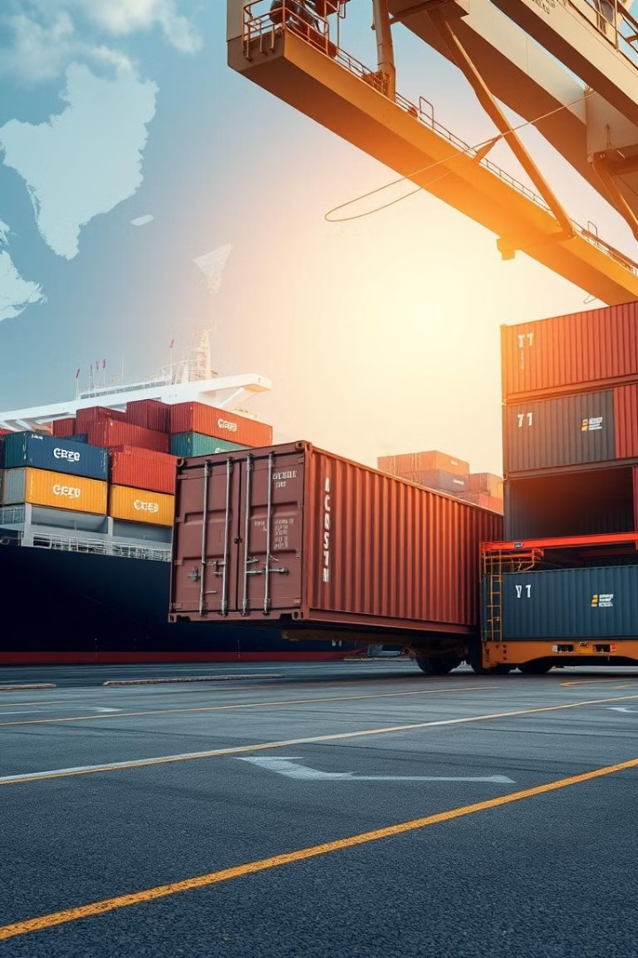
Understanding Foreign Trade Policy
Promoting Exports
Regulating Imports
Policies aim to encourage domestic businesses to sell goods and services internationally, boosting economic growth and creating jobs.
Policies manage the influx of goods from other countries, protecting domestic industries and ensuring national security.
Sustainable Trade Growth
Balance of Trade
Policies encourage environmentally responsible practices and fair trade to ensure sustainable and ethical global trade.
Policies strive to maintain a healthy balance between exports and imports, minimizing trade deficits and promoting economic stability.

Slide 5

Key Procedures in Foreign Trade
Registration and Licenses
  IEC Code:-
  a). Apply Filling application form with required documents (PAN, AADHAR, Cancel chaque, Proof for Business Address rent deed electricity bills etc.) and pay fee online on (DGFT) website https://www.dgft.gov.in
  b). The IEC code is a 10-digit unique identification number that is valid for the entire lifespan of a business. However, it must be renewed annually between April and June. There is no fee to update the IEC during this period.
  c). The IEC can be applied for on behalf of a firm, which can be a proprietorship, partnership, LLP, limited company, trust, HUF, or society.
  d.) All goods import of which is permitted only with an authorization / permission / license can be checked in Indian Trade Classification (Harmonized System) Schedule I. The schedule can be downloaded from https://www.dgft.gov.in
  e.) All Goods of Exports which are Free/ restricted /Prohibited can be checked in Indian Trade Classification (Harmonized System) Schedule II

Slide 6
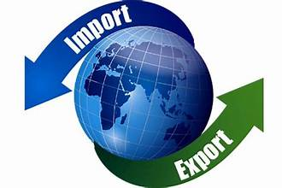
  ICEGATE (Indian Customs Electronic Gateway) E-Commerce Portal of CBIC -
  a.) Registration of IEC code under ICE-GATE website
  b.) It is national portal of Indian Customs of Central Board of Indirect Taxes and Customs (CBIC) that provides e-filing services to the Trade, Cargo Carriers and other Trading partners electronically.
  c.) Services, including electronic filing of the Bill of Entry (import goods declaration), Shipping Bills (export goods declaration), e-Payment of Customs Duty etc.
  d.) ICEGATE is internally linked with multiple partner agencies including RBI, Banks, GST PORTAL, DGFT, DGCIS, Ministry of steel, directorate of Valuation and other various Partner government Agencies involved in EXIM trade enabling faster customs clearance.

Slide 7
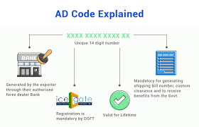
  Registration of AD code on ICE Gate Portal -
  Authorized Dealer Code (AD Code) Issued by the Authorized Dealer Bank who is dealing in Foreign Exchange, has to registered in the Port of Export Through ICE Gate Portal.
  Registration with Export Promotion Council-
  For Availing Various Concessions and Benefits under Foreign Trade policy, The Exporter is Required to register himself with the concerned EPCs. DGFT has created a common digital Platform for application of issuance, renewal, amendment and related process pertaining to RCMC.

Slide 8
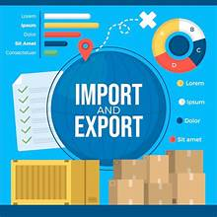
GENERAL PROVISION REGADING IMPORT & EXPORT
Policy regarding import/ export of goods
India trade classification harmonized System code (hsn) of export & import
Compliance of import with domestic laws
Payments and receipts of imports/exports
Status Holder Certificate
Authorized Economic operator (AEO)
Export/Import of restricted goods
Import policy for 2nd hand goods
Sale on high seas
Merchant Trade
Third party export and supporting manufacturer
mandatory documents for export /import of goods
Export Credit Agency (ECA)
Private bonded warehouse for export
Quality Complaints & Trade Disputes

Slide 9
EXPORT PROCEDURE
E.g. ‘A’ company in Jaipur – Rajasthan (Exporter) – gets Order from ‘B’ Company (Importer) in London – UK for Stone Tiles. The Procedure will be as under. Since heavy weight cargo 20’ Container suitable. Steps should be follow:- 1) Contract Between Exporter & Importer for supply of Goods with per specification (units, weight, height etc.), Production Of Goods. 2) Payment Terms : Advance or TT upon BL receipt or LC or DA. The remittance from Importer Bank to Exporter Bank. 3) Inland Container Depots (ICDs) and Container Freight Stations (CFSs) (Private and Government) -Jaipur having ICD Kanakpura – Jaipur, having loading Port e.g. Mundra/Nhava Sheva. In UK the Port of Discharge will be Felixstowe/London. 4) Bookings Placed to Shipping Line serving port with booking number- Booking has the details of time period for stuffing, Port of loading vessel etc. 5) CHA approaches surveyor with Booking – Container allotted to stuff the container at factory or ICD. Container sent to factory , Loaded Sealed by Customs ( preventive) or Self sealing by exporter in case of ICD stuffing material sent to ICD.

Slide 10
EXPORT PROCEDURE
6) Simultaneously CHA files online shipping bill with customs through EDI System on basis of Invoice , packing list or other docs required by customs . Check list is generated with details of cargo stuffed in container with value / Qty as per contract or LC. The complete procedure is paper less where in documents are directly uploaded to customs site via e-Sanchit. 7) After check list generation container arrives at ICD. Based on Checklist custodian allows the container to be gated in. 8) CHA approaches Customs official where in goods is examined to verify the package etc. Post Examination Customs seal the container with RFID seals ( Tamper proof electronic seals in case of ICD Stuffing/ in case of factory Stuffing Exporter seals the container under self sealing permission). After complete procedure and Let export (Final Shipping bill) is given by Customs Authority. 9) After Customs Sealing & Let Export the shipping Line surveyor seals the container with one time bottle seal and unique serial number. 10) Sealed envelope containing Shipping bill / other docs handed over to surveyor who prepares the forwarding note for transport of containers by Custodian.

Slide 11
EXPORT PROCEDURE
11) Export General Manifest : EGM is filed by shipping line / agent electronically to Customs EDI system for physical dispatch of container shipping bill wise. 12) Container dispatched by custodian by train / Road to Port of loading. Container offloaded inside the port and stacked. Upon vessel arrival it is Loaded on Vessel. 13) Upon Loading shipping line issues 3/3 bills of lading on the basis of which importer will take the delivery at destination. 14) BLs along with other documents like Invoice, Packing List, COO, other docs submitted to Exporters bank which is sent to Importers bank. Importer makes the payment to bank and release the docs. These docs used to custom clearance and delivery of the cargo. 15) Through ICE Gate the EXCHANGE copy for foreign remittance to be received is sent directly to RBI and bank to corelate the foreign exchange received in lieu of export material sent as per contract / LC per regulations of FEMA (Foreign Exchange Management Act) to facilitate external trade and payments.

Slide 12
IMPORT PROCEDURE
1) An importer clears the shipment on the basis of documents sent by Exporter. 2) CHA files bill of entry (BOE) electronically basis documents received by Importer. Documents electronically transferred to Customs EDI system – ICEGATE. It can be filed before filing of IGM / after filing of IGM but before container gate in at ICD for payment of duty. After BOE filing Challan for duty is generated which is to be deposited with bank. After deposit of duty BOE is further processed. Late filing of BOE / delay of duty deposit after 24hrs of BOE filing attracts penalties / interest charges. 3) BOE are mainly of 3 types (i) Home Consumption where in duty is immediately paid. (ii) For Ware housing In-bond – where in cargo is ware housed in customs custody but duty not paid. (iii) EX Bond – Duty paid for warehoused import cargo and delivery taken, Other type of BOE Include- High Sea Sales Bill of Entry: Used for goods sold while still in transit, such as on the high seas Re-import Bill of Entry: Used for goods that were previously exported and are being re-imported Bill of Entry for Re-export: Used for goods that are imported to be re-exported

Slide 13
IMPORT PROCEDURE
4) IGM : Import General manifest is filed by Shipping line / Or its agent at port of discharge 24 – 48 hours with local customs before arrival of the vessel to transship the container from Port of Discharge to ICD to generate SMTP – Sub Manifest Transport Permit allowing shipping line to carry container to particular ICD with unique code allotted by customs 5) After discharge container railed out to particular ICD and gated in. The gate in procedure is electronically transferred to Customs EDI where in it reflects in ICE gate the details of container along with BOE. 6) CHA approaches Customs for clearance of goods. The cargo is assessed / examined with respect to BOE and documents. Post clearance customs issues out of charge copy to importer to take the delivery. 7) Simultaneously the original bills of lading is submitted to the shipping line along with charges to obtain delivery order (DO) to destuff the container at Factory or ICD with in free time period agreed by shipper and line at origin. Free time starts from date of container gate in at ICD. Post free time detention per day is charged by line. 8) After destuffing of the cargo empty containers returned to shipping line.

Slide 14
Export Promotion Schemes- in Foreign Trade Policy
A. Schemes- Implemented by commerce Dept
B. Scheme Implemented by Revenue Dept.)
Duty Drawback
IGST Refund
Refund of Duties and Taxes on Exported Products (RoDTEP)
Export of Apparel/ Garments and Made-ups (RoSCTL)
Advance Authorization Scheme (AA)
Export Promotion Capital Goods (EPCG) Scheme
Duty Free Import Authorization (DFIA)
EOU, EHTPs, STPs, BTPs
SEZs (Special Economic Zones)
Deemed Export
Interest Equalization Scheme (IES)-current rate of interest up to 3%
Market Access Initiative (MAI) Scheme and Marketing Development Assistance (MDA)
C. Trade Agreements :-
Free Trade Agreements/ Presential Trade Agreements
Unilateral Tariff Preferences
  Generalized System of Presences
  Duty Free Tariff Preferences Scheme for LDCs
  3. TRQ under FTA/CECA

Slide 15





Opportunities for Professionals in Foreign Trade
EXIM Management
Trade Financing and Risk Management
Logistics and Supply Chain
International Marketing and Sales
Handling export documentation, compliance, and customs procedures.
Working with banks and financial institutions on trade credit, Letters of Credit, and mitigating risks associated with international transactions.
Managing international shipments, warehousing, and ensuring seamless delivery of goods.
Identifying new markets, negotiating trade deals, and expanding businesses globally.
Policy Advisory and Consulting
Providing expert advice to businesses on leveraging trade policies and incentive schemes.

Slide 16
Skills Essential for Success in Foreign Trade
1
Global Trade Laws and Regulations
In-depth knowledge of international trade agreements, customs regulations, and legal frameworks.
2
Documentation and Logistics Software
Proficiency in using specialized software for trade documentation, shipping, and logistics management.
Financial Instruments
3
Understanding of trade finance mechanisms, including Letters of Credit, payment terms, and risk management strategies.
Networking and Communication
4
Strong communication skills, networking abilities, and the ability to build relationships with international suppliers and buyers.
Market Research and Analysis
5
Analytical skills to conduct market research, identify trends, and assess the potential of specific markets.

Slide 17

Opportunities for Entrepreneurs and Startups
1
2
Export-Import Business
Export-Oriented E-Commerce
Specializing in niche markets with high demand, such as organic food, handicrafts, or sustainable products.
Leveraging online platforms to reach global customers and streamline international sales.
3
Facilitating B2B Trade
Creating platforms that connect businesses across borders, enabling efficient trade and facilitating global partnerships.

