Slide 1

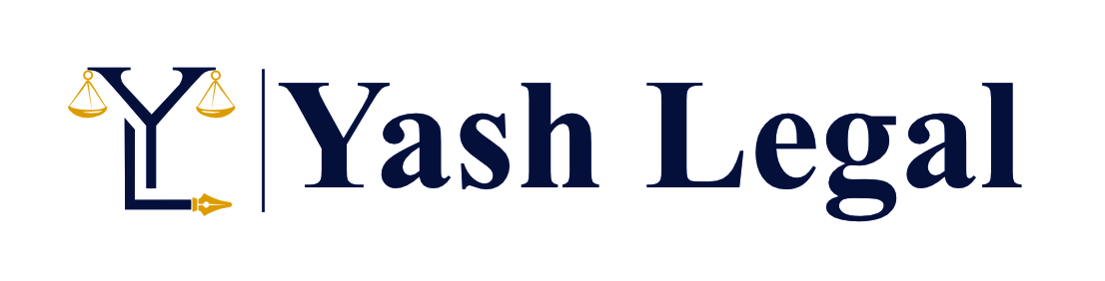
GST – FUTURE IS “LITIGATION”
Adv. (CA) Yashasvi Sharma
B. Com. (Hons.), LL.B., FCA, CCIDT (ICAI), CCCA (ICAI)
Cell : +91-9829210717
© YASH LEGAL - www.yashlegal.com

Slide 2


Slide 3
PRE-REQUISITES FOR LITIGATION
Mindset.
Approach / Temperament.
Knowledge of parent law and relevant Articles of COI / allied legislatures.
Skill of reading between the lines (interpretational proficiency).
Preparation starts from the first communication filed with Dept.
Thorough knowledge of judicial pronouncements and their application.

Slide 4


Slide 5
FREQUENTLY USED - LEGAL MAXIMS
Void Ab initio →
The act was bad since beginning.
  Delhi Development Authority Vs Kochhar Construction Work & Ors., 1998 (8) SCC 559 → SC used the latin term "ab initio" to arrive at a conclusion that the proceedings were ab initio defective as the firm in whose name the proceedings were instituted was not registered at the date of the institution of the proceedings.
  Rajashekar & Ors. Vs Trinity House Building Co-operative Society & Ors., 2016 (16) SCC 46 Transactions of the sale made during the pendency of the proceedings were held to be wholly illegal and void ab initio in law and therefore the same were held to be not sustainable in law.

Slide 6
Actori incumbit onus probandi →
The burden of proof lies on the plaintiff
  Indra Raja & Ors. Vs John Yesurethinam, MANU/TN/4369/2011 →
  The cardinal principle of law of evidence is that "Actori incumbit onus probandi"
  The burden of proof rests upon the plaintiff.
Actus Non Facit Reum Nisi Mens Sit Rea →
The intent and act must both concur to constitute the crime
  State of Rajasthan Vs Shera Ram, AIR 2012 SC 1: 2012 (1) SCC 602 →
  For committing a crime, the intention and act both are taken to be the
  constituents of the crime.

Slide 7
Audi Alterem Partem →
  No man shall be condemned unheard
  Maneka Gandhi Vs Union Of India & Ors., 1978(1) SCC 248: 1978 (2) SCR 621
  Supreme Court elucidated the sides of the said maxim –
  (a) Notice of the case to be met and
  (b) Opportunity to explain.
Delegatus non potest delegare →
Delegated power can not be further delegated without power/ authority
  The Delhi Laws Act, 1912, 1951 (2) SCR 747 (Seven Judges Bench, SC)
  Sidhartha Sarawgi V Board of Trustees for the Port of Kolkata & Ors. 2014 (16) SCC 248

Slide 8
Ejusdem Generis →
Of the same class, or kind
  Kavalappara Kottarathil Kochuni & Ors. Vs The State of Madras & Ors.
  1960 (3) SCR 887 (5 Judges Bench SC)
  The meaning of this maxim is that when general words follow particular and
  specific words of the same nature, the general words must take their colour
  from earlier words.
  Maharashtra University of Health Sciences and Ors. Vs Satchikitsa Prasarak Mandal and Ors., 2010 (3) SCR 91
  SC interpreted “ejusdem generis” as meaning “of the same kind or nature” and
  held it to be a principle of construction. This principle is presumed to apply
  unless there is some contrary indication.

Slide 9
Ignorantia Facti Excusat Ignorantia Juris Non Excusat →
Ignorance of facts may be excused but not ignorance of law
  Inder Singh Vs Union of India, MANU/DE/1552/2014
  Court did not entertain the plea of a party that he was not aware of the right to
  file an appeal i.e. ignorance of law is not an excuse.
Lex Posterior Derogat Priori →
A later law repeals an earlier law
Locus Standi →
The right of a party to bring an action or to appear before court or Right be heard
  Oswal Chemicals & Fertilizers Ltd. Vs Commissioner of Central Excise, Bolpur, 2015 (4) SCC 431
  Appellant who had paid excise duty to manufacturer, had necessary locus standi
  to file application claiming refund of duty.

Slide 10
Nemo Debet Esse Judex in Propria Sua Causa →
No judge should adjudicate a dispute which he or she has dealt with in any capacity
  Bidhannagar (Salt Lake) Welfare Association Vs Central Valuation Board & Ors. 007 (6) SCC 668
  The principle of Justice is based on two vital aspects :
  Nobody should be condemned unheard and
  Nobody should be judge on his own cause.
Prosecutor should not be judge.
Pari Materia → Of the same matter; on the same subject.

Slide 11
Res Judicata →
A thing adjudged
  Narayana Prabhu Venkateswara Prabhu Vs Narayana Prabhu Krishna Prabhu (1977) 2 SCC 181
  SC held that one of the tests in deciding whether the doctrine of “res judicata”
  applies to a particular case or not is to determine whether two inconsistent
  decrees will come into existence if it is not applied.
Suppressio Veri or Suggestio Falsi →
Concealment of truth or a statement of falsehood
  Avtar Singh Vs Union of India (UOI) & Ors., 2016 (8) SCC 471 (3 Judges Bench SC)
  One of the principles to be kept in mind by an employer is that before a person
  is held guilty of suppressio veri or suggestio falsi, knowledge of the fact must be
  attributable to him.

Slide 12
Actus Dei Nemini Injuriam →
  Law holds no man responsible for the Act of God
  Mali Ram Mahabir Prasad Vs Shanti Debi & Ors. {AIR 1992 PAT 66 (Patna)}
  Court Held that the strike is an act of god which can hardly be resisted by any litigant by applying any amount of skill or ability of his own.
Actio Personalis Moritur Cum Persona →
  A personal right of action dies with the person
  Girja Nandini Devi & Ors. Vs Bijendra Narain Choudhury {AIR 1967 SC 1124}
  Relief claimed after death cannot be enjoyed by anyone else.

Slide 13
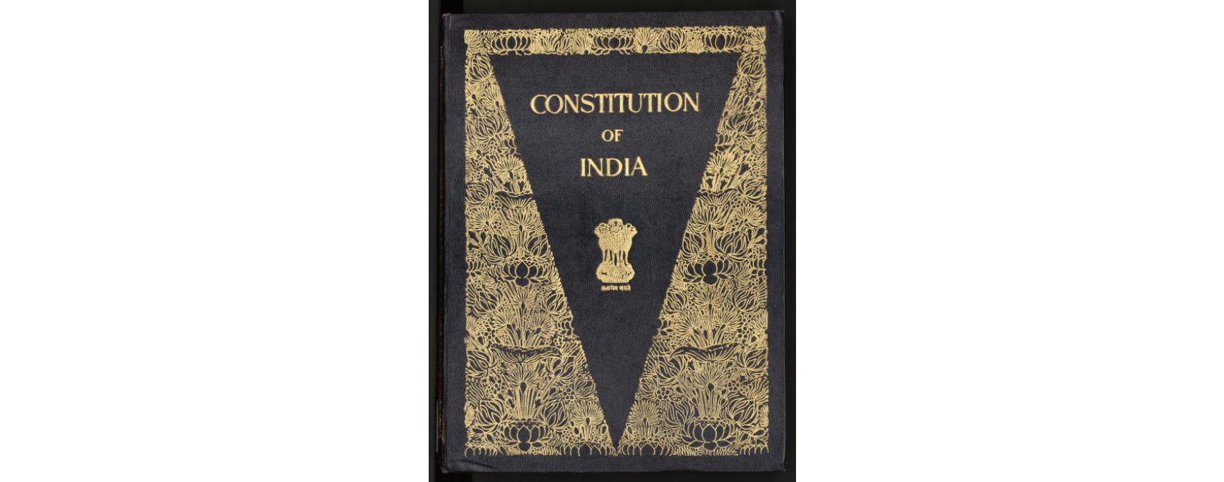

Slide 14
CONSTITUTION OF INDIA
PREAMBLE
“WE, THE PEOPLE OF INDIA, having solemnly resolved to constitute India into a SOVEREIGN SOCIALIST SECULAR DEMOCRATIC REPLUBLIC and to secure to all its citizens :
JUSTICE, social, economic and political;
LIBERTY of thoughts, expression, belief, faith and worship,
EQUALITY of status and of opportunity; and to promote among them all FRETERNITY assuring the dignity of the individual and the unity and integrity of the nation ;
IN OUR CONSTITUENT ASSEMBLY this twenty – sixth day of November, 1949, do HEREBY ADOPT, ENACT AND GIVE TO OURSELVES THIS CONSTITUTION.”
Note: The basic structure of the constitution cannot be amended under the power of Article – 368.
{Keshavanand Bharti V. State of Kerala (AIR 1973 SC 1461)}

Slide 15
PART – III → FUNDAMENTAL RIGHTS
Article – 14 → “Equality before law – The State shall not deny to any person equality before the law or the equal protection of the laws within the territory of India.”
  Concept of Manifest Arbitrariness.
  State Of U.P. And Ors vs Deepak Fertilizers & … {Appeal (Civil) 3511 of 2001 (SC)}
  State Of Andhra Pradesh & Anr vs Nalla Raja Reddy & Ors. {1967 AIR 1458 (SC)}
  Navtej Singh Johar v. Union of India {WP(Criminal) No. 76 of 2016 (SC)}
  Apollo Surgical (Raj.) (Bank Guarantee and surety)

Slide 16
“Article – 19 → Protection of certain rights regarding freedom of speech etc.
  (1) (a) …..; (b) …..; (c) …..; (d) …..; (e) …..;
  (g) to practice any profession, or to carry on any occupation, trade or business.”
  KMC Constructions Ltd. and Anr. vs. Principal Commissioner of Central Tax and 4 Ors. {(Tel) Appeal Number : WP.No.18575 of 2020}.
  Union of India v. Bombay Tyres International Ltd. (2017) (SC)
  J.K. Jute Mills Co. Ltd. v. Union of India (2018) (SC)
  Difference between Article 14 & Article 19 ?

Slide 17
Article – 21 → Protection of life and personal liberty.
  Olga Tellis v. Bombay Municipal Corporation (1985)(SC)
  Maneka Gandhi v. Union of India (1978) (SC)
  Pooranchand Saran & Ors. V. UOI & Ors {38 JKJVR 439 (Raj)}
  Paresh Nathalal Chauhan {2019 (10) TMI 1139 (Guj)}

Slide 18
`
Article – 27 → Freedom as to payment of taxes for promotion of any particular religion.
Article – 32 → Remedies for enforcement of rights conferred by this part.
Article – 108 → Provisions as to introduction and passing of bills.
Article – 109 → Special Procedure in respect of Money Bills.
Article – 110 → Definition of Money Bills – (1)……. (a) the imposition, abolition, remission, alteration or regulation of any tax;
Article – 226 → Power to High Courts to issue certain writs.
Article – 246 → Subject-matter of laws made by Parliament and by Legislatures of States.
Article – 246A → Special provision with respect to goods and services tax.
Article – 248 → Residuary powers of Legislation.

Slide 19
Article – 265 → Taxes not to be imposed save by authority of law.
{Rajasthan Chemist Association (SC) – MRP as notional value; will never be part of sale of goods- it looses
it’s significance altogether}
{Hotel Bajaj & Ors. V. State of Andhra (SC)–Purchase Tax upheld on goods sold in Inter State transactions}
Article – 270 → …`.. (1A) The tax collected by the Union under Clause (1) of Article 246A shall also be distributed between the Union and the States in the manner provided in Clause (2).
Article – 279A → Goods and Services Tax Council.
Article – 286 → Restriction as to imposition of tax on the sale or purchase of goods.

Slide 20
Article – 300A → Person not to be deprived of property save by authority of law.
What does Vested Right means : A right unrestricted of any contingency {J.S.Yadav vs State Of U.P & Anr on 18 April, 2011}
The expression property is not confined to land rather, it includes copyrights and other IPR and embraces every possible interest recognized by law. {K.T. Plantation V. State of Kerala AIR 2011 SC 3430}.
Acquisition of land for industrial development, did not violate Article 300A as it was a lawful taking of property for a public purpose. {State of Gujarat v. Patel Farsukhbhai Somabhai (2015)}
ITC is not the right of the dealer rather, it is a concession given by the legislature. {Jayam and Company V. Assistant Commissioner and Anr, {(2016) 15 SCC 125} {Godrej and Boyce Mfg. Co. Pvt. Ltd. & Ors V. Commissioner of Sales Tax and Others, (1992) 3 SCC 624}

Slide 21
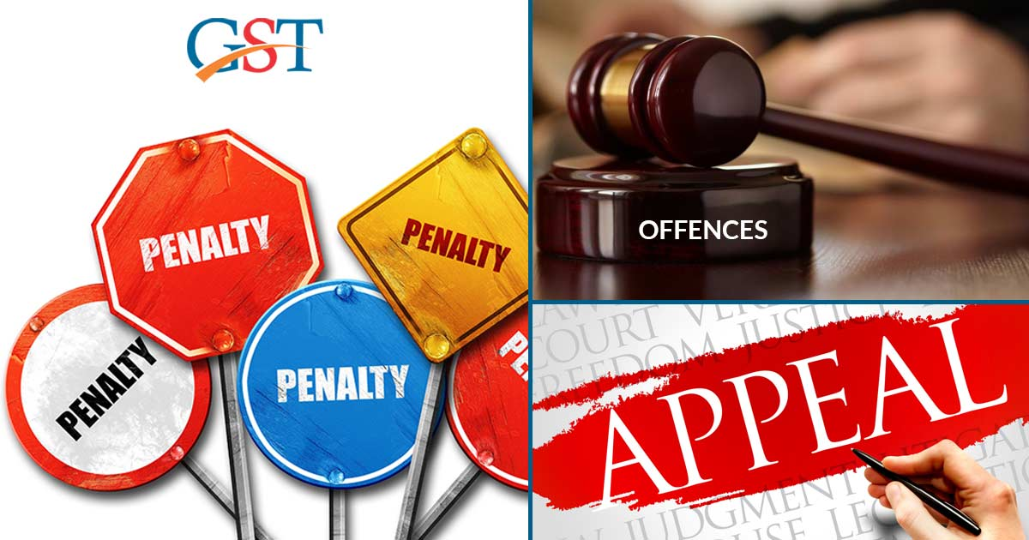

Slide 22
Appeals and Revision
Sections 107- 121 of the C/RGST Act, 2017 → Chapter XVIII
Rule 108 – 116 of the C/RGST Rules, 2017 → Chapter XIII
Forms GST APL-01 - GST APL-08 & GST RVN-01

Slide 23

APPEAL -
APPEAL -
Britannica
  Appeal, the resort to a higher court to review the decision of a lower court, or to a court to review the order of an administrative agency. In varying forms, all legal systems provide for some type of appeal.
Law dictionary
  A challenge to a previous legal determination. An appeal is directed towards a legal power higher than the power making the challenged determination.
  The person pursuing an appeal is called an appellant/ plaintiff, while the person defending the lower court's ruling is the respondent.

Slide 24
SECTION - 107
Any person → Aggrieved by any decision or order → of an adjudicating authority → appeal to Appellate Authority → Within three months → from the date when order communicated.
Communication or Service →
  Ratan Industries Ltd. V. State of U.P. → No service if sent on wrong mail.
  Ranchi Carrying Corpn. V. State of U.P. → No service on fixation on truck.
  Singh Traders V. Additional Comm. → No service if served to truck driver.
  Ram Prasad Sharam V. Chief Comm. → SCN not uploaded on website → Liable to struck down.

Slide 25
CGST Commissioner → On suo-moto or upon request of SGST Commissioner or UTGST Commissioner → Examine the record of any proceedings → Adjudicating authority passed any decision or order → For the purpose of satisfying the legality or propriety of the said decision → Direct any subordinate officer to apply to the Appellate Authority → within six months. (Revision)
Condonation of delay → ONE MONTH.

Slide 26
No appeal can be filed :
  Unless entire admitted demand is deposited;
  Unless 10% of remaining tax subject to Rs. 25 Cr. is deposited;
  25% of the penalty in case of 129(3) is deposited.
Automatic stay on remaining demand.
Opportunity of hearing to be given to the appellant.
Maximum three adjournments may be awarded to appellant.
Grounds may be added/ altered/ modified.

Slide 27
AA may confirm, modify, annul the order → CANNOT REMAND.
Pre issuance of SCN is must before passing order related to where tax has not been paid or short-paid or erroneously refunded, or where input tax credit has been wrongly availed or utilized.
The Appellate Authority shall, where it is possible to do so, hear and decide every appeal within a period of one year from the date on which it is filed → If issuance of order is stayed → One year would be Excluding the period of such stay.
Upon disposal communicate the order.
Order shall be binding on parties.

Slide 28
Rule 108
Appeal to be filed in Form GSTR APL-01 electronically or otherwise notified → Provisional acknowledgement would be generated.
If order uploaded on portal → No need to file certified copy of order.
If order not uploaded → File self certified copy of order in seven days.
Form GSTR APL-02 (Final Acknowledgment) will be generated → Appeal treated to be filed.
Date of filing would be acknowledgement date → Not filed in seven days – Date of physical filing.

Slide 29
APPELLATE TRIBUNAL
SECTION – 109 TO 116
Constitution of Appellate Tribunals and benches.
Procedure for Appellate Tribunals.
Appeal to Appellate Tribunal :
  File appeal of orders of Section 107/ 108 within three months from communication.
  May not admit cases where tax/ fee/ penalty/ fine is < Rs. 50,000/-.
  Commissioner may suo-moto or otherwise may direct subordinate to file appeal within six months.
Cross objection → Respondent → Within forty five days of notice.
Condonation of delay → Three months (Appeal)/ Forty Five days (Cross Objections).

Slide 30
No appeal can be filed :
  Unless entire admitted demand is deposited;
  Unless 10% (Additional) remaining tax subject to Rs. 20 Cr. is paid;
Remaining amount would be deemed to be stayed for recovery.
Application to Tribunal → For rectification or restoration → Must be with prescribed fees.
The Tribunal may modify/ annul/ confirm or remand the case.

Slide 31
No adjournments → More than three times.
Rectification of order → Suo-moto or on application → Rectify within three months from order → If demand increasing → Opportunity must be given.
Tribunal Shall decide the case within twelve months, if possible.
Order should be communicated in writing.
Order shall be binding on parties.
Refund amount deposited under Section 107(6) & 112(8) with Interest. {Section 115}

Slide 32
AUTHORIZED REPRESENTATIVE – SECTION 116
Any person → except when asked for personal examination on oath or affirmation → May appear through A/R.
Who can be A/R –
  Relative/ Employee;
  Advocate in practice → Not debarred from practice;
  CA/CS/CMA holds COP→ Not debarred from practice;
  Retired officer of CTD → Not below Gazetted Officer → Retired at least one year before.
  Any GSTP.

Slide 33
Who can not be an A/R :
  Dismissed or removed Govt. officer;
  Person convicted for any any offence under the GST Act(s);
  Any insolvent;
Person disqualified under any GST Act would remain disqualified for all the GST Act(s).

Slide 34
Appeal to High Court – Section 117 .
Appeal to Supreme Court – Section 118.
Merely filling appeal before HC or SC would not effect the order of Appellate Tribunal → Demand shall be payable as per order of Tribunal. (Section 119)
Directions may be issued by Board on recommendation of the Council to not to file appeal in certain cases on monetary basis or otherwise. (Section 120)

Slide 35
Non appealable orders/ decisions - Section 121
  Order transferring proceedings to another officer;
  Order pertaining to the seizure or retention of books of account, register and other documents;
  Order sanctioning prosecution under this Act;
  Order passed under section 80.

Slide 36
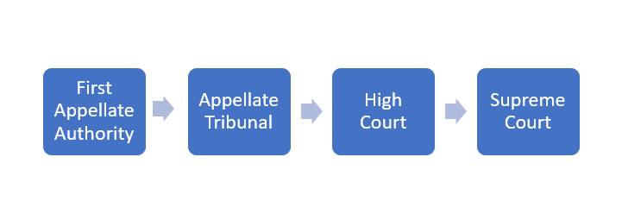
APPEAL – HIERARCHY

Slide 37
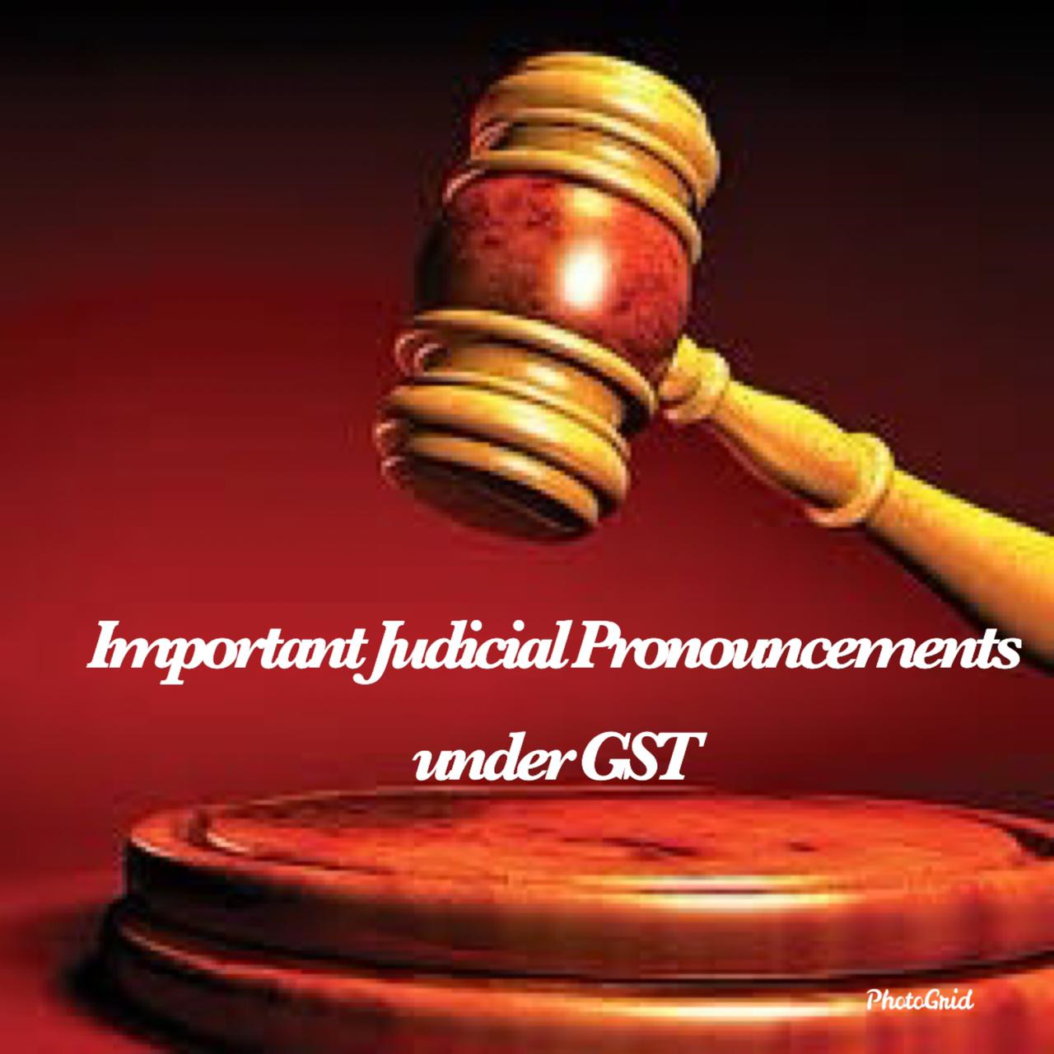

Slide 38

Yashasvi Sharma & Associates - www.cayashasvi.com

Slide 39
Paresh Nathalal Chauhan 2019 (10) TMI 1139(Gujrat)
  Search started on 11.10.2019 and continued till 18.10.2019.
  Hon’ble Court ordered revenue to produce confidential report prepared during the proceedings.
  It was reveled from the report that the proceedings were completed on 12.10.2019.
  Still, the officers stayed there and examined the phone call records of the family members.
  Also, recorded statements of the family members by pressurizing them and checking their phones.
  The Hon’ble HC recorded a very serious point in the order that the “….. act of officers shocked the conscience of this court.”
  The Hon’ble Court also observed that there is no power given to the officers under Section 67(2) to record statements of family members to know the whereabouts of the assessee.
                Contd.

Slide 40
The Hon’ble Court further discussed the constitutional aspect of personal liberty and held : “Article 21 of the constitution of India reads thus:
“21. Protection of life and personal liberty – no person shall be deprived of his life or personal liberty except according to procedure established by law.”
In the facts of the present case, the family members of the petitioner have been deprived of their personal liberty not only by being confined in the residential premises and being permitted to leave only with the consent of the authorized officer, and that too, at times with an escort; but also by an intrusion on their right to privacy by several strangers residing in their residential premises for eight days, that too, without any authority of law”.
Court also discussed Section 157 of the CGST Act, 2017 and held that even that Section can not provide shelter of these kind of deeds mentioning “….. Protection of such action under Section 157 of the GST Acts may unleash a regime of terror insofar as the taxable persons are concerned.”

Slide 41
Santosh Kumar Gupta Prop. Mahan Polymers
V/s.
Commissioner, Delhi GST & Ors.
{W.P.(C) 17171/2022 (Del)}
Search conducted on under Section 67(1) on 18.10.2022.
Petitioner was compelled to reverse ITC of Rs. 22,14,226/-.
No adjudication was pending regarding this ITC.
Statements were recorded and ITC was reversed at 11:30 pm while he was under total control of the officials.
Reversal was done under duress.
Petitioner stoutly disputed the reversal as voluntary.

Slide 42
The Hon’ble Court held → “….. 21. Undisputedly, the same has been made while the petitioner’s premises were being searched and he was being subjected to questioning / enquiries. We do not find it difficult to accept that the petitioner may have found the circumstances intimidating and had, accordingly, agreed to reverse the ITC. We are unable to accept that the reversal of ITC was made voluntarily without any suggestion or encouragement by the officers as contended by Mr. Aggarwal. But for the search continuing till late at night, there were no circumstances which would, in normal course, lead the petitioner to reverse the ITC late at night.
22. In the circumstances, we direct the respondents to reverse the ITC amounting to Rs. 22,14,226/- in the petitioner’s ECL. We however clarify that this would not preclude the concerned authorities from safeguarding the interest of the revenue including issuing order under Section 83 of the DGST act or Rule 86A of the DGST rules, if the requisite conditions are satisfied.”

Slide 43
Gaurav Saurav Traders and Contractors
V/s.
State of U.P. & 4 others.
{writ tax No. 1378 of 2022 (all)}
Search & Seizure was conducted on 02.09.2022 at the premises of the petitioner.
Mandatory provision of Section 67(1) not complied with.
Authorization for search & seizure was given on 31.08.2022.
Reasons for conducting search provided later and were signed by JC on 01.09.2022.
The Hon’ble Court Held → ….. “Upon a careful perusal of the section quoted above, it is clear that it is only after reasons are provided to the joint commissioner that he can authorize in writing any search and seizure to be carried out.
In the present case, the said procedure had not been followed, and accordingly, the entire authorization is vitiated and liable to be quashed.
Under such circumstances, the entire search and seizure that has been carried out is based on an illegal authorization and is accordingly quashed and set aside. The authorities are directed to release all goods and documents that they may have detained or confiscated within a period of 15 days from date.”

Slide 44
Lovelesh Singhal Prop. Shivani overseas v/s.
Commissioner Delhi GST & Ors.
[W.P.(C) 16353/2022 (del)]
Search conducted on 07.10.2022 and was continued till 02:30 am on 08.10.2022.
The petitioner states that he was detained in the office from 4 pm of 07.10.2022 to 2.30 am of 08.10.2022.
Petitioner contended that during this time, the petitioner succumbed to the intimidation of the visiting team and was compelled to reverse ITC of Rs. 18,72,000/-.
Reason to believe was → Registration of the suppliers cancelled retrospectively while petitioner contended it was no reason for mandating suprresion.
                Contd.

Slide 45
The Hon’ble Court held → “ In the present case, we are unable to accept that the authorization for conducting search or inspection under Section 67 of the CGST act is illegal for want of reasons to believe that the grounds for conducting the said search as set out in Section 67(1)(a) of the CGST Act, exist.”
Court further held “29. It is not necessary to examine in detail any controversy whether such payments were made voluntarily. Clearly, where a taxpayer turns around and states that the payments had not been made involuntarily and the circumstances prima facie indicate so, the taxpayer must be granted the benefit of withdrawing such payments. Obviously, in such cases, the taxpayer would forfeit immunity from levy of any penalty and the concerned authorities are not precluded from proceeding against the taxpayer in respect of any default and to the full extent as permissible under law.” Contd.

Slide 46
“32. It is also important to note that the requisite procedure under Rule 142 of the CGST rules has also not been complied with. Admittedly, the respondents have not issued any acknowledgement accepting the payment made by the petitioner in form GST DRC-04 as required under the CGST rules. In vallabh textiles v. Senior intelligence officer and ors. (Supra) [2022] 55 TAXLOK.COM 072 (delhi), a coordinate bench had held that failure to follow the prescribed procedure would also lead to the conclusion that the deposit made by the taxpayer was not voluntary.”
Conclusion → “43. In view of the above, we direct the respondents to reverse the ITC of Rs. 18,72,000/- deposited by the petitioner on 08.10.2022 and forthwith credit the same in his ECL.”

Slide 47
Arvind Goyal CA V. UOI & Ors.
{[2023] 56 TAXLOK.COM 051 (Del)}
Search operation was conducted at the residence of the petitioners.
During the course of the search cash aggregating to Rs.1,22,87,000/- found and seized by Department officers without seizure memo.
Petitioner contended that the GST officers had no power to seize any cash in exercise of its powers being cash excluded from goods.
The Hon’ble Court held :
“17. In the present case, the GST officers have dispossessed the petitioners of the currency found in their premises during search operations conducted under Section 67(2) of the GST Act but have not seized the currency under the said provision. Plainly, their action in doing so is without authority of law.
20. Insofar as the action of the officers of dispossessing the petitioners of their currency is concerned; it is clear that the said action of taking away currency was illegal and without any authority of law. The amount of Rs.18,87,000/- has already been returned to petitioner no.1. The respondents are directed to forthwith return the balance amount along with the interest accrued thereon to the petitioners. The bank guarantee furnished by petitioner no.1 for release of currency is directed to be released forthwith.”

Slide 48
Bhumi Associates V/s. UOI through secretary
{[2021] 33 TAXLOK.COM 045 (Guj)}
“We propose to pass an interim order issuing the following directions. “The central board of indirect taxes and customs as well as the chief commissioner of central/ state tax of the state of gujarat are hereby directed to issue the following guidelines by way of suitable circular/instructions:
(1) no recovery in any mode by cheque, cash, e-payment or adjustment of input tax credit should be made at the time of search/inspection proceedings under Section 67 of the Central/Gujarat Goods and Services Tax Act, 2017 under any circumstances.
(2) even if the assessee comes forward to make voluntary payment by filing form DRC-03, the assessee should be asked/ advised to file such form DRC-03 on the next day after the end of search proceedings and after the officers of the visiting team have left the premises of the assessee.
(3) facility of filing complaint/ grievance after the end of search proceedings should be made available to the assessee if the assessee was forced to make payment in any mode during the pendency of the search proceedings.
(4) if complaint/ grievance is filed by assessee and officer is found to have acted in defiance of the aforestated directions, then strict disciplinary action should be initiated against the concerned officer.”

Slide 49
Neeraj Paper Marketing ltd.
V/S.
Special Commissioner, Department of Trade and Taxes, GNCTD & Ors.
{W.P. (Civil) – 158/2023 (Del)}
Search conducted on the petitioner on 29.07.2022.
Rs. 25.20 lacs deposited in cash ledger and Rs. 3 lacs ITC was reversed through DRC-03 between 11:45 pm to 12:45 am, by coercing the director.
Procedure of rule 142 not followed → DRC-04 not issued.
Department contended that the petitioner did not retract from his statements recorded during search and now it is not open form him to contend that the payment was not voluntary.
Court held “18. As noticed above, it is not disputed that payments aggregating to Rs. 28,20,000/- have been made at 11:49 PM and at 12:38 PM during the search operations. We are, therefore, inclined to accept the petitioner’s contention that the payments made by it were not voluntary payments but under compelling circumstances.”

Slide 50
Retraction of statements
What is retraction ?
  Simple meaning - - > withdrawal of statement recorded.
Bannalal Jat Construction Pvt. Ltd. V. ACIT-Central Circle-2, Ajmer
{d.B. Income tax Appeal No. 140/2018(Raj.)}
The Hon’ble Court held :
“….. The retraction has to be genuinely made within reasonable time and immediately after such a statement has been recorded either by filing a complaint to the superior authority of otherwise brought to the notice of the higher officials, duly sworn affidavit or statements supported by convincing evidence.”

Slide 51
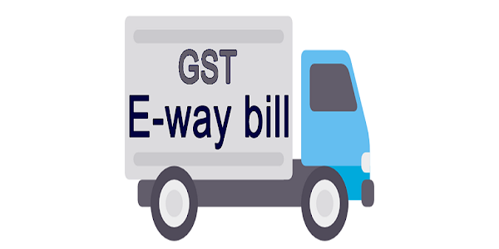

Slide 52
Smart roofing (P) ltd. v/s.
The state tax officer (int), Madurai
{W.P.(MD) NO.5720 OF 2022 AND W.M.P.(MD) NO.4567 OF 2022(Mad}
Petitioner consigned goods from Chennai to additional place of business at Madurai.
The additional place of business was not entered in RC.
Under these circumstances vehicle was detained.
Hon’ble court held - “6. No doubt, the authorities acting under the act were justified in detaining the goods inasmuch as there is a wrong declaration in the e-way bill. However, the facts indicate that the consignor and the consignee are one and the same entity, namely, head office and the branch office. ….. 7. Considering the fact that there is only a technical breach committed by the petitioner and there is no intention to evade tax, I am inclined to quash the impugned order and allow this writ petition by directing the respondent to release the vehicle and the consignment to the petitioner, if the same has not been released already.”

Slide 53
Ne Equipment Solutions (P) Ltd. Vs. State of Tripura & Others (Tri.)
{WP(C) NO. 577/2021}
The petitioner company sold excavator which was being transported from Silchar to Agartala with sale invoice and e-way bill.
The transport department checked and stopped the vehicle as it was not registered in the State.
Later on the vehicle was released after payment of dues.
In the mean time the e-way bill expired. Fresh e-way bill was generated.
The GST officials detained the goods in want of valid e-way bill.
The Hon’ble Court held : “The validity expired on account of unforeseen and unexpected delay in crossing the check post since the transport department stopped the movement of the vehicle on the ground that the machinery was not registered in the State of Tripura. ….. The tax authorities must make a clear distinction between deliberate tax evasion and technical or minor defects which manifest no intention to evade tax.”

Slide 54
ASSISTANT COMMISSIONER (ST) & ORS.
V/S.
SATYAM SHIVAM PAPERS PVT. LIMITED
{[2022] 44 TAXLOK.COM 041 (SC)}
E-way bill was generated on 04.01.2020 by the petitioner.
Due to political rally the route was blocked → Vehicle could not move till 8:30 pm.
By that time shop of the consignee was closed and next two days were holidays.
Consignment moves on next working day but was detained due to expired e-way bill.
Hon’ble Telangana High Court set aside the order stating that there was no ill-intent.
The e-way bill expired due to unavoidable circumstances.
Imposed cost of Rs. 10,000/-.
Hon’ble Supreme Court stated there is no need to interfere the detailed order of HC.
Imposed further cost of Rs. 59,000/- to be paid to respondent in four weeks.

Slide 55
Bajaj Rubber Company
V/S.
Assistant Commercial Taxes Officer, Bhiwadi
S.B. Sales Tax Revision 311/2008
Goods detained while in movement. Notice issued for non – availability of VAT – 47 / 47A.
Form, generated on the same date, presented with reply.
Form not accepted.
Hon’ble Court held – If the Form is generated after the detention but on same day, penalty under Section 76(6) is not leviable.

Slide 56
Deepam Roadways V. DSTO, STO, AC (ST), Chennai
{W.P. No. 476 of 2023 (Mad)}
Vehicle detained while in movement.
Requirements of Section 129(3) not met with.
The Hon’ble Court held :
“5. In the instant case, after detaining the petitioner's vehicle and the goods on 26.10.2022, notice was issued by the respondents on 31.10.2022 within seven days from the date of detention. However, the consequential order for payment of penalty was passed only on 10.11.2022 which is beyond the period of seven days from the date of service of notice on the petitioner. Having passed the impugned order beyond the period of seven days from the date of service of notice on the petitioner which is contrary to Section 129(3) of the CGST Act, 2017, the impugned orders have to be necessarily quashed and the writ petitions will have to be allowed.”

Slide 57
Commercial Steel Company V. A.C. of State {Writ Petition No. 2161 of 2020(Tel.)}
  Goods despatched from Karnataka to Telangana.
  Conveyance went off route and detained by officer under presumption of delivery to other place than that of mentioned in the documents.
  All the requisite documents produced for verification.
  Tax & penalty levied.
  Hon’ble Court held :
  “27. ….. Therefore, in our considered opinion, the impugned action of the respondents in collecting the amount of Rs. 4,16,447/- from the petitioner towards tax and penalty under the CGST and SGST Act, 2017 under threat of detention of the vehicle carrying the said goods for an absurd reason (‘wrong destination’) when the vehicle in question carried all the proper documents evidencing that it was an inter-state sale transaction is clearly arbitrary, violative of articles 14, 265 and 300-A of the constitution of India. ….. Accordingly, the writ petition is allowed as above with costs of Rs. 25,000/- to be paid by 1st respondent.”

Slide 58
State of Punjab V. Shiv Enterprises & Ors.
CIVIL APPEAL NO. 359 OF 2023 {ARISING OUT OF SLP (C) NO. 19295/2022 (SC)}
Vehicle detained and checked during movement.
All documents were in order and presented for verification.
Information received that the goods purchased were from supplier who does not have inward supplies and makes only supply without payment of tax.
Department detained goods and invoked Section 130.
There is no allegation that the petitioner has contravened any provision of the Act or the rules framed thereunder much less with an intent to evade payment of tax.
The opinion of the authorities which forms basis of proceedings under Section 130 must have reasonable nexus with the action of the person against whom proceedings are being initiated. Such nexus must be manifest from the record and conveyed to the person.
P&H High Court quashed the SCN. Contd…

Slide 59
Hon’ble Supreme Court held :
“Apart from the fact that the aforesaid is factually incorrect, even otherwise, it was premature for the High Court to opine anything on whether there was any evasion of the tax or not. The same was to be considered in an appropriate proceeding for which the notice under Section 130 of the Act was issued. Therefore, we are of the opinion that the High Court has materially erred in entertaining the writ petition against the show cause notice and quashing and setting aside the same. However, at the same time, the order passed by the High Court releasing the goods in question is not to be interfered with as it is reported that the goods have been released by the appropriate authority.”

Slide 60
Robbins Tunnelling and Trenchless Technology (India) Pvt. Ltd.
V/s.
The State of M.P. and others {W.P. No.12913/2020 (MP)}
Machine was received from HO at USA to Mumbai.
CFA appointed to get the same cleared and sent to Katni, M.P. office.
CFA mentioned it’s own name in e-way bill as recipient.
Vehicle detained by the Department and levied tax & penalty.
Court held : “13. Regard being had to the pleadings advanced on behalf of the parties, and bestowing our anxious consideration on the relevant provisions of the GST Act, we find that the respondents are not justified in rejecting the appeal of the petitioner on the ground that the mistake committed while generating the E-way bill, was not a clerical error or a small mistake. Accordingly, the impugned orders passed by the respondents, dated 28-9-2019 (Annexure-P/14) and 14-12-2018 (Annexure-P/12) confirming the tax and penalty to the tune of Rs. 2224268/-, are hereby quashed. The respondents are directed to consider the case of the petitioner for imposition of a minor penalty, treating it to be a clerical mistake, as per Circular, dated 14-9-2018 No. CBEC/20/16/03/2017-GST issued by the Ministry of Finance.”

Slide 61
Orson Holdings Company Limited V. Union of India
R/Special Civil Application No. 18982 of 2018 (Guj)
Vehicle intercepted and detained during movement.
All the requisite documents presented for verification.
E-way bill was expired by 48 hours.
Penalty imposed.
Hon’ble Court Held: Quashed the order -
“7. In the instant case also, as we could notice that the goods of the said vehicle has been detained at 6:05 p.m. at Amirgadh on 27.9.2018, after about expiry of 48 years. This case is squarely covered by the decision of this Court which has not been further challenged and even otherwise, from the facts which are robust in nature, it can be gathered that there does not appear to be any ill-intent on the part of the petitioner to use the expired e-Way bill. The company is situated at Howrah, West Bengal and the place of delivery was Jamnagar, Gujarat and in transit, this e-Way bill has expired.”

Slide 62
K.P. Sugandha Ltd. V. State of Jharkhand & Ors. (Jha) {WPT No. 36 of 2020 WPT No. 49 of 2020}
  Petitioner manufactures tobacco & allied products. Despatched goods to its dealer at Raipur.
  In transit, conveyance was intercepted. Invoice and e-way bill presented for verification.
  Goods found undervalued. Officer levied tax & penalty U/S 129.
  Court Held :
  ”Given the said facts and circumstances of the case, this court is of the opinion that under valuation of a good in the invoice cannot be a ground for detention of the goods and vehicle for a proceeding to be drawn under section 129 of the central goods and service tax act, 2017 read with rule 138 of the central goods and service tax rules, 2017.”

Slide 63

Yashasvi Sharma & Associates - www.cayashasvi.com

Slide 64
Suncraft Energy (P) Ltd. & Anr. V/s. ACST Ballygunge Charge & Ors
{WPA 12153 of 2023 (Cal)}
Some of the suppliers’ bills not reflecting in 2A.
Appellant contended to have been fulfilled all the conditions for claiming ITC.
ITC denied without any further enquiry.
The Hon’ble High Court held “The assessing authority without resorting to any action against the selling dealer has ignored the tax invoices produced by the appellant as well as the bank statement to substantiate that they have paid the price for the goods and services rendered as well as the tax payable there on, the action of the assessing authority has to be branded as arbitrarily. Therefore, before directing the appellant to reverse the input tax credit and remit the same to the government, the first respondent ought to have taken action against the supplier and unless and until the assessing authority is able to bring out the exceptional case where there has been collusion between the appellant and the supplier or where the supplier is missing or the supplier has closed down its business or the supplier does not have any assets and such other contingencies, straight away the assessing authority was not justified in directing the appellant to reverse the input tax credit availed by them. Therefore, we are of the view that the demand raised on the appellant dated 20.02.2023 is not sustainable.”
The SLP filed by the revenue was rejected by the Hon’ble Apex Court.

Slide 65
D.Y. Beathel Enterprises V. State Tax Officer (Mad.)
{W.P.(MD)Nos.2127, 2117, 2121, 2152, 2159, 2160, 2168, 2177, 2500, 2530, 2532, 2534, 2538, 2539, 2540, 2503 & 2504 of 2021}
Beathel Ent. Purchased goods from Charles and his wife.
Payment, including tax, through banking channels.
Charles and his wife did not pay the tax to Govt. exchequer.
Department asked the bonafide purchaser to reverse ITC.
Court quashed the impugned orders and remitted back the case for further examination of the supplier and firmly narrated that the ITC reversal is not automatic in these cases. Held :
“Thus, the impugned orders suffers from certain fundamental flaws. It has to be quashed for more reasons than one.
a) Non-examination of Charles in the enquiry
b) Non-initiation of recovery action against Charles in the first place”

Slide 66
Union of India V. Bharti Airtel Ltd. & Ors.
CIVIL APPEAL NO. 6520 OF 2021 (ARISING OUT OF S.L.P. (C) NO. 8654 OF 2020)
The common portal is only a facilitator to feed or retrieve such information and need not be the primary source for doing self assessment.
Form GSTR-2A is only a facilitator for taking an informed decision while doing such self-assessment.

Slide 67
ARS Steel & Alloy International Pvt. Ltd. v. State Tax Officer (Mad.) {C.W. No.2885 of 2020}
This matter was confined to a decision on the legal issue as to whether a reversal of Input Tax Credit (ITC) is contemplated in relation to loss arising from manufacturing process.
The Hon’ble Court held : “15. In the light of the discussion as above, I am of the view that the reversal of ITC involving Section 17(5)(h) by the revenue, in cases of loss by consumption of input which is inherent to manufacturing loss is misconceived, as such loss is not contemplated or covered by the situations adumbrated under Section 17(5)(h).”

Slide 68
State of Karnataka V/s. Ecom Gill Coffee Trading (P) Ltd.
{(2023) 111 GSTR 1 (SC)}
Ecom Gill purchased green coffee beans.
Claimed ITC from 27 dealers but denied as :
  Six found to be de-registered;
  Three sold goods to Ecom but did not file returns.
  Six outrightly denied turnover and did not pay taxes.
First appeal was rejected.
Tribunal allowed ITC stating Ecom purchased goods under genuine invoices.
Revision was dismissed by the Hon’ble High Court.
Hon’ble Apex Court allowed the appeal of Revenue stating that merely production of genuine invoices does not prove the actual delivery of goods. Delivery of physical delivery must be on record to prove the genuineness of the transaction.

Slide 69
LGW Industries Ltd. V. Union of India (Cal)
[2021] 43 TAXLOK.COM 051 (Calcutta)
Petitioner received goods from suppliers through genuine invoices. The purchases were duly supported by valid documents.
The suppliers, allegedly fake and non existing → Dept. cancelled their registration retrospectively and denied ITC.
Court held : “If it is found upon considering the relevant documents that all the purchases and transactions in question are genuine and supported by valid documents and transactions in question were made before the cancellation of registration of those suppliers and after taking into consideration the judgments of the Supreme Court and various High Courts which have been referred in this order and in that event the petitioners shall be given the benefit of input tax credit in question.”

Slide 70
Gargo Traders V/s. Joint Commissioner State Tax & Ors.
{WPA 1099/2022 (Kol)}
Mere cancellation of registration of supplier from retrospective date doesn’t form good ground for denial of ITC. The payment were made through proper banking channel in due time as prescribed under the Statute.
No connivance was proved by the revenue between the petitioner and it’s supplier.
Invoices, e-way bills, delivery receipts are with the petitioner.
Hon’ble Court directed revenue to consider all documents and pass order afresh.

Slide 71
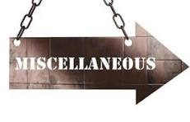

Slide 72
CHETANKUMAR JASRAJ PALGOTA HUF
V/S.
STATE OF MAHARASHTRA & OTHRS.
{[2023] 67 TAXLOK.COM 070 (Bom)}
Petitioner filed an appeal and requested the appellate-authority to adjust the sum of Rs. 1 Crore deposited under protest, as a pre-deposit for the appeal proposed to be filed.
On the date of the deposit, there was no demand against the Petitioner, therefore, the retention of the said amount by the Respondents is without authority of law.
The Hon’ble Court held “12. In view thereof, we pass the following order:-
(i) The Respondents are directed to treat sum of Rs. 1 Crore as pre-deposit for the purpose of Section 107(6) of the CGST/MGST Act and the appeal be decided on merits. (ii) …..”

Slide 73
M/s. Chitra Automobile v. the State of Jharkhand and Ors.
[W.P. (T) No. 4784 of 2022 dated January 24, 2023 (Jha)]
SCN was served on the petitioner for allegedly violating provisions of GST Act as the SCN was issued without specific charge and without striking off non-applicable charges.
Demand of Rs. 30,22,585/- (GST + Interest) was created.
Department issued DRC-07 (summary order) for non-filling of SCN reply.
Order was passed within seven days of SCN.
The Hon’ble Court held “10. As we are of the considered view that the impugned show cause notice in the instant case does not fulfill the ingredients of a proper show cause notice and thus amounts to violation of principles of natural justice; the challenge is maintainable in exercise of writ jurisdiction of this Court. Accordingly, the show cause notice under Section 73(1) of the Act dated 12.02.2022 (Annexure-1), summary of show cause notice in FORM GST DRC-01 of the same date (Annexure-2) and also the summary of order dated 17.02.2022 in FORM GST DRC-07 (Annexure-3), are, quashed and set aside.”

Slide 74
Associated Power Structures (P) Ltd. V/s. State of Bihar(Patna)
{CIVIL WRIT JURISDICTION CASE NO. 8542 OF 2021}
The officer did not follow the principle of natural justice.
The Hon’ble Court observed “ We only caution the officer to be careful in future and not commit such mistake again, for such type of mistake not only causes harassment to the parties but also shatters faith of the people in the system.”

Slide 75
Balaji Theatre v. Chief Secretary
{[2020] 118 taxmann.com 160 (Madras)}
The municipality asked to pay entertainment tax on cinema run by the petitioner.
Petitioner contended that the entertainment tax has been subsumed in GST hence cannot be levied.
Hon’ble Court held – The levy is constitutional in the light of Entry 62 of the State List read with 101st Constitutional Amendment. Further, the municipality can impose entertainment tax.

Slide 76


