Slide 1
Emerging Trends in ICAI Disciplinary Pronouncements :
PREVENTION & PREPAREDNESS
CA. Vimal Chopra, Ex-Chairman, ICAI-CIRC

Slide 2
LEGAL FRAMEWORK
Act- The CA Act, 1949
Rules - Chartered Accountants(Procedure of Investigations of Professional and Other Misconduct and Conduct of Cases) Rules 2007 and Amendments.
Regulations – The CA Regulations 1988
Code of Ethics- Code of Ethics,2009 ;
  Code of Ethics,2019 Vol-I, II and III (1.7.2020)

Slide 3
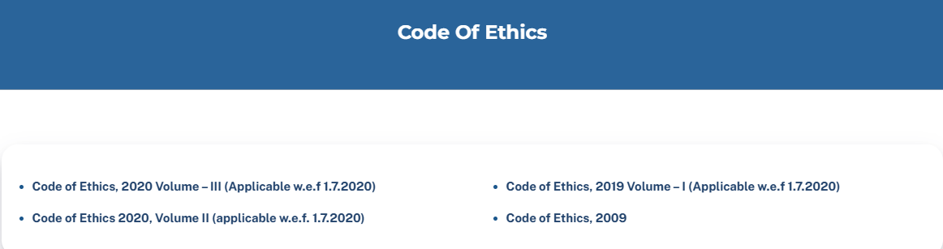

Slide 4
Latest position
12th edition of Code of Ethics is applicable w.e.f 1st July, 2020. (in suppression of the 11th edition issued in 2009), except following.
w.e.f. 1.10.2022
  1. Responding to Non-Compliance of Laws and Regulations (NOCLAR)[Sections 260 and 360]
  2. Fees - Relative Size [Paragraphs 410.3 to R410.6]
  3. Taxation Services to Audit Clients [Sub-section 604]

Slide 5
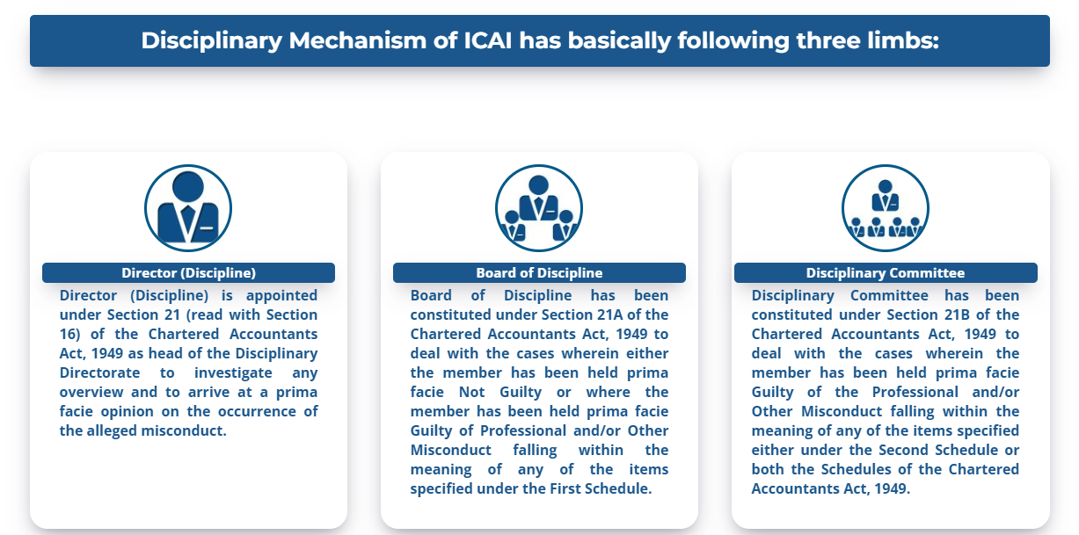
DISCIPLINARY DIRECTORATE

Slide 6
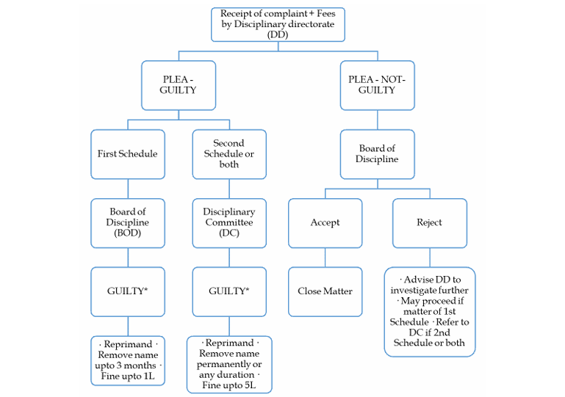
FLOW CHART OF DISCIPLINARY PROCEEDINGS

Slide 7
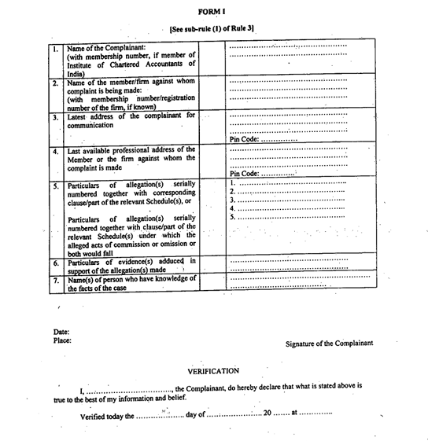

Slide 8
Common issues – Disciplinary cases
Easy E-/Physical Complaint filing – ( Fees is Rs 2500 + 18% GST = 2950 only!)
Non- issue of NOCs (Registered AD)
Conflict of Interest – Shareholding/ Directorship etc.
Ethical Breaches
Interaction with Regulators - MCA, RBI, SFIO, CBI, ED,
ICAI Quality Control –FRRB/TAQRB/PRB
More than 3000 pending DC cases/complains and increasing
Shift from True & Fair view to Misrepresentation of Facts & Figures.
Hundreds of Multiple Empanelment Forms, attachments, Affidavits etc.
Benami sort of Planning- Using family members for bye pass of regulations

Slide 9
Common issues – Disciplinary cases
Professional Negligence and lack of due diligence
Poor Documentation and Record keeping
Fraud detection – negligence in finding and reporting
Non Compliance with Standards
Mis representation of facts or certifications
Involvement in illegal or unethical activities
Undermining the reputation of self and profession

Slide 10
QUALITY MECHANISM - ICAI
NFRA- National Financial Reporting Authority
FRRB- Financial Reporting Review Board
PRB- Peer Review Board
TAQRB – Tax Audit Quality Review Board
Audit Directorate
Tender Monitoring Directorate

Slide 11
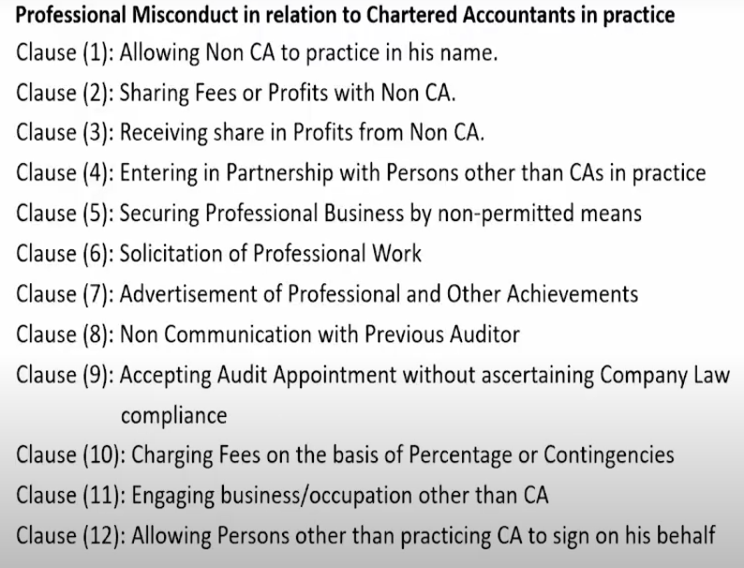
Part- I of FIRST SCHEDULE

Slide 12
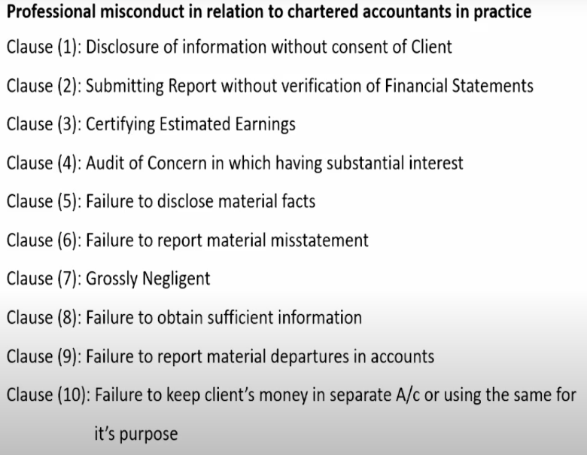
Part- I of SECOND SCHEDULE

Slide 13
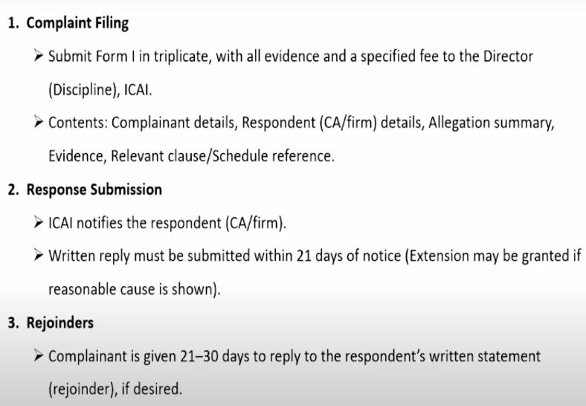
Complaint filing Mechanism

Slide 14
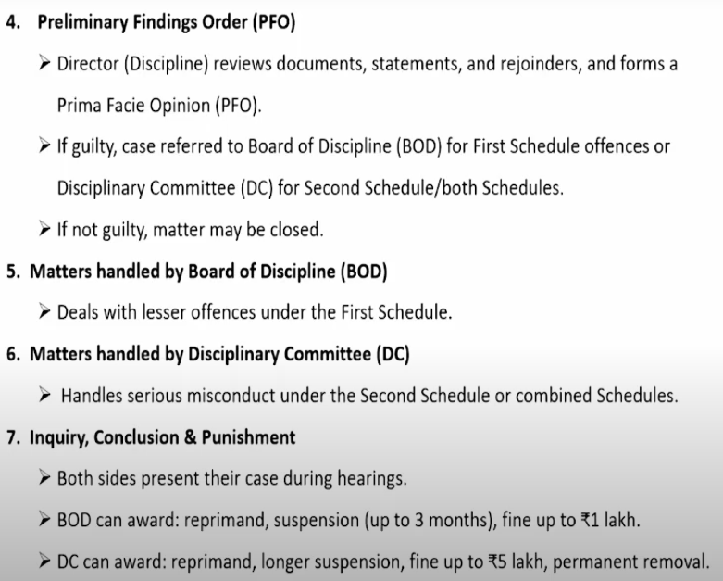

Slide 15
Emerging Trends in Misconduct
Failure to meet Mandatory CPE requirements
Failure to get Peer Review Requirements met
Whistle blower Complaints
Non-Compliance with Laws (NOCLAR)
Misusing Professional Position

Slide 16
Proactive Preparedness
Audit Documentation – Physical / Electronic
Inquiry Protocols
Upholding Independence
Tech for quality and
Communication Protocols

Slide 17
Likely Punishments under ICAI Regulations
Monetary Penalties UP TO 5 Lacs
Reprimand
Suspension from Practice
Removal from Register
Restrictions & Costs

Slide 18
Fees – Relative Size (410.3 A1-410.6)
total fees generated from an audit client vs. total fees of that firm - Self-interest or intimidation threat. (Paragraph 410.3 A1 )
large proportion of the revenue of one partner or one office of the firm
Appropriate and no audit participative, reviewer to review the work.
Non public interest entity audit client – 2 consecutive years - total fees with its related entities > 40% of the total fees received by the firm, then (20% for PIE)
Disclose to ICAI this fact except when total fees of firm ≤ 20 Lacs (incl related firms)/appointed by Govt or regulator.
If the fees described in paragraph R410.3a continue to exceed 40% after two years, the firm shall each year disclose to the ICAI.

Slide 19
Booklet on Important Decisions of the Ethical Standards Board/Council (July-2022)
Whether CAs can print photographs on the visiting cards ?
ESB in 2021 clarified - Printing of photographs on Visiting card/E-Visiting cards is not permissible.
DSA for marketing of Bank cards and verification of credit card application
  not permitted to market any specific product.
  may verify credit card credential.
  may provide services that are in the nature of verification etc. being assurance services
  perform all those services, which a Chartered Accountant can provide e.g. MC & OS.

Slide 20
Booklet on Important Decisions of the Ethical Standards Board/Council (July-2022)
Whether a member can be a Director in Cooperative Bank ?
  may be a non-executive/ independent director, no day-to-day and no Audit by partners
Franchise for a TIN – FC (Tax Information Network – Facilitation Centre)
  May establish a TIN - FC under franchise from the other entity which is already a TIN-FC.
Whether client may use the name of CA firm mentioning it as a knowledge partner?
  mentioning a firm as a knowledge partner or in the Thank You advertisement – not permitted
  mention name of an individual member with prefix/suffix “CA” as a “knowledge partner”- permitted.

Slide 21
Booklet on Important Decisions of the Ethical Standards Board/Council (July-2022)
Whether a resident director, as per the stipulation of Section 149(3) of the Companies Act, 2013, would be covered under the scope of “Director Simplicitor”?
  No. of days of stay in India ≥ 182 days don’t alter Director Simplicitor expectations.
Can a CA be settler of Trust
  Yes . As per Regulation 191 of Chartered Accountants Regulations, 1988,
Can a CA exercise lien over the client documents and records until his fees is paid?
  NO. unless it is required by any law , in force or vide the order of a court of law.

Slide 22
Booklet on Important Decisions of the Ethical Standards Board/Council (July-2022)
Whether Chartered Accountants in practice can become Financial Advisors and receive fees/commission from Financial Institutions such as Mutual Funds, Insurance Companies, NBFCs etc.?
  NO. being fees which are based on a percentage of profits / contingent upon the findings.
Can a CA Firm print its vision and values behind its visiting cards?
  NO . As per Clause (6) of Part-I of First Schedule of CA Act, 1949.
If a member in practice can take the class as guest lecturer and receive honorarium based on per class basis.?
  YES. Occasionally invited. No violation of Clause (11) of above Schedule.

Slide 23
Booklet on Important Decisions of the Ethical Standards Board/Council (July-2022)
Can a practising chartered accountant be an honorary office bearer in a trust /society/section 8 Company, and sign cheques in such capacity?
  Yes Honorary office-bearership of “charitable, educational or other non commercial organisations”, he may perform any activity which is appurtenant to such honorary position/ Office.
Can a practising chartered accountant start a society (NGO) for betterment of fellow Chartered Accountants and doing social work?
  YES. Caution- No use of CA Logo by NGO / No remuneration for holding office of NGO.
Whether a practicing member act as mediator in Court?
  YES. “mediator‟ would be deemed to be covered within the meaning of “arbitrator”- permitted

Slide 24
Booklet on Important Decisions of the Ethical Standards Board/Council (July-2022)
Whether a member in practice is generally permitted to write script/story for a movie?
  NO. merely writing a script/story for a movie would not fall within provisions of Appendix (9)
Whether partner of a CA Firm doing audit of Insurance company may accept surveyor work of the said Company?
  NO. Conflict of interest, likely to impact independence of auditor.
Whether a practicing member engage them as Registration Authority or Registration Authority associate for the limited purpose of obtaining digital signatures for clients.?
  YES.

Slide 25
Booklet on Important Decisions of the Ethical Standards Board/Council (July-2022)
Whether a chartered accountant who is an Information Security Auditor of a Bank can hold Credit Card of the same Bank?
  YES. Chapter X of Council General Guidelines, 2008 will apply if there is outstanding balance of Rs, 1,00, 000/-* beyond prescribed credit period limit
Can a member in practice provide pay roll services?
  YES. If he is not Auditor. Section 2(2)(i) and (iii) of the CA Act, 1949
Can a practicing CA provide an equity research service that it can publish retail research report after giving NISM research analyst exam?
  YES. but he cannot publish retail report as it would amount to other business or occupation.

Slide 26
Booklet on Important Decisions of the Ethical Standards Board/Council (July-2022)
Whether a member may issue a certificate required mandatorily by banks from CAs, with regard to transactions over which the member has no control?
  YES. But it has to be in compliance with the accounting and auditing standards of the ICAI.
On the requirement to share information sought by the Client from the auditors, and to whom it must be provided.
  Not to disclose the information of his client unless required by any law but YES for sharing of information to even to minority partner /shareholder
Whether a member can associate with a Firm otherwise than as a partner or employee? Whether such relationship is permissible without charging any remuneration from the Firm?
  YES. It would be limited to sharing his expertise with the Firm only, and not with clients of the Firm.

Slide 27
Booklet on Important Decisions of the Ethical Standards Board/Council (July-2022)
Whether a member may advertise from its branch located outside India?
  No. Membership vs Citus. In case of conflict, the more stringent provision(s) would have to be complied..
Whether it is permissible for a member in practice to write his own blog on any subject and whether it contain advertisements related to general finance sector posted by third parties?
  Should not amount to solicitation of professional work or advertisement
  name of individual member may be mentioned on the blog and not the Firm name
  not be against the public policy or bring disrepute to the profession ; comply other regulations
Whether it is permissible for a statutory auditor of a listed Company to provide Management Services to the Company during his cooling off period.?
  YES. to provide non assurance services during the cooling off period..

Slide 28
Booklet on Important Decisions of the Ethical Standards Board/Council (July-2022)
Whether WhatsApp can be used to send messages (and mention services) to make people aware that a member has started new practice.?
  NO
Whether commercial transactions-ordinary course of business - at arm’s length price would result in indebtedness where the outstanding amount exceeds Rs 5 lakhs and is settled in accordance with the credit period granted by the audit client at terms similar to those offered to other customers
  will not result in indebtedness (as per provisions of Companies Act, 2013)
Can a CA Firm register itself on Udyog Aadhar, a web portal of Ministry Micro, Small and Medium Enterprises.
  YES

Slide 29
Booklet on Important Decisions of the Ethical Standards Board/Council (July-2022)
Whether a member in practice can empanel with NCLT as scrutinizer, while being a partner in a partnership Firm?
  YES. Can be so in Individual capacity as well.
Whether a member in practice can have his office premise (of CA Firm) and Coaching Centre) at the same place?
  NO.
Whether a member in practice may become member of Indian Council of Arbitration (ICA)?
  YES ; empaneling with ICA would be deemed as ancillary to becoming arbitrator

Slide 30
Booklet on Important Decisions of the Ethical Standards Board/Council (July-2022)
Can a Chartered Accountants Firm, tax audit of which is done by a sole proprietorship Firm, audit business concern of the son of the sole proprietor?
  NO. considering independence of mind and independence of appearance.
Whether a member in practice can enter into partnership with another member in practice in a Partnership Firm which is not a Firm of Chartered Accountants registered with the Institute?
  not permissible for a partnership Firm not registered with the Institute to undertake professional assignments, even if it comprises only of members in practice.
Whether a Practicing CA can get Registered as a GST Suvidha Kendra (GSK)?
  No. GST services can be provided only by members in practice or by CA firms

Slide 31
Booklet on Important Decisions of the Ethical Standards Board/Council (July-2022)
Whether a member in practice can do advertisement of a commodity without consideration on one-time basis, which involves visibility on hoardings and walls?
  NO.
Whether member can upload videos on youtube and receive money from YouTube if videos go well on the platforms, will that affect me in any way as a practicing Chartered Accountant?
  YES. But commercialization of the same is not permissible.
Whether a member in practice can become a Managing director or a whole-time director in a Company registered under Section 8 of Companies Act, 2013?
  YES. But No remuneration. Director Simplicitor.

Slide 32
Booklet on Important Decisions of the Ethical Standards Board/Council (July-2022)
Whether the disqualification on Audit from the point of view of Indebtedness as contained in Council General Guidelines, 2008 will apply to Internal audit and Concurrent audit?
  NO. {apply only to statutory audits}
Whether a member in practice can engage as Trademark or Patent Attorney?
  NO. But w.r.t. professional advisory related to IPR only is permitted.
Whether a member may provide Virtual CFO Services?
  Virtual CFO be not permitted to be undertaken by a member in practice.

Slide 33
Booklet on Important Decisions of the Ethical Standards Board/Council (July-2022)
Whether a Chartered Accountant in practice may become member of “Board of Management” in Primary (Urban) Co-operative Banks (UCBs)?
  YES. Position is similar to that of a Director-Simplicitor; where there is no involvement of member in the day-to-day functioning/ operations and not signatory etc. and only sitting fees for the services rendered are provided
Whether a member in practice can accept the appointment of statutory audit of the society wherein immediate family member i.e., spouse or dependent, of member hold honorary position of one of the managing committee of the institutes governed by the society ?
  NO. independence of mind / independence of appearance.
Whether a member in practice/firm of CA’s can register themselves on GeM Portal (Government e- marketplace)?
  YES. Since it is the third party which is operating, and not the client itself. Adhere tender guideline however.

Slide 34
Booklet on Important Decisions of the Ethical Standards Board/Council (July-2022)
Whether the Members in practice are allowed to run podcasts on any online platforms wherein they can display their firm name, details and wherein the employees of the firm state their names within the podcast?
  NO.
Which services can a member in practice provide in the area of Cyber Security ?
  no issue in providing cyber security consultancy services to clients.
  But not permitted to get accreditation from the international bodies for providing the certificates of ISO, SOC etc
.

Slide 35
Booklet on Important Decisions of the Ethical Standards Board/Council (July-2022)
Whether a member in practice take license of investment advisor (as required by SEBI to provide service of Investment advice) and provide both the service as Investment advisor and other attestation as required by CA being in practice?
  YES. But not allowed to engage in services of broking, underwriting, portfolio management and cannot take agency of mutual funds etc.
Can a member in practice accept the appointment as Special Invitee of a University offered to him on Honorary basis ?
  YES .
Whether a Statutory Auditor can engage in assignment of compilation of financial statements (conducted under SRS-4410) of the same Company for the same financial year?
  NO. Accepting the assignment of Compilation engagement would create self-review threat.

Slide 36
THANKS

