Slide 1
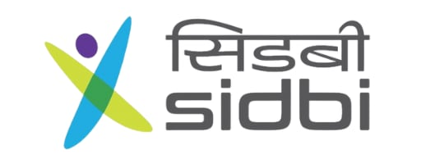



Slide 2
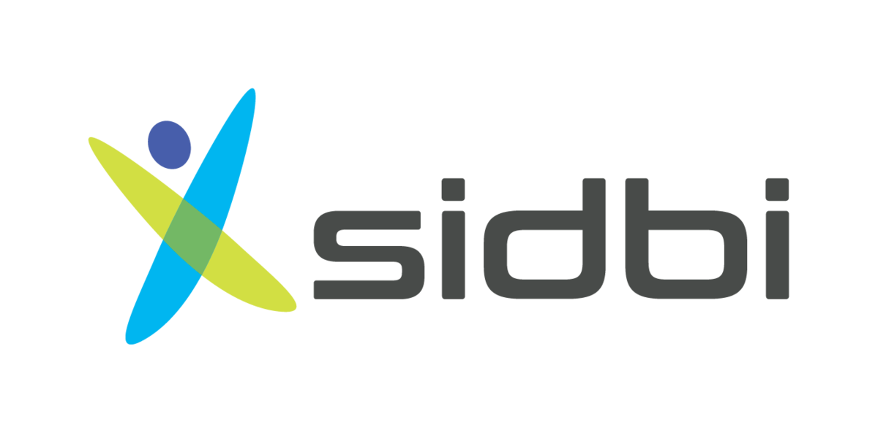





Business FY 2024-25
Outstanding Growth
SMA %
1.07%
32%
FY 2024-25
New Customer Added
4046 Nos.
Fresh Sanctions
Disbursements
16,017 Cr
10,288 Cr

Slide 3





Introduction to SIDBIs direct lending schemes
Machinery/Equipment Finance
31000+ Cr
O/s
Portfolio
Project Finance – Capex Requirements/Brownfield
16000+
Customers
Project Finance – Greenfield/ New Investment
16
Regional Offices
140+
Branch
Offices
Working Capital/ Overdraft
Green Finance – Energy Efficient Projects

Slide 4
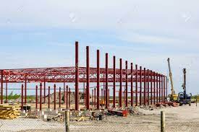
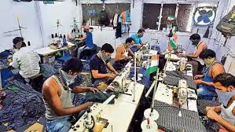
Assistance for expansion /setting up new unit
Purchase of land
Civil works
Machine & Equipments
Margin money for WC
Eligibility
MSME as per MSMED Act
Loans Upto
Rs. 100 Crore
Direct Credit Scheme
Assistance upto
75% of Project cost for Existing entity
67% for new entity
Flexible Repayment Upto 10 Years
ROI- MCLR based / Fixed ROI
Vanilla Product for all your “Capex Needs”

Slide 5
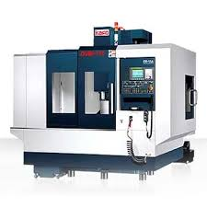
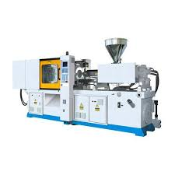
Purchase of Machinery/Equipments
Immediate
In -Principle Decision
Eligibility
3 Years Operation
GST Registration
Udyam Registration
EXPRESS
Flexible Repayment Upto 5 Years
Loans Upto
Rs. 5 Crore (Existing SIDBI customers)
Rs. 3 Crore (New to SIDBI customers)
*Upto 100% funding with Cash collateral
ROI- MCLR based / Fixed ROI
For Your “EXPRESS” Needs

Slide 6
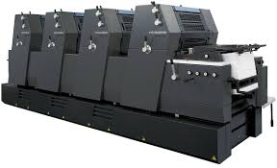
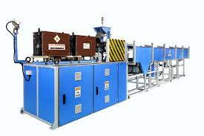
Purchase of Machinery/Equipments
2nd Hand Machinery and Minor civil work also covered
Dual Financing Model
100% Financing with cash collateral
Promoter contribution Model with upto 75% finance
Eligibility
3 Years of Operations with Cash Profits
SPEED
Flexible Repayment
Upto 7 Years
Loans Upto
Rs. 20 Crore
ROI- MCLR based / Fixed ROI
Adding “SPEED” to your
Growth Story…

Slide 7

Assistance for energy efficient investments in MSMEs
Solar PV & Windmill
Energy efficient Machinery
Dual Financing Model
100%Financing Model
PC Model – Upto 75% finance.
End to End Energy Efficiency-4E
Eligibility
Existing unit with 3 years operation and cash profit
Flexible Repayment Upto 7 Years
MSE-GIFT Subsidy Scheme
Assistance Upto
Rs. 20 Crore
“Greening the MSME Ecosystem”

Slide 8


Assistance for regular working capital needs of the business.
Arrangement with Yes, IDBI & City Union bank for maintaining Working capital account.
Eligibility
Existing MSME not availing CC/OD from any other bank.
Greenfield entity where term loan is also considered.
Working Capital
ToD and Adhoc facilities also available
MCLR Linked Attractive RoI
“For day-to-day business requirements”

Slide 9
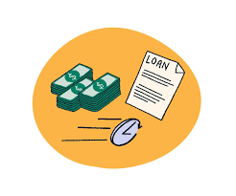
Overdraft assistance for working capital requirements
Arrangement with Yes, IDBI & City Union bank for maintaining Overdraft account.
Eligibility
3 Years of Operations
Presently not availing CC/OD from other banks.
SWIFT
Low processing fees @0.25%
MCLR Linked Attractive RoI
Assistance Upto
Rs. 3 Crore
“Swift” assistance for your working capital requirements…

Slide 10

Assistance for any business-related expenditure
Loan upto 70% of market value of collateral security.
Eligibility
3 Years of Operations with cash profits
Net profit in two of the past 3 FYs
Secured Business Loan
Flexible Repayment Upto 10 Years
Assistance Upto
Rs. 20 Crores (Mfg)
Rs. 10 Crores (Trading)
MCLR Linked Attractive RoI
“Quick Business Loan” against Immovable Property

Slide 11
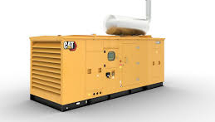
Assistance for purchasing new/replacing old DG sets with modern technologies
Encouraging MSME’s to purchase new DG Set for cleaner Environment
Eligibility
2 Years of Operations with cash profits
Net profit in past 1 FY
Flexible Repayment Upto 5 Years
EDGE
Assistance Upto
Rs. 5 Crore
ROI- MCLR based / Fixed ROI
Dual Financing Model
100%Financing Model with 10% cash collateral
PC Model – Upto 90% finance.
“Growth shouldn’t Stop”

Slide 12

To modernize / renovate their existing facilities to strengthen revenue stream
Modernization and Renovation of Hotel, Restaurants and other service Enterprises in MSME Sector
Eligibility
3 Years of Operations with cash profits
Net profit in immediate FY
MORE
Flexible Repayment Upto 8 Years
Assistance Upto
Rs 5 Crore
ROI- MCLR based / Fixed ROI

Slide 13
Eligibility
-MSMEs as per MSME Act
- Minimum 51% stake of SC/ST Entrepreneurs
Encouraging SC/ST Entrepreneurs
Assistance Upto
Rs. 3 Crore
SAATH
0.5% yearly incentive
50% CGTMSE fees is borne by SIDBI
Assistance upto
80% of Project cost for Existing entity
75% for new entity
Flexible Repayment Upto 7 Years
ROI- MCLR based / Fixed ROI
Providing SAATH to SC/ST Entrepreneurs

Slide 14
Eligibility
-MSMEs as per MSME Act
- Minimum 51% stake of Women Entrepreneurs
Encouraging Women Entrepreneurs
ARJANA
0.5% yearly incentive on satisfactory repayment track record
50% CGTMSE fees is borne by SIDBI (upto cover of Rs. 3.00 Crore)
Flexible Repayment Upto 10 Years
ROI- MCLR based / Fixed ROI
Encouraging Women Entrepreneurs

Slide 15
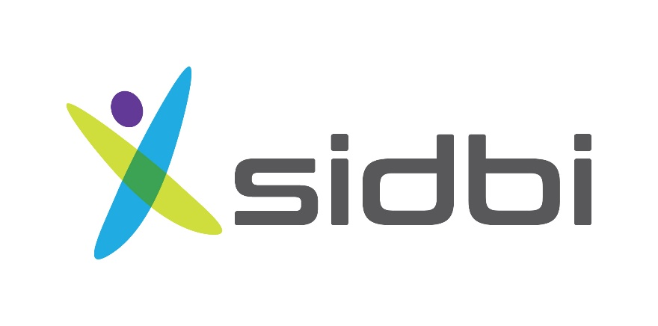
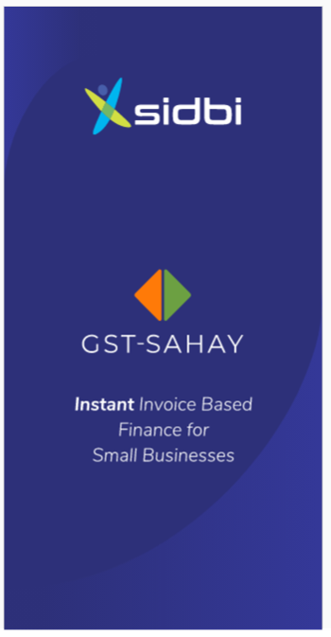
GST-Sahay
Invoice Based Financing
For SIDBI’s existing customers

Slide 16
Priviledge Customer Scheme
Loan offer by SIDBI to existing well performing SIDBI customers for their annual non-project / project specific investment plans.
Customers should have “Satisfactory” payment track record with no delay in monthly payment beyond 30 days.
Should have reported net profits.
Silver
2 years satisfactory payment track record.
Net profit in last 2 FYs.
Loan upto Rs. 100 lakh.
Gold
3 years satisfactory payment track record.
Net profit in last 3 FYs.
Loan upto Rs. 200 lakh
Platinum
5 years satisfactory payment track record.
Net profit in last 4 FYs.
Loan upto Rs. 300 lakh

Slide 17




Thank you
@sidbiofficial
@sidbiofficial
@sidbiofficial
For more information, you can reach:
Name | Designation | Contact
Atul Pardeshi | Assistant Manager | 9096893176
SIDBI, Sitapura Industrial Area Branch. G-1/43, Sitapura Industrial Area, Jaipur 302022

