Slide 1
Review Procedure & Reporting by Peer Reviewer
Source : https://icai.org/post/peer-review-board
CA. Vimal Chopra
Ex-Chairman CIRC of ICAI

Slide 2
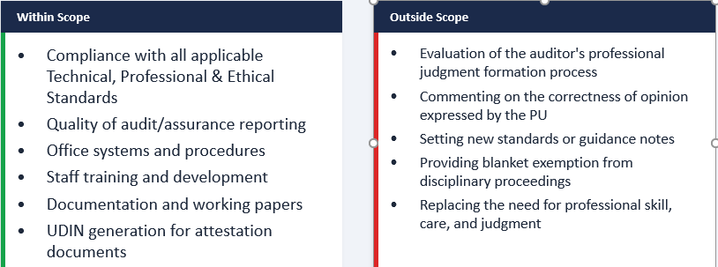
What Falls Within the Reviewer's Scope?

Slide 3
Role & Approach of the Reviewer
The Reviewer concentrates on adequacy of procedures laid down — not on the process of judgment formation
Purpose: to assess that the opinion expressed by the PU is based on compliance with appropriate procedures, systems, techniques, and tools applied effectively and consistently
The Reviewer examines engagement records pertaining to attestation services
Focus areas where practicing members need guidance in improving quality, consistency, and adaptability
Reviewer works at PU's office — cannot copy or extract client documents; only take abstract notes
May take help of one qualified assistant; but the Reviewer alone signs the Final Report
Key: The Reviewer reviews the application of existing standards — not to set new standards.

Slide 4
Reporting by Peer Reviewer
The Reviewer assesses procedural adequacy, not judgment — focus on systems and documentation
Assurance services + compliance of T P E Standards + QC within PU
Areas of Control to be addressed by Report
  Independence (I)
  Maintenance of Professional Skill and Standards (MPSS)
  Outside Consultation (OC)
  Staff recruitment, supervision and development. (SRSD)
  Office administration. (OA)

Slide 5
COMPLIANCE REVIEW PROCEDURE
(I,MPSS,OC,SRSD,OA)
Independence (I) - A PU is expected to
policy - ensure independence, objectivity and integrity - partners and staff.
communicate - policies & expected standards of professional behavior to all staff.
monitors compliance with policies and procedures relating to Independence.
review - PU association with clients for objectivity & independence.
financial statements are prepared by the PU or TCWG ?
It would give an indication on the degree of independence exercised by PU.

Slide 6
COMPLIANCE REVIEW PROCEDURE-2
(I,MPSS,OC,SRSD,OA)
(b) Maintenance of Professional Skills and Standards :- PU to have
• established plan - personnel needs(present/future) at all levels, based anticipated clientele, business growth, impending retirements, etc.
• established recruitment policy.
• new personnel informed of the relevant personnel policies/procedures
• continuing education programmes(CEP) for partners/staff.
• Access of Assur. team on AS/SA & pronouncements by professional bodies
• conduct programmes for expertise in specialized areas and industries ?

Slide 7
COMPLIANCE REVIEW PROCEDURE-3
(I,MPSS,OC,SRSD,OA)
  (c) Outside Consultation
  • Is there a policy for consulting experts (both internal and external).
  • Has the PU built up a network of other accountants, solicitors and advocates, and technical consultants in industries in which its clients operate.

Slide 8
COMPLIANCE REVIEW PROCEDURE-4
(I,MPSS,OC,SRSD,OA)
(d) Staff Recruitment, Supervision and Development : PU to have
• written guidelines - responsibility at each level, and on the expected performance and qualifications necessary for advancement to the next level.
• system for gathering & evaluating information on performance of personnel.
• system of counselling its personnel on performance & career opportunities.
• system of assigning an audit to the most appropriate Personnel. Are requirements of specialised expertise and personnel skills given due consideration?
• written guidelines for maintaining working papers (form and content).
• standardised forms, checklists, & questionnaires to assist in conduct of audit

Slide 9
COMPLIANCE REVIEW PROCEDURE-5
(I,MPSS,OC,SRSD,OA)
(e) Office Administration : PU to Have
• established procedures for record retention + security aspects.
• maintain a record containing particulars such as client’s name, nature of engagement, particulars regarding date of commencement of audit, date of audit report, billing, etc.
• maintain staff register.
• Library containing relevant books and all publications of ICAI.

Slide 10
WHY PERFORM COMPLIANCE PROCEDURE?
Objectives
    Perform Compliance Procedures
    Assess General Controls based on Compliance Procedures
    Decide Nature, extent and timing of Substantive Procedure

Slide 11
CRITERIA FOR SAMPLE SELECTION-
To ensure-
  Samples – High, Medium or Low - risk factors of assurance functions
  assurance activities handled by each and every partner
  associate concern of PU should be clearly identified
  If outgoing auditors are related to the incoming auditors ?
  Robust HO and Branch Communications in place
  All locations of the PU should be taken into consideration
  also cover the assignments which are quoted much below the prescribed minimum fees as per the ICAI guidelines
  check the files of those clientele which have been disassociated with the PU for professional and non-professional reasons.
  if other consultancy services are more billable than assurance services?

Slide 12
ILLUSTRATIVE CHECKLISTS OF THE PRACTICE UNIT
Preliminary Review Procedures
  pre-audit minutes
  Appointment letter and the relevant resolution
  first audit? check ADT-1 is filed ? NOC is obtained from predecessor?
  audit risk is assessed ? the professional judgement and audit procedure
  nature of business + internal control system + TCWG controls
  appropriate checklist w.r.t identification of materiality ? + is it Logical ?
  applicability of small company, CASR, Internal Audit, IFC and CARO ?
  Audit team is deployed on the nature/risk involved in the assignment?
  audit strategy and plan+documented and communicated inter se Audit team.
  New Clients – Due Procedure; Old Clients- client continuation procedures

Slide 13
Preliminary Review Procedures-2
Written terms of engagement in line with SA
Competency of the team to be assessed before start
quality control procedures are complied with ?
Annual Report of Previous Year referred ?
fundamental accounting assumptions ? Adhered (C,GC,A)
items of significant importance+ properly checked
In case of Company
  Shareholding pattern, fresh issue ?- ROC Compliance, shareholder's agreement, verified the MCA records online?

Slide 14
Preliminary Review Procedures-3
In case of Partnership firm or LLP
  PSR ratio of the partners from the partnership deed
  LLP, check the signatory details and designed partner from the MCA records
Include test of Journal entries + to assessee risk of fraud or misstatement
Performance of analytical review procedures+ substantive tests of detail to obtain sufficient, relevant & reliable audit evidence for each audit objective
Checklist - audit programme - inter-team discussion is prepared ?
Checklist – for compliance with applicable AS(s), CARO, GST etc.
if disclosure of change in an accounting policy + material effect + documents ?
all the major issues/discussion points are documented and communicated to the management and TCWG.

Slide 15
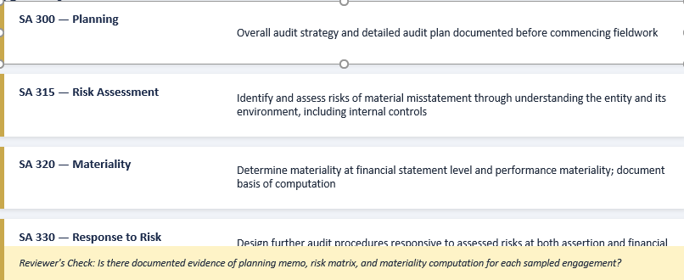
Audit Planning & Risk Assessment (SA 300, 315, 320)

Slide 16
Audit Planning
Connect of management team from PU with the entity + TCWG.
PU has followed the following procedures diligently ?
  Developed an audit strategy consideration scope of the engagement;
  Considered business + regulatory environment surrounding entity ;
  Considered entity specific issues including reliance on the work of internal audit;
  Preliminary setting of materiality levels + review of risk including fraud risk
audit plan + nature, timing and extent of the audit procedures to reduce the audit risk to an acceptably low level

Slide 17
Audit Evidence (SA 500 Series)
SA 500 requires auditor to obtain sufficient and appropriate audit evidence to draw reasonable conclusions
SA 505 — External Confirmations: bank confirmations, debtor/creditor confirmations, legal confirmations
SA 520 — Analytical Procedures: substantive analytical procedures must be documented with expectations and investigation of variances
SA 530 — Sampling: document basis for sample selection, evaluation of results, and projection of misstatements
SA 550 — Related Parties: identify related party transactions, assess disclosure adequacy, and evaluate risk of fraud
SA 560 — Subsequent Events: procedures to identify events occurring between financial statement date and auditor's report date

Slide 18
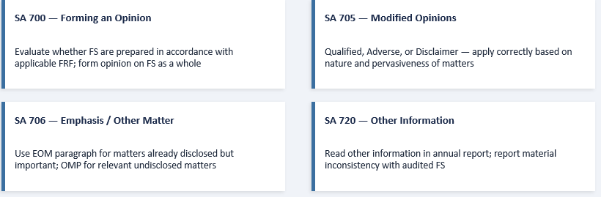
Audit Reporting (SA 700–706)

Slide 19
Documentation Requirements (SA 230)
Working papers must enable an experienced auditor with no prior connection to understand: nature, timing, extent of procedures performed; results obtained; and significant matters and conclusions
Permanent audit file: entity-level information, engagement letters, organizational structure, internal control documentation
Current audit file: audit programs, lead schedules, analysis of balances, confirmation replies, representation letters
Final assembly within 60 days of the auditor's report date — file must then be locked against changes
Retention period: minimum 7 years from date of auditor's report (ICAI Announcement)
Document identification: each working paper must bear engagement name, date, preparer initials, and reviewer sign-off

Slide 20
Compliance with Accounting Standards
Reviewer verifies that financial statements comply with applicable Accounting Standards (AS / Ind AS)
Common areas of scrutiny: Revenue Recognition (AS 9 / Ind AS 115), Depreciation (AS 6 / Ind AS 16), Leases (AS 19 / Ind AS 116), Related Party Disclosures (AS 18 / Ind AS 24)
Check whether disclosures required by each standard are complete and adequate
Verify consistency in application of accounting policies across periods
For companies under Ind AS: assess compliance with fair value measurements, impairment testing, and expected credit loss models
Practical Tip: Maintain a standard-wise compliance checklist for each engagement to ensure no disclosure requirement is missed during reporting.

Slide 21
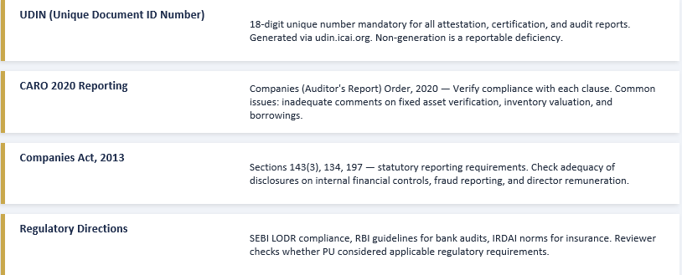
UDIN, CARO & Regulatory Compliance

Slide 22
Senior Review Checklists
whether the working papers contain all audit evidence + cross referenced
Summary of work done, problems, important judgements + audit conclusions
Review by senior in-charge + all assistants, audit programme + work performed
Updating of audit working papers including permanent records
checklists prepared was reviewed by the audit manager in-charge ?
Comparison of budgeted time to actual and reasons for major variations.
Review of unadjusted errors - determine materiality at individual/overall
Review of -draft financials –acceptability with AS(s), Audit , opinion-Reports
significant events have occurred post BS date – its impact
final deliverables checklist + approval by the audit partner in-charge.
Planning of next year's audit

Slide 23
Partner Review Checklists
Check -documents and working papers are available/ stored appropriately.
Ensure - final clearance obtained from independent reviewer for tax computation.
Check - final deliverables checklist -by audit in-charge
Review - the Auditor's report for appropriateness of reporting and the qualification and comments are discussed with Management before signing off.

Slide 24
Final Audit File and checkpoints
Review of final audit files should typically include -
Items requiring partner’s attention
Summary of unadjusted errors + theirs non materiality.
Lead schedules and audit conclusions for each material area and where necessary, a more detailed review of the specific areas. Further all the memorandum of changes (MOC’s) and audit adjustments (typically known as audit JV’s) should be signed off by TCWG and documented in the audit file.
Also, whether audit qualifications are being discussed and concurred with TCWG before issuing to the investors and necessary documents for the same should be in order supporting the claim.
Keep closing trial balance signed off by the appropriate authority and documented by the PU. Such a measure would also support the opinion as expressed by the auditor in his report, “Whether financial statements are in agreement with books of account”

Slide 25
QUALITY OF REPORTING – SUPERVISION IN ENGAGEMENT
Complexity of Subject matter
Qualifications of Engagement Team
Extent of consultations available and used
Degree of authority delegated to assistants on engagement
Performance Review
Inherent Risk in the Engagement

Slide 26
Time Budget
System in place to avoid Wastage of man-hours
Comparison of Actual and budgeted time by senior.
Partner will ensure time management.

Slide 27
OFFICE PROCEDURE
Understanding Client and Work
Selection of Engagement Team
Preparation of Audit Plan and Programme
Direction and Supervision by competent personnel
Review of Work Performed

Slide 28
Staffing
Unambiguity in Job Descriptions for all levels
New Employees like orientation programme, discussion of office procedures etc
Performance Appraisal in place

Slide 29
TRAINING AND OFFICE ADMINISTRATION
To Acquire and Achieve
  Theoretical Knowledge
  Skill to apply theoretical knowledge
  Disciplined Attitude
  Professional Orientation
  Ethical Values

Slide 30
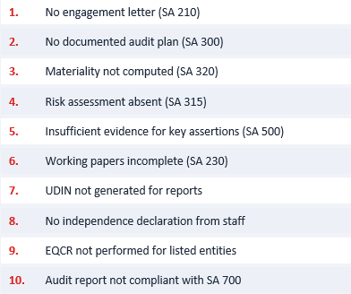
Top 10 Non-Compliance Issues in PR

Slide 31
QRB Quality Review Observations
ICAI has published 3 volumes of "Guidance on Non-Compliances Observed by QRB During Quality Reviews" covering 46 common deficiency types across 151+ cases.
Volume 1–3 cover non-compliance with SQC, SAs, and the Companies Act
Key focus areas: SA 230 (Documentation), SA 240 (Fraud Detection), SA 315 (Risk Assessment), SA 520 (Analytical Procedures)
QRB findings are referred to ICAI for advisory or disciplinary action
Internal Financial Controls (IFC) over Financial Reporting — frequently inadequate documentation of control testing
Firms are advised to use ICAI's published guidance to proactively strengthen their engagement quality

Slide 32
TIME TO SAY
THANKS

