Slide 1
PRESENTED BY
P.C. Parwal, FCA
§
ITA
2025
Clubbing and Aggregation
Rules
Under the New Income Tax Act – 2025
✉ pparwal@kalanico.com ● ☎ 98298-88804
Professional Development Session

Slide 2
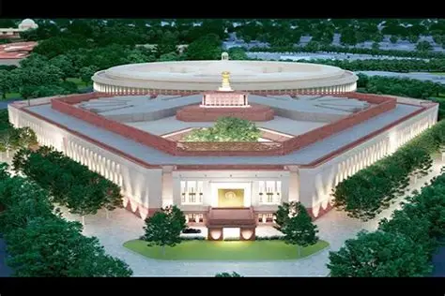
Income-tax Act, 2025:
A Comprehensive Reform
A structural overhaul of India's direct tax framework
to create a simplified, modern, and efficient system aligned with contemporary economic realities

Slide 3
Five Critical Challenges Requiring Reform
Increasing Complexity
High Litigation
Fragmented Structure
Continuous amendments led to layered provisions, multiple provisos, explanations. Interpretation required frequent cross-referencing, making the law difficult even for professionals.
Ambiguity in drafting resulted in multiple interpretations. This significantly increased tax disputes and litigation burden across all levels.
Provisions relating to similar subjects were scattered across different sections. Lack of logical arrangement made navigation inefficient and time-consuming.
Outdated Framework
Compliance Burden
The original Act was not designed for a digital and globalised economy. Digital transactions, e-assessments automation were introduced through amendments.
Procedural complexity increased compliance costs for taxpayers, especially small entities and first-time filers.

Slide 4

What was the need?
Simplify statutory language
Improve structural clarity
Reduce interpretational disputes
Deleting obsolete provisions
Approach adopted
Eliminate intricate language to enhance readability
Remove redundant and repetitive provisions for better navigation
Reorganize sections logically to facilitate ease of reference

Slide 5

What Remains Unchanged
Core Taxation Principles
Reform Focus Areas
The reform preserves fundamental tax principles that have stood the test of time:
The changes primarily target:
Presentation and readability
Clarity and precision
Operational efficiency
Facilitation of ease of doing business
Charging of income tax on a fiscal year basis
Classification of heads of income
Determination of residential status
Basic charge of tax computation

Slide 6
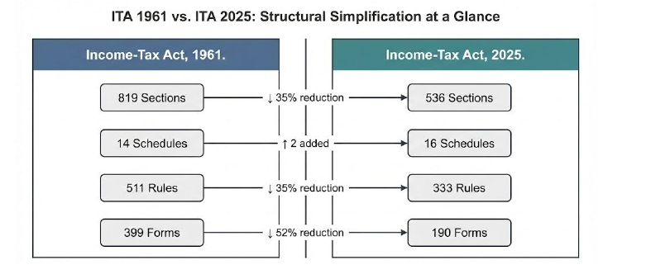
STRUCTURAL CHANGES
Particulars | 1961 Act | 2025 Act
Words | 5.12 lakhs | 2.60 lakhs
Chapters | 47 | 23
Sections | 819 | 536
Tables | 18 | 57
Formulae | 6 | 46
Schedules | 14 | 16
Pages | 823 | 622
Rules | 511 | 333
Forms | 399 | 190
Besides about 1200 Provisos and 900 Explanations have been removed. Their simplified content has been placed as sub-sections or clauses.

Slide 7
CHAPTERS OVERVIEW
Chapter | Overview | Sections
Chapter 1 | Preliminary | 1-3
Chapter 2 | Basis of Charge | 4-10
Chapter 3 | Incomes which do not form part of Total Income | 11-12
Chapter 4 | Computation of Total Income | 13-95
Chapter 5 | Income of other persons, Included in the Total Income of the Assessee. | 96-100
Chapter 6 | Aggregation of Income | 101-107
Chapter 7 | Set off, or Carry Forward And Set Off of Losses | 108-121
Chapter 8 | Deductions to be made in Computing Total Income | 122-154
Chapter 9 | Rebate And Reliefs | 155-160
Chapter 10 | Special Provisions Relating to Avoidance of Tax | 161-177
Chapter 11 | General Anti-Avoidance Rule | 178-184
Chapter | Overview | Sections
Chapter 12 | Mode of Payment in Certain Cases | 185-189
Chapter 13 | Determination of tax in Special Cases | 190-235
Chapter 14 | Tax Administration | 236-261
Chapter 15 | Return of Income | 262-267
Chapter 16 | Procedure for Assessment | 268-301
Chapter 17 | Special tax provisions for certain persons. | 302-355
Chapter 18 | Appeals, Revision and Alternate Dispute Resolution. | 356-389
Chapter 19 | Collection and Recovery of Tax | 390-430
Chapter 20 | Refunds | 431-438
Chapter 21 | Penalties | 439-472
Chapter 22 | Offences and Prosecution | 473-498
Chapter 23 | Miscellaneous | 499-536

Slide 8
SCHEDULES OVERVIEW
Schedule | Overview | Ref section
SCHEDULE I | Conditions For Certain Activities Not To Constitute Business Connection In India | [See section 9(12)]
SCHEDULE II | Income Not To Be Included In Total Income | [See section 11]
SCHEDULE III | Income Not To Be Included In Total Income Of Eligible Persons | [See section 11]
SCHEDULE IV | Income not to be included in total income of eligible non-residents, foreign companies and other such persons | [See section 11]
SCHEDULE V | Income not to be included in total income of certain eligible persons including investment funds, business trusts and their unit holders | [See section 11]
SCHEDULE VI | Income not to be included in total income of certain eligible persons in international financial services centre or having income therefrom | [See section 11]
SCHEDULE VII | Persons Exempt From Tax | [See section 11]
SCHEDULE VIII | income not to be included in the total income of political parties and electoral trusts | [See section 12]
SCHEDULE IX | Deduction For Tea Development Account, Coffee Development Account And Rubber Development Account For Computing Income Under The Head “Profits And Gains Of Business Or Profession | [See section 48]
SCHEDULE X | Deduction for site restoration fund for computing income under the head “profits and gains of business or profession | [See section 49]
SCHEDULE XI | Part A - Recognised Provident Funds; Part B - approved superannuation funds and gratuity funds; Part C - power to make rules for provident funds, superannuation funds and gratuity funds | [See section 2(91)]
SCHEDULE XII | Part A – minerals; Part B - groups of associated minerals | [See section 51]
SCHEDULE XIII | List of articles or things | [See section 45(2)]
SCHEDULE XIV | Insurance business | [See section 55]
SCHEDULE XV | Deduction in respect of life insurance premia, contribution to provident fund, subscription to certain equity shares, etc | [See section 123]
SCHEDULE XVI | Permitted modes of investment or deposits | [See section 350]

Slide 9

CHAPTER I: PRELIMINARY
[Sections 1 to 3]

Slide 10
Short title, extent and commencement.
1. (1) This Act may be called the Income-tax Act, 2025.
(2) It extends to the whole of India.
(3) Save as otherwise provided in this Act, it shall come into force on the 1st April, 2026.
Definitions.
2. In this Act, unless the context otherwise requires,—
(1) “accountant” shall have the meaning assigned to it in section 515(3)(b);
……………..
(112) “zero coupon bond” means a bond
………..
So, total 112 definitions have been provided in section 2. In the IT Act 1961, there were 94 terms which were defined in section 2.
Key changes:
Section 2(13) of the IT Act 2025 provides statutory definition of “assessment” that includes reassessment and recomputation. The definition enhances clarity and removes ambiguity by explicitly covering the term ‘recomputation’ which was not there in the definition of IT Act 1961

Slide 11
Key changes:
Section 2(19) of the IT Act 2025 provides statutory definition of “books or books of account”. In the definition “cloud-based storage” has also been specifically included in this definition. Also, ‘portable data storage devices’, ‘external hard drives’ or ‘memory cards’ have been specifically included in the definition.
Section 2(23) defines the term “charitable purpose”. Charitable Purpose’ includes: (a) relief of the poor; (b) education; (c) yoga; (d) medical relief; (e) preservation of the environment (including watersheds, forests and wildlife); (f) preservation of monuments or places or objects of artistic or historic interest; (g) the advancement of any other object of general public utility (GPU).
The definition omits the restrictive proviso of GPU earlier provided in 1961 Act. Instead, Section 346 of the 2025 Act incorporates a similar restriction on commercial activities by registered NPOs engaged in GPU.
Thus, the revised definition clarifies the concept of a charitable purpose without imposing any limitations. The restrictions on commercial activities remain unchanged but are addressed under Section 346, effectively distinguishing the definition of a charitable purpose from eligibility for tax exemption. NPOs engaged in GPU activities must now comply with Section 346 to adhere to the restrictions on commercial operations while maintaining their charitable status.
The other notable change is changing the reference from “trust” to “non-profit organization”

Slide 12
Key changes:
Section 2(94) of the 2025 Act clarifies that “relative”, in relation to an individual, means the husband, wife, brother, sister or any lineal ascendant (maternal as well as paternal) or descendant of that individual.
The phrase (maternal as well as paternal) has been specifically added to include maternal side as well.

Slide 13
Section 3: Tax Year
The concept of ‘tax year’ has been introduced replacing ‘previous year’ and ‘assessment year’.
As per section 3 of Income-tax Act, 2025, “Tax Year” means the twelve months period of the financial year commencing on the 1st April.
Use of the terms ‘previous year’ and ‘assessment year’ replaced with “tax year”
In case where business or profession is newly set up, or a source of income newly coming into existence in any financial year, the tax year will be the period beginning with —
(a) the date of setting up of such business or profession; or
(b) the date on which such source of income newly comes into existence,
and ending with the said financial year.

Slide 14
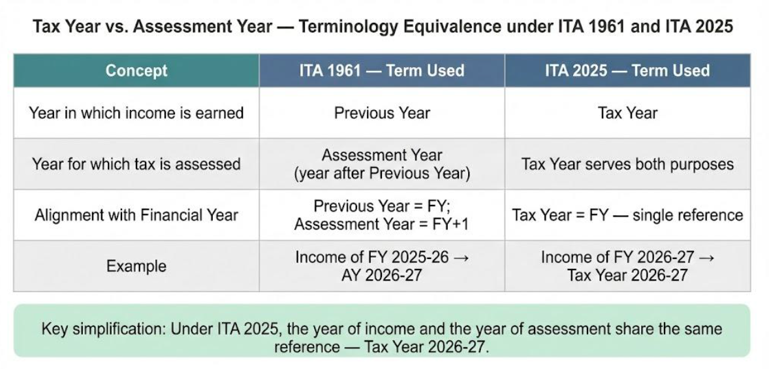

Slide 15

CHAPTER V
Income of other persons, included in assessee’s total income [Section 60 to 65 in IT ACT, 1961]
Vs.
Income of Other Person Included In Total Income of Assessee
[Section 96 to 100 in IT Act, 2025]

Slide 16
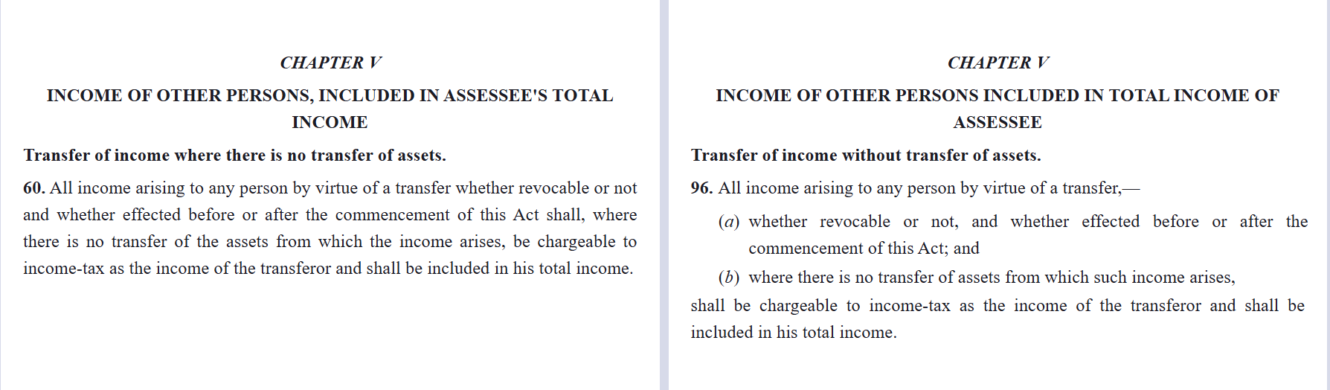
If you transfer just income (not the asset), that income is taxed in your hands.
Same rule, but simpler words—no major change.

Slide 17
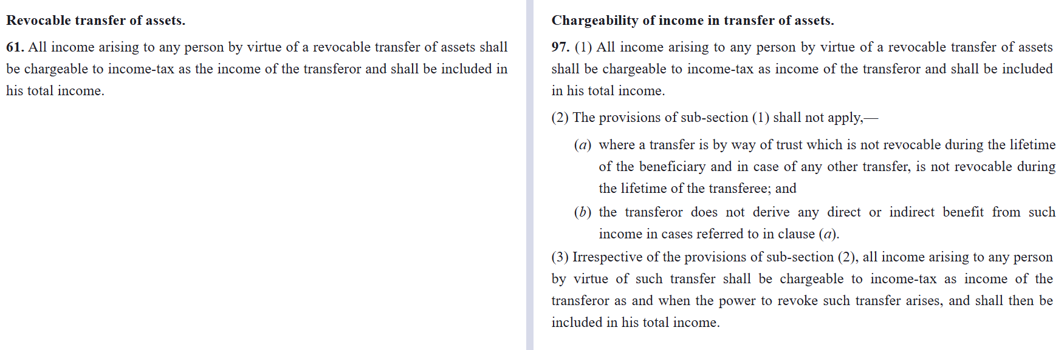
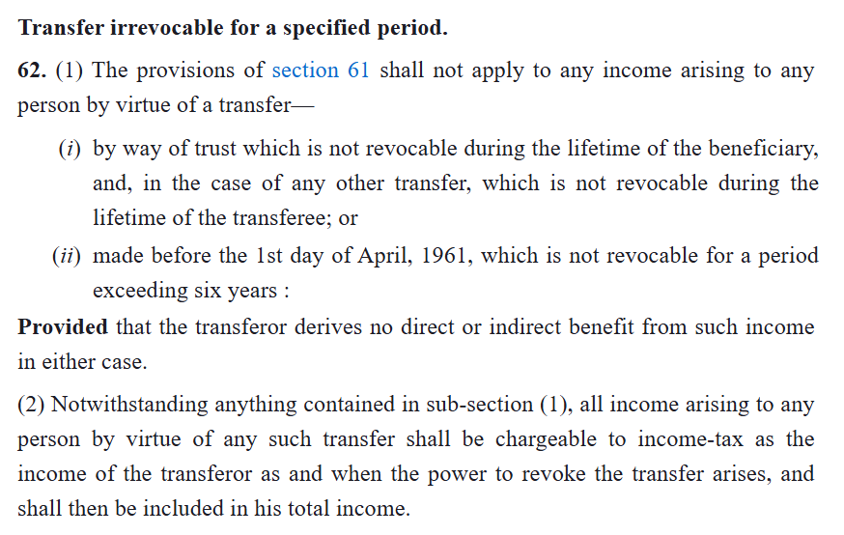

Slide 18
Section 97 of the Income Tax Act, 2025, largely mirrors Sections 61-63 of the 1961 Act by taxing income from revocable transfers in the transferor's hands, with no explicit mention of a "post-5-year irrevocable" exception in available texts. While Section 62 of the 1961 Act carves out exceptions to Section 61's revocable transfer rule—such as irrevocable trusts during the transferee's lifetime without transferor benefit, pre-June 1, 1961 transfers becoming irrevocable after 6 years, or absolute transfers with no reverter—Section 97 of the 2025 Act integrates and tightens these into its sub-clauses with stricter timing, not extending safe-harbor wait periods beyond 6 years for exemptions, ensuring short-term "irrevocable" structures remain taxable to curb transient tax avoidance while embedding clearer compliance norms.

Slide 19
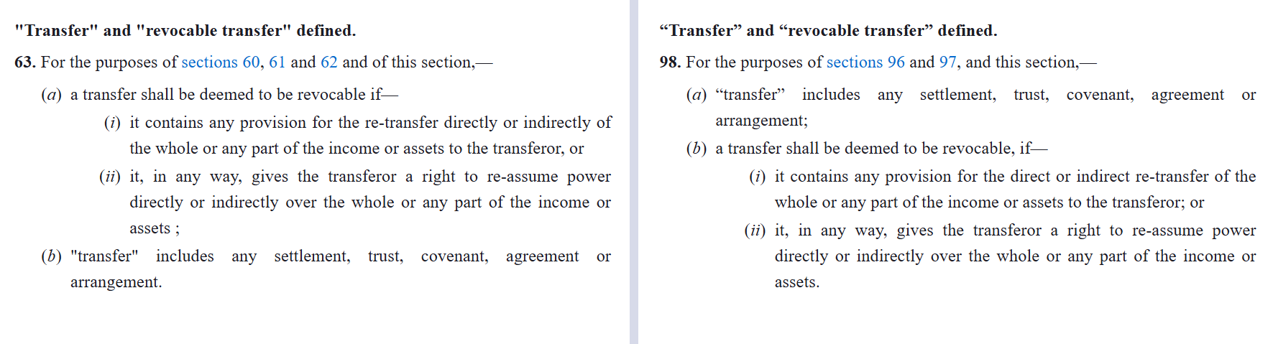
Same definition but more streamlined- no major shift

Slide 20
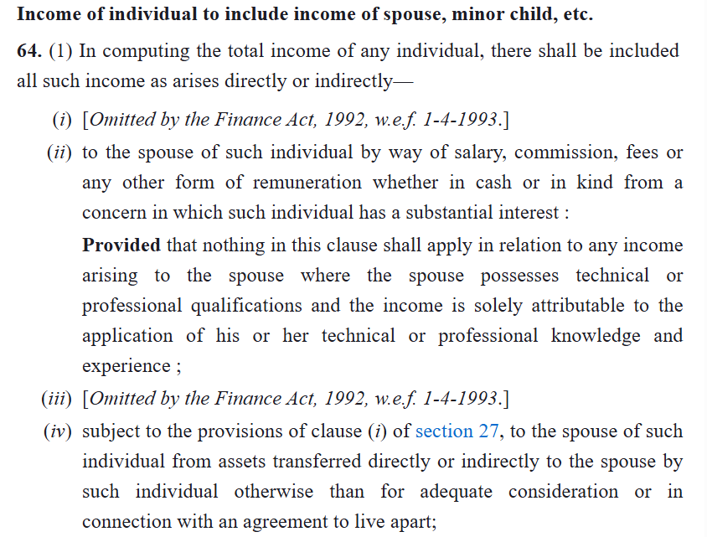
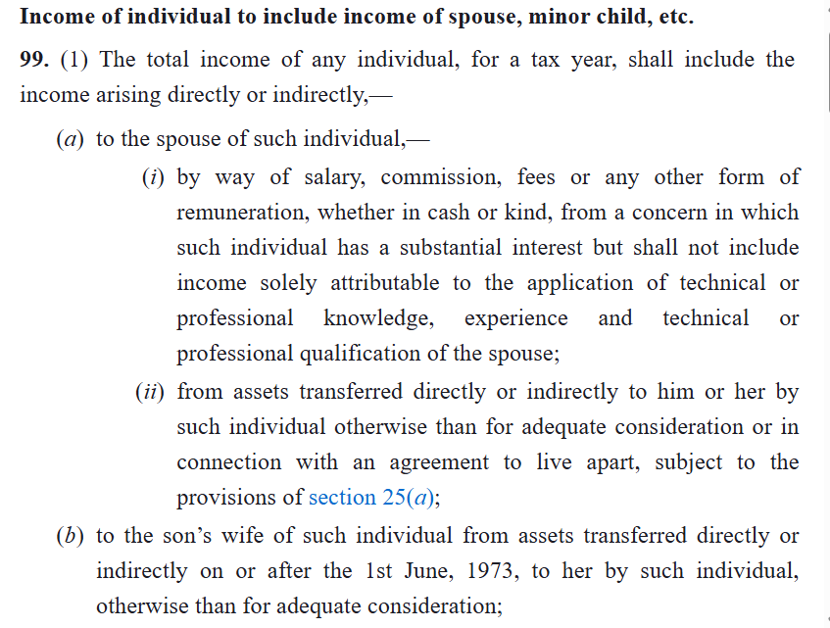

Slide 21
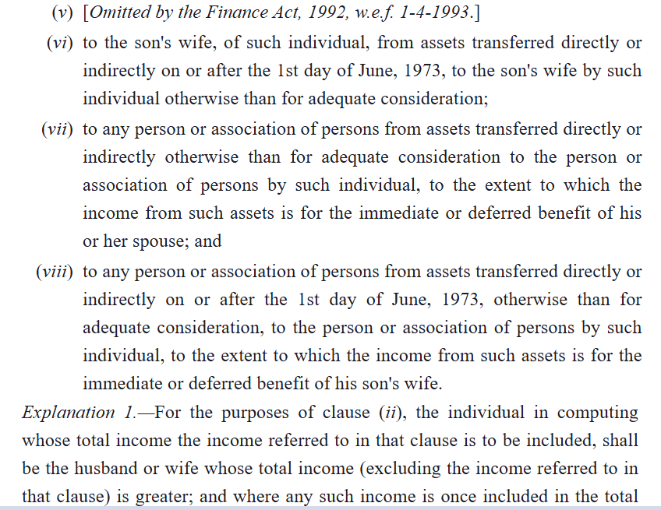
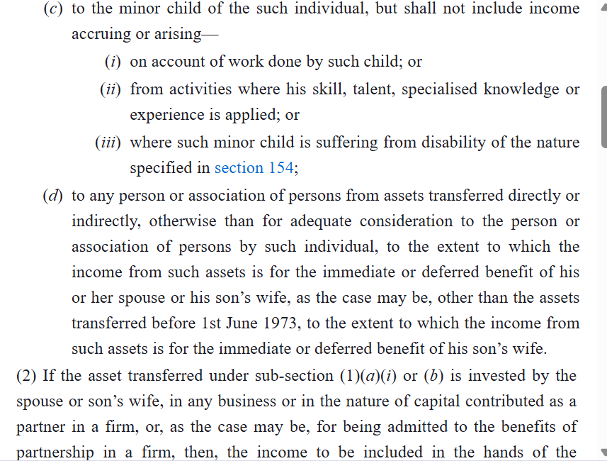

Slide 22
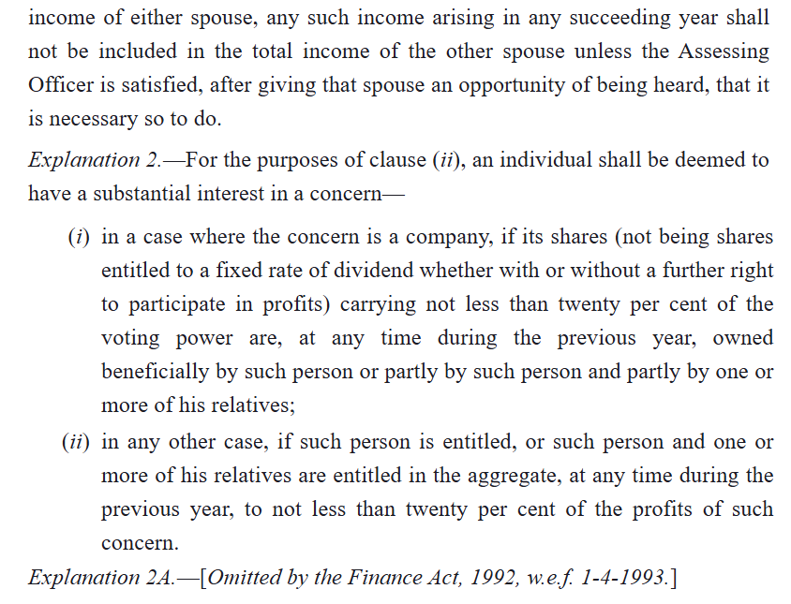
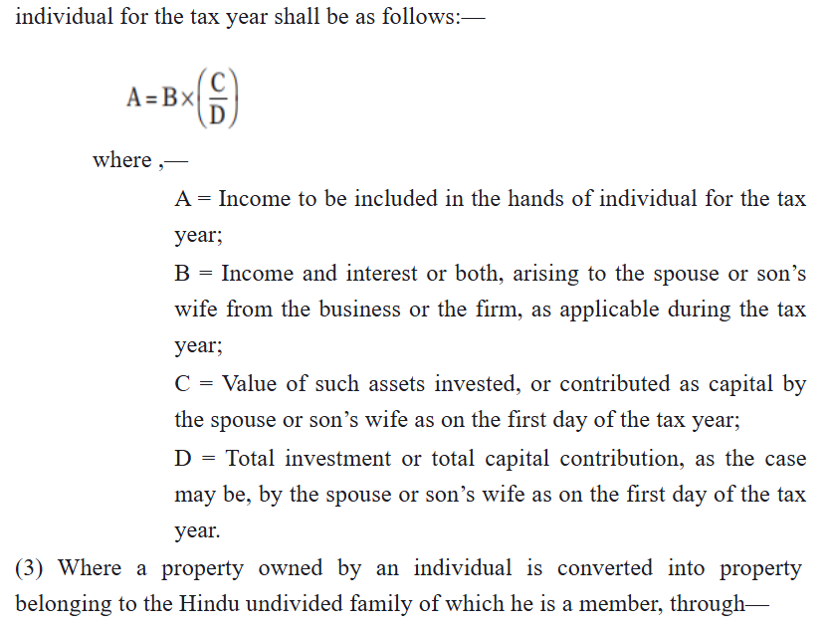

Slide 23
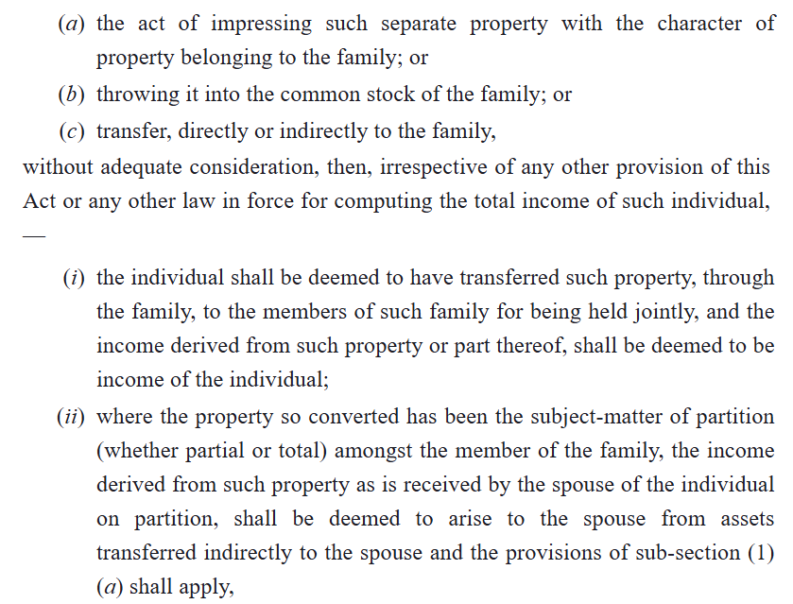
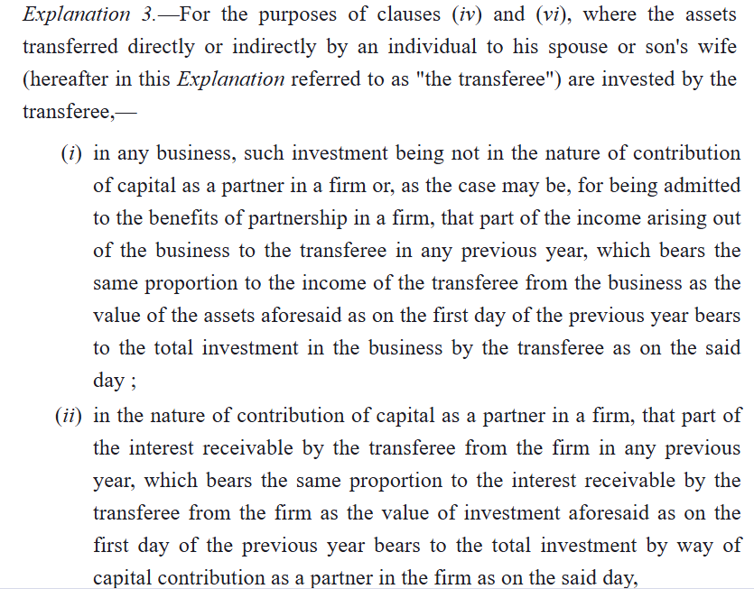

Slide 24
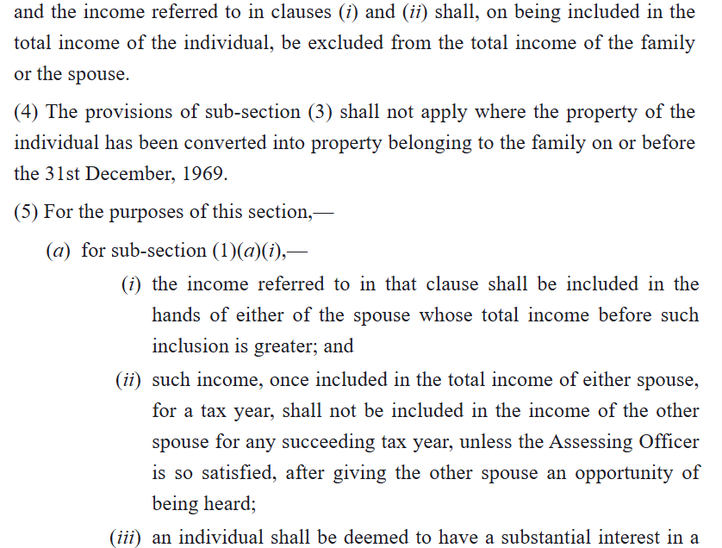
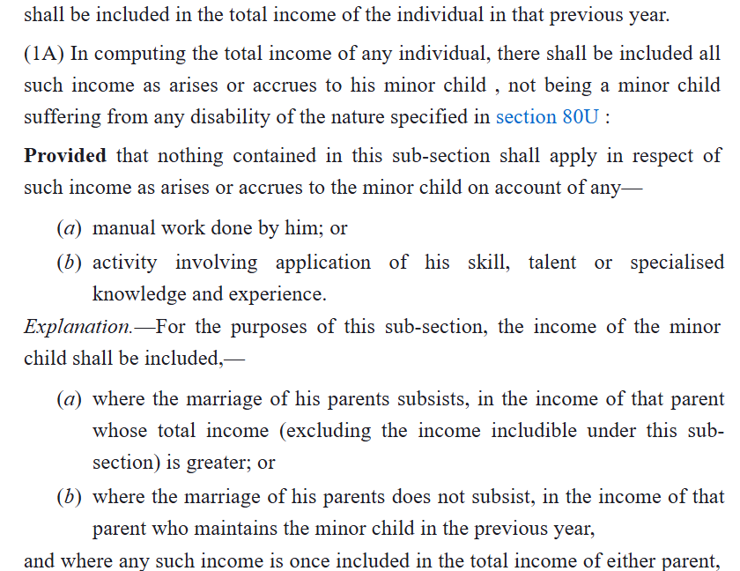

Slide 25
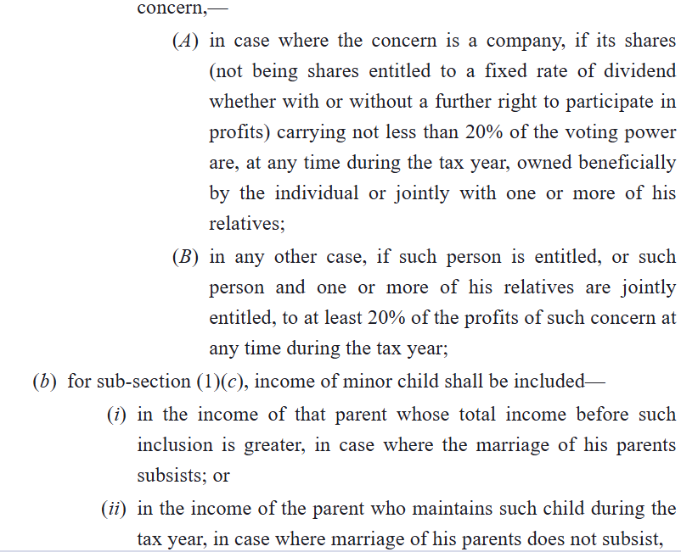
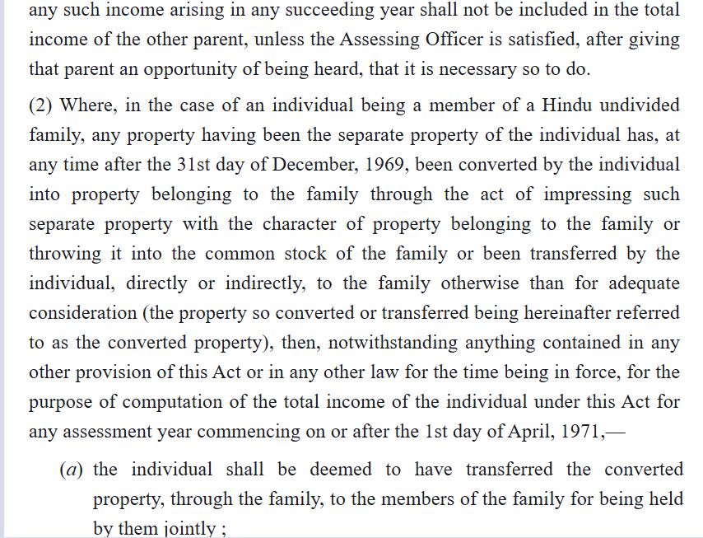

Slide 26
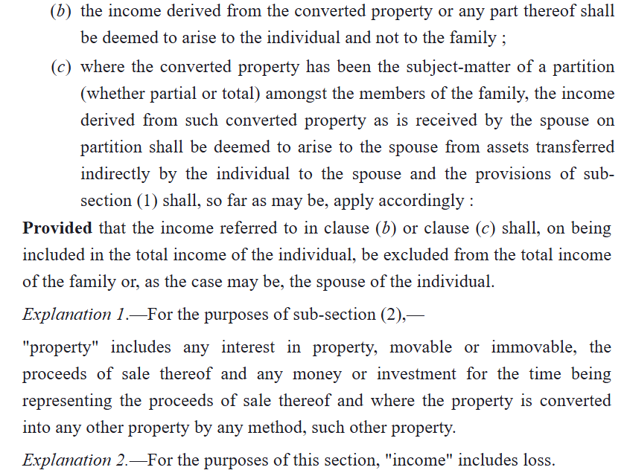
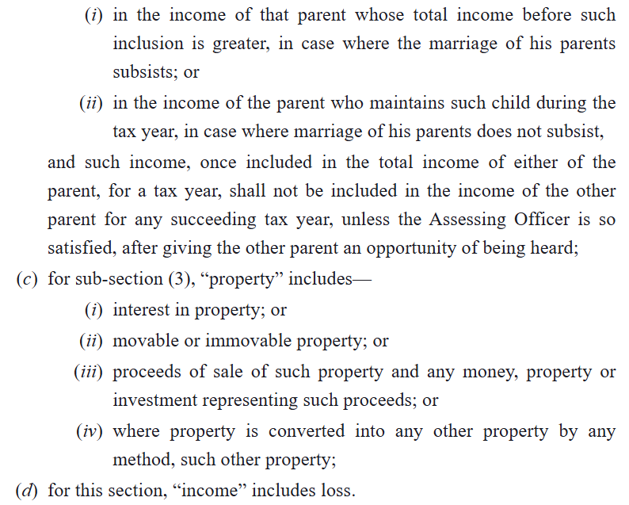

Slide 27
Income of individual to include income of spouse, minor child, etc Section 64(1) vs 99 1961 Act: Clubs income from assets given to spouse, son's wife (no consideration). 2025 Act (s.99): Same targets, but splits s.99 for spouse/minor/son's wife; drops some old loopholes.​ Section 64(1A) vs 99 1961 Act: Minor child's all income (beyond basic exemption) clubbed to parent (higher earner). 2025 Act (s.99): Same, but clearer split between parents if both earn. Section 64(2) vs 99 1961 Act: Converts separate property into HUF property—income clubs back. 2025 Act (s.99): Similar for HUF throws; adds rules for capital gains on such shifts.​ [Section 64(1) of the 1961 Act clubs income from assets transferred without adequate consideration to a spouse, son's wife, or minor child (excluding skill-based income) into the transferor's hands to stop tax splitting. The 2025 Act's Sections 99 keep this but split it—for spouse/minor/son's wife—fixing old loopholes like indirect transfers through spouse-controlled companies or firms and cross-spouse swaps that courts sometimes let slip, now explicitly taxing based on control or benefit.]

Slide 28
[Section 64(1A) of the 1961 Act clubs a minor child's total income (beyond their basic exemption) with the parent having higher income, but lacks clarity on equal-earning parents or separated couples, often leading to disputes. Section 99 of the 2025 Act retains this but introduces a "clearer split" via explicit rules: income splits equally between earning parents (50:50), or fully to the higher earner only if one parent's income exceeds the other's by 50%+; for separated/divorced parents, it defaults to the custodial parent unless a court order specifies otherwise, reducing litigation over allocation.] [Section 64(2) of the 1961 Act deems income from individual property converted to HUF property (without adequate consideration) as taxable in the transferor's hands, preventing tax splitting via HUF throws. Section 99 of the 2025 Act mirrors this but adds explicit rules for capital gains: any latent gains existing at conversion are crystallized and clubbed with the transferor (computed as if sold at fair market value on conversion date), with HUF taking the stepped-up base cost for future sales—thus curbing deferral abuse while clarifying post-conversion gain taxation.]

Slide 29
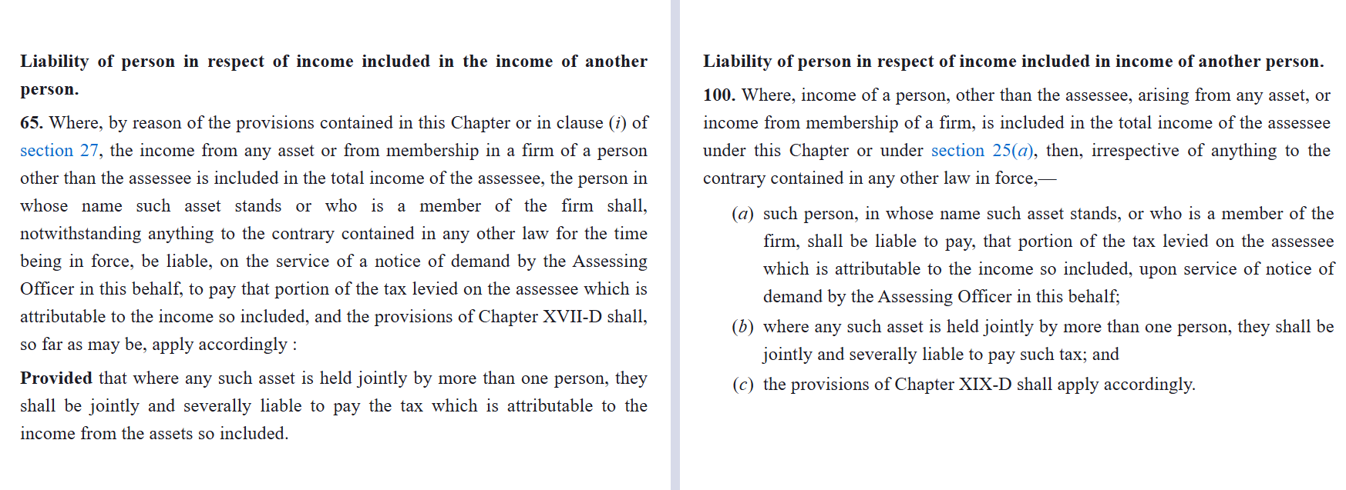
Liability of transferee person, same idea- no real shift

Slide 30
CHAPTER VI
Aggregation of Income & Set off or carry forward of losses
Aggregation of income
[Section 68, 69, 69A, 69B, 69C, 69D in IT ACT, 1961]
and
Set off, carry forward and set off
[Section 70,71,71A,71B,72,72A,72AA,72ab,73,73a,74,74a,75,78,79,79A & 80]
Vs.
Aggregation of income
[Section 102 to 107 in IT Act, 2025]
And
Chapter VII
Set off, or carry forward and set off of losses
[section 108 to 121 of it Act, 2025]

Slide 31
brief description of section 68 to 69D
(Now section 102 to 106)
Section 68 : Sums credited in books without satisfactory explanation of nature/source treated as assessee's income.​
Section 69 : Unrecorded investments where source unexplained deemed as income of investment year.​
Section 69A : Ownership of unrecorded money, bullion, jewellery, or valuables without acquisition source proof taxed as income.​
Section 69B : Excess investment over explained sources (e.g., in property/assets) treated as unexplained income.​
Section 69C : Spending without satisfactory source explanation deemed as assessee's income.​
Section 69D : Amounts borrowed/repaid via hundi (now negotiable instruments added) without account-payee mode deemed income

Slide 32
Comparison of sections of IT Act, 1961 with IT Act, 2025
Income Tax Act, 1961 | Income Tax Act, 2025
Section 68- Cash Credits | Section 102- Unexplained Credits
Section 69- Unexplained investments | Section 103- Unexplained investments
Section 69A- Unexplained money, etc. | Section 104- Unexplained asset “asset” includes money, bullion, jewellery, virtual digital asset or another valuable article
Section 69B- Amount of investments, etc., not fully disclosed in books of account. | Merged with section 103 & 104
Section 69C- Unexplained expenditure | Section 105- Unexplained expenditure
Section 69D- Amount borrowed or repaid on hundi | Section 106- Amount borrowed or repaid through negotiable instrument, hundi, etc.
Section 115BBE- Tax on income referred to in section 68 to 69D | Section 107- Income referred to in sections 102 to 106 shall be charged to tax as per the provisions of section 195

Slide 33
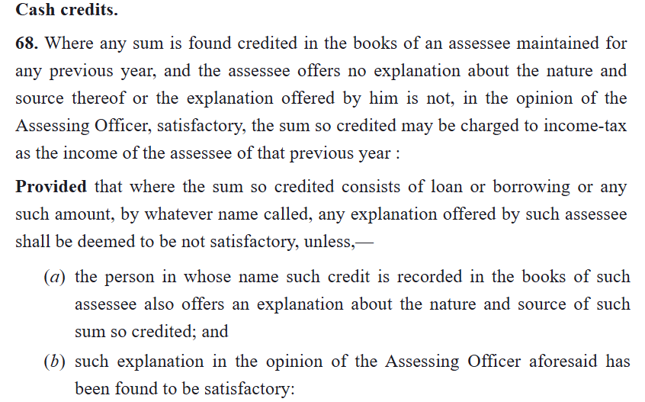
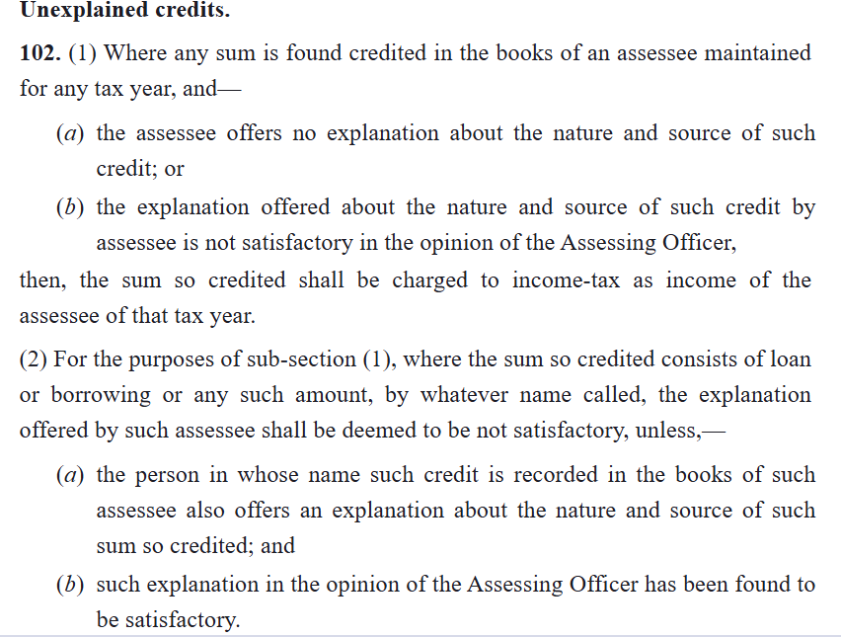
Major Changes in IT act, 2025
Heading of the sections
In section 69D (now section 106), word “Negotiable Instruments” is added.
The word “MAY” now replaced with the word “SHALL”

Slide 34
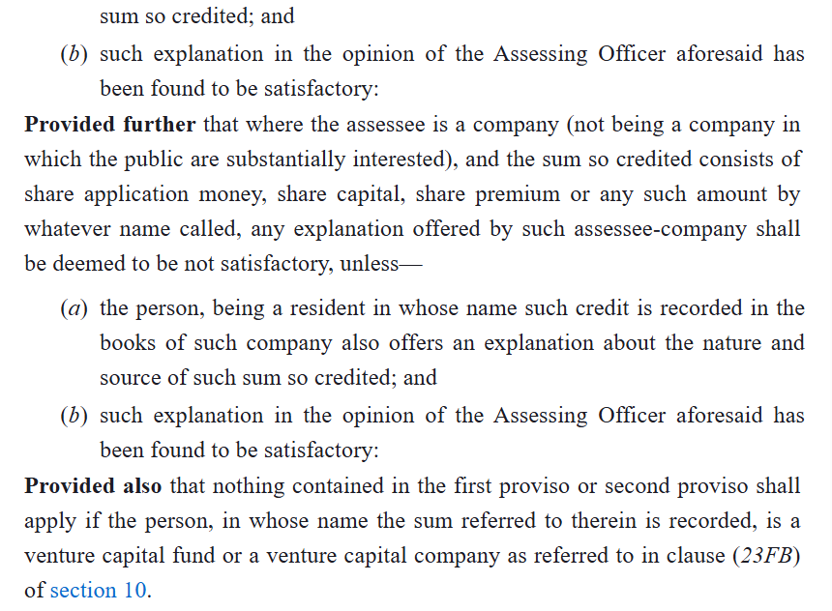
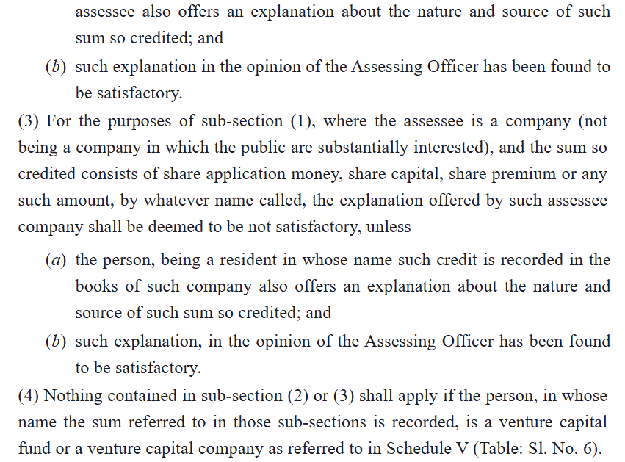
Major Changes in IT act, 2025
Heading of the sections
In section 69D (now section 106), word “Negotiable Instruments” is added.
The word “MAY” now replaced with the word “SHALL”

Slide 35
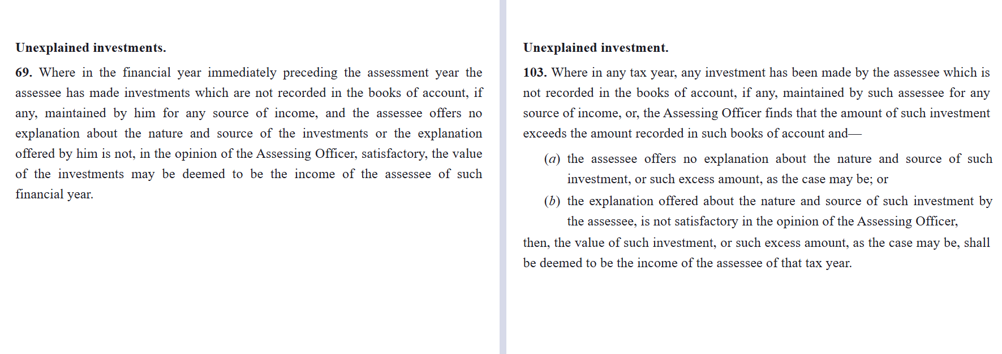
Major Changes in IT act, 2025
Heading of the sections
In section 69D (now section 106), word “Negotiable Instruments” is added.
The word “MAY” now replaced with the word “SHALL”

Slide 36
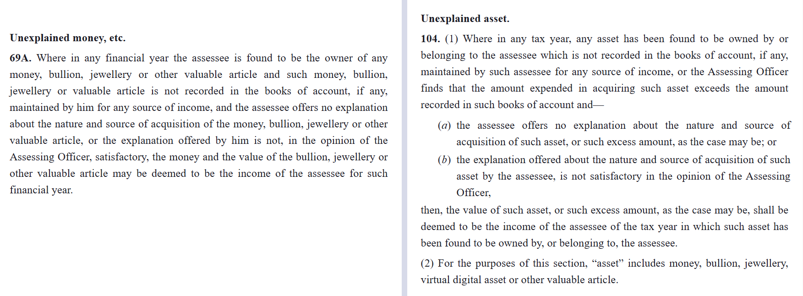
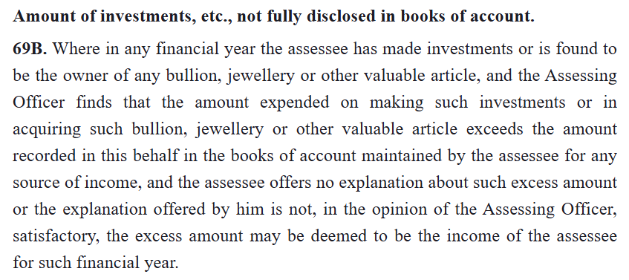
Major Changes in IT act, 2025
Heading of the sections
In section 69D (now section 106), word “Negotiable Instruments” is added.
The word “MAY” now replaced with the word “SHALL”

Slide 37
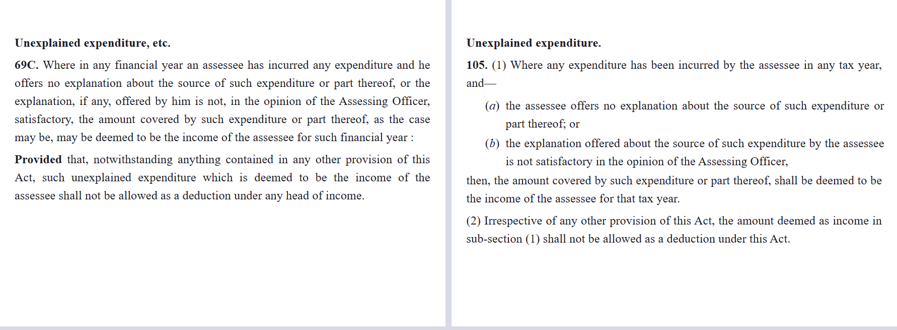
Major Changes in IT act, 2025
Heading of the sections
In section 69D (now section 106), word “Negotiable Instruments” is added.
The word “MAY” now replaced with the word “SHALL”

Slide 38
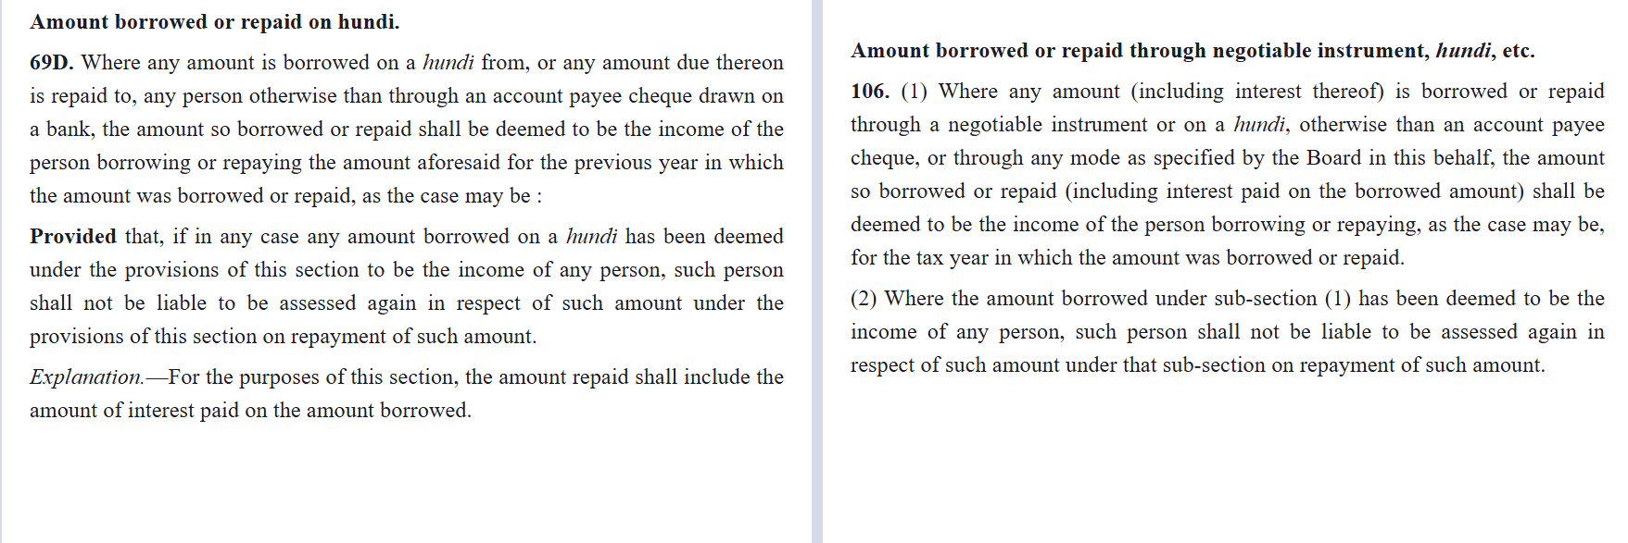
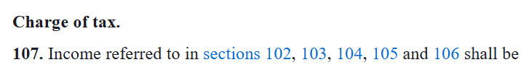

Major Changes in IT act, 2025
Heading of the sections
In section 69D (now section 106), word “Negotiable Instruments” is added.
The word “MAY” now replaced with the word “SHALL”

Slide 39
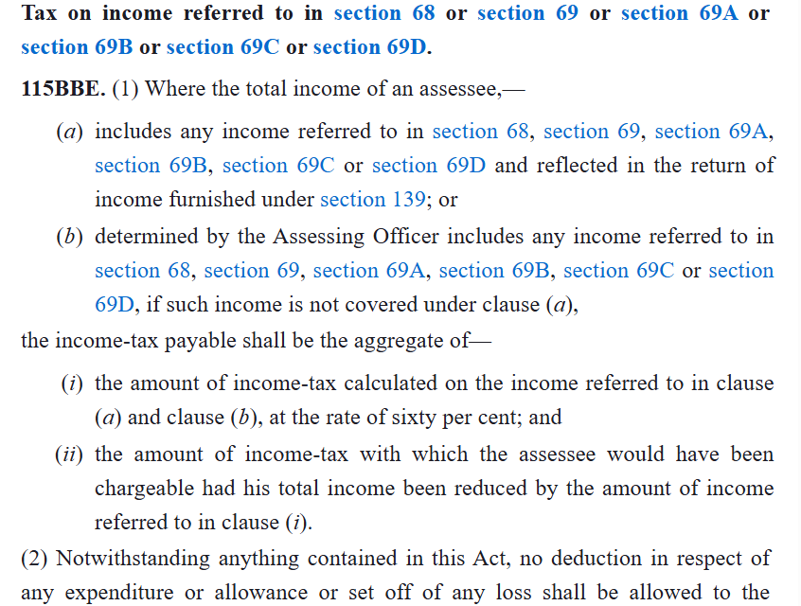
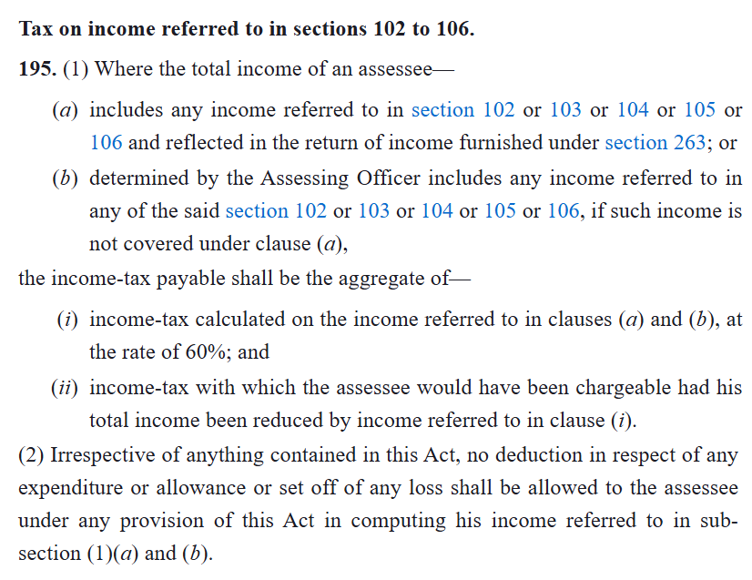
Major Changes in IT act, 2025
Heading of the sections
In section 69D (now section 106), word “Negotiable Instruments” is added.
The word “MAY” now replaced with the word “SHALL”

Slide 40
Major Changes in IT act, 2025
Heading of the sections
In section 69D (now section 106), word “Negotiable Instruments” is added.
The word “MAY” now replaced with the word “SHALL”

Slide 41
Impact of these changes

Slide 42
heading of sections
Section 68 : - Cash credits to unexplained credits
Renaming section 68 from “cash credits” to “unexplained credits” is reasonable because it better reflects the true breadth of the provision, which has always covered all unexplained sums credited in the books—such as share capital, loans and deposits—and not merely cash entries, thereby aligning the marginal heading with the substantive text and improving internal consistency. This clearer terminology reduces interpretational confusion that previously fueled disputes over whether non‑cash credits fell outside the section, helping both taxpayers and the Department apply it more uniformly and cutting down litigation based on semantics alone. In the new Income‑tax Act, the corresponding provision adopts this refined nomenclature while retaining the same charging mechanism, which enhances drafting clarity and contributes to a more predictable, principle‑based tax regime.

Slide 43
Judicial Clarifications
The Bombay High Court in Orient Trading Co. Ltd. v. CIT (1963) 49 ITR 723 clarified the nature and source requirements for cash credits under section 68, emphasizing proof beyond the heading.
In CIT v. Vishal Export Overseas Ltd., ITAT ruled that declared sales, even if suspected bogus, cannot be added as unexplained cash credits under section 68, focusing on substance over terminology.

Slide 44
ISSUES- Section 68/102
Burden of proof- by whom to be discharged?
Whether any sum refers only to sum of money or it can be any amount credited in the books of accounts?
Whether section 68 attracted on amounts representing purchase made on credit?
PCIT Vs. Kulwinder Singh (2017) 156 DTR 333 (P&H) (HC) [Favour]
Smt. Rekha Krishnaraj Vs. ITO (2013) 91 DTR 132 (Kar.) (HC) [Against]
Rejection of books vis-à-vis section 68
CIT Vs. Modern Rubber Industries (2013) 218 Taxman 70 (All.) (HC) (Mag.)
CIT Vs. G.K. Contractors 90 DTR 305 (Raj.) (HC)
Presumptive taxation vis-a-vis section 68
Whether bank pass book represents books of accounts?
Kamal Kumar Mishra Vs. ITO (2013) 143 ITD 686 (Luck) (Trib.)
Mehul V. Vyas Vs. ITO (2017) 164 ITD 296 (Mum.) (Trib.)

Slide 45
Credits in partner’s account on the first day of business
CIT Vs. M. Venkateshwara Rao & Ors. (2015) 119 DTR 189 (AP) (HC)
CIT Vs. Kewal Krishan & Partners 18 DTR 121 (Raj.) (HC) (2009)
CIT Vs. Kishori Lal Santoshi Lal 216 ITR 9 (Raj.) (HC) [Against]
Whether section 68 mandatory if explanation of assessee is not found satisfactory by AO
ITO Vs. Umrao Construction Pvt. Ltd. 2 SOT 837 (Jaipur) (Trib.)
Harish Kumar Vs. DCIT 85 ITD 366 (Hyd.) (Trib.)
Whether advance received adjusted against sales in subsequent year or sale consideration can be added u/s 68?
ACIT Vs. Hirapanna Jeweller (2021) 202 DTR 337/ 189 ITD 608 (Visakha) (Trib.)
Section 68 vis-à-vis accommodation entries
Section 68 vis-à-vis client code modification
Section 68 vis-à-vis long term capital gain in shares claimed exempt
Section 68 vis-à-vis section 56(2)(viib)- Section 56(2)(viib) inapplicable on or after 01.04.2025
Subhlakshmi Vanijya Pvt. Ltd. & Ors. Vs. CIT (2015) 124 DTR 249/ 155 ITD 171 (Kol.) (Trib.)

Slide 46
Section 68 vis-à-vis section 56(2)(x)
Section 68 vis-a-vis peak credit vis-à-vis papers found in search
Whether proviso to sec. 68 inserted w.e.f. 01-04-2013, is retrospective or prospective in nature?
CIT vs. Gagandeep Infrastructure Pvt. Ltd. (2017) 247 Taxman 245 (Bom.) (HC) [Favour]
The proviso to sec. 68 which creates an obligation on the issuing co. to explain the source of share capital & premium has been introduced by the Finance Act, 2012 with effect from 01.04.2013 and does not have retrospective effect. Prior thereto, as per Lovely Exports 317 ITR 218 (SC), if the AO regards the share premium as bogus, he has to assess the shareholders but cannot assess the same as the issuing company's unexplained cash credit.
Subhlakshmi Vanijya Pvt. Ltd. & Ors. Vs. CIT (2015) 124 DTR 249 (Kol.) (Trib.) [Against]
Contention that the proviso to sec.68 attached a new obligation and hence, it should be declared as prospective cannot be accepted. It is axiomatic that proving genuineness of a transaction of any credit, including share capital, was always an essential constituent of sec.68. Since sec.68 covers ‘any sum credited’ in the books without any exception, which inter alia includes share capital, it cannot be held that the examination of share capital with premium etc. was earlier outside the ambit of sec.68 and now this amendment has brought it into its purview. Therefore, though amendment to sec. 56(2)(viib) is prospective, the amendment to sec.68 is retrospective.

Slide 47
Section 69A/69B : - Unexplained Money/ Investment replaced by Unexplained Asset in section 104
This broadening and renaming enhances clarity by encompassing digital and emerging assets under a single, precise term, reducing ambiguity in taxing undocumented possessions and adapting to technological advancements. It aligns with simplifications like merging section 69B into 69 and 69A, providing certainty on tax rates directly in the chapter.
The shift to "unexplained assets" in the 2025 Act broadens clarity for modern assets like VDAs without prior heading-based litigation, preventing potential future ambiguities.

Slide 48
ISSUES- Section 69 to 69C- 103 to 106
Burden of proof- by whom to be discharged?
Value of stock declared to bank in excess of that recorded in books of A/c.
Sale of commodity in excess of quantity recorded in books of A/c.
Expenditure on non-verifiable purchases- Section 69 or 69C.
Addition for low household withdrawals of partners in case of firm.
Difference in cost of construction recorded in books vis-à-vis DVO report obtained u/s 142A
On money paid on purchase of immovable property.
Addition for jewellery found in search.
Addition u/s 69B vis-à-vis Section 56(2)(x) on account of difference in stamp value of property.
Can undisclosed income be claimed as source of unrecorded expenditure.
Income declared in the return not substantiated by assessee, say tuition income, agricultural income etc.

Slide 49
Section 69D : - Enlarged to include Negotiable Instruments
Incorporating "negotiable instrument" alongside "hundi" in the updated section 69D of the Income-tax Act, 2025, delivers significant benefits by broadening the provision's reach to combat evasion through modern informal credit mechanisms like promissory notes or bills of exchange, while retaining the trigger for non-account payee cheque transactions. This expansion plugs loopholes where evaders bypassed hundi-specific rules by using other documents, ensuring high-value untraceable borrowings or repayments—whether borrowed or interest-inclusive—are deemed taxable income at the punitive 39% rate, thereby deterring underground financing prevalent in trade sectors. Moreover, the explicit terminology fosters greater clarity for taxpayers and assessing officers, minimizing interpretational litigation over document types, aligning with India's digital banking initiatives, and promoting traceable, compliant transactions overall.

Slide 50
Notable Cases: -
CIT v. Kamal Chand Jain 189 ITR 449 (Bombay HC): Document on letterhead for bilateral transaction in English was not a hundi (lacking hundi paper, vernacular form); section 69D inapplicable, addition deleted.​
Ajit Chintaman Karve v. ITO ITA Nos.470 to 472/PN/2011 (Bombay HC): Promissory notes held not hundis, so 69D provisions not triggered.​
Ravi B. Jaising v. ACIT ITSSA No. 4592/MUM/2017: Borrowing via promissory note (not hundi) excluded 69D applicability.​
Common Disputes: -
Documents must meet hundi characteristics: vernacular script, specific paper, multi-party nature—not bilateral or English promissory notes.​
No hundi found during search (e.g., loose papers): No addition under 69D.​
This limitation prompted the 2025 expansion to "negotiable instruments" to cover evasion via substitutes.

Slide 51
Introduction of “Negotiable instruments”
Wider Coverage: Targets modern instruments used in hawala or accommodation entries, not limited to traditional hundis.​
Stronger Deterrence: Ensures punitive taxation (60% + penalty) on non-compliant transactions, curbing cashless black money routes.​
Simplified Proof: Shifts full burden to assessee for source verification, reducing litigation over instrument validity.

Slide 52
The introduction of "negotiable instruments" in the expanded section 69D equivalent of the Income Tax Act, 2025, surpasses the limitations of the old "hundi" provision by encompassing a broader range of modern financial tools like promissory notes, bills of exchange, and cheques, rather than restricting to archaic hundis that required multiple parties (typically issuers, bearers, and payees) for validation and lacked any statutory definition under the Act. This eliminates ambiguity and evasion loopholes where undefined hundis enabled untraceable black money circulation through informal networks, now mandating that amounts borrowed or repaid via non-account-payee negotiable instruments be deemed unexplained income if sources fail scrutiny. Overall, it modernizes enforcement, aligns with the Negotiable Instruments Act, 1881, simplifies proof burdens, and plugs hawala-like routes more effectively, fostering transparency without needing complex multi-party validations. "Negotiable instruments" in IT Act, 2025 removes these defenses by covering all statutorily defined instruments under NI Act, 1881, enabling easier invocation without hundi-specific proof.

Slide 53
CASE LAWS ON HUNDI
CIT vs Ram Niwas 372 ITR 1 (Delhi HC): Document not a "hundi" (bilateral, not on hundi paper); primary requirement unmet, so s.69D inapplicable despite AO's claim.​
DCIT vs Sanjay Lal (ITAT Agra): No physical hundi found; loose paper (LPS-6) lacked date/transaction details, struck entries; addition deleted as ingredients absent.​
Andhra Pradesh/Calcutta/Madras HC (ref in Delhi HC): Defined hundi criteria (multi-party, specific paper); non-conforming docs exempt from deeming fiction.

Slide 54
“MAY” “SHALL”
The change from "may" to "shall" in sections 102 to 105 of the Income Tax Act, 2025 simplifies tax enforcement by making it mandatory to treat unexplained cash credits, investments, assets, or expenses as taxable income, rather than leaving it to the officer's choice. This cuts down on subjective decisions, speeds up assessments, and reduces court cases over disputes. Overall, it boosts fair compliance, deters evasion with clear rules, and helps collect more revenue efficiently

Slide 55
litigation BECAUSE OF THE WORD “MAY”
Ashish Sumatibhai Shah vs DCIT ITA No. 221/Ahd/2019 (ITAT Ahmedabad):
Addition deleted as AO cannot treat source as unexplained merely on unsatisfactory explanation; "may" grants discretion, not obligation.​
Namdev Arora vs CIT ITA No. 159 of 2016 (Punjab & Haryana HC):
Tribunal erred invoking s.68 post-facto without notice, as "may" limits arbitrary application to book credits.​
CIT vs Smt. P.K. Noorjahan 237 ITR 570 (SC):
"May" in s.69 (similar to s.68) confers AO discretion, not mandatory taxing.​

Slide 56
RATIONALISATION OF TAX RATE IN RESPECT OF UNEXPLAINED INCOME/ INVESTMENT/ EXPENDITURE/ CREDITS ETC. AND EXPANDING THE SCOPE OF IMMUNITY FROM PENALTY [w.e.f. 01.04.2026]
Existing section of IT Act, 1961 | Existing Provisions | Existing section of IT Act, 2025 | Amended Provisions
115BBE | If income is declared in the return of income furnished u/s 139 & tax has been paid before end of relevant PY Tax @ 60% + surcharge @ 25% of tax + cess @ 4% of tax & surcharge. Thus, total incidence of tax is 78%. | 195 | Tax @ 30% + surcharge @ 25% of tax + cess @ 4% of tax & surcharge. Thus, total incidence of tax is 39%.
271AAC | If income is added by AO In addition to tax, penalty @ 10% of tax payable (i.e. 6% of income) u/s 271AAC would be levied. Thus, total incidence of tax & penalty is 84%. | 443/ 439 | Section 443 omitted and penalty subsumed in section 439 where penalty for misreporting income is 200% of the tax payable on such income. Thus total tax and penalty would be 117% of the tax payable on such income (39% Tax + 78% Penalty).
270AA | Immunity from penalty-Immunity only in case of underreporting of income (not on misreporting), if tax and interest is paid within the period specified in the notice of demand and no appeal is filed. | 440 | Immunity on misreporting of income also provided on payment of 100% of additional income tax. However, where addition is made by AO which is chargeable to tax u/s 195 of the Act, immunity will be provided on payment of 120% of additional income tax. Thus total tax and penalty where income is in nature of unexplained income/ investment/ expenditure/ credits etc. would be 85.80% of the tax payable (39% Tax + 46.8% Additional tax) as against the present tax and penalty of 84% (78% + 6%).

Slide 57
CASE LAWS
Abdul Hamid Vs. ITO (2020) 183 ITD 711 (Gauhati) (Trib.)
Section 115BBE does not apply to business receipts/ business turnover. Where department had itself accepted that undisclosed amount in assessee’s bank account was undisclosed business receipts/ turnover, section 115BBE would not be attracted.
Hari Narain Gattani Vs. DCIT (2021) 186 ITD 434 (Jaipur) (Trib.)
Where assessee surrenders undisclosed income during search action for relevant year, it is not necessary that tax rate has to be charged as per provisions of section 115BBE.
Maruthi Babu Rao Jadav Vs. ACIT (2021) 199 DTR 66 (Kerala) (HC) [Against]
There were two seizures of cash made on 2nd Aug., 2016 and 3rd Nov., 2016 respectively, both in the financial year 2016-17 and on the said amounts tax was rightly imposed @ 60% u/s 115BBE and surcharge @ 25%. There was no new liability created and the rate of tax merely stood enhanced by the Taxation Laws (Second Amendment) Act, 2016 and the Finance Act, 2017 which is applicable to the assessments carried on in that year. Assessee’s contention that if an amendment is brought into force on 1st April, 2017, it can only apply to the assessment made in 2018-19 (assessment year) of the income accrued for the previous financial year which is 2017-18, is not sustainable.

Slide 58
Hon’ble Madurai Bench of Madras High Court in case of S.M.I.L.E Microfinance Ltd. Vs. ACIT order dt. 19.11.2024 has held that section 115BBE is applicable from 01.04.2017 and not prior to that date. Relevant extracts of the decision reads as under:-
“17. In the aforesaid objects and reasons nowhere it is stated that due to “demonetization” the unaccounted money ought to be charged 60% rate of tax. It only states that step had been taken to curb black money by withdrawing Specified Bank Notes of denomination of Rs.500 and Rs.1000. And also states the people may find illegal ways of converting their black money into black again, hence as per experts advice heavy penalty ought to be levied. From the language of the object “that instead of allowing people to find illegal ways of converting their black money into black again”, it is evident that the government is intended to impose the same for future transactions. Especially the use of word “again” in the object would clearly indicate it is for future transactions i.e. from 01.04.2017. Therefore this Court is of the considered opinion that the revenue is empowered to impose 60% rate of tax for the transactions from 01.04.2017 onwards and not prior to the said cut-off date. And for prior transaction the revenue is empowered to impose only 30% rate of tax.”

Slide 59

THANK YOU
Compiled by
CA P.C. Parwal
Kalani & Co LLP, Chartered Accountants
Milestone Building, Tonk Road, Jaipur
Mobile:- 98298-88804 E-mail:- pparwal@kalanico.com
Offices at: Jaipur, Jodhpur, Kota, Pali, Bhilwara, Udaipur, Pune, Guwahati & Affiliate office at: Delhi, Mumbai

