Slide 1
Taxation of Partnership Firms & TDS on Payments to Partners:
Law, Controversies and
Practical Challenges
CA Anoop Bhatia

Slide 2
Definition of Firm, Partner & Partnership: Old Law & New Law
Old Act: Sec 2(23)(i) / (ii) / (iii)
New Act: Sec 2(45) / (74) / (75)
Sec 2(45): “Firm” shall have the same meaning as assigned to it in section 4 of the Indian Partnership Act, 1932 (9 of 1932), and shall include a “limited liability partnership” as defined in section 2(1)(n) of the Limited Liability Partnership Act, 2008 (6 of 2009);

Slide 3
Term ‘Partner’ separately defined in New Act
Sec 2(74) “partner” shall have the same meaning as assigned to it in section 4 of the Indian Partnership Act, 1932 (9 of 1932), and shall include—
any person who, being a minor, has been admitted to the benefits of partnership; and
a partner of a limited liability partnership as defined in section 2(1)(q) of the Limited Liability Partnership Act, 2008 (6 of 2009);
[similar to Sec 2(23)(ii) of the Old Act]

Slide 4
Definition of Term Partnership:
Sec 2(75): “partnership” shall have the same meaning as assigned to it in section 4 of the Indian Partnership Act, 1932 (9 of 1932), and shall include a “limited liability partnership” as defined in section 2(1)(n) of the Limited Liability Partnership Act, 2008 (6 of 2009);

Slide 5
Constitution, Change in Constitution, Succession etc. of the Firm:
 | Old Act | New Act
Assessment as a Firm | S 184 | S 325
Assessment when Sec 184 not complied with | S 185 | S 326
Change in Constitution of Firm | S 187 | S 327
Succession of One Firm by another Firm | S 188 | S 328
Joint & Several Liability of Partners for tax payable by Firm | S 188A | S 329
Firm Dissolved or Business Discontinued | S 189 | S 330
Liability of Partner of LLP in liquidation | S 167C | S 331

Slide 6
Sec 325: Assessment as a Firm (Sec 184 of Old Act)
325. (1) A firm shall be assessed as a firm for the purposes of this Act, if— (a) the partnership is evidenced by an instrument; and
(b) the individual shares of the partners are specified in that instrument.
(2) A certified copy of the instrument of partnership referred to in sub-section (1) shall accompany the return of income of the firm of the tax year in respect of which assessment as a firm is first sought.
(3) For the purposes of sub-section (2), the copy of the instrument of partnership shall be certified in writing by all the partners (not being minors) or, where the return is made after the dissolution of the firm, by all persons (not being minors), who were partners in the firm immediately before its dissolution and by the legal representative of any such partner who is deceased.

Slide 7
Sec 325 continues……
(4) Where a firm is assessed as such for any tax year, it shall be assessed in the same capacity for every subsequent year, if there is no change in the constitution of the firm or the shares of the partners as evidenced by the instrument of partnership on the basis of which the assessment as a firm was first sought.
(5) Where any such change had taken place in the tax year, the firm shall furnish a certified copy of the revised instrument of partnership along with the return of income for such tax year, and all the provisions of this section shall apply accordingly.

Slide 8
Sec 325 continues…..
(6) Irrespective of anything contained in any other provision of this Act, where, in respect of any tax year, there is on the part of a firm any such failure as is mentioned in section 271,—
the firm shall be so assessed that no deduction by way of any payment of interest, salary, bonus, commission or remuneration, by whatever name called, made by such firm to any partner of such firm shall be allowed in computing the income chargeable under the head “Profits and gains of business or profession”; and
such payment shall not be chargeable to income-tax under section 26(2)(g).
Sec 271 refers to Best Judgement Assessment i.e. Sec 144 of the Old Act.

Slide 9
Sec 326: Assessment when sec 325 not complied with (Sec 185 of Old Act)
326. Irrespective of anything contained in any other provision of this Act, where a firm does not comply with the provisions of section 325 for any tax year,—
(a) no deduction by way of any payment of interest, salary, bonus, commission or remuneration, by whatever name called, made by such firm to any partner of such firm shall be allowed in computing its income chargeable under the head “Profits and gains of business or profession”; and
(b) such interest, salary, bonus, commission or remuneration shall not be chargeable to income-tax under section 26(2)(g) in the hands of partners of such firm.

Slide 10
Sec 327: Change in Constitution of a Firm (Sec 187 of Old Act)
327. (1) Where at the time of making an assessment under section 270 or 271, it is found that a change has occurred in the constitution of a firm, the assessment shall be made on the firm as constituted at the time of making the assessment.
(2) For the purposes of this section, there is a change in the constitution of the firm—
if one or more of the partners cease to be partners or one or more new partners are admitted, subject to the condition that at least one person who was partner of the firm before the change continues as partner after such change; or
where all the partners continue with a change in their respective shares or in the shares of some of them.
(3) The provisions of sub-section (2)(a) shall not apply to a case where the firm is dissolved on the death of any of its partners.

Slide 11
Payment of Interest & Remuneration to Partners:
Old Act: Sec 40(b) read with Sec 28(v)
New Act: Sec 35(e) read with Sec 26(2)(g)

Slide 12
Sec 35(e): Interest & Remuneration to Partners (Sec 40(b) of Old Act)
Amounts not deductible in certain circumstances.
35. Irrespective of any other provision of Chapter IV-D, the following amounts shall not be allowed as deduction in computing the income chargeable under the head “Profits and gains of business or profession”:—
……..
(e) the expenditure incurred by a firm, assessable as such –
(i) in the nature of salary, bonus, commission or remuneration, by whatever name called (herein referred as remuneration) to a partner, who is not a working partner; or

Slide 13
Sec 35(e) continues……
(ii) on the remuneration to a working partner, and interest to any partner, if it is—
not authorised by the partnership deed applicable for the period for which such remuneration or interest is paid; or
authorised by and is as per the terms of partnership deed but relates to the period prior to the date of such partnership deed, or which was not authorised by the earlier partnership deed; or

Slide 14
Sec 35(e) continues…..
(iii) on the aggregate remuneration to all working partners as authorised by the partnership deed, exceeding the amount computed as under:—
on the first ₹ 600000 of the book profit or in case of a loss, ₹300000 or at the rate of 90% of the book profit, whichever is higher;
on the balance of the book profit, at the rate of 60%; or

Slide 15
(iv) on interest to any partner as authorised by the partnership deed, exceeding 12% simple interest per annum, so, however, that—
where an individual is a partner in a firm, on behalf, or for the benefit, of any other person (such partner and the other person being herein referred to as “partner in a representative capacity” and “person so represented”, respectively),—
  interest paid by the firm to such individual otherwise than as partner in a representative capacity, shall not be taken into account for the purposes of this clause;
  interest paid by the firm to such individual as partner in a representative capacity and interest paid by the firm to the person so represented shall be taken into account for the purposes of this clause;
(B) where an individual is a partner in a firm otherwise than as partner in a representative capacity, interest paid by the firm to such individual shall not be taken into account for the purposes of this clause, if such interest is received by him on behalf, or for the benefit, of any other person;

Slide 16
Book Profit & Working Partner
(v) in this clause—
“book profit” means the net profit, as shown in the profit and loss account for the relevant tax year, computed as per Chapter IV-D as increased by the aggregate amount of the remuneration to all the partners of the firm, if such amount has been deducted while computing the net profit;
“working partner” means an individual who is actively engaged in conducting the affairs of the business or profession of the firm of which he is a partner;

Slide 17
Taxation of Interest & Remuneration in the hands of Partner:
Old Act: Sec 28(v)
New Act: Sec 26(2)(g)
Income under head “Profits and gains of business or profession”.
26.(1) The incomes referred to in sub-section (2) shall be chargeable to income-tax under the head “Profits and gains of business or profession”. (2) The income under sub-section (1) shall include—
……..
(g) any interest, salary, bonus, commission or remuneration, by whatever name called, which is due to, or received by, a partner of a firm from such firm to the extent allowed under section 35(e) as a deduction in computing the income of the firm;

Slide 18
Partner’s shares in profits of the firm:
Old Act: Sec 10(2)
New Act: Sec 11 read with Schedule III

Slide 19
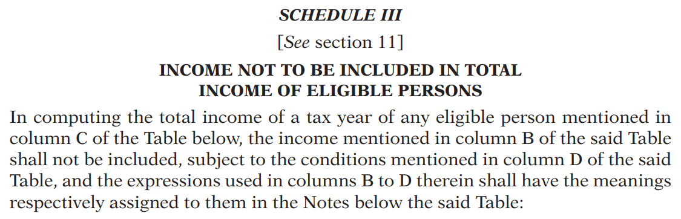
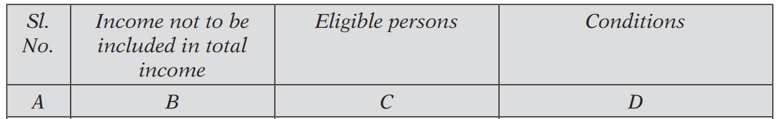
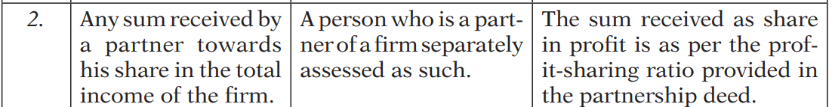

Slide 20
Types of Taxation of a Partnership Firm:
Presumptive Income Taxation
  U/s 44AD / 58
  U/s 44ADA / 58
  U/s 44AE / 58
Actual Income Taxation
  In case turnover exceeds threshold limit of ₹ 1 crore / 3 crores & 10 crores
  In case of a LLP

Slide 21
Sec 58: Presumptive Taxation (for residents)
58. (1) The provisions of sections 26 to 54, to the extent contrary to this section, shall not apply to the manner of computation of profits and gains of the specified business or profession in sub-section (2).
(2) The profits and gains of any specified business or profession as mentioned in column B of the Table below, carried on by an assessee specified in column C of the said Table, having total turnover or gross receipts of business or profession during the tax year specified in column D and computed in the manner specified in column E thereof, shall be deemed to be the profits and gains of such business or profession chargeable to tax under the head “Profits and gains of business or profession”.

Slide 22
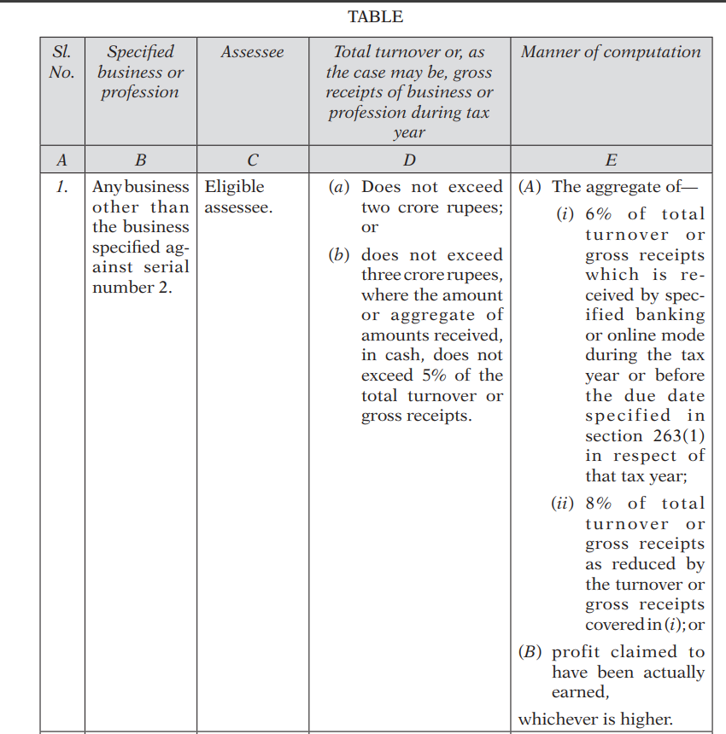

Slide 23
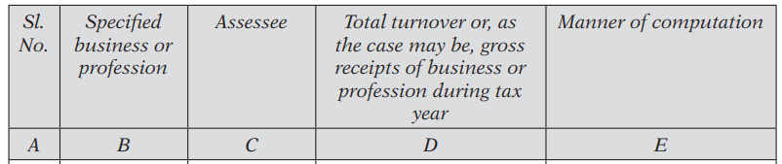
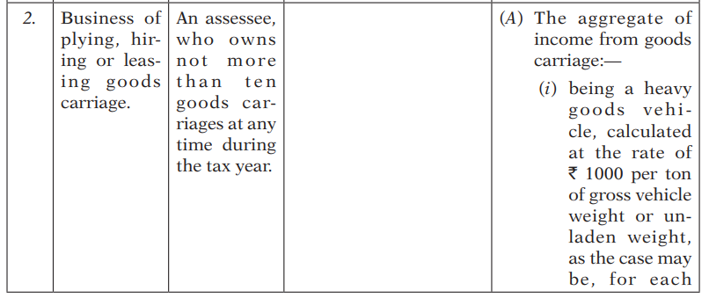

Slide 24
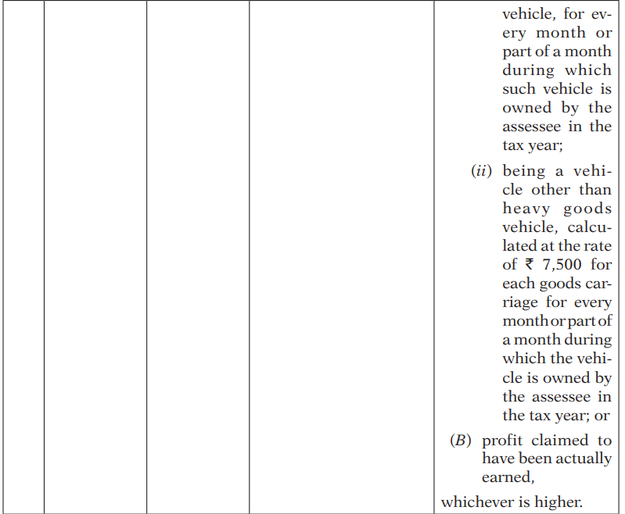

Slide 25
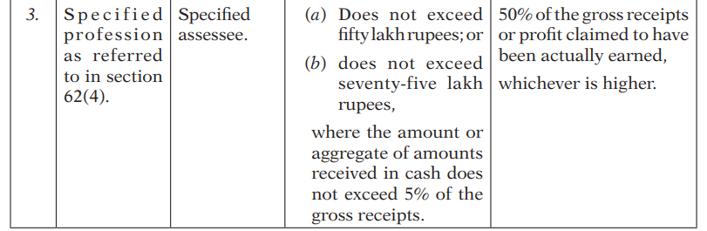

Slide 26
Eligible Assessee:
(11) For the purposes of this section,—
“eligible assessee” means an individual, a Hindu undivided family, or a firm other than a limited liability partnership, who is resident in India, and who—
(i) [***]
(ii) has not claimed any deduction under Chapter VIII-C for the relevant tax year;
(iii) does not carry on specified profession as defined in section 62(4);
(iv) does not earn any income in the nature of commission or brokerage;
(v) does not carry on any agency business;

Slide 27
Specified Assessee:
(b) “specified assessee” means an individual or a firm, other than a limited liability partnership, who is a resident in India;

Slide 28
TDS on Payments to Partners:
(Inserted by the Finance (No.2)Act 2024 wef 01.04.2025)
Payment to partners of firm:
194T. (1) Any person being a firm, responsible for paying any sum in nature of salary, remuneration, commission, bonus or interest to a partner of the firm, shall, at the time of credit of such sum to the account of the partner (including the capital account) or at the time of payment thereof, whichever is earlier shall, deduct income tax thereon at the rate ten per cent.
(2) No deduction shall be made under sub-section (1) where such sum or the aggregate of such sums credited or paid or likely to be credited or paid to the partner of the firm does not exceed twenty thousand rupees during the financial year.

Slide 29
TDS on payments to partners under the New Act: Sec 393 (Chapter XIX)
Sec 393(1): For payments to Residents
Sec 393(2): For payments to Non-Residents
Sec 393(3): For payment to Any Person
Sec 393(4): For no deduction at source
Sec 393(6): Declaration for no deduction at source

Slide 30
Sec 393(3)
(3) Where any income or sum of the nature specified in column B of the Table below, is credited or paid by the person specified in column C during the tax year, to any person, the person responsible for making payment of such income or sum, shall deduct income-tax—
on the entire amount of such income or sum, where the amount or aggregate of amounts exceed the threshold limit specified in column D, or on net winnings as per Note 1 of the Table;
at the rate specified in column D;
at the time of payment thereof in cash or by way of a cheque or a draft or by any other mode, or as specified therein; and
subject to the provisions of sub-sections (4), (5), (6), (8) and (9).

Slide 31
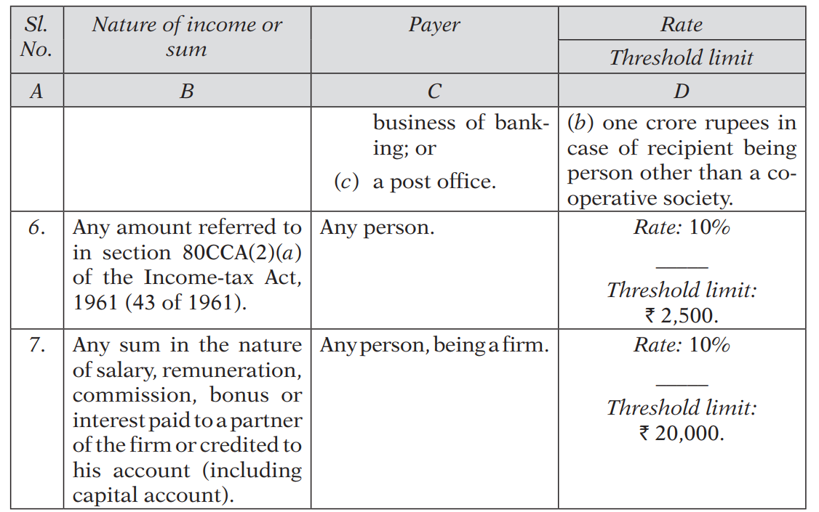
S.No. 7 of the Table forming part of Sec 393(3) titled: ‘For Payment to Any Person’

Slide 32
Practical Aspects of TDS on Payment to Partners:
Time of deduction: payment or credit Whicher is earlier.
Capital withdrawal & TDS
In case firm opts for presumptive taxation whether TDS provisions are applicable ?
Current vs. Fixed Capital Method: does it affects TDS applicability ?
Passing of an year end entry towards interest / remuneration and corresponding TDS impact ?
What about the remuneration allowable under section 40(b) or section 35(e) ?
Can a partner provide form 15G/15H or a declaration under S 393(6) for proposed deduction of tax at source on the interest amount ?
Can a partner obtain a low rate certificate as per sec 395 (Old Act Sec 197) ?

Slide 33
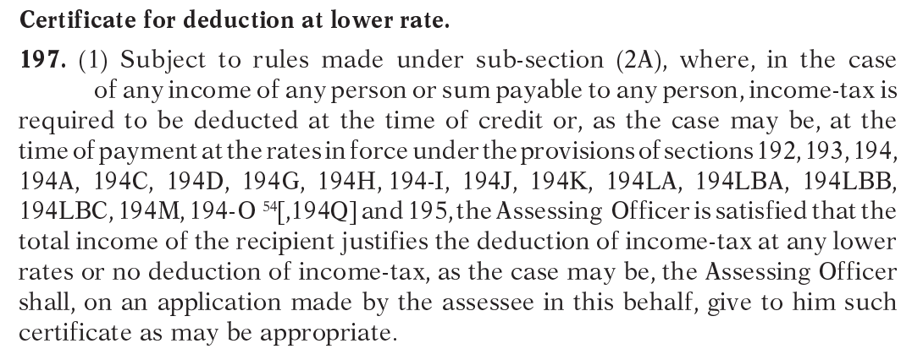
Sec 197: Certificate for deduction at lower rate:

Slide 34
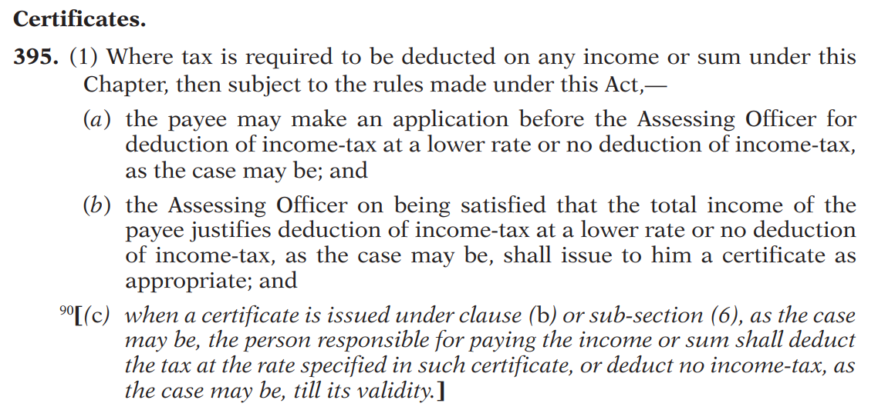
New Act: Sec 395 (rwr 213)

Slide 35
Capital Gain aspects of Firm & Partner:
 | Old Act | New Act
Capital asset introduction by partner into firm | Sec 45(3) | Sec 67(9)
Capital asset distribution of firm to partner | Sec 45(4) rws 9B | Sec 67(10) rws 8
Conversion of Firm into a Company | Sec 47(xiii) | Sec 70(1)(zd)
Conversion of Co. into LLP | Sec 47(xiiib) | Sec 70(1)(ze)

Slide 36
Key takeaways:
All the concepts of taxation of partnership firm as well as LLP are duly maintained in New Income Tax Act 2025.
Even TDS provisions on payment of remuneration / interest to partners are duly maintained in New Income Tax Act 2025.
Entries in the books of account of firm (in case of actual income taxation) are quite relevant in determining TDS liability of the Firm.
Capital gain tax provisions are similarly incorporated in New Act.

Slide 37
Thanks !! Jai Hind !!! Jai ICAI !!!

