Slide 1
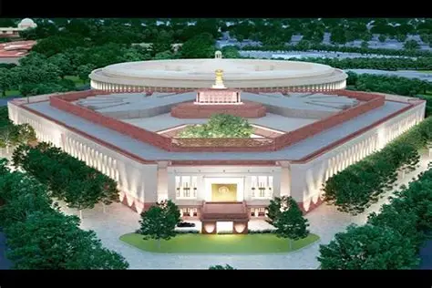
Overview of New Income-tax Act, 2025:
A Comprehensive Reform
A structural overhaul of India's direct tax framework
to create a simplified, modern, and efficient system aligned with contemporary economic realities
CA P.C. Parwal, Kalani & Co LLP

Slide 2
Five Critical Challenges Requiring Reform
Increasing Complexity
High Litigation
Fragmented Structure
Continuous amendments led to layered provisions, multiple provisos, explanations. Interpretation required frequent cross-referencing, making the law difficult even for professionals.
Ambiguity in drafting resulted in multiple interpretations. This significantly increased tax disputes and litigation burden across all levels.
Provisions relating to similar subjects were scattered across different sections. Lack of logical arrangement made navigation inefficient and time-consuming.
Outdated Framework
Compliance Burden
The original Act was not designed for a digital and globalised economy. Digital transactions, e-assessments automation were introduced through amendments.
Procedural complexity increased compliance costs for taxpayers, especially small entities and first-time filers.
CA P.C. Parwal, Kalani & Co LLP

Slide 3

What was the need?
Simplify statutory language
Improve structural clarity
Reduce interpretational disputes
Deleting obsolete provisions
Approach adopted
Eliminate intricate language to enhance readability
Remove redundant and repetitive provisions for better navigation
Reorganize sections logically to facilitate ease of reference
CA P.C. Parwal, Kalani & Co LLP

Slide 4

What Remains Unchanged
Core Taxation Principles
Reform Focus Areas
The reform preserves fundamental tax principles that have stood the test of time:
The changes primarily target:
Presentation and readability
Clarity and precision
Operational efficiency
Facilitation of ease of doing business
Charging of income tax on a fiscal year basis
Classification of heads of income
Determination of residential status
Basic charge of tax computation
CA P.C. Parwal, Kalani & Co LLP

Slide 5
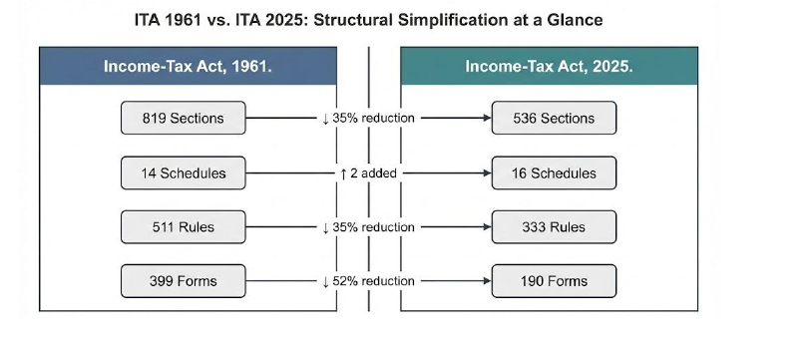
STRUCTURAL CHANGES
Particulars | 1961 Act | 2025 Act
Words | 5.12 lakhs | 2.60 lakhs
Chapters | 47 | 23
Sections | 819 | 536
Tables | 18 | 57
Formulae | 6 | 46
Schedules | 14 | 16
Pages | 823 | 622
Rules | 511 | 333
Forms | 399 | 190
Besides about 1200 Provisos and 900 Explanations have been removed. Their simplified content has been placed as sub-sections or clauses.
CA P.C. Parwal, Kalani & Co LLP

Slide 6
AMENDMENTS BY FA, 2026 in IT ACT, 2025
                1. FA, 2026 made 87 amendments in IT Act, 2025
2. Section 443 relevant to section 271AAC of IT Act, 1961 deleted by FA, 2026
3. New section 354A for merger of registered non-profit organization in certain cases introduced
4. Section 447 for penalty for failure to furnish report u/s 172 [Report from an accountant to be furnished by person entering into international transaction or specified domestic transaction] omitted and converted into fee by incorporating clause (d) in section 428.
Immunity from penalty for misreporting of income incorporated in section 440.
Deduction of employees contribution, if deposited by the employer upto the due date of filing of return of income u/s 263(1) Act is allowable.
CA P.C. Parwal, Kalani & Co LLP

Slide 7
CHAPTERS OVERVIEW
Chapter | Overview | Sections
Chapter 1 | Preliminary | 1-3
Chapter 2 | Basis of Charge | 4-10
Chapter 3 | Incomes which do not form part of Total Income | 11-12
Chapter 4 | Computation of Total Income | 13-95
Chapter 5 | Income of other persons, Included in the Total Income of the Assessee. | 96-100
Chapter 6 | Aggregation of Income | 101-107
Chapter 7 | Set off, or Carry Forward And Set Off of Losses | 108-121
Chapter 8 | Deductions to be made in Computing Total Income | 122-154
Chapter 9 | Rebate And Reliefs | 155-160
Chapter 10 | Special Provisions Relating to Avoidance of Tax | 161-177
Chapter 11 | General Anti-Avoidance Rule | 178-184
Chapter | Overview | Sections
Chapter 12 | Mode of Payment in Certain Cases | 185-189
Chapter 13 | Determination of tax in Special Cases | 190-235
Chapter 14 | Tax Administration | 236-261
Chapter 15 | Return of Income | 262-267
Chapter 16 | Procedure for Assessment | 268-301
Chapter 17 | Special tax provisions for certain persons. | 302-355
Chapter 18 | Appeals, Revision and Alternate Dispute Resolution. | 356-389
Chapter 19 | Collection and Recovery of Tax | 390-430
Chapter 20 | Refunds | 431-438
Chapter 21 | Penalties | 439-472
Chapter 22 | Offences and Prosecution | 473-498
Chapter 23 | Miscellaneous | 499-536
CA P.C. Parwal, Kalani & Co LLP

Slide 8
SCHEDULES OVERVIEW
Schedule | Overview | Ref section
SCHEDULE I | Conditions For Certain Activities Not To Constitute Business Connection In India | [See section 9(12)]
SCHEDULE II | Income Not To Be Included In Total Income | [See section 11]
SCHEDULE III | Income Not To Be Included In Total Income Of Eligible Persons | [See section 11]
SCHEDULE IV | Income not to be included in total income of eligible non-residents, foreign companies and other such persons | [See section 11]
SCHEDULE V | Income not to be included in total income of certain eligible persons including investment funds, business trusts and their unit holders | [See section 11]
SCHEDULE VI | Income not to be included in total income of certain eligible persons in international financial services centre or having income therefrom | [See section 11]
SCHEDULE VII | Persons Exempt From Tax | [See section 11]
SCHEDULE VIII | income not to be included in the total income of political parties and electoral trusts | [See section 12]
SCHEDULE IX | Deduction For Tea Development Account, Coffee Development Account And Rubber Development Account For Computing Income Under The Head “Profits And Gains Of Business Or Profession | [See section 48]
SCHEDULE X | Deduction for site restoration fund for computing income under the head “profits and gains of business or profession | [See section 49]
SCHEDULE XI | Part A - Recognised Provident Funds; Part B - approved superannuation funds and gratuity funds; Part C - power to make rules for provident funds, superannuation funds and gratuity funds | [See section 2(91)]
SCHEDULE XII | Part A – minerals; Part B - groups of associated minerals | [See section 51]
SCHEDULE XIII | List of articles or things | [See section 45(2)]
SCHEDULE XIV | Insurance business | [See section 55]
SCHEDULE XV | Deduction in respect of life insurance premia, contribution to provident fund, subscription to certain equity shares, etc | [See section 123]
SCHEDULE XVI | Permitted modes of investment or deposits | [See section 350]

Slide 9

CHAPTER I: PRELIMINARY
[Sections 1 to 3]

Slide 10
Short title, extent and commencement.
1. (1) This Act may be called the Income-tax Act, 2025.
(2) It extends to the whole of India.
(3) Save as otherwise provided in this Act, it shall come into force on the 1st April, 2026.
Definitions.
2. In this Act, unless the context otherwise requires,—
(1) “accountant” shall have the meaning assigned to it in section 515(3)(b);
……………..
(112) “zero coupon bond” means a bond
………..
So, total 112 definitions have been provided in section 2. In the IT Act 1961, there were 94 terms which were defined in section 2.
Key changes:
Section 2(13) of the IT Act 2025 provides statutory definition of “assessment” that includes reassessment and recomputation. The definition enhances clarity and removes ambiguity by explicitly covering the term ‘recomputation’ which was not there in the definition of IT Act 1961
CA P.C. Parwal, Kalani & Co LLP

Slide 11
Key changes:
Section 2(19) of the IT Act 2025 provides statutory definition of “books or books of account”. In the definition “cloud-based storage” has also been specifically included in this definition. Also, ‘portable data storage devices’, ‘external hard drives’ or ‘memory cards’ have been specifically included in the definition.
Section 2(23) defines the term “charitable purpose”. Charitable Purpose’ includes: (a) relief of the poor; (b) education; (c) yoga; (d) medical relief; (e) preservation of the environment (including watersheds, forests and wildlife); (f) preservation of monuments or places or objects of artistic or historic interest; (g) the advancement of any other object of general public utility (GPU).
The definition omits the restrictive proviso of GPU earlier provided in 1961 Act. Instead, Section 346 of the 2025 Act incorporates a similar restriction on commercial activities by registered NPOs engaged in GPU.
Thus, the revised definition clarifies the concept of a charitable purpose without imposing any limitations. The restrictions on commercial activities remain unchanged but are addressed under Section 346, effectively distinguishing the definition of a charitable purpose from eligibility for tax exemption. NPOs engaged in GPU activities must now comply with Section 346 to adhere to the restrictions on commercial operations while maintaining their charitable status.
The other notable change is changing the reference from “trust” to “non-profit organization”
CA P.C. Parwal, Kalani & Co LLP

Slide 12
Key changes:
Section 2(94) of the 2025 Act clarifies that “relative”, in relation to an individual, means the husband, wife, brother, sister or any lineal ascendant (maternal as well as paternal) or descendant of that individual.
The phrase (maternal as well as paternal) has been specifically added to include maternal side as well.
CA P.C. Parwal, Kalani & Co LLP

Slide 13
Section 3: Tax Year
The concept of ‘tax year’ has been introduced replacing ‘previous year’ and ‘assessment year’.
As per section 3 of Income-tax Act, 2025, “Tax Year” means the twelve months period of the financial year commencing on the 1st April.
Use of the terms ‘previous year’ and ‘assessment year’ replaced with “tax year”
In case where business or profession is newly set up, or a source of income newly coming into existence in any financial year, the tax year will be the period beginning with —
(a) the date of setting up of such business or profession; or
(b) the date on which such source of income newly comes into existence,
and ending with the said financial year.
CA P.C. Parwal, Kalani & Co LLP

Slide 14
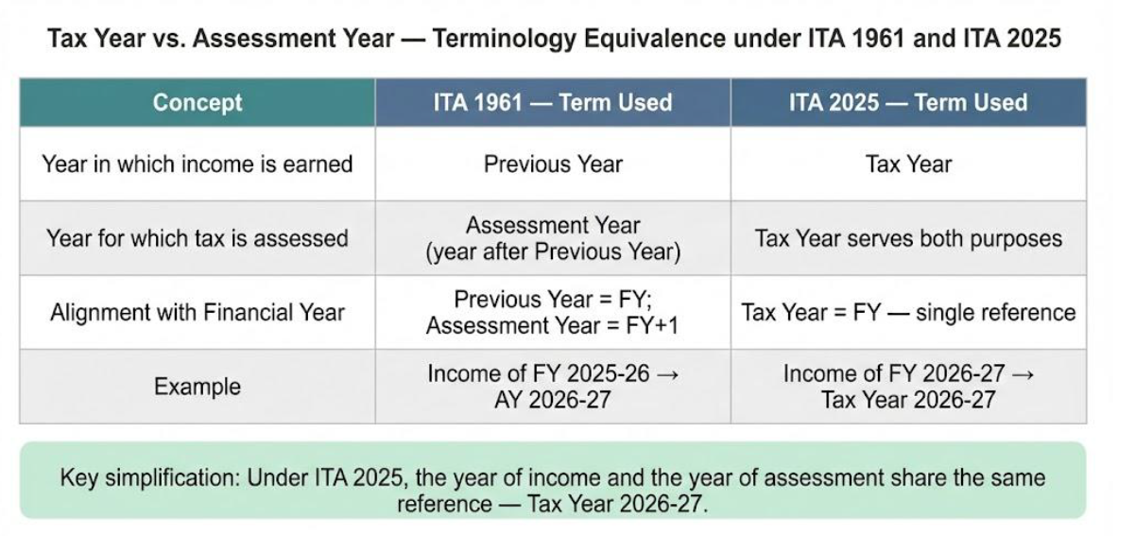
CA P.C. Parwal, Kalani & Co LLP

Slide 15
CHAPTER II: Basis of charge
[Sections 4 to 10]

Slide 16
Section of IT Act 2025 | Name of section | Section of IT Act 1961 | Remarks
Section 4 | Charge of income-tax | Section 4 | Section 4 is the charging section of the Act, which empowers the Government to impose income tax. Tax collected at source (TCS) has explicitly been included within the scope and ambit of the provision. In 1961 Act, it was mentioned that income tax shall be deducted at source or paid in advance. There was no reference to TCS. This error has been corrected.
Section 5 | Scope of total income | Section 5 | There are no substantial changes in the provisions of the ITA 2025 compared to the ITA 1961. For residents, global income is taxable, for non-resident – income that accrues or arises or deemed to accrue or arises or received in India is taxable
Section 6 | Residence in India | Section 6 | There are no substantial changes in the provisions of the ITA 2025 compared to the ITA 1961. The concept of residential status in same with language simplification
Section 7 | Income deemed to be received and dividend deemed to be income in a tax year | Section 7 & 8 | There are no substantial changes in the provisions of the ITA 2025 compared to the ITA 1961.
Section 8 | Income on receipt of capital asset or stock in trade by specified person, from specified entity. | Section 9B | There are no substantial changes in the provisions of the ITA 2025 compared to the ITA 1961. Section has been renumbered
CA P.C. Parwal, Kalani & Co LLP

Slide 17
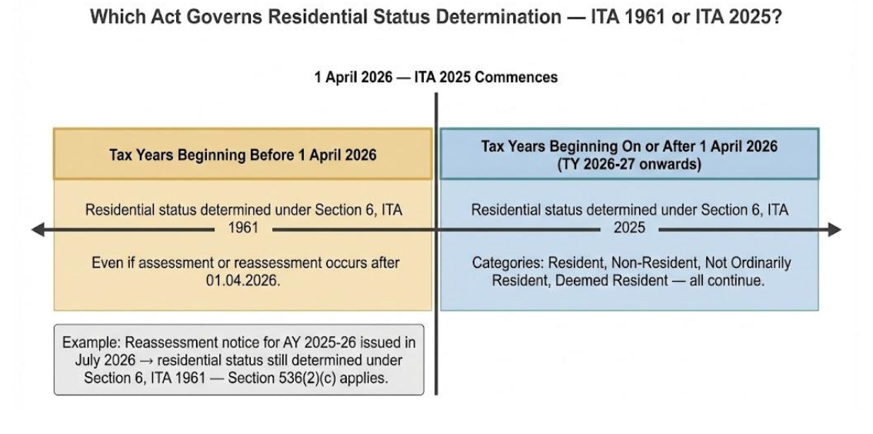
CA P.C. Parwal, Kalani & Co LLP

Slide 18
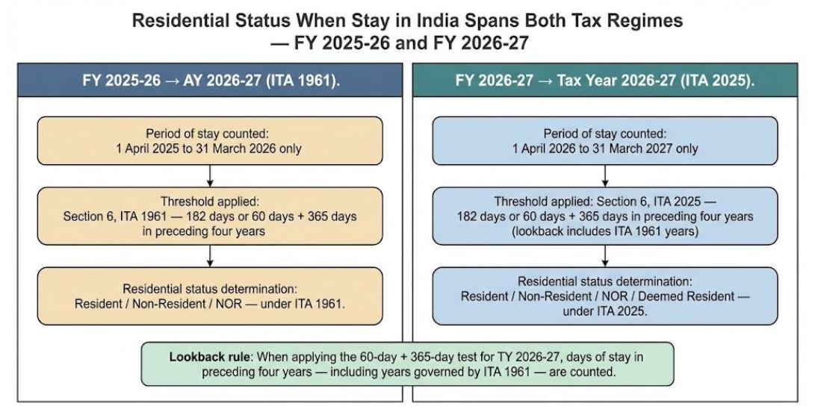
CA P.C. Parwal, Kalani & Co LLP

Slide 19
Section of IT Act 2025 | Name of section | Section of IT Act 1961 | Remarks
Section 9 | Income deemed to accrue a rise in India | Section 9 | The following incomes shall be deemed to accrue or arise in India : The income accruing or arising, directly or indirectly, through or from— (a) any asset or source of income in India; or (b) any property in India; or (c) any business connection in India; or (d) the transfer of a capital asset situated in India Income from salary earned in India Salary payable by the Government to an Indian citizen for service outside India Dividends paid by an Indian Company outside India Interest Royalty Fees for technical services Gift
Under the 1961 Act, the phrase “the transfer of all or any rights (including the granting of a licence)…” was used in Explanation 2(i) & 2(v) to section 9(1)(vi), whereas the phrase “the transfer of all or any rights” was used in Explanation 4 to section 9(1)(vi). However, under the 2025 Act, the former phrase has been replaced with the new phrase “the transfer or grant of all or any rights (including the granting of a licence)…”, and the latter phrase has been replaced with the new phrase “the transfer or grant of all or any rights”. This appears to be an attempt to nullify the Supreme Court's ruling in Engineering Analysis Centre of Excellence (P.) Ltd. v. CIT [2021] 125 taxmann.com 42 (SC)
CA P.C. Parwal, Kalani & Co LLP

Slide 20
CHAPTER III: Incomes which do not form part of total income.
[Sections 11 & 12]

Slide 21
Section of IT Act 2025 | Name of section | Section of IT Act 1961 | Remarks
Section 11 | Income is not included in total income. | Section 10,11,12, 12A, 12AA, 12AB, 12AC, 13 | In computing the total income of any person for a tax year under this Act, any income enumerated in Schedules II, III, IV, V, VI, VII shall not be included, subject to fulfilment of conditions specified therein. … The Central Government may make rules or issue notifications for the purposes of this section as specified in Schedules II, III, IV, V, VI and VII.
Section 12 | Incomes not included in total income of political parties and electoral trusts | Section13A and 13B | 12. (1) In computing the total income of any political party or an electoral trust for a tax year under this Act, any income enumerated in Schedule VIII shall not be included, subject to fulfilment of conditions specified therein (2) Wherever the conditions referred to in Schedule VIII are not satisfied in any tax year in respect of any income enumerated in the said Schedule, such income shall be charged to tax under this Act for that tax year. (3) The Central Government may make rules or issue notifications for the purposes of this section as specified in Schedule VIII.
CA P.C. Parwal, Kalani & Co LLP

Slide 22

NON-PROFIT ORGANISATION
Use of the term registered non-profit organization
Replacing trust, institution, university, educational institution, hospital, etc. to remove confusion
Present: Provisions scattered across Chapters
IT Act 2025: All provisions in single part (XVII-B)
Registration
Income
Commercial activities
Compliances
Violations
Approval for donations
Interpretations
Chapter I
Commercial activities in case of GPU: Proviso to section 2(15)
All the explanations and provisions removed
Chapter III
Section 10(23C), 11,12,12A, 12AA, 12AB, 12AC & 13
Tables:
Application for registration
Specified income and the tax year in which it is taxable
Computation of tax on accreted income
Chapter VIA
Section 80G
Minimum cross references due to better structuring
Chapter XII
Section 115BBC, 115BBI
Redundant provisions removed
Chapter XIIEB
Section 115TD, 115TE, 115TF

Slide 23
EXEMPTIONS (SECTION 10)
A substantial reduction of the words from the approximately 30,000 words to approximately 13,500 words.
All the clauses of section 10 of 1961 Act have been placed in 6 different schedules as follows:-
Schedule II (17 clauses) | Income not to be included in the total income, for e.g. agriculture income, LIC, PPF, scholarship, payment from approved superannuation fund, NPS, interest on gold deposit bond, etc.
Schedule III (39 clauses) (effectively 43 clauses) | Income not to be included in the income of eligible persons such as partners of firm, member of HUF, constituency allowance, capital gain on transfer of agricultural land, etc. Certain allowances to employees are exempt like House Rent Allowance (HRA), Leave Travel Allowance (LTA), Uniform allowance (for official use). Clause 38A to 38D inserted by FA, 2026.
Schedule IV (14 clauses) | Income not to be included in the total income of eligible non-resident
Schedule V (8 clauses) | Income not to be included in the total income of certain eligible persons including investment funds, business trusts and their unit holders
Schedule VI (12 clauses) | Income not to be included in the total income of certain eligible persons in IFSC
Schedule VII (48 clauses) | Persons exempt from tax like CERC, IRDA, university or educational or hospital or other institution wholly or substantially financed by Government, recognized provident fund, superannuation fund, gratuity fund, etc.

Slide 24
CHAPTER IV: Computation of total income
[Sections 13 to 95]

Slide 25
Section:13 Heads of Income
Save as otherwise provided in this Act, all incomes shall, for the purposes of charge of income-tax and computation of total income, be classified under the following heads of income
Salaries
House Property
Business/Profession
Income from employment and services rendered
Income from real estate and rental properties
Profits from commercial activities and professional services
Capital Gains
Other Sources
Profits from sale of capital assets
Residual category for miscellaneous income types
Section:14 Income not forming part of total income
and expenditure in relation to such income:
There are no substantial changes in the provisions of the ITA 2025 compared to the ITA 1961.
CA P.C. Parwal, Kalani & Co LLP

Slide 26
CHAPTER IV: Part B - Salaries
[Sections 15 to 19]

Slide 27
Section of IT Act 2025 | Name of section | Section of IT Act 1961 | Remarks
Section 15 | Salaries | Section 15 | There are no substantial changes in the provisions of the ITA 2025 compared to the ITA 1961. Salary due or paid or arrears is taxable under this head
Section 16 | Income from salary | Section 17 | There are no substantial changes in the provisions of the ITA 2025 compared to the ITA 1961. Salary definition ‘includes’ wages, annuity, pension, gratuity, fee or commission, perquisite, advance salary, leave encashment, taxable PF, etc.
Section 17 | Perquisites | Section 17 | There are no substantial changes in the provisions of the ITA 2025 compared to the ITA 1961.
Section 18 | Profits in lieu of salary | Section 17 | Under Section 17(3)(ii) of the 1961 Act, gratuity, commuted pension, and retrenchment compensation were specifically excluded from the definition of “profits in lieu of salary” because of their exemption status under section 10. In the 2025 Act, Section 18 does not provide any such exclusion, and these receipts are included within the meaning of “profits in lieu of salary”. The rationale behind this is that since these items are no longer considered as exempt income, but rather allowed as deductions from salary under section 19, they must necessarily be included in salary first, and only then reduced by way of deduction, if eligible.
Section 19 | Deduction from salaries | Section 16 | Key change: The deduction on account of entertainment allowance to a government employee is no longer tax-deductible under the 2025 Act.
Notes:
Section 19 – Employment tax deduction, standard deduction, death cum retirement gratuity, commutation of pension, voluntary termination, leave encashment etc

Slide 28
Calculation of deduction of HRA is as under:
Actual HRA received;
Rental expenditure actually incurred less 10% of salary;
50% or 40% of salary
(%age is based on location – number of cities in 50% bracket increased to 8 in IT Rules 2026 as compared to 4 in IT Rules, 1962 - refer table below)
(which-ever is lower)
Salary includes dearness allowance, if provided, but excludes all other allowances and perquisites
Deduction not available in new tax regime (section 202 of IT Act 2025)
Particulars | Rule 2A of IT Rules 1962 | Rule 279 of IT Rules 2026
Statutory Reference | Section 10(13A) of IT Act, 1961 | Section 11 Schedule III [Table: Sl. No. 11] of IT Act, 2025
50% Salary Cities | Bombay, Calcutta, Delhi, and Madras | Mumbai, Kolkata, Delhi, Chennai, Hyderabad, Pune, Ahmedabad, and Bengaluru (additionally included)
40% Salary Cities | Any other place | Any other place
CA P.C. Parwal, Kalani & Co LLP

Slide 29
Leave Travel Assistance (LTA) Changes
Updated Travel Norms & Blocks
Particulars | Rule 2B of IT Rules, 1962 | Rule 278 of IT Rules, 2026
Statutory Reference | Section 10(5) of IT Act, 1961 | Section 11 Schedule III [Table: Sl. No. 8] to the IT Act 2025
Air Travel Limit | Amount not exceeding the air economy fare of the national carrier. | Amount not exceeding the fare admissible for the class of travel to which the employee is entitled.
No Rail Connectivity (No Public Transport) | Amount equivalent to the air-conditioned first-class rail fare. | Admissible at a rate of ₹30 per kilometre.
Block of Four Years | Commencing from the calendar year 1986. | Commencing from the calendar year 2022.
Deduction not available in new tax regime (section 202 of IT Act 2025)
CA P.C. Parwal, Kalani & Co LLP

Slide 30
Particulars | Rule 2BB of IT 1962 | Rule 280 of IT Rules 2026 | Remarks
Children Education Allowance | Rs 100 per month per child for maximum 2 children | Rs 3,000 per month per child for maximum 2 children | Deduction not available if new tax regime is opted (section 202 of IT Act 2025 corresponds to section 115BAC(1A) of IT Act 1961)
Allowance to meet hostel expenditure of child of employee | Rs 300 per month per child for maximum 2 children | Rs 9,000 per month per child for maximum 2 children | Deduction not available if new tax regime is opted
Transport allowance (only to Handicapped employee) | Rs 3,200 per month | Rs 15,000 + DA (Metro cities) Rs 8,000 + DA (Other cities) | Deduction available to employee in new regime of taxation as well
Allowances granted to meet the cost of travel on tour or on transfer | No change | No change | Deduction available to employee in new regime of taxation as well
Sum paid in connect with transfer, packing and transportation of personal effect | No change | No change
Allowance granted on tour or period of journey in connection with transfer, to meet the ordinary daily charges incurred by employee on account of absence from his normal place of duty | No change | No change
Allowance granted to meet the expenditure incurred on conveyance in performance of duties of an office where no free conveyance is provided by the employer | No change | No change
CA P.C. Parwal, Kalani & Co LLP

Slide 31
Perquisite Category | Rule 3 of IT Rules, 1962 | Rule 15 of IT Rules, 2026
Interest free or concessional loan to employee by the employer | Perquisite value = Interest computed at the annual rate charged by SBI on 1 April of tax year on loan by bank for same purpose, using maximum outstanding monthly balance, reduced by interest paid by employee, if any No perquisite value: if loan is given for medical treatment of specified diseases; or if loan amount does not exceed Rs 20,000 in aggregate | Perquisite value = Interest computed at the annual rate charged by SBI on 1 April of tax year on loan by bank for same purpose, using maximum outstanding monthly balance, reduced by interest paid by employee, if any No perquisite value: if loan is given for medical treatment of specified diseases; or if loan amount does not exceed Rs 2,00,000 in aggregate
Free food and non-alcoholic beverages by employer to employee | Perquisite value = Expenditure incurred by employer less amount paid or recovered by the employee No perquisite value: if free food and non-alcoholic beverages is provided during working hours at office; or through paid vouchers usable only at eating joints, to the extent of Rs 50 per meal The above benefit was not available if employee opted for new regime of taxation | Perquisite value = Expenditure incurred by employer less amount paid or recovered by the employee No perquisite value: if free food and non-alcoholic beverages is provided during working hours at office; or through paid vouchers usable only at eating joints, to the extent of Rs 200 per meal 22 working days * 2 meals * Rs 200 * 12 = Rs 1,05,800. Benefit in new regime of taxation as well
CA P.C. Parwal, Kalani & Co LLP

Slide 32
Perquisite Category | Rule 3 of IT Rules, 1962 | Rule 15 of IT Rules, 2026
Free gift voucher or token received by the employee from employer on ceremonial occasions or otherwise | Perquisite value = Amount of such gift No perquisite value: If the value of gift was below Rs 5,000 in aggregate during the year | Perquisite value = Amount of such gift No perquisite value: If the value of gift was below Rs 15,000 in aggregate during the year
Movable assets (belonging to employer or hired by him) | Perquisite value = 10% p.a. of actual cost of asset or the amount of rent paid by employer, less any amount recovered from employee No perquisite value: If asset provided is the nature of laptop or computer | Perquisite value = 10% p.a. of actual cost of asset or the amount of rent paid by employer, less any amount recovered from employee No perquisite value: If asset provided is the nature of laptop, computer, tablets, and mobile phones.
Medical treatment outside India | Expenditure incurred by employer on medical treatment of employee or any family member outside India or for travel and stay abroad will not be treated as a perquisite only if the gross total income of the employee does not exceed Rs 2 lakhs | Expenditure incurred by employer on medical treatment of employee or any family member outside India or for travel and stay abroad will not be treated as a perquisite only if the gross total income of the employee does not exceed Rs 8 lakhs
Any other benefit or amenity | Any benefit granted free of cost or at concessional rates will be perquisite it is given to any employee whose income chargeable under the head Salaries exceeds Rs 50k | Any benefit granted free of cost or at concessional rates will be perquisite it is given to any employee whose income chargeable under the head Salaries exceeds Rs 4 lacs
CA P.C. Parwal, Kalani & Co LLP

Slide 33
Perquisite Category | Rule 3 of IT Rules, 1962 |  | Rule 15 of IT Rules, 2026
1. If the motor car is owned or hired by the employer and is used partly for official purpose and partly for private purpose
Circumstance | Where cubic capacity of engine does not exceed 1.6 litres or the motor car is electric vehicle | Where cubic capacity of engine exceed 1.6 litres | Where cubic capacity of engine does not exceed 1.6 litres or the motor car is electric vehicle | Where cubic capacity of engine exceed 1.6 litres
(i) expenses on maintenance and running are met or reimbursed by the employer | Rs 1,800 (plus Rs 900 if driver is also provided by the employer) p.m. | Rs 2,400 (plus Rs 900 if driver is also provided by the employer) p.m. | Rs 5,000 (plus Rs 3,000 if driver is also provided by the employer) p.m. | Rs 7,000 (plus Rs 3,000 if driver is also provided by the employer) p.m.
(ii) expenses on maintenance and running are met fully met by assessee/ employee | Rs 600 (plus Rs 900 if driver is also provided by the employer) p.m. | Rs 900 (plus Rs 900 if driver is also provided by the employer) p.m. | Rs 2,000 (plus Rs 3,000 if driver is also provided by the employer) p.m. | Rs 3,000 (plus Rs 3,000 if driver is also provided by the employer) p.m.
2. If the motor car is owned by employee but the running and maintenance charges including driver salary is met or reimbursed by the employer
(i) if the vehicle is used wholly and exclusively used for official purpose | Nil perquisite value, subject to conditions that employer maintains complete details of journey undertaken for official purpose like date of journey, destination, mileage and amount of expenditure incurred and employer gives a certificate that expenditure was incurred wholly and exclusively for performance of official duties
(ii) if the vehicle is used partly for official purpose and partly for personal purpose | Perquisite value = Actual expenditure incurred by the employer less amount specified in 1(i) above i.e. Rs 5,000 or Rs 7,000 as the case may be plus Rs 3,000 if driver salary is also reimbursed or met by the employer, subject to above condition of maintaining details by employer
3. If the vehicle other than motor car is owned by employee but the running and maintenance charges including driver salary is met or reimbursed by the employer
(i) if the vehicle is used wholly and exclusively used for official purpose | Nil perquisite value, subject to conditions that employer maintains complete details of journey undertaken for official purpose like date of journey, destination, mileage and amount of expenditure incurred and employer gives a certificate that expenditure was incurred wholly and exclusively for performance of official duties.
(ii) if the vehicle is used partly for official purpose and partly for personal purpose | Perquisite value = Actual expenditure incurred by the employer less Rs 3,000 p.m., subject to above condition of maintaining details by employer
CA P.C. Parwal, Kalani & Co LLP

Slide 34
CHAPTER IV: Part C - Income from House Property
[Sections 20 to 25]

Slide 35
Section of IT Act 2025 | Name of section | Section of IT Act 1961 | Remarks
Section 20 | Income from House Property | Section 22 | There are no substantial changes in the provisions of the ITA 2025 compared to the ITA 1961.
Section 21 | Determination of Annual Value | Section 23 | There are no substantial changes in the provisions of the ITA 2025 compared to the ITA 1961.
Section 22 | Deductions from income from House Property | Section 24 | There are no substantial changes in the provisions of the ITA 2025 compared to the ITA 1961.
Section 23 | Arrears of rent and unrealized rent received subsequently. | Section 25A | There are no substantial changes in the provisions of the ITA 2025 compared to the ITA 1961.
Section 24 | Property owned by co-owners. | Section 26 | There are no substantial changes in the provisions of the ITA 2025 compared to the ITA 1961.
Section 25 | Interpretations | Section 27 | There are no substantial changes in the provisions of the ITA 2025 compared to the ITA 1961.
CA P.C. Parwal, Kalani & Co LLP

Slide 36
Section of IT Act 2025 | Remarks
Section 20 | Annual value of property consisting of any buildings or lands appurtenant thereto, owned by the assessee is chargeable under house property head. It is not applicable to such portions of the property, as the assessee occupy for his business or profession, the profits of which are chargeable to income-tax
Section 21 | The annual value of any property shall be deemed to be the higher of the following: (a) the sum for which it might reasonably be expected to let from year to year; or (b) the actual rent received or receivable by the owner, if the property or any part of it is let Where a property is held as stock-in-trade and is not let wholly or partly at any time during the tax year, the annual value of such property shall be nil upto 2 years from the end of the financial year in which the certificate for completion of construction is obtained from the competent authority (6) The annual value of the property consisting of a house or any part thereof shall be taken as nil, if the owner occupies it for his own residence or cannot actually occupy it due to any reason and is applicable for 2 houses
Section 22 | Following deductions are allowed: (a) 30% of the annual value (b) interest payable on borrowed capital Maximum deduction allowed is Rs 2 lacs where property is self occupied and acquisition or construction is completed within 5 years from the end of tax year in which capital was borrowed; and (ii) certificate of interest is furnished
CA P.C. Parwal, Kalani & Co LLP

Slide 37
CHAPTER IV: Part D - Profits and gains of business or profession
[Sections 26 to 66]

Slide 38
The following FAQs are issued by the Income-tax Department concerning Chapter IV-D [containing sections 26 to 66 of the 2025 Act]:
QV.1 What are the major changes in the chapter Profits and gains of business and profession?
(i) The flow of the sections has been revised to improve coherence, create logical links, and ensure a smoother progression.
(ii) Similar sections, such as those on presumptive taxation for residents and non-residents, have been merged to simplify the content, make it more concise, and consolidate all related scenarios in one place.
(iii) Provisions on similar topics, such as deductions on employee welfare, which were previously scattered across the chapter, have been grouped together for easier understanding and compliance.
(iv) Formula-based explanations have been added to clarify complex concepts that were previously difficult to understand, such as the definition of Written-down Value.
(v) Provisions involving multiple scenarios, like those for determining Actual Cost, which were previously presented as provisos or explanations, have been organized into a table for better readability and comprehension.
(vi) All provisos and explanations in the chapter have been converted into sub-sections to eliminate ambiguity and ensure clarity.
(vii) Redundant and already sun-set provisions have been removed.
(vii) As a result, the total word count has been reduced by more than half, and the number of sections has decreased from 65 to 41.
CA P.C. Parwal, Kalani & Co LLP

Slide 39
Section of IT Act 2025 | Name of section | Section of IT Act 1961 | Remarks
Section 26 | Income under the head, “Profit and gains or business or profession” | Section 28 | Section 26(2)(e) of the 2025 Act brings all kinds of import-export incentives within the ambit of the charging provision for taxability under the head of business income. The new provision refrained from specifying the name of the scheme under which the incentives or benefits are received for taxability. Instead, it provides that “the amount of any profit on sale of import licence, cash assistance against export, duty drawback or duty remission or any other export incentive, received or receivable” shall be covered within the scope of business or profession income.
Section 27 | Income how computed | Section 29 | There are no substantial changes in the provisions of the ITA 2025 compared to the ITA 1961.
Section 28 | Rent, rates, taxes, repairs and insurance for buildings | Section 30, 31, 38 | There are no substantial changes in the provisions of the ITA 2025 compared to the ITA 1961.
Section 29 | Deductions related to employee welfare | Section 36, 40A(7), 40A(9) | In the 1961 Act, provisions related to expenses for contributions to Provident Fund, Gratuity Fund, Superannuation Fund, etc., were spread across various sections, such as 40A(7), (9) and 36(1)(iv), (iva), (v), (va). In the 2025 Act, these provisions have been consolidated under section 29, making them easier to understand and comply with. Deduction of employees’ contribution, if deposited by the employer upto the due date of filing of return of income under section 263(1) of the Act is allowable.
CA P.C. Parwal, Kalani & Co LLP

Slide 40
Section of IT Act 2025 | Name of section | Section of IT Act 1961 | Remarks
Section 30 | Deduction of certain premium | Section 36 | There are no substantial changes in the provisions of the ITA 2025 compared to the ITA 1961.
Section 31 | Deduction of bad debt and provision for bad and doubtful debt | Section 36(1)(vii)/(via) and 36(2) | Presentation has been made in tabular format
Section 32 | Other deductions | Section 36 | There are no substantial changes in the provisions of the ITA 2025 compared to the ITA 1961.
Section 33 | Deduction for depreciation | 32 | FAQs by Income-tax Department QV.5 What is the difference between section 32 of IT Act,1961 and new section 33 of Income-tax Bill, 2025, i.e. “Deduction for depreciation”? Ans: Section 32 of the Income-tax Act, 1961, which deals with depreciation, has become very complex over the past 63 years. It includes 6 clauses/sub-sections, 9 provisos, and 6 Explanations. In the new Act, all provisos and Explanations have been converted into sub-sections/clauses, reducing the word count by 40%. These changes make the provision easier to understand and comply with. There has been no change in the rate of depreciation, eligibility, or method of allowance.
Section 34 | General conditions for allowing deductions | 37 | There are no substantial changes in the provisions of the ITA 2025 compared to the ITA 1961.
CA P.C. Parwal, Kalani & Co LLP

Slide 41
Deduction for depreciation.
33. (1) A deduction in respect of depreciation of—
(a) buildings, machinery, plant or furniture, being tangible assets;
(b) ……………, being intangible assets acquired on or after the 1st April, 1998, not being goodwill of a business or profession,
owned wholly or partly by the assessee and used wholly and exclusively for the purposes of the business or profession, shall be allowed, as per the provisions of this section.
(3) (a) In case of any block of assets, deduction in respect of depreciation shall be such percentage of its written down value, as may be prescribed;
(b) when any building, machinery, plant or furniture is partly, or not wholly and exclusively, used for the purposes of the business or profession, the deduction under clause (a) shall be restricted to the fair proportionate part thereof as determined by the Assessing Officer, having regard to the usage of such building, machinery, plant or furniture for the purposes of the business or profession;
Depreciation.
32. (1) In respect of depreciation of
buildings, machinery, plant or furniture, being tangible assets
………………, being intangible assets acquired on or after the 1st day of April, 1998, not being goodwill of a business or profession
owned, wholly or partly, by the assessee and used for the purposes of the business or profession, the following deductions shall be allowed
CA P.C. Parwal, Kalani & Co LLP

Slide 42
38. (2) Where any building, machinery, plant or furniture is not exclusively used for the purposes of the business or profession, the deductions under sub-clause (ii) of clause (a) and clause (c) of section 30, clauses (i) and (ii) of section 31 and clause (ii) of sub-section (1) of section 32 shall be restricted to a fair proportionate part thereof which the Assessing Officer may determine, having regard to the user of such building, machinery, plant or furniture for the purposes of the business or profession.
CA P.C. Parwal, Kalani & Co LLP

Slide 43
Section of IT Act 2025 | Name of section | Section of IT Act 1961 | Remarks
Section 35 | Amounts not deductible in certain circumstances | Section 40 | There are no substantial changes in the provisions of the ITA 2025 compared to the ITA 1961.
Section 36 | Expense or payments not deductible in certain circumstances | Section 40A (payments to specified persons) | There are no substantial changes in the provisions of the ITA 2025 compared to the ITA 1961.
Section 37 | Certain deductions allowed on actual payment basis only | Section 43B | (1) The sums payable, as specified in sub-section (2), which are otherwise allowable as a deduction under this Act, shall be allowed as a deduction while computing the income chargeable under section 26 only in the tax year in which such sums are actually paid irrespective of— (a) any provision to the contrary in this Act; or (b) method of accounting regularly followed; or (c) the tax year in which the liability was incurred.
Section 38 | Certain sums deemed as profit and gains of business or profession. | Section 41 | There are no substantial changes in the provisions of the ITA 2025 compared to the ITA 1961.
Section 39 | Computation of actual cost | Section 43(1) | There are no substantial changes in the provisions of the ITA 2025 compared to the ITA 1961.
Section 41 | Written down value of depreciable asset | Section 43(6) | There are no substantial changes in the provisions of the ITA 2025 compared to the ITA 1961.
Section 42 | Capitalising impact of foreign exchange fluctuation | Section 43A | There are no substantial changes in the provisions of the ITA 2025 compared to the ITA 1961.
CA P.C. Parwal, Kalani & Co LLP

Slide 44
Section of IT Act 2025 | Name of section | Section of IT Act 1961 | Remarks
Section 43 | Taxation of foreign exchange fluctuation | Section 43AA | There are no substantial changes in the provisions of the ITA 2025 compared to the ITA 1961.
Section 44 | Amortization of certain preliminary expenses | Section 35D | There are no substantial changes in the provisions of the ITA 2025 compared to the ITA 1961.
Section 53 | Full value of consideration for transfer of assets other than capital assets in certain cases | Section 43CA | There are no substantial changes in the provisions of the ITA 2025 compared to the ITA 1961.
Section 57 | Revenue Recognition for Construction and Service Contracts | Section 43CB | There are no substantial changes in the provisions of the ITA 2025 compared to the ITA 1961.
Section 58 | Special provision for computing profit and gains of business or profession on presumptive basis in case of certain residents. | Section 44AA, 44AB, 44AD, 44ADA, 44AE | Tabular presentation for better and easy understanding of provisions. Further, under the 1961 Act, the requirement of keeping and maintaining the books of account, etc. and getting the accounts audited under Section 44AB was there if an assessee claimed lower profits and gains than the deemed profits and gains In the 2025 Act, the following twin conditions should be satisfied: a) The assessee claims lower profits and gains than the deemed profits and gains computed in accordance with Column E of Table: Sl. No. 2 in Section 58(2) [corresponding to Section 44AE of the 1961 Act]; and (b) Such assessee’s total income exceeds the maximum amount which is not chargeable to tax.
CA P.C. Parwal, Kalani & Co LLP

Slide 45
Section of IT Act 2025 | Name of section | Section of IT Act 1961 | Remarks
Section 62 | Maintenance of books of account | Section 44AA | The books of accounts maintained in electronic mode shall remain accessible in India at all times and the backup of such books of account and other documents maintained in electronic mode shall be kept on a daily basis in servers physically located in India. The books shall be kept and maintained for a period of 7 tax years from the end of relevant tax year
Section 63 | Tax audit | Section 44AB
Nature of Business or Profession | Category of Taxpayer | When audit is mandatory?
Any professions (specified or non-specified) | Any | If gross receipts from profession during the relevant previous year exceeds Rs. 50 lakhs
Business | Cash receipt and payment up to 5% | If total sales, turnover or gross receipt from business during the previous year exceeds Rs. 10 crore
Business | Any | If total sales, turnover or gross receipt from business during the previous year exceeds Rs. 1 crore
CA P.C. Parwal, Kalani & Co LLP

Slide 46
CHAPTER IV: Part E - Capital Gains
[Sections 67 to 91]

Slide 47
Section of IT Act 2025 | Name of section | Section of IT Act 1961 | Remarks
Section 67 | Capital gains | Section 45 | Charging section. There are no substantial changes in the provisions of the ITA 2025 compared to the ITA 1961.
Section 68 | Capital gains on distribution of assets by companies in liquidation. | Section 46 | There are no substantial changes in the provisions of the ITA 2025 compared to the ITA 1961.
Section 69 | Capital gains on purchase by company of its own shares or other specified securities. | Section 46A | Pursuant to Finance Act 2026, capital gains on share buyback is treated as capital gains only and not dividends. Difference between consideration and cost of acquisition will be taxable as capital gains. Where the promoter is participating in share buyback, a higher tax will be levied (22%/ 30%).
Section 70 | Transactions not regarded as transfer. | Section 47 | There are no substantial changes in the provisions of the ITA 2025 compared to the ITA 1961.
Section 71 | Withdrawal of exemption in certain cases | Section 47A | There are no substantial changes in the provisions of the ITA 2025 compared to the ITA 1961.
Section 72 | Modes of computation of capital gains | Section 48 | There are no substantial changes in the provisions of the ITA 2025 compared to the ITA 1961.
Section 73 | Cost with reference to certain modes of acquisition | Section 49 | There are no substantial changes in the provisions of the ITA 2025 compared to the ITA 1961.
Section 74 | Special provision for computation of capital gains in case of depreciable assets. | Section 50 | There are no substantial changes in the provisions of the ITA 2025 compared to the ITA 1961.
CA P.C. Parwal, Kalani & Co LLP

Slide 48
Section of IT Act 2025 | Name of section | Section of IT Act 1961 | Remarks
Section 75 | Special provision for cost of acquisition in case of depreciable asset | Section 50A | There are no substantial changes in the provisions of the ITA 2025 compared to the ITA 1961.
Section 76 | Special provision for computation of capital gains in case of market-linked debentures. | Section 50AA | There are no substantial changes in the provisions of the ITA 2025 compared to the ITA 1961.
Section 77 | Special provision for computation of capital gains in case of slump sale. | Section 50B | There are no substantial changes in the provisions of the ITA 2025 compared to the ITA 1961.
Section 78 | Special provision for full value of consideration in certain cases | Section 50C | There are no substantial changes in the provisions of the ITA 2025 compared to the ITA 1961.
Section 79 | Special provision for full value of consideration for transfer of share other than quoted shares. | Section 50CA | There are no substantial changes in the provisions of the ITA 2025 compared to the ITA 1961.
Section 80 | Fair market value deemed to be full value of consideration in certain cases. | Section 50D | There are no substantial changes in the provisions of the ITA 2025 compared to the ITA 1961.
Section 81 | Advance money received | Section 51 | There are no substantial changes in the provisions of the ITA 2025 compared to the ITA 1961.
CA P.C. Parwal, Kalani & Co LLP

Slide 49
Section of IT Act 2025 | Name of section | Section of IT Act 1961 | Remarks
Section 82 | Profit on sale of property used for residence | Section 55 | There are no substantial changes in the provisions of the ITA 2025 compared to the ITA 1961.
Section 83 | Capital gains on transfer of land used for agricultural purposes not to be charged in certain cases | Section 54B | There are no substantial changes in the provisions of the ITA 2025 compared to the ITA 1961.
Section 84 | Capital gains on compulsory acquisition of land and building not to be charged in certain cases. | Section 54D | There are no substantial changes in the provisions of the ITA 2025 compared to the ITA 1961.
Section 85 | Capital gains not to be charged on investment in certain bonds. | Section 54EC | There are no substantial changes in the provisions of the ITA 2025 compared to the ITA 1961. The drafting error in the charging provision for capital gains is corrected by including a reference to provisions providing exemption
Section 86 | Capital gains on transfer of certain capital assets not to be charged in case of investment in residential house. | Section 54F | There are no substantial changes in the provisions of the ITA 2025 compared to the ITA 1961.
Section 87 | Exemption of capital gains on transfer of assets in cases of shifting of industrial undertaking from urban area | Section 54G | There are no substantial changes in the provisions of the ITA 2025 compared to the ITA 1961.
CA P.C. Parwal, Kalani & Co LLP

Slide 50
Section of IT Act 2025 | Name of section | Section of IT Act 1961 | Remarks
Section 90 | Meaning of “adjusted”, “cost of improvement”, and “cost of acquisition”. | Section 55 | There are no substantial changes in the provisions of the ITA 2025 compared to the ITA 1961.
Section 91 | Reference to Valuation Officer | Section 55A | There are no substantial changes in the provisions of the ITA 2025 compared to the ITA 1961.
CA P.C. Parwal, Kalani & Co LLP

Slide 51
CHAPTER IV: Part F - Income from other sources
[Sections 92 to 95]

Slide 52
Section of IT Act 2025 | Name of section | Section of IT Act 1961 | Remarks
Section 92 | Income from other sources | Section 56 | Definition of term relative is as under: “relative” means— (i) in case of an individual— (A) spouse; (B) brother or sister; (C) brother or sister of the spouse; (D) brother or sister of either of the parents; (E) any lineal ascendant (maternal as well as paternal) or descendant; (F) any lineal ascendant (maternal as well as paternal) or descendant of the spouse; (G) spouse of the person referred to in items (B) to (F); and (ii) for a Hindu undivided family, any member thereof;
Section 93 | Deductions | Section 57 | There are no substantial changes in the provisions of the ITA 2025 compared to the ITA 1961.
Section 94 | Amounts not deductible | Section 58 | There are no substantial changes in the provisions of the ITA 2025 compared to the ITA 1961.
Section 95 | Profits chargeable to tax | Section 59 | There are no substantial changes in the provisions of the ITA 2025 compared to the ITA 1961.
CA P.C. Parwal, Kalani & Co LLP

Slide 53

CHAPTER V
Income of Other Person Included In Total Income of Assessee
[Section 96 to 100 in IT Act, 2025]

Slide 54
Section 60 vs 96: Transfer of Income without transfer of assets 1961 Act (s.60): If you transfer just income (not the asset), that income is taxed in your hands. 2025 Act (s.96): Same rule, but simpler words—no major change.
Section 61 vs 97: Revocable transfer of assets -> Chargeability of income in transfer of assets 1961 Act (s.61): Income from revocable transfers is yours for tax. 2025 Act (s.97): Covers revocable and some irrevocable transfers; adds clearer exceptions like post-5-year irrevocable ones—slightly wider net. Section 62 vs 97: Transfer irrevocable for a specified period -> Chargeability of income in transfer of assets 1961 Act (s.62): Exceptions to revocable rule (e.g., transfers before 1961 or irrevocable after 2 years). 2025 Act (s.97 part): Folded into s.97 with longer wait periods for exceptions—more strict timing.​ [Clause 97 of the Income Tax Act, 2025, largely mirrors Sections 61-63 of the 1961 Act by taxing income from revocable transfers in the transferor's hands, with no explicit mention of a "post-5-year irrevocable" exception in available texts. While Section 62 of the 1961 Act carves out exceptions to Section 61's revocable transfer rule—such as irrevocable trusts during the transferee's lifetime without transferor benefit, pre-June 1, 1961 transfers becoming irrevocable after 6 years, or absolute transfers with no reverter—Section 97 of the 2025 Act integrates and tightens these into its sub-clauses with stricter timing, not extending safe-harbor wait periods beyond 6 years for exemptions, ensuring short-term "irrevocable" structures remain taxable to curb transient tax avoidance while embedding clearer compliance norms.]
Section 63 vs 98: "Transfer" and "revocable transfer" defined 1961 Act (s.63): Defines "revocable" (control or re-transfer power). 2025 Act (s.97 part): Same idea in s.97, but streamlined definition—no real shift.​
Section 60 vs 96
1961 Act (s.60): If you transfer just income (not the asset), that income is taxed in your hands.
2025 Act (s.96): Same rule, but simpler words—no major change.
Section 61 vs 97
1961 Act (s.61): Income from revocable transfers is yours for tax.
2025 Act (s.97): Covers revocable and some irrevocable transfers; adds clearer exceptions like post-5-year irrevocable ones—slightly wider net.
[Clause 97 of the Income Tax Act, 2025, largely mirrors Sections 61-63 of the 1961 Act by taxing income from revocable transfers in the transferor's hands, with no explicit mention of a "post-5-year irrevocable" exception in available texts.]
Section 62 vs 97 (part)
1961 Act (s.62): Exceptions to revocable rule (e.g., transfers before 1961 or irrevocable after 2 years).
2025 Act (s.97 part): Folded into s.97 with longer wait periods for exceptions—more strict timing.​

Slide 55
Income of individual to include income of spouse, minor child, etc Section 64(1) vs 99 1961 Act: Clubs income from assets given to spouse, son's wife (no consideration). 2025 Act (s.99): Same targets, but splita s.99 for spouse/minor/son's wife; drops some old loopholes.​ Section 64(1A) vs 99 1961 Act: Minor child's all income (beyond basic exemption) clubbed to parent (higher earner). 2025 Act (s.99): Same, but clearer split between parents if both earn. Section 64(2) vs 99 1961 Act: Converts separate property into HUF property—income clubs back. 2025 Act (s.99): Similar for HUF throws; adds rules for capital gains on such shifts.​ [Section 64(1) of the 1961 Act clubs income from assets transferred without adequate consideration to a spouse, son's wife, or minor child (excluding skill-based income) into the transferor's hands to stop tax splitting. The 2025 Act's Sections 99 keep this but split it—for spouse/minor/son's wife—fixing old loopholes like indirect transfers through spouse-controlled companies or firms and cross-spouse swaps that courts sometimes let slip, now explicitly taxing based on control or benefit.]

Slide 56
[Section 64(1A) of the 1961 Act clubs a minor child's total income (beyond their basic exemption) with the parent having higher income, but lacks clarity on equal-earning parents or separated couples, often leading to disputes. Section 99 of the 2025 Act retains this but introduces a "clearer split" via explicit rules: income splits equally between earning parents (50:50), or fully to the higher earner only if one parent's income exceeds the other's by 50%+; for separated/divorced parents, it defaults to the custodial parent unless a court order specifies otherwise, reducing litigation over allocation.] [Section 64(2) of the 1961 Act deems income from individual property converted to HUF property (without adequate consideration) as taxable in the transferor's hands, preventing tax splitting via HUF throws. Section 99 of the 2025 Act mirrors this but adds explicit rules for capital gains: any latent gains existing at conversion are crystallized and clubbed with the transferor (computed as if sold at fair market value on conversion date), with HUF taking the stepped-up base cost for future sales—thus curbing deferral abuse while clarifying post-conversion gain taxation.]
Section 65 vs 100: Liability of person in respect of income included in the income of another person 1961 Act: Liability of transferee person. 2025 Act: Same idea- no real shift.

Slide 57
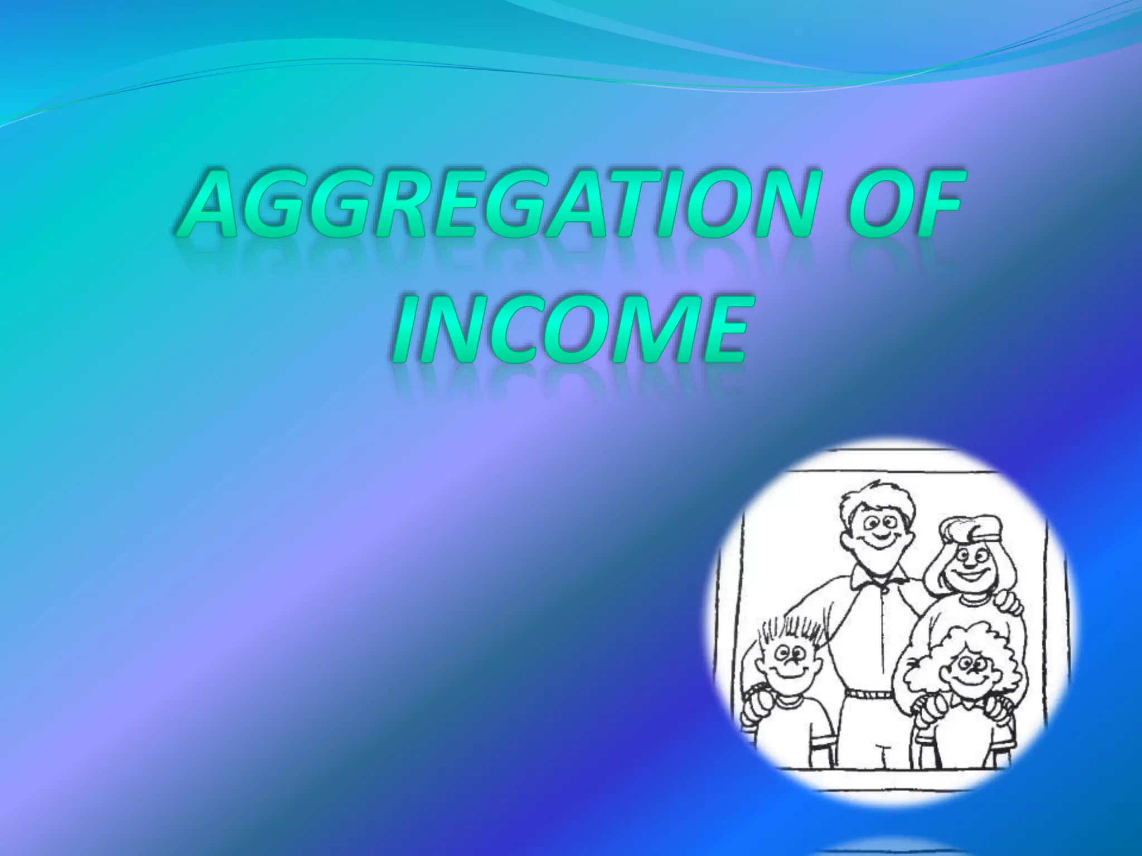
CHAPTER VI
(Aggregation Of Income)
Section 102 to 107 in IT Act, 2025

Slide 58
Comparison of sections of IT Act, 1961 with IT Act, 2025
Income Tax Act, 1961 | Income Tax Act, 2025
Section 68- Cash Credits | Section 102- Unexplained Credits
Section 69- Unexplained investments | Section 103- Unexplained investments
Section 69A- Unexplained money, etc. | Section 104- Unexplained asset “asset” includes money, bullion, jewellery, virtual digital asset or another valuable article
Section 69B- Amount of investments, etc., not fully disclosed in books of account. | Merged with section 103 & 104
Section 69C- Unexplained expenditure | Section 105- Unexplained expenditure
Section 69D- Amount borrowed or repaid on hundi | Section 106- Amount borrowed or repaid through negotiable instrument, hundi, etc.
Section 115BBE- Tax on income referred to in section 68 to 69D | Section 107- Income referred to in sections 102 to 106 shall be charged to tax as per the provisions of section 195

Slide 59
“MAY” “SHALL”
The change from "may" to "shall" in sections 102 to 105 of the Income Tax Act, 2025 simplifies tax enforcement by making it mandatory to treat unexplained cash credits, investments, assets, or expenses as taxable income, rather than leaving it to the officer's choice. This cuts down on subjective decisions, speeds up assessments, and reduces court cases over disputes. Overall, it boosts fair compliance, deters evasion with clear rules, and helps collect more revenue efficiently.

Slide 60
RATIONALISATION OF TAX RATE IN RESPECT OF UNEXPLAINED INCOME/ INVESTMENT/ EXPENDITURE/ CREDITS ETC. AND EXPANDING THE SCOPE OF IMMUNITY FROM PENALTY [w.e.f. 01.04.2026]
Existing section of IT Act, 1961 | Existing Provisions | Existing section of IT Act, 2025 | Amended Provisions
115BBE | If income is declared in the return of income furnished u/s 139 & tax has been paid before end of relevant PY Tax @ 60% + surcharge @ 25% of tax + cess @ 4% of tax & surcharge. Thus, total incidence of tax is 78%. | 195 | Tax @ 30% + surcharge @ 25% of tax + cess @ 4% of tax & surcharge. Thus, total incidence of tax is 39%.
271AAC | If income is added by AO In addition to tax, penalty @ 10% of tax payable (i.e. 6% of income) u/s 271AAC would be levied. Thus, total incidence of tax & penalty is 84%. | 443/ 439 | Section 443 omitted and penalty subsumed in section 439 where penalty for misreporting income is 200% of the tax payable on such income. Thus total tax and penalty would be 117% of the tax payable on such income (39% Tax + 78% Penalty).
270AA | Immunity from penalty-Immunity only in case of underreporting of income (not on misreporting), if tax and interest is paid within the period specified in the notice of demand and no appeal is filed. | 440 | Immunity on misreporting of income also provided on payment of 100% of additional income tax. However, where addition is made by AO which is chargeable to tax u/s 195 of the Act, immunity will be provided on payment of 120% of additional income tax. Thus total tax and penalty where income is in nature of unexplained income/ investment/ expenditure/ credits etc. would be 85.80% of the tax payable (39% Tax + 46.8% Additional tax) as against the present tax and penalty of 84% (78% + 6%).

Slide 61
CHAPTER VII: Set off or Carry Forward and set off of losses
[Sections 108 to 121]

Slide 62
STRUCTURAL COMPARISON
SUBJECT | Income-tax Act, 2025 | Income-tax Act, 1961 | Change
Intra-head set off | Sec 108 | Sec 70 | No change
Inter-head set off | Sec 109 | Sec 71 | No change
House property loss cap | Rs.2 lakh (109(1)(b)) | Rs.2 lakh (71(3A)) | No change
Capital loss restriction | Sec 109(2) | Sec 71(3) | No change
Business loss carry forward | Sec 112 | Sec 72 | 8 years retained
Capital Loss carry Forward | Sec 111 | Sec 74 | 8 years retained
Speculation loss | Sec 113 | Sec 73 | 4 years retained
Specified business | Sec 114 | Sec 73A | No change
Race horse loss | Sec 115 | Sec 74A | 4 years retained
Clause (m) & (n) of Section 536(2) provide for continued carry forward and set off of losses under the new Act.
CA P.C. Parwal, Kalani & Co LLP

Slide 63
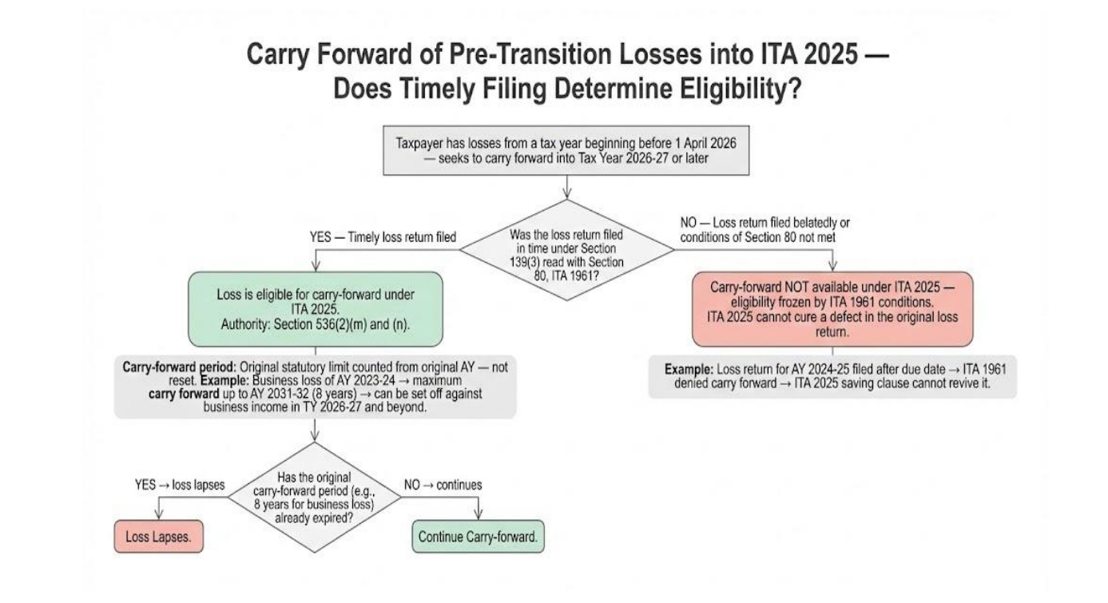
CA P.C. Parwal, Kalani & Co LLP

Slide 64
CHAPTER XIX: Collection & Recovery of tax- Part B- Deduction & Collection at source
[Sections 392 to 402]

Slide 65
All the TDS sections in IT Act, 1961 (section 193 to 194T) are now consolidated under one section, i.e. section 393.
Section 393 of the Act contains 3 Tables applicable to three broad categories of Payees- Residents, Non-residents and any person. The respective Table for each category in turn specifies the nature of income or sum, monetary threshold, payer/person and the applicable rate of TDS. For example, the proposed provisions relating to TDS on rent are shown below:
Nature of income or sum | Payer | Rate
 |  | Threshold limit
Income by way of rent | Person other than specified person | Rate:2%
 |  | Threshold limit: Rs. 50,000 for a month or part of a month
Further there is separate table for non deduction of tax at source and declaration for no deduction of tax at source.

Slide 66
Similarly the provisions of TCS contained in section 206C of the IT Act, 1961 has been covered in section 394.
Section 394 of Act contains one Table which specifies the nature of receipts, monetary threshold, collector and rate of TCS. The said section also lays down the conditions for no collection of TCS.
Furthermore, provisions relating to the following matters, which were present through-out the Chapter in the existing Act, have been merged and placed together as independent sections in the Act,
Certificates including Lower Deduction/Collection Certificates
Compliance and reporting (filing of statements etc.)
Consequences of failure to deduct or collect tax or pay the tax deducted or collected
Processing of Statements

Slide 67
Key FAQs on Interplay and Transition from the Income Tax Act, 1961 to the Income Tax Act, 2025 – Issued by CBDT

Slide 68
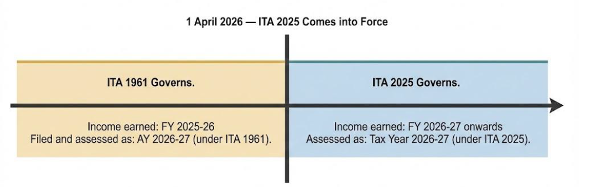
Question | Answer
Does the Income Tax Act, 2025 completely replace the Income Tax Act, 1961? | Yes. The 1961 Act stands repealed on the 01.04.2026. However, certain transitional provisions specify continuation of proceedings under the old Act to avoid disruption in pending matters and ensure a smooth transition.
Is the Income Tax Act 2025 introducing new taxes or increasing tax burden?” | No, The income Tax Act, 2025 does not impose any new tax
When the Income-tax Act, 2025 refers to a "tax year" starting on 1st April 2025 or earlier, how should that be understood | Section 536(3) of the Income-tax Act, 2025 provides that any reference of a tax year shall be read as a reference to the corresponding 'previous year' under the old Act. This provision is transitional and does not change the tax treatment applicable to those years. Example: If the new Act refers to 'tax year 2024-25,' it corresponds to the 'previous year 2024-25' under the old Act, which in turn corresponds to Assessment Year 2025-26.
Is there any “missing year” or overlap due to the shift from Assessment Year to Tax Year? | No, there is no missing year or overlap.

Slide 69
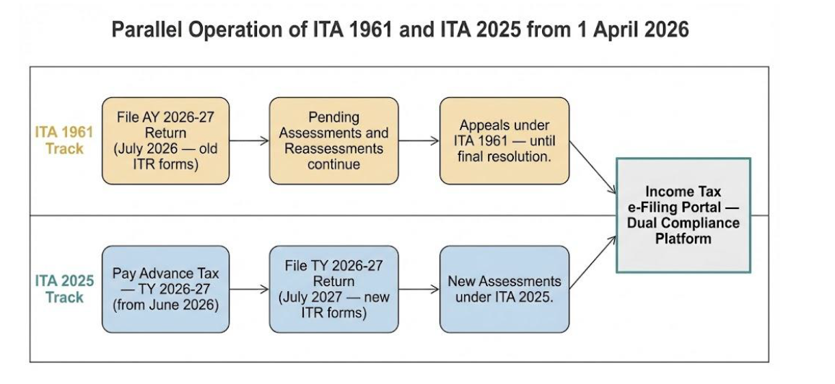
Question | Answer
How will pending proceedings and notices issued under the Income-tax Act, 1961 be treated after the new Act comes into force? | 536(2)(c) of the new Act provides that the provisions of the repealed Income-tax Act shall continue to apply to any proceeding pending on the date of commencement of this Act and to any proceedings initiated on or after the 1st April, 2026 (including notices, assessment, re-assessment, recomputation, rectification, penalty, reference, revision and appeals) in respect of any tax year beginning before the 1st April, 2026 and such proceedings shall be carried out as per the procedure specified in the repealed Income tax Act.
Do old circulars, instructions and notifications issued by the tax department continue even after the new Act comes into force? | Yes. As per the provisions of section 536(2)(j) of the Income Tax Act, 2025, circulars, notifications, instructions, approvals, etc, issued under the old Act will remain valid as long as they do not conflict with the new Act.
For how long will the old and new Acts run in parallel? What does this mean for taxpayers practically?
CA P.C. Parwal, Kalani & Co LLP

Slide 70
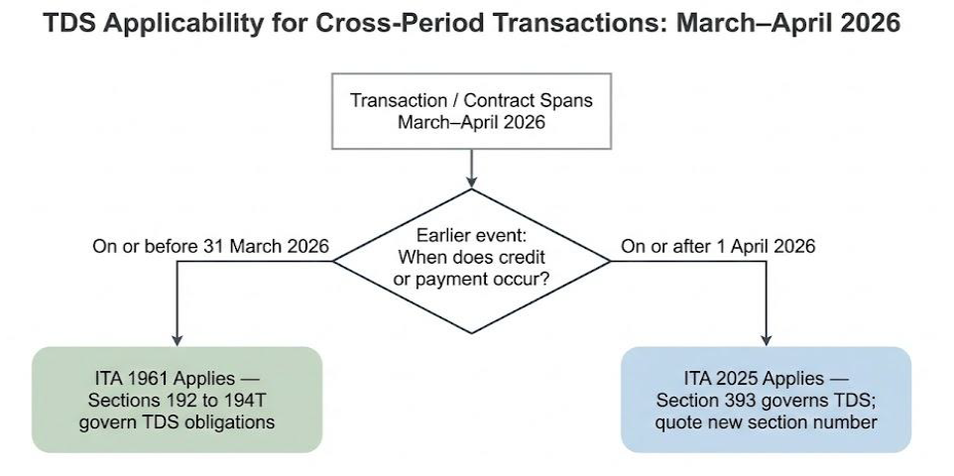
Question | Answer
Does the fundamental obligation to discharge income-tax through TDS/TCS, advance tax, or self-assessment tax continue under the Income-tax Act, 2025? | Yes, the core obligation to pay income-tax—whether by way of tax deducted or collected at source (TDS/TCS), advance tax, self-assessment tax, or regular assessment—continues unchanged under the Income-tax Act, 2025
What change has been introduced in the Income Tax Act, 2025 with respect to the Tax Deducted at Source (TDS) provisions contained in the Income Tax Act, 1961? | Broadly, there is no change in policy but new Act presents the TDS provisions in a simplified and tabular manner. All the TDS sections (Section 192 to 194T) in the Income Tax Act, 1961 are now consolidated under two sections, section 392 and section 393 of the income Tax Act, 2025.
How is TDS determined for contracts or services spanning over the period of March–April 2026? Also, is there any change in due date to deposit TDS, TCS and filing of return, interest rate, advance tax due dates, etc | No change in any compliance date for making payment or returns, or deposit of advance tax
CA P.C. Parwal, Kalani & Co LLP

Slide 71
Question | Answer
Will a lower/nil withholding certificate issued under Section 197 of the old Act remain valid for payments/credits made on or after 1st April, 2026 | Yes. A certificate issued under Section 197 of the Income-tax Act, 1961 shall remain valid for payments/credits made on or after 1st April, 2026 provided that it is issued for lower/Nil deduction of tax in respect of projected receivable for tax year 2026-27.
Self-assessment tax for AY 2026-27 (FY 2025-26) is paid in July 2026. Which Act governs this payment | Self-assessment tax is merely a mode of discharging the tax liability, and the applicable law is determined by the year of income, not by the date of payment. The section 140A of the Income-tax Act, 1961 shall govern the payment of self-assessment tax in this situation.
What happens to Minimum Alternate Tax (MAT)/Alternate Minimum Tax (AMT) credits allowable to be carried forward under the old Act but not yet utilized before 1 April 2026 | Any unutilised credit for MAT/AMT allowed to be carried forward under the provisions of section 115JAA or 115JD of the Income Tax Act, 1961, are treated as eligible credits under the Income Tax Act, 2025
Due dates for filing tax returns | Remains the same, as under:
Particulars | Due date
1. Assessee’s where transfer pricing applies | 30 November
2. Company or Assessee (other than company) where accounts are audited or partner of firm whose accounts are audited | 31 October
3. Assessee having income under PGBP where accounts are not audited or partner of firm | 31 August
4. Any other assessee | 31 July
CA P.C. Parwal, Kalani & Co LLP

Slide 72
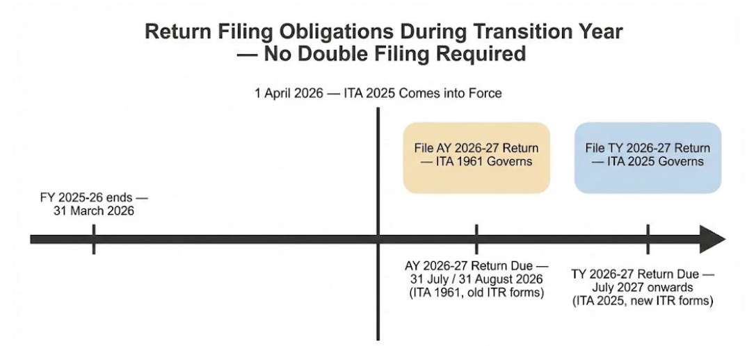
Question | Answer
Return filing flow chart
Filing of updated returns | The updated return for AY 2026-27 and earlier years will be filed under Section 139(8A) of the old Act. The old Act continues to govern all proceedings relating to tax years before 1st April, 2026.
For remittances made on or after 1st April, 2026, which forms and provisions will apply? | For remittances made on or after 1st April, 2026, the provisions of the Income tax Act, 2025 will apply. The prescribed forms (Form No. 145 and 146) under the Income-tax Rules, 2026 are required to be used. The substantive requirements — furnishing information about the remittance, obtaining CA certificate for amounts exceeding the prescribed threshold, ensuring TDS compliance — remain the same
If a remittance is made in April 2026 for a liability accrued in February 2026, then the TDS rates and reporting formats would be governed by which statute (IT ACT 1961 or 2025)? | The procedural requirement (Form 15CA/CB) follows the law in force on the date of remittance (2025 Act). However, the taxability of the underlying income is governed by the Act applicable to the year of accrual (1961 Act).
CA P.C. Parwal, Kalani & Co LLP

Slide 73
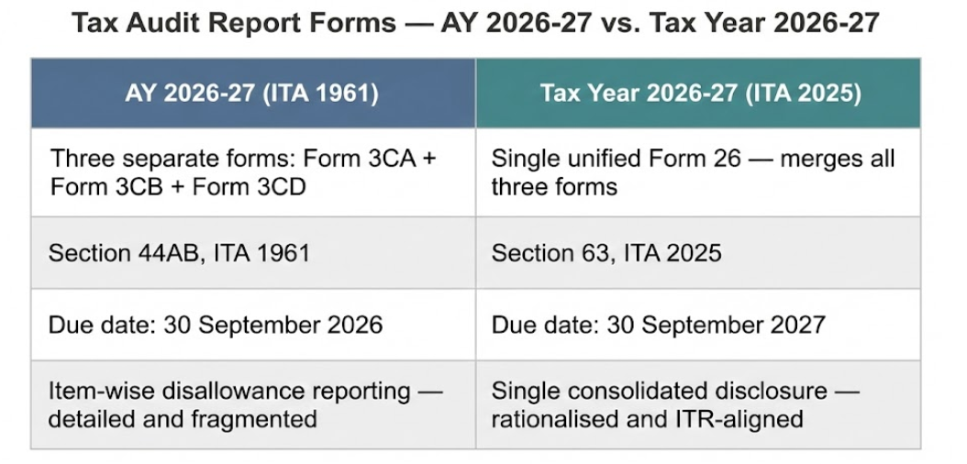
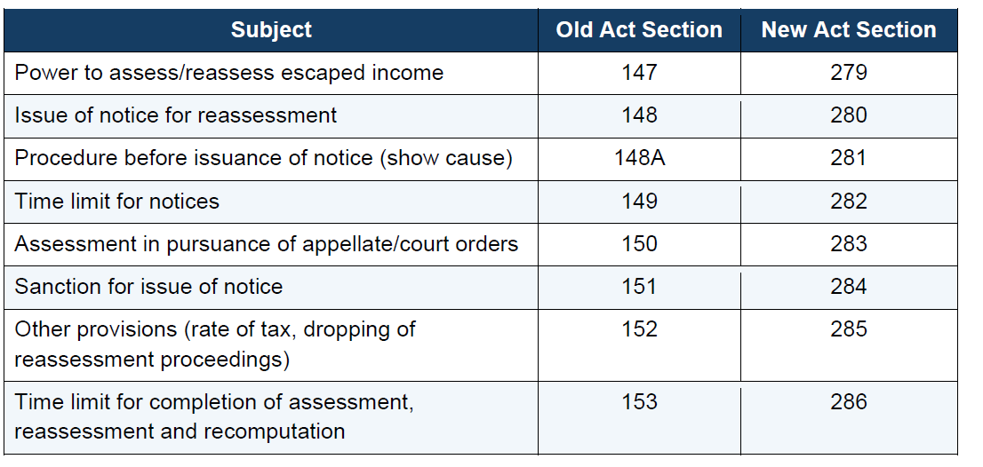
Question | Answer
Tax audit forms
What are the provisions for reopening of assessment (income escaping assessment) under the Income-tax Act, 2025?
CA P.C. Parwal, Kalani & Co LLP

Slide 74
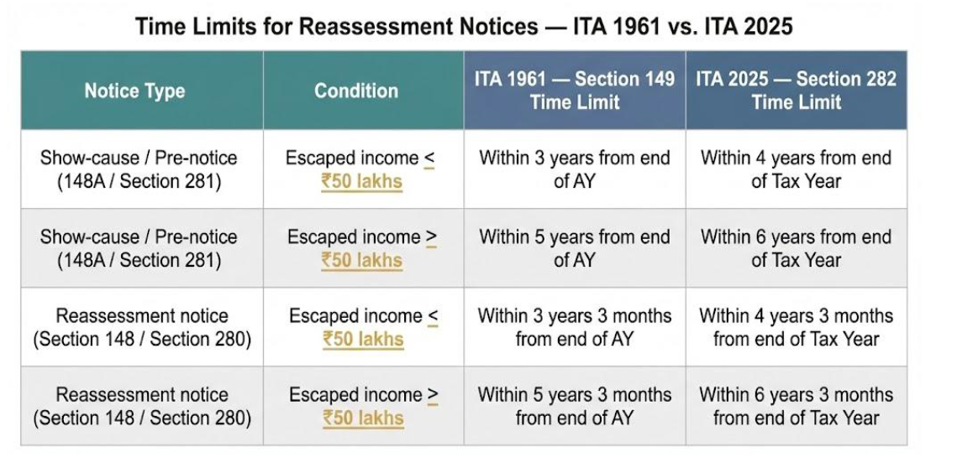
Question | Answer
For which tax years will the reassessment provisions of the new Act apply? | The reassessment provisions of the Income-tax Act, 2025 (Sections 279–286) will apply to Tax Year 2026-27 and subsequent tax years. For any tax year beginning before 1st April, 2026, only the old Act provisions will apply for reassessment
What are the time limits for issuing reassessment notices under the Income Tax Act, 2025?
CA P.C. Parwal, Kalani & Co LLP

Slide 75
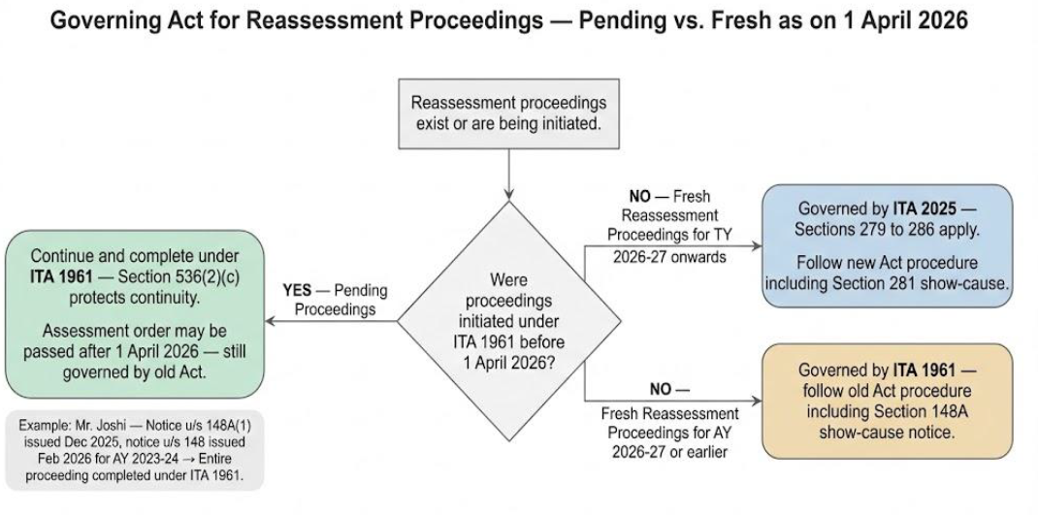
Question | Answer
Governing act for reassessment proceedings
CA P.C. Parwal, Kalani & Co LLP

Slide 76
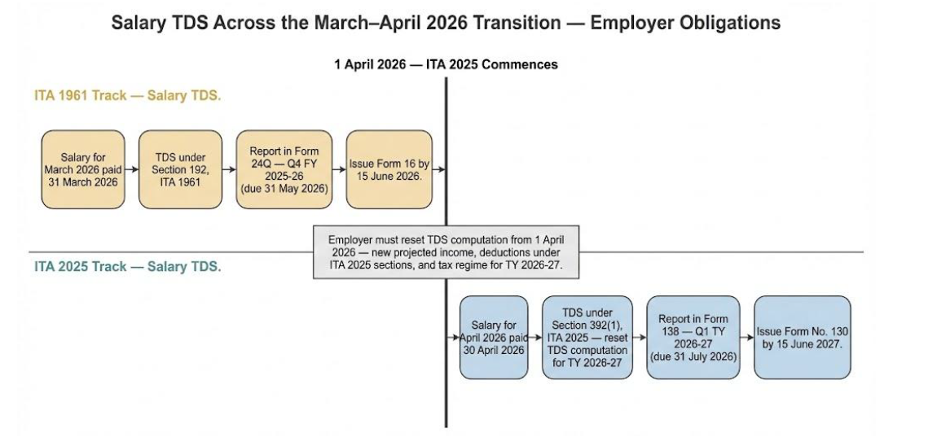
Question | Answer
Salary TDS compliance
CA P.C. Parwal, Kalani & Co LLP

Slide 77
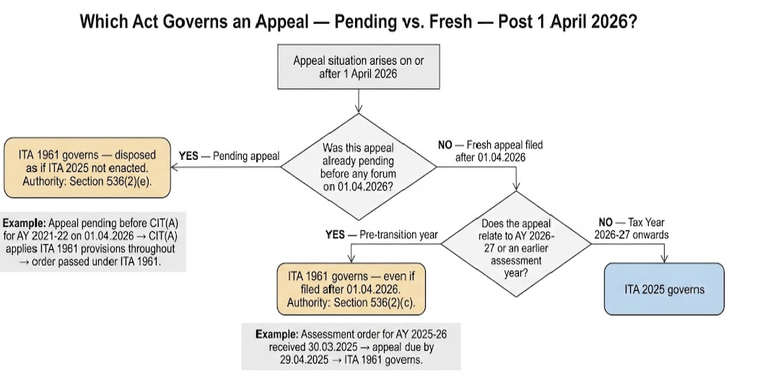
Question | Answer
Which Act governs an appeal
CA P.C. Parwal, Kalani & Co LLP

Slide 78
Question | Answer
If a search was initiated on a person under section 132 of the old Act before the new law came into effect, which law applies to the connected proceedings? | All proceedings connected with such a search continue to be governed by the old Act as if the new Act had not been enacted. For example, if a search on Mr. A is initiated in the month of January 2026, assessments and all other proceedings connected with the search will be under the provisions of the old Act.
CA P.C. Parwal, Kalani & Co LLP

Slide 79
Major Income Tax Forms
Description | Old Form (1961 Act) | New Notified Form (2025 Act)
TDS Certificate for Salary | Form 16 | Form 130
Annual Tax Statement (Tax Credit) | Form 26AS | Form 168
TDS Certificate (Non-Salary) | Form 16A | Form 131
Quarterly TDS Return (Salaries) | Form 24Q | Form 138
Quarterly TDS Return (Non-Salary) | Form 26Q | Form 140
Quarterly TDS Return (Non-Resident) | Form 27Q | Form 144
Foreign Remittance Information | Form 15CA | Form 145
Accountant’s Certificate for Remittance | Form 15CB | Form 146
Tax Audit Report & Statement of Particulars | Form 3CA/3CB/3CD | Form 26
Indian individuals (Citizens of India) | Form 49A | Form 93
Indian Companies / Entities incorporated or formed in India | Form 49A | Form 94
Individuals not being Citizens of India | Form 49AA | Form 95
Entities incorporated or formed outside India | Form 49AA | Form 96
Lower/ nil withholding certificate | Form 13 | Form 128

Slide 80
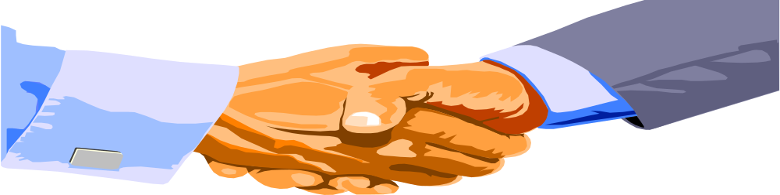
THANK YOU
Compiled by
CA P.C. Parwal
Kalani & Co LLP, Chartered Accountants
Mobile No.- 98298-88804
E-mail- pparwal@kalanico.com
Offices at: Jaipur, Jodhpur, Kota, Pali, Bhilwara, Udaipur, Pune, Guwahati & Affiliate office at: Delhi, Mumbai

