Slide 1
Guidance Note on Financial Statements of Non-Corporate Entities
COMMITTEE-ACCOUNTING STANDARDS BOARD
EFFECTIVE DATE- APRIL 1,2024

Slide 2
INTRODUCTION
In case of the Non-Corporate entities, considering the wide spectrum of role and responsibilities performed by them, undoubtedly there are wide users/stakeholders of the financial information of these Non-Corporate entities.
in case of some Non-Corporate entities the users of financial information are similar to the corporate sector, e.g., many statutory corporations or authorities raise substantial financial resources from capital and financial markets. Therefore, the investors or lenders of such Non-Corporate entities have similar financial information needs as that of corporate investors.

Slide 3
IMPORTANCE
Financial Statements form the backbone for financial planning, analysis, benchmarking and decision making. If Non-Corporate entities follow high quality reporting framework, its financial statements faithfully represent its transactions and are more reliable, complete and comparable.
Extent or size of economic and financial activities of the Non-Corporate entities have grown over the period of time.
By the help of Indian Government there is a push for higher private participation through ‘Public-Private-Partnership’ model, it has also led to substantial increase in the number of Non-Corporate entities in private sector as well as in government sector and increase in size of financial activities of these Non-Corporate entities.

Slide 4
APPLICABILITY OF ACCOUNTING STANDARDS
Accounting Standards apply in respect of any entity engaged in commercial, industrial or business activities
Even if where a very small proportion of the activities, Accounting Standards would apply to all its activities including those, which are not commercial, industrial or business in nature
At present, there are three sets of Accounting Standards:
Indian Accounting Standards (Ind AS) for specified class of companies
Accounting Standards (AS) notified under Companies (Accounting Standards) Rules 2021, for companies other than those following Ind AS
Accounting Standards (AS) prescribed by ICAI for entities other than companies..

Slide 5
SETS OF ACCOUNTING STANDARDS
1. Indian Accounting Standards (Ind AS) for Companies
Ind AS have been notified and are applicable to all listed companies and Non-Banking Financial Companies (NBFCs) and to unlisted companies and unlisted NBFCs with net worth of INR 250 crores or more. Ind AS are also applicable to holding/subsidiaries/joint ventures/associates companies of such companies.
2. Accounting Standards (AS) notified under Companies Rules, 2021 for companies other than those following Ind AS
Companies that are not covered under Ind AS are required to apply Accounting Standards

Slide 6
3. Accounting Standards (AS) prescribed by ICAI for entities other than companies.
Only be applicable to the companies, announced the scheme for applicability of Accounting Standards (AS) issued by ICAI to non-company entities. In this regard, the criteria for classification of non-company entities as decided by CAI is given in Appendix A.
For the purpose of applicability of Accounting Standards, Non-company entities are classified into four categories, viz., Level I, Level II, Level III and Level IV. Level I entities are large size entities, Level II entities are medium size entities, Level III entities are small size entities and Level IV entities are micro entities. Level IV, Level III and Level II entities are referred to as Micro, Small and Medium size entities (MSMEs).
Level I entities are required to comply in full with all the Accounting Standards.
Certain exemptions/relaxations have been provided to Level II, Level III and Level IV Non-company entities

Slide 7
COMPLIANCE WITH ACCOUNITNG STANDARDS
The Accounting Standards will be mandatory from the respective date(s) mentioned in the Accounting Standard(s)
Ensuring compliance with the Accounting Standards while preparing the financial statements is the responsibility of the management of the enterprise
Financial Statements cannot be described as complying with the Accounting Standards unless they comply with all the requirements of each applicable Standard.

Slide 8
AUDIT OF FINANCIAL STATEMENTS
Non-corporate entities, if audit of financial statements is required under a statute, the Auditor shall conduct the audit and issue the Auditors’ Report in accordance with the Standards on Auditing issued by the ICAI.
For the purpose of tax audit, the auditor should issue a report taking into consideration the "Guidance Note on Tax Audit under Section 44AB of the Income-tax Act, 1961” issued by the ICAI

Slide 9
Objective and Scope of Guidance Note
NON-CORPORATE ENTITES-All Business or Professional Entities, other than Companies incorporated under Companies Act and Limited Liability Partnerships incorporated under Limited Liability Partnership Act are considered to be Non-Corporate entities. The most common structures are as follows:-
(a) Sole proprietorship firms
(b) Hindu Undivided Family
(c) Partnership Firms
(d) Association of Persons
(e) Society registered under any law for the time being in force
(f) Trust (private or public) registered under any law for the time being in force or unregistered.
(g) Statutory Corporations, Autonomous bodies and Authorities
(h) Any form of organization that is engaged fully or partially in any Business or Profession

Slide 10
What are Financial Statements?
Financial statements form part of the process of financial reporting .The objective of financial statements is to provide information about the financial position, performance and cash flows of an entity. A complete set of financial statements normally includes:
a balance sheet
a statement of profit and loss
a cash flow statement (where applicable)
notes and other statements and explanatory material that are an integral part of the financial statements.

Slide 11
BALANCE SHEET
The elements directly related to the measurement of financial position in the balance sheet are assets, liabilities and equity. These are defined as follows:
An asset is a resource controlled by the enterprise as a result of past events from which future economic benefits are expected to flow to the enterprise.
A liability is a present obligation of the enterprise arising from past events, the settlement of which is expected to result in an outflow from the enterprise of resources embodying economic benefits.
Equity is the residual interest in the assets of the enterprise after deducting all its liabilities.
Items are recognized as assets or liabilities in the balance sheet if they satisfy the criteria for recognition as specified in the relevant Accounting Standards and, if there is no specific Accounting Standard, as specified in the said Framework.

Slide 12
STATEMENT OF PROFIT / LOSS
The Statement of Profit and Loss primarily focuses on an entity’s income and expenses during a particular period. Income and expenses are defined in the Framework as follows:
Income is increase in economic benefits during the accounting period in the form of inflows or enhancements of assets or decreases of liabilities that result in increases in equity, other than those relating to contributions from equity participants.
Expenses are decreases in economic benefits during the accounting period in the form of outflows or depletions of assets or incurrences of liabilities that result in decreases in equity, other than those relating to distributions to equity participants.
Criteria for recognition of income and expenses are prescribed in relevant Accounting Standards and, if there is no specific Accounting Standard dealing with the item, the recognition criteria prescribed in the Framework may be referred

Slide 13
CASH FLOW STATEMENT
Cash flow information is useful in assessing the ability of the enterprise to generate cash and cash equivalents and enables users to develop models to assess and compare the present value of the future cash flows of different enterprises.
For non-company entities, AS 3 provides that financial statements of Micro, Small and Medium Sized Enterprises (Level IV, Level III and Level II non-company entities), may not include cash flow statements, i.e., preparation of cash flow statement is not mandatory.
The three components of the cash flow statement are listed below.
Operating Activities: Operating activities are the principal revenue-producing activities of the enterprise and other activities that are not investing or financing activities.
Investing Activities: Investing activities are the acquisition and disposal of long-term assets and other investments not included in cash equivalents
Financing Activities: Financing activities are activities that result in changes in the size and composition of the owners’ capital and borrowings of the enterprise

Slide 14
GENERAL INSTRUCTIONS FOR PREPARATION OF FINANCIAL STATEMENTS
Where compliance with the requirements of the relevant statute including Accounting Standards as applicable to the Non-Corporate entity require any change in treatment or disclosure including addition, amendment, substitution or deletion in the head or sub-head or any changes, inter se, in the financial statements or statements forming part thereof, the same shall be made and the formats shall be modified accordingly.
Certain non corporate entities may need to amend the descriptions used for particular line items in the formats of financial statements and for the financial statements themselves, e.g., Association of Persons may need to use terminology “members’ funds” instead of “owners’ funds”.
Except in the case of the first Financial Statements prepared by the Non-Corporate entity (after its incorporation) the corresponding amounts (comparatives) for the immediately preceding reporting period for all items shown in the Financial Statements including notes shall also be given.

Slide 15
The disclosure requirements specified in the formats are in addition to and not in substitution of the disclosure requirements specified in the Accounting Standards issued by the Institute of Chartered Accountants of India.
Notes to accounts shall contain information in addition to that presented in the Financial Statements and shall provide where required
narrative descriptions or disaggregation's of items recognized in those statements; and
information about items that do not qualify for recognition in those statements.
a balance shall be maintained between providing excessive detail that may not assist users of financial statements and not providing important information as a result of too much aggregation.
Once a unit of measurement is used, it should be used uniformly in the Financial Statements.

Slide 16
Criteria for classification of Non-company Entities -Level I Entities
Non-company entities which fall in any one or more of the following categories, at the end of the relevant accounting period, are classified as Level I entities:
Entities whose securities are listed or are in the process of listing on any stock exchange, whether in India or outside India.
Banks (including co-operative banks), financial institutions or entities carrying on insurance business.
All entities engaged in commercial, industrial or business activities, whose turnover (excluding other income) exceeds rupees two-fifty crore in the immediately preceding accounting year.
All entities engaged in commercial, industrial or business activities having borrowings (including public deposits) in excess of rupees fifty crore at any time during the immediately preceding accounting year.
Holding and subsidiary entities of any one of the above.

Slide 17
Level II Entities -Non-company entities which are not Level I entities but fall in any one or more of the following categories are classified as Level II entities
All entities engaged in commercial, industrial or business activities, whose turnover (excluding other income) exceeds rupees fifty crore but does not exceed rupees two-fifty crore in the immediately preceding accounting year
All entities engaged in commercial, industrial or business activities having borrowings (including public deposits) in excess of rupees ten crore but not in excess of rupees fifty crore at any time during the immediately preceding accounting year.
Holding and subsidiary entities of any one of the above.

Slide 18
Level III Entities-Non-company entities which are not covered under Level I and Level II but fall in any one or more of the following categories are classified as Level III entities:
(i) All entities engaged in commercial, industrial or business activities, whose turnover (excluding other income) exceeds rupees ten crore but does not exceed rupees fifty crore in the immediately preceding accounting year.
(ii) All entities engaged in commercial, industrial or business activities having borrowings (include public deposit) in excess of rupees two crore but does not exceed rupees ten crore at any time during the immediately preceding accounting year.
(iii) Holding and subsidiary entities of any one of the above.
Level IV Entities-Non-company entities which are not covered under Level I, Level II and Level III are considered as Level IV entities.

Slide 19
Applicability of Accounting Standards to Non-company Entities
(1) Applicability of the Accounting Standards to Level 1 Non- company entities. Level I entities are required to comply in full with all the Accounting Standards.
(2) Applicability of the Accounting Standards and exemptions/relaxations for Level II, Level III and Level IV Non-company entities

Slide 20
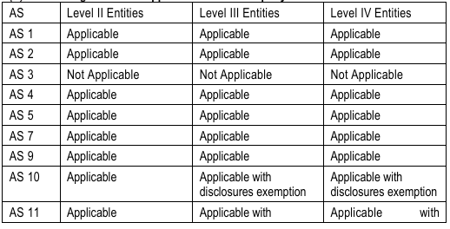

Slide 21
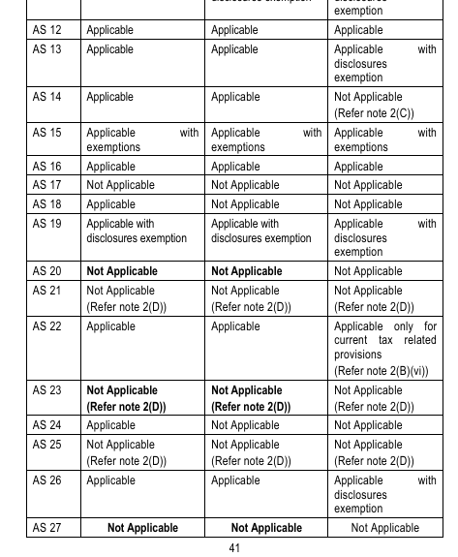

Slide 22
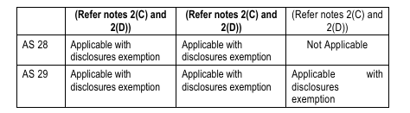

Slide 23
Accounting Standards in respect of which relaxations/exemptions from certain requirements have been given to Level II, Level III and Level IV Non-company entities:
(i) Accounting Standard (AS) 10, Property, Plant and Equipment Paragraph 87 relating to encouraged disclosures is not applicable to Level III and Level IV Non-company entities.
(ii) AS 11, The Effects of Changes in Foreign Exchange Rates (revised 2018) Paragraph 44 relating to encouraged disclosures is not applicable to Level III and Level IV Non-company entities.
(iii) AS 13, Accounting for Investments Paragraph 35(f) relating to disclosures is not applicable to Level IV Non-company entities.

Slide 24
(iv) Accounting Standard (AS) 15, Employee Benefits (revised 2005)
Level II and Level III Non-company entities whose average number of persons employed during the year is 50 or more are exempted from the applicability of the following paragraphs:
paragraphs 11 to 16 of the standard to the extent they deal with recognition and measurement of short-term accumulating compensated absences which are non-vesting (i.e., short-term accumulating compensated absences in respect of which employees are not entitled to cash payment for unused entitlement on leaving);
paragraphs 46 and 139 of the Standard which deal with discounting of amounts that fall due more than 12 months after the balance sheet date;
recognition and measurement principles laid down in paragraphs 50 to 116 and presentation and disclosure requirements laid down in

Slide 25
paragraphs 117 to 123 of the Standard in respect of accounting for defined benefit plans. However, such entities should actuarially determine and provide for the accrued liability in respect of defined benefit plans by using the Projected Unit Credit Method and the discount rate used should be determined by reference to market yields at the balance sheet date on government bonds as per paragraph 78 of the Standard. Such entities should disclose actuarial assumptions as per paragraph 120(l) of the Standard; and
recognition and measurement principles laid down in paragraphs 129 to 131 of the Standard in respect of accounting for other long-term employee benefits. However, such entities should actuarially determine and provide for the accrued liability in respect of other long-term employee benefits by using the Projected Unit Credit Method and the discount rate used should be determined by reference to market yields at the balance sheet date on government bonds as per paragraph 78 of the standard.

Slide 26
Level II and Level III Non-company entities whose average number of persons employed during the year is less than 50 and Level IV Non-company entities irrespective of number of employees are exempted from the applicability of the following paragraphs:
paragraphs 11 to 16 of the standard to the extent they deal with recognition and measurement of short-term accumulating compensated absences which are non-vesting (i.e., short-term accumulating compensated absences in respect of which employees are not entitled to cash payment for unused entitlement on leaving);
paragraphs 46 and 139 of the Standard which deal with discounting of amounts that fall due more than 12 months after the balance sheet date;
recognition and measurement principles laid down in paragraphs 50 to 116 and presentation and disclosure requirements laid down in paragraphs 117 to 123 of the Standard in respect of accounting for defined benefit plans. However, such entities may calculate and account for the accrued liability under the defined benefit plans by reference to some other rational method, and

Slide 27
recognition and measurement principles laid down in paragraphs 129 to 131 of the Standard in respect of accounting for other long-term employee benefits. Such entities may calculate and account for the accrued liability under the other long-term employee benefits by reference to some other rational method, e.g., a method based on the assumption that such benefits are payable to all employees at the end of the accounting year.
(v) AS 19, Leases
Paragraphs 22 (c),(e) and (f); 25 (a), (b) and (e); 37 (a) and (f); and 46 (b) and (d) relating to disclosures are not applicable to Level II Non-company entities.
Paragraphs 22 (c),(e) and (f); 25 (a), (b) and (e); 37 (a), (f) and (g); and 46 (b), (d) and (e) relating to disclosures are not applicable to Level III Non company entities.
Paragraphs 22 (c),(e) and (f); 25 (a), (b) and (e); 37 (a), (f) and (g); 38; and 46 (b), (d) and (e) relating to disclosures are not applicable to Level IV Non-company entities.

Slide 28
(vi) AS 22, Accounting for Taxes on Income
Level IV Non-company entities shall apply the requirements of AS 22, Accounting for Taxes on Income, for Current tax defined in paragraph 4.4 of AS 22, with recognition as per paragraph 9, measurement as per paragraph 20 of AS 22, and presentation and disclosure as per paragraphs 27-28 of AS 22.
Transitional requirements On the first occasion when a Non-company entity gets classified as Level IV entity, the accumulated deferred tax asset/liability appearing in the financial statements of immediate previous accounting period, shall be adjusted against the opening revenue reserves.
(vii) AS 26, Intangible Assets
Paragraphs 90(d)(iii); 90(d)(iv) and 98 relating to disclosures are not applicable to Level IV Non-company entities.

Slide 29
(viii) AS 28, Impairment of Assets
(a) Level II and Level III Non-company entities are allowed to measure the ‘value in use’ on the basis of reasonable estimate thereof instead of computing the value in use by present value technique. Consequently, if Level II or Level III Non-company entity chooses to measure the ‘value in use’ by not using the present value technique, the relevant provisions of AS 28, such as discount rate etc., would not be applicable to such an entity. Further, such an entity need not disclose the information required by paragraph 121(g) of the Standard
(b) Also, paragraphs 121(c)(ii); 121(d)(i); 121(d)(ii) and 123 relating to disclosures are not applicable to Level III Non-company entities.

Slide 30
(ix)AS 29, Provisions, Contingent Liabilities and Contingent Assets (revised 2016)
Paragraphs 66 and 67 relating to disclosures are not applicable to Level II, Level III and Level IV Non-company entities. (A) In case of Level IV Non-company entities, generally there are no such transactions that are covered under AS 14, Accounting for Amalgamations, or jointly controlled operations or jointly controlled assets covered under AS 27, Financial Reporting of Interests in Joint Ventures. Therefore, these standards are not applicable to Level IV Non-company entities. However, if there are any such transactions, these entities shall apply the requirements of the relevant standard.
Relevant AS is applicable only if a Non-company entity is required or elects to prepare and present consolidated financial statements or interim financial report.
AS 21, Consolidated Financial Statements,
AS 23, Accounting for Investments in Associates in Consolidated Financial Statements,
AS 27, Financial Reporting of Interests in Joint Ventures (to the extent of requirements relating to Consolidated Financial Statements),
AS 25, Interim Financial Reporting

Slide 31
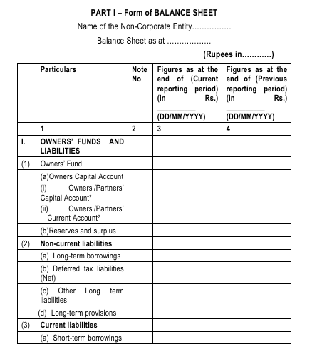
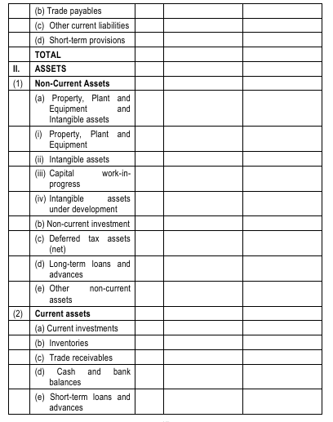


Slide 32
GENERAL INSTRUCTIONS FOR PREPARATION OF BALANCE SHEET
1. An asset shall be classified as current when it satisfies any of the following criteria:
(a) it is expected to be realized in, or is intended for sale or consumption in, the company’s normal operating cycle
(b)it is held primarily for the purpose of being traded
(c) it is expected to be realized within twelve months after the reporting date or
(d) it is cash or cash equivalent unless it is restricted from being exchanged or used to settle a liability for at least twelve months after the reporting date.
All other assets shall be classified as non-current.

Slide 33
2. An operating cycle is the time between the acquisition of assets for processing and their realization in cash or cash equivalents. Where the normal operating cycle cannot be identified, it is assumed to have a duration of 12 months
3. A liability shall be classified as current when it satisfies any of the following criteria:
(a) it is expected to be settled in the company’s normal operating cycle
(b) it is held primarily for the purpose of being traded
(c) it is due to be settled within twelve months after the reporting date
(d) the Non-Corporate entity does not have an unconditional right to defer settlement of the liability for at least twelve months after the reporting date. Terms of a liability that could, at the option of the counterparty, result in its settlement by the issue of equity instruments do not affect its classification.
All other liabilities shall be classified as non-current.

Slide 34
4. A receivable shall be classified as a ‘trade receivable’ if it is in respect of the amount due on account of goods sold or services rendered in the normal course of business.
5. A payable shall be classified as a ‘trade payable’ if it is in respect of the amount due on account of goods purchased or services received in the normal course of business.
6. A Non-Corporate entity shall disclose the following in the Notes to Accounts:

Slide 35
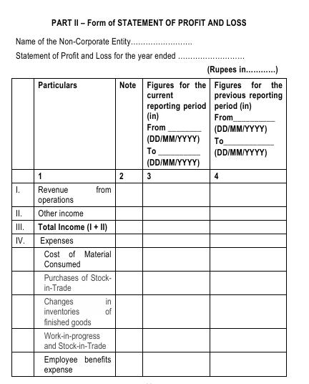
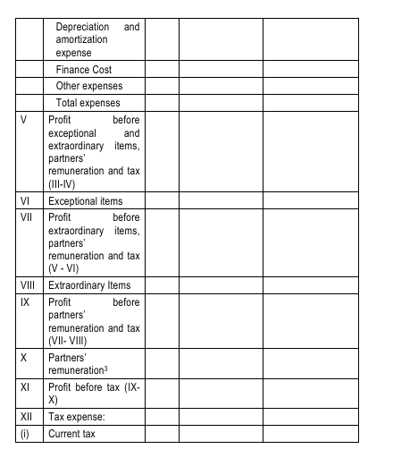

Slide 36
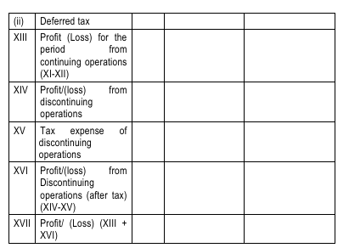

Slide 37
General Instructions for Preparation of Statement of Profit and Loss
The provisions of this Part shall be applied to the income and expenditure account in like manner as they apply to a statement of profit and loss.
2. (A) Revenue from operations shall disclose separately in the notes revenue from—
(a) Sale of products
Less: Excise duty
(b) Sale of services
(c) Other operating revenues
In respect of a finance Non-Corporate entity, revenue from operations shall include revenue from—
(a) Interest
(b) Other financial services.

Slide 38
3. Finance Costs shall be classified as:
(a) Interest expense (other than interest on partners’/members’ capital)
(b) Interest on partners’/members’ capital
(c) Other borrowing costs
(d) Applicable net gain/loss on foreign currency transactions and translation.
4. Other income shall be classified as:
(a) Interest Income
(b) Dividend Income
(c) Net gain/loss on sale of investments
(d) Other non-operating income (net of expenses directly attributable to such income).

Slide 39
5. Following shall be disclosed by way of notes regarding aggregate expenditure and income on the following items:-
(i) (a)Employee Benefits Expense showing separately (i) salaries and wages, (ii) Contribution to provident and other funds, (iii) staff welfare expenses;
(b) Any item of income or expenditure which exceeds one per cent of the revenue from operations or Rs.1,00,000 whichever is higher;
(c) Adjustments to the carrying amount of investments;
(d) Net gain or loss on foreign currency transaction and translation (other than considered as finance cost);
(e) Details of items of exceptional and extraordinary nature;
(f) Prior period items.

Slide 40
(ii) Expenditure incurred on each of the following items, separately for each item:—
(a) Consumption of stores and spare parts;
(b) Power and fuel;
(c) Rent;
(d) Repairs to buildings;
(e)Repairs to machinery;
(f) Insurance;
(g) Rates and taxes, excluding, taxes on income;
(h) Miscellaneous expenses.

Slide 41
NOTES TO ACCOUNTS
A. Owners’ Funds
For each owner capital/current account, following items for the year to be disclosed separately:
opening balance
capital Introduced/Contributed during the year
remuneration for the year
interest for the year
withdrawals during the year
share of profit or loss for the year (share in % and amount)
closing balance.

Slide 42
B. Reserves and Surplus
(i) Reserves and Surplus shall be classified as:
Capital Reserves
Revaluation Reserve
Other Reserves – (specify the nature and purpose of each reserve and the amount in respect thereof)
Undistributed Surplus i.e. balance in Statement of Profit and Loss.
(ii) Debit balance of statement of profit and loss shall be shown as a negative figure under the head ‘Undistributed Surplus’. Similarly, the balance of ‘Reserves and Surplus’, after adjusting negative balance of surplus, if any, shall be shown under the head ‘Reserves and Surplus’ even if the resulting figure is in the negative.

Slide 43
C. Long-Term Borrowings
Long-term borrowings shall be classified as:
Term loan
▪ From banks
▪ From other parties
Deferred payment liabilities.
Loans and advances from related parties.
Long term maturities of finance lease obligations
Other loans and advances (specify nature).
Borrowings shall further be sub-classified as secured and unsecured. Nature of security shall be specified separately in each case.
Where loans have been guaranteed by partners/proprietor/owners or others, the aggregate amount of such loans under each head shall be disclosed.
Terms of repayment of term loans and other loans shall be stated.

Slide 44
D. Long-term provisions
The amounts shall be classified as:
Provision for employee benefits.
Others (specify nature).
E. Short-term borrowings
(i) Short-term borrowings shall be classified as:
(a) Loans repayable on demand
▪ From banks
▪ From other parties
(b)Loans and advances from related parties.
(c) Other loans and advances (specify nature).
(ii) Borrowings shall further be sub-classified as secured and unsecured. Nature of security shall be specified separately in each case.
(iii) Where loans have been guaranteed by partners/proprietor/ owners or others, the aggregate amount of such loans under each head shall be disclosed. current maturities of Long term borrowings shall be disclosed separately.

Slide 45
F. Trade Payables
The following details relating to Micro, Small and Medium Enterprises shall be disclosed in the notes:-
(a) the principal amount and the interest due thereon (to be shown separately) remaining unpaid to any supplier at the end of each accounting year;
(b) the amount of interest paid by the buyer in terms of section 16 of the Micro, Small and Medium Enterprises Development Act, 2006, along with the amount of the payment made to the supplier beyond the appointed day during each accounting year;
(c) the amount of interest due and payable for the period of delay in making payment (which have been paid but beyond the appointed day during the year) but without adding the interest specified under the Micro, Small and Medium Enterprises Development Act, 2006;
(d) the amount of interest accrued and remaining unpaid at the end of each accounting year; and
(e) the amount of further interest remaining due and payable even in the succeeding years, until such date when the interest dues above are actually paid to the small enterprise, for the purpose of disallowance of a deductible expenditure under section 23 of the Micro, Small and Medium Enterprises Development Act, 2006.

Slide 46
G. Other current liabilities
The amounts shall be classified as:
Current maturities of finance lease obligations;
Interest accrued but not due on borrowings;
Interest accrued and due on borrowings;
Income received in advance;
Other payables (specify nature)
H. Short-term provisions
The amounts shall be classified as:
Provision for employee benefits.
Others (specify nature).

Slide 47
I. Property, Plant and Equipment
(i) Classification shall be given as:
Land
Buildings
Plant and Equipment
Furniture and Fixtures
Vehicles
Office equipment
Others (specify nature)
(ii) Assets under lease shall be separately specified under each class of asset.
(iii) A reconciliation of the gross and net carrying amounts of each class of assets at the beginning and end of the reporting period showing additions, disposals acquisitions through business combinations, amount of change due to revaluation (if change is 10% or more in the aggregate of the net carrying value of each class of Property, Plant and Equipment) and other adjustments and the related depreciation and impairment losses/reversals shall be disclosed separately.

Slide 48
J. Intangible assets
(i) Classification shall be given as:
Goodwill
Brands /trademarks
Computer software
Mastheads and publishing titles ,mining rights
Copyrights, and patents and other intellectual property rights, services and operating rights
Recipes, formulae, models, designs and prototypes
Licenses and franchise
Others (specify nature)
(ii) A reconciliation of the gross and net carrying amounts of each class of assets at the beginning and end of the reporting period showing additions, disposals, acquisitions through business combinations, amount of change due to revaluation (if change is 10% or more in the aggregate of the net carrying value of each class of intangible assets) and other adjustments and the related amortization and impairment losses or reversals shall be disclosed separately.

Slide 49
K. Non-current investments
(i)Non-current investments shall be classified as trade investments and other investments and further classified as:
Investment property;
Investments in Equity Instruments;
Investments in preference shares;
Investments in Government or trust securities;
Investments in debentures or bonds;
Investments in Mutual Funds;
Investments in partnership firms;
Other non-current investments (specify nature)
Under each classification, details shall be given of names of the entities (indicating separately whether such entities are joint ventures or controlled special purpose entities) in whom investments have been made (showing separately investments which are partly-paid). In regard to investments in the capital of partnership firms, the names of the firms (with the names of all their partners, total capital and the shares of each partner) shall be given.
(ii) Investments carried at other than at cost should be separately stated specifying the basis for valuation thereof.

Slide 50
(iii) The following shall also be disclosed:
(a) Aggregate amount of quoted investments and market value thereof;
(b) Aggregate amount of unquoted investments;
(c) Aggregate provision for diminution in value of investments.
L. Long-term loans and advances
(i) Long-term loans and advances shall be classified as:
Capital Advances;
Loans and advances to related parties (giving details thereof);
Other loans and advances (specify nature).
(ii) The above shall also be separately sub-classified as:
Secured, considered good;
Unsecured, considered good;
Doubtful.
(iii) Allowance for bad and doubtful loans and advances shall be disclosed

Slide 51
M. Other non-current assets
Other non-current assets shall be classified as:
(i) Security Deposits
(ii) Bank deposits with more than 12 months maturity
(iii) Others (specify nature).
N. Current Investments
(i) Current investments shall be classified as:
Investments in Equity Instruments
Investment in Preference Shares
Investments in government or trust securities
Investments in debentures or bonds
Investments in Mutual Funds
Investments in partnership firms
Other investments (specify nature).

Slide 52
Under each classification, details shall be given of names of the entities (indicating separately whether such entities are joint ventures or 25 controlled special purpose entities) in whom investments have been made (showing separately investments which are partly-paid). In regard to investments in the capital of partnership firms, the names of the firms (with the names of all their partners, total capital and the shares of each partner) shall be given.
(ii) The following shall also be disclosed:
The basis of valuation of individual investments
Aggregate amount of quoted investments and market value thereof
Aggregate amount of unquoted investments
Aggregate provision made for diminution in value of investments.

Slide 53
O. Inventories
(i) Inventories shall be classified as:
Raw materials
Work-in-progress
Finished goods
Stock-in-trade (in respect of goods acquired for trading)
Stores and spares
Loose tools
Others (specify nature).
(ii) Goods-in-transit shall be disclosed under the relevant sub-head of inventories.

Slide 54
P. Trade Receivables
(i) Aggregate amount of trade receivables outstanding for a period exceeding six months from the date they are due for receipt shall be stated separately.
(ii) Trade receivables shall be sub-classified as:
Secured considered good
Unsecured considered good
Doubtful.
(iii) Allowance for bad and doubtful debts shall be disclosed separately.

Slide 55
Q. Cash and bank balances
(i) Cash and cash equivalents shall be classified as:
Balances with banks
Cheques, drafts on hand
Cash on hand
Others (specify nature).
(ii) Other bank balances shall be classified as
Bank Deposits - Earmarked balances with banks.
Margin money or deposits under lien shall be disclosed separately.
Bank deposits with original maturity for more than 3 months but less than 12 months from reporting date.
others (specify nature)

Slide 56
R. Short-term loans and advances
(i) Short-term loans and advances shall be classified as:
(a) Loans and advances to related parties (giving details thereof)
(b) Others (specify nature).
(ii) The above shall also be sub-classified as:
(a) Secured, considered good
(b)Unsecured, considered good
(c) Doubtful.
(iii) Allowance for bad and doubtful loans and advances shall be disclosed under the relevant heads separately.
S. Other current assets (specify nature).
This is an all-inclusive heading, which incorporates current assets that do not fit into any other asset categories.

Slide 57
T. Contingent liabilities (to the extent not provided for)
(i) Contingent liabilities shall be classified as:
Claims against the non-corporate entity not acknowledged as debt
Guarantees
Other money for which the non-corporate entity is contingently liable.

Slide 58
Additional requirements
An MSME which avails the exemptions or relaxations given to it shall disclose (by way of a note to its financial statements) the fact that it is an MSME, the Level of MSME and that it has complied with the Accounting Standards insofar as they are applicable to entities falling in Level II or Level III or Level IV, as the case may be. (2)
Where an entity, being covered in Level II or Level III or Level IV, had qualified for any exemption or relaxation previously but no longer qualifies for the relevant exemption or relaxation in the current accounting period, the relevant standards or requirements become applicable from the current period and the figures for the corresponding period of the previous accounting period need not be revised merely by reason of its having ceased to be covered in Level II or Level III or Level IV, as the case may be. The fact that the entity was covered in Level II or Level III or Level IV, as the case may be, in the previous period and it had availed of the exemptions or relaxations available to that Level of entities shall be disclosed in the notes to the financial statements. The fact that previous period figures have not been revised shall also be disclosed in the notes to the financial statements.

Slide 59
Where an entity has been covered in Level I and subsequently, ceases to be so covered and gets covered in Level II or Level III or Level IV, the entity will not qualify for exemption/relaxation available to that Level, until the entity ceases to be covered in Level I for two consecutive years. Similar is the case in respect of an entity, which has been covered in Level II or Level III and subsequently, gets covered under Level III or Level IV.
If an entity covered in Level II or Level III or Level IV opts not to avail of the exemptions or relaxations available to that Level of entities in respect of any but not all of the Accounting Standards, it shall disclose the Standard(s) in respect of which it has availed the exemption or relaxation.

Slide 60
If an entity covered in Level II or Level III or Level IV opts not to avail any one or more of the exemptions or relaxations available to that Level of entities, it shall comply with the relevant requirements of the Accounting Standard.
An entity covered in Level II or Level III or Level IV may opt for availing certain exemptions or relaxations from compliance with the requirements prescribed in an Accounting Standard: Provided that such a partial exemption or relaxation and disclosure shall not be permitted to mislead any person or public.
In respect of Accounting Standard (AS) 15, Employee Benefits, exemptions/ relaxations are available to Level II and Level III entities, under two sub classifications, viz., (i) entities whose average number of persons employed during the year is 50 or more, and (ii) entities whose average number of persons employed during the year is less than 50. The requirements stated in paragraphs (1) to (6) above, mutatis mutandis, apply to these sub-classifications.

Slide 61
ILLUSTRATIVE FORMAT OF FINANCIAL STATEMENTS
LINK TO EXCEL SHEET

