Slide 1

Tax Audit Practical
Issues !!!
(AY 2026-27)
CA Anoop Bhatia

Slide 2
Tax Audit Clauses:
Clause | Coverage | Description
Sec 44AB (a) | Business turnover / gross receipts exceed threshold | Ordinary business audit
Sec 44AB (b) | Profession gross receipts exceed ₹50 lakh | Ordinary professional audit
Sec 44AB (c) | Presumptive income under 44AE / 44BB / 44BBB declared below prescribed income | Lower-than-presumptive audit
Sec 44AB (d) | 44ADA income declared below 50% and total income exceeds basic exemption | Lower-than-presumptive professional audit
Sec 44AB (e) | 44AD(4) applies and total income exceeds basic exemption | Opting-out / lock-in audit

Slide 3
Sec 44AD: Special provision for computing profits and gains of business on presumptive basis.
(4) Where an eligible assessee declares profit for any previous year in accordance with the provisions of this section and he declares profit for any of the five assessment years relevant to the previous year succeeding such previous year not in accordance with the provisions of sub-section (1), he shall not be eligible to claim the benefit of the provisions of this section for five assessment years subsequent to the assessment year relevant to the previous year in which the profit has not been declared in accordance with the provisions of sub-section (1).
(5) Notwithstanding anything contained in the foregoing provisions of this section, an eligible assessee to whom the provisions of sub-section (4) are applicable and whose total income exceeds the maximum amount which is not chargeable to income-tax, shall be required to keep and maintain such books of account and other documents as required under sub-section (2) of section 44AA and get them audited and furnish a report of such audit as required under section 44AB.

Slide 4
Ceiling on Number of Tax Audits to 60: Recent Changes / Guidelines
The Chartered Accountants (Limit on Number of Tax Audits) Guidelines, 2025 applicable wef 01.04.2026.
This limits number of tax audit to 60 from Assessment Year to Financial Year approach.
In this regard FAQs issued by ICAI are important to understand.

Slide 5
Chartered Accountants (Limit on Number of Tax Audits) Guidelines, 2025 applicable wef 01.04.2026
Dated: 14/05/2026
For implementation of the ceiling on Tax Audit assignments through the UDIN system, only specified sub-categories under “GST & Tax Audit” shall be considered for computation of the ceiling. The ceiling on Tax Audit assignments is 60 per financial year per member and is applicable with effect from 1st April, 2026.

Slide 6
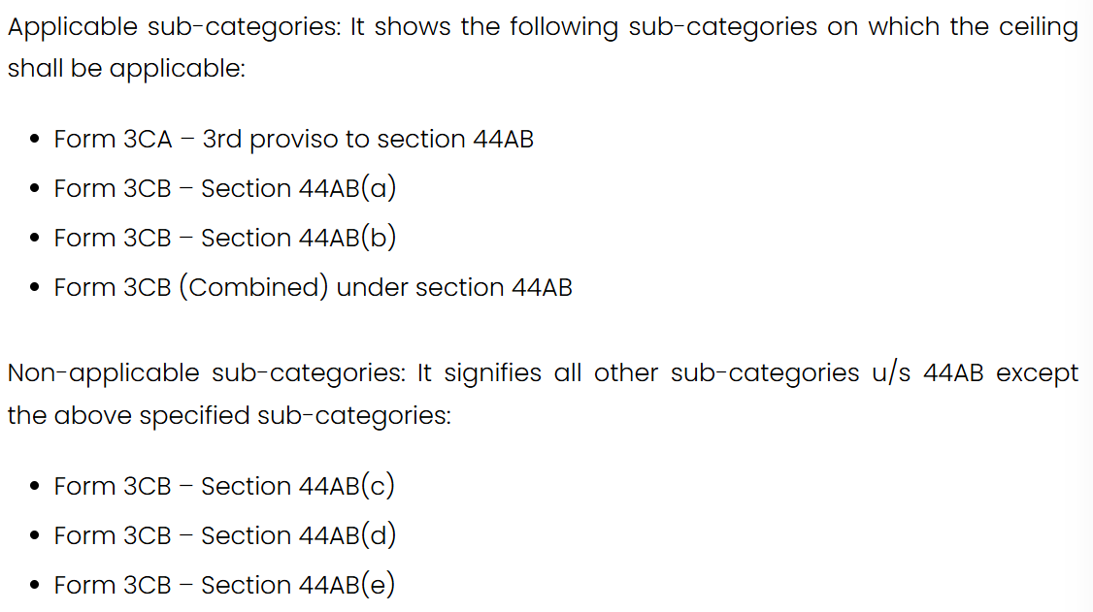
Key Definitions:

Slide 7
From ICAI FAQs on the guidelines:
Q1. What is the ceiling on Tax Audit assignments for UDIN generation?
Q2. How is the ceiling of Tax Audit assignments computed?
Q3. Which sub-categories are considered for the purpose of Tax Audit ceiling?
Q4. Whether Tax Audit assignments undertaken in different firms or in individual capacity are aggregated?
Q5. Whether UDIN generated for revised Tax Audit Reports is counted within the ceiling?
Q6. How are UDINs for Head Office and Branch audits treated for ceiling purposes?
Q7. How are multiple assessment years for the same assessee treated?
Q8. How are multiple forms for the same assessee treated?

Slide 8
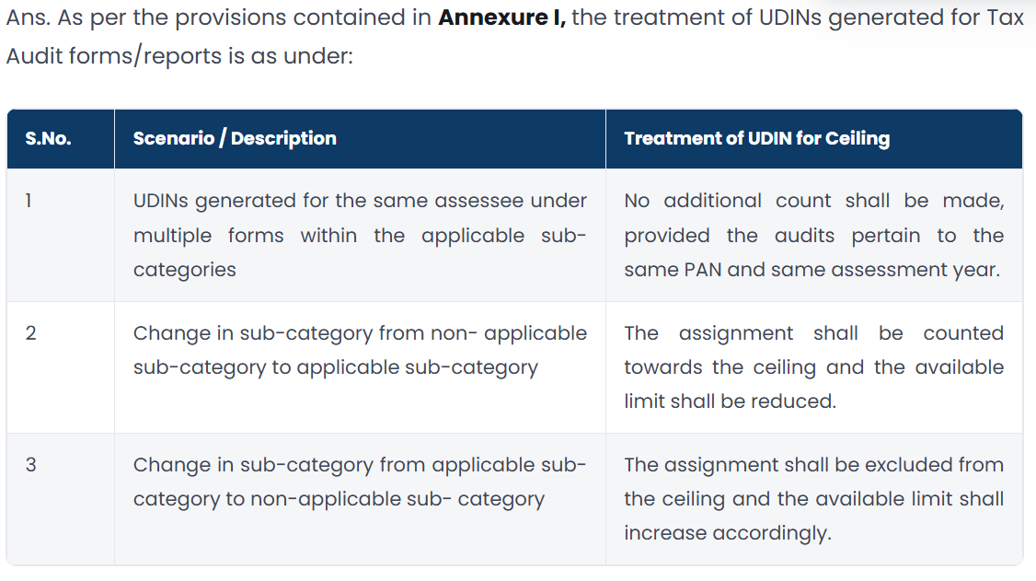
Q9. How are multiple forms for the same assessee treated?

Slide 9
Whether every UDIN generated automatically consumes one slot out of the 60-audit ceiling.

Slide 10
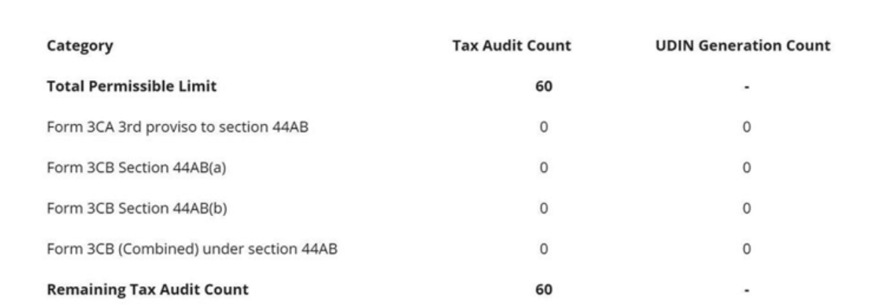
How it appears on SSP portal:

Slide 11
Various critical aspects before one conducts a tax audit:
Materiality vs. Absolute Assurance (True & Correct Information)
Tax audit is applicable on assessee or on a business or profession ?
Whether it applies only on the business income aspects or even on capital gain / other sources aspects ?
Whether reporting in tax audit clauses impacts total income determination of the assessee by IT Department.
Role of GST, TDS reporting on Audit Turnover / Sales etc.
F&O Transactions & Tax Audit
Commission Transactions & Tax Audit
Whether tax audit delay may attract fees for the AY 2026-27.

Slide 12
Important Tax Audit Clauses

Slide 13
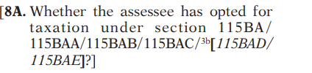
Clause 8A: Special Taxation Provision Reporting

Slide 14
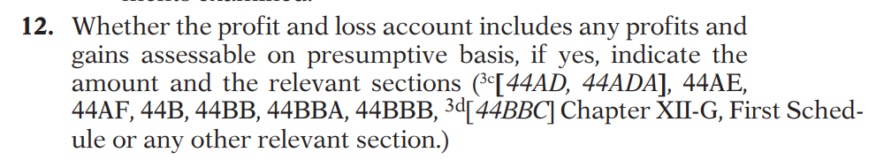
Clause 12: Presumptive aspect reporting

Slide 15
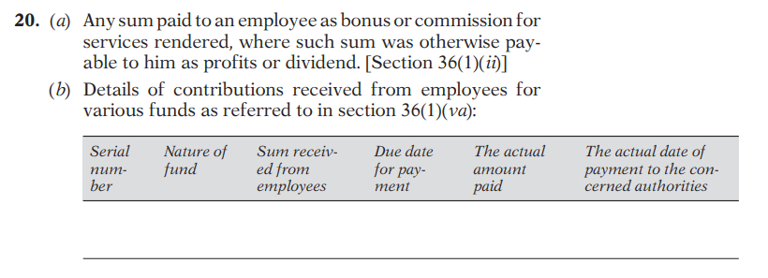
Clause 20: Employee Dues Reporting

Slide 16
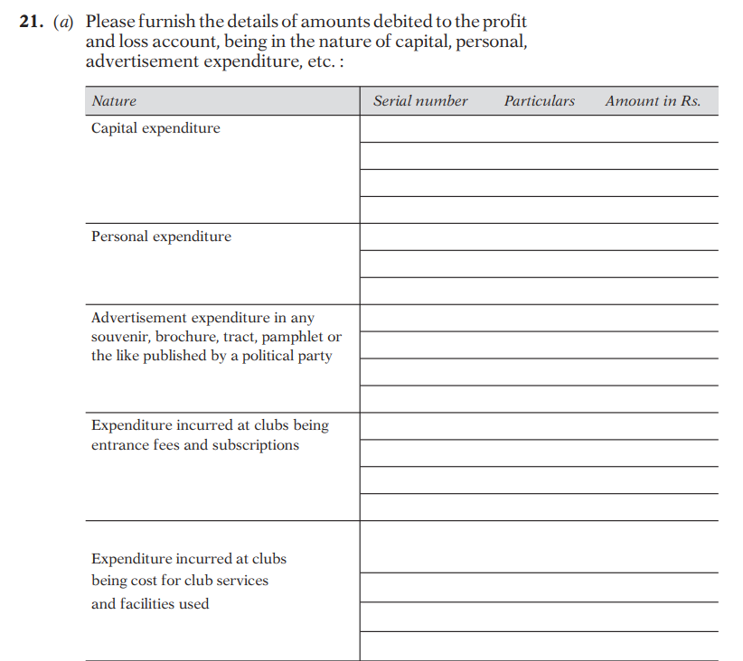
Clause 21: Various amounts debited to P&L being in the nature of capital, personal, advertisement expenditure etc.

Slide 17
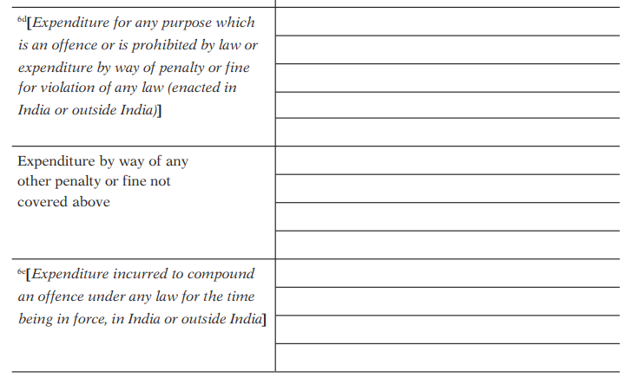
Clause 21 continues……

Slide 18
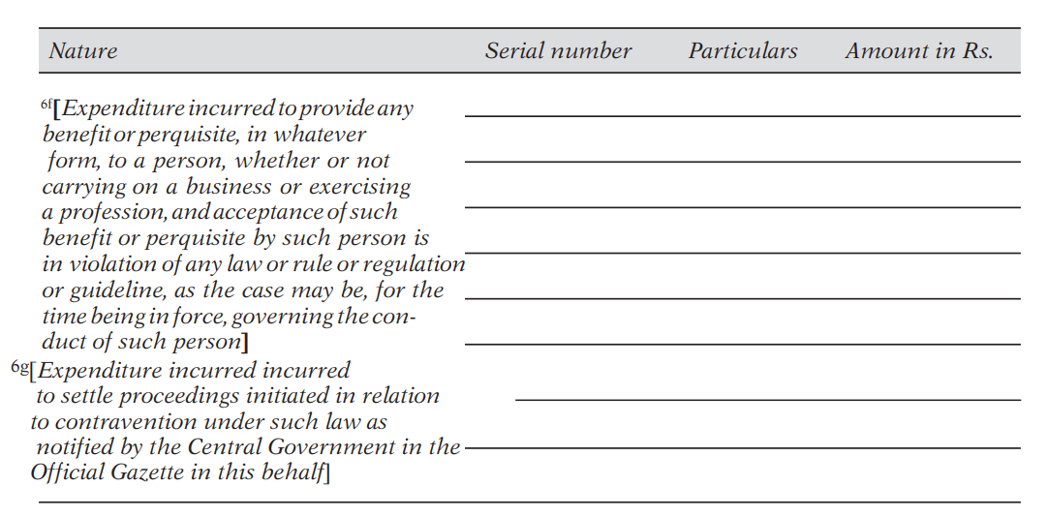
Clause 21 continues…….

Slide 19
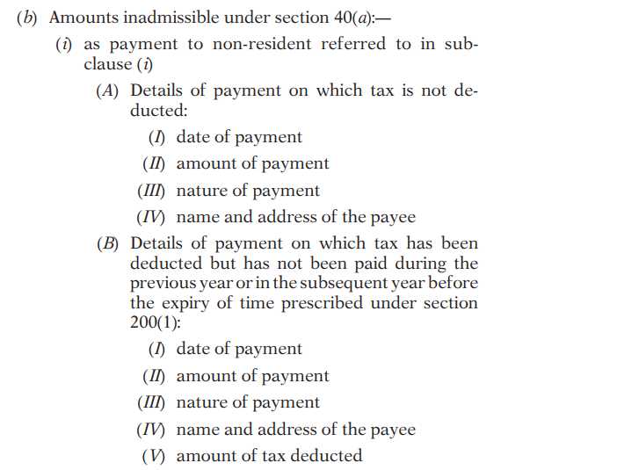
Clause 21 continues…..

Slide 20
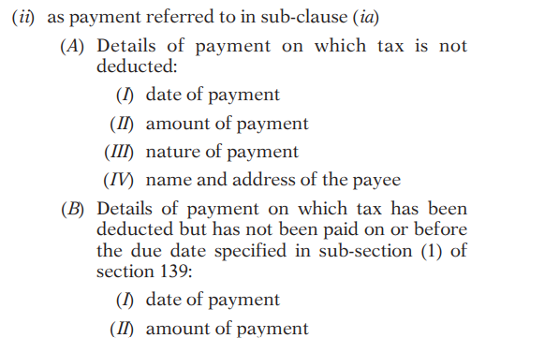
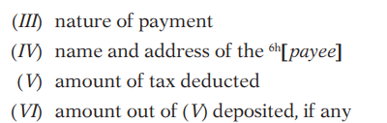
Clause 21 continues……..

Slide 21
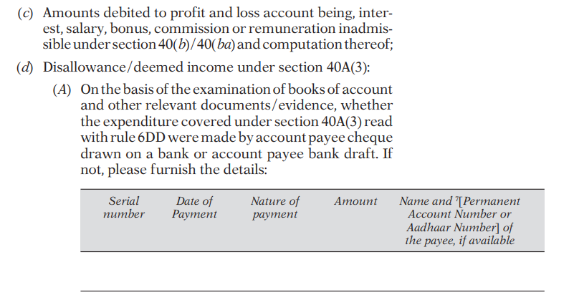
Clause 21 continues……

Slide 22
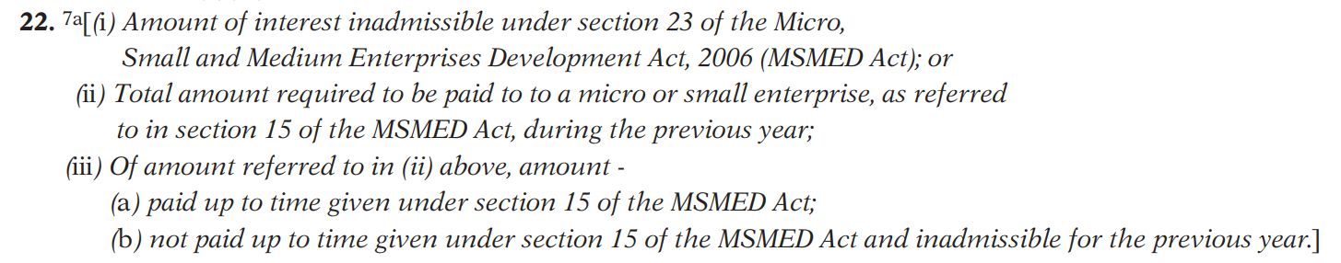
Clause 22: MSME Reporting (Revised Version)

Slide 23
As per Tax Audit Guidance Note…….
42.4 Clause 22 has two limbs – under the first limb, covering sub-clause (i), the amount of interest inadmissible under section 23 of the MSMED Act needs to be stated.
Under the second limb covering remaining two sub-clauses, under sub-clause (ii) the total amount required to be paid to a micro or small enterprise, as referred to in section 15 of the MSMED Act during the previous year needs to be stated. Sub-clause (iii) begins with “Of the amount referred to in (ii) above”, indicating that the amount to be reported in (a) and (b) of subclause (iii) are out of the amount referred to in (ii) above.
In sub-clause (iii) under (a), the amount paid up to the time given under section 15 of the MSMED Act, and under (b) the amount not paid up to time given under section 15 of the MSMED Act and inadmissible for the previous year needs to be stated. Thus, the amount to be reported under (b) is the payment which satisfies the dual conditions, namely, paid beyond the time given under section 15 of the MSMED Act and inadmissible for the previous year.

Slide 24
Excerpts from Tax Audit Guidance note continue…….
Reporting under Clause 22(i)
42.20 The tax auditor while verifying the reporting in clause 22(i) should take the following steps:
Obtain a full list of suppliers of the assessee which fall within the purview of the definition of “Supplier” under section 2(n) of the MSMED Act. It is the responsibility of the auditee to correctly classify and identify suppliers who are covered under that Act.
In respect of payments made to such suppliers, obtain a list of all instances where there was delay in payment beyond the time limit specified under Section 15 of the MSMED Act, the interest payable for such delay and the interest actually paid.
Review the list so obtained and verify the accuracy thereof on test check basis including the calculation of interest. Also, cross check the disclosure made in the financial statements in terms of Section 22 of the MSMED Act with the list so obtained. In case of company auditees, reference may also be made to half-yearly Form MSME-1, if any, furnished by such companies to the ROC.

Slide 25
Continue……
Verify from the books of account and Financial Statements whether any interest payable or paid to supplier(s) in terms of section 16 of the MSMED Act has been provided for in the books of account or has been debited to the Profit & Loss Account.
Verify that only interest paid or payable in terms of Section 16 of the MSMED Act which has been debited to the Profit & Loss account is reported under clause 22(i). Such interest is not allowable as deduction for the purposes of computation of income under the Income-tax Act, 1961 in terms of Section 23 of the MSMED Act.

Slide 26
Continue………
42.21 A question may come up as to what the disallowance would be in a case where the auditee is liable to pay interest under MSMED Act, but has not provided for the same in his books. Where the tax auditor, upon due verification, finds that the auditee has neither provided for nor paid any interest payable under the MSMED Act, then no amount is inadmissible in terms of section 23 of MSMED Act and the amount to be reported under Clause 22 would be NIL.
42.22 However, where the auditee has adopted mercantile system of accounting, non-provision of interest liability may affect the true and fair view of financial statements, and the tax auditor should give suitable qualification/observation in Form 3CB.

Slide 27
Continue……..
Reporting under Clauses 22(ii) and (iii)
42.23 Sub-clause (ii) of Clause 22 requires reporting of amounts which are payable under the MSMED Act to Micro and Small Enterprises during the year. Sub-clause (iii) of Clause 22 requires reporting of (a) amount paid upto the time given under section 15 of the MSMED Act, 2006; and (b) amount not paid upto time given under section 15 of the MSMED Act and inadmissible for the previous year. In the revised clause (iii)(b) applicable from 1.4.2025, reference to clause (h) of Section 43B has been replaced by the phrase “inadmissible for the previous year” with reference to Section 15 of MSMED Act. It is presumed that the clause seeks to cover only such payments which are covered under clause (h) of Section 43B.
42.24 The provisions of section 43B(h) are applicable only in respect of sum payable by the assessee to a micro or a small enterprise, and not to a medium enterprise. The second limb of Clause 22 now specifically seeks reporting in relation only to micro and small enterprises.

Slide 28
Continue……..
42.30 The word “or” at the end of sub-clause (i) of Clause 22 in the notified form 3CD should be read as “and” since the reporting under sub-clause (i) and those under sub-clauses (ii) and (iii) are not alternative but are concurrent.
42.31 The amount inadmissible as per sub-clause (iii) for a financial year would become the opening balance/part of the opening balance in the subsequent financial year for purpose of reporting reported in clause 26(A), i.e. any sum referred to in section 43B(h) which pre-existed on the first day of the previous year but was not allowed in the assessment of any preceding previous year.

Slide 29
Clause 23: Payments to Related Parties
Particulars of Payments made to persons specified under section 40A(2)(b).

Slide 30
Clause 25: Profits covered under section 41
Any amount of profits chargeable to tax under section 41 and computation thereof.

Slide 31
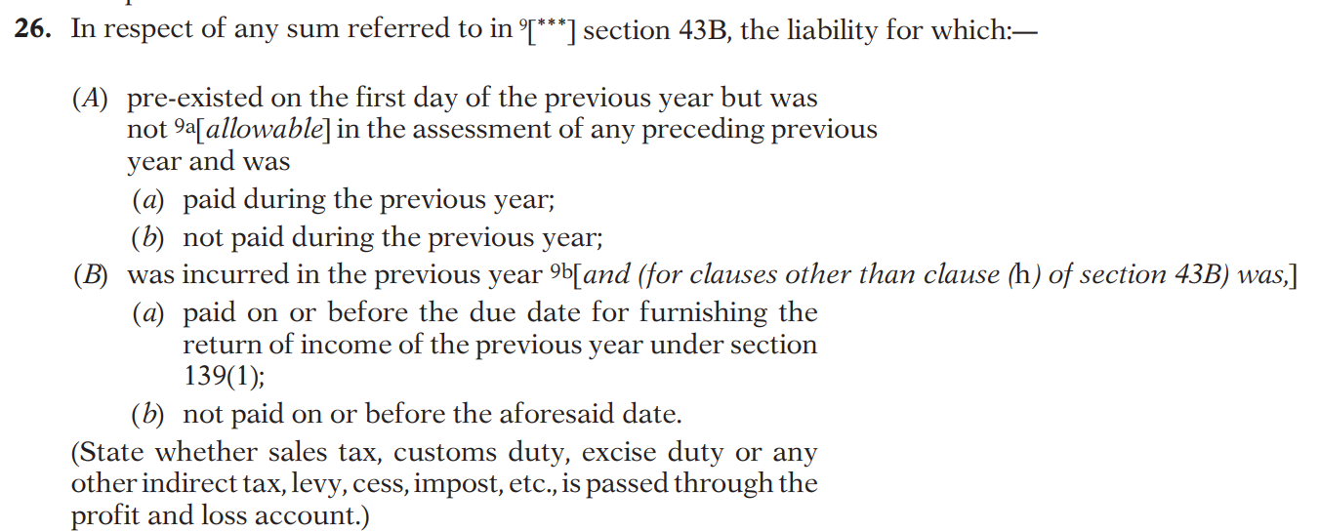
Clause 26: Revised Version

Slide 32
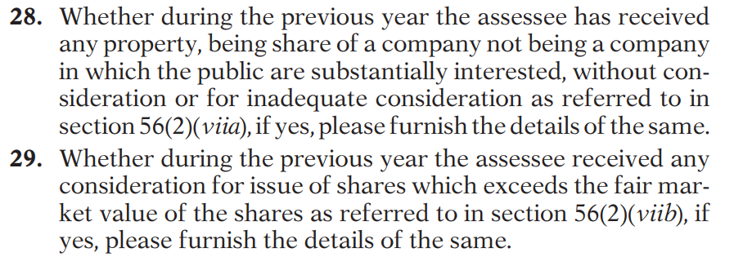
Clause 28 & 29: Omitted

Slide 33
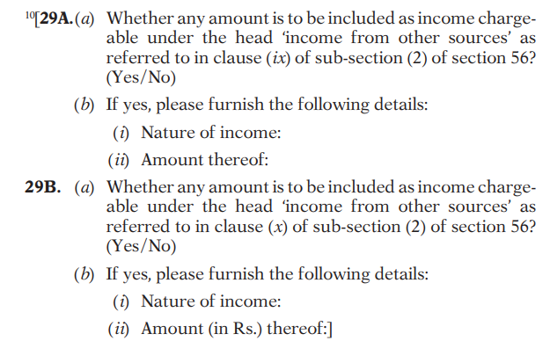
Clause 29A & 29B

Slide 34
Clause 31:
(a): Particulars of each loan / deposit taken or accepted exceeding 269SS limit
(b): Particulars of each specified sum taken or accepted exceeding 269SS limit
(ba) & (bb): Particulars of each receipt exceeding 269ST limit
(bc) & (bd): Particulars of each payments exceeding 269ST limit
(c): Particulars of each repayment made of loan /deposit / specified sum exceeding 269T limit.
(d) & (e): Particulars of repayment received of loan / deposit / specified sum exceeding 269ST limit.

Slide 35
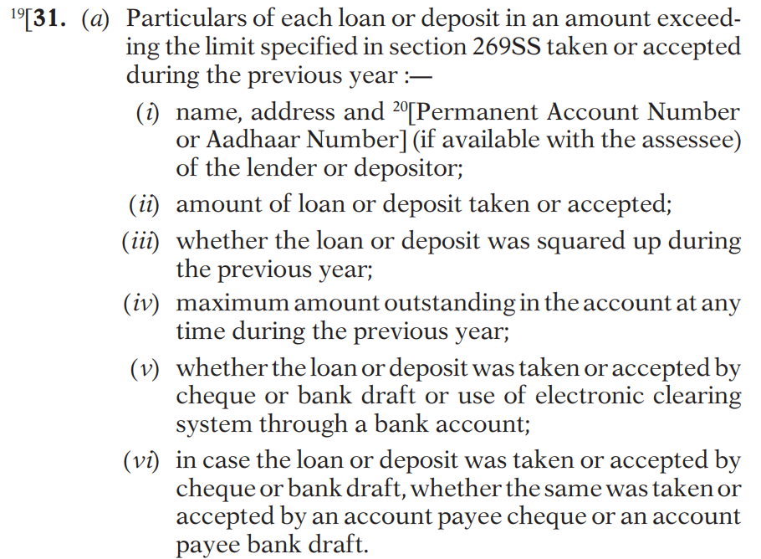
Clause 31(a): Previous Versions

Slide 36
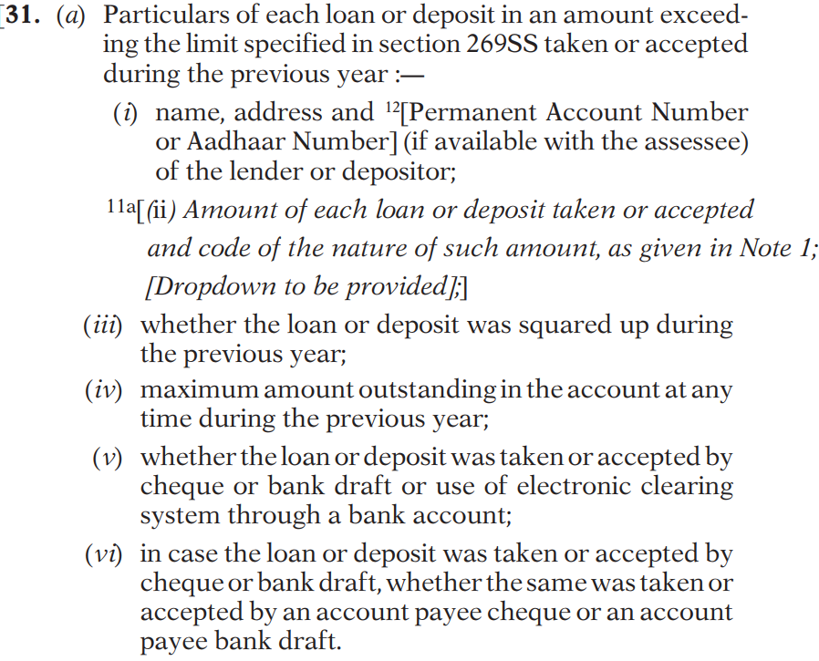
Clause 31(a): Revised Version

Slide 37
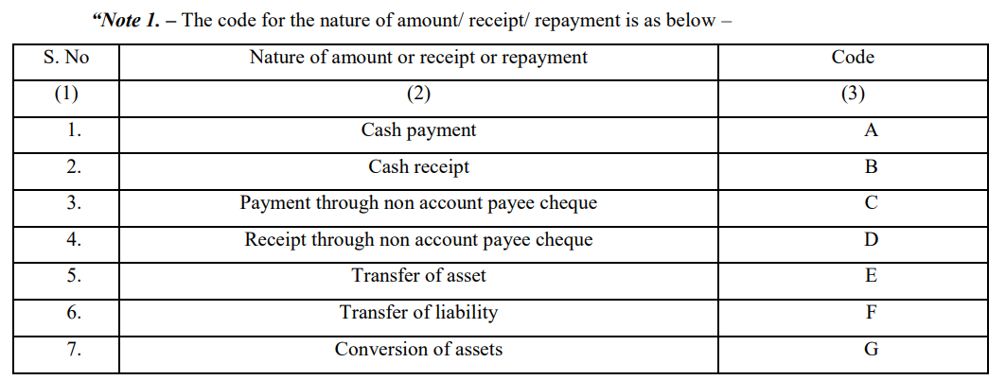
Code of the nature of amount / receipt / repayment is as below:

Slide 38
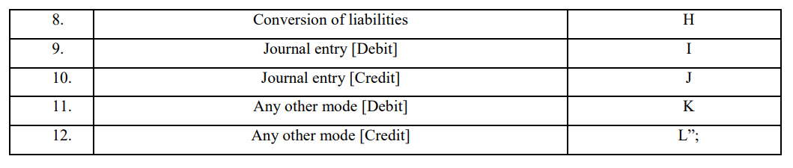
Code list continues……….

Slide 39
Sec 2(22)(f): as inserted by the Finance (No.2) Act 2024 (wef 01.10.2024)
2(22) “Dividend” includes:
f) any payment by a company on purchase of its own shares from a shareholder in accordance with the provisions of section 68 of the Companies Act, 2013 (18 of 2013);
Sec 68 of the Companies Act 2013:
68. Power of Company to Purchase its Own Securities
(1) Notwithstanding anything contained in this Act, but subject to the provisions of sub-section (2), a company may purchase its own shares or other specified securities (hereinafter referred to as buy-back) out of—
(a) its free reserves;
(b) the securities premium account; or
(c) the proceeds of the issue of any shares or other specified securities:

Slide 40
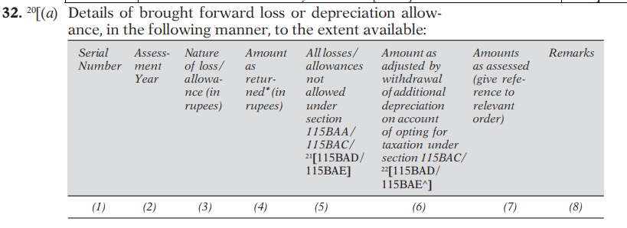
Clause 32: Carry Forward Losses / Depreciation

Slide 41
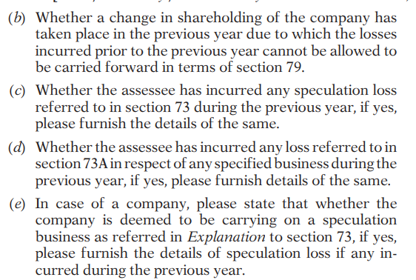
Clause 32 continues……

Slide 42
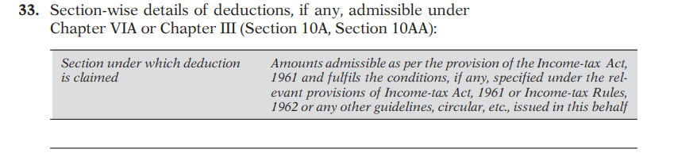
Clause 33: Chapter VI-A Deduction:

Slide 43
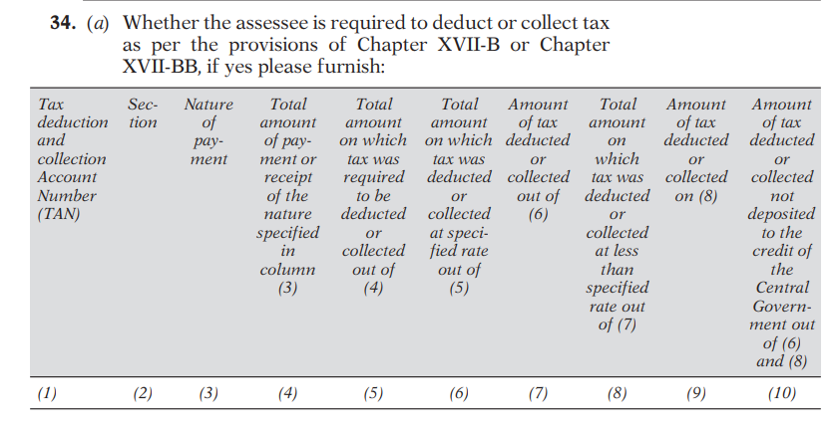
Clause 34: TDS Reporting (a), (b) & (c) / 194T

Slide 44
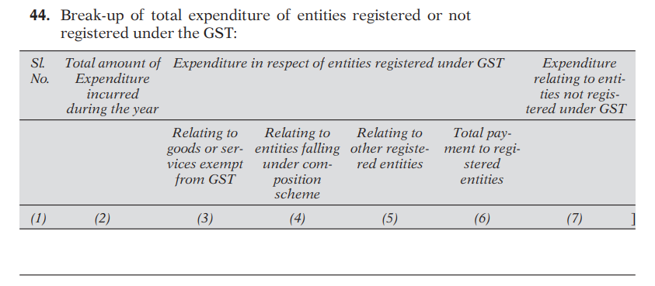
Clause 44: GST Reconciliation

Slide 45
Thanks !! Jai Hind !!!

