Slide 1
Tax Audit under Section 44AB
INCOME-TAX ACT, 1961 — REVISED 2025
A comprehensive guide for Chartered Accountants and taxpayers on the provisions, applicability, and procedures governing tax audit in India.

Slide 2
Introduction: What is a Tax Audit?
Tax Audit under Section 44AB
What is an Audit?
The Income-tax law requires taxpayers to get their business/profession accounts audited from the viewpoint of Income-tax law. Section 44AB mandates that certain classes of taxpayers must get their accounts audited by a Chartered Accountant to ascertain compliance with the provisions of the Income-tax law.
The audit report is given in Form Nos. 3CA/3CB and the statement of particulars in Form 3CD.
The dictionary meaning of "audit" is check, review, or inspection. Various types exist under different laws — company law requires company audit, cost accounting law requires cost audit, etc.

Slide 3
Objectives of Tax Audit
Proper Maintenance of Records
Facilitates Tax Administration
Assures that books of account and other records are properly maintained and reflect true and correct particulars in Form No. 3CD.
Enables proper presentation of accounts before tax authorities, saving Assessing Officers' time on routine verifications like checking totals and verifying purchases and sales.
Form 3CD Reporting
One key objective is to ascertain and derive the requirements of Form No. 3CD and report in Form Nos. 3CA/3CB, covering generally all items in Form No. 6B under section 142(2A).

Slide 4
Provisions of Section 44AB — Applicability
Section 44AB mandates audit by a Chartered Accountant before the "specified date" (one month prior to return due date under section 139) in the following circumstances:
Business — Turnover Limit
1
Total sales/turnover/gross receipts exceed ₹1 crore (or ₹10 crore if cash receipts and payments do not exceed 5% of total). Non-account payee cheques/drafts are deemed cash. [44AB(a)]
2
Profession — Gross Receipts
Gross receipts in profession exceed ₹50 lakhs in any previous year. [44AB(b)]
3
Presumptive Business — Lower Income Claim
Profits deemed under section 44AE/44BB/44BBB but taxpayer claims lower income. [44AB(c)]
4
Presumptive Profession — Lower Income Claim
Profits deemed under section 44ADA but taxpayer claims lower income and income exceeds the maximum non-chargeable limit. [44AB(d)]
5
Section 44AD(4) — Income Exceeds Limit
Provisions of section 44AD(4) applicable and income exceeds the maximum non-chargeable limit. [44AB(e)]

Slide 5
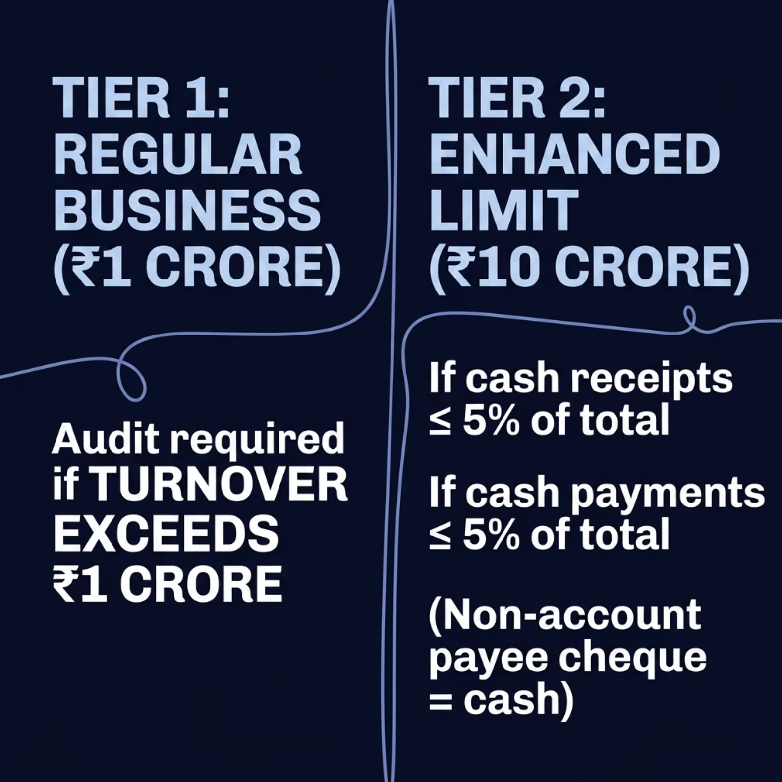

Business Audit — Section 44AB(a)
Key Conditions
Regular threshold: ₹1 Crore total sales/turnover/gross receipts
Enhanced threshold: ₹10 Crore if cash receipts ≤5% and cash payments ≤5%
Non-account payee cheque or bank draft = deemed cash

Slide 6
Scenario 1
Particulars Amount
Turnover ₹78 lakh
Cash receipts 15%
Net profit ₹9 lakh
Since turnover is below ₹1 crore, tax audit is not applicable.
Scenario 2
Particulars Amount
Turnover ₹1.45 crore
Cash receipts 18%
Net profit ₹11 lakh
Turnover exceeds ₹1 crore and cash condition for ₹10 crore benefit is not satisfied.
Tax audit applicable.
Scenario 3
Particulars Amount
Turnover ₹8.20 crore
Cash receipts 3%
Cash payments 4%
Since both cash receipts and cash payments do not exceed 5%, enhanced limit of ₹10 crore applies.
Audit not applicable

Slide 7
Scenario 4
Particulars Amount
Turnover ₹7.5 crore
Cash receipts 2%
Cash payments 9%
Even though cash receipts are within 5%, cash payments exceed 5%.
Hence enhanced limit not available.
Normal limit of ₹1 crore applies.
Audit applicable.
Scenario 5
Particulars Amount
Turnover ₹11.80 crore
Cash receipts 1%
Cash payments 1%
Even though transactions are mostly digital, turnover exceeds ₹10 crore.
Audit applicable.
For companies, societies, charitable trusts etc., respective governing law prescribes format. Responsibility for maintenance of books and preparation of financial statements lies with the assessee.
For entities without prescribed format, ICAI Guidance Notes on Non-Corporate Entities and LLPs apply (effective 1st April 2024).

Slide 8
QUESTION - 1
Mr A is engaged in trading business for FY 2025-26 with following details:
Total Turnover : ₹ 7.50 crore
Cash Receipts : 3% of total receipts
Cash Payments: 4% of total payments
Whether tax audit under Section 44AB is applicable ?
Options:
Yes, because turnover exceeds ₹ 1 crore
Yes, because turnover exceeds ₹ 5 crore
No, because enhanced limit of ₹ 10 crore is applicable
NO, because presumptive taxation automatically applies

Slide 9
Profession Audit — Section 44AB(b)
Threshold
Applicable To
No Cash Relaxation
Gross receipts in profession exceed ₹50 Lakhs in any previous year
Doctors, lawyers, engineers, architects, consultants, and all professionals
Unlike business, the ₹10 Crore cash-compliance relaxation does not apply to professionals
Example — Professional (Doctor)
Gross receipts: ₹60 Lakh.
Audit required under Sec 44AB(b) — exceeds ₹50 L limit.

Slide 10
Presumptive Taxation — Sections 44AB(c) & (d)
44AB(c) — Business
44AB(d) — Profession
Applies when profits are deemed under 44AE / 44BB / 44BBB and the assessee claims income lower than the deemed profits.
Applies when profits are deemed under 44ADA, assessee claims lower income, and total income exceeds the maximum non-taxable limit.
Example (c)
Example (d)
Transport operator under 44AE deems ₹6 Lakh profit but declares ₹4 Lakh → audit required
Consultant under 44ADA deems ₹25 Lakh (50% of ₹50L receipts) but declares ₹18 Lakh & income exceeds basic exemption → audit required

Slide 11
Section 44AD(4) — Section 44AB(e)
When Does 44AB(e) Apply?
When sub-section (4) of section 44AD is applicable — i.e., the assessee:
Example: A retailer opted out of 44AD, declares ₹3 Lakh income (below 8% of turnover), and total income exceeds ₹2.5 Lakh basic exemption → tax audit triggered under 44AB(e).
Was earlier under 44AD but opted out, OR
Declared income below the prescribed 8%/6% rate
And whose income exceeds the maximum amount not chargeable to income-tax in that previous year.

Slide 12
Exceptions & Key Definitions
When Section 44AB Does NOT Apply
Who is an "Accountant"?
Persons declaring profits under section 44AD(1) or 44ADA(1) on presumptive basis
Persons deriving income under section 44B or 44BBA (non-resident shipping/airlines)
Where audit under another law is complied with — a further report in prescribed form is still required
A Chartered Accountant as defined in section 2(1)(b) of the CA Act, 1949, holding a valid Certificate of Practice. Wide-ranging restrictions apply under Explanation to section 288(2) read with Rule 51A regarding relationships with the auditee.

Slide 13
'Profession' and 'Business' Explained
Business — Section 2(13)
Profession — Section 2(36)
"Includes any trade, commerce, or manufacture or any adventure or concern in the nature of trade, commerce or manufacture." The word “Business” is one of the wide import — activity carried on continuously with a view to earning income.
Includes "vocation" — a way of living. Involves intellectual or manual skill , as distinguished from production or sale of commodities.
Notified Professions — Section 44AA(1) & Rule 6F
Legal, Medical, Engineering, Architectural
Accountancy, Technical Consultancy, Interior Decoration
Authorised Representative, Company Secretary
Film Artists/Actors, Directors, Music Directors, Singers, Editors, Lyricists, Dress Designers
Information Technology (Notification S.O. 385(E) dated 04.05.2001)
Activities held to be business include: advertising agents, clearing & forwarding agents, couriers, insurance agents, nursing homes, stock broking, and travel agents.

Slide 14
Sales, Turnover & Gross Receipts — Definitions & Treatment
The terms "sales", "turnover", and "gross receipts" are not defined in the Income-tax Act and must be construed per the method of accounting regularly employed (section 145).
Included in Turnover/Gross Receipts
Excluded from Turnover/Gross Receipts
Discount in sales invoice (reduces sale price)
Turnover discount (even if allowed via credit notes)
Special rebate in nature of trade discount
Price of goods returned (even from earlier years)
Sales of scrap shown under miscellaneous income
Shares/securities held as stock-in-trade
Cash assistance against exports; drawback repayments
Hire charges, liquidated damages, insurance claims (except fixed assets)
Advance received and forfeited from customers
Value of any benefit or perquisite from business/profession
Sale proceeds of fixed assets or investment assets
Sale proceeds of shares/securities held as investment
Rental income (unless assessable as business income)
Dividends (except for dealers in shares)
Interest (unless assessable as business income)
Reimbursement of actual expenses (e.g., customs duty by clearing agent)
Out-of-pocket expenses collected separately by professionals
Partner's share of profit, interest, remuneration from firm
Agriculture receipts [section 2(1A)]
Write-back of amounts payable to creditors

Slide 15
QUESTION - 2
Mr X has following receipts during FY 2025-26
Particulars Amount
Sale of goods ₹ 92 lakh
Sale of old machinery ₹ 8 lakh
Dividend from Investments ₹ 2 lakh
Commission income ₹ 6 lakh
Rental income from House Property ₹ 4 lakh
What amount shall be considered as turnover/gross receipts for Section 44AB applicability?
Options:
₹ 1.12 crore C. ₹ 98 lakh
₹ 1.08 crore D. ₹ 1 crore

Slide 16
SPECIAL CASES
Commission Agents
Key Principle
Where a person acts as an agent, only the commission earned forms part of turnover — not the full sale price. The sale price received/receivable forms part of his sales/turnover as the case may be.
Share Brokers — Turnover Treatment
On Behalf of Customer
Personal Account
Broker does not take title. Securities are delivered directly to customer. Only brokerage counts for Section 44AB limit.
When broker trades on own account, the full sale value is included for Section 44AB limit.
Sub-Broker
Treated identically to a share broker — same principles apply.

Slide 17

Share Broker — Detailed Example
Scenario
Turnover for Section 44AB
Broker A executes trades for Client B and also trades personally.
Component
Amount
Brokerage on client trades
₹20,000
Sale value of personal trades
₹11,50,000
Client Trades (₹)
Personal Trades (₹)
Total Turnover
₹11,70,000
Purchase: ₹50,00,000 | Sale: ₹52,00,000
Brokerage earned: ₹20,000
Purchase: ₹10,00,000 | Sale: ₹11,50,000
Sale value: ₹11,50,000
Client trade value of ₹1,02,00,000 is excluded — property never transferred to broker.

Slide 18
Speculative Transactions — Definition
A speculative transaction is one where a contract for purchase/sale of commodity (including stocks & shares) is settled otherwise than by actual delivery — squared up by paying the difference.
Contract Entered
No Delivery
Full contract note issued for asset value
Settled by paying difference only
Turnover = Difference
Aggregate of positive & negative differences

Slide 19

Speculative Transactions — Detailed Example
Transactions During the Year
Turnover Computation
Contract
Result
Difference
Positive Differences
Negative Differences
Contract 1
Favourable
+₹45,000
₹45,000 + ₹20,000 = ₹65,000
₹30,000 + ₹15,000 = ₹45,000
Contract 2
Unfavourable
–₹30,000
Contract 3
Favourable
+₹20,000
Total Turnover (Sec 44AB)
Contract 4
Unfavourable
–₹15,000
₹65,000 + ₹45,000 = ₹1,10,000
Each transaction is independent. Aggregate of both favourable and unfavourable differences = turnover.

Slide 20
QUESTION - 3
Mr. Rakesh entered into intraday speculative transactions during FY 2025-26 with the following results:
Particulars Amount
Profit on certain trades ₹ 14 lakh
Loss on certain trades ₹ 9 lakh
Share delivery based profit ₹ 6 lakh
Dividend income ₹ 1 lakh
What amount shall be considered as turnover for speculative transactions under Section 44AB?
Options:
₹ 5 lakh C. ₹ 14 lakh
₹ 23 lakh D. ₹ 30 lakh

Slide 21
Derivatives, Futures & Options — Turnover Rules
01
02
03
Squared-off Transactions
Premium on Sale of Options
Reverse Trades
Total of favourable + unfavourable differences = Turnover
Premium received is included in turnover (unless already in net profit)
Difference on any reverse trade also forms part of turnover
04
05
Open Positions (Year-End)
Delivery-Based Settlement
Turnover recognised in the year when transaction is actually squared off
Difference between trade price & settlement price = turnover. If underlying asset held as stock-in-trade, entire sale value also counts as business turnover.

Slide 22

Derivatives — Detailed Example
Assessee's F&O Transactions
Turnover Calculation
Transaction
Amount
Favourable + Unfavourable Diff.
Premium on Options
Favourable difference (squared)
+₹80,000
₹80,000 + ₹50,000 = ₹1,30,000
₹15,000
Unfavourable difference (squared)
–₹50,000
Premium received on options sold
₹15,000
Reverse Trade Difference
Total Turnover
₹1,55,000
Difference on reverse trade
₹10,000
₹10,000
Open position (not squared)
–
Open position excluded — will be counted when squared off in a future year.

Slide 23

Delivery-Based Transactions — Example
Rule
Example
Where purchase/sale of commodity (including stocks & shares) is delivery-based — whether intended or by default — the total value of sales is turnover.
Transaction
Value
Shares purchased (delivery)
₹3,00,000
Shares sold (delivery)
₹3,45,000
Turnover for Sec 44AB
₹3,45,000
Unlike speculative/F&O, full sale value counts — not just the difference.

Slide 24
Aggregation, Gross Receipts & Key Principles
Aggregation of Business Activities
Gross Receipts in Profession
Where an assessee carries on more than one business, aggregate sales/turnover/gross receipts of all businesses are clubbed to determine if the prescribed limit is exceeded.
Each partnership firm is a separate assessee — figures considered separately.
Turnover of businesses under sections 44B/44BBA is excluded. Turnover of businesses opting for presumptive taxation under 44AD/44ADA/44AE/44BB/44BBB is also excluded.
Includes all receipts from carrying on the profession.
Out-of-pocket expenses collected separately by professionals (solicitors, advocates, CAs) do not form part of gross receipts. If included in a consolidated fee, the whole amount is gross receipts.
Advances for services not yet rendered are liabilities, not receipts.
Profession + Business Together
Limits apply independently. The accounts must be audited if either the business turnover exceeds the prescribed limit for business or the professional receipts exceed the prescribed limit for profession. Merely combining business and professional receipts is not relevant; each is considered independently against its respective threshold.. Liability is determined each year independently.
Partner's Remuneration
Interest, salary, bonus, commission received by a partner from the firm cannot be treated as gross receipt/turnover — it is the firm carrying on business, not the partner individually. (Perizad Zorabian Irani v. PCIT, Bombay HC, 09.03.2022)

Slide 25
QUESTION - 4
Mr. Z, a Chartered Accountant, received the following during FY 2025-26:
Particulars Amount
Professional Fees ₹ 42 lakh
Reimbursement of ROC filing fees collected separately from clients ₹ 3 lakh
Consolidated fee including travelling and documentation expenses ₹ 5 lakh
What amount shall be considered as gross receipts for applicability of Section 44AB?
Options:
₹ 42 lakh C. ₹ 45 lakh
₹ 50 lakh D. ₹ 47 lakh

Slide 26
Liability to Tax Audit — Special Cases
Exempt Income
Trusts & Co-operative Societies
Neither Section 44AB nor any other provision exempts persons whose income is exempt from tax. If turnover/gross receipts exceed prescribed limits, audit is mandatory regardless of taxability.
Trusts/institutions exempt under Sections 10(21), 10(23C), 11, etc., and co-operative societies under Section 80P must get accounts audited if business turnover exceeds prescribed limits.
Below Taxable Limit
Non-Residents
Even if total income is below the taxable limit, audit under Section 44AB is required if prescribed conditions are satisfied. The object is to assist the Assessing Officer in computing total income.
Section 44AB makes no distinction between resident and non-resident. A non-resident must get accounts audited if turnover/gross receipts exceed limits, confined only to Indian operations.

Slide 27
Specified Date & Tax Audit Filing Process
What is the "Specified Date"?
E-Filing Steps
01
Assessee assigns Form 3CA/3CB
As per Explanation (ii) to Section 44AB, "specified date" means one month prior to the due date for furnishing return of income under Section 139(1).
Assessee assigns the prescribed tax audit form(3CA/3CB) to the CA on the e-filing portal.
02
For most assessees: 30th September
Where Section 92E report is required: 31st October
Assessee fills Form 3CD
Particulars in Form 3CD are filled by the assessee.
03
Individuals and HUFs can verify Form 3CB-3CD using EVC or DSC; CAs must use DSC mandatorily.
CA uploads with Digital Signature
CA accepts assignment and uploads Forms 3CA/3CB and 3CD using digital signature, accompanied by audited financial statements.
04
Assessee approves on portal
Assessee must login and approve the uploaded forms. Department tracks the upload date, not acceptance date.

Slide 28
Penalty for Non-Compliance — Section 271B
Section 271B: If any person fails to get accounts audited or furnish the audit report as required under Section 44AB, the Assessing Officer may direct payment of penalty equal to 0.5% of total sales/turnover/gross receipts or ₹1,50,000, whichever is less.
Under Section 273B, no penalty is imposable if the assessee proves there was reasonable cause for the failure. The onus of proving reasonable cause lies on the assessee.
Resignation of Auditor
Loss of Accounts
Resignation of the tax auditor or accountant and consequent delay or non-cooperation.
Loss of accounts due to fire, theft, seizure, or natural calamities beyond assessee's control.
Labor Problems
Portal Failure
Strike, lock-out for a prolonged period, or death/physical inability of the partner in charge of accounts.
Official e-filing portal failure of the Income-tax Department.

Slide 29

Tax Auditor — Eligibility & Restrictions
Who Can Be a Tax Auditor?
Prohibited Categories [Section 288(2)]
A Chartered Accountant as defined in Section 2(1)(b) of the Chartered Accountants Act, 1949, holding a valid Certificate of Practice under Section 6(1). The audit can be performed by an individual CA or a firm of CAs (partner's name must be stated).
Assessee himself, or partner/member of the assessee firm/HUF
Relative of the assessee or any person competent to verify return under Section 140
Officer or employee of the assessee
Person holding security/interest in assessee (relative: up to ₹1,00,000)
Person indebted to assessee (relative: up to ₹1,00,000)
Person with prescribed business relationship [Rule 51A]
Person convicted of fraud (10 years not elapsed)
Can be the statutory auditor or any other CA in full-time practice
Part-time practitioners are not entitled to perform attest functions (effective 1st April 2005)
Tax consultant of the assessee can conduct tax audit
Internal auditor cannot be appointed as tax auditor (ICAI decision effective 12-12-2008)
A CA responsible for writing/maintaining books of account of the assessee cannot audit such accounts.

Slide 30
Tax Auditor — Ceiling Limits & Professional Conduct
60
₹1L
Max Tax Audit Assignments
Indebtedness Threshold
Per member per Financial Year (w.e.f. 1.4.2026). Earlier: per Assessment Year.
CA cannot accept tax audit if indebted to concern exceeding ₹1,00,000.
Professional Conduct
Fees cannot be contingent on findings/results (Clause 10, Part I, First Schedule, CA Act)
CA writing books of account cannot audit them
Before accepting, communicate with previous auditor
Cannot be removed for giving adverse report
UDIN mandatory for all tax audit reports (CBDT effective 27th April 2020); must be updated within 60 days if not generated at submission

Slide 31
Inclusions & Exclusions in Ceiling Limit
Included in Ceiling Limit
Excluded from Ceiling Limit
Tax audits under Sec 44AB
Tax audit of company, LLP, firm, proprietorship
Joint audit counted separately for each auditor
Separate branch audit treated as additional assignment
Different PANs = separate assignments
Voluntary tax audit also counted
Audits under Sec 44AD, 44ADA, 44AE
Revised tax audit report not counted again
Head Office + branches covered together = one assignment
Internal audits
Concurrent audits
GST audits/certifications
Trust/society audits
Statutory audit under Companies Act
Stock Audits/ Bank Audits

Slide 32
QUESTION - 5
M/s ABC & Co., Chartered Accountants, conducted tax audit of:
Head Office of XYZ Ltd.
4 branches of XYZ Ltd.
All branches were covered in the same consolidated tax audit report.
How many assignments will be counted towards the tax audit ceiling limit?
Options:
1 Assignment C. 5 Assignments
4 Assignments D. 6 Assignments

Slide 33

Accounts & Income-tax Law
Section 145 — Method of Accounting
Income under "Profits and gains of business or profession" or "Income from other sources" computed as per cash or mercantile system regularly employed by assessee. Central Government may notify Income Computation and Disclosure Standards (ICDS). If AO not satisfied about correctness/completeness of accounts, assessment made under Section 144.
ICDS: 10 standards issued for computation of income under 'PGBP' and 'Income from Other Sources'. Applicable only for computation, not for maintenance of books of account. Elucidated in ICAI's Technical Guide on ICDS.
Form of Financial Statements
For companies, societies, and charitable trusts, the respective governing law prescribes the format. Responsibility for maintenance of books and preparation of financial statements lies with the assessee.
For non-corporate entities and LLPs, ICAI has issued Guidance Notes on Financial Statements (effective for periods beginning on or after 1st April 2024).

Slide 34
Accounting Standards
ICAI issues Accounting Standards harmonised with international developments. Legal recognition granted in 1998 via Section 211(3A)-(3C), Companies Act 1956. Under Companies Act 2013, Section 133 prescribes standards recommended by ICAI after NFRA examination.
Companies
Non-Company Entities
Tax Audit Applicability
Companies (Accounting Standards) Rules, 2021 effective from 1st April 2021. Classified as SMCs and Non-SMCs. Ind AS (converged with IFRS) applicable to listed companies, NBFCs, and unlisted companies/NBFCs with net worth ≥ ₹250 crores.
ICAI issues AS harmonised with MCA rules with minor differences. Guidance Note on Financial Statements of Non-Corporate Entities and Guidance Note on LLPs effective for periods beginning on or after 1st April 2024.
AS apply to financial statements audited under Section 44AB. Members must examine compliance with mandatory Accounting Standards during tax audit. Exemptions/relaxations exist for SMCs and MSMEs (see Appendix XII).

Slide 35
Audit Procedures
1
True & Fair View Opinion
2
Working Papers & Documentation
Tax auditor expresses opinion on whether financial statements give a true and fair view (Form 3CB) or annexes statutory audit report (Form 3CA). Applies SA 530 (Audit Sampling) based on nature, volume, materiality, and internal controls.
Maintain working papers per SA 230 — audit evidence, notes on work done, explanations received, decisions taken, judicial pronouncements relied upon, and management certificates. Documentation must be sufficient and appropriate.
3
Management Representations
4
Internal Audit & First-Time Audits
Obtain written representations per SA 580 for items not fully available in books (e.g., Section 40A(2)(b) payments, ICDS, MSME creditors). Draft Sample Management Representation Letter in Appendix IXA.
If internal audit exists, guided by SA 610 (Revised). For first-time audits, comply with SA 510 (Revised) on opening balances. If statutory audit already done, tax auditor need not repeat — annex audited accounts and verify Form 3CD particulars.

Slide 36
Audit Report — Forms & Revision
Form 3CA
Form 3CD
+
For persons already required to get accounts audited under any other law (e.g., companies, co-operative societies). Tax auditor annexes statutory audit report.
Statement of particulars annexed to both forms. Tax auditor reports whether particulars are true and correct.
Form 3CB
Form 3CD
+
Statement of particulars annexed to both forms. Tax auditor reports whether particulars are true and correct.
For persons not required under any other law. Tax auditor gives opinion on whether accounts give a true and fair view.
Revision of Tax Audit Report
Permitted under Rule 6G(3) if payment under Sections 40/43B necessitates recalculation of disallowance. Revision allowed before end of relevant assessment year.
Must reference the earlier report(s) and state reasons for revision
Same tax auditor must revise; new UDIN required each time
Can be revised multiple times for technical/legal reasons

Slide 37
Tax Audit
Under Section 44AB
Income-tax Act, 1961 (Revised 2025)
Forms 3CA · 3CB · 3CD | Clauses 1–13 & Particulars

Slide 38
Filing Process Of Tax Audit Report & Compliance Framework
1
Form Issuance
2
Document Attachment
3
Electronic Upload
Tax auditor issues Form 3CA or 3CB (as applicable) along with Form 3CD particulars — in hard copy (physically signed) or soft copy (digitally signed)
Audited Balance Sheet, P&L/Income & Expenditure Account, and statutory audit report (where accounts audited under another law) to be attached
Tax auditor uploads Form 3CA/3CB and Form 3CD on the Income Tax portal; all forms digitally signed by the auditor
4
UDIN Update
5
Assessee Acceptance
6
Acknowledgement
Unique Document Identification Number (UDIN) mandatorily updated by tax auditor under CA login on the Income Tax portal
After submission by auditor, the assessee must accept the report on the Income Tax portal to complete online furnishing
Acknowledgement number generated on the Income Tax portal — confirms completion of tax audit report filing
Notes:
Walk through the 6-step filing process. Key points: (1) Report can be in hard or soft copy. (2) UDIN is mandatory. (3) Assessee must accept on portal. (4) Acknowledgement marks completion. Emphasise digital signing requirement.

Slide 39
KEY DIFFERENCES
Form 3CA vs Form 3CB
ASPECT
FORM 3CA
FORM 3CB
Applicability
Taxpayers already required to get accounts audited under any other law (e.g. Companies Act)
Taxpayers required to get accounts audited only under Section 44AB (e.g. sole proprietors, HUFs, firms)
Prior Audit Requirement
YES — audit already conducted under another statute
NO — no prior statutory audit is conducted
Who Certifies It
CA certifies and refers to the existing statutory audit report
CA independently audits the accounts and certifies the report
Dependency on Another Report
Report is supplementary to existing audit report
Report is standalone — not dependent on any prior audit
Typical Entities
Companies (Companies Act audit), Cooperative Societies, etc.
Proprietorships, Partnership Firms, LLPs, HUFs (no other audit law applies)
Nature of Audit Work
Limited — CA reviews and supplements the existing audit
Comprehensive — CA conducts full audit from scratch

Slide 40
SIMILARITIES
Common Grounds — Form 3CA & Form 3CB
Both forms serve the same overarching legal purpose under the Income Tax Act, 1961
§
Legal Basis — Section 44AB
✔
Chartered Accountant Mandatory
📋
Accompanied by Form 3CD
Both are prescribed under Section 44AB of the Income Tax Act, 1961. They are the mechanism through which tax audit compliance is reported to the Income Tax Department.
In both cases, the audit report must be signed and certified by a practicing Chartered Accountant (CA). Self-certification is not allowed under either form.
Both Form 3CA and Form 3CB must compulsorily be filed along with Form 3CD — the detailed statement of particulars.
🖥
Electronic Filing (e-Filing)
📅
Due Date is Identical
⚖
Penalty for Non-Compliance
Both forms must be filed electronically on the Income Tax e-filing portal (www.incometax.gov.in). Manual / paper filing is not accepted.
The filing deadline for both forms is the same — typically 30th September of the relevant Assessment Year (subject to any CBDT extensions).
Failure to file either form attracts a penalty under Section 271B — 0.5% of turnover/gross receipts or ₹1,50,000, whichever is lower.

Slide 41
Q1
Which audit form is generally used when a company’s audit is conducted as per the calendar year?
A
Form 3CA
B
Form 3 CB
C
Both Form 3CA and 3 CB
D
None of these
Answer:

Slide 42
Auditor Responsibilities, Qualifications & Branch Reporting — Form 3CA
Standard | Reference | Relevance in Form 3CA Context
SA 600 | Using the Work of Another Auditor | Applies when tax auditor relies on branch auditor's report or statutory auditor's work; principal auditor's responsibility defined
SA 700 | Forming an Opinion & Reporting | Tax auditor must comply with SA 700 reporting requirements while giving opinion on Form 3CA
SA 705 | Modifications to the Auditor's Opinion | Applies when auditor is unable to obtain required branch information — must disclose impact in Para 3 of Form 3CA
Domestic Branch Reporting
Overseas Branch Reporting
Qualifications & Observations
Where branch accounts are audited by branch auditors:
• Branch auditors submit Form 3CA to management/principal tax auditor
• Principal tax auditor submits consolidated report
For foreign branches audited by overseas professionals:
• Tax auditor in India obtains Form 3CD information from assessee, who gets it from overseas auditor
• Reliance on overseas auditor's information is permissible
• If assessee is unable to obtain relevant information — disclose and report impact
When any requirement is answered negatively or with qualification:
• Reasons must be stated in the audit report
• Report Para 3 must reference the specific Form 3CD clause no.
• Ensures comprehensive report and enables users to assess impact
Notes:
SA 600, 700, and 705 are the key Standards of Auditing relevant to Form 3CA. Branch reporting requires consolidated reporting by principal auditor. Overseas branches require specific wording in Para 3. Inability to obtain information must be disclosed with impact assessment.

Slide 43
Form 3CB contains TWO Separate Opinions
Opinion 1
Opinion 2
Financial Statements &
Books of Account
Particulars in
Form 3CD
VS
Standard of Reporting
"True and Fair"
Standard of Reporting
"True and Correct"
Both opinions are expressed by the Tax Auditor based on audit procedures conducted

Slide 44
Qualifications, Observations & Special Cases in Form 3CB
Amalgamation / Merger / Demerger
Qualification for Non-Production of Books
Where courts/authorities approve restructuring from a specified date, with gap between date of merger/demerger and the court order:
• Returns of income of earlier periods of merged/demerged entities are required
• Financial Statements are NOT audited under Companies Act or any other law
• Therefore, Form 3CB must be issued to certify such Financial Statements
Where tax auditor is called to report on one or more businesses but books of other businesses are not produced:
• Auditor must mention that audit of those businesses was NOT conducted (books not produced)
• If financial statements include results of such businesses — audit report in Form 3CB must be qualified accordingly
Branch Audit in Form 3CB
Where assessee (not required under other law) has branches:
• Separate tax auditors may be appointed for branches
• Branch auditor gives Form 3CB to HO tax auditor
• HO auditor relies on branch reports (with checks) and submits consolidated Form 3CB
• Branch auditor references must be mentioned; UDIN required
Notes:
Special cases in Form 3CB: (1) Merger/demerger — Form 3CB is applicable even where no other law mandates audit. (2) Partial books — must qualify report. (3) Branch auditor reports consolidated by HO auditor. (4) Incomplete 3CD particulars — do not withhold report, qualify Para 5 instead.

Slide 45
Introduction to Form 3CD & Reporting Principles
Form 3CD is the Statement of Particulars required to be furnished under Section 44AB, annexed to both Form 3CA and Form 3CB. It contains multiple clauses covering comprehensive financial and tax information.
Assessee's Responsibilities — Preparing Form 3CD
Prepare and authenticate the statement of particulars in Form 3CD
Rely on judicial pronouncements
Follow Accounting Standards (AS), Ind AS, Guidance Notes, and SAs issued by ICAI
Where conflict of judicial opinion exists — refer to view followed and disclose
Tax Auditor's Responsibilities — Verifying Form 3CD
Where same item requires reporting at multiple clauses — furnish at one, cross-reference at other
If auditor disagrees with assessee — state both viewpoints in the report
Apply law applicable in the relevant year even if audit form not amended.
If information is incomplete/inadequate — qualify report; do NOT withhold audit report
Notes:
Form 3CD is central to the tax audit — it is the detailed statement of particulars. Both the assessee (who prepares) and the auditor (who verifies) have distinct responsibilities. The auditor should never withhold the report even if information is incomplete — instead, qualify Para 3/5.

Slide 46
Form 3CD — Part A: Clauses 1 to 4
Clause | Reporting Requirement | Key Compliance Point
Clause 1 Name | Name of assessee as per PAN; trade name if different; branch name if applicable | If name changed during FY: report name at year-end. If changed after year-end but before signing: report year-end name. Disclose name change as observation.
Clause 2 Address | Address as communicated to Income Tax Department as on signing date | For company: registered office address. For branch/unit: branch address. Verify from IT portal. Differences to be reported as observation.
Clause 3 PAN / Aadhaar | Permanent Account Number of assessee; Aadhaar number for individuals (alternative) | In e-filing: PAN is mandatory field; Aadhaar is optional. Both may be stated where applicable.
Clause 4 Indirect Tax Registrations | Whether assessee liable for indirect taxes (GST, excise, customs, sales tax, service tax, etc.); all registration/identification numbers | Obtain management representation (SA 580). If indirect tax law applicable but assessee not registered — report appropriately.
Notes:
Part A covers basic assessee identification. Key points: (1) Name — report name at year-end regardless of when change occurred; (2) Address — verify from IT portal; (3) PAN mandatory in e-filing; (4) Indirect taxes — all registrations including multiple registrations for branches must be reported. SA 580 written representation applies for indirect taxes.

Slide 47
Form 3CD — Part A: Clauses 5 to 8A
Clause | Reporting Requirement | Key Compliance Point
Clause 5 Status | Status of assessee : Individual, HUF, Company, Firm, AOP, BOI, Local Authority, Artificial Juridical Person | Report the correct legal status category. LLP is included in 'Firm' per Section 2(23) read with LLP Act, 2008.
Clause 6 Previous Year | Period of previous year (from __ to __). | For amalgamations, demergers, new businesses, closures — start/end dates may differ. Apply professional judgement.
Clause 7 Assessment Year | Assessment year relevant to the previous year being audited | Directly corresponds to the previous year. Must be correctly stated.
Clause 8 Audit Clause | Relevant clause of Section 44AB under which audit conducted | Companies/Societies audited under other laws: audit under proviso to Sec 44AB — NOT under clause (a) or (b).
Clause 8A Special Tax Regime | Whether assessee opted for taxation under: 115BA, 115BAA, 115BAB, 115BAC, 115BAD, or 115BAE | Verify relevant option exercise form filed. If not filed — obtain written representation. Report choice as on signing date. Where solely based on representation — disclose in Para 3/Para 5.
Notes:
Clauses 5-8A cover status, period, and the tax regime. Clause 8A is critical — auditor must check which option exercise form (10-IB through 10-IEA) has been filed. If not filed, get written representation. Report as of the date of signing. LLPs fall under 'Firm' category for Clause 5.

Slide 48
Special Tax Regimes — Section 115BA to 115BAE (Clause 8A Reporting)
Section | Eligible Assessee | Tax Rate | Option Form | Key Conditions / Restrictions
115BA | Manufacturing Domestic Company (w.e.f. AY 2017-18) | 25% | 10-IB | Set up on or after 1 Mar 2016; only manufacturing/production; no specified deductions (10AA, 32(1)(iia), 33AB, 35AD etc.); no 80 deductions except 80JJAA; no MAT exemption
115BAA | Any Domestic Company (w.e.f. AY 2020-21) | 22% | 10-IC | No specified deductions (10AA, 32(1)(iia), 33AB, 35AD), Chapter VI-A (except 80JJAA & 80M); MAT NOT applicable; option irrevocable
115BAB | New Manufacturing Domestic Company (w.e.f. AY 2020-21) | 15% (Mfg) 22% (Others) 30% (TP excess) | 10-ID | Set up ≥ 1 Oct 2019; commenced production by 31 Mar 2024; not split/reconstruction; no used machinery/plant; conditions on business scope; irrevocable
115BAC | Individual/HUF/AOP/BOI/ Artificial Juridical Person | Slab rates (Default w.e.f. AY 2025-26) | 10-IEA (to opt out) | Default regime from AY 2025-26; no deductions under 10(5), 10(13A), 24(b), 35AD, Chapter VI-A (except 80CCD(2), 80CCH(2), 80JJAA); option revocable once for business income
115BAD | Resident Co-operative Society (w.e.f. AY 2021-22) | 22% | 10-IF | No deductions under 10AA, 32(1)(iia), 33AB, 35AD, Chapter VI-A (except 80JJAA); option irrevocable
115BAE | New Manufacturing Resident Co-operative Society (w.e.f. AY 2024-25) | 15% (Mfg) 22% (Others) 30% (TP excess) | 10-IFA | Set up ≥ 1 Apr 2023; commenced production by 31 Mar 2024; not split/reconstruction; only manufacturing activity; option irrevocable
Notes:
Clause 8A requires the tax auditor to identify which special regime the assessee has opted for and verify the relevant option form. Note: MAT does not apply to 115BAA and 115BAB. 115BAC is the default regime from AY 2025-26 for individuals/HUFs. All regimes (except 115BAC for business income) are irrevocable. The auditor reports the choice as on the date of signing.

Slide 49
Q2
Section 115BAA offers a concessional tax rate for domestic companies. Which Form must be filed and what is the rate?
A
Form 10-IB; 25%
B
Form 10-IC; 22% (eff. 25.168%)
C
Form 10-ID; 15%
D
Form 10-IEA; slab rates
Answer :

Slide 50
Clause 9 & 10 — Partner/Member Details & Business Nature
Clause | Reporting Requirement | Key Compliance Point
Clause 9(a) Partner / Member Names & Ratios | For firms/AOP/BOI: names of all partners/members and their profit-sharing ratios (%) throughout the entire previous year | Loss-sharing ratio included ('profit sharing' covers negative profits). Representative partners — disclose beneficial partner's name.
Clause 9(b) Change in Partners / Ratios | Particulars of any change in partners/members or their profit/loss sharing ratio since the last date of the preceding year | All changes during entire previous year must be stated.
Clause 10(a) Nature of Business / Profession | Nature of each business/profession carried on during the previous year (if more than one — all to be stated) | State principal line of each business: manufacturing, trading, commission agent etc.
Clause 10(b) Change in Business Nature | Particulars of any change in the nature of business or profession during the previous year | Disclose all changes that occurred during the previous year — nature, date, and extent of change.
Notes:
Clause 9 applies to firms and AOPs — covers profit sharing and all changes. Clause 10 covers nature of all businesses. Key takeaways: UDIN is mandatory, Form 3CA/3CB selection is based on other-law audit requirement, audit report cannot be withheld, SA compliance is mandatory.

Slide 51


Clause 11 (a) - Prescribed Books of Account
CLAUSE 11(a)
Which professionals MUST maintain specific books?
Who must follow?
Mandatory Books
Under Rule 6F, persons in SPECIFIED PROFESSIONS whose gross receipts exceed ₹1.5 lakh in any 3 of the preceding years:
1. Cash Book
Record of all cash transactions
Legal (Lawyers)
Medical (Doctors)
Engineering
Architectural
Accountancy (CAs)
Technical Consultancy
Interior Decoration
Authorised Representative
Film Artist
2. Journal
Only if Mercantile system followed
3. Ledger
Summary of all accounts
⚠️ No books are prescribed for Business assessees or Non-specified professions under sub-section (2).

Slide 52




Clause 11 (b) – Books maintained & their location
CLAUSE 11(b)
Where are the books kept? The auditor must verify.
Two things to report:
1
List of Books Maintained
2
Address of Each Location
Include ALL books — financial and non-financial records. Get a complete list from the assessee.
If books are at multiple places, report each address separately with details of books at that location.
Special Situations:
Computer-Based Books
Company Assessee
Mixed Format (Hard + Soft)
Report the server address or head office / registered office. For cloud storage — report the unique IP address.
Verify whether Form is filed under Companies Act for keeping books outside the registered office.
Clearly distinguish which records are in computer system and which are maintained in hard copy form.

Slide 53
Introduction to Clause 12 Reporting
Key Distinction:
Report the amount included in the P&L account — NOT the amount assessable under the presumptive section.
State if P&L includes profits assessable on presumptive basis.
Verify amounts correspond to business/profession covered.
If no such profit — no reporting required under this clause
Check each relevant section independently.
New: Section 44ADA specifically included from A.Y. 2024-25.
If no books exist for presumptive segment:
Sec 44BBC included from A.Y. 2025-26. Sec 44BBD from A.Y. 2026-27.
Qualify the report in Para 3 / Form 3CA or Para 5 / Form 3CB — mandatory.

Slide 54
All Sections Covered under Clause 12
# | Section | Business Covered | Category
1 | 44AD | Eligible business of an eligible assessee | Resident
2 | 44ADA | Professions u/s 44AA(1) | Resident
3 | 44AE | Goods carriages — assessee owning ≤ 10 vehicles | Resident
4 | 44B | NR shipping (non-cruise) — 7.5% of aggregate | Non-Resident
5 | 44BB | NR mineral oil services — 10% of aggregate | Non-Resident
6 | 44BBA | NR aircraft operation — 5% of aggregate | Non-Resident
7 | 44BBB | Foreign company — turnkey power projects — 10% | Non-Resident
8 | 44BBC ★ | NR cruise ship operation — 20% (A.Y. 2025-26+) | New
9 | 44BBD ★ | NR electronics manufacturing services (A.Y. 2026-27+) | New
10 | Ch. XII-G | Tonnage income — qualifying shipping companies | Special
11 | First Sch. | Insurance business | Special

Slide 55
Sections 44AD, 44ADA & 44AE — Key Provisions
RESIDENT PROVISIONS
44AD — Business
44ADA — Profession
44AE — Goods Carriages
Individual / HUF / Firm (Resident)
Resident Individual / HUF / Firm
Any assessee owning ≤ 10 vehicles
Turnover: ≤ ₹2 Cr
Gross receipts: ≤ ₹50 lakh
Heavy goods vehicle:
↑ ₹3 Cr if cash receipts < 5%
↑ ₹75 lakh if cash receipts < 5%
₹1,000/ton/month
Presumptive income: 8% / 6%
Presumptive income: 50%
Other vehicles:
6% applies on digital receipts
of gross receipts
₹7,500/month
Opt-out → mandatory audit u/s 44AD, the 5-year lock-in rule may apply.
★ Included in Clause 12 from A.Y. 2024-25
* No need to maintain detailed books
Income is presumed on a per vehicle per month basis, instead of turnover-based calculation.

Slide 56
Q3
Under Section 44AE, what is the presumptive income for a HEAVY GOODS VEHICLE?
A
₹7,500 per vehicle per month
B
8% of total freight receipts
C
₹1,000 per ton of GVW per month
D
₹10,000 per vehicle per month
Answer :

Slide 57
NON-RESIDENT PROVISIONS
Sections 44B, 44BB, 44BBA & 44BBB
Section | Nature of Business | Presumptive Rate | Lower Profit?
44B | NR shipping (non-cruise) — carriage of passengers/livestock/mail/goods shipped at Indian ports | 7.5% of aggregate | No
44BB | NR mineral oil services — providing services/facilities or supply of plant & machinery on hire for prospecting/extraction | 10% of aggregate | Yes (if books + audit)
44BBA | NR aircraft operation — carriage of passengers/goods from any place in India or outside India | 5% of aggregate | No
44BBB | Foreign company — civil construction/erection/testing for turnkey power project approved by Central Govt. | 10% of amount paid/payable | Yes (if books + audit)
Aggregate amount = (i) amounts paid/payable for services in India + (ii) amounts received/deemed received in India.
Both components must be verified. Set-off of unabsorbed depreciation & brought-forward losses NOT allowed under 44BB and 44BBB.

Slide 58
NEW SECTIONS
Sections 44BBC & 44BBD — Newest Additions
Section 44BBC
Effective A.Y. 2025-26
Section 44BBD
Effective A.Y. 2026-27
Cruise Ship Operation — Non-Resident
Electronics Manufacturing Services — Non-Resident
Assessee:
Non-resident operating passenger cruise ships
Assessee:
Non-resident providing services / technology
Capacity / Size:
Carrying capacity > 200 passengers OR length ≥ 75m
Purpose:
Setting up electronics manufacturing in India
Voyage condition:
At least 2 Indian sea ports or same port twice
Scheme:
Notified by Meit (Ministry of Electronics & IT)
Primary purpose:
Passengers only — not for cargo carriage
Recipient:
Resident company under notified scheme
Ministry:
Tourism or Shipping guidelines must be followed
Conditions:
Prescribed conditions must be satisfied
Presumptive rate:
20% of aggregate amounts u/s 44BBC(2)
Presumptive rate:
As notified under the applicable scheme
Lower profit?
No — cannot claim lower income
Lower profit?
No — cannot claim lower income
Set-off losses:
Not allowed
Set-off losses:
Not allowed (Finance Act 2025)

Slide 59
Q4
Section 44BBC (effective AY 2025-26) applies to which assessee at what presumptive rate?
A
Resident shipping companies; 7.5%
B
NR cruise ship operators; 20%
C
Foreign companies in power projects; 10%
D
NR aircraft operators; 5%
Answer:

Slide 60
AUDIT PROCEDURE
Three Situations the Auditor Will Encounter
Single set of books — mixed business
A
Assessee maintains regular books of account and has both presumptive and normal business in the same P&L.
Action: Apportion common expenditure on a fair and reasonable basis. Document the apportionment method clearly.
If not satisfied with reasonableness → qualify in Para 3 / Form 3CA or Para 5 / Form 3CB.
Separate books for each business
B
Assessee maintains separate sets of accounts for presumptive and non-presumptive businesses.
Action: Verify the disclosed profit directly from the separate books maintained for the presumptive segment.
Most straightforward situation — cross-check figures from both sets of books.
No books for presumptive business ⚠ Danger Zone
C
Assessee has regular books for main business but NO books at all for the presumptive segment — only net income credited to main P&L.
Action: State the amount from P&L with a note of inability to verify the figure.
Mandatory qualification in Form 3CB — cannot form opinion on true & fair view without books.

Slide 61
Reporting Tables — Section 44AE & Tonnage Tax
Working paper formats required to support Form 3CD figures
Section 44AE — Vehicle Details
Nature of Vehicle | No. of Vehicles | Month Acquired | Income/Month | Months Owned | GVW/Nature | Income for Year
— | — | — | — | — | — | —
— | — | — | — | — | — | —
Chapter XII-G — Tonnage Income Details
Name of Ship | Net Tonnage (DGS Cert.) | Rounded to 100 | Tonnage Income/Day | Days Operated | Tonnage Income/Year
— | — | — | — | — | —
— | — | — | — | — | —

Slide 62
Clause 13(a–c): Method of Accounting
Clause 13(a)
Clause 13(b)
Clause 13(c)
Method employed
Change in method?
Effect of the change
State whether the assessee follows Cash or Mercantile (accrual) system of accounting in the previous year under audit.
State whether there was any change vis-à-vis the immediately preceding previous year. Obtain written confirmation from assessee.
Disclose increase/decrease in profit caused by the change. If impossible to quantify — state that fact.
Hybrid system (mixture of cash and mercantile) is NOT PERMITTED under Section 145. Once chosen, the method must be followed consistently.
Change in accounting policy (e.g., stock valuation method) ≠ change in method. Policy changes go in financial statements, NOT Clause 13(b).
Companies Act 2013 (Sec 128): Every company MUST maintain books on accrual basis. This overrides the assessee's choice of method for companies.

Slide 63
Clause 13(d–f): ICDS Reporting Requirements
Mercantile System
→
ICDS Applies
|
Cash System
→
ICDS Does NOT Apply
Clause 13(d)
Clause 13(e)
Clause 13(f)
Adjustments required?
Detail each adjustment
Disclosures per ICDS
State yes or no — whether any adjustment to profit/loss is required for ICDS compliance under Section 145(2).
For each ICDS separately: Increase in profit / Decrease in profit / Net effect. Cannot be bundled — each standard is stated independently.
Narrative disclosures as required by each ICDS
ICDS is for income computation only — not for maintenance of book.
Refer to CBDT Circular 10/2017 dated 23rd March 2017 for official clarifications on ICDS implementation across all 10 standards.

Slide 64
All 10 Income Computation & Disclosure Standards
Notified by CBDT under Section 145(2) — applicable to all assessees following the mercantile system
ICDS
I
Accounting Policies
ICDS
VI
Foreign Exchange Rates
Application of significant accounting assumptions and policies for income computation.
Corresponds to AS 11 and Ind AS 21; treatment of forex gains/losses.
ICDS
II
Valuation of Inventories
ICDS
VII
Government Grants
Inventory valuation for business assessees; specific rules on cost determination.
Meaning, scope, forms, point of taxation and disclosure of government grants.
ICDS
III
Construction Contracts
ICDS
VIII
Securities
Revenue and cost recognition for contracts spanning more than one year.
Part A: stock-in-trade (general). Part B: scheduled banks & public FIs.
ICDS
IV
Revenue Recognition
ICDS
IX
Borrowing Costs
Based on AS 9; significant differences from GAAP treatment.
For deduction u/s 36(1)(iii), Explanation 8 to Sec 43(1) and Sec 57(iii).
ICDS
V
Tangible Fixed Assets
ICDS
X
Provisions, Contingent Liabilities & Assets
Land, building, machinery, plant or furniture held for production/services.
Excludes financial instruments, executory contracts and insurance contracts.

Slide 65
Q5
Which statement about ICDS (Income Computation & Disclosure Standards) is CORRECT?
A
ICDS applies to all assessees regardless of accounting method
B
ICDS adjustments affect MAT book profit u/s 115JB
C
ICDS applies only to mercantile system assessees
D
ICDS replaces Accounting Standards for book preparation
Answer :

Slide 66
Clause 13(e) — ICDS Adjustment Table Format
Format as prescribed in Form 3CD — each standard must be reported separately
ICDS | Standard | Increase in Profit (₹) | Decrease in Profit (₹) | Net Effect (₹)
I | Accounting Policies | — | — | —
II | Valuation of Inventories | — | — | —
III | Construction Contracts | — | — | —
IV | Revenue Recognition | — | — | —
V | Tangible Fixed Assets | — | — | —
VI | Foreign Exchange Rates | — | — | —
VII | Government Grants | — | — | —
VIII | Securities | — | — | —
IX | Borrowing Costs | — | — | —
X | Provisions, Contingent Liabilities & Assets | — | — | —
 | Total | — | — | —

Slide 67

Form 3CD: Tax Audit Reporting
Clauses 14 to 20
A comprehensive guide to closing stock valuation u/s 145A, capital asset conversions, amounts not credited to P&L, property transfer reporting, depreciation, amount admissible as deduction and employee provident fund reporting.

Slide 68
Clause 14: Valuation of Closing Stock
Closing stock includes raw materials, WIP, finished goods, consumables, stores/materials, maintenance supplies, and loose tools remaining at year-end.
The tax auditor must report (a) the method of valuation employed in the previous year , and (b) Details of deviation, if any, from the method of valuation prescribed under section 145A, and its effect on profit or loss.
Clause 14(a): Method of Valuation
For Accounting Purpose
For Tax Purpose
Closing stock valued as per AS/IND AS — Cost or NRV, whichever is lower.
Same base as AS/IND AS, adjusted per Section 145A for applicable taxes/duties.
As per AS, Cost of inventory includes
Cost of inventory includes cost of purchase, cost of conversion, and other costs incurred to bring inventories to their present location and condition..
Consistency Rule
Method of stock valuation must be consistently followed from year to year.
Any change in the method of valuation of closing stock under this clause

Slide 69




Clause 14(b): Why Section 145A Was Introduced
Section 145A was introduced to create uniform treatment of taxes/duties in valuation of purchases, sales, and inventory, and to avoid under-valuation or over-valuation of stock.
Before 145A
The Problem
Businesses used different methods — exclusive (excluding duty) or inclusive (including duty) — causing inconsistent inventory valuation.
Assessee adjusted only closing stock, not opening stock, purchases, and sales — leading to undervalued stock and higher COGS.
The Result
Section 145A
Higher COGS → lower profit → lower taxable income, distorting tax liability.
Ensures uniform treatment of taxes/duties across purchases, sales, and inventory. Covers goods, services, and securities.

Slide 70
Question 1
Section 145A was introduced mainly to ensure uniform treatment of taxes and duties in:
Salary computation
Capital gains computation
Purchases, sales, and inventory valuation
Depreciation calculation

Slide 71
Clause 15: Capital Asset Converted into Stock-in-Trade
Conversion of a capital asset into stock-in-trade is treated as a 'transfer' under Section 2(47). Under Section 45(2), conversion is treated as a transfer in the year of conversion, but capital gains are taxed only when the converted asset is sold..
Full Value of Consideration
Business Income Component
What to Report ?
Description of Capital Asset
Date of acquisition
Cost of acquisition (original cost, not indexed/WDV/FMV),
Amount recorded as stock at conversion.
Fair Market Value (FMV) on the date of conversion is deemed to be the full value of consideration for capital gains computation.
The difference between sale price and FMV on conversion date is treated as business income under 'Profits and Gains of Business or Profession'.
Verifying Cost of Acquisition
The tax auditor should verify the cost and date of acquisition, particularly where prior accounts were not audited, or assets were acquired under Section 49.
Purchased Assets
Self-Constructed Assets
Per AS 10/Ind AS 16, cost comprises purchase price and attributable costs. Evidence includes purchase invoices, bank statements, and cartage/installment entries.
Cost includes costs directly related to the specific asset and allocable construction costs. Auditor must examine the basis of cost allocation.

Slide 72
Assets Acquired in Exchange
Inherited Assets
Cost is the fair value of the asset given up, unless the fair value of the asset received is clear. Examine valuer's report or market quotes.
Where no documentary evidence exists, the auditor may rely upon reports of experts such as valuers to determine cost of acquisition to the original owner.
Example :
Mr. Z buys land for ₹10 Lakhs in 2015 and constructs a house on it for ₹15 Lakhs in 2018. In 2021, he exchanges this entire house for a commercial shop (Fair Market Value: ₹35 Lakhs). In 2026, his son, Y, inherits this commercial shop through a will.
Determine the Cost of Acquisition (COA) for Income Tax purposes at each stage:
What is the COA of the land?
What is the COA of the constructed building?
What is the COA of the exchanged commercial shop for Mr.Z?
What will be the COA of the shop when Y eventually sells it?

Slide 73
Solution: Cost of Acquisition (COA) at Each Stage
COA of the Land: ₹10,00,000
  Rule: Actual purchase price paid by the assessee.
COA of the Constructed Building: ₹15,00,000
  Rule: Actual cost incurred for construction/improvement of the structure.
  (Note: The total bundled cost of the house property before exchange stands at ₹25,00,000).
COA of the Exchanged Commercial Shop (for Mr.Z): ₹35,00,000
  Rule: When an asset is acquired via exchange, it is treated as a transfer. The COA of the new asset becomes its Fair Market Value (FMV) on the transaction date.
COA of the Shop for Y (Inheritance): ₹35,00,000
  Rule: Under Section 49(1), inheritance is not a taxable transfer. The COA to the legal heir is the cost to the previous owner (Mr. Z cost for the shop, which was ₹35,00,000).

Slide 74

Indexation & Special Provisions
Indexation Benefit — General Rule
Special Provision for Resident Individuals/HUFs
For LTCG, the indexed cost is calculated by applying indexation up to the year of conversion of the capital asset into stock-in-trade.
For land or building acquired before 23.07.2024 then indexation benefit available for them. Further resident individuals and HUFs can opt for:
Option A
Option B
Important: Indexation benefit is not available for long-term capital assets transferred on or after 23rd July 2024.
Pay tax at 12.5% without indexation
Pay tax at 20% with indexation
Whichever is more beneficial to the assessee.

Slide 75
Clause 16: Amounts Not Credited to P&L Account
This clause requires description and amount of all taxable incomes NOT shown in the Profit & Loss account but still taxable under Income-tax law — to prevent under-reporting of income and ensure correct tax computation.
Income u/s 28
1
Business/professional income not credited to P&L — e.g. compensation on termination, export incentives, Keyman insurance proceeds, perquisites.
2
Refunds / Duty Drawbacks
It includes duty drawbacks, refunds of customs/excise/service tax/sales tax/VAT/GST which earlier claim as expense.
Must be admitted as due by authorities, not just claimed, within the relevant previous year.
Escalation Claims Accepted
3
Escalation claims means extra income from contracts due to price increase or cost escalation clauses..
These must be accepted by other party not be under negotiation or disputed .

Slide 76
Any Other Income
4
Any income found by auditor — having regard to AS-9/Ind AS 115 on Revenue Recognition — but not recorded in P&L.
Capital Receipts (Income Nature)
Clause 14
5
Compensation for surrendering rights, profit on sale of fixed assets not credited to P&L, non-refundable deposits. Equity, loans, and borrowings excluded.
Closing stock valuation method and Section 145A deviations
OTHER POITNS
Cash vs. Mercantile Basis
If the assessee follows cash basis, only income received in cash should be considered. If the assessee follows mercantile basis, admitted income matters regardless of receipt.
Avoiding Double Reporting
If income is reported under sub-clauses (b), (c), or (d), it need not be reported again under sub-clause (a).

Slide 77
Question 2.
Duty drawback or GST refund is reportable under Clause 16 only when:
Refund application is filed
Amount is estimated by assessee
Refund is admitted as due by authority
Amount is transferred to reserve

Slide 78
Clause 17: Transfer of Land/Building Below Stamp Duty Value
Where land, building, or both is transferred during the previous year for consideration less than the value adopted, assessed, or assessable by any State Government authority (under Section 43CA or 50C), specific reporting obligations arise for the tax auditor.
Section 43CA
Section 50C
Applicable to non-capital assets — land, building, or both. Stamp duty value is deemed the full value of consideration for computing profits & gains.
Applicable to capital assets — land, building, or both. Stamp duty value is deemed the full value of consideration for Section 48 purposes.
Sections 43CA & 50C: Key Provisions & 110% Exception
The 110% Exception :-
The General Rule
If the stamp duty value does not exceed 110% of the consideration
actually received, the actual consideration is considered as full value — no deeming fiction applies.
Where consideration received is less than stamp duty authority value, the stamp duty value is deemed to be the full value of consideration for computing income — under Section 43CA for non-capital assets and Section 50C for capital assets.
Both sections share the same 110% threshold, providing relief for minor valuation differences.

Slide 79
Auditor's Verification Duties Under Clause 17
Details of Property
Furnish the nature of property (land or building) with its address. If more than one property is transferred, details of all such properties must be mentioned. Obtain a list from the assessee and verify from P&L or balance sheet.
Consideration Received or Accrued
The amount of consideration received or accrued during the relevant previous year, as disclosed in the books of account, must be furnished for all land/building transferred during the year.
Obtain relevant information regarding sale from the assessee.
Special Cases
If stamp duty value exceeds FMV, the difference between transaction value and FMV is considered for ascertaining income.
Verifying Stamp Duty Value
If property is not registered, verify documents from relevant authorities or obtain third-party representation (lawyer/solicitor).

Slide 80
Clause 18: Depreciation Reporting
Depreciation is allowable on both tangible and intangible assets. From 01.04.2021, goodwill does not qualify for depreciation. Clause 18 requires the tax auditor to report following particulars.
(a) Description
(b) Rate
Description of asset/block of assets
Rate of depreciation applicable
(c) WDV
(d) Additions/Deductions
Actual cost or written down value; adjustments under sub-clauses (ca), (cb), (cc)
With dates; date put to use; exchange rate, subsidy adjustments
(e) Depreciation
(f) Closing WDV
Depreciation allowable under the Act
Written down value at end of the year

Slide 81
Cost of Asset
Actual Cost
Currency Exchange Rate Adjustments — Section 43A
"Actual Cost" means the actual cost of assets to the assessee, reduced by any portion met directly or indirectly by any other person or authority like govt. subsidy.
Subsidy cannot be directly related to a specific asset; a proportionate amount shall be excluded. Subsidy received during the year for assets acquired in earlier years must be deducted from WDV in the year of receipt.
Further, requires that expenditure exceeding Rs 10,000 otherwise than by account payee cheque/draft or electronic.
The auditor must also verify that GST input credit deducted from the cost of capital goods tallies with credit availed.
Where an asset is acquired from outside India and there is a change in exchange rate resulting in increase or reduction in liability (in Indian currency) at the time of payment, such difference is added or deducted from the cost of the asset under Section 43A.
The adjustment is limited to the exchange difference actually paid during the previous year.

Slide 82

Asset Classification & Depreciation Rates
Classification Principles
Rates & Existing Assets
Once the classification is determined, the applicable tax rates applied.
For existing assets, auditor may rely upon the assesse’s income-tax records for classification and WDV but must mention this fact in observations.
If there is any dispute regarding classification or depreciation rate, and the auditor has a different view, it must be mentioned along with workings and effect in observations in Form 3CA/3CB.
The tax auditor must examine classification of assets into various blocks. A particular asset may be classified as plant or machinery for one class of assessee but not for another. The purpose for which the asset is used is also material. The auditor should:
Ensure classification is in accordance with legal principles.
Obtain certificates from technical experts where needed.
Pending Disputes: A suitable note should be included in the observations para regarding unresolved disputes from earlier years (rate of depreciation, WDV determination, ownership). The note should clarify that depreciation allowable may change upon resolution of pending assessments/appeals.

Slide 83
Asset Category (Income Tax Block) | Examples of Assets | Depreciation Rate
Residential Building | House property used for business, staff quarters | 5%
Non-Residential Building | Office building, factory building, shop | 10%
Temporary Structure | Wooden structure, temporary shed | 40%
Furniture & Fittings | Tables, chairs, office furniture | 10%
Plant & Machinery (General) | Machines, equipment, tools | 15%
Motor Cars (General Use) | Cars used in business | 15%
Motor Cars used on Hire | Taxi, Ola/Uber cars | 30%
Computers & Computer Software | Desktop, laptop, software | 40%
Books (Professional) | Books used by professionals | 40%
Pollution Control Equipment | Air/water pollution control machines | 40%
Renewable Energy Devices | Solar plant, windmill | 40%
Ships | Ships used in business | 20%
Aircraft/Aeroplanes | Aircraft used for business | 40%
Intangible Assets | Patent, trademark, license, franchise | 25%

Slide 84
Additions & Deductions
Additions/deductions must be reported with dates. For additions, the date on which the asset was put to use must be reported.
The auditor may call for production records, installation details, GST records, power connection records, title deeds, or building completion certificates. In absence of documentation, a management representation letter may be obtained.
Additional Depreciation
Additional depreciation is allowable for new machinery/plant installed on or after 31st March 2005 for assessee engaged in manufacture, production, or power generation/distribution.
Exclusions: Previously used machinery, office/residential premises, office appliances, road transport vehicles.
Assessee opting for S.115BA, 115BAA, 115BAB, 115BAD, or 115BAE cannot claim additional depreciation.
Mandatory Depreciation & Unabsorbed Depreciation
Explanation 5 to S.32(1) makes depreciation claim mandatory — WDV must be reduced by depreciation allowable whether or not claimed.
Where full deduction of capital goods cost is allowed (e.g., S.35 scientific research), such asset must not be included in the block of assets.

Slide 85
WDV Adjustments Under Concessional Tax Regimes
Sub-clause (ca) of Clause 18 requires reporting of one-time WDV adjustments when assessee opt for concessional tax regimes. These adjustments are applicable only for the specified assessment year of first opting. In this only unabsorbed additional depreciation attributable to Section 32(1)(iia) is added to opening WDV.
A.Y. 2020-21 — S.115BAA
A.Y. 2024-25 — S.115BAC(1A)
Domestic companies opting for concessional tax @ 22% (+ surcharge 10% + cess 4%). Loss & depreciation attributable to impermissible deductions deemed fully given effect – no further deduction allowed. WDV of block of assets as on 1st April 2019 increased by depreciation/unabsorbed depreciation
Default tax regime for individuals, HUF, AOP, BOI, artificial juridical persons (excluding those who exercised option under S.115BAC(5) for A.Y. up to 2022-23). WDV of block of assets as on 1st April 2023 increased by depreciation attributable to S.32(1)(iia) not allowed to be set off.
1
2
3
A.Y. 2021-22 — S.115BAC & S.115BAD
Individuals/HUFs (S.115BAC) and Co-operative Societies (S.115BAD) opting for concessional regime. WDV of block of assets as on 1st April 2020 increased by depreciation not allowed to be set off.

Slide 86
Question 3.
Section 43A deals with adjustment in actual cost of imported assets due to:
GST credit mismatch
Inventory valuation
Exchange rate fluctuation
Stamp duty valuation

Slide 87

Clause 19: Amounts admissible under sections
Clause 19 requires the tax auditor to report section-wise deductions, for special expenditures admissible as per the provisions of the Income-tax Act, 1961.
Section 33AB — Tea, Coffee & Rubber
Section 33ABA — Petroleum & Natural Gas
Applicability: Assessee engaged in prospecting , or production of petroleum or natural gas in India, under an agreement with the Central Government.
Conditions: Deposits in special account with SBI as per scheme approved by Ministry of Petroleum and Natural Gas; or in Site Restoration Account. Any interest credited is deemed a deposit. Must be deposited before end of previous year.
Eligible Amount : Sum equal to amount deposited, or
20% of profits of such business (computed before this deduction),
whichever is less.
Applicability: Assessee growing and manufacturing Tea, Coffee, or Rubber in India.
Condition:
Deposits in special account with NABARD, as per scheme approved by Tea Board, Coffee Board, or Rubber Board; or in a deposit account with prior Central Government approval.
Must be deposited before expiry of six months from end of previous year or before return due date, whichever is earlier. Interest credited to these accounts is treated as a deposit
Eligible Amount : Sum equal to amount deposited
or
40% of profits of such business (computed before this deduction),
whichever is less.
Amounts under Sections 33AB and 33ABA are typically not debited to P&L as per accounting principles but must still be reported under Clause 19.

Slide 88
Question 4.
Section 33ABA applies to assessee engaged in:
Banking business
Hotel business
Petroleum and natural gas business
Agricultural business

Slide 89
Section 35 — Scientific Research Deductions
35(1)(i) — Revenue Expenditure
1
100% of revenue expenditure on scientific research related to business is allowed as deduction. Pre-commencement salary (excluding perquisites) and material expenditure incurred within 3 years before business commencement is deemed expended in the year business commences.
2
35(1)(ii) — Approved Research Bodies
100% of sum paid to approved research association, university, or institution for scientific research (notified in Official Gazette).
3
35(1)(ia) — Indian Company for R&D
100% of sum paid to an Indian company registered for scientific R&D, approved by prescribed authority fulfilling prescribed conditions.
35(1)(iii) — Social Science Research
4
100% of sum paid to approved research association, university, or institution for social science or statistical research.
35(1)(iv) — Capital Expenditure
5
100% of capital expenditure on scientific research (excluding land). Pre-commencement expenditure within 3 years deemed in year of commencement. No depreciation allowed on such assets.
35(2AA) — National Lab / IIT
6
100% of sum paid to National Laboratory, University, IIT, or specified person with direction that sum be used for scientific research program approved by the
prescribed authority,.
35(2AB) — In-House R&D
7
100% of expenditure on in-house R&D facility (excluding land/building) for companies in bio-technology or manufacturing (excluding Eleventh Schedule articles), approved by prescribed authority.

Slide 90
Sections 35ABA & 35ABB — Telecom Spectrum & License
Section 35ABA — Spectrum Fee (w.e.f. A.Y. 2024-25)
Section 35ABB — Telecom License Fee
Spectrum fees are the costs that telecom operators must pay to national governments to acquire the right to use radiofrequency airwaves.
The deduction is allowed proportionately over a look-forward period ( over the useful life of the spectrum right) i.e. from actual payment or business commencement, whichever later, through license period). rule. No depreciation u/s 32(1) on same expenditure is allowed.
If an assessee fails to pay an installment; no deduction will be allowed for the previous year in which the failure occurs.
Rule 6A(1): Telecom operators have two payment choices:- Option A: Upfront Payment (Pay everything on day one). Option B: Deferred Payment (Pay in yearly installments spread over 15–20 years). The interest on deferred installments is not allowed as a deduction under Section 35ABA.
Sale/Transfer: Sold at a profit: Any excess amount over the remaining WDV (up to the total deductions already claimed) is taxed as business income under PGBP. Sold at a loss: If the sale price is less than the remaining WDV, the unrecovered balance is claimed as a deduction in that sale year. Partial transfer: Future annual deductions are simply recalculated by spreading the remaining, reduced balance over the license's left-over life.
Capital expenditure for acquiring right to operate telecom services.
Deductions is allowed proportionately (from actual payment or business commencement, whichever later, through license period). If an assessee fails to pay an installment; no deduction will be allowed.
Landmark Case — Bharti Hexacom Ltd. [2023] 155 taxmann.com 322 (SC):
Argument: Telecom operators had to pay two types of license fees to the Department of Telecommunications (DoT): 1. A one-time entry fee. 2. A variable annual license fee based on a percentage of their Annual Gross Revenue (AGR).
Supreme Court held that entry fee and variable annual license fee paid to DoT under New Telecom Policy, 1999 are capital in nature and must be amortized under Section 35ABB.

Slide 91
Question 5.
The amount deductible under Section 35ABA is calculated on:
A) Market value of license
B) Proportionate basis over license validity period
C) Written down value method
D) 100% immediate deduction

Slide 92
Sections 35AD, 35CCC & 35CCD — Specified & Notified Projects
Section 35AD — Specified Business
Section 35CCC — Agricultural Extension
Applicability: Assessee engaged in specified business such as Cold chain facilities or warehousing facilities for agricultural produce or sugar storage, Hospitals containing a minimum of 100 beds and , opting for this section.
Conditions : 1. Must be a brand-new business, not formed by splitting or reconstructing an existing one.
2. Must use new plant and machinery, allowing a maximum of 20% second-hand equipment.
3.The acquired assets must be used exclusively for the specified business for at least 8 continuous years.
4. Any single-day capital payment exceeding ₹10,000 to a person must be made via proper banking channels
Eligible Amount: 100% of capital expenditure incurred wholly excluding Land, Goodwill, Financial Instruments.
Pre-commencement expenditure allowed in year operations commence if capitalized in books on commencement date.
Applicability: Assessee incurring expenditure on agricultural extension project notified by the Board per prescribed guidelines.
Eligible Amount : From Assessment Year 2021-22 Onwards: 100% of expenditure incurred.
Section 35CCD — Skill Development
Applicability: Company incurring expenditure on skill development project notified by the Board per prescribed guidelines.
Quantum: 100% of expenditure incurred.

Slide 93

Sections 35D, 35DD, 35DDA & 35E — Amortized Deductions
Section 35D — Preliminary Expenses
Section 35DD — Amalgamation or Demerger Expenses
Indian company or resident person incurring expenditure before or during the formation and incorporation for extension/new unit.
Maximum Cap: Total eligible expenses are capped at 5% of the Cost of Project or 5% of the Capital Employed, whichever is higher.
Deduction: Equally over 5 consecutive years (20% per year) beginning with the year of business commencement or expansion.
Indian company incurring expenditure wholly and exclusively for the process of amalgamation or demerger.
Deduction: 5 consecutive years (1/5th or 20% per year) starting from the financial year in which the amalgamation or demerger takes place.
Section 35E — Mineral Extraction
Indian company or resident person engaged in prospecting, extraction, or production of minerals. Deduction: 1/10th of eligible expenditure per year.
Eligible Expenses: Money spent on exploring, finding, or developing a mine or natural deposit for specific minerals listed in the Seventh Schedule(Survey, Studies, testing). Excludes capital costs.
Section 35DDA — Voluntary Retirement
Assessee paying sum to employee under VRS scheme.
Deduction: 5 consecutive years (1/5th or 20% per year) starting right from the specific year the payments are made.
For all amortized deductions, the Tax Auditor must verify the commencement year and ensure deductions are spread correctly over the prescribed number of years.

Slide 94
Example. Alpha Global Limited," an existing Indian company, set up a new industrial unit and commenced operations. The company incurred the following expenditures before the commencement of the new unit:
Preparation of project report & feasibility report: Rs. 2,50,000
Market survey necessary for the business: Rs. 1,00,000
Legal charges for drafting MOA/AOA: Rs.50,000
Share issue expenses (underwriting commission, brokerage): Rs. 1,50,000
ROC fees paid for increasing the Authorized Share Capital: Rs. 2,00,000
Advance paid to suppliers for purchasing plant machinery: Rs. 4,00,000
Financial Details for the Unit (as of the last day of the previous year of commencement):
Cost of Project: Rs. 1,50,00,000
Capital Employed: Rs. 1,20,00,000
Required:
i. Compute the total amount of preliminary expenses eligible to be capitalized and claimed as a deduction u/s 35D.
ii. Determine the amount of deduction the company can claim in the first year and the subsequent four years.
Allowed
Allowed
Allowed
Allowed
Not Allowed
Not Allowed

Slide 95
Solution :
Step 1: Identify Actual Qualifying Expenses
Total actual preliminary expense incurred = 2,50,000 + 1,00,000 + 50,000 + 1,50,000 = 5,50,000
Step 2: Calculate the Maximum Cap
The eligible expenses are capped at 5% of the Cost of Project or 5% of Capital Employed, whichever is higher:
5% of Cost of Project = 5% of Rs. 1,50,00,000 = 7,50,000
5% of Capital Employed = 5% of Rs. 1,20,00,000 = Rs. 6,00,000
Higher of the two = Rs. 7,50,000
The amount qualifying for the deduction is the lower of the Actual Eligible Expenditure (Rs. 5,50,000) or the Maximum Cap (Rs. 7,50,000).
Qualifying expenditure = Rs. 5,50,000
Deduction per year = Rs. 5,50,000/5 = Rs. 1,10,000 per annum eligible to claim a deduction for 5 years

Slide 96
Special Tax Regimes — Restrictions on Deductions
Where an assessee has opted for a special tax regime, deductions under certain sections are not available. The Tax Auditor must verify the applicable regime and disallow ineligible claims.
Companies & Co-operative Societies
Individuals / HUF / AOP / BOI / Artificial Juridical Person
Sections 115BA, 115BAA, 115BAB, 115BAD, 115BAE
Not entitled to claim deductions under Sections 35AD, 33AB, 33ABA, 35(1)(ii)/(iia)/(iii)/(2AA)/(2AB), 35CCC, 35CCD, etc.
Section 115BAC
Under the default tax regime, not entitled to claim deductions under 35(1)(ii)/(iia)/(iii)/(2AA), 33AB, 33ABA, 35AD, 35CCC, etc.
Clause 20(a) — Bonus / Commission
Deduction for sum paid to employee as bonus or commission for services rendered. Provided such sum would not have been payable as profit or dividend to employee who is shareholder. In this clause auditor report description and amount.
Type of Payout | To a Regular Employee? | To a Shareholder-Employee?
Based on Sales/KPIs | ✅ Allowed (Deductible Expense) | ✅ Allowed (If justified by actual work)
Based on Year-End Profit Spikes | ✅ Allowed (Standard staff bonus) | ❌ Disallowed (Treated as a disguised dividend)
During a tax audit, the auditor scrutinized management payments and must explicitly state whether any bonus or commission paid to an employee falls
under this restricted territory.

Slide 97
Clause 20(b) — Employee Contributions
Covers PF, Superannuation, ESI, and other welfare fund contributions received from employees (u/s 2(24)(x)).
Checkmate Services (P.) Ltd. vs. CIT (SC)
The Supreme Court ruled that employee PF and ESI contributions are held in trust by the employer and treated as income under Section 2(24)(x). Therefore, the flexibility of Section 43B—which allows payments up to the tax return filing date—applies strictly to employer contributions only. To claim a tax deduction, employers must deposit the employee’s share on or before the specific due dates mandated by the respective welfare acts.
An employer is even one day late according to the PF/ESI Act timeline, the deduction is permanently disallowed. It becomes the employer’s taxable income, and they must pay tax on it.
The Tax Auditor should report details of contributions received from employees for various funds in following manner :-
Nature of Fund
Month
Amount
Actual Date
Due Date
The actual amount paid
Provident Fund
—
—
—
—
—
ESI Fund
—
—
—
—
—
Other Welfare Fund
—
—
—
—
—

Slide 98

Form 3CD — Clause 21: Disallowances & Expenditure Reporting
A comprehensive guide to reporting inadmissible expenditure under Clauses 21(a) to 21(i) of the Income-tax Act, 1961.
TAX AUDIT
FORM 3CD

Slide 99
Clause 21 — Overview
Clause 21 requires the tax auditor to report expenditure incurred by the assessee across nine sub-clauses. Expenses may be fully allowable, partially allowable, or fully inadmissible.
21(a)
21(b)
21(c)
Capital, personal, political advertisement & club expenses
TDS-related disallowances u/s 40(a)
Partner/member remuneration & interest u/s 40(b)/40(ba)
21(d)
21(e)–(i)
Cash payments exceeding limits u/s 40A(3)
Gratuity, employer contributions, contingent liabilities, Sec 14A & interest on capital borrowed

Slide 100

Clause 21(a)(i)&(iii) — Capital & Political Expenditure
Capital Expenditure
Not allowable unless specifically provided (e.g., Sec 35). Tests include: Nature of benefit, fixed vs. circulating capital, and relation to business framework. The nature of receipt in the hands of the recipient is not a determining factor to decide the nature of payment in the hands of payer.
Political Advertisement
Expenditure on advertisement in souvenirs/brochures of a political party is disallowed u/s 37(2B). The expenditure incurred on such an advertisement will have to be indicated against this clause.

Slide 101
Clause 21(a)(ii) — Personal Expenditure
Personal Expenditure
Not deductible u/s 37. Includes expenses disguised under business heads (e.g., family travel under staff head). Auditor must verify via narration ,internal audit reports etc. about whether they are in ordinary course of business.
Sl. No. | Nature and particulars of expenditure | Account head under which debited | Amount of expenditure | Remarks

Slide 102

Clause 21(a)(iv)&(v) — Club Expenses
Club Expenses
Entrance fees, subscriptions, and club service costs must be reported. Personal nature expenses should be shown separately under 21(a)(ii). Auditor may refer payments via credit card agencies and it must be scrutinised.
Sr. No. | Name of the Club | Nature of Amount paid |  |  | Remarks
 |  | Entrance/ admission Fees | Subscription expenses | Cost of Club Services and facilities used | Remarks

Slide 103
Clause 21(a)(vi) — Penalties & Fines
1
Penal vs. Compensatory
2
Scope — India & Outside India
3
Auditor's Role
Only penal amounts are disallowed. Compensatory payments are allowable. Composite payments must be bifurcated.
Auditor should report the details of such expenses debited to P&L. He may rely on expert opinion. Show-cause notices/orders must be examined. Here the materiality principle also applies.
Post-amendment, penalties for violation of laws in India and outside India must be reported under (vi).

Slide 104
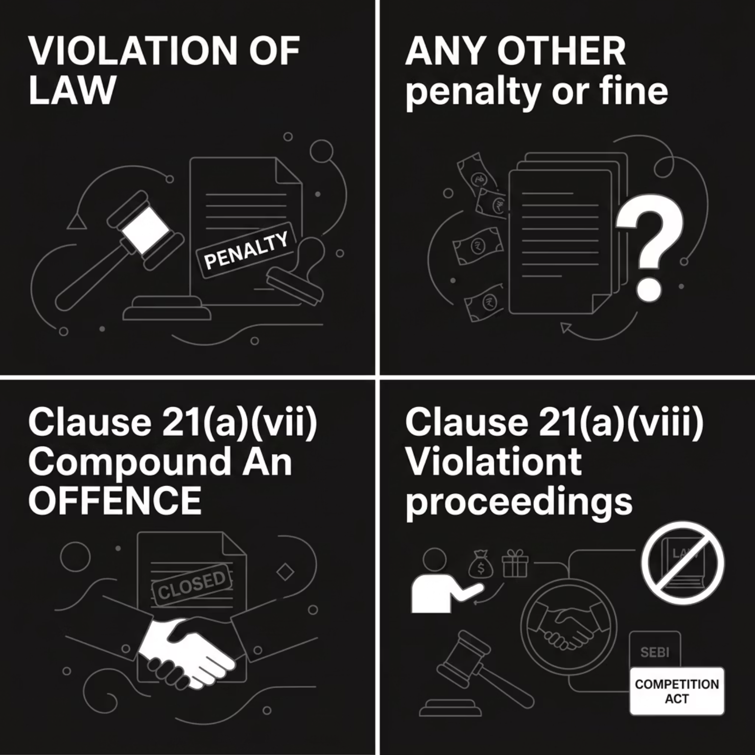
Clause 21(a)(vii), (viii) & (ix) — Specific Prohibited Expenditures
(vii) Compounding of Offences
(viii) Benefits/Perquisites Violating Law
Fees paid to compound offences under any law in India or outside India (e.g., Income-tax, FEMA, Company Law). Auditor may verify applications, payment evidence, and P&L entries.
Any benefit/perquisite (cash or kind) to a person where acceptance violates law/rule/guideline. Aligns with CBDT Circular 5/2012 and Apex Laboratories judgment on pharma freebies.
(ix) Settlement of Proceedings
This is inserted by Finance Act 2024. Covers settlements under SEBI Act, Securities Contracts Act, Depositories Act, and Competition Act.

Slide 105

Clause 21(b) — TDS Disallowances u/s 40(a)
1
40(a)(i) — Non-Resident Payments
100% disallowed if TDS not deducted or it is not paid by the due date of furnishing return.
2
40(a)(ia) — Resident Payments
30% disallowed if TDS not deducted or it is not paid by the due date of furnishing return.
Note : When TDS is deposited after the respective due date of furnishing return, the
inadmissible expense would be allowed as an expense in the previous year in
which it is paid.
3
40(a)(iia) — Wealth Tax
Not deductible. Wealth Tax Act is abolished w.e.f. 01.04.2016.

Slide 106
40(a)(iii) — Salary to Non-Resident
4
Disallowed if TDS is not deducted or it is not paid by the due date of furnishing return, on any salary
payable outside India.
Note : When TDS is deposited after the respective due date of furnishing return, the
inadmissible expense would not be allowed as an expense in the previous year in
which it is paid.
40(a)(iv) — Provident Fund
5
Any payments made are disallowed ,unless effective TDS arrangement exists on all taxable payments
made by the fund to the respective employee.
40(a)(v) — Employer Tax on Perquisites
Tax paid by employer on non-monetary perquisites which are exempt in the hands of employee u/s 10(10CC), are not deductible as expense in the hands of the employer.
Example :
Suppose ABC Ltd. provides the following to Mr. A:
Salary = ₹12,00,000
Rent-free accommodation (perquisite value) = ₹3,00,000
Assume the tax on the perquisite works out to ₹90,000.
Instead of recovering this tax from Mr. A, ABC Ltd. pays the ₹90,000 tax itself.
Tax Treatment
For Mr. A (Employee):
The ₹90,000 tax paid by the employer is exempt under Section 10(10CC).
Mr. A is not taxed on this tax payment.
For ABC Ltd. (Employer):
The ₹90,000 paid as tax cannot be claimed as a business expense. It is disallowed under Section 40(a)(v).
6

Slide 107

Clause 21(c) — Partner/Member Remuneration u/s 40(b)/40(ba)
Conditions for Allowability
Section 40(ba) — AOP/BOI
Remuneration paid to working partner(s) only
Authorised by and in accordance with partnership deed
Does not pertain to period prior to partnership deed
Any interest or remuneration paid by an AOP/BOI to its member is not allowable. Net interest disallowed where member has also paid interest to AOP/BOI.
Limits on Remuneration (Sec 40(b))
Auditor must obtain computation of total income and verify against partnership deed and supplementary documents.
Book Profit Slab
Up to AY 2024-25
From AY 2025-26
First slab / in case of loss
Upto Rs.3,00,000 90% of B.P. or Rs.1,50,000 {Higher}
Upto Rs.6,00,000 90% of B.P. or Rs.3,00,000 {Higher}
Balance book profit
60%
60%

Slide 108
Consideration for Computing Book Profit :
Step-1 : Net Profit of the firm as per Profit & Loss Account
Step-2 : Make Adjustment as per Section 28 to 44 of Income Tax Act, 1961
Step-3 : Add remuneration paid to partner (Debited to P&L)
Considerations for any Interest paid to Partner :
It can be paid to Working/ Non-Working Partner.
Authorized by and in accordance with partnership deed
Maximum Limit of 12% p.a.

Slide 109

Example:
M/s ABC & Co. (Partnership Firm)
Net Profit as per P&L A/c (after charging expenses): ₹12,00,000
Expenses debited:
• Remuneration to Working Partners – ₹4,00,000
• Interest on Capital to Partners @15% – ₹1,50,000
• Personal Expenses of Partner – ₹40,000
Partnership Deed permits: Interest @12% p.a. and remuneration as per Income-tax Act.
Solution:
Computation of Book Profit u/s 40(b):
Net Profit as per P&L A/c ₹ 12,00,000
Add: Remuneration to Partners ₹ 4,00,000
Add: Excess Interest to Partners ₹ 30,000
(15%-12%)
Add: Personal Expenses debited to P&L ₹40,000
Book Profit u/s 40(b) ₹16,70,000
Maximum Allowable Remuneration:
90% of first ₹6,00,000 ₹5,40,000
60% of balance ₹10,70,000 ₹6,42,000
Maximum Permissible Remuneration ₹11,82,000
Actual Remuneration Paid ₹4,00,000
Allowable Remuneration ₹4,00,000

Slide 110
QUESTION
A firm has a Book Profit of ₹8,40,000. What is the maximum allowable remuneration to working partners for AY 2026-27?
[A] Rs. 7,56,000
[B] Rs. 6,84,000
[C] Rs. 5,04,000
[D] Rs. 5,40,000

Slide 111
Clause 21(d) — Cash Payments u/s 40A(3) & 40A(3A)
General Limit
Goods Carriage
40A(3A) — Subsequent Payment
Rs.10,000 per person per day. Payment otherwise than by account payee cheque/draft/electronic mode — disallowed.
Higher limit of Rs.35,000 per person per day for plying, hiring, or leasing of goods carriages.
If liability was earlier allowed but payment made in cash exceeding limit subsequently, it is deemed as business income.
Rule 6DD provides exemptions (banking entities, Government payments, cottage industry, etc.).
Rule 6ABBA prescribes electronic modes: UPI, NEFT, RTGS, IMPS, Credit/Debit Card, Net Banking, BHIM.

Slide 112
Clauses 21(e)–(i) — Remaining Provisions
21(e) — Gratuity u/s 40A(7)
Provision for gratuity is not allowable. Only contributions to an approved gratuity fund and actual gratuity payable during the year are deductible.
21(f) — Employer Contributions u/s 40A(9)
Contributions to funds/trusts (other than recognised PF, approved superannuation, notified pension, approved gratuity) are not allowable when made in employer capacity.
21(g) — Contingent Liabilities
Only contingent liabilities debited to P&L (Which were disclosed as contingent liability in the Previous Year)
must be reported — not those disclosed in notes. The Tax Auditor is advised to refer AS-29/Ind AS 37.
21(h) — Section 14A Disallowance
Expenditure relating to exempt income (e.g, agricultural income) is inadmissible.
21(i) — Interest on Capital Borrowed u/s 36(1)(iii)
Interest on capital borrowed for asset acquisition is not allowable for the period from borrowing date until asset is put to use.

Slide 113

Clause 22: MSME Reporting under Form 3CD
Guidance Note on Tax Audit under Section 44AB — Classification, Provisions & Reporting Requirements

Slide 114
MSME Classification Criteria
Composite criteria of investment and annual turnover (MSME Notification S.O. 2119(E))
Criterion
Micro Enterprise
Small Enterprise
Medium Enterprise
Investment in Plant & Machinery (1.7.2020 – 31.3.2025)
≤ ₹1 Crore
≤ ₹10 Crore
≤ ₹50 Crore
Annual Turnover (1.7.2020 – 31.3.2025)
≤ ₹5 Crore
≤ ₹50 Crore
≤ ₹250 Crore
Investment in Plant & Machinery (w.e.f. 1.4.2025)
≤ ₹2.50 Crore
≤ ₹25 Crore
≤ ₹125 Crore
Annual Turnover (w.e.f. 1.4.2025)
≤ ₹10 Crore
≤ ₹100 Crore
≤ ₹500 Crore
Classification based on Udyam Registration Certificate.

Slide 115

KEY PROVISIONS
Sections 15, 16 & 23 — MSMED Act
Section 15 — Payment Obligation
Buyer must pay on agreed date (in writing) or Appointed Day. Agreed period must not exceed 45 days from acceptance/deemed acceptance.
Section 16 — Interest on Delay
On default, buyer pays compound interest with monthly rests at 3× bank rate (RBI), overriding any agreement.
Section 23 — Disallowance
Interest under this Act is not deductible under Income-tax Act, 1961.

Slide 116
DEFINITIONS
Relevant Definitions — MSMED Act (Part I)
Section
Term
Definition
2(d)
Buyer
Whoever buys goods or receives services from a supplier for consideration.
2(n)
Supplier
A registered micro or small enterprise includes NSIC, SIDC, companies/co-ops engaged in selling MSME goods/services.
2(b)
Appointed Day
Day following expiry of 15 days from acceptance/deemed acceptance. If written objection within 15 days, runs from date objection is removed.

Slide 117
QUESTION
If a buyer delays payment to an MSME supplier, interest is payable at:
[B] 3 times RBI Bank Rate
with simple interest
[A] 2 times RBI Bank Rate
[C] 3 Times of RBI Bank Rate
with monthly compounded
interest
[D] 12% per annum

Slide 118


REPORTING
Clause 22(i) — Reporting Inadmissible Interest
What to Report
Interest paid or payable u/s 16, debited to P&L — inadmissible u/s 23.
Auditor's Steps
Obtain list of registered MSME suppliers.
Identify delayed payments beyond Section 15 limits.
Verify interest calculations; cross-check with Section 22 disclosures & Form MSME-1
Confirm only P&L-debited interest is reported
If no interest provided/paid → i.e. reported NIL.
+
Mercantile basis is followed : Non-provision may require Form 3CB qualification.

Slide 119

REPORTING
Clauses 22(ii) & 22(iii)(a)/(b) — Payment Reporting
22(ii) — Total Payable
22(iii)(a) — Paid Within Time
22(iii)(b) — Inadmissible Amount
Total amount payable to micro/small enterprises during the year (incl. amounts not claimed as deduction), whether paid or outstanding.
Payments from 22(ii) settled within Section 15 time limit (agreed period or 45 days; or Appointed Day if no agreement).
Amounts:
claimed as deduction;
outstanding at year-end;
unpaid beyond Section 15 limit.
Inadmissible amount u/s 22(iii)(b) becomes opening balance for Clause 26(A) in subsequent year.

Slide 120

Clause 23: Particulars of Payments to Persons under Section 40A(2)(b)
Section 40A(2)(b) of the Income-tax Act, 1961 empowers the Assessing Officer to disallow excessive or unreasonable payments made to specified persons having a close relationship with the assessee. This clause requires the tax auditor to examine and report all such payments in Form 3CA/3CB.
CLAUSE 23
SECTION 40A(2)(B)

Slide 121
Persons Covered under Section 40A(2)(b)
The section covers six categories of specified persons:
1
Individual Assessee's Relative
Any relative of the assessee as defined u/s 2(41) of the Income-tax Act, 1961.
Company / Firm / AOP / HUF
2
Any director, partner, or member of the entity, or any relative of such director, partner, or member.
3
Person with Substantial Interest
Any individual with substantial interest in the assessee's business or profession, or any relative of such individual.
Entity with Substantial Interest
4
Company, firm, AOP, or HUF having substantial interest, or any director, partner, member, or relative thereof, or any company in which the first company has substantial interest.
Entity Linked via Director / Partner
5
Entity where a director, partner, or member has substantial interest in the assessee's business, or any director,
partner, member,or relative of such person.
Business Carried by Related Person
6
Any person carrying on business where the assessee (individual or entity) or their relative/director/partner/member has substantial interest in that person's business.

Slide 122
Explanation: Substantial Interest & AO's Power
Definition of Substantial Interest
Assessing Officer's Power
For purposes of this sub-section, a person is deemed to have substantial interest if:
The section enjoins on the Assessing Officer the power to fix the quantum of disallowance where payments to specified persons are deemed excessive or unreasonable having regard to fair market value.
Under this clause, the particulars of all payments made to persons covered under section 40A(2)(b) must be examined and reported by the tax auditor.
Company: Beneficial owner of shares (not fixed dividend shares) carrying not less than 20% of voting power at any time during the previous year.
Any other case: Beneficially entitled to not less than 20% of profits of such business or profession at any time during the previous year.

Slide 123
Audit Procedures for Clause 23
The tax auditor should undertake the following steps:
Obtain Full List of Specified Persons
Obtain Details of Payments
1
Cross-verify assessee's information from members register, list of directors, register of concerns, etc.
2
Obtain complete details of all payments made to the specified persons during the previous year.
Localise Area of Enquiry
As it may be difficult to locate all such payments, localise enquiry by:
Calling for all contracts/agreements and segregating payments to specified persons;
Scrutinizing appropriate ledger accounts for credit purchases/expenses;
Refer to AS-18 / IND-AS-24 related party disclosures
Scrutinise All Payment Items
3
Scrutinise all items of payments to the above persons for reasonableness.
4

Slide 124

Working Papers Format for Clause 23
It is recommended that the tax auditor maintains the following information in working papers in the format provided in the e-filing utility:
Sr. No.
Name of Related Person
PAN of Related Person
Aadhaar Number (if available)
Relation
Nature of Transaction & Date
Payment Made (₹)
1
—
—
—
—
—
—
2
—
—
—
—
—
—
3
—
—
—
—
—
—
4
—
—
—
—
—
—
5
—
—
—
—
—
—
6
—
—
—
—
—
—
7
—
—
—
—
—
—
Note: The tax auditor should ensure all payments to persons specified under section 40A(2)(b) are captured. Where reliance is placed on assessee's information, an appropriate disclosure should be made in the tax audit report.

Slide 125
QUESTION
Which of the following details is NOT specifically required in the working paper format for Clause 23?
[B] Aadhaar number
(if available)
[A] PAN of related person
[C] Nature of transaction
and date
[D] Market value of goods purchased

Slide 126
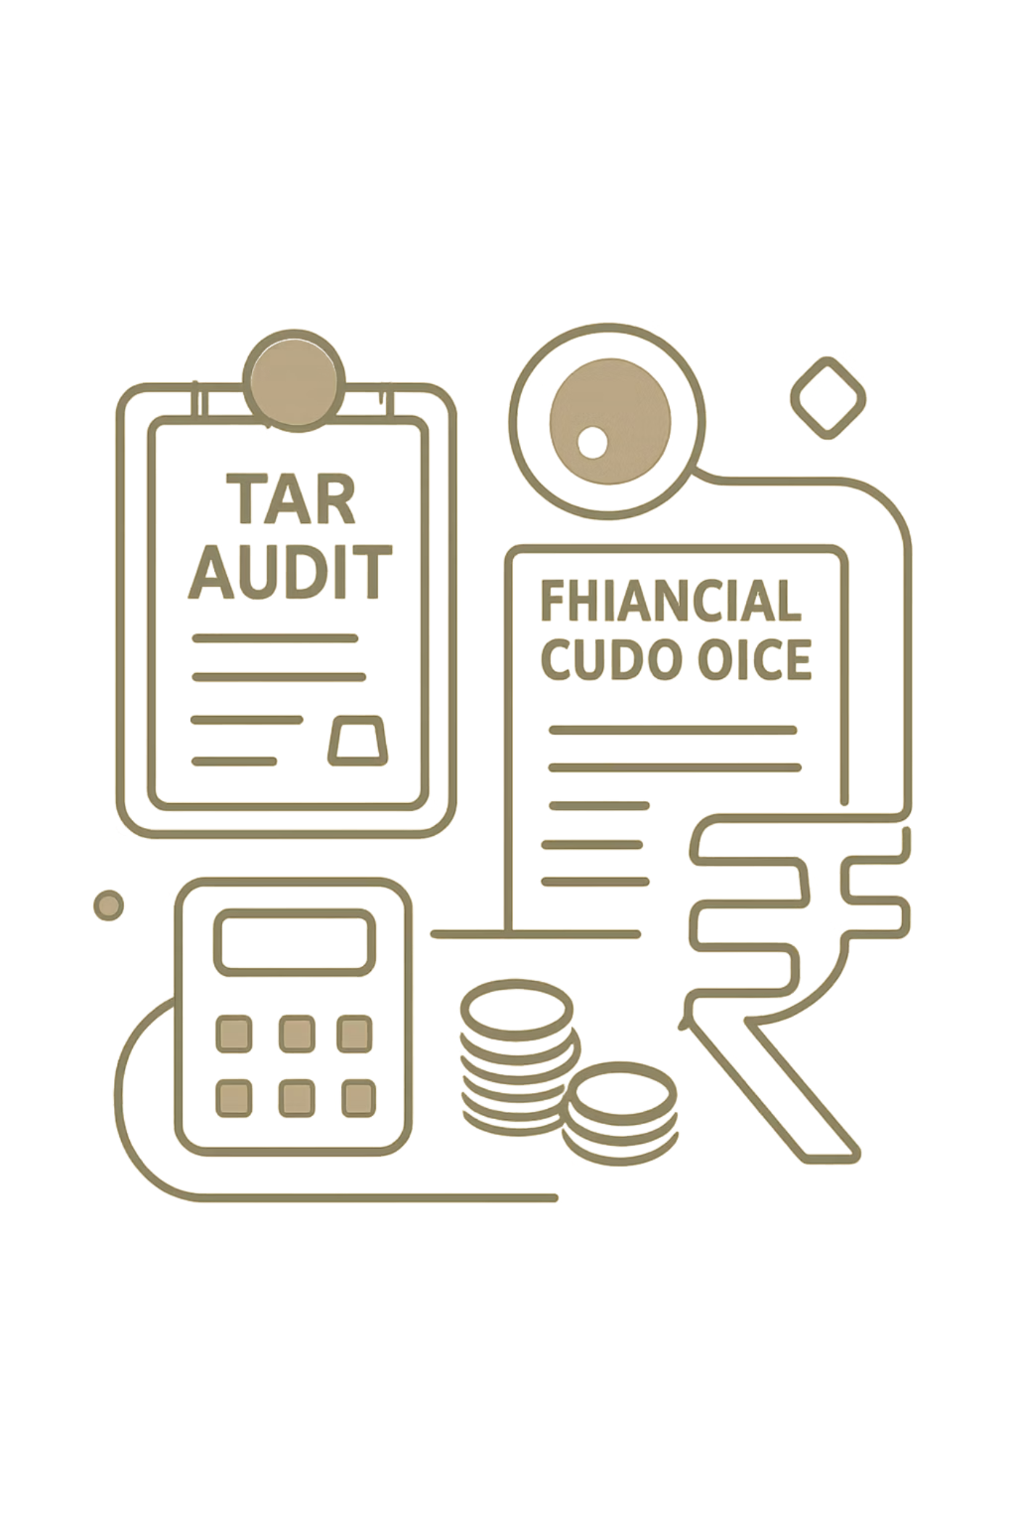
Clause 24 - Deemed Profits & Gains
Disclosure of amounts deemed chargeable as business income under Sections 32AC, 32AD, 33AB, 33ABA & 33AC. Tax auditors must verify compliance and report deemed income per the e-filing utility format.

Slide 127

Investment Incentives: Sections 32AC & 32AD
Section 32AC — New Plant & Machinery
15% deduction for companies engaged in manufacturing.
Investment window: 1 Apr 2013 – 31 Mar 2015.
Aggregate cost must exceed ₹100 crore.
Lock-In-Period : 5 Years from the date of Acquisition.
Example: A company investing ₹120 Cr in new machinery (2014) claims ₹18 Cr deduction. Non-compliance triggers deemed income.
Section 32AD — Backward Areas
15% deduction for new plant/machinery
Location : Notified Backward areas of Andhra Pradesh, Bihar, Telangana, West Bengal.
Investment window: 1 Apr 2015 – 31 Mar 2020.
Lock-In-Period : 5 Years from the date of Acquisition.
Example: An enterprise setting up a factory in rural Bihar (2017) invests ₹50 Cr and claims ₹7.5 Cr deduction.

Slide 128
QUESTION
A manufacturing company invested ₹150 crore in new plant & machinery during FY 2014-15 and claimed deduction under Section 32AC.
Subsequently, one of the qualifying assets was sold within the
prescribed lock-in period. What is the likely tax consequence?
[A] No consequence since
deduction was already
allowed.
[B] Deduction claimed earlier
may be treated as deemed
income.
[C] Only depreciation will be withdrawn.
[D] Capital gains alone will
arise.

Slide 129
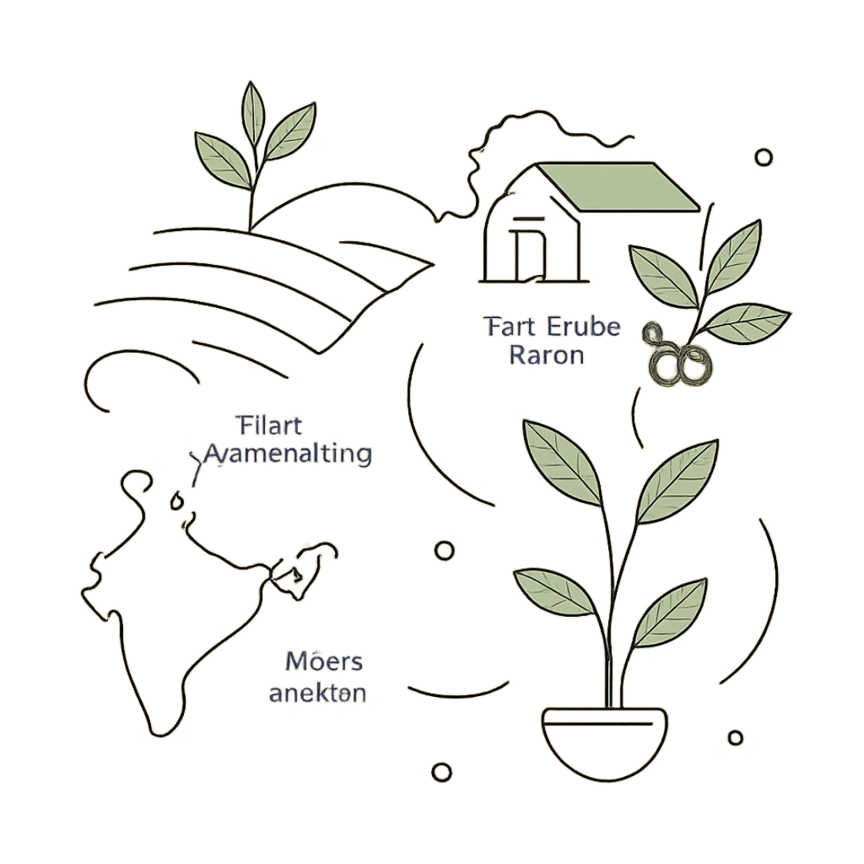
Development Accounts & Restoration Fund: Sections 33AB & 33ABA
Section 33AB — Development Accounts
Section 33ABA — Site Restoration Fund
Deduction for deposit of amount in Tea, Coffee & Rubber Development Accounts. In case of withdrawal, for any non-approved purpose, the amount so withdrawn would be treated as deemed income under sub-sections (4), (5), (7) & (8) must be reported.
Example: A tea company deposits profits into its Tea Development Account. Withdrawal for non-approved purposes triggers deemed income.
Deduction for contributions to Site Restoration Fund. Deemed income under sub-sections (5), (7) & (8) must be reported. Interest credited or withdrawals for unapproved purposes are taxable.
Example: An oil company claims deduction for Site Restoration Fund but uses funds for unrelated purposes — deemed business income.

Slide 130


Shipping Reserve & Auditor's Working Papers
Section 33AC — Shipping Business Reserve
Deduction for reserves created out of shipping profits, utilized per sub-section (2). Deemed income under sub-sections (3) & (4) for reserves must be reported.
Example: A shipping company creates a reserve from profits. If withdrawn for non-approved purposes, it becomes deemed business income.
Auditor's Working Papers Format
Section
Description
Amount
Remarks
32AC / 32AD / 33AB / 33ABA / 33AC
Nature of deemed income
₹ Value
Reference to triggering transaction(s)

Slide 131
TAX AUDIT
Clause-by-Clause Analysis
Clauses 25 to 31 | Form 3CD
Section 44AB of the Income-tax Act, 1961
Section 43B
CENVAT Credit
Prior Period Items
Section 56(2)
Section 269SS/ST/T
Hundi Loans
ICAI Guidance Note (Revised 2025)

Slide 132
Overview: Clauses 25 to 31 at a Glance
Index
Clause 26
Statutory dues & deferred liabilities – payment basis deduction
Clause 30
Hundi borrowings repaid otherwise than by account payee cheque
[Sec 43B]
[Sec 69D]
Clause 27(a)
CENVAT/ITC credits availed or utilised during the year
Clause 30A
Primary TP adjustments and secondary adjustments reporting
[CENVAT]
[Sec 92CE]
Clause 27(b)
Prior period income or expenditure in P&L account
Clause 30B
Thin capitalisation – interest limitation rules
[AS-5/IND AS 8]
[Sec 94B]
Clause 29A
Forfeiture of advance received on transfer of capital asset
Clause 30C
Impermissible Avoidance Arrangements (GAAR)
[Sec 56(2)(ix)]
[Sec 96]
Clause 29B
Receipt of money/property without adequate consideration
Clause 31
Loans, deposits, specified sums & repayments
[Sec 56(2)(x)]
[Sec 269SS/ST/T]
Tax Audit under Section 44AB | ICAI Guidance Note (Revised 2025)

Slide 133
Clause 25 | Section 41 — Profits Chargeable to Tax
Clause 25
Any amount chargeable to tax u/s 41 — where deduction was allowed in prior years and later recovered/remitted — taxable as Business Income
§ 41(1) | Loss / Expense Recovery
§ 41(2) | Power Sector Assets
§ 41(3) | Scientific Research Assets
§ 41(4) / (4A) | Bad Debt / Special Reserve
Deduction allowed in prior year for loss/exp/trading liability
Assessee obtains benefit or remission of liability subsequently
Amount of benefit / value of remission = Business Income
Applies to generation / distribution of power undertakings
SLM depreciation on individual assets — not block basis
Excess of Sale+Scrap over WDV (≤ Cost − WDV) = taxable
Capital asset used in scientific research (dedn. u/s 35) sold
NOT used for any other business purpose before sale
Lower of: Sale Proceeds OR Deduction allowed u/s 35
Bad debt allowed u/s 36(1)(vii) — excess recovery over (Debt−Dedn.) taxable
41(4A): Amount withdrawn from special reserve u/s 36(1)(viii) taxable
Obtain a complete list of all amounts chargeable u/s 41 with supporting evidence, correspondence, etc.
Examine past records to verify correctness of information provided by the assessee.
Report amount chargeable u/s 41 irrespective of whether it is credited to P&L account or not.
If any trading liability written back is already offered to tax in a prior period — do NOT tax it again.
Check whether amounts written back re: remission/cessation of trading liability are credited to P&L.
If amount u/s 41 is NOT routed through P&L / Income & Expenditure account — include this fact in the Observation Para of the audit report.
✦ Tax Auditor's Duties — Clause 25
✦ Working Paper Format (e-Filing Utility)
Maintain the following in working papers for furnishing details in the e-filing utility format:
Sr. No. | Name of Person | Amount of Income | Section | Description of Transaction | Computation if any
1 | 2 | 3 | 4 | 5 | 6
Tax Audit under Section 44AB | ICAI Guidance Note (Revised 2025) | Clause 25 — Section 41

Slide 134
Clause 26 | Sec 43B – All Specified Payments: Clauses (a) to (h)
Clause 26
Section 43B: Deduction allowable only on ACTUAL PAYMENT — irrespective of accounting method (mercantile or cash basis)
(a)
Taxes, Duties, Cess & Fee
(e)
Interest — Scheduled Bank / Co-operative Bank
Any tax (GST, sales tax, VAT, service tax, excise duty, municipal/property tax, etc.), duty, cess or fee by whatever name called, payable under any law — EXCLUDING Income-tax, TDS and TCS
Interest on any loan or advances from a Scheduled Bank or Co-operative Bank (other than Primary Agricultural Credit Society or Primary Co-operative Agricultural and Rural Development Bank) — per agreement terms
(b)
Employer Contributions to Welfare Funds
(f)
Leave Encashment / Leave Salary
Any sum payable as employer by way of contribution to any Provident Fund, Superannuation Fund, Gratuity Fund or any other fund for the welfare of employees
Any sum payable by the assessee as an employer in lieu of any leave at the credit of his employee
(c)
Bonus or Commission to Employees
(g)
Payments to Indian Railways for Use of Railway Assets
Any bonus or commission payable to employees for services rendered — where such sum would not have been payable as profits or dividend if not paid as bonus/commission
Any sum payable to Indian Railways for USE of railway assets (e.g., hire of wagons/rail sidings, lease of railway land or buildings) — does NOT include basic rail freight for transport services
(d)
Interest — Public Financial Institutions / SFC / SIIC
(h)
Dues to Micro or Small Enterprises (MSME)
Interest on any loan or borrowing from any Public Financial Institution, a State Financial Corporation or a State Industrial Investment Corporation — payable per agreement terms
Any sum payable to a Micro or Small Enterprise beyond the time limit specified in Section 15 of the MSMED Act, 2006. No proviso for payment up to ITR due date — must be paid within the MSMED Act's prescribed limit
(da)
Interest — Notified NBFCs
Interest on any loan or borrowing from such class of Non-Banking Financial Companies (NBFCs) as may be notified by the Central Government — payable per agreement terms
Tax Audit under Section 44AB | ICAI Guidance Note (Revised 2025)

Slide 135
Clause 26 | Section 43B(h) – MSME Dues & Reporting Structure
Clause 26
NEW: Clause (h) of Section 43B – Amounts payable to Micro & Small Enterprises (MSMEs) beyond the time limit under Section 15 of the MSMED Act, 2006 are disallowed unless paid within that period.
26(A)(a) ✓
26(A)(b) ✗
Pre-existing liability (as on 1st day of PY) → PAID during PY
Pre-existing liability (as on 1st day of PY) → NOT PAID during PY
26(B)(a) ✓
26(B)(b) ✗
Liability incurred in PY [clauses (a)-(g)] → Paid on/before due date u/s 139(1)
Liability incurred in PY [clauses (a)-(g)] → NOT paid on/before due date u/s 139(1)
Tax Audit under Section 44AB | ICAI Guidance Note (Revised 2025)

Slide 136
Clause 26 | Practical Example – Section 43B Reporting
Example
Scenario: ABC Ltd – FY 2024-25 (PY), Due date for ROI: 31 Oct 2025
Particulars | Amount | Paid By | Clause | Treatment
GST payable (Mar-25) – unpaid as on 31/3/25 | ₹3,00,000 | Paid in Sep 2025 (before due date) | 26(B)(a) | ALLOWED
ESIC (FY 2024-25) – accrued | ₹80,000 | Paid on 15 Nov 2025 (after due date) | 26(B)(b) | DISALLOWED
Outstanding PF from FY 2023-24 (pre-existing) | ₹50,000 | Paid in Dec 2024 during PY | 26(A)(a) | ALLOWED
Bonus (FY 2024-25) accrued but unpaid | ₹1,20,000 | Not paid till due date | 26(B)(b) | DISALLOWED
MSME Vendor (clause h) – overdue beyond 45 days | ₹2,00,000 | Not paid during PY | 26(A)(b) or NIL | DISALLOWED
Auditor must verify payment evidence: bank statements, challans, and subsequent year records.
Tax Audit under Section 44AB | ICAI Guidance Note (Revised 2025)

Slide 137
Clause 26 | Section 43B – Key Judicial Rulings
Clause 26
Supreme Court
Bank guarantee ≠ actual payment. Bottling fees under Excise Act are not taxes – fall outside Section 43B.
CIT v. McDowell & Co Ltd (2009)
Supreme Court
Excise/customs duty paid in a year is fully deductible, irrespective of amount included in closing stock valuation.
Berger Paints India v. CIT (2004)
Supreme Court
Advance deposit of duty also qualifies as 'actual payment' under Section 43B – eligible for deduction.
CIT v. Modipon Ltd (2017)
CBDT Circular
Conversion of interest into loan/debenture does not constitute actual payment. Deduction allowed only when converted interest is actually paid.
Circular No. 7/2006 – Interest Conversion
Finance Act, 2021
Employee contributions (e.g., PF deducted from salary) – delay beyond due date = PERMANENT disallowance even if paid later.
Explanation 5 to Section 43B
Tax Audit under Section 44AB | ICAI Guidance Note (Revised 2025)

Slide 138
Clause 26 | Tax Auditor's Verification Checklist
Clause 26
Before signing the Tax Audit Report, verify each of the following:
Obtain list of all Section 43B items debited to P&L – taxes, PF/ESI/gratuity, bonus, interest on borrowings, leave encashment, MSME dues
Verify whether liabilities are pre-existing (from 1st day of PY) or freshly incurred during the year
Check payment challans, bank statements for ALL payments; verify dates against due date of ITR filing u/s 139(1)
For MSME dues (clause h): verify payment within 15/45 days as per MSMED Act, cross-check with Clause 22(iii)(b)
Examine subsequent year books (up to date of signing audit report) for payments made after year-end
Verify that employee-deducted contributions (PF, ESIC) are paid by due date – permanent disallowance if late (post Finance Act 2021)
Ensure GST under Reverse Charge Mechanism (RCM) – if booked but unpaid before due date → report under this clause
For interest converted into loan/debenture: deduction allowed only when actually paid (Circular No. 7/2006)
Obtain and maintain working paper in prescribed format (Sr. No., Section, Nature of liability, Amount)
Tax Audit under Section 44AB | ICAI Guidance Note (Revised 2025)

Slide 139
MCQ 1 | Clause 26 – Section 43B
Q. Under Section 43B, deduction for statutory dues is allowable on which basis?
(A) Accrual basis only
(B) Actual payment basis
(C) Either accrual or cash basis
(D) At discretion of the assessee
Tax Audit under Section 44AB | ICAI Guidance Note (Revised 2025)

Slide 140
Clause 27(a) | CENVAT / Input Tax Credit – Reporting
Clause 27(a)
Requires factual disclosure of CENVAT/ITC availed, utilised, and outstanding balance – and their accounting treatment in the P&L account.
Key Reporting Requirements
Working Paper Format
Report CENVAT/ITC credits availed during the year
Report credits utilised for payment of duty liability
Disclose treatment in P&L (exclusive vs. inclusive method)
Report opening and closing CENVAT credit balances separately
Reconcile CENVAT ledger with statutory records (GSTR-2B/CENVAT Rules)
Post-GST (from 1 July 2017): CENVAT applicable only for 6 products – petroleum crude, diesel, petrol, ATF, natural gas, tobacco
Particulars | CENVAT Amt (₹)
Opening Balance
CENVAT Availed
CENVAT Utilised
Closing / Outstanding Balance
Note: Dept. e-filing utility refers to 'ITC' – verify whether it matches your assessee's applicable regime (CENVAT vs. GST ITC).
Tax Audit under Section 44AB | ICAI Guidance Note (Revised 2025)

Slide 141
Clause 27(b) | Prior Period Income / Expenditure in P&L
Clause 27(b)
Applicability: Only under Mercantile System of accounting. Under cash system, all items are of current year even if relating to prior periods.
IMPORTANT POINTS FOR AUDITOR
Tax Auditor should scrutinise the ledger for prior period debit/credit entries in P&L accounts
There is a difference between expenditure of any earlier year debited to the profit and loss account and the expenditure relating to any earlier year, which has crystallised during the relevant year. Material adjustments necessitated by circumstances which though related to previous periods but determined in the current period, will not be considered as prior period items.
If assessee treated an item as current year expense but auditor concludes it's a prior period item → examine correct disclosure
In AS – 5/ Ind AS 8, it has been explained that material charges (expenses) or credits (income) which arise in the current year as a result of errors or omissions in the accounts of the earlier years will be considered as prior period items/prior period errors.
Tax Audit under Section 44AB | ICAI Guidance Note (Revised 2025)

Slide 142
Clause 29A | Section 56(2)(ix) – Forfeiture of Advance on Capital Asset
Clause 29A
This clause requires disclosure of whether any amount is chargeable to tax under section 56(2)(ix). Section 56(2)(ix) provides for taxability as Income from Other Sources of any sum of money received as an advance or otherwise in the course of negotiations for transfer of a capital asset, if such sum is forfeited and the negotiations do not result in transfer of such capital asset.
What to Report
What NOT to Report
Advance received in course of negotiation for capital asset transfer
Advance which has been forfeited by the assessee
Negotiation did NOT result in transfer
Applicable: assets recorded in business books
Advance on personal capital asset not in business books
Forfeiture of advance on sale of stock-in-trade (taxable u/s 28(i))
Advance outstanding for long time / time-barred but not yet forfeited
Mere write-back without actual forfeiture act
Tax Audit under Section 44AB | ICAI Guidance Note (Revised 2025)

Slide 143
Clause 29B | Section 56(2)(x) – Receipt Without Consideration or Without Adequate Consideration.
Clause 29B
Taxable as Income from Other Sources when received without consideration or for inadequate consideration:
Money
Without consideration: If aggregate money is more than 50,000 then whole of money shall be taxable.
Threshold: > ₹50,000
Immovable Property
Without consideration: full stamp duty value taxable. For consideration: excess of stamp duty value over consideration (if > higher of ₹50,000 or 10% of consideration)
Threshold: > ₹50,000 (stamp duty value)
Other Property
(Shares, Jewellery, Art etc.)
Without consideration: full FMV. For consideration: excess FMV over consideration, if > ₹50,000
Threshold: > ₹50,000 FMV
Note: 'Property' includes land/building, shares/securities, jewellery, art, bullion. Excludes stock-in-trade. FMV per Rules 11U & 11UA.
Tax Audit under Section 44AB | ICAI Guidance Note (Revised 2025)

Slide 144
Clause 29B | Section 56(2)(x) – Key Exemptions
Clause 29B
The following receipts are EXEMPT from Section 56(2)(x) and need NOT be reported:
I
From any RELATIVE (as defined)
VI
From any Fund/Foundation/University/Hospital/Trust u/s 10(23C)
II
On the occasion of MARRIAGE of the individual
VII
From Trust/Institution registered u/s 12A, 12AA or 12AB
III
Under a WILL or by way of INHERITANCE
VIII
By way of transaction NOT regarded as transfer under section 47
IV
In CONTEMPLATION OF DEATH of the payer/donor
IX
From an individual by a trust created or established solely for the benefit of relative of the individual.
V
From any LOCAL AUTHORITY [Explanation to s.10(20)]
X
Tax Audit under Section 44AB | ICAI Guidance Note (Revised 2025)

Slide 145
MCQ 2 | Clause 29B – Section 56(2)(x)
Q. Under Section 56(2)(x), receipt of money without consideration is taxable if aggregate exceeds:
(A) ₹25,000
(B) ₹50,000
(C) ₹1,00,000
(D) ₹2,00,000
Tax Audit under Section 44AB | ICAI Guidance Note (Revised 2025)

Slide 146
Clause 30 | Section 69D – Hundi Borrowings
Clause 30
Section 69D: Any amount borrowed on hundi or any amount due thereon (including interest) repaid otherwise than through an account payee cheque shall be deemed as income of the borrower in that year.
Details of the amount borrowed on hundi (including interest on such amount borrowed) and details of repayment of such borrowings otherwise than by an account payee cheque, are required to be indicated under this clause.
Tax auditor must obtain complete list of hundi borrowings and repayments from the assessee
Verify each transaction with books of account, hundi documents, and payment instruments
Repayment by account payee cheque is the ONLY allowed mode – any other mode attracts Section 69D
If satisfactory evidence is not available, obtain management representation/certificate
Circulars No. 208 (Nov 1976) and No. 221 (Jun 1977) provide CBDT guidance on Section 69D
Working Paper: Key Fields to Maintain
Name / Address | PAN (if available) | Amount Borrowed | Date of Borrowing | Amount Repaid | Date of Repayment
ABC Traders, Jaipur | AAAPX1234Z | ₹5,00,000 | 15 Apr 2024 | ₹5,00,000 | 12 Oct 2024
Tax Audit under Section 44AB | ICAI Guidance Note (Revised 2025)

Slide 147
MCQ 3 | Clause 30 – Section 69D (Hundi)
Q. Under Section 69D, repayment of a hundi loan by which mode is permitted to avoid it being treated as income?
(A) Cash payment
(B) Account payee cheque
(C) Journal entry
(D) Non-account payee cheque
Tax Audit under Section 44AB | ICAI Guidance Note (Revised 2025)

Slide 148
Clause 30A | Section 92CE – Transfer Pricing: Primary & Secondary Adjustments
Clause 30A
When a Primary TP Adjustment is made, Secondary Adjustment under Section 92CE requires treating the excess money as a notional advance to the AE, attracting imputed interest.
Five Triggers for Reporting under Clause 30A:
Key Thresholds & Rates
1
Assessee's own voluntary TP adjustment in return of income
No Secondary Adjustment if:
Primary adj. ≤ ₹1 crore OR relates to AY ≤ 2016-17
2
AO-made adjustment accepted by the assessee
Repatriation Time Limit:
90 days from specified trigger dates (Rule 10CB)
3
Advance Pricing Agreement (APA) entered on/after 1 April 2017
Interest – INR transactions:
1-yr SBI MCLR + 325 bps (3.25%)
4
Safe Harbour Rules (Section 92CB)
Interest – Foreign currency:
6-month SOFR/ARR + 300 bps (LIBOR discontinued Dec 2021/Jun 2023)
5
Mutual Agreement Procedure (MAP) under DTAA (Section 90/90A)
Alternative option:
Pay 18% additional income-tax on excess money not repatriated [Sec 92CE(2A)]
Tax Audit under Section 44AB | ICAI Guidance Note (Revised 2025)

Slide 149
Clause 30B | Section 94B – Thin Capitalisation / Interest Limitation
Clause 30B
Applicable to: Indian companies / Permanent Establishment of foreign companies. Interest paid to Non-Resident AE > ₹1 crore. Excess interest (over 30% of EBITDA) is disallowed.
Disallowed Interest = Lower of:
(i) Total interest to NR AE in excess of 30% of EBITDA (as per final standalone audited accounts) OR (ii) Interest paid/payable to AEs for that PY
Disallowed amount can be carried forward for up to 8 assessment years.
Threshold: Section 94B not triggered if NR AE interest ≤ ₹1 crore
Excluded entities: Banking, Insurance, notified NBFCs, Finance companies in IFSC (w.e.f. AY 2025-26)
EBITDA: As per final audited standalone accounts – NOT as adjusted for income-tax computation
Negative EBITDA: Treat as Nil – entire AE interest becomes disallowable
Debt includes: loans, financial instruments, finance leases, derivatives, discounts or other finance charges
Carried-forward excess interest: Verify from prior year computation – max 8 AYs following year of disallowance
Tax Audit under Section 44AB | ICAI Guidance Note (Revised 2025)

Slide 150
CLAUSE 30C | SECTION 96 — GENERAL ANTI AVOIDANCE RULES (GAAR) & IMPERMISSIBLE AVOIDANCE ARRANGEMENT (IAA)
WHAT IS GAAR?
WHAT IS AN IMPERMISSIBLE AVOIDANCE ARRANGEMENT (IAA)?
General Anti-Avoidance Rules under Chapter X-A (Sections 95–102); procedural provisions in Section 144BA; Rules 10U to 10UF
An arrangement is to be treated as an IAA, if its main purpose is to obtain tax benefit (“Main Purpose” Test) and it satisfies any one or more of the four tests (“Additional Tests”) specified in Section 96.
Objective: Target ABUSIVE transactions entered with MAIN OBJECT of avoiding taxes '
FOUR ADDITIONAL TESTS (Satisfy ANY ONE) — Section 96(1)
Test 1 — Abnormal Rights
Test 2 — Misuse / Abuse
1
2
Looks at REAL INTENT & EFFECT of transactions, irrespective of legal structure superimposed to camouflage purpose
Test 3 — Lacks Substance
Test 4 — Abnormal Manner
Carried out by means or in a manner NOT ordinarily employed for BONA FIDE purposes [Sec. 96(1)(d)]
Arrangements entered PRIOR TO 01 April 2017 are EXCLUDED from GAAR
Creates rights or obligations NOT ordinarily created between persons dealing at arm's length [Sec. 96(1)(a)]
Results, directly or indirectly, in misuse or ABUSE of provisions of the Income-tax Act [Sec. 96(1)(b)]
Lacks COMMERCIAL SUBSTANCE
Triggered only when arrangement is declared as IAA by Pr. CIT / CIT / Approving Panel under Section 144BA
\
Section 96(2): If main purpose of a STEP in the arrangement is to obtain tax benefit → the entire arrangement is PRESUMED to be entered for obtaining tax benefit, unless assessee proves to the contrary.

Slide 151
CLAUSE 30C | WHEN GAAR IS NOT APPLICABLE & AUDITOR'S REPORTING APPROACH
WHEN GAAR IS NOT APPLICABLE [Rule 10U]
AUDITOR'S REPORTING APPROACH [Form 3CD]
1
Tax Benefit < ₹3 Crore
WHAT TO REPORT UNDER CLAUSE 30C
GAAR not applicable if aggregate tax benefit to ALL PARTIES to the arrangement in the relevant A.Y. does not exceed ₹3 Crore. (Interest and penalty not included in computing tax benefit — Rule 10U(1)(a))
30C(a)
Yes / No — Whether assessee entered into an IAA as referred to in Section 96 during the previous year
Foreign Institutional Investor (FII)
30C(b)(i)
Nature of the Impermissible Avoidance Arrangement — describe the arrangement specifically
2
Not applicable to an FII that has NOT availed any tax treaty benefit and has invested in listed/unlisted securities with prior permission of competent authority per SEBI (FII) Regulations, 1995 — Rule 10U(1)(b)
30C(b)(ii)
Amount (₹) of TAX BENEFIT arising in the previous year in AGGREGATE to ALL parties to the arrangement
3
Non-Resident via Offshore Derivatives
AUDITOR'S EXAMINATION STEPS
Not applicable to a non-resident investing by way of offshore derivative instruments (or otherwise) in FIIs — Rule 10U(1)(c)
Check if PCIT/CIT/Approving Panel previously declared any arrangement as IAA — if YES and transactions continue in current year → REPORT
4
Pre-01 April 2017 Investments
Check if any reference for declaring arrangement as IAA is pending — if transactions in current year → REPORT with note
Not applicable to income accruing from transfer of investments made PRIOR TO 01.04.2017. However, tax benefit obtained from such arrangement AFTER 01.04.2017 is still covered — Rule 10U(1)(d) & 10U(2)
Examine responses given to show cause notices and status of appeals by the assessee
Obtain management representation on existence of any impermissible avoidance arrangement

Slide 152
Clause 31 | Overview: Sections 269SS, 269ST & 269T
Clause 31
Sec 269SS
Taking/Accepting Loans & Deposits
Limit: ₹20,000
No person shall accept loan, deposit or specified sum ≥ ₹20,000 other than by account payee cheque / bank draft / any other electronic mode.
An exception is provided for deposit accepted by / loan taken from Primary Agricultural Credit Societies (“PACS”) and Primary Co-Operative Agricultural and Rural Development Bank (“PCARD”). In such cases, a higher limit of Rs. 2 lakhs would be applicable.
[Cl 31(a) & 31(b)]
Sec 269ST
Receiving Cash Payments
Limit: ₹2,00,000
No person shall receive ₹2 lakh or more in aggregate from a person in a day/ in respect of a single transaction / in respect of transactions relating to one event or occasion from a person otherwise than through banking channels.
[Cl 31(ba)–(bd)]
Sec 269T
Repayment of Loans & Deposits
Limit: ₹20,000
Section 269T prohibits repayment of loans, deposits, or specified advances of ₹20,000 or more otherwise than through prescribed banking channels.
An exception is provided for repayment by Primary Agricultural Credit Societies (“PACS”) and Primary Co-Operative Agricultural and Rural Development Bank (“PCARD”) by raising the amount to Rs 2,00,000 applicable w.e.f. 1st April 2023.
[Cl 31(c)–(e)]
Tax Audit under Section 44AB | ICAI Guidance Note (Revised 2025)

Slide 153
Clause 31(a) | Section 269SS – Loan, Deposit & Specified Sum
Cl 31(a)
This clause seeks certain particulars of each loan or deposit in an amount exceeding the limit specified in section 269SS taken or accepted during the previous year.
Clause 31(a) – Loan or Deposit
While verifying the reporting under this clause, the tax auditor may keep in mind the following typical situations-
Sale proceeds collected by the selling agent will not be considered as loan or deposit.
Opening credit balance of loan taken in earlier years is not specifically required to be disclosed.
Even if the loans are taken free of interest, the information will still have to be given.
Security deposits against contracts, etc. will be covered by the definition of ‘deposit’ and therefore, such information will have to be given.
Interest accrued during the year and credited to deposit or loan account is not required to be reported under this clause.
Loans and deposits taken or accepted by means of transfer entries or journal entries in the books of account constitute acceptance of deposits or loans otherwise than by account payee cheques. Hence, such entries have to be reported under this clause.
Tax Audit under Section 44AB | ICAI Guidance Note (Revised 2025)

Slide 154
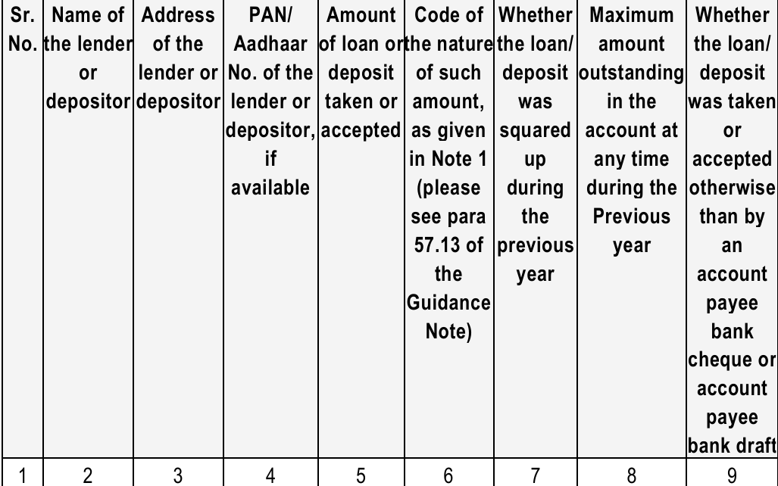
Clause 31(a) | Working Papers by Tax Auditor
Cl 31(a)
It is recommended that the tax auditor maintains the following information in his working papers for the purpose of verifying the reporting in this clause in the format provided in the e-filing utility.
Tax Audit under Section 44AB | ICAI Guidance Note (Revised 2025)

Slide 155
Clause 31 (b) | Section 269SS – Loan, Deposit & Specified Sum
Cl 31 (b)
Under this sub-clause, particulars of any “specified sum” taken or accepted in relation to transfer of an immovable property, whether or not the transfer takes place has been dealt with.
Clause 31(b) – Specified Sum
Clause 31(a) – Loan or Deposit
While verifying the reporting under this clause, the tax auditor may keep in mind the following typical situations-
The reporting is required irrespective of whether the immovable property is held as capital asset or stock in trade.
The tax auditor should ascertain whether the assessee has any immovable property which has been transferred or was proposed to be transferred during the year and review the relevant agreements, documents etc.
The auditor should satisfy himself that the proceeds arising from such transfer, based on the review of documents, has been duly credited to the bank account by an account payee cheque or account payee bank draft or use of electronic clearing system through a bank account or through such other electronic mode as may be prescribed.
Tax Audit under Section 44AB | ICAI Guidance Note (Revised 2025)

Slide 156
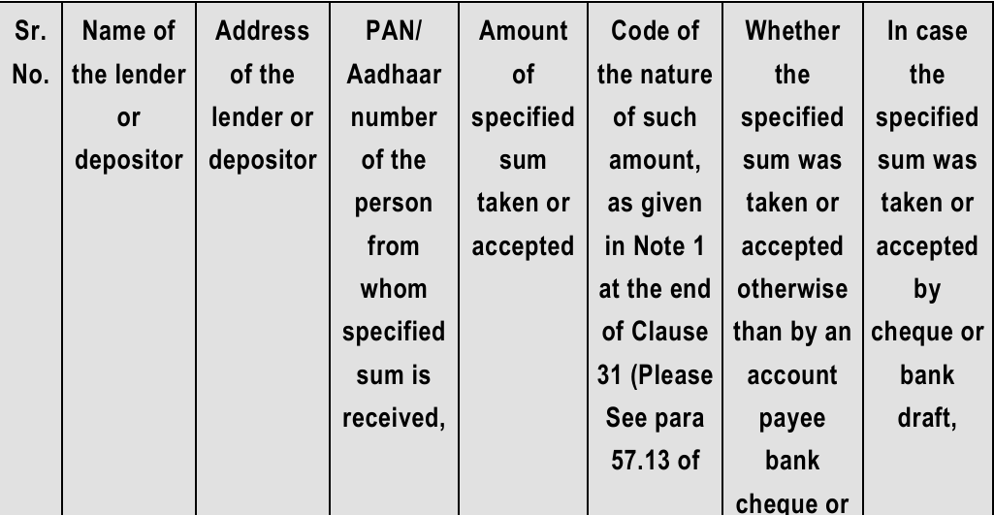
Clause 31(B) | Working Papers by Tax Auditor
Cl 31(B)
It is recommended that the tax auditor maintains the following information in his working papers for the purpose of verifying the reporting in this clause in the format provided in the e-filing utility-
Tax Audit under Section 44AB | ICAI Guidance Note (Revised 2025)

Slide 157
Clause 31 | Practical Example – Section 269SS Violations
Example
Scenario: XYZ Traders – FY 2024-25 | Mixed mode loan transactions
Transaction | Amount | Mode | Sec 269SS? | Report in Clause 31?
Loan from Ramesh (individual) via journal entry | ₹50,000 | Journal Entry | YES – Violation | 31(a) – Code I (Journal Debit)
Security deposit from tenant via UPI | ₹1,00,000 | UPI (Electronic) | NO – Permitted | 31(a) – But report with Code
Loan via non-account payee cheque | ₹25,000 | Non A/C payee cheque | YES – Violation | 31(a) – Code D (Receipt)
Advance for property sale received in cash | ₹75,000 | Cash | YES – Violation | 31(b) – Specified Sum (Code B)
Loan from partner via NEFT (account payee) | ₹5,00,000 | NEFT | NO – Permitted | 31(a) – No violation; still report
Share application received via RTGS | ₹2,00,000 | RTGS | NOT applicable – not a deposit | Not required (Rugmini case)
Tax Audit under Section 44AB | ICAI Guidance Note (Revised 2025)

Slide 158
MCQ 4 | Clause 31 – Section 269SS
Q. Under Section 269SS, what is the limit for accepting a loan or deposit in cash?
(A) ₹10,000
(B) ₹50,000
(C) ₹20,000
(D) ₹2,00,000
Tax Audit under Section 44AB | ICAI Guidance Note (Revised 2025)

Slide 159
Clause 31(ba)–(bd) | Section 269ST – Restricting Cash Receipts ≥ ₹2 Lakh
Cl 31(ba-bd)
The sub-clauses 31(ba), (bb), (bc) and (bd) deal with reporting of transactions of receipts and payments in excess of the specified limit made otherwise than by the modes specified in section 269ST.
31(ba) |Sub-clause 31(ba) deals with receipts by the assessee of an amount of Rs 2 lakh or more otherwise than by way of a cheque or bank draft or use of electronic clearing system through a bank account.
31(bb) |Sub-clause 31(bb) deals with receipts by the assessee of an amount of Rs 2 lakh or more by way of a cheque or bank draft not being an account payee cheque or account payee bank draft.
Report: Name, Address, PAN/Aadhaar, Nature of txn, Amount, Date
Report: Name, Address, PAN/Aadhaar, Amount
31(bc) | Sub-clause 31(bc) deals with payments made by the assessee of an amount of Rs 2 lakh or more otherwise than by way of a cheque or bank draft or use of electronic clearing system through a bank account.
31(bd) |Sub-clause 31(bd) deals with payments made by the assessee of an amount of Rs 2 lakh or more as by way of a cheque or bank draft not being an account payee cheque or account payee bank draft.
`
Report: Name, Address, PAN/Aadhaar, Nature of txn, Amount, Date
Report: Name, Address, PAN/Aadhaar, Amount
Provisions of section 269ST do not apply to receipt by Government, any banking company, post office savings bank or a co-operative bank or transactions of loan or deposit or `specified sum’ referred to in section 269SS. Section 269ST covers ONLY receipts; sub-clauses 31(bc) & 31(bd) extend to PAYMENTS too.
Tax Audit under Section 44AB | ICAI Guidance Note (Revised 2025)

Slide 160
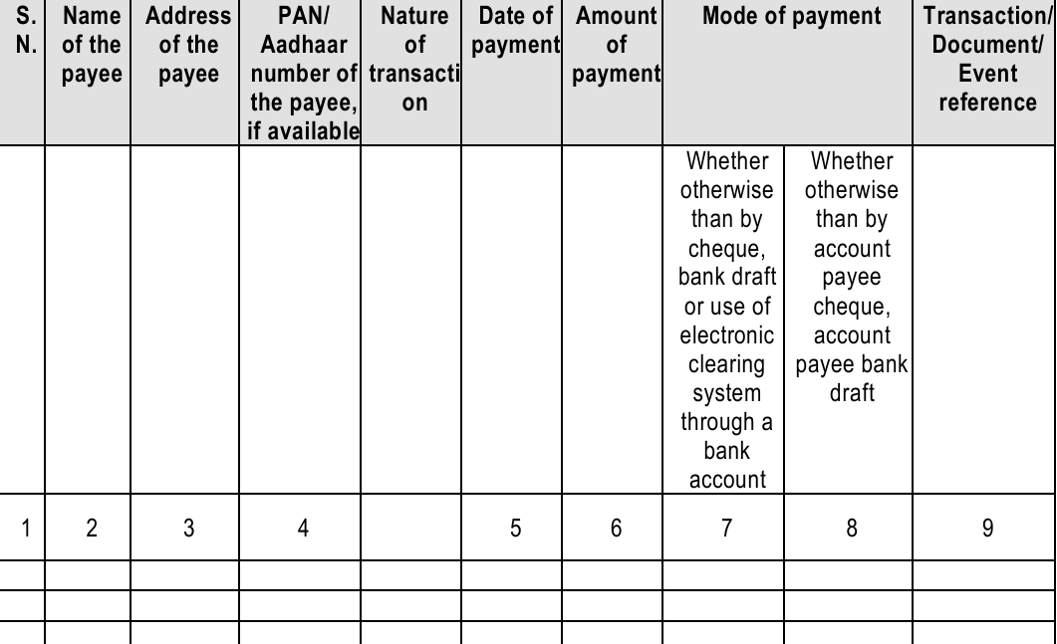
Clause 31(ba)-(bd) | Working Papers by Tax Auditor
Cl 31(a)
It is recommended that the tax auditor maintains the following information in his working papers for the purpose of verifying the reporting in this clause in the format provided in the e-filing utility.
Tax Audit under Section 44AB | ICAI Guidance Note (Revised 2025)

Slide 161
Clause 31(c)–(e) | Section 269T – Repayment of Loans & Specified Advance
Cl 31(c-e)
Threshold: Repayment of loan/deposit + interest ≥ ₹20,000. Repayment must be by account payee cheque/DD in name of the depositor, or by electronic mode. Exception: PACS/PCARD – threshold ₹2,00,000 (w.e.f. 1 Apr 2023).
Clause 31(c): Assessee repays loan/deposit – report ALL repayments (even partial) where total outstanding ≥ ₹20,000
Clause 31(d): Assessee receives repayment of a loan it gave – received otherwise than by cheque/DD/electronic mode
Clause 31(e): Assessee receives repayment by non-account payee cheque or bank draft
Company assessee: 'Loan or deposit' = repayable after notice / after a period (demand loans excluded)
Non-company assessee: 'Loan or deposit' = loan/deposit of any nature (demand loans also included)
Journal entries discharging loans = 'otherwise than by account payee cheque' → must be reported
Note 1 – Nature Code List (Applicable to Clauses 31(a), 31(b), 31(c)):
Code | Nature | Code | Nature
A | Cash Payment | G | Conversion of Assets
B | Cash Receipt | H | Conversion of Liabilities
C | Non A/C payee Cheque Payment | I | Journal Entry [Debit]
D | Non A/C payee Cheque Receipt | J | Journal Entry [Credit]
E | Transfer of Asset | K | Any other mode [Debit]
F | Transfer of Liability | L | Any other mode [Credit]
Tax Audit under Section 44AB | ICAI Guidance Note (Revised 2025)

Slide 162

Tax Audit Reporting: Clauses 32–44
This comprehensive guide that addresses brought forward losses, depreciation allowances, shareholding changes, speculation losses, specified business losses, Chapter VIA deductions, TDS/TCS compliance, quantitative stock reporting, deemed dividend provisions, buyback taxation, statutory audit disclosures, and key financial ratios, demands and refunds under other tax laws, statutory reporting forms (61/61A/61B), Country by Country Reporting under Section 286, and GST expenditure classification.

Slide 163

CLAUSE 32(A)
Brought Forward Loss & Depreciation Allowance
Further auditor has to disclosed in the remark column
Pending assessment or
Appellate proceedings or
about any delay in filing loss returns
Core Requirements
The amount of brought forward loss or depreciation allowance must be quantified as per return and assessment orders read with appellate orders, if any.
Depreciation on goodwill is not available from AY 2021-22 onwards.
Where a claim pertains to one assessment year as per the return but relates to another year as per the assessment order (e.g., depreciation on assets capitalised at year-end), particulars must be re-stated with reference to the assessment year as per the assessment order, accompanied by a suitable explanation in the remarks column.
After verifying Following Documents
Income-tax returns filed or updated
Assessment orders and appellate orders
Rectification or revisional orders for earlier years
Pending assessment or appellate proceedings and delays in filing loss returns
Losses That Cannot Be Carried Forward
Loss from gambling, betting, card games, etc.
Loss from an exempt source (e.g., share of loss of a partnership firm cannot be set off against other business income)
Section 80 read with Section 139(3): No loss shall be carried forward unless the return is filed within the due date under Section 139(1), except for house property loss (Section 71B) and unabsorbed depreciation (Section 32(2)).

Slide 164
Question 1
While preparing the tax audit report, the auditor notices that a claim (such as depreciation on assets capitalised at year-end) pertains to one assessment year as per the return of income, but the same claim actually relates to a different assessment year as per the assessment order. What is the correct reporting treatment in such a case?
The claim should be ignored in the tax audit report since it pertains to a different year
The claim should be reported only in the year in which it appears in the return of income
The particulars should be re-stated with reference to the assessment year as per the assessment order, along with an appropriate explanation in the remarks column
The claim should be reversed and excluded from both assessment years

Slide 165

CLAUSE 32(A) — CONTINUATION
Maximum Period of Carry Forward & Set-Off Rules
The table below summarises the nature of each loss, the income against which it may be set off, and the maximum carry-forward period from the end of the relevant assessment year.
Section
Nature of Loss
Set-Off Against
Max. Carry-Forward Period
32(2)
Unabsorbed depreciation
Income under any head other than salaries
Indefinite
71B
Unabsorbed loss from house property
Income from house property
8 assessment years
72
Unabsorbed business loss
Profits and gains from business or profession
8 assessment years
73
Loss from speculation business
Income from any speculation business
4 assessment years
73A
Loss from specified business u/s 35AD (assessee not in default tax regime u/s 115BAC)
Profit from any specified business (irrespective of eligibility u/s 35AD)
Indefinite
74
Long-term capital loss
Long-term capital gains
8 assessment years
74
Short-term capital loss
Short-term/Long-term capital gains
8 assessment years
74A
Loss from owning and maintaining race horses
Income from the activity of owning and maintaining race horses
4 assessment years
Search/Survey Proceedings : Further from AY 2022-23 onwards, if any undisclosed income is determined during search, requisition, or survey proceedings, then no set-off of brought forward losses or unabsorbed depreciation is permitted against such undisclosed income. Therefore, the tax auditor must verify whether any search or survey has taken place and make necessary adjustments to losses carried forward and appropriate disclosure must be made in Form No. 3CA/3CB.

Slide 166
CLAUSE 32(B)
Whether a change in shareholding of the company has taken place in the previous year due to which the losses incurred prior to the previous year cannot be allowed to be carried forward in terms of section 79
Where a change in share holding has taken place in PY, then no loss incurred in any year prior to the previous year shall be carried forward and set off against the income of the previous year, unless on the last day of that previous year and on the last day of the previous year in which the loss was incurred, the shares of the company carrying not less than 51% of the voting power were beneficially held by the same persons.
Section 79
Example:-
Loss incurred by CSK Pvt. Ltd. in PY 24-25 and earned income for PY 25-26
Equity Shareholding on 31/03/25 31/03/26
Mr. A 34% 35%
Mr. B 33% 33%
Mr. C 33% -
Mr. D - 32%
Losses of PY 24-25 can be set off against income of PY 25-26 because 51% or more equity share held be same persons on 31/03/25 and 31/03/2026

Slide 167
Beneficial vs. Registered Ownership
Eligible Startups
— Exception
Year-by-Year
Verification
Section 79 refers to beneficial ownership, not registered ownership.
A declaration must be obtained from the assessee regarding beneficial ownership. The Delhi High Court judgment in Yum Restaurants (India) Pvt. Ltd. v. ITO (380 ITR 637) offers a viewpoint regarding interpretation of beneficial ownership.
The 51% condition does not apply to eligible startups under Section 80-IAC, provided
The shareholders holding voting power on the last date of the loss year continue to hold those shares, and
The loss was incurred within ten years of incorporation
The startup must hold a certificate from the Inter-Ministerial Board of Certification.
Comparison of shareholding must be done with reference to the last day of the current previous year and the last day of every previous year in which the loss was incurred. Each year of loss must be evaluated separately — not in aggregate. Refer to the Register of Members and MCA filings for same.
A start-up may raise fresh funding and dilute promoters below 51%, yet still retain carry-forward losses if the above conditions are satisfied.

Slide 168
CLAUSE 32(B) — CONTINUATION
Exceptions to Section 79 & Auditor's Verification
Section 79 does not apply to shareholding changes arising from the following circumstances:
Death or Gift to Relative
Change consequent upon death of a shareholder, or transfer of shares by way of gift to any relative of the shareholder making such gift.
Foreign Company Amalgamation/Demerger
Change in shareholding of an Indian subsidiary of a foreign company resulting from amalgamation or demerger of the foreign company, provided 51% shareholders of the amalgamating/demerged foreign company continue as shareholders of the resulting company.
IBC Resolution Plan
A resolution plan approved under the Insolvency and Bankruptcy Code, 2016, after affording a reasonable opportunity of being heard to the jurisdictional Principal Commissioner or Commissioner.
Tribunal-Appointed Directors & Strategic Disinvestment
Changes pursuant to Tribunal action under Sections 241/242 of the Companies Act, 2013, or to an erstwhile public sector company post strategic disinvestment, provided the ultimate holding company continues to hold 51% voting power. Non-compliance triggers Section 79(1) for that and subsequent years.
Unaffected by Section 79
Working Papers Recommended
Section 79 does not affect set-off of unabsorbed depreciation (Section 32(2)) — CIT v. Concord Industries Ltd. (119 ITR 458) and CIT v. Shri Subbulaxmi Mills Ltd. (249 ITR 795 SC). Unabsorbed capital expenditure on scientific research and family planning is also unaffected. However, Section 79A regarding undisclosed income during search/survey must still be checked.
Shareholding schedules (legal + beneficial) for current and prior year
Proof of continuity of shareholding in cases under clause (f)
Management representation for complex group structures or indirect holding
Register of Members and MCA filings for year-on-year comparison

Slide 169
CLAUSES 32(C) & 32(E)
Speculation Losses — Sections 73 & Deemed Speculation
Definition — Section 43(5)
A "speculative transaction" means a transaction in which a contract for the purchase or sale of any commodity, including stocks and shares, is periodically or ultimately settled otherwise than by actual delivery. However, the following are not deemed as speculative: hedging contracts, jobbing/arbitrage by exchange members, eligible derivatives trading on recognised stock exchanges, and eligible commodity derivatives subject to commodities transaction tax.
Deemed Speculation — Explanation to Section 73
A company (excluding companies with income mainly from securities, house property, capital gains, or other sources, and companies whose principal business is trading in shares, banking, or lending) that purchases and sells shares of other companies is deemed to carry on speculation business to that extent.
Working Paper Format — Clause 32(c)
Section 73 — Treatment of Speculation Losses
Sr.
Nature of Loss
Amount of loss for the current year
Brought Forward loss of the earlier yr.
Total loss to be carried forward to the subsequent year
Carry-Forward Break-up Year wise
Loss from speculation business can only be set off against profits of another speculation business (Section 73(1)). Unabsorbed losses are carried forward for a maximum of four assessment years (Section 73(4)). Unabsorbed depreciation and capital expenditure on scientific research relating to speculation business are carried forward under Section 72(2), not Section 73.
As per CBDT Circular No. 23, the assessee may choose the order of set-off (brought forward losses first or current year losses first) — whichever is more advantageous.
Working Paper Format — Clause 32(e)
Sr.
Section
Nature of Loss
AY of Loss
Amount
Set-Off Current AY
Amt. to be Carry Forward

Slide 170

CLAUSE 32(D)
Specified Business Losses — Section 73A
Section 73A governs carry forward and set-off of losses from specified businesses referred to in Section 35AD. Loss from a specified business can only be set off against profits of any other specified business — it is not necessary that the nature of the specified business be the same. Unabsorbed losses can be carried forward for an indefinite period.
Set-Off Rule
Carry-Forward
Multiple Specified Businesses
Loss computed in respect of any specified business u/s 35AD shall not be set off except against profits and gains of any other specified business. The nature of the specified business in which loss is set off need not be the same as that in which loss was incurred.
Where loss is not wholly set off, the unabsorbed portion shall be carried forward to the following assessment year indefinitely, and set off against profits of any specified business assessable for that year.
If the assessee carries on more than one specified business and losses are incurred in more than one, details of loss for each business must be specified separately in the tax audit report.
Working Paper Format — Clause 32(d)
Nature of Specified Business
Set-Off Against Other Specified Business
Loss carry forward
To the next A.Y.
Sr.
Amount of
loss incurred, if
any, during
the previous
year, with
regard to the
specified business
mentioned in (b)
Brought Forward specified business Loss
Year of Loss
Whether loss Set-off Against Other Income?
The tax auditor must verify from books of account whether the assessee is carrying on any specified business u/s 35AD. If yes, details of losses incurred during the previous year must be furnished. Cross-check with Income Tax Portal data or last year's ITR for accuracy.

Slide 171
Question 2
A manufacturer enters into a forward contract for raw material price protection and settles it without delivery. What is the tax treatment?
Speculative transaction
Not speculative (hedging allowed)
Capital gain
Income from other sources

Slide 172
CLAUSE 33
Chapter VIA Deductions & Sections 10A/10AA Exemptions
Chapter VIA deductions are categorised as: (A) Deductions in respect of certain payments, (B) Deductions in respect of certain incomes, and (C) Other deductions. Reporting under Clause 33 is required only with reference to items in the audited books. Section 10A is not available from AY 2012-13, though it remains a reporting requirement.
Section 80AC — Timely Filing Condition
Branch/Unit Audit Considerations
No deduction under Part C (Deduction in respect of certain income) of Chapter VIA shall be allowed unless the return is furnished by the due date under Section 139(1). Since the tax audit report is submitted before the return filing deadline, the auditor may remark that admissibility is subject to timely filing of the return.
Where audit is of a specific branch or unit, deductions must be reported with reference to that branch's books, with remarks excluding HO/other branches. For HO audits, the auditor must consider branch audit reports and comply with SA-600 — Using the Work of Another Auditor.
Sections Requiring Separate Audit Reports
Special Tax Regimes — Sections 115BA/115BAA/115BAB/115BAC/115BAD/115BAE
Sections 80-IA, 80-IB, 80-IC, and 80JJAA require separate audit reports/certificates. The tax auditor should refer to these certificates (whether issued by themselves or another auditor) and comply with SA-600. For Section 10AA, verification can be from the CA certificate issued in that regard.
Assessees opting for these concessional tax regimes cannot claim most Chapter VIA or Chapter III deductions. Admissibility must be examined in light of Clause 8(a) reporting. (except 80JJAA).

Slide 173
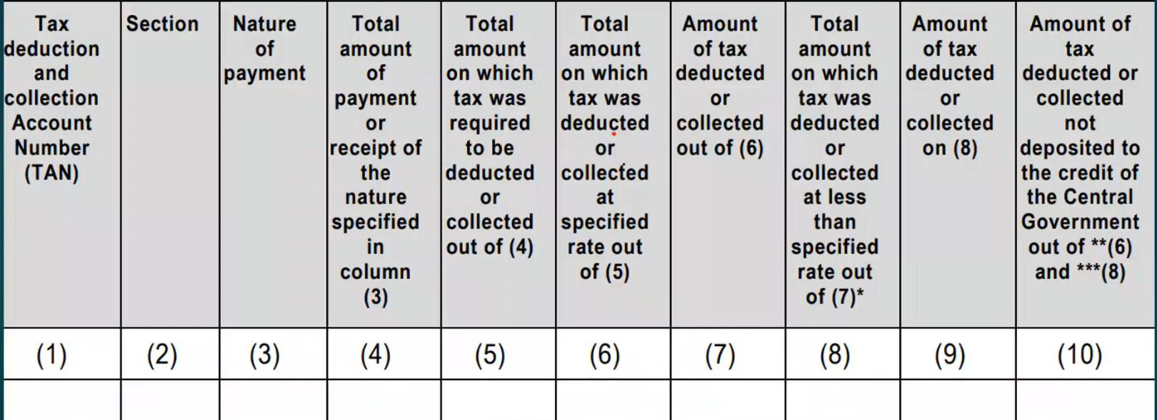
CLAUSE 34(A)

Slide 174
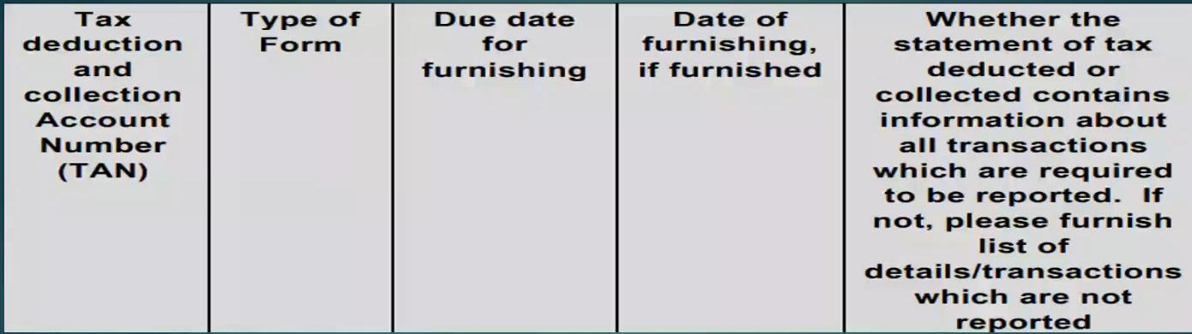
CLAUSE 34(B)
The Auditor verifies if the assessee is required to file TDS/TCS statements for the financial year under audit.
Type of form-24Q, 26Q, 27Q and 27EQ

Slide 175

CLAUSES 34(A), 34(B) & 34(C)
TDS/TCS Compliance — Reporting Requirements
Clause 34(a) — TDS/TCS Details
Clause 34(b) — TDS/TCS Statements
The tax auditor must verify applicability of Chapter XVII-B/XVII-BB provisions and report TAN, section, nature of payments, total amounts, amounts on which tax was required to be deducted/collected, actual deduction/collection at specified and lower rates, and tax not deposited to the Central Government.
Verify whether the assessee has furnished TDS/TCS statements within prescribed due dates. Report TAN, form type, due date, actual filing date, and whether all required transactions are reported. Transactions below threshold limits (e.g., Sections 194C, 194J) must still be disclosed in TDS/TCS statements with suitable flagging as mandated under Income-tax Rules, 1962.
Column (10): Report tax deducted/collected but not deposited till the audit date (late deposits before audit date need not be reported)
Verify using TDS/TCS returns, TRACES status, and books of account
Consider higher TDS rates under certain circumstances like non furnishing of PAN, non-filers of return as provided in Sections 206AA/206AB (Sections 206AB omitted w.e.f. 1-4-2025)
Clause 34(c) — Interest Liability
Report interest payable under Section 201(1A) (TDS) or Section 206C(7) (TCS) for non-deduction, non-collection, or if deducted has not been paid to the credit of the Central Government as required by the Act. Verify from books as on 31st March and Form 26AS/AIS/TIS. If disputed on TRACES, re-calculate up to the audit report date and mention in observations paragraph. Under mercantile accounting, consider impact on true and fair view if interest is unpaid and unprovided till 31st March.
Information under Clauses 34(a) and (b) should be reconciled with disallowances under Section 40(a) in Clause 21(b) for cross-checking appropriateness of reporting.

Slide 176
Clause 35(a): Trading Concern — Quantitative Details
CLAUSE 35(A)
Clause 35(a) applies to enterprises that are trading concerns, as reported in Clause 10(a). The tax auditor must obtain certificates from the assessee in respect of principal items of goods traded, covering opening stock, purchases, sales, and closing stock — each with its measurement unit — along with the extent of shortage, excess, or damage and the reasons thereof.
Auditor's Obligations
What Constitutes "Principal Items"?
Confirm the enterprise is a trading concern per Clause 10(a)
Obtain certificates for principal items of goods traded
Record opening stock, purchases, sales, and closing stock with measurement units
Capture shortage/excess/damage and reasons thereof
Examine all quantitative information from the records
"Principal items" are those that constitute more than 10% of the aggregate value of purchases, consumption, or turnover, as the case may be. Petty items need not be reported.
The entire quantitative information must be examined from the records. What constitutes a principal item depends on the facts of each case.

Slide 177
Clause 35(b): Manufacturing Concern — Yield & By-Products
CLAUSE 35(B)
Clause 35(b) applies where the enterprise is a manufacturing concern (reported in Clause 10(a)). The tax auditor must obtain certificates in respect of principal items of raw materials, finished goods, and by-products, with measurement units and quantitative information — only for items where it is practicable, having regard to records maintained.
Yield & Percentage of Yield
By-Products: Definition & Treatment
Principal Items Threshold
Information about 'yield', 'percentage of yield', and 'shortages/excess' must be reported. These metrics help the auditor assess production efficiency and identify discrepancies between input consumption and output generation.
As with Clause 35(a), only principal items need be reported — normally those constituting more than 10% of aggregate purchases, consumption, or turnover. The auditor may verify figures using sampling in large concerns where item-by-item verification is impracticable.
By-products are products whose manufacture results incidentally from the main product, or where waste from the main product is further processed. Where a by-product is continuously generated, it should be treated at par with any other product produced for sale and disposal, and similar quantitative records must be maintained.

Slide 178
Clause 36A: Deemed Dividend — Section 2(22)(e)
CLAUSE 36A
SECTION 2(22)(E)
Clause 36A requires reporting whether the assessee received any amount in the nature of dividend under Section 2(22)(e). Sub-clause (e) deems certain payments by closely held companies to be dividend in the hands of the recipient.
Five Conditions for Section 2(22)(e)
Key Definitions
Payment by a company in which public are not substantially interested (closely held company)
Payment by way of advance, loan, or payment on behalf of / for the benefit of a specified shareholder
Specified shareholder = beneficial owner of shares holding not less than 10% of voting power (stand-alone shareholding; relatives not considered); status as on date of loan/advance
Payment to the shareholder or any concern in which the shareholder is a member/partner with substantial interest
Company must have accumulated profits at least to the extent of the loan/advance; dividend restricted to such accumulated profits
Concern (Expl. 3): Includes HUF, firm, AOP, BOI, or company. Substantial interest = beneficially entitled to not less than 20% of income.
Person with substantial interest in a company (S. 2(32)): Beneficial owner of shares (not fixed-dividend shares) carrying not less than 20% of voting power.

Slide 179

Clause 36A: Auditor's Verification Procedures
Obtain certificate listing all closely held companies where assessee holds ≥10% voting power
Obtain certificate of loans/advances received by concerns in which assessee has substantial interest
Verify Form 26AS/AIS/TIS for TDS under Section 194 by the closely held company
Where registered shareholder not equal beneficial owner, obtain an undertaking and verify Companies Act, 2013 compliance
Check for trade advances — CBDT Circular No. 19/2017 excludes commercial transactions from Section 2(22)(e)
Review current account transactions to distinguish normal business from loans/advances that are taxable as deemed dividend
Under clause 36A(a), it has to be mentioned whether the assessee has received any amount in the nature of dividend as referred section2(22)(e). If the answer is ‘yes’, then each such amt. received as dividend u/s 2(22)(e) is to be reported under sub-clause (b) of clause 36A. The tax auditor has to verify the details in respect of this sub-clause, and it is recommended to maintain appropriate working papers.
If payment on behalf of assessee is treated as remuneration (e.g., as MD), it is not again chargeable under Section 2(22)(e).

Slide 180
Clause 36B: Buyback of Shares — Section 2(22)(f)
CLAUSE 36B
EFFECTIVE 01-10-2024
Sub-clause (f) was inserted in Section 2(22) with effect from 1st October 2024, broadening "dividend" to include any payment by a company on purchase of its own shares from a shareholder under Section 68 of the Companies Act, 2013. Clause 36B requires reporting the amount received and cost of acquisition of shares bought back.
Section 68: Key Conditions for Buyback
Auditor's Reporting & Verification
Funded from free reserves, securities premium, or proceeds of fresh issue (not same-kind earlier issue)
Buy back is Authorised by articles; special resolution passed (Board resolution if buy back is of ≤10% of paid-up equity and free reserves)
Buyback ≤25% of aggregate paid-up capital and free reserves (If buy back of equity shares: 25% of total paid-up equity capital in that FY)
the ratio of the aggregate of secured and unsecured debts owed by the company after buy-back is not more than twice the paid up capital and its free reserves.
All shares must be fully paid-up
Listed company buyback per SEBI regulations; unlisted per prescribed rules
No offer within one year of preceding buyback closure
Completed within one year of resolution; shares extinguished and distroyed within 7 days
No further issue of same kind for 6 months (except bonus, conversions, ESOPs)
Report only buybacks completed on or after 1st October 2024
Confirm shares/securities form part of tax-audit financials (personal accounts excluded)
Cross-verify via TIS/AIS . Further companies listed on recognised stock exchange must report buybacks of an amount Rs.10 lakh or more in a F.Y. (other than open market)
Check Form SH-8/SH-9 filed with ROC
Obtain Management Representation Letter for disclosure of buyback amounts
Auditor must report cost of shares purchased. This is needed to compute tax impact correctly.

Slide 181
Question 3
XYZ Pvt. Ltd., a closely held company, gives a loan of ₹15 lakh to Rahul, who holds 12% voting power in the company. The company also has sufficient accumulated profits. How will this transaction be treated under the Income-tax Act?
It will be treated as business income
It will be treated as deemed dividend in the hands of Rahul
It will be exempt as it is a loan transaction
It will be treated as capital gain

Slide 182
Question 4
ABC Pvt. Ltd., a closely held company, buys back shares from Mr. X (shareholder holding 15% voting power) on 15 November 2024 under Section 68 of the Companies Act, 2013. Mr. X receives ₹10 lakh over and above his cost of acquisition. How will this amount be treated for tax purposes?
Capital gain in the hands of Mr. X
Deemed dividend under Section 2(22)(f)
Business income of ABC Pvt. Ltd
Exempt income since it is a buyback transaction

Slide 183
Clauses 37 & 38: Cost Audit & Central Excise Audit
CLAUSE 37
CLAUSE 38
Clauses 37 and 38 require the tax auditor to report on cost audit and Central Excise audit, respectively. In both cases, the auditor must ascertain whether such audits were conducted, obtain copies of reports, and note any disqualifications or disagreements — without expressing an independent opinion on those reports.
Clause 37 — Cost Audit
Clause 38 — Central Excise Audit
Ascertain from management whether a cost audit was carried out
Obtain a copy of the cost audit report
Note details of any disqualification or disagreement on any matter/item/value/quantity reported by the cost auditor
No opinion required if audit was ordered but not carried out
If audit ordered but not completed by the time of tax audit report, state that the report is unavailable
Report only on cost audit reports whose time period falls within the relevant previous year and received up to the date of the tax audit report
Ascertain from management whether any audit was conducted under the Central Excise Act, 1944
Obtain a copy of the excise audit report
Note details of any disqualification or disagreement on any matter/item/value/quantity reported by the excise auditor
No opinion required if audit was ordered but not carried out
If excise audit is not completed by the time of the tax auditor's report, state that the report is unavailable
Report only on excise audit reports whose time period falls within the relevant previous year and received up to the date of the tax audit report

Slide 184
Clause 39: Service Tax Audit — Section 72A, Finance Act 1994
CLAUSE 39
LEGACY PROVISION
With service tax subsumed into GST and no longer in operation, the relevance of Clause 39 has substantially diminished. Reporting under this clause would, in most cases, not arise in the current tax environment.
Auditor's Approach
When Reporting May Still Arise
Only in exceptional cases involving legacy issues from the pre-GST regime might some consideration be warranted — such as where a demand was raised, adjudicated, or concluded during the year under audit. These would be rare, transitional scenarios.
This clause is effectively a legacy provision post-GST implementation. Auditors should focus on whether any pre-GST service tax demands or audits remain pending or were concluded during the relevant previous year.

Slide 185
Clause 40: Financial Ratios — Turnover, Profit & Stock
CLAUSE 40
Clause 40 requires disclosure of key financial ratios for the previous year and preceding previous year. These ratios apply to assessees engaged in manufacturing or trading activities; for service providers, only Total Turnover (S.No. 1) and Net Profit/Turnover (S.No. 3) need be furnished. Ratio No. 5 (Material Consumed/Finished Goods) is not required for trading concerns.
S.No.
Particulars
Previous Year
Preceding Previous Year
1
Total turnover of the assessee
—
—
2
Gross profit / turnover
—
—
3
Net profit / turnover
—
—
4
Stock-in-trade / turnover
—
—
5
Material consumed / finished goods produced (principal items only)
—
—
Key Definitions
Value of Finished Goods Produced
Gross Profit/Margin: Excess of proceeds of goods sold and services rendered over their cost, before administration, selling, distribution, and financing expenses. (Negative result = gross loss).
Net Profit: Excess of revenue over expenses for the accounting period — net profit before tax. (Negative result = net loss.)
Stock-in-Trade (S.No. 4): Only closing stock of finished goods; excludes stores, spare parts, loose tools, raw materials, and WIP.
Material Consumed (S.No. 5): Includes raw materials, stores, spare parts, and loose tools.
Raw material consumption
+ Stores and spare parts consumption
+ Wages
+ Other manufacturing expenses (excluding depreciation)
= Sub-total
+ Opening stock in process
− Closing stock in process
= Value of finished goods produced
All ratios are in value terms only. Ensure consistency between numerator and denominator; significant deviations must be disclosed in Form 3CA/3CB. Preceding year figures should be from the last audit report or reinstated figures. If preceding year was not audited, disclose in the observation para.

Slide 186
CLAUSE 41
Demand / Refund Orders Under Other Tax Laws
The auditee may be assessed under various tax laws beyond the Income-tax Act, 1961 and Wealth-tax Act, 1957, resulting in demand or refund orders. The tax auditor must obtain copies of all such orders issued during the previous year and received by the assessee up to the date of audit. Tax laws covered include GST, Central Excise Duty, Service Tax, Customs Duty, VAT, Central Sales Tax, Professional Tax, etc. The auditor should exercise professional judgment in determining applicability of relevant tax laws for reporting.
Key Reporting Principles
Working Paper Format (as per e-filing utility)
Demand/refund order may pertain to a period other than the relevant previous year — reporting is still required under this clause if received during the C.Y.
Verify books of account and orders passed by respective Departments
Cross-verify demands from online portals of respective Departments
Any adjustment of refund against demand must be reported
Obtain Management Representation from the assessee
For corporate assessees, cross-check with contingent liability disclosures in audited financials and CARO disclosures in statutory auditor's report
The tax auditor should maintain the following information in working papers:
S. No.
Financial Year
Applicable Act
Order No.
Date
Amount & Remarks
1
Year to which demand/refund relates
Name of Act
Demand/Refund Order No.
Demand raised/issued
Amount of demand & pending proceedings
Details of relevant proceedings should be furnished in the remarks column, stating the authority before which the matter is pending.

Slide 187
CLAUSE 42
Reporting Forms 61, 61A & 61B — Applicability
Clause 42 requires the tax auditor to ascertain whether the assessee is required to furnish Form No. 61, 61A, or 61B, and if so, report the requisite details. The requirement is based on conditions stated in the relevant section and rule.
Form No. 61
Form No. 61A
Form No. 61B
Section 139A(5)(c), Rules 114B, 114C, 114D
Filed by persons who have received declarations in Form No. 60. Persons who have to file Form No. 61 are persons referred to in:
persons audited under Section 44AB, persons who raise bills for: cash payments exceeding Rs. 50,000 to hotels/restaurants; cash payments exceeding Rs. 50,000 for foreign travel or foreign currency; and transactions of sale/purchase of goods or services (other than those in Rule 114B) exceeding Rs. 2 lakhs per transaction.
Section 285BA, Rule 114E
Form 61A is used by specified reporting entities such as banks, post offices, and companies to report high-value financial transactions like cash deposits, property transactions, and investments in securities. Its main purpose is to enable the Income Tax Department to monitor large transactions and ensure tax transparency.
Rules 114F, 114G, 114H
Form 61B also know as Statement of Reportable Accounts, required to be filed by certain financial institutions(such as bank etc). Its main objective is to enable international tax transparency by sharing financial account information with tax authorities to curb tax evasion and track foreign income/assets. Under this, Rule 114F defines various terms; Rule 114G prescribes information to be maintained and reported; Rule 114H prescribes due diligence requirements.

Slide 188
CLAUSE 42 — CONTINUED
Forms 61/61A/61B — Due Dates, Reporting & Verification
Due Dates for Furnishing
Auditor's Verification Duties
Form No.
Due Date
61
31st October (for Form 60 received April–September); 30th April (for Form 60 received October–March of preceding FY)
Every reporting financial institution must register with the Principal DGIT (Systems), providing details of the Designated Director and Principal Officer, and obtain a registration number quoted in Form 61B
Examine Forms 61, 61A, and 61B uploaded on the income tax portal
If forms have been revised, verify whether all required particulars are reported in the revised form
Tax auditor may rely on Management Representation Letter for completeness of transactions reported
Date of furnishing can be obtained from the assessee's e-filing acknowledgement number
61A
31st May of the immediately following financial year
61B
31st May of the immediately following financial year
Reporting Requirements (Sub-clause b)
Where the assessee is required to furnish any of these form then, the following must be reported:
ITDREIN (Income-tax Department Reporting Entity Identification Number) — a Unique ID issued after registration of the reporting entity
Type of Form (61, 61A, or 61B)
Due date for furnishing
Date of actual furnishing (from e-filing acknowledgement)
Whether the Form contains all required details/transactions
If not, a list of details/transactions not reported

Slide 189
CLAUSE 43
Country by Country Report — Section 286
Clause 43 seeks information about applicability of filing a report under Section 286(2), which deals with Country by Country (CbC) Reporting by an 'international group'. The reporting requirement does not apply if the total consolidated group revenue does not exceed Rs. 6,400 crores (as per Rule 10DB).
Key Definitions
Four Situations Triggering Reporting Obligation
International Group [Section 286(9)(g)]: A group including (i) two or more enterprises resident in different countries/territories, or (ii) an enterprise resident in one country carrying on business through a permanent establishment in other countries/territories
Alternate Reporting Entity [Section 286(9)(c)]: Any constituent entity designated by the group, in place of the parent entity, to furnish the CbC report in its country of residence on behalf of the group
Parent Entity [Section 286(9)(h)]: The entity required to furnish the CbC report as the ultimate parent of the international group
Reporting Accounting Year [Section 286(9)(a)]: The accounting year for which the CbC report is furnished
The obligation to furnish the CbC report under Section 286(2) arises in the following situations:
Assessee is the parent entity of the international group and is resident in India
Assessee is resident in India and has been designated as the alternate reporting entity of the international group
Assessee is a constituent with its parent entity resident in India, and no other resident constituent has been designated as alternate reporting entity
Assessee is neither parent nor alternate reporting entity, but another Indian resident constituent has been designated as the alternate reporting entity then that entity must file report.
Under Section 286(1), every constituent entity resident in India (where the parent is non-resident) must notify the prescribed authority in Form No. 3CEAC within 10 months from the end of the reporting accounting year (due date: 31st January).
The tax auditor should verify if any of these four situations exist and check whether Form No. 3CEAC has been filed by the assessee whose parent is a non-resident.

Slide 190

CLAUSE 43 — CONTINUED
CbC Report — Reporting Details & Auditor's Verification
If the reply to Clause 43(a) is affirmative, the following information must be furnished in the tax audit report:
(i) Who Furnished the Report
(ii) Name of Parent Entity
Whether the report was furnished by the assessee, its parent entity, or an alternate reporting entity. The tax auditor should verify the acknowledgement for furnishing the report.
The term 'parent entity' is defined in Section 286(9)(h). The auditor should examine which entity qualifies as the parent entity and verify it has been correctly reported.
(iii) Name of Alternate Reporting Entity
(iv) Date of Furnishing
Defined in Section 286(9)(c). The auditor should examine whether any alternate reporting entity exists and, if yes, state its name. Obtain a certificate from the assessee regarding constitution of the international group and designation of the alternate reporting entity.
The date of furnishing should be stated from the acknowledgement for the report under Section 286(2). If filed by the parent or another constituent entity, the auditor should obtain a copy of the report and its acknowledgement.
Form No. 3CEAC has a due date of 31st January (10 months from end of reporting accounting year), which falls after the tax audit specified date (30th September/31st October). Therefore, details relating to the immediately preceding previous year for which Form 3CEAC has been filed in the relevant previous year or before the specified date can be furnished.

Slide 191
CLAUSE 44
Break-up of Total Expenditure — GST Registration Status
Clause 44 requires reporting the break-up of total expenditure based on the GST registration status of the entities to whom payments are made. The format requires total expenditure and its classification into registered (further sub-classified) and unregistered entities.
Sl. No.
Total Expenditure Incurred
Exempt from GST
Composition Scheme
Other Registered
Total to Registered
Not Registered
1
2
3
4
5
6
7
Scope & Exclusions
Working Paper — Reconciliation Format
Only expenses amounting to 'supply' under Section 7 of CGST Act, 2017 are reported in Columns 3–7
Activities in Schedule III to CGST Act (e.g., employee remuneration) need not be reported in Columns 3–7
Non-cash charges (depreciation u/s 32, bad debts u/s 36(1)(vii)) are excluded from Columns 3–7 but included in Column 2
Capital expenditure should also be reported — the word 'expenditure' covers both revenue and capital
In case of multiple GST registrations, consolidate expenditure across all GSTINs; retain reconciliation for inter-branch supplies eliminated at consolidation
Description
Amount (Rs.)
Total value of expenditure in P&L (Column 2)
XXXX
Add: Capital expenditure not in P&L
XXXX
Less: Non-cash charges
XXXX
Less: Transactions in securities & money
XXXX
Less: Expenditure excluded under Schedule III, CGST Act
XXXX
Balance: Value for Clause 44
XXXX
Details of all additions and deductions must be maintained GSTIN-wise for each sub-entity of the legal entity.

Slide 192
CLAUSE 44 — CONTINUED
GST Expenditure Classification — Columns 3 to 7
Column 3: Expenditure Relating to Goods/Services Exempt from GST
Column 4: Expenditure Relating to Composition Scheme Entities
Column 5: Expenditure Relating to Other Registered Entities
Report value of all inward supplies exempt from GST. Section 2(47) of CGST Act defines exempt supply as supply attracting nil rate, wholly exempt under Section 11/Section 6 of IGST Act, and includes non-taxable supply. Relevant notifications include: Nos. 1/2017, 2/2017, 11/2017, 12/2017 CT(R) and Nos. 1/2017, 2/2017, 8/2017, 9/2017 IT(R).
Non-taxable supplies under Section 2(78) include: alcoholic liquor for human consumption; petroleum crude, high speed diesel, motor spirit, natural gas, aviation turbine fuel; and un-denatured extra neutral alcohol/rectified spirit (w.e.f. 01/11/2024).
Governed by Section 10 of CGST Act. Key characteristics: composition dealer cannot charge GST, cannot make inter-State supply, issues only bill of supply (not tax invoice), and must mention "Composition taxable person, not eligible to collect tax on supplies" on the bill. Where GSTIN of composition taxpayers is not identified at procurement, a suitable remark may be included in Form 3CA/3CB.
Value of all inward supplies from registered dealers, excluding supplies from composition dealers and exempt supplies from registered dealers.
Column 6: Total Payment to Registered Entities
Column 7: Expenditure Relating to Entities Not Registered under GST
The word 'payment' should be harmoniously interpreted as 'expenditure'. Column 6 = Sum of Columns 3 + 4 + 5 (total expenditure in respect of all registered entities).
Value of inward supply of goods/services received from unregistered persons. Total of Columns 6 and 7 should tally with Column 2, except for excluded expenditures. Auditor should differentiate the supplier's registration status at the time of supply from their current status; disclose known cancellations with retrospective effect in notes.

Slide 193
CLAUSE 44 — VERIFICATION
SIGNATURE & FURNISHING
Verification, Disclosure & Signature Requirements
Auditor's Verification for Clause 44
Signature & Furnishing of Tax Audit Report
The tax auditor should obtain from the assessee the following details and verify on a test-check basis, retaining them as working papers:
Form 3CD must be signed by the person competent to sign Form 3CA/3CB, with full name, address, membership number, firm registration number, place, and date
For soft copy reports, the tax auditor must affix a Digital Signature; time and date of signature are automatically captured and must tally with the manual date on hard copy
Forms 3CA/3CB and 3CD must be uploaded on the Income Tax Department website and digitally signed; the assessee must accept the report under their digital signature
Primary responsibility of electronic furnishing lies with the assessee (Rule 12(2)); Sections 5 & 6 of Information Technology Act, 2000 give legal recognition to electronic/digital signatures
For Joint Auditors: one auditor uploads a consolidated report with disclosure from joint auditors; hard copy signed by all should be given to the assessee
UDIN should be written on the hard copy of Form 3CA/3CB; no compulsory mechanism exists for inserting UDIN prior to uploading
Expenditure Head
Entity Name
GSTIN
Value Debited
ITC Taken
Total Paid
Remarks
Where the assessee cannot provide required details, an appropriate disclosure/disclaimer should be made in Form 3CA/3CB. If the assessee has provided reasons for inability, the same may be reported if found appropriate. An appropriate disclosure should also be made regarding the view taken on the meaning of "total expenditure" and the method of filling columns.

