Slide 1
ETHICAL STANDARDS
Compliances with
Ethical Standards
CA. Vimal Chopra
Ex-Chairman, ICAI-CIRC

Slide 2
Legal Framework
Act
The CA Act, 1949
Rules
Chartered Accountants (Procedure of Investigations of Professional and Other Misconduct and Conduct of Cases) Rules 2007 and Amendments.
Regulations
The CA Regulations 1988
Code of Ethics
Code of Ethics, 2026 Vol-I, II & III (1.4.2026)
Compliances with Ethical Standards
2 / 54

Slide 3
Source Material
1
Ethical Standards Board portal — https://ethics.icai.org/
2
CODE OF ETHICS (Volume – I, II and III) Revised 2026
3
Booklet on Important Decisions of the Ethical Standards Board/Council (Jul-22)
4
CA Ethics Plus (2024-25)
5
FAQ on Ethical Issues, 2025 (Revised Edition 2025)
6
Select Order(s) of NFRA
Compliances with Ethical Standards
3 / 54

Slide 4
Ethical Standards
Code requires CAs to comply with the fundamental principles of Ethics.
Apply the conceptual framework to identify, evaluate and address threats
Have inquiring mind, exercising professional judgment, use third party test.
existence of conditions, policies and procedures established by the profession, legislation, regulation, the firm, or the employing organization might impact the identification of threats.
address threats, apply safeguards, take actions, bring to acceptable level
Be independent when perform audit/review /other assurance engagements
Audit Documentation – Physical / Electronic
Inquiry Protocols – Fraud, Modified opinion, Adverse Comments
2-way Communication Protocols
General & Specific Control(s) - Planning, Execution, Monitoring, Reporting.
Compliances with Ethical Standards
4 / 54

Slide 5
Revised Code of Ethics (13th Edition)
Effective from 1 April 2026
The revised Code of Ethics (13th edition) - Volume-I, II & III is applicable with effect from April 01, 2026 except for the s.no. (xxxi).
The s.no. (xxxi) “Assessment and evaluation of Social Impact, CSR Impact, Business Responsibility and Sustainability Reporting, and the like” of Management Consultancy and other services issued under Section 2(2)(iv) of the C As Act, 1949 in Code of Ethics, Volume-I is effective from December 11, 2025.
Code of Ethics Volume – I – Domestic provisions of the C As Act,1949, Regulations, etc., Council Guidelines and decisions. This is the foundational volume governing everyday professional conduct in India.
Code of Ethics Volume – II - Global Convergence (IESBA 2024) Converged with International Ethics Standards Board for Accountants (IESBA) Code of Ethics 2024 edition. (Provides contextualised guidance for Indian practitioners navigating global mandates, independence principles, and cross-border engagements.)
Code of Ethics Volume – III - Ethics Standards for Sustainability Assurance (including independence standards/ norms for ESG reporting, BRSR, CSR impact assessment, and social impact evaluations.)
Compliances with Ethical Standards
5 / 54

Slide 6
Code of Ethics – What is new in brief
1
Advertisement Reform
Reform in Advertisement Guidelines to open new possibilities for emerging and mid sized Indian CA firms to enhance visibility, expand their reach, and compete confidently at a global level.
2
IESBA 2024 Convergence + Sustainability
Revised Code of Ethics has now converged its Code of Ethics with the 2024 edition of the International Ethics Standards Board for Accountants (IESBA) Code of Ethics. New Ethical Standards for Sustainability Assurance (based on standards issued by IESBA, have been incorporated into the Code of Ethics. (Vol-III)
3
Expanded MCS List
Revised Code of Ethics, expanded the list of Management Consultancy and Other Services (MCS) to include a wider range of contemporary, digital-age services, social impact assessment, artificial intelligence-related services, forensic accounting, and other emerging professional domains. This expansion meets evolving needs of the economy and enables CA's to offer more diverse and modern professional services.
Compliances with Ethical Standards
6 / 54

Slide 7
Solicitations, Promotion, Advertisements etc.
Part – I of The First Schedule — Prohibitions
Clause (7): Advertisement of Professional and Other Achievements :- Advertising professional attainments or services, or using any designation or expressions other than chartered accountant on professional documents, visiting cards, letter heads or sign boards, unless it be a degree of a University established by law in India or recognised by the Central Government or a title indicating membership of the Institute of Chartered Accountants of India or of any other institution that has been recognised by the Central Government or may be recognised by the Council;
Provided that a member in practice may advertise through a write up, setting out the services provided by him or his firm and particulars of his firm subject to such guidelines as may be issued by the Council;
Advertisement Guidelines, 2008. (Chapter-3 of Vol-I)
“write up” means the writing of particulars as per the Guidelines, setting out services rendered (names of Clients not allowed)
Any writing or display of the particulars of the Members/Firms issued, circulated or published by way of print or electronic mode or otherwise including in newspapers, journals, magazines and websites which include social Networking Websites (in Push as well in Pull mode) in accordance with the Guidelines.
Compliances with Ethical Standards
7 / 54

Slide 8
5 Fundamental Principles of Professional Ethics
A professional accountant is required to comply with the following fundamental principles:
(a)
Integrity — Being straightforward and honest in all professional relationships.
(b)
Objectivity — Not allow bias, conflict of interest or undue influence of others to override professional judgments.
(c)
Professional Competence and Due Care — Maintain professional knowledge and skill at the level required to ensure that a client or employer receives competent professional service based on current developments in practice, legislation and techniques (Diligent working)
(d)
Confidentiality — The confidentiality of information acquired – should not disclose any such information to third parties without proper and specific authority unless there is a legal or professional right or duty to disclose. Confidential information acquired as a result of professional and employment relationships should not be used for the personal advantage of the professional accountant or third parties.
(e)
Professional Behaviour — Should comply with relevant laws and regulations and should avoid any action that discredits the profession.
Compliances with Ethical Standards
8 / 54

Slide 9
General Application — Threats for Professional Accountant (PA)
Self-interest threats may occur as a result of the financial or other interests (including of a relative)
Self-review threats may occur when a previous judgment needs to be re-evaluated by PA responsible for that judgment
Advocacy threats may occur when a PA promotes a position or opinion to the point that subsequent objectivity may be compromised
Familiarity threats may occur when, due to a relationship, a PA becomes too sympathetic to the interests of others
Intimidation threats may occur when a PA may be deterred from acting objectively by threats (real/perceived).
Compliances with Ethical Standards
9 / 54

Slide 10
General Application — Safeguards
Professional / Legal
Safeguard by Professional Body – Awareness, Education, CPE.
Safeguard by Statue Making changes in Legislation, Rules and Regulations.
Work Environment
Safeguard in working environment – Safeguard at the stage of Firm/Organization. Quality Control Policies, rotation, review
Engagement Specific Safeguard(s)
Client Level
Client's systems and procedures centric Safeguards. Independent review, disclosures.
Note: “Know Your Client” (KYC) Guidelines are mandatory from 1.1.2017.
Compliances with Ethical Standards
10 / 54

Slide 11
General Application — NOCLAR
(No Compliances with Law and Regulations)
1
Meaning and Scope
2
Public Interest Objective
3
Discuss with Management
4
Escalate to TCWG
5
Disclosure (If permitted / required)
6
Documentation.
Compliances with Ethical Standards
11 / 54

Slide 12
Code of Ethics — Evolution
Area | 2009 Code | 2019 Code (12th Edition) | 2026 Code (13th Edition)
Framework | Basic Principles only | Conceptual Framework approach – Identity, Evaluate, address threats | IESBA 24 aligned, AI & Sustainability added.
IESBA Alignment | Partial | Fully aligned with IESBA 2018 | Converged with IESBA 2024
Independence | General guidance | Detailed provisions, documentation requirements | New PIE Provisions, NAS Bar, fee dependency thresholds.
Non-Assurance Services | Limited Coverage | Expanded prohibited/permissible NAS guidance | Additional PIE prohibitions for self review threats
NOCLAR | Not Applicable | Introduced – Listed Companies > Rs. 250 Cr. Turnover | All listed and material subsidiaries. No threshold.
Sustainability / ESG | Not Addressed | Initial guidance included | New Chapter 5 – comprehensive sustainability assurance ethics.
Compliances with Ethical Standards
12 / 54

Slide 13
Independence Standards — Part 4A and 4B
Part A
Independence for Audit & Review Engagements (A & RE)
Part B
Independence for Assurance Engagements Other than A & RE
Aspects Covered
Fees, Compensation & Evaluation Policies, Gifts & Hospitalities,
Actual or Threatened Litigations,
Financial Interests, Loans & Guarantees,
Business Relationships, Family & Personal Relationships,
Recent Service with Audit Client, Serving as Director/Officer & Other Assurance Clients,
Employment with Audit Client & Other Assurance Clients, Temporary Personal Assignments,
Long Association with Audit Client & Other Assurance Clients, Auditors Rotation,
Provision of Non Assurance Services to Audit Clients and Other Assurance Clients.
Reports that include a Restriction of Use or Distribution.
Elaborate Guidance on various Non Assurance Services to Audit Clients and Other Assurance Clients.
Compliances with Ethical Standards
13 / 54

Slide 14
Professional or Other Misconduct
1
“professional or other misconduct” shall be deemed to include any act or omission specified in any of the Schedules. Plus powers/duty cast on Director (Disciplines)
2
misconduct under any other circumstances' has to be determined on case to case basis keeping in view the facts of the circumstances of each case.
Compliances with Ethical Standards
14 / 54

Slide 15
Volume I — Chapter Structure
CHAPTER-1 Authority Attached to the Documents Issued by the Institute
CHAPTER-2 The Chartered Accountants Act, 1949 (Sec. 2, 6, 7, 8, 20-22, 24-27)
FIRST SCHEDULE Part-I: Prof. Misconduct in relation to CA(s) in practice (Cl. 1-12) | Part-II: in Service | Part-III: Members Generally | Part-IV: Other Misconduct of Members in General
SECOND SCHEDULE Part-I: Prof. Misconduct in relation to CA(s) in practice (Cl. 1-10) | Part-II: in Service | Part-III: Members Generally
CHAPTER-3 Council Guidelines for Advertisement, 2008
CHAPTER-4 Guidelines on Ethical Issues, 2026
CHAPTER-5 Self-Regulatory Measures Recommended by the Council
Compliances with Ethical Standards
15 / 54

Slide 16
Appendices to CoE — Volume I
'A'
List of Engagement and Quality Control Standards issued by ICAI
'B'
List of Accounting Standards effective as on April 01, 2025
'C'
Disciplinary Mechanism (Para 2.7.3)
'D'
Qualifications of institutions, organisations, etc. (Para 2.14.1.4(iii))
'E'
Unjustified removal of Auditors (2.14.1.9(xliii))
'F'
Permissions (2.14.1.11(ii)), 2.15.1.4(ii), 2.15.1.4(viii), 2.15.1.4(ix).
'G'
The CA (Limit on Number of Tax Audits) Guidelines, 2025
'H'
Guidelines for Corporate Form of Practice
'I'
Guidelines – Printing of Letter-Heads and Visiting Cards
'J'
Guidelines on (UDIN)
'K'
Guidelines on Tenders
'L'
Guidelines of CA India Logo
Compliances with Ethical Standards
16 / 54

Slide 17
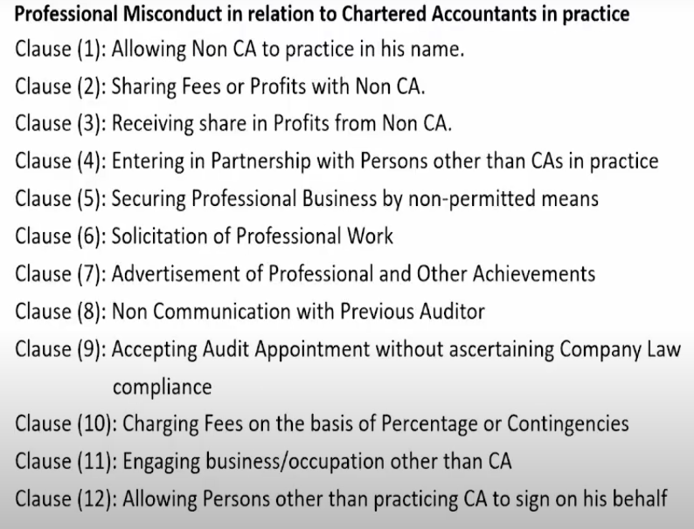
Part-I of FIRST SCHEDULE (BOD)
Compliances with Ethical Standards
17 / 54

Slide 18
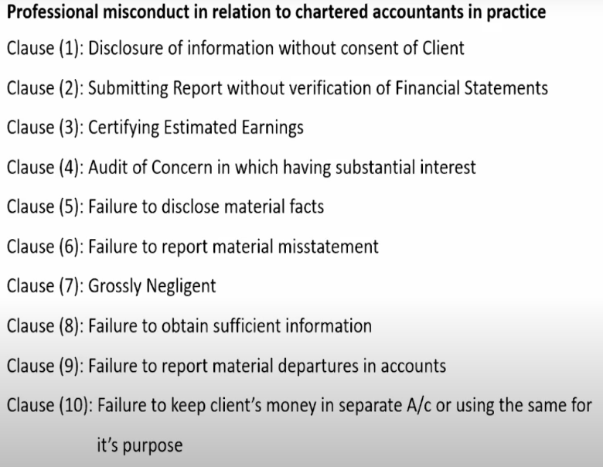
Part-I of SECOND SCHEDULE (DC)
Compliances with Ethical Standards
18 / 54

Slide 19
Volume II
Part 1 Complying with the Code, Fundamental Principles and Conceptual Framework and is applicable to all chartered accountants.
Part 2 Chartered Accountants in Service, which sets out additional material that applies to chartered accountants in service when performing professional activities – engaged or contracted in an executive or non executive capacity. And Includes PCA performing professional activities as an employee of CA Firm.
Part 3 CA(s) in Practice, which sets out additional material that applies to CA(s) in practice when providing professional services.
Independence Standards which sets out additional material that applies to CA(s) in practice when providing assurance services, as follows:
Part 4A Independence for Audit and Review Engagements,
Part 4B Independence for Assurance Engagements Other than Audit and Review Engagements
Part 5 Ethics Standards for Sustainability Assurance (including Independence Standards) — Sections 5100 to 5350: ethics standards for all sustainability assurance engagements; Sections 5400 to 5600: independence standards for sustainability assurance engagements that are within the scope of the Independence Standards
Compliances with Ethical Standards
19 / 54

Slide 20
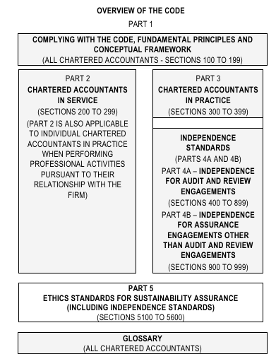
Overview of the Code
Compliances with Ethical Standards
20 / 54

Slide 21
Volume III
A new and dedicated ethics framework for sustainability assurance — covering the full scope of what CAs are increasingly being asked to do in the ESG and non-financial reporting space. This includes:
1
ESG Reporting — Environmental, Social, and Governance disclosures for listed entities
2
Business Responsibility and Sustainability Reporting (BRSR) — Mandatory for top-listed companies under SEBI
3
CSR Impact Assessment — Evaluating the outcomes of corporate social responsibility spends
4
Social Impact Assessments — Broader social outcome evaluations beyond traditional financials
5
Independence Standards — Specific norms governing auditor independence in sustainability assurance engagements
Compliances with Ethical Standards
21 / 54

Slide 22
Latest Position-w.r.t. – NOCLAR, Fees %2 TR, TS-AC
13th edition of Code of Ethics is applicable w.e.f 1st April, 2026 (in suppression of the 12th edition (1.7.2020), except following.
w.e.f. 1.10.2022
1.
Responding to Non-Compliance of Laws and Regulations (NOCLAR) [Sections 260 and 360]
2.
Fees – Relative Size [Paragraphs 410.3 to R410.6]
3.
Taxation Services to Audit Clients [Sub-section 604]
Compliances with Ethical Standards
22 / 54

Slide 23
Write-Up Rules — CA Advertisement
Whether a write-up appears on a website, in a directory listing, or in any other format, it must satisfy the following conditions under Clause 3.1.1 of the Guidelines:
Do's
Don'ts
Promotes Honest & Truthful, Factual description, Accurate statement on Qualification and experience. Can publish list of clients name (if permitted by them), Include contact details and website, Use CA India Logo, PP size photo, Elected role based positions held in ICAI, Font size not to exceed 14, Mention M.No. or F.R. No. Mandatorily.
No exaggeration, disparaging reference, reference to private awards, use monograms or catchy slogans, no disrepute to profession, in compliance of Act, Regulations and CoE, 2026, Monogram of any kind, use of any kind of catch words. All these are not permissible
Compliances with Ethical Standards
23 / 54

Slide 24
New Permissions — Advertisements
While restrictions on Solicitation prohibition, Testimonials / endorsements, Banner advertising on websites, Listing on commercial aggregator apps for exclusive services, Private awards/accreditations in write-up CONTINUES, However following relaxations have been given:
Push technology for non-exclusive services — (Explicitly permitted for non-exclusive services (accounting, consultancy, etc.)
Network firm websites — (Formally permitted; network firms may build and maintain their own websites)
Write-up content flexibility — (Greater flexibility in scope and contemporary forms of presentation)
Communication received back by the Incoming Auditor with “Office found Locked” written on the AD shall be deemed as delivered
Communication in case of certification has been dispensed with.
If Communication sent by with remarks “No such office exists at this address”, and address is registered with Institute — deemed to be delivered.
Compliances with Ethical Standards
24 / 54

Slide 25
Director Simplicitor
“Director Simplicitor” means an ordinary/simple Director who is not a Managing Director or Whole time Director and is required only in the Board Meetings of the company and not paid any remuneration except for attending such meetings.
1
As per Section 149(4) of Companies Act, 2013, every listed public company shall have at least one-third of the total number of directors as independent directors
2
Director Simplicitor can participate in policy or financial decisions of the company during meetings, but he should not execute the said decisions or get involved in business of the company
3
director Simplicitor can sign the financial statement and other statutory documents of the company as required to be signed by the Director while discharging his statutory obligation.
4
Compliances with Ethical Standards
25 / 54

Slide 26
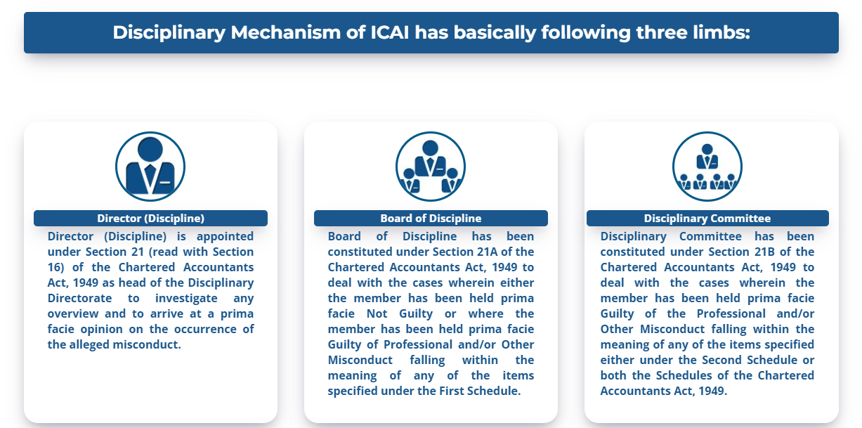
Disciplinary Directorate
Compliances with Ethical Standards
26 / 54

Slide 27
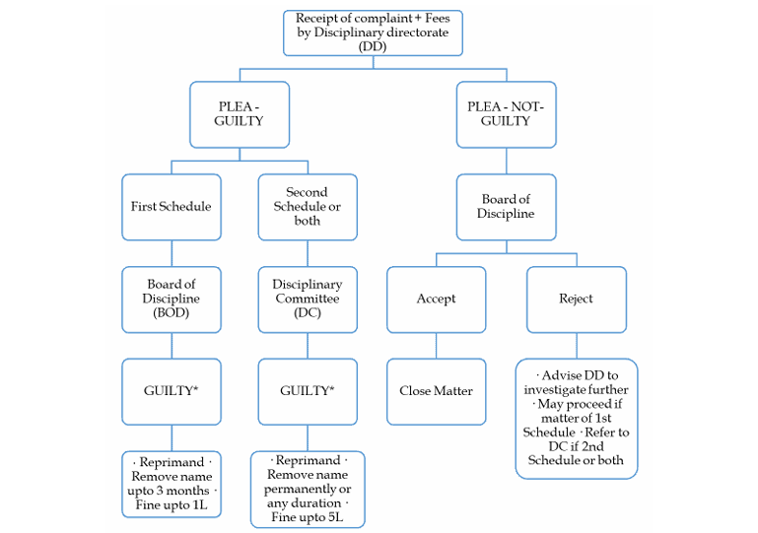
Flow Chart of Disciplinary Proceedings
Compliances with Ethical Standards
27 / 54

Slide 28
Common Issues — Disciplinary Cases (1 of 2)
Easy E-/Physical Complaint filing — (Fees is Rs 2500 + 18% GST = 2950 only!)
Non-issue of NOCs (Registered AD)
Conflict of Interest — Shareholding / Directorship etc.
Ethical Breaches
Interaction with Regulators — MCA, RBI, SFIO, CBI, ED,
ICAI Quality Control — FRRB / TAQRB / PRB
More than 3000 pending DC cases/complains and increasing
Shift from True & Fair view to Misrepresentation of Facts & Figures.
Hundreds of Multiple Empanelment Forms, attachments, Affidavits etc.
Benami sort of Planning — Using family members for bye pass of regulations
Compliances with Ethical Standards
28 / 54

Slide 29
Common Issues — Disciplinary Cases (2 of 2)
Professional Negligence and lack of due diligence
Poor Documentation and Record keeping
Fraud detection — negligence in finding and reporting
Non Compliance with Standards
MIS representation of facts or certifications
Involvement in illegal or unethical activities
Undermining the reputation of self and profession
Compliances with Ethical Standards
29 / 54

Slide 30
Emerging Trends & Likely Punishments
Emerging Trends in Misconduct
Likely Punishments under ICAI Regulations
Failure to meet Mandatory CPE requirements
Failure to get Peer Review Requirements met
Whistle blower Complaints
Non-Compliance with Laws (NOCLAR)
Misusing Professional Position
Monetary Penalties Up to 5 Lacs
Reprimand
Suspension from Practice
Removal from Register
Restrictions & Costs
Compliances with Ethical Standards
30 / 54

Slide 31
Quality Mechanism — ICAI
NFRA
National Financial Reporting Authority
FRRB
Financial Reporting Review Board
PRB
Peer Review Board
TAQRB
Tax Audit Quality Review Board
AD
Audit Directorate
CAQD
Centre for Audit Quality Directorate – AQMM etc.
TMD
Tender Monitoring Directorate
Compliances with Ethical Standards
31 / 54

Slide 32
NFRA Orders — Scope
NFRA considers violations of Companies Act (Chapter X – Audit & Accounts); Companies (Audit and Auditors) Rules, 2014, CARO-2020, NFRA Rules 2018.
1
Further NFRA also consider compliance of SA's, SQC, Code of Ethics.
2
Fraud Reporting — Promptness in reporting very important. (143(12))
3
Compliances with Ethical Standards
32 / 54

Slide 33
NFRA Orders — Some Trends (1 of 3)
Auditor's vigilance is required even after issue of Audit Report/compilation of Audit Documentation it continues even after as per SA 560, Subsequent Events.
license to audit from ICAI comes with a pre-requisite attached responsibility of 'acting in public interest'; 'integrity' and 'professional behavior' are fundamental principles of Code of Ethics.
Not filled audit formats, but particulars of information mentioned in those formats and ensuring no conflict/contradiction with actual scenario can save auditor.
inadequate audit procedures or their documentation as required by SA's can't be repaired by issuing modified opinion/disclaimer etc.
Planning, executing and documenting audit procedures and results to consider para 26 & 47 of SA 240. (Presumption of fraud risk in revenue recognition etc.)
Compliances with Ethical Standards
33 / 54

Slide 34
NFRA Orders — Some Trends (2 of 3)
Auditor to perform adequate audit procedures, maintain adequate documentation and exercise professional skepticism irrespective of quality of auditee.
Apart from accounting, auditing and ethical standards, corresponding regulatory/judiciary decisions are also to be considered.
Audit documentation to enable understanding the nature, timing and extent of the audit procedures performed to comply with the SAs and applicable legal, regulatory frameworks and the results achieved and how dealt. (Para 8 of SA 230)
Communications (email or other) of Audit Engagement Team with Auditee are also helpful apart from audit evidence and working papers to establish audit procedures etc.
Compliances with Ethical Standards
34 / 54

Slide 35
NFRA Orders — Some Trends (3 of 3)
Inter-Group movement of funds and same auditor/related directly-Indirectly to be proactive, question and evaluate its impact.
Audit of CFS is a separate audit engagement & require separate audit working papers, audit program, audit procedures planned and performed, audit workings and so on.
NFRA is evaluating auditor's adherence to the Act, SAs, SQCs and Code of Ethics, and is being fully mindful that statutory auditor is not a forensic auditor.
Question and verify the business rationale of the investments made while evaluating impairment/diminution of investments as per AS-13
Compliances with Ethical Standards
35 / 54

Slide 36
Statutory Auditors — Restrictions & Permissions
Restrictions on Statutory Auditors
What is Permissible
To prepare Business Responsibility & Sustainability Reporting (BRSR) study to Audit Clients. But advisory services may be provided.
To engage in assignment of compilation engagement, of that entity as per SRS 4410.
CoP holder cannot be appointed as an Internal Auditor and Procurement officer simultaneously in an organization.
To render professional services to IFSC units from offices outside IFSC.
to set up practice in IFSC/GIFT city.
Member in practice can become professional director in the Board of Management of a Co-operative Bank.
The vision and mission statement may be printed on the firm profile and may be provided in response to a specific request but not permitted to publish on letter head, visiting card or stationery etc
Compliances with Ethical Standards
36 / 54

Slide 37
Appendix 'H' of Vol-II — 'Part Time in Practice'
Council Resolution
Any member engaged in any other business or occupation, in terms of general or specific permission granted shall be deemed to be 'Part Time in Practice' except in case of the specific or general permission under Regulation 190A so granted.
A member who is deemed to be 'Part Time in Practice' is not entitled to perform attest function and shall not be entitled to train articled assistants.
Attest function means services pertaining to audit, review, certification, agreed upon procedures, and compilation, as defined in the Framework of Statements on Standard Auditing Practices and Guidance Notes on Related Services published in the July, 2001 issue of the Institute's Journal.
Note: Part Time Association with Firm (For MEF/CAG Empanelment) does not mean 'Part Time in Practice'
Thus follow general permission or seek specific permission prior.
Compliances with Ethical Standards
37 / 54

Slide 38
Fees — Relative Size (410.3 A1 – 410.6)
total fees generated from an audit client vs. total fees of that firm — Self-interest or intimidation threat. (Paragraph 410.3 A1)
large proportion of the revenue of one partner or one office of the firm
Appropriate and no audit participative, reviewer to review the work.
Non public interest entity audit client — 2 consecutive years — total fees with its related entities > 40% of the total fees received by the firm, then (20% for PIE)
Disclose to ICAI this fact except when total fees of firm ≤ 20 Lacs (incl related firms) / appointed by Govt or regulator.
If the fees described in paragraph R410.3a continue to exceed 40% after two years, the firm shall each year disclose to the ICAI.
Compliances with Ethical Standards
38 / 54

Slide 39
FAQ-2025 (5th Edition) — Not Permitted Items (1 of 2)
S.No. | Question | Answer
1 | Whether a member in practice is permitted to undertake the management of NRI funds? | No
2 | Can a Chartered Accountant provide 'Portfolio Management Services' (PMS) as part of CA practice? | No
3 | Can a Management Consultancy Company advertise its services? | No
4 | Can a member in practice be part of Association of persons (AOP), with other members, or other professionals? | No
5 | Whether members in practice can list themselves with online Application based service provider Aggregators? | No
6 | Can a Chartered Accountant in practice pay to any person any share, commission or brokerage in the fees or profits of his professional business? | No
7 | Can a Chartered Accountant in practice solicit professional work by making roving enquiries? / by advertisement? / services of other persons not his employee? | No
8 | Whether a member in practice / Firm of Chartered Accountants is permitted to use logo on letter-heads, stationery, etc.? | No
9 | Whether it is permissible for a member to mention himself as “GST Consultant”? | No
10 | Whether a Chartered Accountant can accept appointment as an auditor after sending communication to the previous auditor through registered post without acknowledgment due? | No
11 | Whether a statutory auditor of a company can be appointed in the adjourned meeting in place of existing statutory auditor where no special notice for removal or replacement of the retiring auditor is received at the time of the original meeting? | No
12 | Whether a member in practice owning intellectual property rights of domain names sell these domain names to some entity for earning royalty on the same? | No
Compliances with Ethical Standards
39 / 54

Slide 40
FAQ-2025 (5th Edition) — Not Permitted Items (2 of 2)
S.No. | Question | Answer
13 | Whether a member in practice can also practice simultaneously as an Actuary? | No
14 | Whether members in practice are allowed to transact in commodity derivatives? | No
15 | Can a Chartered Accountant in practice disclose information acquired in the course of his professional engagement? | No
16 | Can a member act as a Tax Auditor and Internal Auditor of an entity? | No
17 | Whether statutory Auditor of a Company can give feedback to a Credit rating agency with regard to Auditee Client? | No
18 | Whether a partnership Firm not registered with the Institute can undertake professional assignments if it comprises of members in practice as the partners? | No
19 | Whether a Statutory Auditor can engage in assignment of compilation of financial statements (conducted under SRS-4410) of the same Company for the same financial year? | No
20 | Whether a member in practice can become a Mutual fund distributor? | No
21 | Pension Fund Trust can provide investment advisory services to the trust? | No
22 | Whether a member can accept appointment as Statutory Auditor of certain branch(es) of a Bank, while he is the Revenue Auditor of different branch(es) of the same Bank? | No
23 | Does Section 260 (Responding to Non-compliance with Laws and Regulations) of Volume-I of the Code of Ethics apply to employees in Chartered Accountants Firms? | No
24 | Are the provisions of NOCLAR applicable in case of tax audit under Income Tax Act, 1961 or any other law | No
Compliances with Ethical Standards
40 / 54

Slide 41
Booklet on Important Decisions of the ESB / Council (Jul-2022)
Part 1 of 13
M/Q
Q. Printing of photographs on the visiting cards / Website?
Printing of photographs on Visiting card/E-Visiting cards is not permissible. (Q3 of FAQ-25) BUT display of Passport Size photo on website is permitted (Para 3.3.7 of CG for Advt 2008-Vol-II)
M/Q
Q. DSA for marketing of Bank cards and verification of credit card application (Q2 of FAQ-25)
Not permitted to market any specific product. May verify credit card credential. May provide services that are in the nature of verification etc. being assurance services. Perform all those services, which a Chartered Accountant can provide e.g. MC & OS.
YES
Q. Whether a member can be a Director in Cooperative Bank? (Q5 of FAQ-25)
May be a non-executive / independent director, no day-to-day and no Audit by partners
YES
Q. Franchise for a TIN-FC (Tax Information Network – Facilitation Centre) (Q6 of FAQ-25)
May establish a TIN-FC under franchise from the other entity which is already a TIN-FC.
Compliances with Ethical Standards
41 / 54

Slide 42
Booklet on Important Decisions of the ESB / Council (Jul-2022)
Part 2 of 13
M/Q
Q. Whether client may use the name of CA firm mentioning it as a knowledge partner?
Mentioning a firm as a knowledge partner or in the Thank You advertisement – not permitted. Mention name of an individual member with prefix/suffix “CA” as a “knowledge partner” – permitted.
YES
Q. Whether a resident director, as per the stipulation of Section 149(3) of the Companies Act, 2013, would be covered under the scope of “Director Simplicitor”? (Q8)
No. of days of stay in India ≥ 182 days don't alter Director Simplicitor expectations.
YES
Q. Can a CA be settler of Trust? (Q9)
Yes. As per Regulation 191 of Chartered Accountants Regulations, 1988.
NO
Q. Can a CA exercise lien over the client documents and records until his fees is paid? (Q10)
NO. unless it is required by any law, in force or vide the order of a court of law.
Compliances with Ethical Standards
42 / 54

Slide 43
Booklet on Important Decisions of the ESB / Council (Jul-2022)
Part 3 of 13
NO
Q. Whether Chartered Accountants in practice can become Financial Advisors and receive fees/commission from Financial Institutions such as Mutual Funds, Insurance Companies, NBFCs etc.? (Q11)
NO. being fees which are based on a percentage of profits / contingent upon the findings.
NO
Q. Can a CA Firm print its vision and values behind its visiting cards? (Q12)
NO. As per Clause (6) of Part-I of First Schedule of CA Act, 1949.
YES
Q. If a member in practice can take the class as guest lecturer and receive honorarium based on per class basis? (Q16)
YES. Occasionally invited. No violation of Clause (11) of above Schedule.
YES
Q. Can a practising chartered accountant be an honorary office bearer in a trust/society/section 8 Company, and sign cheques in such capacity? (Q17)
Yes. Honorary office-bearership of “charitable, educational or other non commercial organisations”, he may perform any activity which is appurtenant to such honorary position/Office.
Compliances with Ethical Standards
43 / 54

Slide 44
Booklet on Important Decisions of the ESB / Council (Jul-2022)
Part 4 of 13
YES
Q. Can a practising chartered accountant start a society (NGO) for betterment of fellow Chartered Accountants and doing social work? (Q18)
YES. Caution – No use of CA Logo by NGO / No remuneration for holding office of NGO.
YES
Q. Whether a practicing member act as mediator in Court? (Q19)
YES. 'mediator' would be deemed to be covered within the meaning of “arbitrator” – permitted.
NO
Q. Whether a member in practice is generally permitted to write script/story for a movie? (Q20)
NO. merely writing a script/story for a movie would not fall within provisions of Appendix (9).
NO
Q. Whether partner of a CA Firm doing audit of Insurance company may accept surveyor work of the said Company? (Q21)
NO. Conflict of interest, likely to impact independence of auditor.
Compliances with Ethical Standards
44 / 54

Slide 45
Booklet on Important Decisions of the ESB / Council (Jul-2022)
Part 5 of 13
YES
Q. Whether a practicing member engage them as Registration Authority or Registration Authority associate for the limited purpose of obtaining digital signatures for clients? (Q22)
YES.
YES
Q. Whether a chartered accountant who is an Information Security Auditor of a Bank can hold Credit Card of the same Bank? (Q23)
YES. Chapter X of Council General Guidelines, 2008 will apply if there is outstanding balance of Rs. 1,00,000/-* beyond prescribed credit period limit.
YES
Q. Can a member in practice provide pay roll services? (Q24)
YES. If he is not Auditor. Section 2(2)(i) and (iii) of the CA Act, 1949.
YES
Q. Can a practicing CA provide an equity research service that it can publish retail research report after giving NISM research analyst exam? (Q25)
YES. but he cannot publish retail report as it would amount to other business or occupation.
Compliances with Ethical Standards
45 / 54

Slide 46
Booklet on Important Decisions of the ESB / Council (Jul-2022)
Part 6 of 13
YES
Q. Whether a member may issue a certificate required mandatorily by banks from CAs, with regard to transactions over which the member has no control? (Q26)
YES. But it has to be in compliance with the accounting and auditing standards of the ICAI.
M/Q
Q. On the requirement to share information sought by the Client from the auditors, and to whom it must be provided. (Q27)
Not to disclose the information of his client unless required by any law but YES for sharing of information to even to minority partner / shareholder.
YES
Q. Whether a member can associate with a Firm otherwise than as a partner or employee? (Q28) Whether such relationship is permissible without charging any remuneration from the Firm?
YES. It would be limited to sharing his expertise with the Firm only, and not with clients of the Firm.
NO
Q. Whether a member may advertise from its branch located outside India? (Q29)
No. Membership vs Citus. In case of conflict, the more stringent provision(s) would have to be complied.
Compliances with Ethical Standards
46 / 54

Slide 47
Booklet on Important Decisions of the ESB / Council (Jul-2022)
Part 7 of 13
M/Q
Q. Whether it is permissible for a member in practice to write his own blog on any subject and whether it contain advertisements related to general finance sector posted by third parties?
Should not amount to solicitation of professional work or advertisement. Name of individual member may be mentioned on the blog and not the Firm name. Not be against the public policy or bring disrepute to the profession; comply other regulations.
YES
Q. Whether it is permissible for a statutory auditor of a listed Company to provide Management Services to the Company during his cooling off period? (Q31)
YES. to provide non assurance services during the cooling off period, unless otherwise prohibited.
NO
Q. Whether WhatsApp can be used to send messages (and mention services) to make people aware that a member has started new practice? (Q32)
NO.
YES
Q. Whether commercial transactions – ordinary course of business – at arm's length price would result in indebtedness where the outstanding amount exceeds Rs 5 lakhs and is settled in accordance with the credit period granted by the audit client at terms similar to those offered to other customers? (Q34)
Will not result in indebtedness (as per provisions of Companies Act, 2013).
Compliances with Ethical Standards
47 / 54

Slide 48
Booklet on Important Decisions of the ESB / Council (Jul-2022)
Part 8 of 13
YES
Q. Can a CA Firm register itself on Udyog Aadhar, a web portal of Ministry Micro, Small and Medium Enterprises? (Q35)
YES.
YES
Q. Whether a member in practice can empanel with NCLT as scrutinizer, while being a partner in a partnership Firm? (Q36)
YES. Can be so in Individual capacity as well.
NO
Q. Whether a member in practice can have his office premise (of CA Firm) and Coaching Centre) at the same place? (Q37)
NO.
YES
Q. Whether a member in practice may become member of Indian Council of Arbitration (ICA)?
YES; empaneling with ICA would be deemed as ancillary to becoming arbitrator.
Compliances with Ethical Standards
48 / 54

Slide 49
Booklet on Important Decisions of the ESB / Council (Jul-2022)
Part 9 of 13
NO
Q. Can a Chartered Accountants Firm, tax audit of which is done by a sole proprietorship Firm, audit business concern of the son of the sole proprietor? (Q39)
NO. considering independence of mind and independence of appearance.
NO
Q. Whether a member in practice can enter into partnership with another member in practice in a Partnership Firm which is not a Firm of Chartered Accountants registered with the Institute?
Not permissible for a partnership Firm not registered with the Institute to undertake professional assignments, even if it comprises only of members in practice. (Q41)
NO
Q. Whether a Practicing CA can get Registered as a GST Suvidha Kendra (GSK)? (Q43)
No. GST services can be provided only by members in practice or by CA firms.
NO
Q. Whether a member in practice can do advertisement of a commodity without consideration on one-time basis, which involves visibility on hoardings and walls? (Q47)
NO.
Compliances with Ethical Standards
49 / 54

Slide 50
Booklet on Important Decisions of the ESB / Council (Jul-2022)
Part 10 of 13
M/Q
Q. Whether member can upload videos on youtube and receive money from YouTube if videos go well on the platforms, will that affect me in any way as a practicing Chartered Accountant?
YES. But commercialization of the same is not permissible. (Q48)
YES
Q. Whether a member in practice can become a Managing director or a whole-time director in a Company registered under Section 8 of Companies Act, 2013? (Q49)
YES. But No remuneration. Director Simplicitor.
NO
Q. Whether the disqualification on Audit from the point of view of Indebtedness as contained in Council General Guidelines, 2008 will apply to Internal audit and Concurrent audit? (Q50)
NO. {apply only to statutory audits}
NO
Q. Whether a member in practice can engage as Trademark or Patent Attorney? (Q51)
NO. But w.r.t. professional advisory related to IPR only is permitted.
Compliances with Ethical Standards
50 / 54

Slide 51
Booklet on Important Decisions of the ESB / Council (Jul-2022)
Part 11 of 13
NO
Q. Whether a member may provide Virtual CFO Services? (Q52)
Virtual CFO be not permitted to be undertaken by a member in practice.
YES
Q. Whether a Chartered Accountant in practice may become member of “Board of Management” in Primary (Urban) Co-operative Banks (UCBs)? (Q53)
YES. Position is similar to that of a Director-Simplicitor; where there is no involvement of member in the day-to-day functioning/operations and not signatory etc. and only sitting fees for the services rendered are provided.
NO
Q. Whether a member in practice can accept the appointment of statutory audit of the society wherein immediate family member i.e., spouse or dependent, of member hold honorary position of one of the managing committee of the institutes governed by the society? (Q54)
NO. independence of mind / independence of appearance.
YES
Q. Whether a member in practice/firm of CA's can register themselves on GeM Portal (Government e-marketplace)? (Q55)
YES. Since it is the third party which is operating, and not the client itself. Adhere tender guideline however.
Compliances with Ethical Standards
51 / 54

Slide 52
Booklet on Important Decisions of the ESB / Council (Jul-2022)
Part 12 of 13
NO
Q. Whether the Members in practice are allowed to run podcasts on any online platforms wherein they can display their firm name, details and wherein the employees of the firm state their names within the podcast? (Q56)
NO.
M/Q
Q. Which services can a member in practice provide in the area of Cyber Security? (Q57)
No issue in providing cyber security consultancy services to clients. But not permitted to get accreditation from the international bodies for providing the certificates of ISO, SOC etc.
YES
Q. Whether a member in practice take license of investment advisor (as required by SEBI to provide service of Investment advice) and provide both the service as Investment advisor and other attestation as required by CA being in practice? (Q58)
YES. But not allowed to engage in services of broking, underwriting, portfolio management and cannot take agency of mutual funds etc.
YES
Q. Can a member in practice accept the appointment as Special Invitee of a University offered to him on Honorary basis? (Q59)
YES.
Compliances with Ethical Standards
52 / 54

Slide 53
Booklet on Important Decisions of the ESB / Council (Jul-2022)
Part 13 of 13
NO
Q. Whether a Statutory Auditor can engage in assignment of compilation of financial statements (conducted under SRS-4410) of the same Company for the same financial year? (Q60)
NO. Accepting the assignment of Compilation engagement would create self-review threat.
Compliances with Ethical Standards
53 / 54

Slide 54
Thanks
CA. Vimal Chopra | Ex-Chairman, ICAI-CIRC

